Slide 1
JRTC Trends Brief
29 October 2015

Slide 2
Counter-Fire
Average Processing Times
Echelon | Average | TC 3-09.8 Digital | Delta | Observations / Trends
 | 07:06 | N/A |  | BCT clearance of fires process not defined/understood BCTs struggle in clearing ground maneuver units Unit UAPs do not facilitate timely clearance of airspace FSCM / database mismanaged
 | 04:23 | 00:35 | +03:48 | Fire order not tied to AGM Maintaining communications (voice/digital) with firing units Fail to provide gun target line / max ord in a timely manner
 | 02:40 | 00:35 | +02:05 | FSCM / database mismanaged Lack of standardized fire order Fail to maintain digital communications with howitzer sections
 | 01:12 | 00:30 | +00:42 | Lack ability to execute 6400mil firing capability Section crew drills Sections do not leverage digital systems
 | 01:16 | 01:00 | + 00:16 | Sections do not leverage digital systems Failure to understand or enforce proper TLABSPAP
X
II
FDC
M119A3
M777A2
Total Time
13:38
Notes:
Average time from sensor to target engagement
52 Fire Missions used to collect and collate data
Notes:
Communications Failure: Delayed ground and air clearance due to communication failure during operations greatly effects average times.
Air Clearance: Systemic issues with TAIS, AMDWS and AFATDS along with units taking prolonged times to determine gun target line and max ordinal effects the clearance of air.
Digital Systems: Numerous units have neglected the digital systems linking sensor to shooter and attempt to use voice for all CFF and counterfire missions. This delays FM processing and the clearance of fires as each echelon has to transmit the same CFF to the next echelon.
Overlapping Calls for Fire: Units are not tracking fire mission by target number on the TOC floor, as overlapping fire missions begin processing the battle captain looses track of what target was cleared for air or ground and they have to start the process again.
CUOPS Situational Awareness: BCT S3s, FSOs and battle captains frequently do not treat the fire mission drill or counterfire drill with urgency and become distracted during the clearance procedures. Thus the fire command is delayed due to preoccupation with other task.

Slide 3
Pre-Planned and Targets of Opportunity
Average Processing Times
Echelon | Average | TC 3-09.8 Digital | Delta | Observations / Trends
 | 08:29 | N/A |  | Fail to link AFATDS with TAIS/AMDWS Targeting not nested with MDMP; process does not align organic and external combat power against HPT in time and space Targets are not fully developed and Fire Support RXLs not executed to standard
 | 09:23 | 00:35 | + 08:47 | Maintaining communications (voice/digital) with firing units Lack of database management No standardized fire orders Duties and responsibilities not clearly delineated
 | 02:31 | 00:35 | + 01:56 | Improper fire commands and a lack of standardization Not using digital means, either from Battalion or to the guns. Not utilizing TGPCs or Fire Command Standards
 | 02:28 | 00:30 | + 01:58 | Sections do not leverage digital systems Leaders fail to plan for 24-hr tactical operations WRT work/rest cycles and equipment maintenance
 | 04:20 | 01:00 | + 03:20 | Sections do not leverage digital systems Failure to understand or enforce proper TLABSPAP
X
II
FDC
M119A3
M777A2
Avg. Tot. Time
10:14
Notes:
Average time from sensor to target engagement
115 Fire Missions used to collect and collate data
Notes:
Communications Failure: Delayed ground and air clearance due to communication failure during operations greatly effects average times.
Air Clearance: Systemic issues with TAIS, AMDWS and AFATDS along with units taking prolonged times to determine gun target line and max ordinal effects the clearance of air.
Digital Systems: Numerous units have neglected the digital systems linking sensor to shooter and attempt to use voice for all CFF and counterfire missions. This delays FM processing and the clearance of fires as each echelon has to transmit the same CFF to the next echelon.
Overlapping Calls for Fire: Units are not tracking fire mission by target number on the TOC floor, as overlapping fire missions begin processing the battle captain looses track of what target was cleared for air or ground and they have to start the process again.
CUOPS Situational Awareness: BCT S3s, FSOs and battle captains frequently do not treat the fire mission drill or counterfire drill with urgency and become distracted during the clearance procedures. Thus the fire command is delayed due to preoccupation with other task.

Slide 4
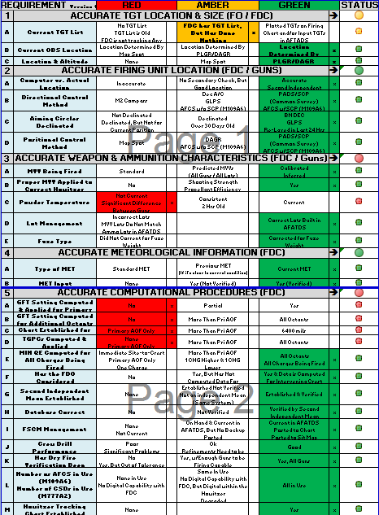
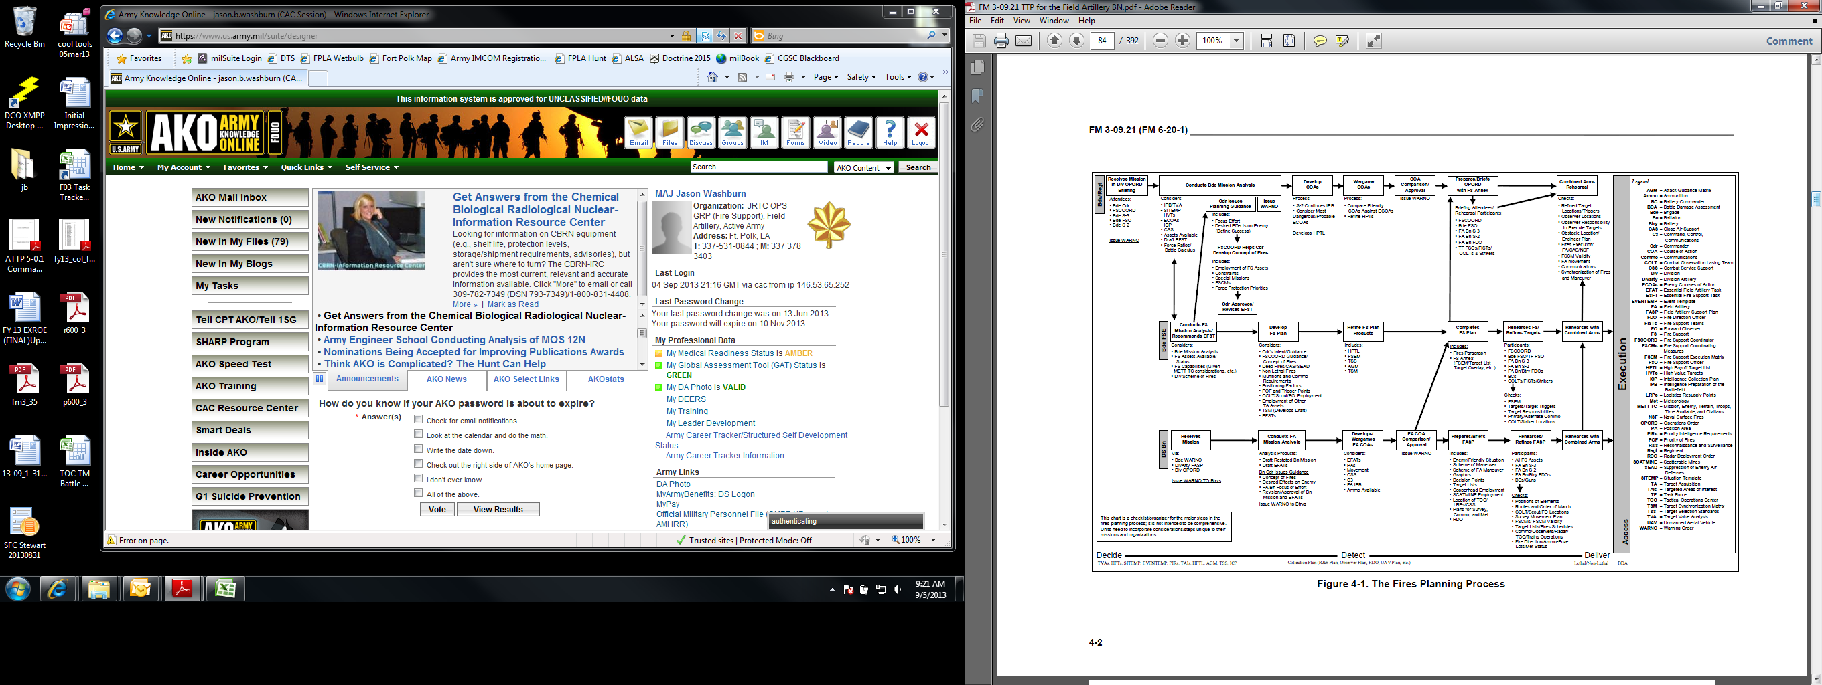
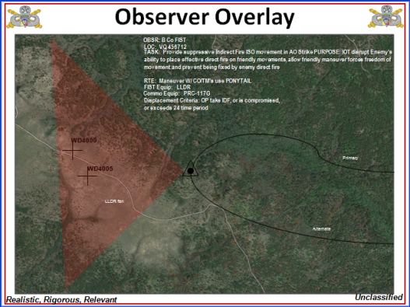
1. FS Planning
Mission Command
Five Requirements
for Accurate Fire
Staff and subordinate commanders must understand principles (philosophy) of mission command as well as science
Must quickly establish reliable voice and digital communications at extended distances
Commanders Intent of Fires must provide BCT staff, fires personnel, and subordinate units with the general guidelines and restrictions for the employment of fires and desired effects
Must be synchronized with maneuver, top down driven, and bottom up refined
Targeting must integrate and synchronize fires using D3A methodology IAW FM 3-60
Joint Fires integration (CCA, CAS, EW, ISR, etc.) and clearance/release authorities
Planning must consider principles: precision, scalable, networked, responsive, synchronized
Every target must have T,P,T,L,O,D,A,C,F
FS Rehearsal must be conducted and targets must be refined in a timely manner
Focus on the fundamentals at every level prior to deployment.
FDCs must be able to troubleshoot
Gunline standards must be IAW FM 6-50
Ammunition lot management, MVVs, and 2nd lot inference across BCT
What is our assessment criteria and frequency?
How are we getting target location?
What do we do if we can’t meet them?
Have we thought about mortars?
2. Development of FASP
4. Observer Plans
MDMP based
Inputs are BCT Scheme of maneuver, TLWS, and scheme of fires
Requires clearly thought out and delineated command and support relationships
Must have movement and logistical triggers for all subordinate units
Must plan survey, MET, and RADAR
How do we utilize M777s and HIMARs?
Have we cross walked FSTs to FATs?
Where are we engaging the enemy and can FISTs and FOs see the target?
Do our FISTs and FOs have the right equipment (LLDR, Viper, Vector, etc.) and are they trained?
What is the PACE plan?
Did we consider depth and redundancy for each target?
Common graphics, updated target list, FSEM, etc (distributed across the BCT)
Are we refining targets?
FM 3-09.21
V6 08JUN15

Slide 5
JRTC ADA Trends
BLUF – ADAM/BAE/ADA sections/staff come to JRTC expecting to learn how to do their jobs instead of coming to JRTC as a culminating event to test and refine what they have already trained to do.
General lack of experience and training within the ADAM/BAE. Most officers have not attended the ADAM/BAE course; many NG Officers are new to Air Defense and have only attended a two week transition course.
  Lack of training before arriving. Soldiers under the impression that JRTC is where they will learn the systems and airspace deconfliction.
  Lack of understanding of their roles within the BDE Staff. Don’t understand how to process data from their systems into information for the CDR.
Not integrating systems (TAIS, AMDWS, ADSI, Transverse, etc) prior to coming to JRTC or after equipment reset.
  Generally, the first week is spent attempting to get their systems working and integrated and is usually not completely integrated until right before the end of the rotation.
  Software is often not updated or the current version is different from what JTF-21 is using; therefore the current version to accommodate the RTU has to be facilitated by the 140A. When the Unit arrives, a verification of software needs to be met to ensure connectivity.
SHORAD units are often completely unprepared upon arrival to JRTC.
  Units do not bring IFF’s or they do not know how to load codes into their Sentinel/Avenger.
  Task Organization/Command Relationships inhibit the CDR/PLs ability to conform to ADA principles and guidelines.
  ADA Officer on the ADAM/BAE staff often completely unprepared to integrate SHORAD into the fight. General lack of knowledge on how SHORAD fights. SHORAD PL’s and CDR’s don’t understand how integrate their assets into the BCT plan.
  NG SHORAD units are confusing NCR TTP’s with doctrinal methods for employment of SHORAD.
Lack of OC/T augmentation for SHORAD elements that come to JRTC. Does not allow for proper coaching of SHORAD units. We need one OCT for each Avenger element that comes to JRTC for proper adjudication of Red Air engagements.

