Slide 1
Remote Weapons System (RWS) Training

Slide 2
RWS Training
Power Up:
  Remove RWS/weapon cover if on.
  Remove VIM and TIM module covers and place in stowage locations. VIM cover is installed on SAU, while the TIM cover is installed on the front of ammunition box.
  Check that all external stowage is secure.
  Check that there are no obstructions that will block the movement or optics of the RWS both front and rear.
  Unlock traverse and elevation transport locks on RWS mount.
  Confirm traverse and elevation manual locks are engaged on RWS mount.
  Lift safety cover and place GUN ARM/SAFE switch to SAFE on FCU.
  Toggle UPPER/LOWER salvo switch to OFF position on FCU.
  Lift safety cover and place BATTLE OVERRIDE switch to OFF on FCU.
  Toggle MODE switch to TRG (Training) on FCU.
  Press FCU POWER ON/OFF key. The ON LED should illuminate and a Warning appears on FCU Screen.

Slide 3
RWS Training
Note:
Defects that occur on the electrical Fire Control System may cause unintentional traverse and elevation movement of the Weapon Station Assembly. Special attention has to be observed when the main current is switched on and off.
Note
Prior to switching the power on, all possible loose objects on RWS must be removed.
Note
It is not necessary to install a weapon or weapon solenoid for RWS to operate in Training Mode.
Note
The system will after "power on", run an internal power-up test and check status to all peripheral devices. The status will be present on the FCU display. Automatic adjustment of the servo system will be performed during the power-up sequence.
Note
Each type of vehicle has a unique vehicle identification called "Vehicle ID" and a combination of signals from different hatches called "Hatch ID". If "Vehicle ID" is unknown, the system will not power on.

Slide 4
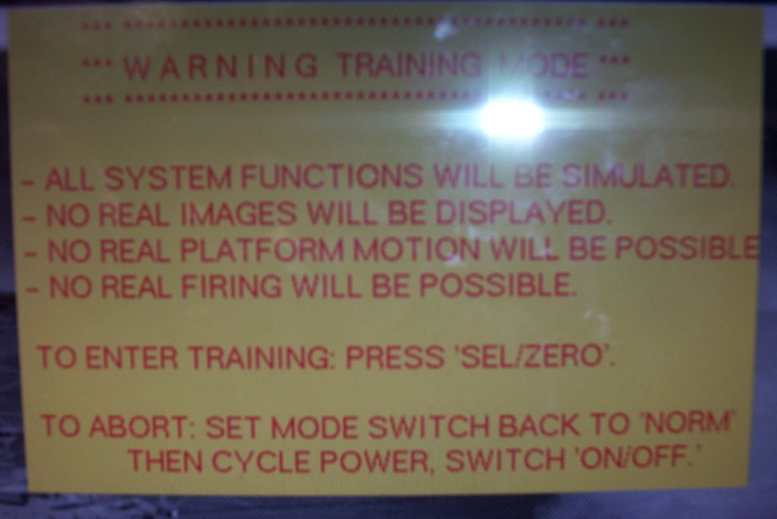
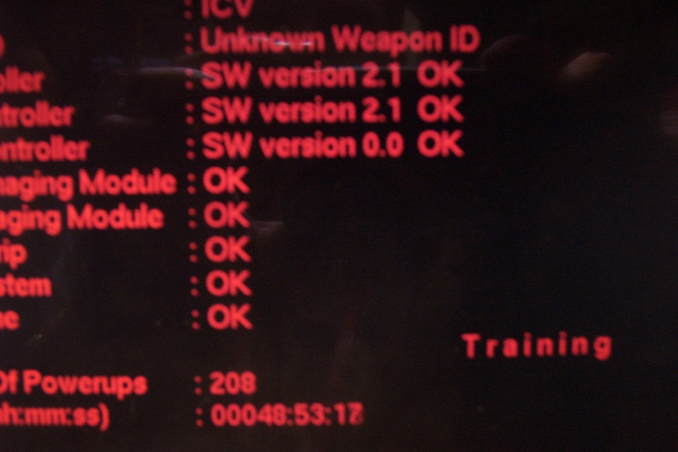
RWS Training
Note
Each type of weapon has a unique "Weapon ID" which will be in use for ballistics calculation. If "Weapon ID" is unknown, the system will not go to "Enabled" position.
Note
When in TRAINING MODE, the word TRAINING appears on the bottom right of the Power-up screen.

Slide 5
RWS Training
Note
Start-up sequence should take approximately two minutes to complete. In extreme cold, the display may take up to 10 minutes to appear. If weapon is not installed, weapon ID unknown will be displayed.
Note
Upon completion of start-up, the Visual Imaging Module (VIM) picture and reticle #1 will be displayed on FCU display.
Note
SAU will perform its self-calibration without moving. This will take approx. 10-30 seconds to complete.
Note
If any lamp fails to illuminate, annotate on DA Form 5988E and report to Field Maintenance at earliest opportunity.
Press SEL/ZERO key in MENU field to continue.
Press LAMP TEST key and check all LED's are illuminated on FCU.
Adjust FCU display image by pressing the BRIGHTNESS +/ - keys until desired screen brightness is acquired.
Press the ET button (1) at the bottom of the VDT main screen, this loads the Embedded Gunnery Training software to allow for set-up for simulation.
Start-up complete.

Slide 6
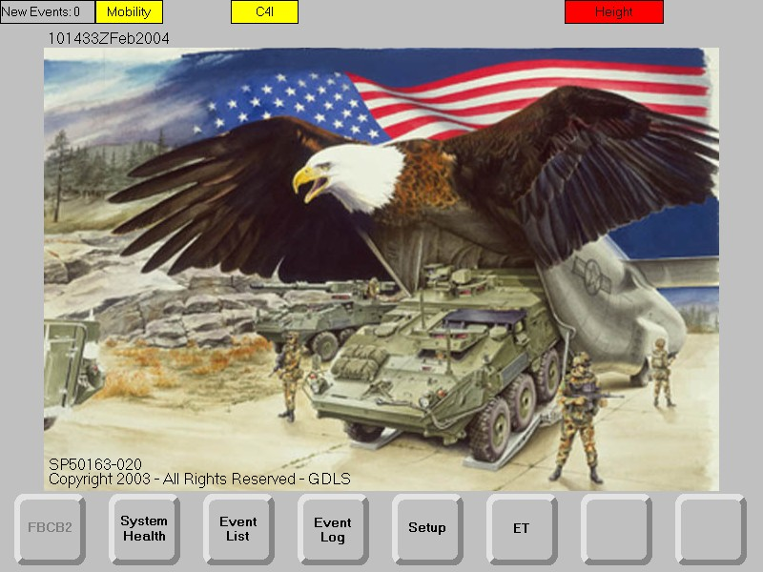
RWS Training
1

Slide 7
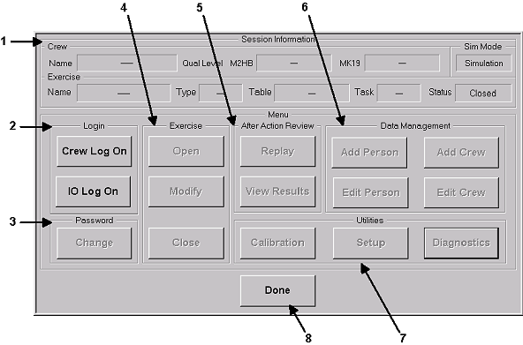
Session Information Window

Slide 8
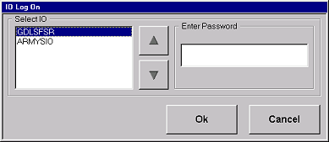
Instructor Operator (I/O) Log On Window

Slide 9
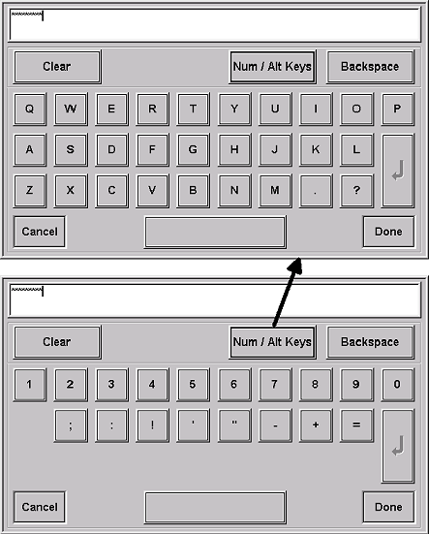
Keyboard Window

Slide 10
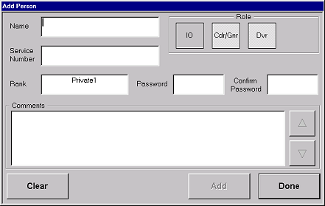
Add Person Window

Slide 11
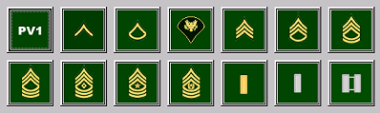
Rank Window

Slide 12
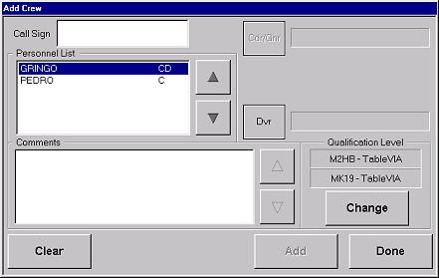
Add Crew Window

Slide 13
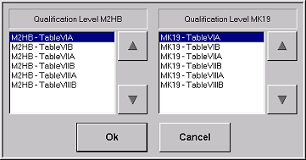
Selecting Qualification Table Window

Slide 14
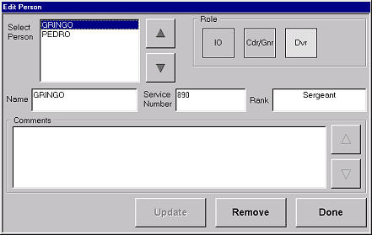
Edit Person Window

Slide 15
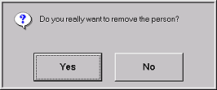
Remove Person Confirmation Window

Slide 16
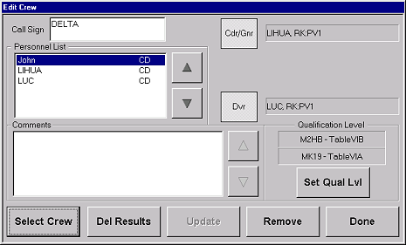
Edit Crew Window

Slide 17
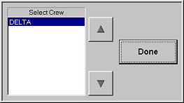
Select Existing Crew Window

Slide 18
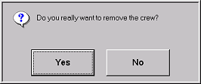
Remove Crew Confirmation Window

Slide 19
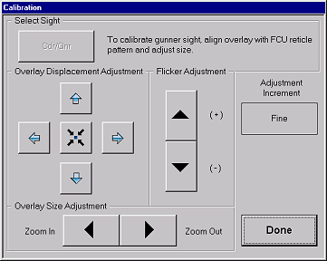
Calibration Window

Slide 20
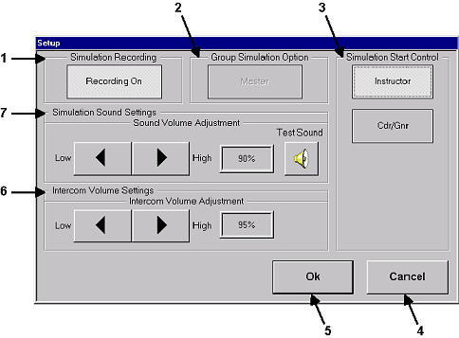
Set-Up Window

Slide 21
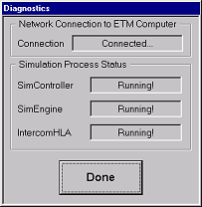
Diagnostics Window

Slide 22
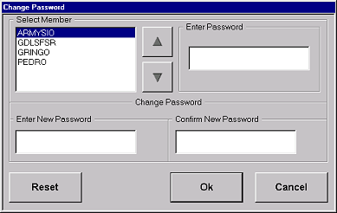
Change Password Window

Slide 23
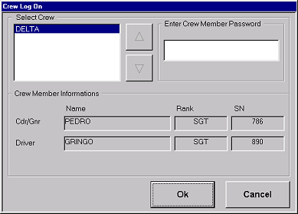
Crew Log On Window

Slide 24
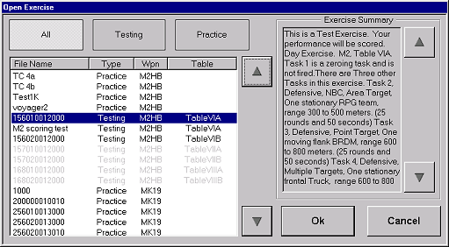
Open Exercise Window

Slide 25
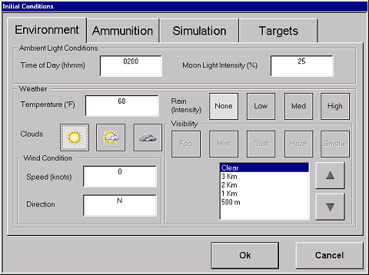
Initial Conditions Window (Environment)

Slide 26
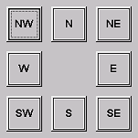
Wind Direction Window

Slide 27
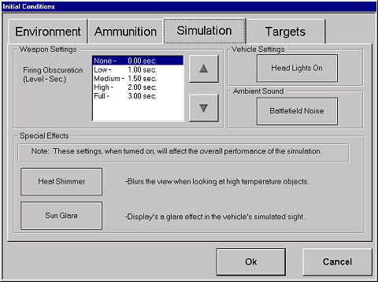
Initial Conditions Window (Simulation)

Slide 28
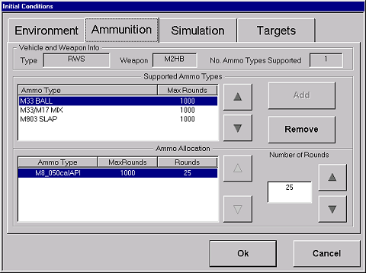
Initial Conditions Window (Ammunition)

Slide 29
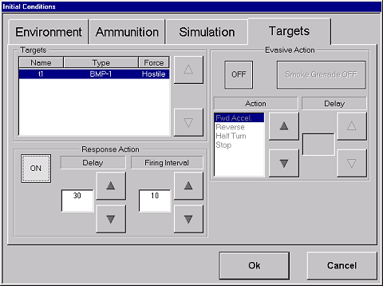
Initial Conditions Window (Target)

Slide 30
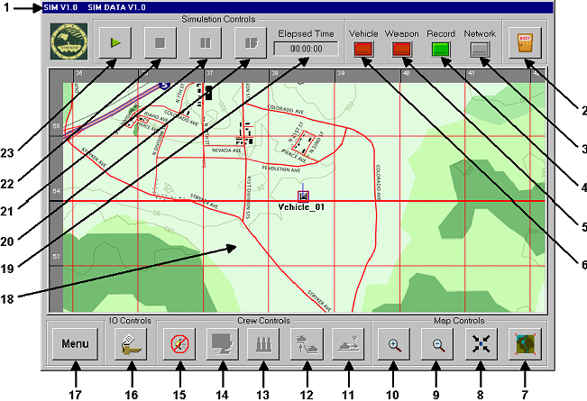
Graphical User Interface (GUI) Window

Slide 31
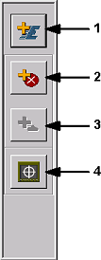
IO Controls Window

Slide 32
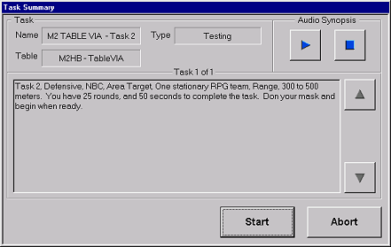
Task Summary Window

Slide 33
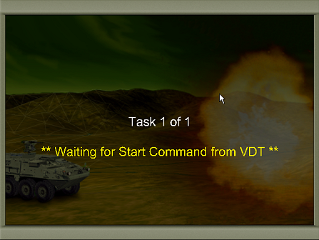
Start Simulation Window (IO)

Slide 34
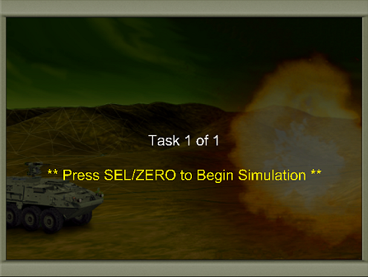
Start Simulation Window (Crew)

Slide 35
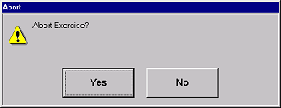
Abort Exercise Window

Slide 36

Initializing Simulation Window

Slide 37
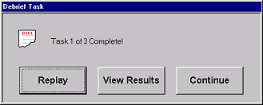
Debrief Task (Practice) Window

Slide 38
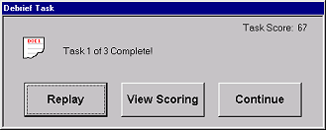
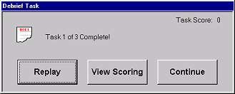
Debrief Task (Testing) Window

Slide 39
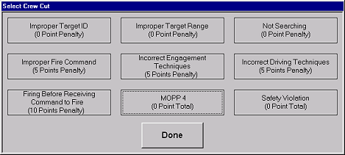
Select Crew Cut Window

Slide 40
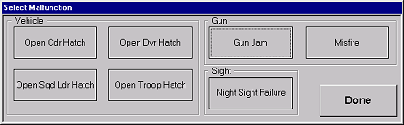
Select Malfunction Window

Slide 41
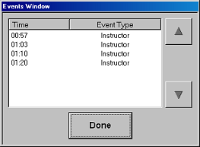
Events Window

Slide 42
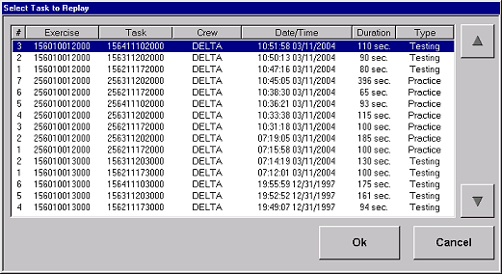
Select Task To Replay Window

Slide 43
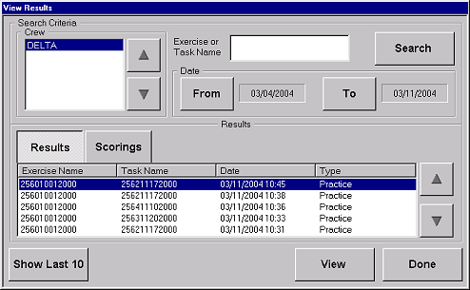
View Results Window (Results)

Slide 44
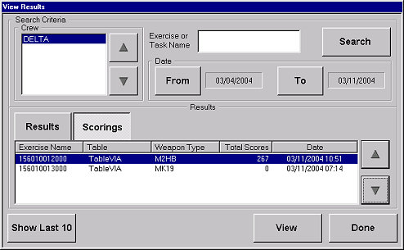
View Results Window (Scoring)

Slide 45
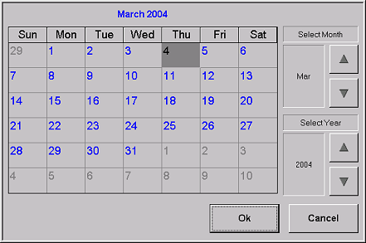
Calendar Window

Slide 46
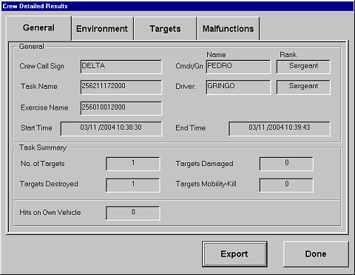
Crew Detailed Results Window
(General)

Slide 47
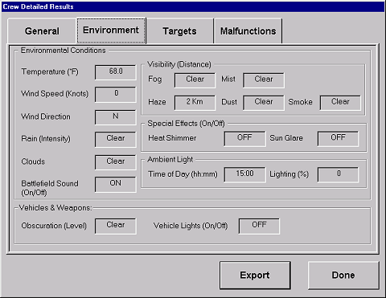
Crew Detailed Results Window (Environment)

Slide 48
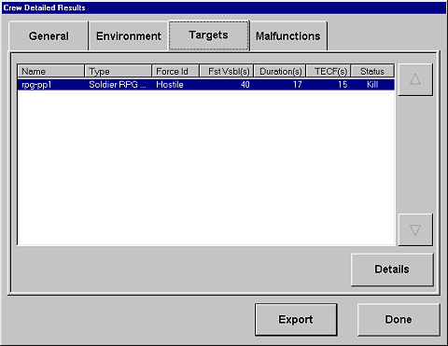
Crew Detailed Results Window (Target)

Slide 49
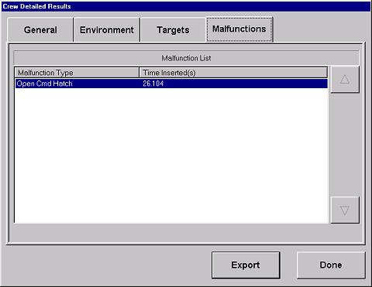
Crew Detailed Results Window (Malfunctions)

Slide 50
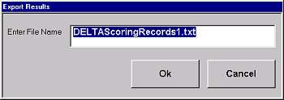
Export Results Window

Slide 51
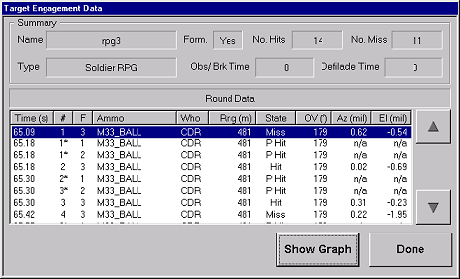
Target Engagement Data Window

Slide 52
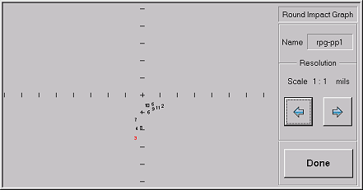
Round Impact Graph Window

Slide 53
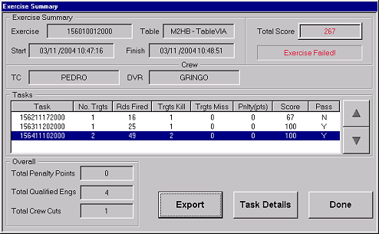
Exercise Summary Window

Slide 54

Task Details Window

Slide 55

Crew Cuts Window

Slide 56

Comments Window

Slide 57

Synopsis Window

Slide 58

Warning Window

Slide 59

Assign Vehicle Positions Window

Slide 60

Group Simulation Notification Window

Slide 61

Loading Test Simulation Window

Slide 62

Retrieving Exercise Window

Slide 63

Starting Simulation Software Window

Slide 64
Notes

