Slide 1


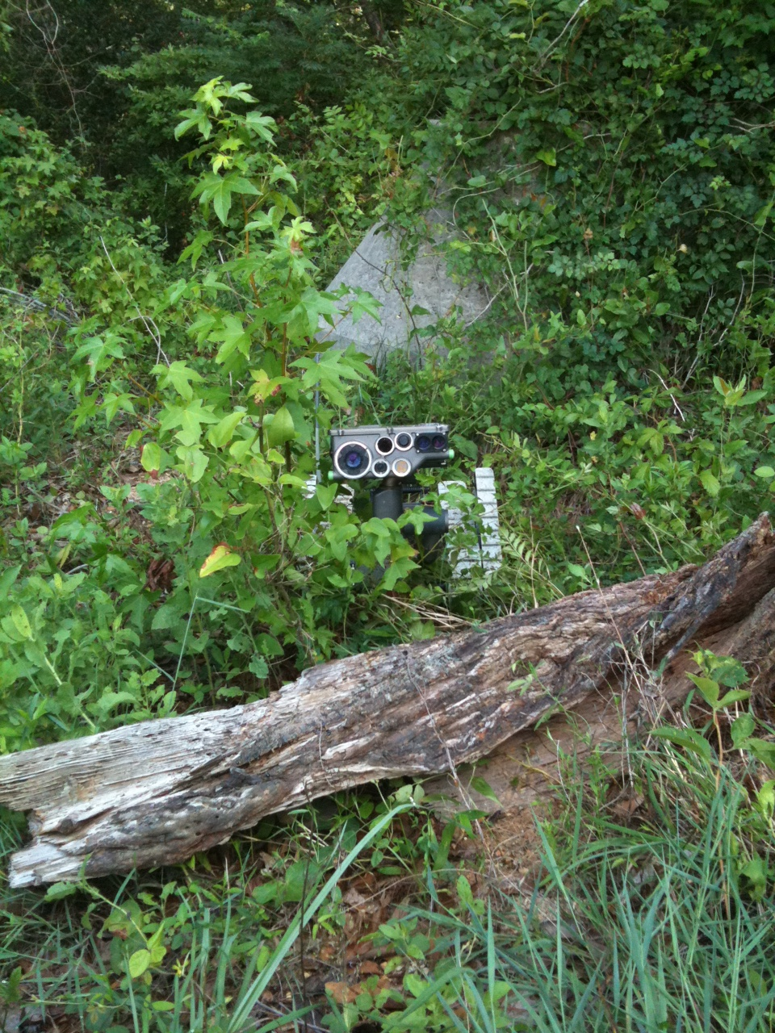
Seminar

Slide 2
Terminal Learning Objective
Action: | Implement selected SUGV Operator Training.
Conditions: | In an operational environment, provided with a laptop computer, television, operational SUGV system, all lesson plans and complete training support packages (digital and hard-copy), TM 9-2350-397-13 & P, Student Job Aid, and Student Guide.
Standards: | Implement selected SUGV Operator Training in accordance with SUGV Trainer Course policies, procedures, TM 9-2350-397-13 & P, Student Job Aid, Student Guide, the Student Evaluation Plan, and a complete Training Support Package.

Slide 3
Evaluation
Students will give a block of instruction on one (1) known class that will be presented the following day.
Students will be evaluated based on:
Their ability to properly present selected material to include covering all applicable notes, cautions, and warnings.
Their knowledge of the characteristics and capabilities of the SUGV.
Their ability to effectively instruct and certify new SUGV operators as well as recertify existing operators in accordance with course materials.

Slide 4
Time Line
0800-0900 Student Class 1
0900-1000 Student Class 2
1000-1100 Student Class 3
1100-1200 Student Class 4
1200-1300 Lunch
1300-1400 Student Class 5
1400-1500 Student Class 6
1500-1600 Student Class 7
1600-1700 Student Class 8

Slide 5
Review
At this time, you have the opportunity to ask any questions you have on any of the material covered in the class.
If you have any questions regarding any of the classes for tomorrow, ask them now as tomorrow class presentations will begin at 0800 and there will be limited time for questions before presentations begin.

Slide 6
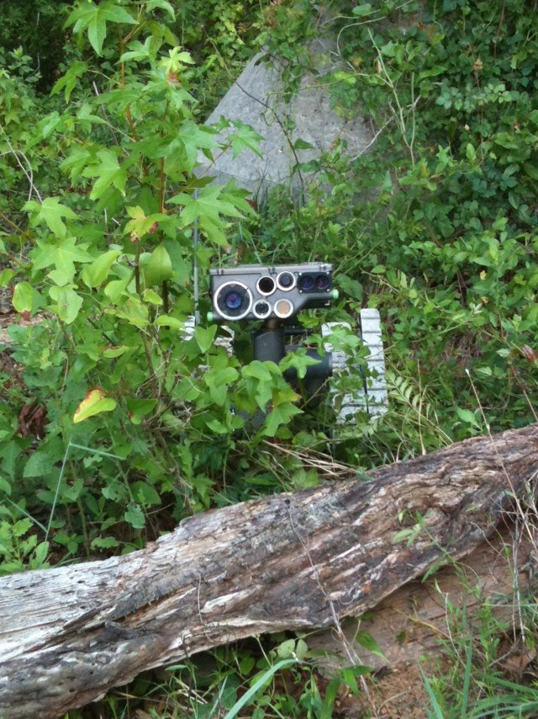
Reconnaissance Mission

Slide 7
Terminal Learning Objective
Action: | Conduct Small Unmanned Ground Vehicle (SUGV) Reconnaissance Mission Maneuvers.
Condition: | In an operational environment provided with TM 9-2350-397-13&P, SUGV Job Aid, SUGV Student Guide, and an operational SUGV system.
Standard: | Conduct Small Unmanned Ground Vehicle (SUGV) Reconnaissance Mission Maneuvers in accordance with TM 9-2350-397-13&P with 80% accuracy by: Properly conducting mission oriented Line of Sight (LOS) Maneuvers; Properly conducting mission oriented Non-Line of Sight (NLOS) Maneuvers.

Slide 8
Mission Oriented LOS Maneuvers
Conduct a reconnaissance of “Baghdad”, vicinity grid GA 0133588602, utilizing the Small Unmanned Ground Vehicle (SUGV) in order to accomplish the following objectives:
Enter and explore the building, vicinity grid GA0140288627, IOT identify potential threats or hazards, enemy disposition, and/or PIR.
Conduct thorough inspection of the drainage pipe GA0142488605 and bridge, vicinity grid GA0142488595, IOT identify potential threats or hazards to coalition forces or the local populace.
Conduct thorough inspection of the vehicle, vicinity grid GA0140188575, IOT identify potential threats or hazards to coalition forces or the local populace.
Maneuver the SUGV to the Release Point vicinity grid GA0135588612.
Report all findings to higher.

Slide 9
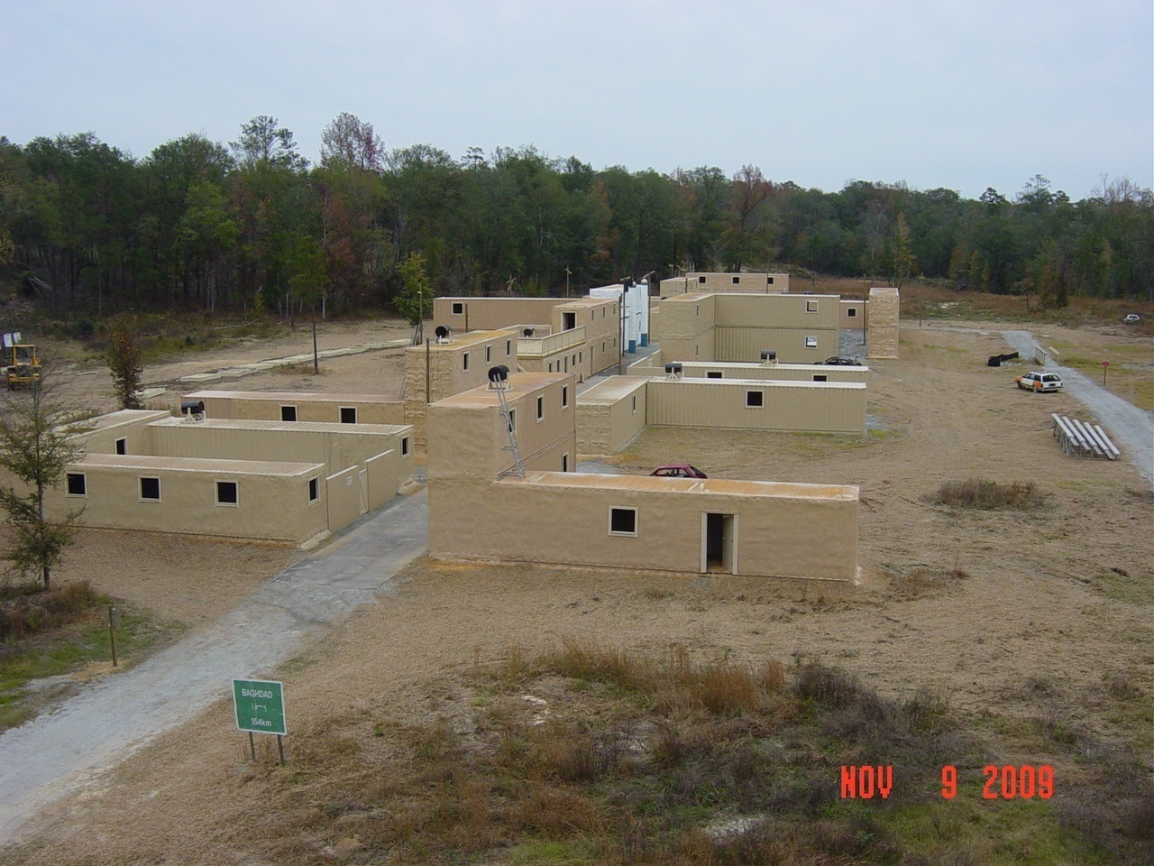
Baghdad
Building
GA 0140288627
Drainage Pipe / Bridge
GA01424605/GA0142488595
Car
GA 0140188595
Release Point
GA 0135588612
Rally point
GA 0133588602

Slide 10
Reconnaissance Mission Tasks
Properly conduct Pre-Mission Checks for the SUGV.
Maneuver the SUGV through obstacles utilizing proper menu options, drive poses and speed utilizing both Line of Sight and Non-Line of Sight techniques.
Locate and identify obstacles and objects inside a building utilizing appropriate camera modes and drive poses.
Locate and identify threats and objects inside drainage pipe utilizing appropriate camera modes and drive poses.
Locate and identify threats and objects under/around the bridge appropriate camera modes and drive poses.
Perform vehicle inspection and identify threats and objects utilizing appropriate camera modes and drive poses.
Notes:
Instructor will execute all drive poses while talking the students through the exercise.

Slide 11
Implement SUGV Training

Slide 12
Evaluation
Evaluations will be based on:
Your ability to properly present selected material to include covering all applicable notes, cautions, and warnings.
Your knowledge of the characteristics and capabilities of the SUGV.
Your ability to effectively instruct and certify new SUGV operators as well as recertify existing operators in accordance with course materials.

Slide 13
Summary
Terminal Learning Objective
Action: Implement selected SUGV Operator Training.
Condition: In an operational environment, provided with a laptop computer, television, operational SUGV system, all lesson plans and complete training support packages (digital and hard-copy), TM 9-2350-397-13 & P, Student Job Aid, and Student Guide.
Standard: Implement selected SUGV Operator Training in accordance with SUGV Trainer Course policies, procedures, TM 9-2350-397-13 & P, Student Job Aid, Student Guide, the Student Evaluation Plan, and a complete Training Support Package.

