Slide 1
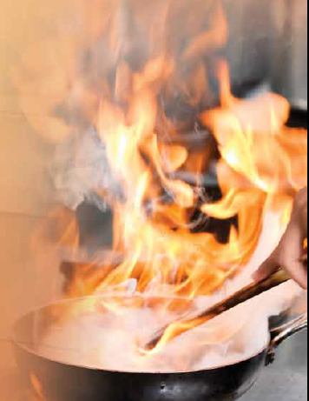
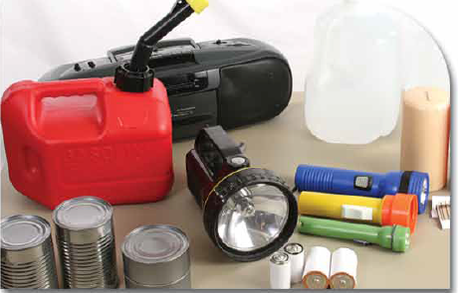
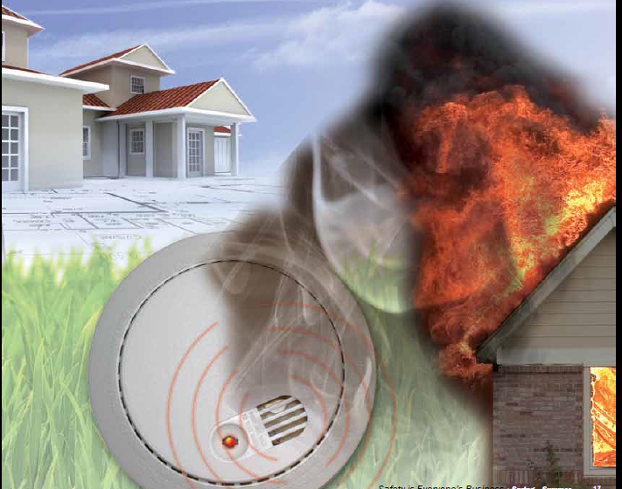
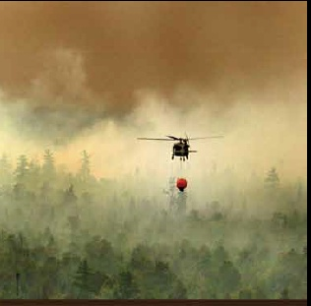
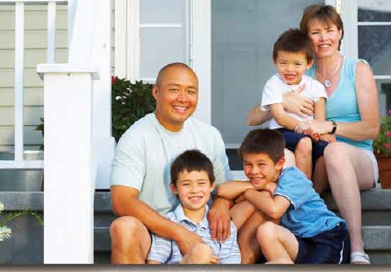
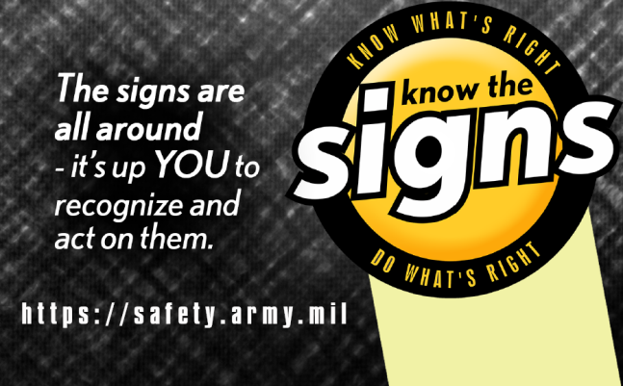
Commander’s Update Brief
AND YOU
SAFETY
Spring Safety
Joseph R. Osborn
IMCOM Safety Office
http://www.imcom.army.mil/Portals/0/hq/organization/safety/SpringSummer.pdf

Slide 2
LAWN CARE
SAFETY

Slide 3
GRILLING
SAFETY

Slide 4
FIREWORKS
SAFETY

