Slide 1

Guide to Electrical Safety
Task Force POWER
USFOR-A Joint Engineer Directorate (JENG)
  UNCLASSIFIED/FOUO
Overall Classification of Brief: UNCLASSIFIED/FOUO
  UNCLASSIFIED/FOUO

Slide 2
Overview
Dangers of Electricity
General Electrical Safety
Electrical Safety in Expeditionary Environment
Afghanistan electrical Incidents

Slide 3
Dangers of Electricity
Electricity is the unseen killer:
    It is invisible to the human eye
    Doesn't make any sound
    Gives off no odor

Slide 4
Dangers of Electricity
Common Effects of Shocks
1-10 Milliamps: Person will feel little or no electrical shock effects or sensation.
10-20 Milliamps: Painful shock will occur like a jolt, but muscle control will not be lost at this amperage.
20-75 Milliamps: This shock is more serious. You'll receive a painful jolt and muscle control will be lost resulting in the inability to let go of something you may have grabbed that is shocking you.
75-100 Milliamps: As the current approaches 100 milliamps, ventricular fibrillation of the heart occurs and cardiovascular damage is done.
100-200 Milliamps: Ventricular fibrillation occurs and death can occur if medical attention is not administered quickly.
Over 200 Milliamps: Severe burns and severe muscle contractions occur. Your heart can stop during a shock because the chest muscles put pressure on the heart. Internal organs can be damaged at this stage and if you survive, a painful recovery can be expected. What may surprise you about this level of shock is that through this clamping effect on the heart, ventricular fibrillation is avoided and the chances of a person's survival is good if the victim is removed from the electrical circuit.
However, as little as 3 milliamps can kill a person under the right circumstances. A small coffeemaker draws 5 amps.

Slide 5
Overview
Dangers of Electricity
General Electrical Safety
Electrical Safety in Expeditionary Environment
Afghanistan electrical Incidents

Slide 6
General Electrical Safety
All electrical wires and components should be treated as if they are live.
Only after being inspected by qualified personnel should they be considered dead.

Slide 7
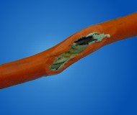
General Electrical Safety
Damaged extension cords
The cord should not be repaired, it needs to be replaced.

Slide 8
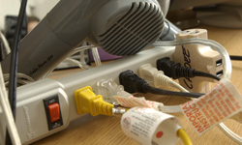
General Electrical Safety
Overloaded power strips
Most common area for overloaded power strips are in overcrowded office spaces and living quarters.

Slide 9
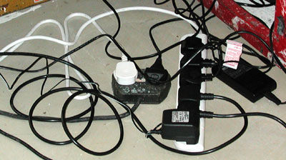
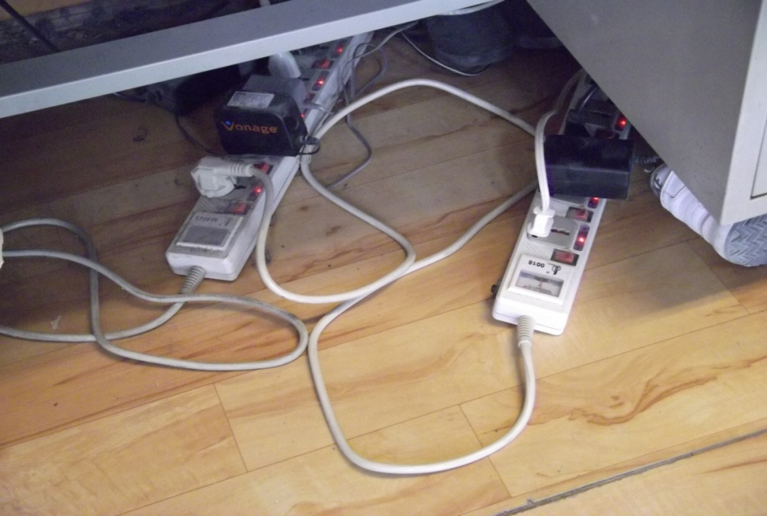
General Electrical Safety
Daisy chained power strips
Daisy chaining of power strips overloads the capacity of the first power strip.

Slide 10
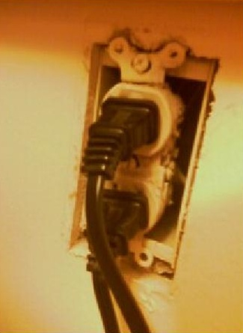
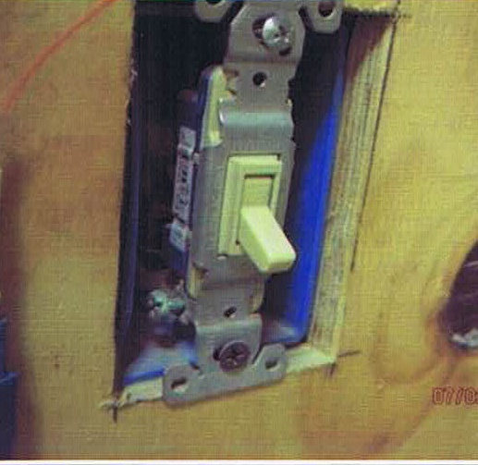
General Electrical Safety
Missing cover plates on outlets and switches
Live electrical parts
Missing cover plates increase the potential of contact with live electrical parts.

Slide 11
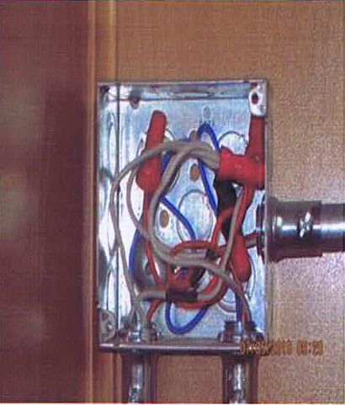
General Electrical Safety
Junction boxes with no covers
Open junction boxes increase the potential for contact with live electrical wires.

Slide 12
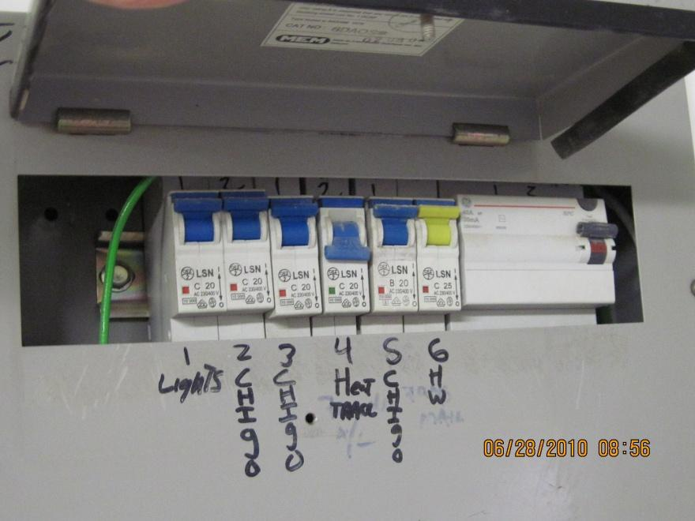
General Electrical Safety
Unused openings in electrical panels
Openings create a potential for contact of live electrical parts.

Slide 13
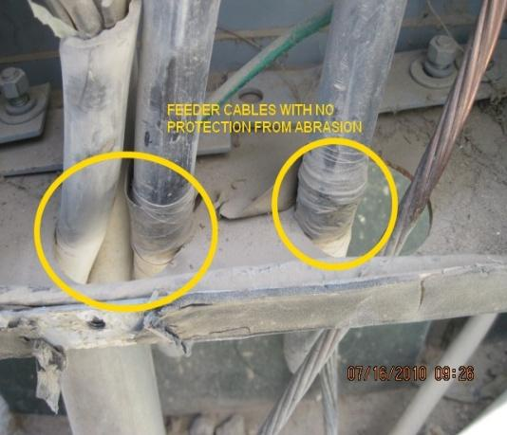
General Electrical Safety
Wires entering enclosures without proper protection
Over time, sharp edges will rub through wire insulation and cause a short circuit, creating a fire hazard.

Slide 14
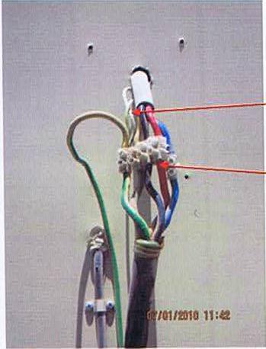
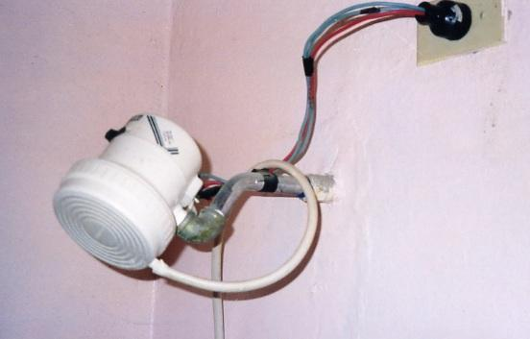
General Electrical Safety
Exposed electrical parts and wires
Exposed wires are subject to physical damage, thus increasing the chance of shock.

Slide 15
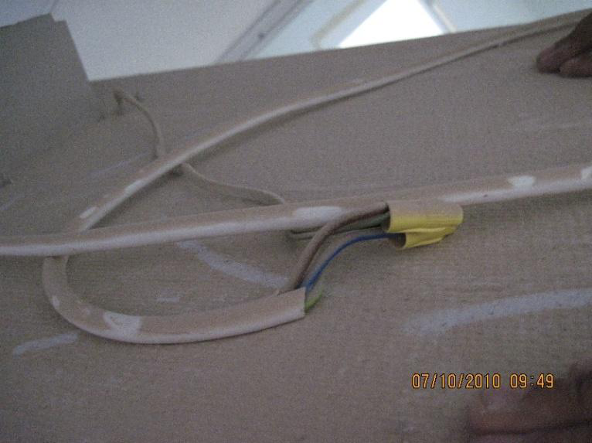
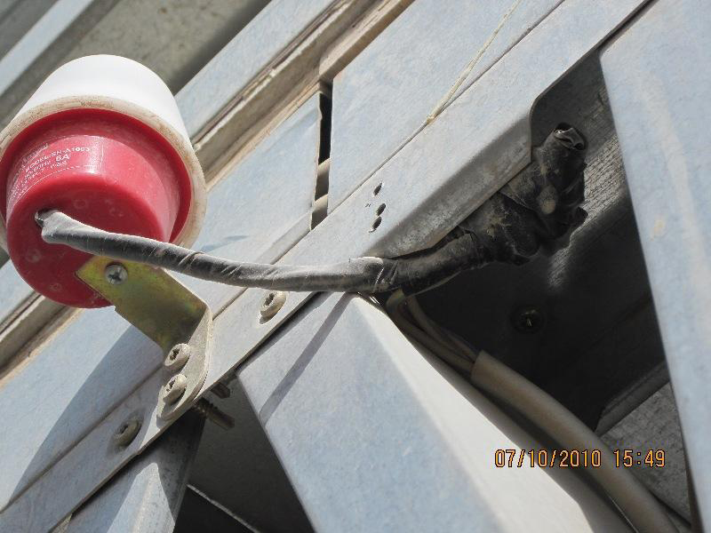
General Electrical Safety
Splices not in an approved junction box
Splices not in a junction box, can easily be separated, leaving live wires exposed.

Slide 16
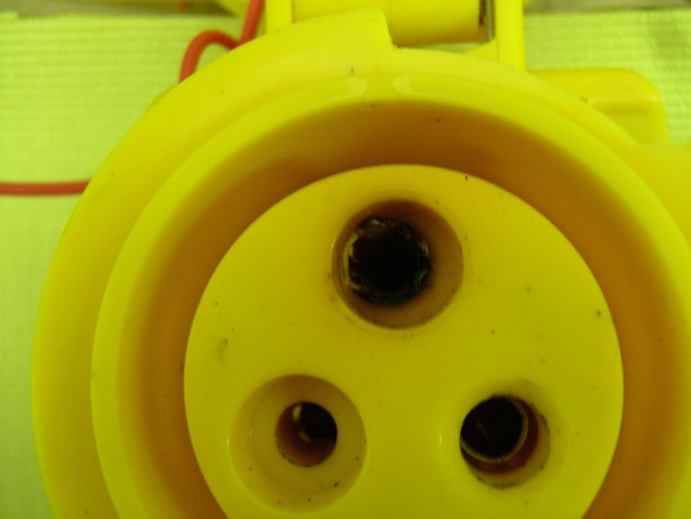
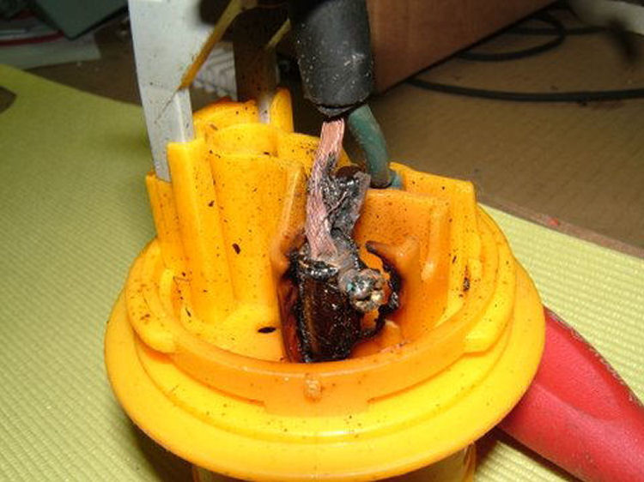
General Electrical Safety
Discolorations or blistering of plastic around extension cords
A discolored receptacle is the result of an overloaded extension cord and creates a electrical shock and fire hazard.

Slide 17
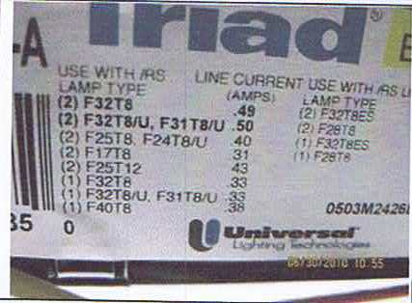
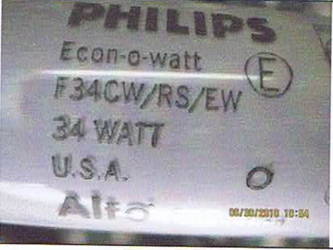
General Electrical Safety
Lamp wattage does not match ballast rating
This condition can cause the ballast to overhead and catch fire. If you have questions concerning this, contact TF POWER

Slide 18


General Electrical Safety
All electrical devices must be UL or CE listed
The label will normally be located on the back of the equipment near the manufacturer’s label. Counterfeiters have started labeling their products as UL/CE compliant. If you have questions about the authenticity of the listing, contact TF POWER.
Power strips, plug adapters, and transformers are banned from being sold at bazaars due to counterfeit/non-listed parts. If they are still being sold at your bazaar, do not buy them and contact TF POWER

Slide 19
Overview
Dangers of Electricity
General Electrical Safety
Electrical Safety in Expeditionary Environment
Afghanistan electrical Incidents

Slide 20
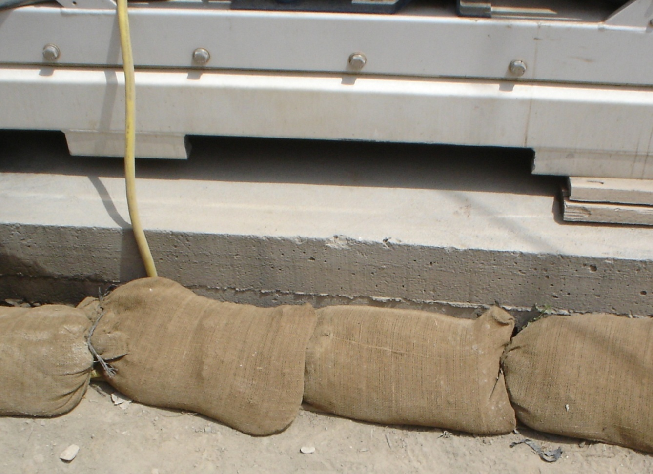
Electrical Safety in Expeditionary Environment
Cover cable runs on top of the ground with sandbags to prevent exposing live wire.

Slide 21
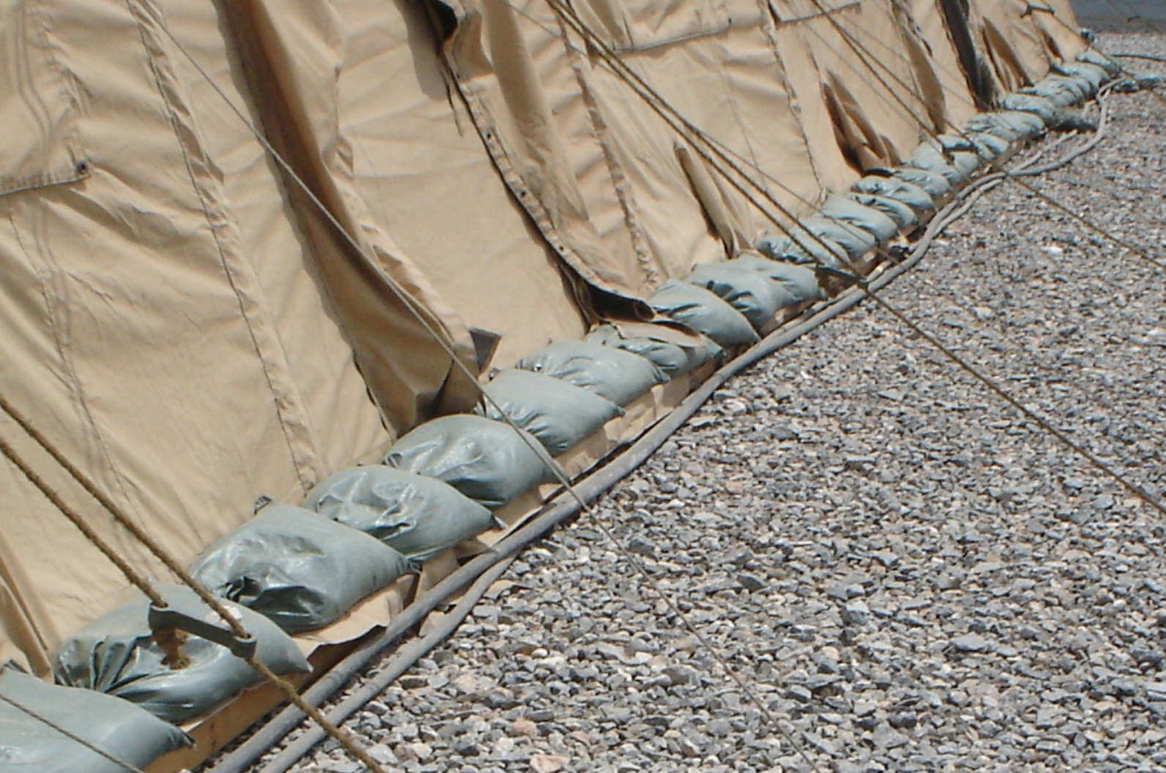
Electrical Safety in Expeditionary Environment
If sandbags are not available, position cables near structures and away from foot traffic to avoid unnecessary damage.

Slide 22
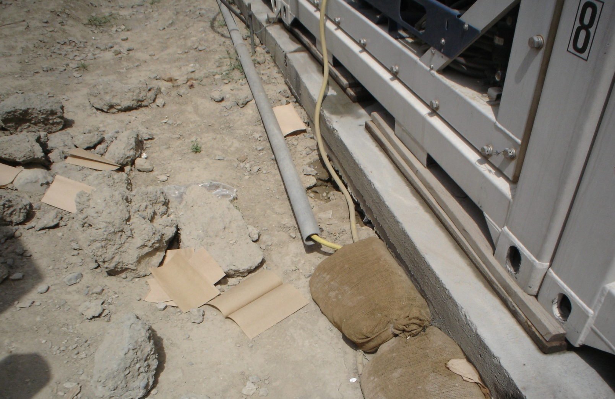
Electrical Safety in Expeditionary Environment
If available, sleeve cables in a rigid connector for maximum protection.

Slide 23
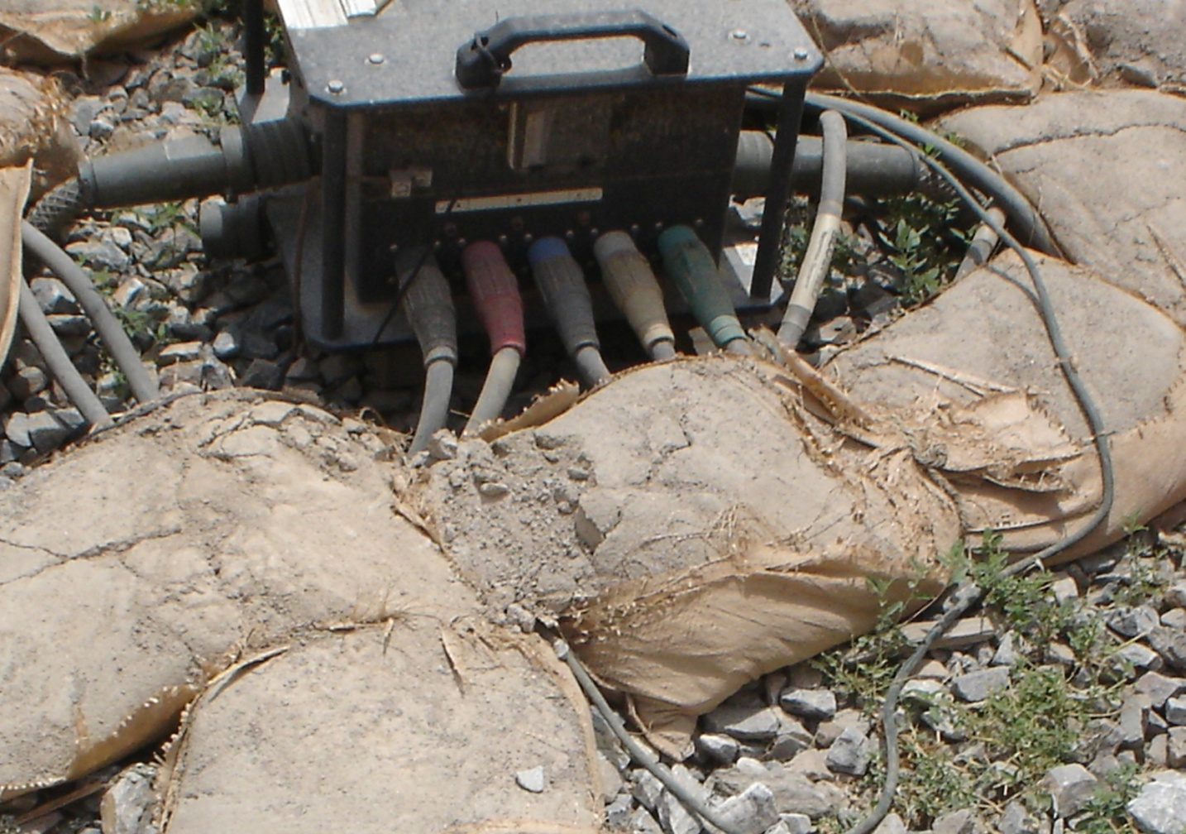
Electrical Safety in Expeditionary Environment
Ensure cable connections to distribution boxes are tight and fully inserted.

Slide 24
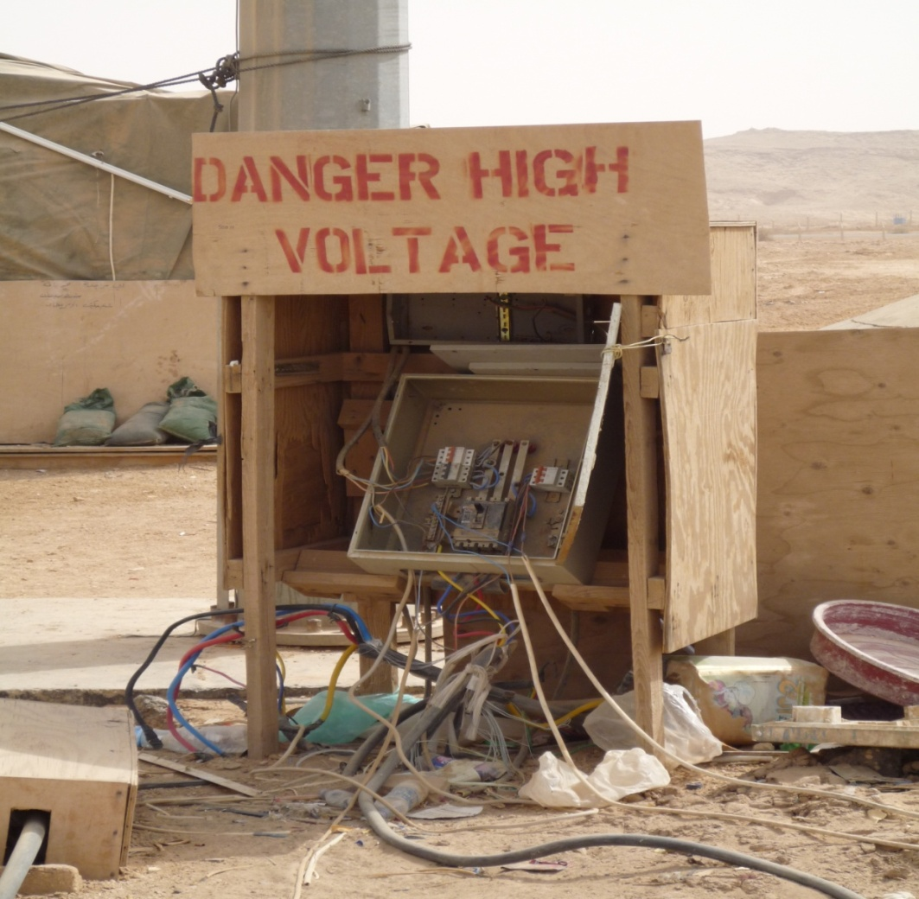
Electrical Safety in Expeditionary Environment
If it looks dangerous, it most likely is.

Slide 25
Overview
Dangers of Electricity
General Electrical Safety
Electrical Safety in Expeditionary Environment
Afghanistan electrical Incidents

Slide 26
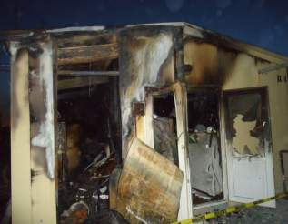
Afghan Electrical Incidents
Counterfeit power strips, plug adapters, and transformers are the #1 cause of fire in theater. Three service members dead from fire due to an unapproved device.
Lessons Learned:
Do not buy any electrical devices at a bazaar
Do not overload/daisychain power strips
Inspect all devices for UL/CE markings (if questions on authenticity, contact TF POWER)

Slide 27
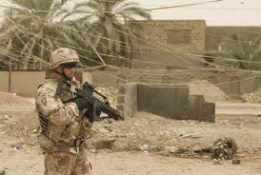
Afghan Electrical Incidents
Low hanging, high voltage lines have killed 4 service members in 2012 alone
Lessons Learned:
Do not assume a line is not live because you can reach it
Do not assume if a line was de-energized it will remain that way
Pay close attention if you have are carrying a radio/antennae
Be extra vigilant when in a turret

Slide 28
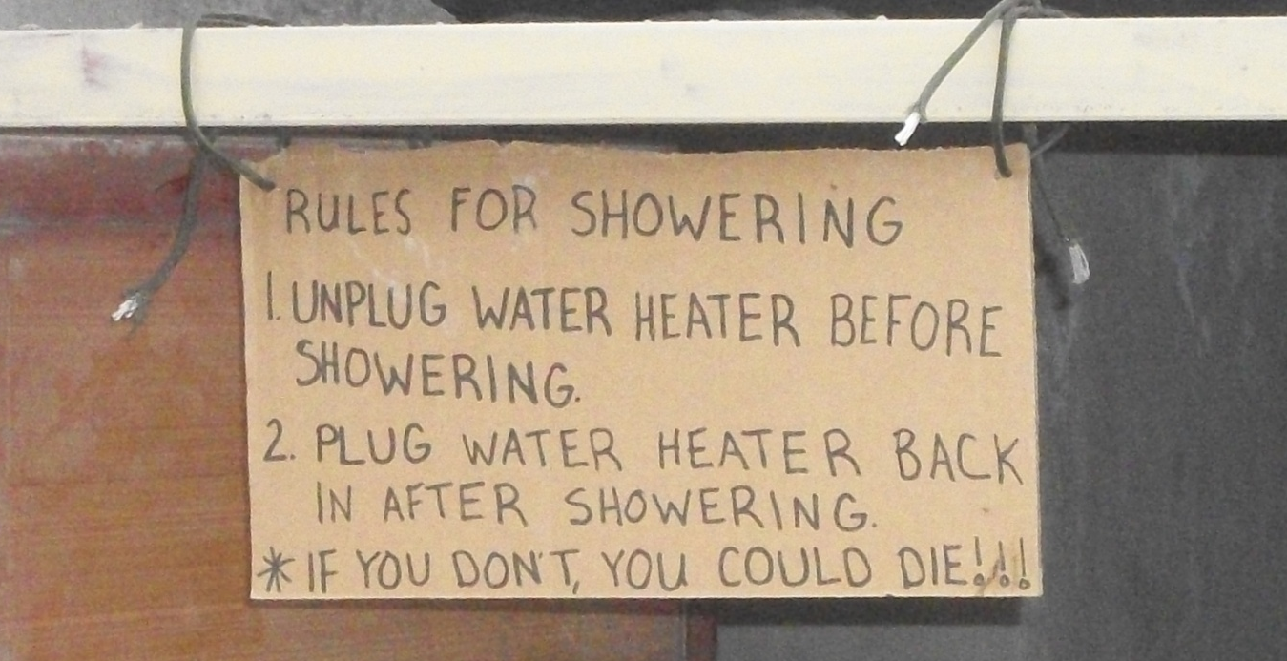
Afghan Electrical Incidents
Wiring by unqualified personnel poses an imminent threat to all deployed personnel. There have been over 50 reported shockings due to bad wiring.
Lessons Learned:
Do not perform electrical work unless you are a qualified professional
“Self Help” wiring has led to numerous fires and shockings
Inspect all devices for UL/CE markings (if questions on authenticity, contact TF POWER)

Slide 29
Contact
For any electrical safety concern, contact TF POWER at:
E-mail: TFPOWER@afghan.swa.army.mil
DSN: 318-449-4295
SVOIP: 308-449-4345
Notes:
To give you some background on the ISBEB board, the first meeting was held back in October 2010 with the purpose of having senior leaders oversee the development of a holistic basing plan for the CJOA-A.
The board meets monthly on the third Monday and submits a quarterly report to COMISAF. Co-chairs are BG Yenter, BG Davis (IJC) and MG Samol (ISAF).
The major tenets of the board are shown here….

