Slide 1

352nd Combat Sustainment Support Battalion
Operations (S3)
Overview
1 January 2011
Notes:
The Logistics branch insignia depicts a diagonally crossed cannon and key surmounted by a ship’s steering wheel. Bearing on the hub is a stylized star. Inscribed on the ship’s wheel is the Latin phrase, “Sustinendum Victoriam,” which means “Sustaining Victory.” Soldier red is the Logistics branch color. The key represents the Quartermaster branch’s supply and service responsibilities; the ship’s wheel denotes the Transportation branch’s responsibilities for the movement of troops, supplies, and equipment; the cannon represents the Ordnance branch’s responsibilities for maintenance and munitions; and the stylized star represents the unity and integration of logistics functions.

Slide 2
Overview Intent
Task: Provide an overview and baseline of processes required to operate Operations and Tactical Operations Center (TOC) within a battalion.
Condition: A battalion size element is operating safely and securely within a combat zone.
Standard:
  Accurately facilitate, report, and document 360 degree communication with brigade, companies, and peer battalions.
  Publish, track, and ensure compliance with operations and fragmentary orders.
  Ensure training requirements are defined and executed to standard.
  Ensure safe execution of mission and training exercises.
  Ensure units are implementing appropriate force protection standards.

Slide 3
Lines of Effort
Operations
Command Inspection Program
Force Protection
OPORDs / FRAGOs
Training
MDMP
Staff Assisted Visit/CMD Insp Prgm
Training
Redeployment
Unit Status Reports
Briefings
Troops-To-Task
Staff Duty
Tactical Operations Center
Request For Information
Battle Drills
Battle Rhythms
Commander’s Critical Incident Requirements
Serious Incident Reports
Tactical Communication
Trackers
Movement Operations
Red Cross Message
Safety
Accountability
Inspections
Composite Risk Management Worksheet
Classes
Briefings
Standard Operating Procedures
FRAGOs
Electronic Warfare Operations
Inspections
FRAGOs
Classes
Standard Operating Procedures
Chemical, Biological, Radiological, and Nuclear
Inspections
FRAGOs
Classes
Standard Operating Procedures

Slide 4

Tactical Operation Center
C
NIPR/SIPR Computer
M
MTS
S
SINGAR
Board
Whiteboard
E
CIDNE
Multi-drawer
Mailbox
Mailbox (In/Out)
R
RIPRNET
Telephone
TV
Television
M
MTS
P
Printer
Map
Maps
Hall
Battle Matrix
Map
EWO Board
T
T
Tactical Comms
C
C
R
Company
C
B
S
Operations Brd
Battle
NCO
Battle NCO
Force Prot/EWO/CBRN
Convoy Brd
Wall
Battle
Captain
Company
OIC
C
FRAGOs
T
C
C
T
C
C
T
Example
Restricted Access
MIRC / Map
M
CCIR/SIR/SPOT
T
Training Board
C
T
P
C
E
COP
C
Editable diagram.
NCOIC
Battle NCO
Training
S2
S2
Weapon Rack
P
C
C
Training Board
C
C
T
Battle Books
C
AFN
Safe
EWO
T
FRAGOs
FRAGOs
RFI Board
Map

Slide 5
TOC Operations Drawdown
Editable worksheet; copy to Excel.

Slide 6
TOC & S3 Troops-To-Task
Editable worksheet; copy to Excel.

Slide 7
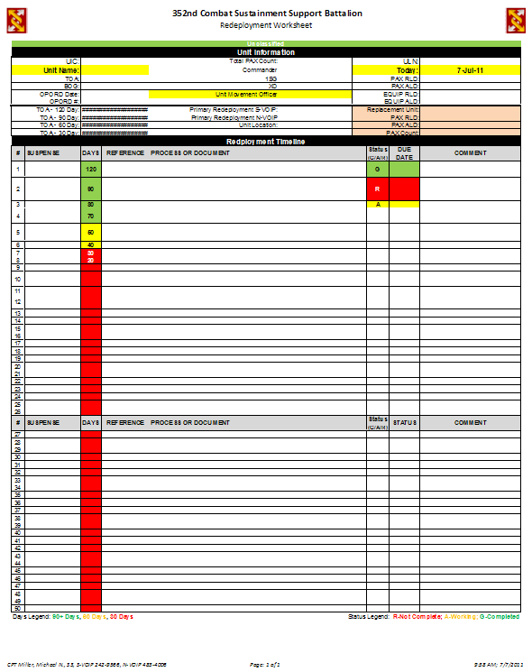
Redeployment Worksheet
Task: Ensure units (personnel & equipment) redeploy on-time.
Condition: Units operating within 352nd CSSB prepare for redeployment to CONUS.
Standards:
Units complete tasks prior to suspense.
JOPES is monitored for changes in movement dates, personnel or cargo.
Units anticipate issues.
Units prepare for briefings.
Attachment provided; see last slide.

Slide 8
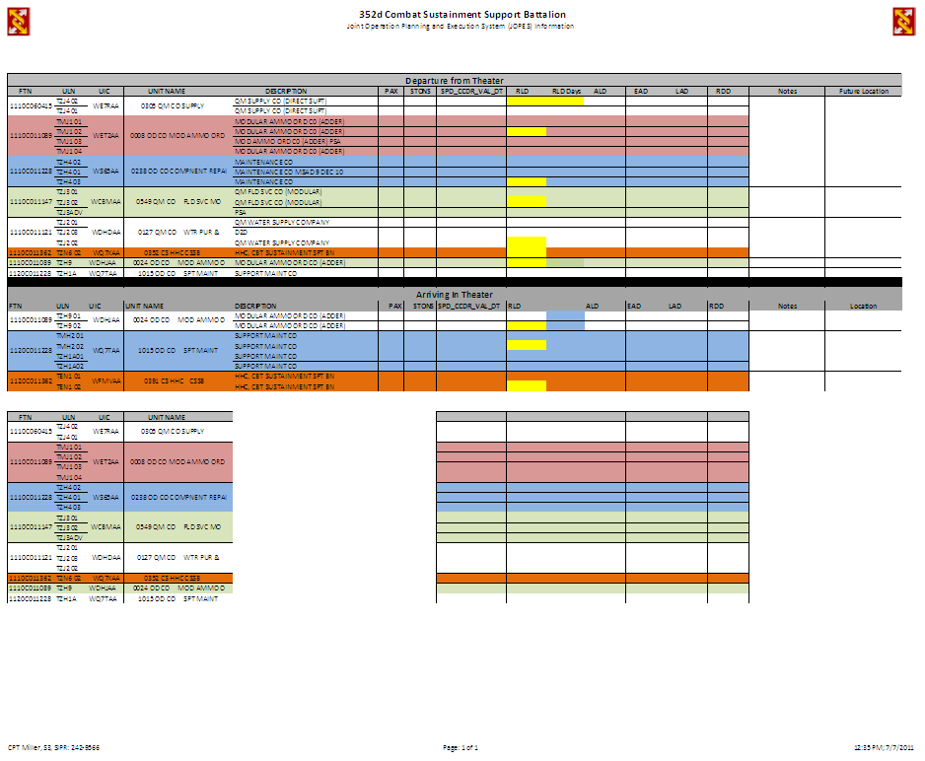
Joint Operation Planning & Execution System
(JOPES) Management
Task: Schedule movement of units (personnel and cargo) from Kuwait to CONUS through JOPES.
Condition: Units preparing for redeployment must meet required-to-load date (RLD), available-to-load date (ALD), earliest arrival date (EAD), latest arrival date (LAD), and required delivery date (RDD).
Standards:
Monitor JOPES (personnel, cargo, departure, arrival locations) for accuracy.
Communicate changes with companies and BDE S5.
Attachment provided; see last slide.

Slide 9
Troops-To-Task
Task: Identify and perform tasks necessary to accomplish mission.
Condition: Higher headquarter tasks must be accomplished that support mission requirements. Subordinate units must allocate personnel to meet all requirements.
Standards:
Identify tasks and requirements.
Compile and report personnel: allocated, available, and assigned..
Identify shortages or inability to fulfill mission requirements.

Slide 10
FRAGO Management
Task: Prepare, disseminate, track, and report current status of orders within the Command.
Condition: Orders are issued at ESC, BDE, and BN levels for execution by staff and companies.
Standards:
Units complete mission prior to suspense.
Units anticipate issues.
Track BDE and BN issued FRAGOs.
Identify affected companies and sections.
WARNOs distributed daily (Sat – Fri rollup).
FRAGO Tracker
WARNO
Staffing Tracker
Enduring FRAGO Tracker
Attachment provided; see last slide.

Slide 11
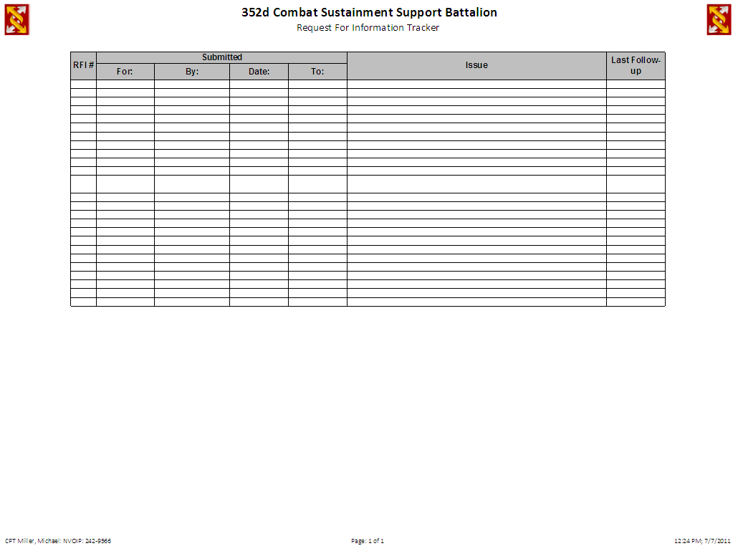
Request for Information (RFI) Management
Task: Ensure orders and guidance is understood and executable.
Condition: BN staff is responsible for ensuring that BDE orders are clear and feasible, identifying areas requiring clarity, and requesting more information when required.
Standards:
BN Staff review orders, anticipate issues, and clarify order/guidance.
BN Staff develop and submit questions and information to BN TOC required for BDE to clarify orders/guidance.
BN TOC submit and track RFI.
BN Staff report to TOC when RFI answered/closed.
Attachment provided; see last slide.

Slide 12
CCIR / SIR / Red Cross / SPOT Tracker
Task: Maintain accurate records for effective reporting and follow-thru of incidents effecting personnel and mission.
Condition: Incidents occur that meet criteria identified as being trackable and reportable.
Standards:
TOC personnel enforce reporting requirements.
TOC personnel accurately enter information into tracker.
TOC personnel report information accurately and within time requirements to appropriate leadership.
Serious Incident Report Tracker
Red Cross MessageTracker
Air/Ground Movement Request Tracker
SPOT Report Tracker
Commander’s Critical Information Req. Tracker
Attachment provided; see last slide.

Slide 13
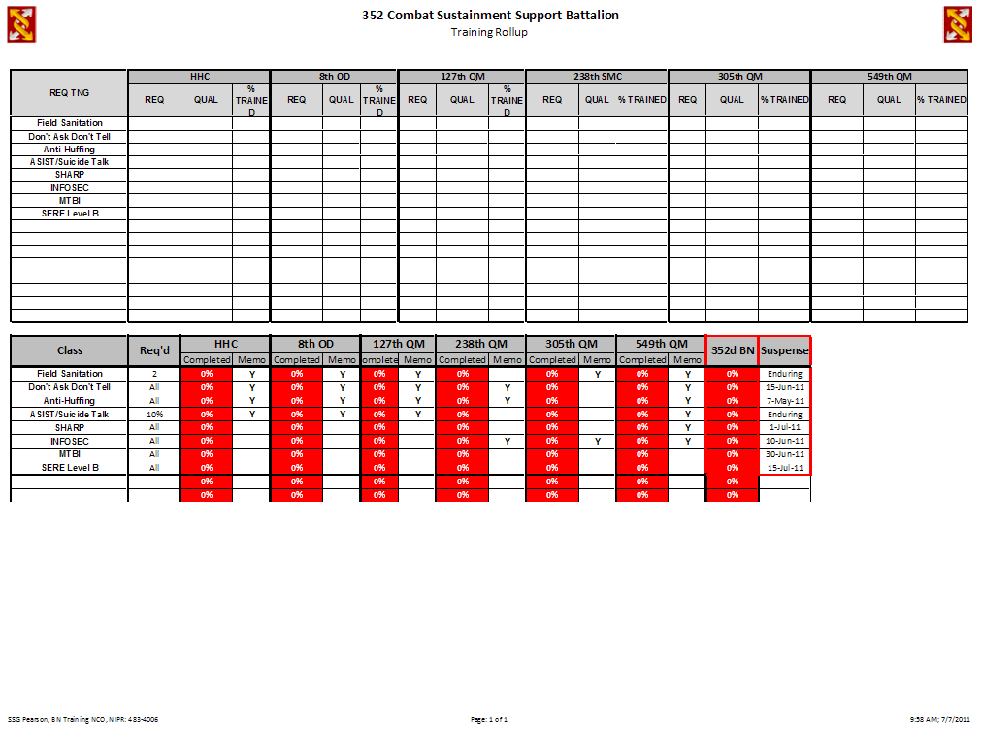
Training Tracker
Task: Anticipate and ensure units have skills necessary to accomplish organizational mission.
Condition: Soldiers are prepared mentally, physically, spiritually, and emotionally to survive and accomplish mission.
Standards:
Units provide updates during weekly training meetings.
Units accomplish training requirements prior to suspense.
Units track progress by Soldier until 100% complete and provide Memorandum of Completion to S3
Updates provided daily to companies and weekly C&S
Attachment provided; see last slide.

Slide 14
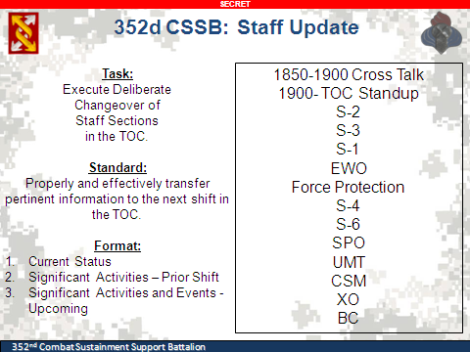
Shift Change
Task: Maintain continuity of operations and promote crosstalk between staff and Tactical Operation Center (TOC) personnel.
Condition: TOC personnel conduct shift change-over at 0700 and 1900, 7 days per week.
Standards:
TOC personnel attend 0700 & 1900 every day; Staff attend 1900 (Mon – Sat).
Provide current status, significant events since last shift change, and anticipated/scheduled significant events prior to next shift change.

Slide 15
Reports Battle Rhythm
Task: Ensure reports are submitted or received in a timely manner.
Condition: Communicate information to higher headquarters and receive information from subordinate commands to ensure mission success.
Standards:
Define report requirements.
Report information accurately.
Anticipate issues to minimize disruption to mission.
Attachment provided; see last slide.

Slide 16
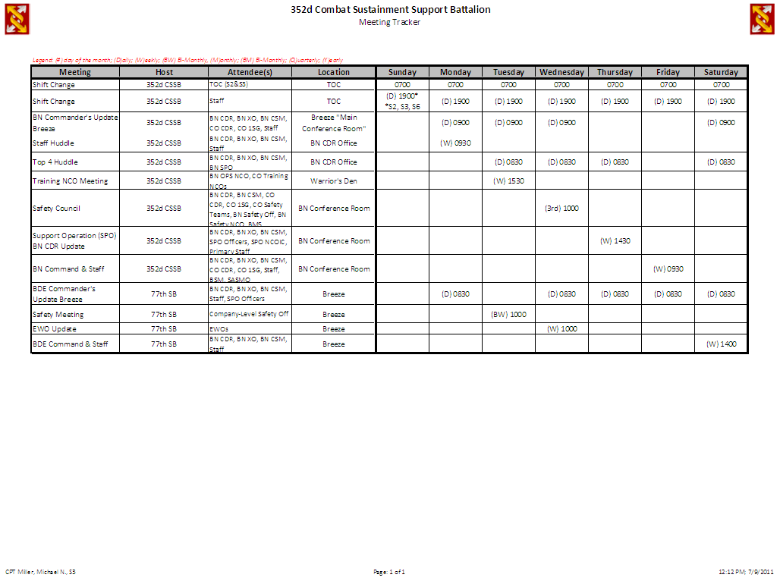
Meeting Battle Rhythm
Task: Attend meetings to ensure 360-degree communication.
Condition: Communicate information to higher headquarters and receive information from subordinate commands to ensure mission success.
Standards:
Define meeting requirements.
Report information accurately.
Anticipate issues to minimize disruption to mission.
Attachment provided; see last slide.

Slide 17
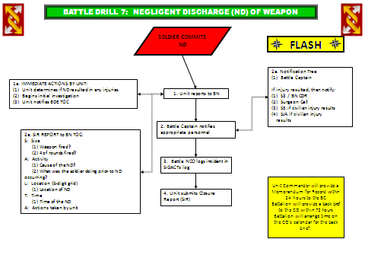
Battle Drills
Task: Efficiently and effectively manage critical events.
Condition: Events occur on battle field requiring methodical and deliberate management by multiple headquarters.
Standards:
Provide guidance for identified or similar events.
Ensure critical steps aren’t missed during high-priority events.
Identify who is responsible for each task.

Slide 18
100% Accountability Worksheet
Task: Accurately account for personnel within designated timeframe.
Condition: Given that Soldiers are located within known locations performing known tasks (mission, reset, PT, etc) within combat zone.
Standards:
100% accountability within 2-hours.
Soldiers location is known by team members/leadership at all times.
Status reporting every 30 minutes until complete.
Attachment provided; see last slide.

Slide 19
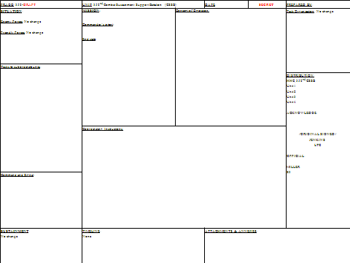
FRAGO
Task: To clearly communicate orders and intent 360-degrees.
Condition: Communicate orders from current and higher headquarters to ensure mission success.
Standards:
Define mission requirements.
Communicate Commander’s intent.
Identify units purpose and involvement.

Slide 20
FRAGO: 352-DRAFT | UNIT: 352nd Combat Sustainment Support Battalion (CSSB) |  | DATE: | SECRET | PREPARED BY:
SITUATION: Enemy Forces: No change Friendly Forces: No change | MISSION: Commander’s intent: Key Tasks: End state: | Concept of Operation: |  |  | Task Organization: No change
Tasks to subordinate units:
 |  |  |  |  | DISTRIBUTION: HHC, 352nd CSSB Unit 1 Unit 2 Unit 3 Unit 4 ACKNOWLEDGE: //ORIGINAL SIGNED// JENKINS LTC OFFICIAL: MILLER S3
 | Coordinating Instructions:
Command and Signal:
SUSTAINMENT: No change | TIMELINE: None |  | ATTACHMENTS & ANNEXES:
Notes:
Bullets: Must follow format in FM 5.0. ( Level 1 - 1., Level 2 - a., Level 3 - (1) )
Situation: Tell a general story of what is to occur.
Mission: Who, What, Where, When, Why (NEVER HOW)
Concept of Operation: General who is doing what.
Tasks to subordinate units or staff: One unit / One task.
Coordinating Instructions: Task being performed by two or more units.
Checklist:
____ Are all the fonts the same.
____ Is DISTRIBUTION correct.
____ Is Command and Signal reflect the correct leadership and contact information.
____ Is the word “Soldier” capitalized correctly.
____ Is the original FRAGO from BDE “inserted” by ATTACHMENTS & ANNEXES?
____ Is information only stated one time (Not in mission statement, situation, end state, etc.)
____

Slide 21
TOC Operational Policy
Task: To clearly communicate acceptable standards for Tactical Operation Center personnel.
Condition: TOC is required to provide 24-hour coverage with limited resources.
Standards:
Define personnel standards.
Define resource requirements and standards.

Slide 22
Attachments

