Slide 1
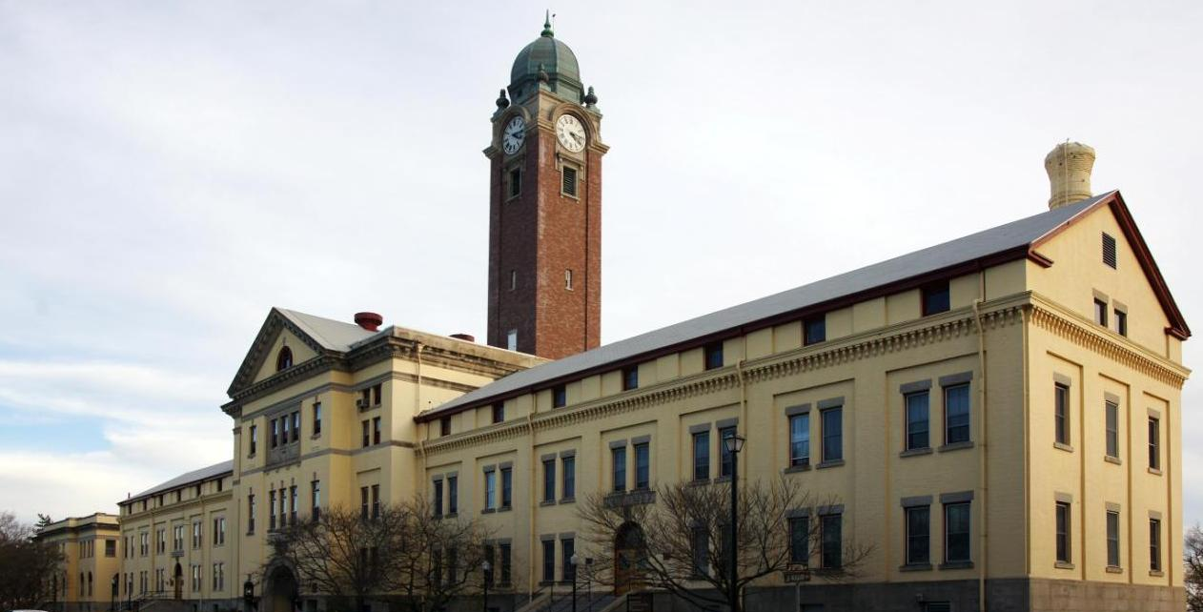
AKMQC 16-003 Institutional KM Presentation 08 MAR 16
LTC GUY H. BUICE
CAC CKO
913-684-4991
Purpose: Discuss Institutional Knowledge Management with the Army Knowledge Management Qualification Course to identify similarities and differences to enable its application in units and organizations
Notes:
TitleSlide

Slide 2
Institutional vs. Operational KM
What does “institutional” mean?
Is there a difference between the two areas with regard to KM?
Notes:
Define Institutional and Operational
Institution can be a place, person, a process or practice.

Slide 3
Institutional vs. Operational KM
What does “institutional” mean?
An established organization
A significant practice, relationship
Someone firmly associated with a place or thing.
Is there a difference between the two areas with regard to KM?
Difference in time available – less in operational environments
Civilian heavy vs. Military heavy
Systems are different, processes very similar
Notes:
Example of “institution””
An established organization (e.g. The Army, MAYO Clinic, IBM, University of Oklahoma, Kansas, Michigan, Texas, The “Institute” of Surgical Research”, The “Institute” of Heraldry)
A significant practice or relationship ( The institution of marriage.)
Someone firmly associated with a place or thing. (Marlon Brando and Al Pacino are each an institution of the modern film industry)

Slide 4
What does “institutional” mean? (An established organization)
Notes:
https://www.youtube.com/watch?v=yPJXEMKtTLE
https://www.youtube.com/watch?v=o42zmYN2_-k
https://www.youtube.com/watch?v=edV1Px8NHk4

Slide 5
What does “institutional” mean? (A significant practice, relationship)

Slide 6
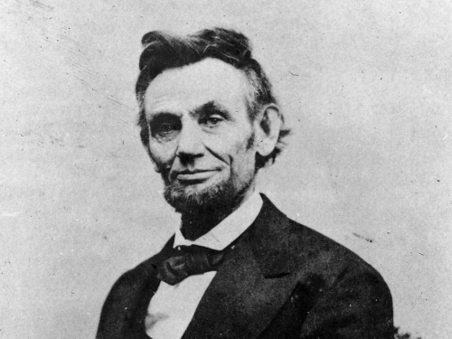
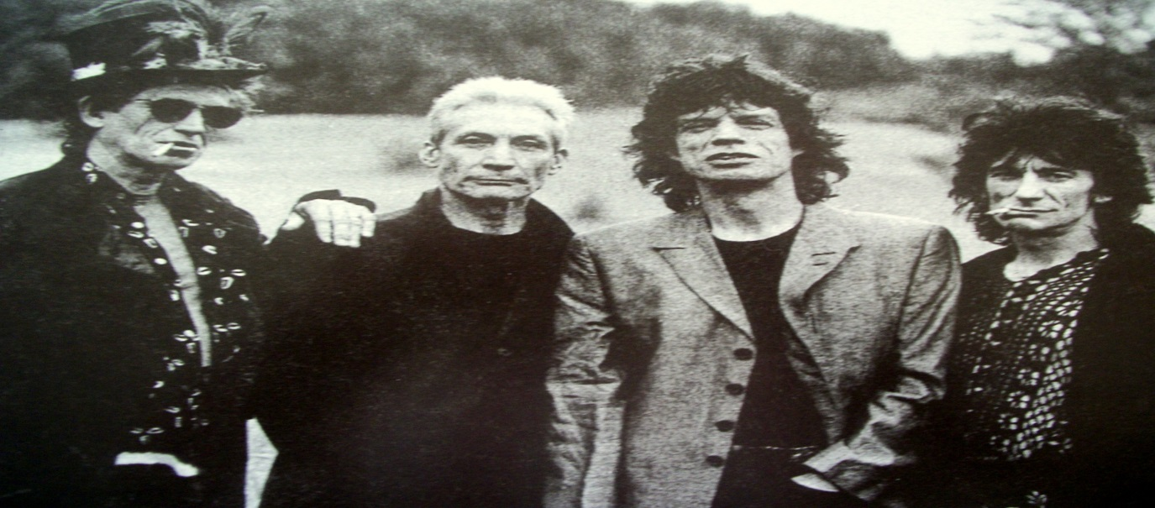
What does “institutional” mean? (Someone firmly associated with a place or thing. )

Slide 7
Perspective: Noun? Verb?
MEANS | WAYS | ENDS
People | People | People
Processes | Processes | Processes
Organization | Organization | Organization
Tools | Tools | Tools
Notes:
Where does In/Out processing fit on this chart?
Is in/out processing a verb? Is it a noun? Is it a means? Is it a way? Is it an end?
How about continuity? On Boarding?
Is IN/OUT processing a tool in and of itself? Would it be useful to develop an inventory of skills and expertise in an organization?

Slide 8
Is there a difference between the two areas with regard to KM?
Difference in time horizons –
nearer in operational environments
Civilian “heavy” vs. Military “heavy”
Systems are different, processes very similar
Terminology (vernacular) may be different

Slide 9
So less talk, let’s just do it…
CoS Guidance: Develop a Common Operating Picture for CAC to synchronize operations and events.
Focus on sharing information
Eliminate the “Click to Know”
Use Existing Information
Notes:
Focus on the sharing. Facilitating an ease of access is a form of sharing in itself.
“Click to Know” suggests that the name of the document or the link does not adequately describe what is behind it. ‘Discovery Learning’ ensues…
When using existing information management locations and processes…describe it / convey it/ refer to it in terms of advantage and familiarity to the user. This requires empathy on the part of the KM-er. The KM person must be able to consider issues from an individual’s or organization’s perspective. (At least in part. Interviews, dialogue, and other forms of engagement will reveal what’s not being initially considered by the KM professionals.)

Slide 10
COP-C T/P
Task: Provide the CAC Common Operating Picture (COP) for major CAC operations.
Purpose: Integrate and synchronize CAC operations via strategy map execution.
Key Tasks:
Develop strategy maps for major CAC operations
Track/update strategy map execution
Analyze strategy maps for execution modification
Receive and analyze event feedback
Assess strategy map effectiveness
Document strategy map process in SOPs/TTPs

Slide 11
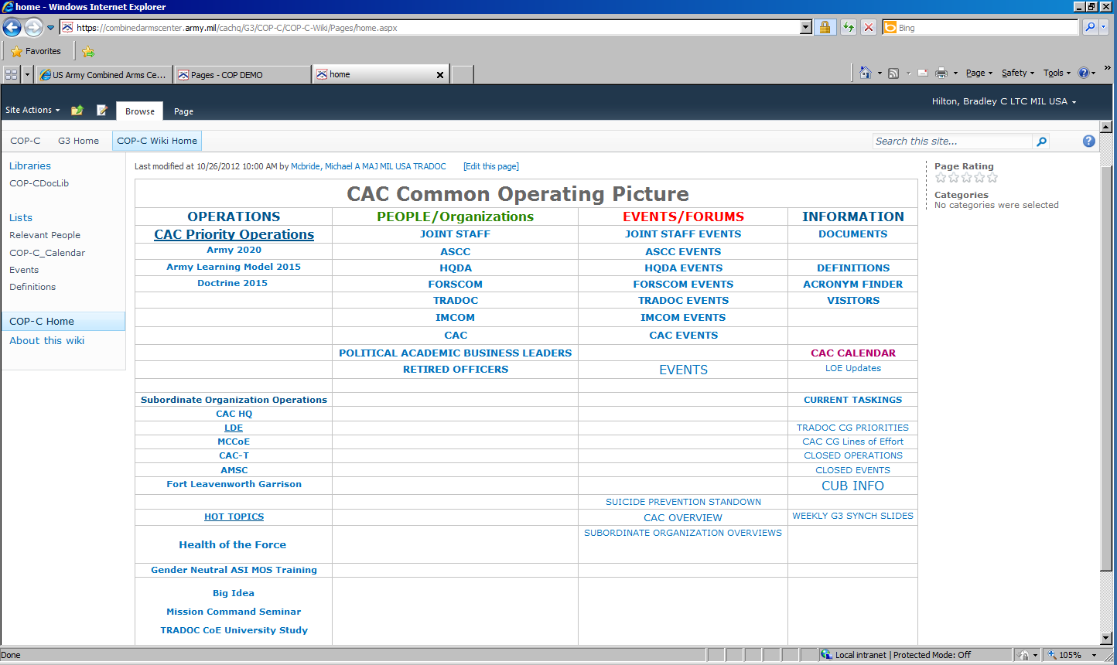
UNCLASSIFIED
UNCLASSIFIED/

Slide 12
What do we do?
Notes:
Interview stake holders
Identify CCIR/IR
What decisions are supported?
Identify authoritative sources

Slide 13
What did we do?
Notes:
Remove emotion from equation – personal animosity
Challenges – G6/G3 personalities
Data ownership issues
Information is power

Slide 14
KM Process and the CAC COP
Assess
Design
Develop
Pilot
Implement
Notes:
Assess:
Stakeholders: who are they? How are they to be identified?
Defining the problem: What is to be solved? “Is it difficult to find things? Such as discovering documents, images, phone numbers, organizational membership…
Issues / obstacles: Identify any conflicting personalities. Who would consider any sort of change a threat to their job? Consider addressing emotional concerns by describing the amount of work not having to be done?
Design:
Identify what the stakeholders currently do…
Design new/adapted process (be wary of automating a bad process)
Identify the requirements. (This is time consuming. Several meetings may be necessary to review the accuracy.)
Develop: this sequence of events may incur some repetition (assess, design, re-assess, re-design, develop, assess, re-design, assess, develop, implement
Pilot: milestones and calendar dates can assist with the stakeholders assuming ownership. Also shows a sense of progress.
Implement: Engagement on personal basis helps lower anxiety of the coming change. Email also helps after the initial individual engagements.

Slide 15
COP/Battle Rhythm Requirements Review 09 DEC 12
Agenda
Background
KM COP Methodology
COP Development
CAC Battle Rhythm
Way Ahead
Guidance/Decision
Purpose: Provide an update to the CAC G3 on development efforts to improve the Combined Arms Center (CAC) Common Operating Picture (COP) and Headquarter Battle Rhythm (BR)

Slide 16
KM Process of Building a COP
UNCLASSIFIED
Global
Information
Grid
Apply Combat Power
Combat Reporting/SITREPs
Data
Information Management
CCIR
Situation
Awareness
Information
Feedback
& Learning
Relevant Information
COP
Situation
Understanding
CAC
Knowledge
Feedback
& Learning
Knowledge
Creation
Problem Solving
& Synchronization
Understanding
Feedback
& Learning
Decision
making
Orders/Directives
Derived from “Next generation Common Operating Picture”, Dennis K. Leedom, Ph.D., Evidence Based research, Inc. http://www.dodccrp.org/events/8th_ICCRTS/Pres/track_4/3_1330leedom.pdf
UNCLASSIFIED
Notes:
Discuss how information flows and is matured through the process
Explain what role CCIR and RI have in this process

Slide 17
COP Development
UNCLASSIFIED
G3 Owns the COP, identify necessary content to support Operational Requirements
Focus on sharing information between HQ and Subordinate Organizations
Eliminate the “Click to Know” for key Information
Spotlight Information that must be “Actioned”
Separate & Organize Reference Information
Use Existing Information Management Locations and Processes if possible (advantage/familiar)
Grow the COP as we use it (STRATCOM with SOs)
UNCLASSIFIED
Notes:
Operational requirements for COP in institutional KM ( tenant units returning from deployment: Welcome Home ceremonies, MP traffic control, Next of Kin Notification, CAO support)
Use existing information…
“achieve this by determining what is advantageous (consider the work not having to be done) and familiar (remind people of the skill sets they already possess that are useful) to users.”
Grow the COP’s content as we use it:
Weather
Action items (taskers)
Who’s deployed
(Hot) Action Items

Slide 18
What we did…
UNCLASSIFIED
Key Current Operations (from G3)
Events
Upcoming Visits
CAC Calendar
Taskings
Battle Rhythm
Events
UNCLASSIFIED
Notes:
“OLD” (initial) COP picture

Slide 19
What we changed…
Key Current Operations (Decision Criteria)
Events
Upcoming Visits (Next 24 Hours)
CAC Calendar (Today’s Events)
Taskings (late or about to become late )
Notes:
“NEW” or ‘current’ COP picture
“Overdue CAC Taskings” = what’s missing
“Due CAC Taskings (next 7 days) = looking forward, things to do…
“CAC Taskings last 7 days” = “looking back” (what we’ve already done or have received in last 7 days.)

Slide 21
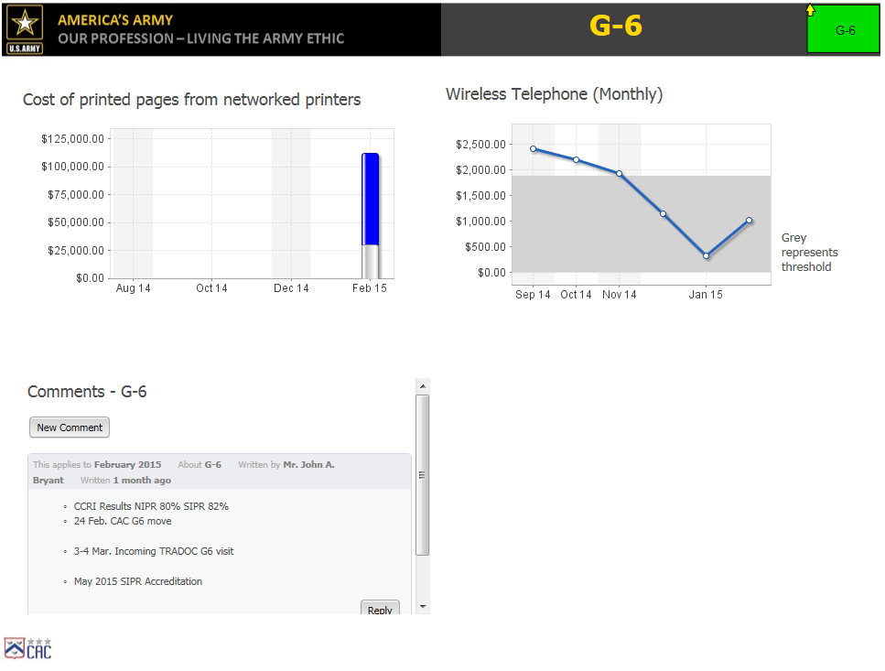

Slide 22
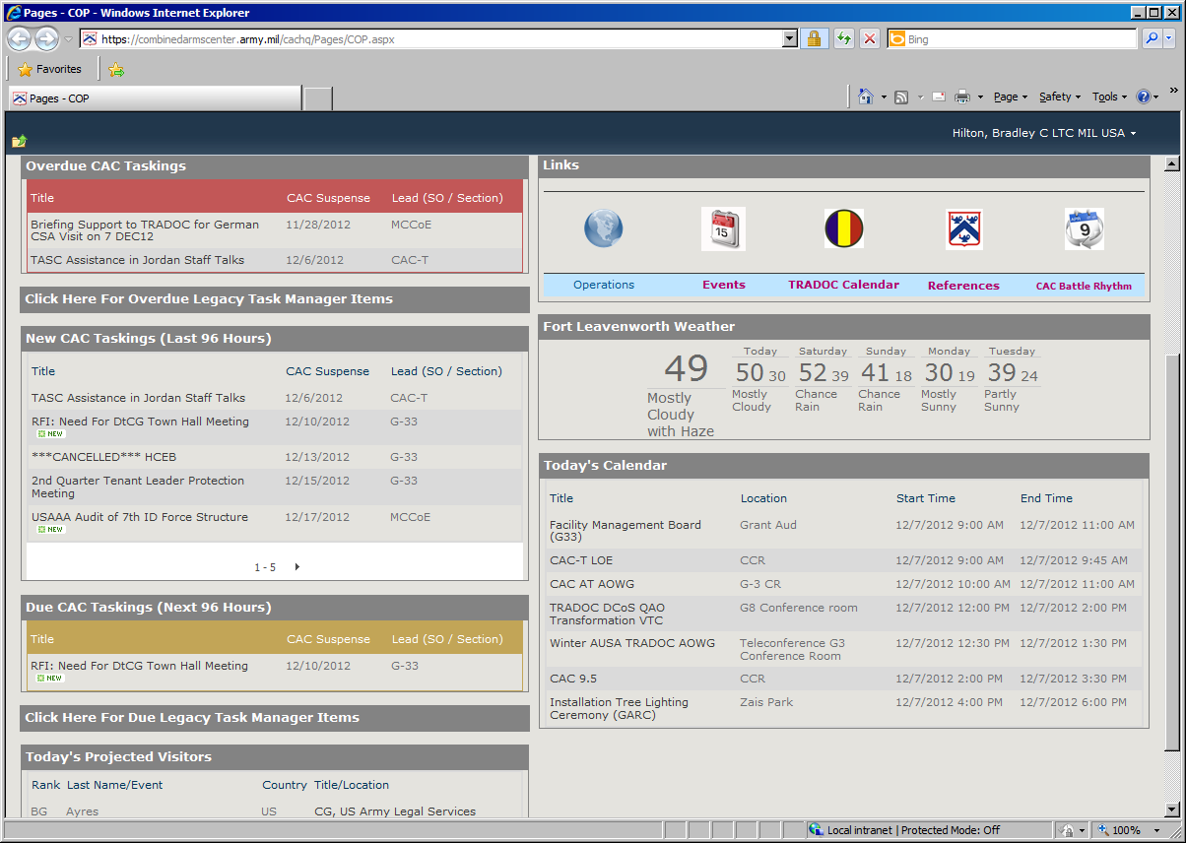
Other CKO Initiatives
UNCLASSIFIED
Common Operating Picture (COP)
OCONUS Tracker
Tasks
Weather
Events and Visits
Battle Rhythm Pages
DtCG & CoS Dashboards
Integration with SOs & CoEs
Centralized Tasking Capability
Event and Visit Coordination
TDA management
Digital Staffing
Read Ahead Drop Boxes
Historian Files
Staff Packages
Executive Services Support
All of these process improvements
Means a change to how people
Do business. Change Management
Skills are critical!
UNCLASSIFIED
Notes:
Battle Rhythm pages (CUB, COS Huddle, CHPC ‘Community Health Promotional Council’)
DtCG and COS dashboards (special attention to special users…in turn this drives participation of those being supervised by DtCG or COS)
Digital Staffing is a info path page on SP with a work flow.
Executive Services and LD&E…effort to reduce duplicative identical processes while consolidating others.

Slide 23
What was the difference?

Slide 24
Take Away’s
Get guidance from your boss!
You are a coordinating staff officer - coordinate
Be a good staff officer:
KM Assessment vs. Staff Assessment
Know the organization’s mission/operations and how you fit in
Change management skills are crucial
The difference between institutional and operational KM is how you do it, not what you do!
Notes:
“Know the organization’s mission/operations and how you fit in” ----this may take a while (6 months? 12 months? TDA/MTOE changes ongoing?, realignment?) How do you find the expertise and the persons on an installation? (Is the GAL worth something? How do I find the phone book? Where is the phone book? Where is a by name list of who works in which organization?)
“Change management skills are crucial”-----articulate to users what is to their ‘advantage’ and describe in terms that are ‘familiar’ to them and context that is familiar to them.

Slide 25
Closing reminders…
Many of the processes and techniques are the same
Timelines are (usually) different
Personnel (Military AND Civilian)
The Tools are different
Its still managing change!

Slide 26
Bibliography
Barnett, T. P. (2004). The Pentagon's New Map: War and Peace in the Twenty-first Century. New York, New York, USA: G.P. Putnam's and Sons.
Boyatzis, R., & McKee, A. (2005). Resonant Leadership: Renewing Yourself and Connecting with Others Through Mindfulness, Hope, and Compassion. Boston: Harvard Business School Press.
Christensen, C. M. (2003). The Innovator's Dilemma. New York: Harper Collins.
Covey, S. R. (2004). The Seven Habits of Highly Effective People: Powerful Lessons In Change. New York: Free Press.
Follett, M. P. (2011). The Giving of Orders. In W. E. Natemeyer, & P. Hersey (Eds.), Classics of Organizational Behavior (4 ed., pp. 19-28). Long Grove, Illinois: Waveland Press, Inc.
Friedman, T. L. (2000). The Lexus and the Olive Tree. New York: Anchor Books.
Friedman, T. L. (2007). The World Is Flat. New York: Picador/ Farrar, Straus and Giroux.
Galula, D. (2006). Counterinsurgency Warfare: Theory and Practice. Westport, CT, USA: Praeger.
Gates, B. (1999). Business @ the Speed of Thought: Succeeding In the Digital Economy. New York: Warner Books, Inc.
Greenwald, H. (2008). Organizations: Management Without Control. Los Angeles: Sage Publications.
Kaplan, R. D. (2010). Monsoon: The Indian Ocean and the Future of American Power. New York: Random House.
McGee, J., & Prusak, L. (1993). Managing Information Strategically. New York: John Wiley & Sons, Inc.
O'Dell, C., Grayson,Jr., C. J., & Essaides, N. (1998). If Only We Knew What We Know: The Transfer of Internal Knowledge and Best Practice. New York: Free Press.
Showalter, D. (2000). The Challenge of Change: Military Institutions and New Realities, 1918-1941. (H. R. Winton, & D. R. Mets, Eds.) Lincoln, NE, USA: University of Nebraska Press.
The U.S. Army/Marine Corps Counterinsurgency Field Manual. (2007). Chicago: University of Chicago Press.
Notes:
Books and articles that impacted the discussion of these slides.
https://www.milsuite.mil/book/blogs/guy/2015/07/18/knowledge-management-km-books-reading-list

Slide 27
SMS Overview
Strategic Management System
Performance measurement
Metrics
www.sms.army.mil
Enterprise Army System
Over 17,000 users
Over 200 Army organizations using it

Slide 28
SMS Demo

Slide 29
Why include this in a KM class?
What role does the CAC CKO play in performance management and SMS?
Shouldn’t the ORSA be doing this?
How is this People, Process, and Tools?
Notes:
What role does the CAC CKO play in performance management and SMS?
Facilitating the institutional memory whereas the organization doesn’t ‘forget’ how to use this tool.
KM office illustrates the interdependencies and what the staff and organizations can expect from one another.
Shouldn’t the ORSA be doing this?
-An “ORSA person” will very likely be involved. But an ORSA won’t know your organization the way you do…the ORSA can help you with the actual measurement, but may not be of much assistance with identifying precisely WHAT to measure that would be of use…
How is this People, Process, and Tools?
SMS addresses ‘people’ in that effective use of it demands that the owner of the metric as well as the updater of the metric’s data evaluate how the organization does business. The ‘people’ within an organization are the only ones who can perform the assessment of what knowledge is missing or is important.
SMS addresses ‘Process’ in that SMS allows for ‘assessment’ of what an organization recognizes about itself with regard to commodities such as time, manning, and budget. SMS analyzes an organization’s knowledge needs by aiding to establish objectives. (e.g. an objective may be to reduce the number of late OERs every month, with a goal of ‘0’ OERs.) SMS, in the hands of a skilled user, is able to illustrate the power of historical data through trendlines and offer a forecast of how well the organization is performing with regard to a specific goal or objective.
SMS is a tool, in and of itself. It is a tool for “assessing”. “Assessment” precedes all of the other steps in the KM process—determining what information leaders need in order to make decisions. It is an Army enterprise solution for organizational performance management graphically depicting quantitative data and while also illustrating milestones of an action plan.

Slide 30
Back-Up Slides

Slide 31
CAC Digital Staffing
AUG SEP OCT NOV
SGS CMD GRP Digital Staffing
Digital staffing process improvement assessment
All CAC staffing packets completed digitally by 18 SEP 13
PII Functionality still being tested
Staff Training Developed
100% CAC Staff
50% CAC
SOs
Assessment
MOPs
Number of packets staffed digitally vs legacy.
Number of help/assistance calls to SGS
MOEs
Increased ability to track packet status
Reduced time for packets to make it through process
Reduced time (man-hours) to manage packets
Increase CAC cultural acceptance of digital resources/processes
Reduced cost associated with staffing
Problem Statement
The current hard copy and email routing of documents up to the CAC command group is complex and time consuming. CAC Needs a capability to staff actions through digital media
End-State
Digital capability that allows both parallel and consecutive review of packets, and is user friendly.
Tasks
Requirement analysis / stakeholder input
Map process
Prototype
Test
Production build
Test
Develop/deliver training
Develop rollout plan
Implement
Way Ahead
18 AUG: 100% CAC HQ actions digital, 15% SO
9 SEP: 100% CAC HQ, 50% SO actions digital
18 SEP – 100% digital.
Classes weekly through OCT, then as needed.
Training video and manual complete and on DS Page
Notes:
MOP’s
Number of packets staffed digitally vs legacy. More is better
Number of help/assistance calls to SGS. More at beginning is better, then tapering off. (indicator more people are using system, then indicator of comfort level with system as long as usage still increases.)
MOE’s
Increased ability to track packet status (reduced time searching for status, less is better)
Reduced time for packets to make it through process (less is better)
Reduced time (man-hours) to manage packets (related to MOE 1, redundant?)
Increase CAC cultural acceptance of digital resources/processes – effect on acceptance of other process improvements (greater requests for improvements, increased participation, adoption by Sos)
Reduced cost associated with staffing (reduced paper and ink usage, less is better)
Source for categories of MOP/MOE is AR 25-1

Slide 32
UNCLASSIFIED
CKO Office Strategic Overview
VISION
Encourage an environment of adaptation, innovation and collaboration that eliminates stovepipes and integrates knowledge processes, increasing organizational learning and efficiency across hierarchical and geographical boundaries.
MISSION
Ensure the CAC knowledge environment supports CAC priorities and Lines of Effort nested within the TRADOC Campaign Plan. Facilitate the improvement of processes and implementation of new solutions to increase knowledge flow and collaboration between the Centers of Excellence, CAC, and TRADOC.
Lines of Effort
Build KM within the Combined Arms Center (CAC) Headquarters
Facilitate CAC’s ability to execute Mission Command
Develop Knowledge Sharing and Collaboration across CAC/TRADOC
Support Knowledge Management DOTMLPF Development ICW MC CoE
UNCLASSIFIED

Slide 33
Strategic Lines of Effort Activities
UNCLASSIFIED
Build KM within the Combined Arms Center (CAC) Headquarters
Shared Understanding (COP, Battle Rhythm)
Knowledge Flow (Common use of tools, processes)
Content Discoverability & Accessibility
Develop Knowledge Sharing and Collaboration across CAC
Standardized and coordinated KM effort across CAC, COEs and Subordinate Organizations
TSP Analysis of KM Tasks
Senior Leader Decision Making (GOSC/CoC/KMWG)
Educated CAC CDRs/LDRs & Trained and Educated KMOs
Facilitate Knowledge Management within the Army
DOTLMPF Development (Institutional to Operational)
Support the AOKM Proponent and CALL
UNCLASSIFIED

Slide 34
Current Activities
UNCLASSIFIED
Portal Development:
COP and Battle Rhythm
Command Dashboards
Integration with SOs & CoEs
Staff Process Improvement
Map CAC/TRADOC Battle Rhythm Inputs/Outputs
Digital Staffing
CAC KM SOP/ Staff Officer’s Guide
Executive Services Processes
SMS
TRADOC Strategic Plan (TSP)
KM Governance (TKMC & KM WG)
KM Education
UNCLASSIFIED

Slide 35
Project: COP
Problem Statement: Develop a Common Operating Picture for CAC to synchronize operations and events.
Guidance: Keep current COP capability with improved search and cross-reference capabilities (user-friendly, intuitive navigation, quad chart capability). There needs to be a synch matrix or calendar that interfaces with the COP. The synch matrix/calendar must be interactive and have re-usable data. There must be a place for online briefings, admin functions, documents, IPRs, staff functions/pages, and travel related documents for the senior leadership.
Tasked by CofS
Assisting: G3, G6
Stakeholders:
CAC Staff, MSOs, Command Group
Milestones
Mission assigned 30 JUL 2012
Mission Analysis/meet with SOs 1 AUG 2012
KMWG review of requirement 9 AUG2012
IPR to CoS 4 SEP2012
Validate CAC COP Requirements 27SEP 2012
Demo in G3 Synch Mtg to SOs 31 OCT 2012
IOC- 31 OCT 2012
IPR to CoS week of 5 NOV 2012
FOC 5 JAN 2013
Guidance / Input
IOC on 27 SEP 12 will not be made due to developer TDY and Lack of information on related processes. New IOC 31OCT12.
Working with Staff sections to ID requirements for CAP function
Way Ahead
Synch Matrix (Calendar)- G6/3 reps are meeting to identify current requirements/capabilities vs. proposed format changes in order to identify sustainment requirements, functionality issues. Will have recommendation for way ahead NLT 31OCT12 for G3 Synch Meeting presentation.

Slide 36
Project: Combined Arms Center (CAC) Common Operating Picture (COP)
Problem Statement: Develop a Common Operating Picture for CAC to synchronize operations and events.
Initial Guidance: Keep current COP capability with improved search and cross-reference capabilities (user-friendly, intuitive navigation, quad chart capability). There needs to be a synch matrix or calendar that interfaces with the COP. The synch matrix/calendar must be interactive and have re-usable data. There must be a place for online briefings, admin functions, documents, IPRs, staff functions/pages, and travel related documents for the senior leadership.
Tasked by : CofS
Assisting: G3, G6
Stakeholders:
CAC Staff, MSOs, Command Group
Milestones
Mission assigned 30 JUL 2012
Mission Analysis/meet with SOs 1 AUG 2012
KMWG review of requirement 9 AUG2012
IPR 1 to CoS 16 AUG 2012
G3/ G6/ CKO COP meeting 10 DEC 2012
Publish COP & Battle Rhythm 13 DEC 2012
FOC 30 DEC 2012
Initiate Continuous Development 30 DEC 2012
Cycle
Incorporate CAC SO Feedback 3-30 JAN 2013
Brief TRADOC KM Council (TKMC) FEB 2013
https://combinedarmscenter.army.mil/cachq/Pages/COP.aspx
Guidance / Input
https://combinedarmscenter.army.mil/cachq/Pages/COP.aspx
G3 Guidance (10 DEC 12):
Add a “Top 5 Issues or Projects” area above the taskers on the COP
Add a threaded discussion to the G3 synch Battle Rhythm Page
Adjust the “late Taskers to more accurately reflect the
Change Projected visitors from day to week
Build a WX Page
Move ES visitors and events above taskers
Way Ahead
Meet with CAC SOs to introduce the COP and collect recommendations for improvements, synchronize capabilities.
Visit TRADOC and CoEs to socialize the COP and integrate processes to improve collaboration & communicating.
Information Paper to the TRADOC DCOS (requested by TRADOC)
Brief the TKMC (FEB 13)
Initiate Continuous Development Cycle
Implement
Solutions
Identify
Requirements
Notes:
https://combinedarmscenter.army.mil/cachq/Pages/COP.aspx

