Slide 1
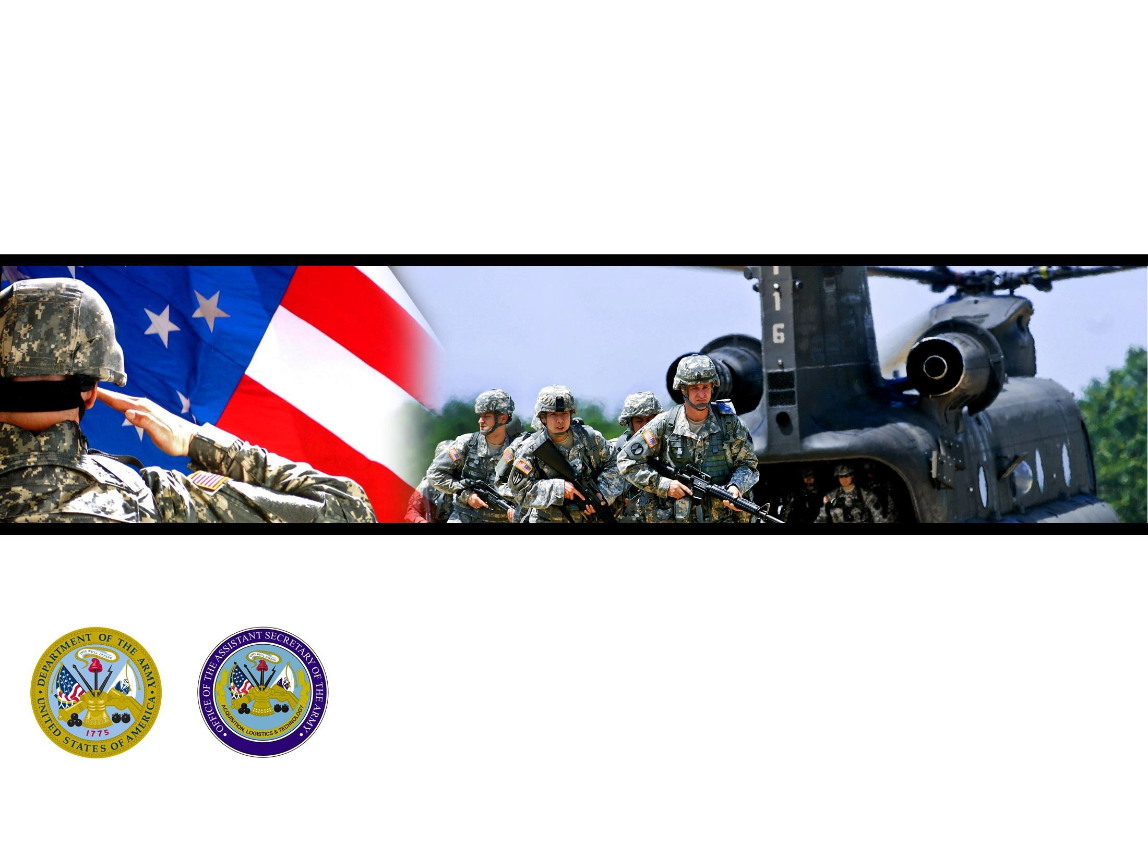









Squad Overmatch Study – Tactical Combat Casualty Care (SOvM-TC3)
America’s Force of Decisive Action
UNCLASSIFIED

Slide 2
SOvM TC3 Study Overview
SOvM/TC3 objectives are to develop a paradigm changing Integrated Squad Training Approach for use across the Army that improves Soldier/Squad decision making, adaptability, and leadership through integrated training of: advanced situational awareness; resilience; enhanced performance; teamwork; tactical combat casualty care under fire; and focused after-action-reviews.
OBJECTIVES:
  Improve patient care in a TC3 environment
  Improve SA & care under fire decision-making among squad members
  Improve tactical performance at the squad level
  Improve tactical resilience among squad members (defined as recovery period before return to tactical effectiveness following a combat stressor)
  Based on training, reduce stress levels in tactical environments for squad members
  Demonstrate the effectiveness of an integrated training approach combining foundation training with practice opportunities in gaming & live environments

Slide 3
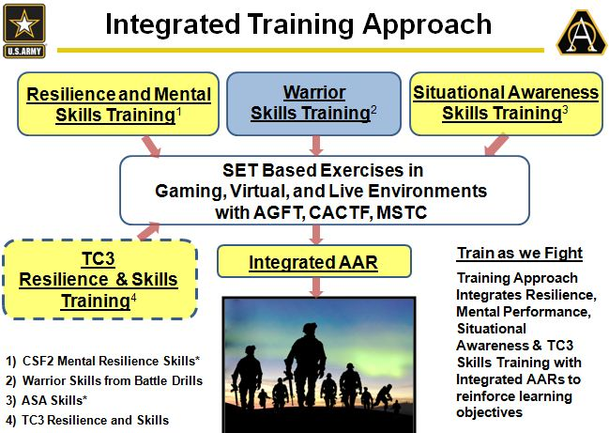
Squad Overmatch/Tactical Combat Casualty Care Study
Technical Description
Study / Product Aims
  Develop squad resilience training that integrates TC3 concepts
  Develop/Validate stress exposure curriculum
  Develop immersive scenarios
  Deliver AAR capability that integrates tactical and cognitive performance feedback
Approach
  Develop TC3 scenarios for integrated training in Gaming, Virtual, Live environments and evaluate Army/Marine squad performance in the Human Dimension
Focused AAR
Milestones
Operational Description
FY | SOvM/TC3 | Sponsor Funding | Army Sponsor Program | AWA 17.1 Excursion
13 | PEO-STRI | ASPMO | PEO-STRI
14 | PEO-STRI (Demonstration) | ASPMO | PEO-STRI
15 | PEO-STRI Exp.1 | DHP | PEO-STRI/MCoE
16 | PEO-STRI Exp.2 | DHP | PEO-STRI/MCoE | MCoE
The Squad Overmatch Study evaluates improved training methodologies to enhance team decision making under stress to include Tactical Combat Casualty Care (TC3). This effort addresses the issue of how to facilitate squad performance in combat casualty management to reduce impact on Army and Marine squad mission success during firefights. TC3 providers and squad leaders will practice decision making that balance tactical and medical in realistic TC3 scenarios. It will provide technology insertion in Gaming, Virtual, and Live environments to influence future capabilities and Army doctrine.

Slide 4

DARPA Squad X
Program Objectives:
Enhance situational awareness of rifle squad.
Provide leaders with maneuver time & space.
Enable rifle squads to dominate their area of operations.
Notables:
Guidance.
Timeframe.
Condition setting.
Desired Inclusion.
Other:
Multi formation (+).
Funding.
Metrics.
Capability Areas.
1st ID, 3rd ID, 4th ID, 7th ID, 25th ID, 82nd ABN, 101st AASLT, 75th RGR, XVIIIth ABN Corps, USASOC, SCoE, ARCIC, BMC, DARPA, PEO STRI, PEO Soldier.

Slide 5
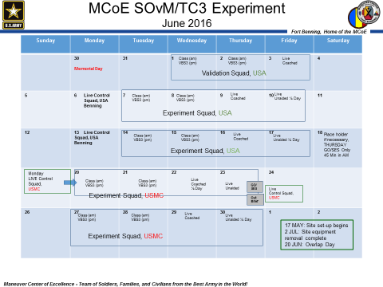
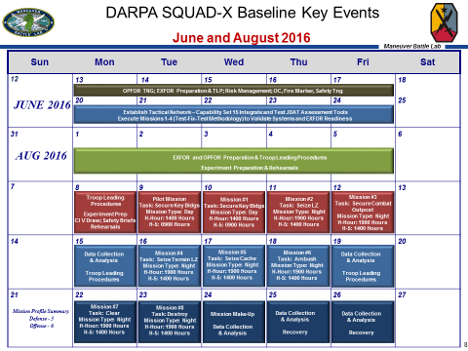
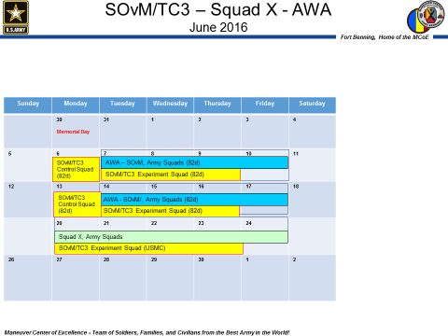
SOvM/TC3 – Squad X – AWA CONOP
Objective: Evaluate the effectiveness of training capability that affords TC3 first-responders the opportunity to practice simulation-based Care Under Fire and Tactical Field Care skills in a squad-based, integrated training immersive environment, to include developing squad-level tactical effectiveness and quality of care metrics.
Squad-X Goals:
-Extend and enhance the situational awareness of the rifle squad
-Provide small unit leaders with increased maneuver time and space
-Enable rifle squads to shape and dominate their area of operations
  Baseline Experimentation – 2016. Objectives:
  -Develop metrics that quantitatively differentiate performance between squads
  -Metrics will lay the foundation for comparative assessment of individual capabilities in Phase 2 of the Squad-X Program
Achieves these objectives:
Provide visibility across the Army
Further validation of the effectiveness of the training approach
Engage operational units and decision makers

Slide 6
SOvM/TC3 – AWA – Squad X
June 2016
Sunday | Monday | Tuesday | Wednesday | Thursday | Friday | Saturday
 | 30 Memorial Day | 31 | 1 | 2 | 3 | 4
5 | 6 | 7 | 8 | 9 | 10 | 11
12 | 13 | 14 | 15 | 16 | 17 | 18
 | 20 | 21 | 22 | 23 | 24
26 | 27 | 28 | 29 | 30 | 1 | 2
Achieves these objectives:
Provide visibility across the Army
Further validation of the effectiveness of the training approach
Engage operational units and decision makers
SOvM/TC3 Control Squad (82d)
AWA – SOvM, Army Squads (82d); (Force-on-force Residential Complex)
SOvM/TC3 Experiment Squad (82d)
SOvM/TC3 Control Squad (82d)
AWA - SOvM/, Army Squads (82d); (Force-on-force Residential Complex)
SOvM/TC3 Experiment Squad (82d)
Squad X – Army EXFOR Squads
SOvM/TC3 Control Squad (USMC) (20 Jun)
SOvM/TC3 Experiment Squad (USMC)
SOvM/TC3 Control Squad (USMC) (24 Jun)
SOvM/TC3 Experiment Squad (USMC)

