Slide 1






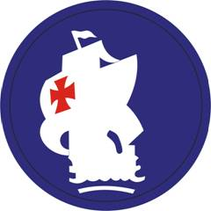

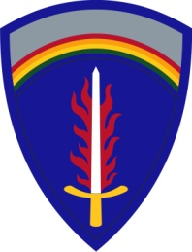
RAF TEAM SURVIVABILITY
Regionally Aligned Forces
RAF
TT
Training Teams
PACOM
CENTCOM

Slide 2
Agenda
Code of Conduct
Guardian Angel / Alamo Plan
Evasion Plan of Action (EPA)
Personnel Recovery
  Personnel Recovery Framework
  Isolated Personnel Responsibilities
Evasion
Survival
Recovery
Notes:
Simply state the agenda

Slide 3
Course Objective
Service Members understand their role as Security Cooperation Team to train, advise, and assist Host Nation Security Forces (HNSF). Teams understand that HNSF must principally
      provide security for the population
      facilitate effective governance
      assist in the provision of basic services, and
      uphold the rule of law
in order to prevent subversion, lawlessness, and insurgency, and address drivers of conflict and instability.
References:
FM 3-07 (Stability Ops), FM 3-07.1 (SFA), FM 3-07.10 (Advising),
FM 3-24 (COIN), FM 3-24.2 (Tactics in COIN)

Slide 4
Learning Objective
Security Cooperation Team must understand their individual role within Personnel Recovery in order to survive and return home with honor.
References:
FM 3-05.70 (U.S. Army Survival); JP 3-50 (Personnel Recovery); FM 3-50.1 (Army Personnel Recovery); FM 3-50.3 (Joint Survival and Evasion)

Slide 5
Executive Order 10631, Code of Conduct for
Members of the Armed Forces of the United
States—As Amended by Executive Order 12017,
November 3, 1977
By virtue of the authority vested in me as President of the United States, and as Commander in Chief of the armed forces of the United States, I hereby prescribe the Code of Conduct for Members of the Armed Forces of the United States which is attached to this order and hereby made a part thereof. Every member of the armed forces of the United States is expected to measure up to the standards embodied in this Code of Conduct while he is in combat or in captivity. To ensure achievement of these standards, each member of the armed forces liable to capture shall be provided with specific training and instruction designed to better equip him to counter and withstand all enemy efforts against him, and shall be fully instructed as to the behavior and obligations expected of him during combat or captivity. The Secretary of Defense (and the Secretary of the Treasury with respect to the Coast Guard except when it is serving as part of the Navy) shall take such actions as is deemed necessary to implement this order and to disseminate and make the said Code known to all members of the armed forces of the United States.
THE WHITE HOUSE
DWIGHT D. EISENHOWER
August 17, 1955
Notes:
The Code of the U.S. Fighting Force is a code of conduct that is an "ethical guide" and a United States Department of Defense directive consisting of six articles to members of the U.S. armed forces addressing how U.S. personnel in combat should act when they must "evade capture, resist while a prisoner or escape from the enemy." It is considered an important part of U.S. military doctrine but is not formal military law in the manner of the Uniform Code of Military Justice and public international law (such as the Geneva Conventions).
Colonel Franklin Brooke Nihart, USMC, worked at Marine Corps headquarters throughout the summer of 1955, outlined his ideas in longhand and the Code of Conduct was established with the issuance of Executive Order 10631 by President Dwight D. Eisenhower on 17 August 1955, after the Korean War. It has been modified twice—once in 1977 by President Jimmy Carter in Executive Order 12017, and most recently in President Ronald Reagan's Executive Order 12633 of March 1988, which amended the code to make it gender-neutral.
Notably, the code prohibits surrender except when "all reasonable means of resistance [are] exhausted and...certain death the only alternative," enjoins captured Americans to "resist by all means available" and "make every effort to escape and aid others," and bars the acceptance of parole or special favors from enemies. The code also outlines proper conduct for American prisoners of war, reaffirms that under the Geneva Conventions prisoners of war should give "name, rank, service number, and date of birth" and requires that under interrogation captured military personnel should "evade answering further questions to the utmost of my ability."

Slide 6
Code of Conduct
ARTICLE I: I AM AN AMERICAN, FIGHTING IN THE FORCES WHICH GUARD MY COUNTRY AND OUR WAY OF LIFE. I AM PREPARED TO GIVE MY LIFE IN THEIR DEFENSE.
ARTICLE II: I WILL NEVER SURRENDER OF MY OWN FREE WILL. IF IN COMMAND, I WILL NEVER SURRENDER THE MEMBERS OF MY COMMAND WHILE THEY STILL HAVE THE MEANS TO RESIST.
ARTICLE III: IF I AM CAPTURED, I WILL CONTINUE TO RESIST BY ALL MEANS AVAILABLE. I WILL MAKE EVERY EFFORT TO ESCAPE AND AID OTHERS TO ESCAPE. I WILL ACCEPT NEITHER PAROLE NOR SPECIAL FAVORS FROM THE ENEMY.
ARTICLE IV: IF I BECOME A PRISONER OF WAR, I WILL KEEP FAITH WITH MY FELLOW PRISONERS. I WILL GIVE NO INFORMATION OR TAKE PART IN ANY ACTION WHICH MIGHT BE HARMFUL TO MY COMRADES. IF I AM SENIOR, I WILL TAKE COMMAND. IF NOT, I WILL OBEY THE LAWFUL ORDERS OF THOSE APPOINTED OVER ME AND WILL BACK THEM UP IN EVERY WAY.
ARTICLE V: WHEN QUESTIONED, SHOULD I BECOME A PRISONER OF WAR, I AM REQUIRED TO GIVE NAME, RANK, SERVICE NUMBER, AND DATE OF BIRTH. I WILL EVADE ANSWERING FURTHER QUESTIONS TO THE UTMOST OF MY ABILITY. I WILL MAKE NO ORAL OR WRITTEN STATEMENTS DISLOYAL TO MY COUNTRY AND ITS ALLIES OR HARMFUL TO THEIR CAUSE.
ARTICLE VI: I WILL NEVER FORGET THAT I AM AN AMERICAN, FIGHTING FOR FREEDOM, RESPONSIBLE FOR MY ACTIONS, AND DEDICATED TO THE PRINCIPLES WHICH MADE MY COUNTRY FREE. I WILL TRUST IN MY GOD AND IN THE UNITED STATES OF AMERICA.

Slide 7
Key Terms
Guardian Angel – An individual designated who conducts passive surveillance during all engagements with Host Nation Forces and Host Nation Representatives to include local populace.
Alamo Plan – An internal plan developed to allow teams the ability to maintain and sustain an isolated defensive position for up to 72 hours.
Personnel Recovery (PR) – The sum of military, diplomatic and civil efforts to prepare for and execute the recovery and reintegration of Isolated Personnel.
Isolated Personnel (IP) – U.S. military, DoD civilians and contractor personnel (and others designated by the President or Secretary of Defense) who are separated from friendly forces and unable to complete their intended mission or activity and are, or may be, in a situation where they must survive, evade, resist or escape.
  Isolated Soldier Guidance (ISG) – Defines what constitutes being isolated and what actions to take if isolated. Is based on the Commander’s PR guidance, but not a set of rules. It must be simple, concise and specific to the mission.
  Evasion Plan of Action (EPA) –A course of action, developed before executing a combat mission, which is intended to improve a potential evader’s chance of successful evasion and recovery by providing recovery forces with an additional source of information that can increase the predictability of the evader’s actions and movement.
  At Risk – Soldiers, DoD civilians and DoD contractors operating worldwide are all “at risk” because of the asymmetrical, noncontiguous operational environment and clusters of failing nations.

Slide 8
Rapport is your First Line of Defense
Keep your Friends Close. Learn everything about them. Learn their Problems. Develop Solutions!!!
Layer your Defenses
Immediate Security | Overwatch
MINDSET: Know what’s Normal in your Partners (Culturally, Personally, Professionally) That knowledge comes from close relationships | Buddy Team- Keep Intervals, 360° Security, Cover entryways / AveApp, Be Ready to Shoot First!
“Absence of the Normal” = Indicators
Situational Awareness Be “Escape Minded” Do regular AARs- Note rapport changes in Partners (especially after fire fights, failed KLEs, SIGACTs) | Squad- Build Rapport!! Spot Potential Threats, Enforce buddy team habits and mutual support, Prepare Physical Security (Searches, CPs), Plan for Active Shooter/PR/Alamo, REHEARSE!
PREPARATION: | Unit- (Tactical Prep, Targeting, Inform/Influence)
Knowledge- Rally Pt/Alamo, PACE, Link Up plan, Lost Soldier Drill, Who is Overwatching Me? | LoE Tactical Prep: TOC Drills, Alamo Plans, QRFs, Resource Physical Security (Search, BiMX)
Protect- Have a Weapon (or 2), be Escape-Minded | LoE Targeting: Early Vetting, confirm/deny Potential Insiders, Recruiters, Target Packets, Finish Force
Navigate- Compass, Map (Print from TIGR), GPS | LoE Inform/Influence: Multiple Audiences (HNSF, Local Govt, Insurgents), Different Messages
Signal- Small VS-17, Squeeze Light, Phone# Card | Reach Back- Spot/Assess potential threats at the lowest level then send info to BSO, Higher HQ, or CONUS to confirm or deny.
Sustain- Tourniquet, Combat Gauze, Power Bar | Use Biometrics, HUMINT, ISR, Exploitation, Deception Detection Techniques, and Know- “Absence of the Normal”

Slide 9
Guardian Angel
MY SHIELD PROTECTS YOU
V
Guardian Angel plan is having all members of the team passively and actively conducting security who are engaged with Host Nation Representatives. This plan is to protect American’s ONLY and only YOU should know what the details are.
This function will be performed discretely by the team or overtly depending on the situation. (roughly 85% will be active/passive)
  -During sudden acts of violence, this plan may go into effect immediately.
*once you initiate this plan, everyone knows*
Considerations:
  - HNF capabilities, local situation, reaction time, communication, sustainment, availability of personnel.
  Personnel placement (Strongholds, Infil points, Exit, CCP, Sensitive Site’s, Max effectiveness of weapons).
  Indicators to look for (reference Call Handbook No. 12-07, FEB 12).
  Engagement Criteria (when to de-escalate the situation or take lethal action).
Notes:
85% is the passive keeping an eye out. The 15% left, is what everyone would expect, walking around making sure HNF isn't pointing a loaded weapon at anyone, etc. Doing more of the obvious, sometimes this may cause an intentional diversion so a passive security can verify exactly what that person needs.
-This is an internal team plan.
Considerations: HNF capabilities =(weapons, ammo, training, political pull, controlling the environment), Local sit.=(everyone should know even the smallest detail that my have an adverse effect towards US), reaction time=(time it takes for the plan to get out and have everyone emplaced), commo=(having the “code word” passed effectively to all members that may be separated), availability= pax. Ava.
-Indicators=majority comes from arguments

Slide 10
Considerations
Individual
  Sidearm placement
  Use of soft underarmor
  Hardening of workspace
Weapons drills
  Shoot from a desk
  Shoot from a sofa / chair
  Shoot from a light tactical vehicle (pickup truck / SUV)
  Shoot with your weak arm
  Active Shooter drills

Slide 11
Alamo Plan
An Alamo Plan is not a set document, doctrine or set of rules. It is a team/unit internal contingency plan that all members know and can be put into action according to a set specific signal (i.e. EAGLE – ANVIL! EAGLE – ANVIL!).
Considerations for developing and establishing an Alamo Plan:
  Initiation Criteria
A) Indicators to enact Alamo Plan
B) Signals
  Defensibility of Site
A) Site location
B) Site hardening
i. Sandbagging
ii. Fighting positions / Gun placement
  Sustainment of Site
A) Ammo Placement
B) Food / Water
C) Special Equipment
i. Commo
ii. Medical
iii. Power source and Fuel
  Escape & Evasion Criteria
A) Indicators to enact E&E
B) Escape Routes
i. EPA / ISG

Slide 12
Current TTP’s
Have an internal camp SOP for communications within the team.
  Let team members know where you are going and for how long.
  Buddy system
  Brevity codes for certain events
  PACE plan (Primary, Alternate, Contingency, Emergency)
    Radio, Pyro, Smoke, etc…
Ensure all members understand
  Rally points on the camp
  Escape and Evasion plan
  Battle positions in case of emergency

Slide 13
Evasion Plan of Action
Evasion Plan of Action (EPA)
  Developed by action elements.
  In an isolating event, the unit HQ has a document outlining the element’s capabilities, intentions and basic plan of action.
  At a minimum, the EPA contains personnel roster, medical information (blood types, allergies, etc.), weapons carried, survival equipment, signaling capability, SOPs and intentions.
  Historically utilized by Aviation and SOF, therefore, some of the information for an EPA may be derived from the ATO (CSAR) SPINS (covered later in this lesson).
Notes:
EPAs include capabilities and outline intentions, or immediate action drills in the event of an isolating incident.
An example of “Intentions” is: “We will move north of crash site to high ground, wait 12 hours, then move west to next terrain feature.”
EPAs are used by commanders and staff to expedite their response to isolating events. When commanders and staff know an IPs capabilities and intentions it assists their planning and actions to recover the IP.
Some of the information for an EPA may be derived from the Air Tasking Order (ATO) Combat Search and Rescue (CSAR) Special Instructions (SPINS) or the units SOP (covered later in this lesson).

Slide 14
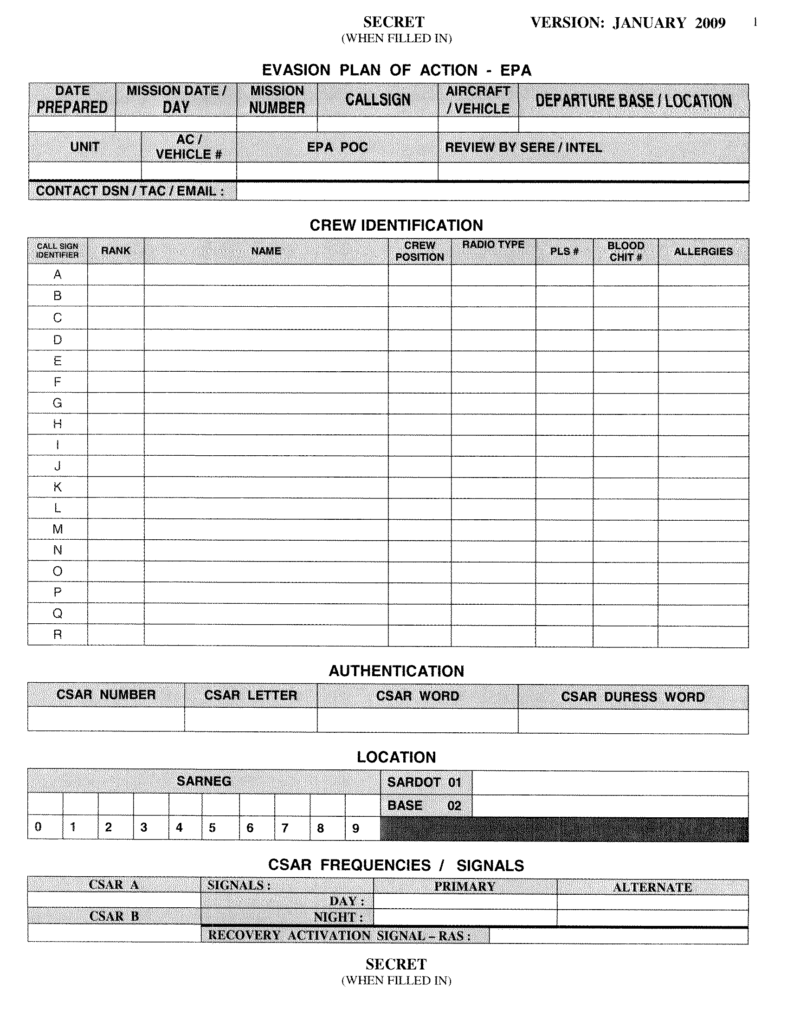
Example EPA
EPA must be accurate and kept updated throughout different missions, and filed with higher headquarters.
Remember, the intent is for commanders and staff, as well as recovery forces to use your EPA to locate and recover you.
Sample EPA to right.
Notes:
EPA must be accurate and kept updated throughout different missions, and filed with higher headquarters.
Remember, the intent is for commanders and staff, as well as recovery forces, to use your EPA to locate and recover you.
Key Information:
Callsign and Vehicle Bumper #
Crew Names
Authentication Information
Communications Plan
Equipment Carried
Short and long-term evasion plans
Pre-mission checklist
Transition: In order to properly execute ISG/EPA, IP’s must be properly equipped.

Slide 15
Personnel Recovery Guidance
Personnel Recovery Guidance (PRG) has no fixed format, it is embedded in various parts of the order.
At a minimum PRG:
  - Establish isolation criteria.
  - Communicate the Commander’s concept for PR.
  - Establish PR command, support, and liaison relationships.
  - Incorporate PR activities in unit SOPs.
  - Include PR in OPLANs and OPORDs.
  Special Considerations
Consider incorporating any standard elements of guidance that pertain to all activities in an Area of Responsibility into unit SOPs. Examples include:
- PR specific radio frequencies (such as Sheriff’s net).
- Designated Areas for Recovery (DAFRs).
- Personal Locator Beacon utilization.
- Particular signaling techniques.

Slide 16
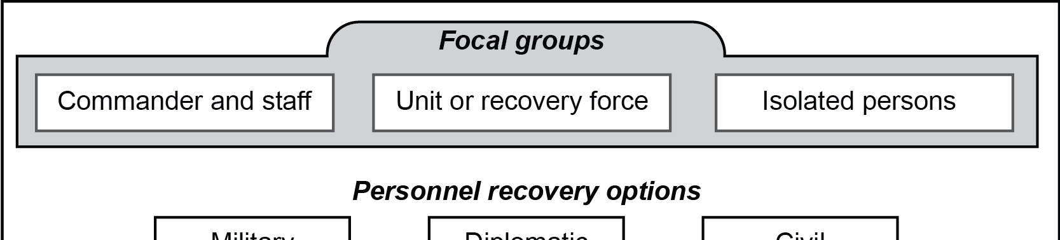
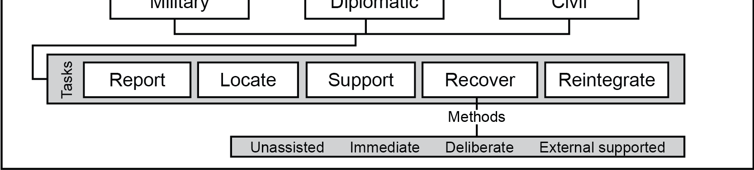
Personnel Recovery Component

Slide 17
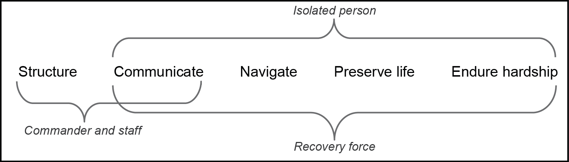
Army Personnel Recovery Proficiencies
What is the isolated person’s responsibility in Personnel Recovery?
What do these proficiencies mean to you the individual?

Slide 18
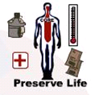

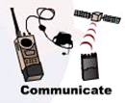

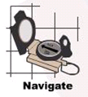
Five PR
Proficiencies as It Relates To The IP
Reinforces security
Includes first aid (for self and others) including monitor and sustain critical aspects of health (e.g. hydration & core body functions)
Understand the architecture that is designed to report, locate and recover IP
Understand roles all three Focal Groups play in IP recovery
“Report” is key to “Locate”
Use all available means to communicate
Maintain situational understanding vs. COE
Endure anticipated hardships
Psychology during evasion & captivity
Defines captivity models of Prisoner of War (PW), Hostage Captivity (HC), Peacetime Government Detention (PGD)
Know where I am
Know where I have to go
Able / capable to get there

Slide 19
Premission Preparation
What you can do to become a “Smart Survivor”
PERSONAL EQUIPMENT
  WHAT GEAR DO YOU HAVE?
  WHERE IS IT STORED?
  KNOW HOW TO USE ITEM!
  KNOW WHEN TO USE ITEM!
  VALUE FOR EVASION / SURVIVAL
  KNOW THE OPERATING PROCEDURES
  REFER TO SURVIVAL KIT & E&R KIT ITEMS PREVIOUSLY LISTED
PERSONAL PREPARATION
  BE FAMILIAR WITH THE LOCAL FOOD
  PHYSICAL CONDITIONING
  PSYCHOLOGICAL PREPARATION FOR A SURVIVAL SITUATION
  HOME FRONT IS ESTABLISHED
    WILL,
    POWER OF ATTORNEY
    DENTAL
  SANITIZE FOR THE MISSION
    NO UNIT RECALL ROSTERS
    NO EMERGENCY CONTACT INFO
    NO BASE MAPS
    NO CREDIT CARD RECEIPTS
    ELIMINATE FOREIGN ODORS

Slide 20
Evasion
1000 days of evasion are better than one day of captivity!
Camouflage: Basic principles
- Disturb the area as little as possible.
- Avoid activity that reveals movement to the enemy.
- Apply personal camouflage.
- Remove bright, shiny or noisy items.
Movement:
- Avoid open terrain and silhouetting (such as fields and ridge lines)
- Avoid built up areas (villages, towns, roads, etc.)
- Move in irregular patterns (zigzag)
- Move slow, take time to STOP, LOOK, LISTEN and SMELL for signs of human / animal activity.
- Move during low light and inclement weather to mask movement and noise.
Navigation: Must know and understand how to use map, compass and terrain association. DO NOT be dependent on electronic means.

Slide 21
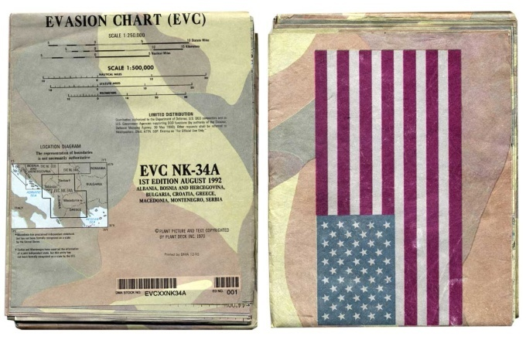
Evasion Aid
Evasion Charts (EVCs) are produced to assist IP’s in navigating and surviving isolating situations.
If a unit or individual plans their ISG or EPA to great detail they may find that traditional maps are inadequate for some isolating situations.
The EVC margin contains survival information such as celestial navigation, edible plants, poisonous creatures, cultural generalities of the area, etc.
Most EVCs are printed on a tear-resistant, waterproof material and can be used as shelter.
Notes:
Evasion Charts are essentially large scale maps printed on tyvek paper. The EVC is water proof, tear resistant, and camouflaged and patterned similarly to the natural ground colors of the area.
EVCs are produced to assist IP personnel to navigate, evade, and survive isolating situations in hostile territory.
The EVC margin contains survival information such as celestial navigation, edible plants, poisonous creatures, cultural generalities of the area, water procurement, etc.
Since EVCs are printed on a tear-resistant, waterproof material, they can also be used for water procurement or as a shelter.

Slide 22
EVC Ordering Procedures
Evasion charts are ordered by the same method and from the same place that other maps and charts are ordered - DLA. Contact your Maps, Charts, and Geodesy (MC&G) section to request EVCs.
You can create your own map ordering account via DOD EMALL.
[https://dod-emall.dla.mil/acct/logout.action]

Slide 23
Legal Aspects Of Evasion During War
Under International Law, an evader is considered a lawful combatant until captured.
  May commit acts of violence against legitimate military targets.
A POW escapee evading recapture is not considered a lawful combatant.
  May not commit hostile acts.
Regardless of your status, evader or escapee, you ALWAY retain the right to Self Defense.
Notes:
4

Slide 24
Use Of Disguises While Evading
Disguises may be worn during both pre-capture and post-capture phases of evasion
Enemy uniforms and/or civilian clothing can legally be worn during escape attempts and while evading capture as long as no military operations or espionage activities are conducted while disguised
Evaders may be required to use a disguise to facilitate movement within an assisted evasion network

Slide 25
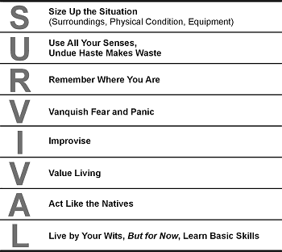
Survival
The key to survival is preparation
Resources available to you include;
  CIA WORLD FACT BOOK (online)
  LOAC BRIEF (Calendar Year requirement)
  ANTI-TERRORISM & FORCE PROTECTION (ATFP) BRIEFS / TRAINING
  ROE BRIEF (Pre-Deployment)
  EVASION AIDS / KITS (E&R Kits)
  COUNTRY STUDY GUIDES
  UNIT INTELLIGENCE BRIEFINGS
  MILITARY THREATS
  TOPOGRAPHY
    Prominent land features
    Water / food sources
  CLIMATE
    Seasonal changes
    Wet or dry season

Slide 26
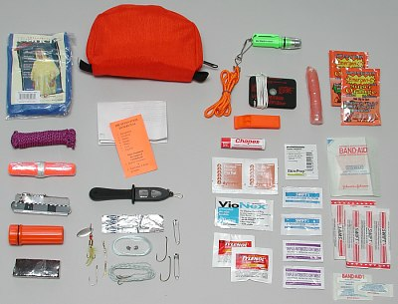
Survival Kits
Select items that are multipurpose, compact, lightweight, durable, and most importantly, functional.
The environment will dictate what include in the kit.
Layer your survival kit between: on your person to in your rucksack to on the truck. (Keep most important items on your body, i.e. knife, map, compass, EVC)
Your survival kit should be broken down into the following categories:
- Water.
- Fire.
- Shelter.
- Food.
- Medical.
- Signal.
- Miscellaneous.
Notes:
SURVIVAL KITS
3-5. The environment is the key to the types of items you will need in your survival kit. How much equipment you put in your kit depends on how you will carry the kit. A kit carried on your body will have
13 to be smaller than one carried in a vehicle. Always layer your survival kit—body, load-bearing vest or equipment, and platform (rucksack, vehicle, or aircraft). Keep the most important items on your body. For
example, your map and compass should always be on your body, as should your basic life-sustaining items (knife, lighter). Carry less important items on your LBE. Place bulky items in the rucksack.
3-6. In preparing your survival kit, select items that are multipurpose, compact, lightweight, durable, and most importantly, functional. An item is not good if it looks great but doesn't do what it was designed for.
Items should complement each other from layer to layer. A signal mirror in your pocket can be backed up by pen flares in your LBE and a signal panel in your rucksack. A lighter in your uniform can be
augmented by a magnesium bar in your LBE and additional dry tinder in your rucksack.
3-7. Your survival kit need not be elaborate. You need only functional items that will meet your needs and
a case to hold the items. For the case, you might want to use a bandage box, soap dish, tobacco tin, firstaid
case, ammunition pouch, or another suitable case. This case should be—
• Water-repellent or waterproof.
• Easy to carry or attach to your body.
• Suitable to accept various-sized components.
• Durable.
3-8. Your survival kit should be broken down into the following categories:
• Water.
• Fire.
• Shelter.
• Food.
• Medical.
• Signal.
• Miscellaneous.
3-9. Each category should contain items that allow you to sustain your basic needs. For example, water— you should have items that allow you to scoop up, draw up, soak up, or suck up water; something to
gather rainwater, condensation, or perspiration; something to transport water; and something to purify or filter water. Some examples of each category are as follows:
• Water—purification tablets, non-lubricated condoms for carrying water, bleach, povidone-iodine
drops, cravats, sponges, small plastic or rubber tubing, collapsible canteens or water bags.
• Fire—lighter, metal match, waterproof matches, magnesium bar, candle, magnifying lens.
• Shelter—550 parachute cord, large knife, machete or hatchet, poncho, space blanket, hammock,
mosquito net, wire saw.
• Food—knife, snare wire, fishhooks, fish and snare line, bouillon cubes or soup packets, highenergy
food bars, granola bars, gill or yeti net, aluminum foil, freezer bags.
• Medical—oxytetracycline tablets (to treat diarrhea or infection), surgical blades or surgical
preparation knife, butterfly sutures, lip balm, safety pins, sutures, antidiarrheal medication
(imodium), antimalarial medication (doxycycline), broad-spectrum antibiotics (rocephin and
zithromax) and broad spectrum topical ophthalmic (eye) antibiotic, antifungal, anti-inflammatory
(ibuprofen), petrolatum gauze, and soap. Medical items may make up approximately 50 percent of
your survival kit.
14
• Signal—signaling mirror, strobe, pen flares, whistle, U.S. flag, pilot scarf or other bright orange
silk scarf, glint tape, flashlight, laser pointer, solar blanket.
• Miscellaneous—wrist compass, needle and thread, money, extra eyeglasses, knife sharpener, cork,
camouflage stick, and survival manual.
3-10. Include a weapon only if the situation so dictates. Ambassadors and theater commanders may
prohibit weapons even in extreme circumstances. Read and practice the survival techniques in this manual
and apply these basic concepts to those you read about in other civilian publications. Consider your
mission and the environment in which you will operate. Then prepare your survival kit with items that are
durable, multipurpose, and lightweight. Imagination may be the largest part of your kit. It can replace
many of the items in a kit. Combined with the will to live, it can mean the difference between surviving to
return home with honor or not returning at all.

Slide 27
SURVIVAL KIT
MIL-B-131H
Type 1 Class III
Bell Fibre Products Corp.
Columbus, Ceorgia
FR2160
LOT NO. 1 Jul 1991
Saw, Finger Ring NSN 5110-00-570-6896 | Whistle, Extreme Cold NSN 8465-01-278-6982
Snare Wire NSN 9525-00-596-3498 | Compass, Smoke Chaser NSN 6605-00-553-8795
Candle NSN 9925-00-202-4417 | Fire Starter, Magnesium NSN 4240-01-160-5618
Plastic Bag NSN 8105-00-837-7755 | Plastic Bag 8105-00-634-4499
Survival Blanket NSN 9210-00-935-6666 | Water Bag, Drinking 8645-00-634-4499
Fishing Kit, Emergency NSN 4220-00-244-0764 | Matches NSN 9920-01-191-3434
Knife, Pocket NSN 6110-00-102-2205
Signaling Mirror NSN 6350-105-1252

Slide 28
Additional Individual Equipment
Individual equipment must support the Five PR Proficiency Tasks:
  Preserve Life
    Personal Survival Kit
    Individual First Aid Kit (IFAK)
  Architecture and Doctrine
    Fundamentals of Army PR (GTA 80-01-001)
  Communicate
    PLB, Radios
    MS-2000, firefly, r/g/ir chemlights, star clusters
    Pointee-Talkee
  Endure Hardship
    Code of Conduct GTA (GTA 21-03-009)
  Navigate
    GPS, Compass, Map/EVC
Consider “layering” of individual equipment…
  On the Soldier
  On the Vehicle
  “Go Bag”
Notes:
Individual equipment must support the 5 PR Proficiency Tasks:
Preserve Life
- Personal Survival Kits
- Individual First Aid Kits
- Combat Lifesaver Kits
Architecture and Doctrine
- PR GTA (GTA 80-01-001) Fundamentals of Army Personnel Recovery
- FM 3-50.1
- CALL Handbook 09-25
Communicate
- Beacons and Radios
- Visual Signaling Equipment
Endure Hardship
- Code of Conduct GTA (GTA 21-03-009)
Navigate
- Compass
- GPS
Maps and evasion charts

Slide 29
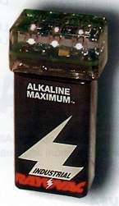

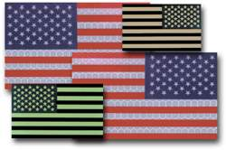
Additional Items of Evasion & Recovery
Per CENTCOM Reg 525-33, the Minimum items that WILL be carried on your person:
  Evasion Chart(s)
    Free issue; through Unit,
    POC is normally the individual who orders Maps & Charts
  Blood Chit
    Free Issue;
    OPR is CENTAF A3-DOOR
  Pointee-Talkee
    Free Issue;
    Downloaded & printed on to regular paper. POC is usually Unit Intel
  IR light
    Can be battery powered or a Chem light

Slide 30
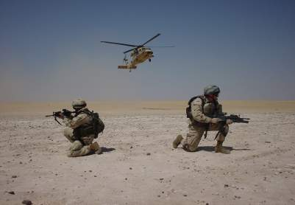
Recovery
YOUR EFFORTS ARE INSTRUMENTAL TO YOUR RECOVERY.
Follow EPA to best of ability.
Be prepared for any form of recovery.
If applicable, be prepared to authenticate via DD Form 1833.
Assist recovery forces in identifying your position.
Assume non-threatening posture.
Secure weapons and avoid quick movement.
DO NOT approach recovery vehicle until instructed.

Slide 31
Phases of Personnel Recovery
LOCATE & IDENTIFY
VISUAL
Mirror
Red/Orange Smoke (MK-13 / 124)
White/Blue Strobe (SDU 5/E)
IR Strobe
  SDU-5/E, Phoenix, Fire Fly
Signal Panel (VS-17/GVX)
Panel Marker, Survival Aviation (Orange)
Flashlight (Red Lense or IR Cap)
IR Chemlight
Glint Tape (IR Reflective)
Space Blanket
Gyro Jet / Pen-Gun Flare
ELECTRONIC
Personal Locator Beacon
Blue Force Tracker
Transceivers
Being able to positively identify your location is vital for your security and that of the recovery forces

Slide 32
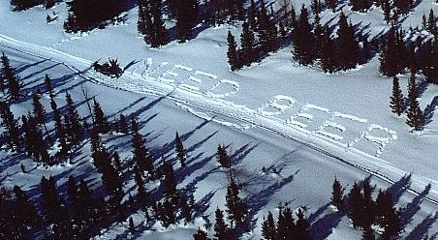
Visual Ground To Air Signals (GTAS)
Commonly constructed in the shape of large letters or shapes.
They are intended to be seen from aircraft or other assets.
  Contrast and Angularity is most easily observed from the air.
The goal in site selection is to make them unobservable to ground forces
Construction principles
  Size 18’ X 3’
  Ratio 6 to 1
Quality construction is key
Ideal Materials are metallic/reflective;
  Space Blanket
  Metallic trash (aluminum cans)
Almost anything will work if coordinated in ISG or an EPA.
+
_
_
K
X
Notes:
Ground to Air Signals (GTAS) are symbols commonly constructed at ground level in the shape of large letters or shapes that can be seen from altitude by aircraft, UASs, and possibly satellites.
Contrast and Angularity is most easily observed from the air; “code letter” right angles do not occur naturally.
The goal in site selection is to make them unobservable to ground forces meaning that if enemy forces are in the immediate area, they would not be able to see the GTAS. For instance, if you constructed an X on the desert floor out of old tires, from the air it would be easily observed as an X. If you were standing right by the GTAS, it would only look like old tires in a row.
The GTAS should be as big as possible. The guidelines of GTAS construction are 18 ft X 3 ft or 6 to 1 ratio, per leg of the symbol.
Quality construction is key. Ideal Materials are metallic/reflective such as Space Blanket or Metallic trash (aluminum cans). In the absence of metallic or reflective materials, pick items that contrast with the surroundings such as black tires on a desert floor or white cloth on a green grassy clearing.

Slide 33
Link-up Procedures
Considerations
Give specific instructions on how IP identify themselves to friendly forces.
Authentication may not be immediately possible due to tactical situation (extraction from high-threat area).
IP may not be immediately recognized as part of the friendly force.
  - U.S. personnel wearing disguise.
  - Host nation personnel.
In unassisted recovery, it is possible that the presence of IP is unknown to the recovery force (especially if not from the same unit).
Friendly forces are more likely to open fire when unexpectedly contacted in hostile areas.

Slide 34
Links
https://jkodirect.jten.mil/Atlas2/faces/page/login/Login.seam?cid=92378
https://combinedarmscenter.army.mil/mccoe/CDID/PRPO/Pages/default.aspx
https://www.us.army.mil/suite/page/650428
(SERE 100.1, PR101A, PR101B, PR101C, PR102, PR202)
USCENTCOM Moderate Risk of Isolation (MRI)

Slide 35
Questions
What is the Guardian Angel Program?
An individual designated who conducts passive surveillance during all engagements
What is an Alamo Plan?
An internal plan developed to allow Security Cooperation Teams the ability to maintain and sustain an isolated defensive position for up to 72 hours.
What are the five PR tasks?
Report, Locate, Support, Recover, and Re-integrate
What is an Evasion Plan of Action (EPA)
A course of action developed before executing a mission that improves an evader’s chance to return to friendly lines.

