Slide 1
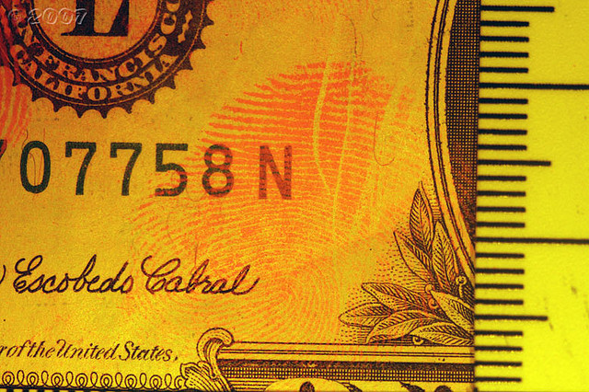
Battlefield Forensics
1 May 2012
VERSION 2.0
Notes:
Introduce yourself:
Only needed for the first time delivering instruction to the students.
Brief description about your experience while in the military to include: (Infantry, EOD, Combat Engineer). How you stay relevant. Example: Input from JCOE, Deploy as a civilian instructor, read storyboards, infusion of intelligence from our forward deployed civilian cells in Afghanistan. Explain how the material covered in this module will help Soldiers in theater conduct COIN operations.

Slide 2
Enabling Learning Objective
Action: | Identify the types of fingerprints and learn to collect latent prints.
Conditions: | Given a classroom environment, classroom instructions, and student guide.
Standards: | Correctly know the types of fingerprints and how to collect latent prints.
Upon completion of this module each student will have the knowledge, skills, and abilities to:
Explain What is Battlefield Forensics, Latent prints & Forensic Science
Identify Fingerprint Patterns and Ridge Characteristics
Properly lift Latent prints using developing powders
Take Fingerprints and complete Fingerprinting Forms
2
Notes:
Objectives:
Upon completion of this module each student will have the knowledge, skills, and abilities to:
Identify the types of fingerprints and main characteristics.
Know the tools used to collect latent prints and the procedures to do it.
This is forensic class.
Appreciating the importance of battlefield forensics and how ?”

Slide 3
Safety Requirements
Safety Requirements: | None
Risk Assessment: | Low
Safety Considerations: | Low
Environmental Considerations: | None
Notes:
Safety Requirements:
Safety Requirements: None
Risk Assessment: Low
Safety Considerations: Low
Environmental Considerations: None
NOTE: It is the responsibility of all Soldiers and DA civilians to protect the environment from damage.

Slide 4
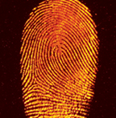
Overview
Forensic Science
What is Battlefield Forensics
Joint Expeditionary Forensic Facilities (JEFF) Program
Crime Scene Evidence Collection
Potential Evidence
Six Forensic Functions
Fingerprint Identification
Fingerprint Pattern & Ridge Characteristics
Latent prints & Developing Powders
Fingerprinting Process
Special Circumstances
Unusual Fingerprints
Taking the Fingerprints
Fingerprinting Forms
Fingerprinting Process
Practical Exercises
Notes:
Overview:
What is Battlefield Forensics Latent prints
Forensic Science
Joint Expeditionary Forensic Facilities (JEFF) Program
Crime Scene Evidence Collection
Potential Evidence
Fingerprint Identification
Fingerprint Pattern & Ridge Characteristics
Latent prints & Developing Powders
Fingerprinting Process
Special Circumstances
Unusual Fingerprints
Taking the Fingerprints
Fingerprinting Forms
Fingerprinting Process
Practical Exercises

Slide 5


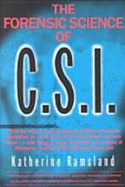
Locard’s Exchange Principle
Formulated in 1910 by Edmond Locard
“The exchange of materials between two objects that occurs whenever two objects come into contact with one another.”
Forensic Science
Broadest definition: applies the knowledge and technology of science for the definition and enforcement of laws.
Notes:
Locard’s Exchange Principle is considered to be one of the founding principles of Forensic Science. It states that the exchange of materials between two objects that occurs whenever two objects come into contact with one another.
Ask the class: What do you think this means?
When a criminal came in contact with an object or person, a cross-transfer of evidence occurred.
Think of CSI. The perpetrator of a crime either takes dirt, soil, fibers, something from the crime scene with them and/or leaves behind DNA, fingerprints, fibers or hair at the crime scene.
So what is forensic science: in the broadest sense it is apply science to laws.
So why does Forensic Science apply to you, as a Soldier?
Reference: Saferstein, Richard. Criminalistics: An Introduction to Forensic Science. 8th Edition. 2004. Pearson Education, Inc. Upper Saddle River, New Jersey.

Slide 6
What is Battlefield Forensics?
Today, the functional lines between traditional warfare and activities like law enforcement, physical security and cyber-crime have very much blurred. New ways have been found to solve problems. The application of forensic science disciplines to this area is commonly referred to as Battlefield Forensics.
The United States Department of Defense (DoD) defines forensics simply:
“The application of multi-disciplinary scientific processes to establish facts.” DoD also applies criminal forensic capabilities and technologies typically used in law enforcement to meet their needs in national security and counter-terrorism.
Notes:
What is Battlefield Forensics?
Today, the functional lines between traditional warfare and activities like law enforcement, physical security and cyber-crime have very much blurred. New ways have been found to solve problems. The application of forensic science disciplines to this area is commonly referred to as Battlefield Forensics.
The United States Department of Defense (DoD) defines forensics simply:
“The application of multi-disciplinary scientific processes to establish facts.” DoD also applies criminal forensic capabilities and technologies typically used in law enforcement to meet their needs in national security and counter-terrorism.

Slide 7
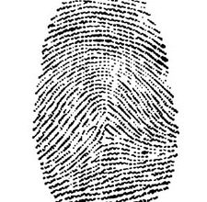
What Kind of Forensic Science
Disciplines are Used?
Forensic science disciplines, research, techniques and tools are used to identify enemies, insurgents and terrorists, linking them through science to other people, places, things, organizations, and events. Other traditional crime scene techniques are also used.
The U.S. military uses amongst others, the following forensic sciences in pursuit of terrorists, and their accomplices:
Latent prints
DNA
firearms and tool marks
forensic document examination
digital evidence discovery, and forensic pathology
Notes:
What Kind of Forensic Science Disciplines are Used?
Forensic science disciplines, research, techniques and tools are used to identify enemies, insurgents and terrorists, linking them through science to other people, places, things, organizations, and events. Other traditional crime scene techniques are also used.
The U.S. military uses amongst others, the following forensic sciences in pursuit of terrorists, and their accomplices:
Latent prints
DNA
firearms and tool marks
forensic document examination
digital evidence discovery, and forensic pathology

Slide 8
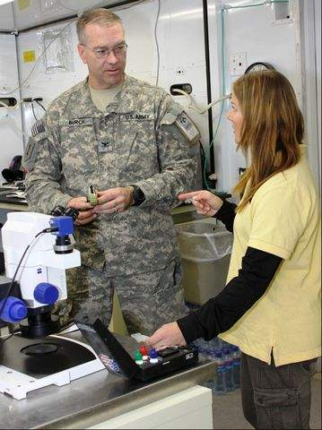
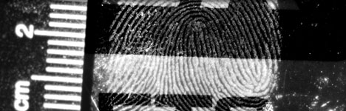
Joint Expeditionary Forensic
Facilities (JEFF) Program
BAE Systems, in collaboration with U.S. Navy sponsors, delivers hard-science capability and full-spectrum engineering in some of the most austere environments across the globe. The Joint Expeditionary Forensic Facilities (JEFF) program stands ready to provide rapid results to meet intelligence, security, stability, and law enforcement needs.
Notes:
Joint Expeditionary Forensic Facilities (JEFF) Program
BAE Systems, in collaboration with U.S. Navy sponsors, delivers hard-science capability and full-spectrum engineering in some of the most austere environments across the globe.
The Joint Expeditionary Forensic Facilities (JEFF) program stands ready to provide rapid results to meet intelligence, security, stability, and law enforcement needs.
There are multiple JEFF labs throughout Afghanistan. The evidence you collect during TSE will be sent to JEFF labs or to NGIC.

Slide 9
Joint Expeditionary Forensic
Facilities (JEFF) Program
To establish identity dominance, JEFF laboratories offer the complete range of forensic disciplines:
Nuclear DNA analysis
Latent print processing
Firearms and tool-mark examination
Drug and chemical examination
Document exploitation (DOMEX)
Intelligence analysis
Forensic photography
Laboratory operations and logistics
Evidence and property management
When combined cohesively under a full-spectrum JEFF laboratory, these and many other forensic disciplines turn raw material and evidence into scientific solutions that eliminate shadows and establish fact. JEFF is the turnkey solution that is rapidly deployable to any location in response to the requirements of military, federal, law enforcement, and civil customers.
Notes:
Joint Expeditionary Forensic Facilities (JEFF) Program
To establish identity dominance, JEFF laboratories offer the complete range of forensic disciplines:
Nuclear DNA analysis
Latent print processing
Firearms and tool-mark examination
Drug and chemical examination
Document exploitation (DOMEX)
Intelligence analysis
Forensic photography
Laboratory operations and logistics
Evidence and property management
When combined cohesively under a full-spectrum JEFF laboratory, these and many other forensic disciplines turn raw material and evidence into scientific solutions that eliminate shadows and establish fact. JEFF is the turnkey solution that is rapidly deployable to any location in response to the requirements of military, federal, law enforcement, and civil customers.

Slide 10
Crime Scene Evidence Collection
Today the battlefield is treated like a crime scene and members of the U.S. military are being taught to collect, analyze, and preserve information on battlefields ranging from tire treads on tarmacs of airports and exploded devices in the mountains of Afghanistan and on the roadways of Iraq.
This information collected by trained military personnel, captured in engagements with terrorists or seized from their bases and safe houses, includes:
latent fingerprints recovered from explosive devices, vehicles and safe houses
hair and blood samples
firearms (for clues as to their origin and use)
papers and identity cards
software, and computer data
Notes:
Crime Scene Evidence Collection:
Today the battlefield is treated like a crime scene and members of the U.S. military are being taught to collect, analyze, and preserve information on battlefields ranging from tire treads on tarmacs of airports and exploded devices in the mountains of Afghanistan and on the roadways of Iraq.
This information collected by trained military personnel, captured in engagements with terrorists or seized from their bases and safe houses, includes:
latent fingerprints recovered from explosive devices, vehicles and safe houses
hair and blood samples
firearms (for clues as to their origin and use)
papers and identity cards
software, and computer data

Slide 11
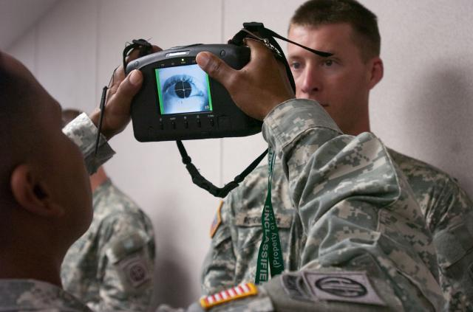
Potential Evidence and
Intelligence Applications
A lot of information gathered in battlefield forensics has significant intelligence applications, but can also be important in making criminal cases against terrorist suspects captured by the military. Biometric evidence obtained on the battlefield also can be used to place terrorist fugitives on various watch lists.
Notes:
Potential Evidence and Intelligence Applications
A lot of information gathered in battlefield forensics has significant intelligence applications, but can also be important in making criminal cases against terrorist suspects captured by the military. Biometric evidence obtained on the battlefield also can be used to place terrorist fugitives on various watch lists.

Slide 12
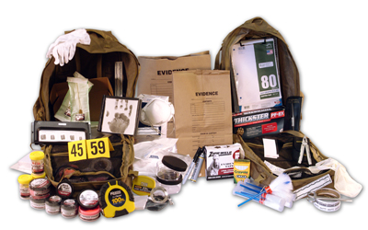
Potential Evidence and
Intelligence Applications
  Military personnel in the army, navy and air force learn how to collect and preserve physical and biological evidence, obtain fingerprints for later analysis and take forensic-quality photographs, from a battle location. Students learn to process evidence, identify usable evidence upon processing and complete intelligence reports.
Notes:
Potential Evidence and Intelligence Applications
Military personnel in the army, navy and air force learn how to collect and preserve physical and biological evidence, obtain fingerprints for later analysis and take forensic-quality photographs, from a battle location. Students learn to process evidence, identify usable evidence upon processing and complete intelligence reports.

Slide 13
Forensic Functions & Mission Areas
6 x Forensic Functions
5 x Mission Areas
Provides the framework for T/C/S development and drives Mission Threads
Notes:
Forensic Functions & Mission Areas
`These are the six forensic functions: Recognize, Preserve, Collect; Analyze; Store; and Share. They do not always occur sequentially, but can occur in parallel order.
Let’s discuss each function:
Recognize: Locate and distinguish materials that have potential forensic value. May entail special methods an advanced training to detect items.
Preserve: Protect materials and data from the moment those items are recognized as holding potential forensic value. Materials must be protected and preserved by available, reasonable measures (marking, packaging, and tracking) to prevent contamination, loss, or alteration.
Collect: This describes recovery of and accounting for materials from a site. The site is documented and contextual information is recorded, within the parameters allowed by the situation. This often includes limited processing of specific items or areas in an effort to detect additional forensically-relevant information. Presumptive testing of materials may also be involved.
Analyze: Forensic analysis may occur from the recognition of materials and contextual information at the site, to in-depth examination at mobile or traditional laboratories. Presumptive testing of materials may be involved. A variety of factors dictate the type of analyses and examinations that a lab will perform. * Forensic analyses attempt to scientifically link materials, people, places, things, intentions, activities, and events. Results may require interpretation and further scientific analysis.
*Reference: USMC Warfighting Publication 2-1 Intelligence Operations, SEP03
Store: Materials and associated information should be maintained until forensic material disposition is fully adjudicated, or resolved. Policies and procedures should dictate proper disposition. Balancing information assurance with necessary retrieval capabilities is critical when storing data.
Share: As forensic analyses are completed, results are catalogued and shared in accordance with policies and procedures. Interoperability is key to developing databases and retrieving information .* Sharing information with the relevant stakeholders, including the submitting unit is vital.
During TSE and BFF, you will be doing the first 3 forensic functions. Depending on your MOS, you may do parts of function 4 such as analyzing documents for intelligence and other things. You will also maintain a copy of your reports for your records. All information will be shared with other law enforcement agencies, such as CEXE, TEDAC, WTI or NGIC.
*Reference DoD Net-Centric Operational Environment Joint Integrating Concept, Version 1.0, OCT05
The forensic functions then play a factor in the Mission Areas. Could the forensic evidence you collect play a role in force protection on your FOB?
Reference: PMO’s Forensics Guide for Commanders

Slide 14
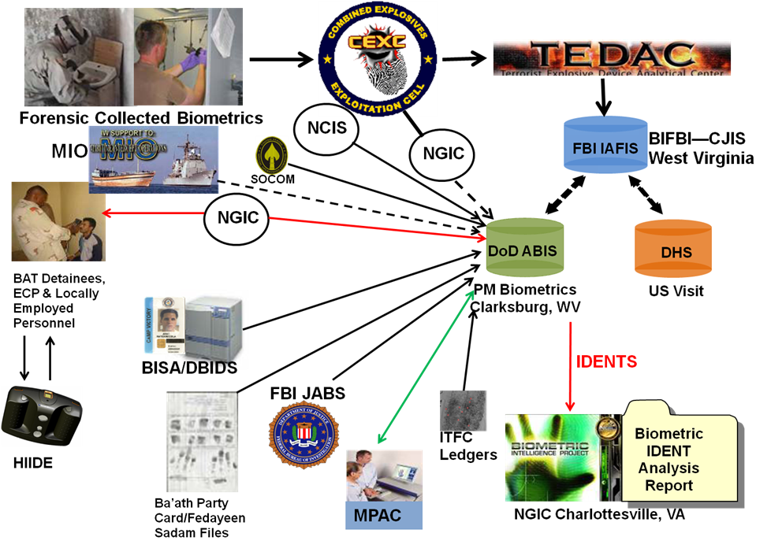
Forensics Architecture – How It All Fits Together
Notes:
Forensics Architecture – How It All Fits Together
So where are you as the Soldier in all of this?
Forensics establishes what the enemy has done. Forensic examiners access and input data into this database and then forward the information to organizations such as the Combined Explosives Exploitation Cell (CEXC) who in turn process forensic material and help facilitate prosecution and/or target insurgent/criminal networks.
Multiple agency are working together to share and process the information.
DoD Automated Biometric Identification System (ABIS)
Integrated Automated Fingerprint Identification System or IAFIS

Slide 15



Fingerprint Identification
Fingerprint Identification is the method of identification using the impressions made by the minute ridge formations or patterns found on the fingertips. No two persons have exactly the same arrangement of ridge patterns, and the patterns of any one individual remain unchanged throughout life. Fingerprints offer an infallible means of personal identification. Other personal characteristics may change, but fingerprints do not.
Fingerprints can be recorded on a standard fingerprint card or can be recorded digitally and transmitted electronically to the FBI for comparison. By comparing fingerprints at the scene of a crime with the fingerprint record of suspected persons, officials can establish absolute proof of the presence or identity of a
person.
Notes:
Fingerprint Identification
Fingerprint Identification is the method of identification using the impressions made by the minute ridge formations or patterns found on the fingertips. No two persons have exactly the same arrangement of ridge patterns, and the patterns of any one individual remain unchanged throughout life. Fingerprints offer an infallible means of personal identification. Other personal characteristics may change, but fingerprints do not.
Fingerprints can be recorded on a standard fingerprint card or can be recorded digitally and transmitted electronically to the FBI for comparison. By comparing fingerprints at the scene of a crime with the fingerprint record of suspected persons, officials can establish absolute proof of the presence or identity of a person.

Slide 16
Fingerprint Identification
The first year for the first known systematic use of fingerprint identification began in the United States is 1902. The New York Civil Service Commission established the practice of fingerprinting applicants to prevent them from having better qualified persons take their tests for them. The New York state prison system began to use fingerprints for the identification of criminals in 1903.
In 1904 the fingerprint system accelerated when the United States Penitentiary at Leavenworth, Kansas, and the St. Louis, Missouri, Police Department both established fingerprint bureaus.
The growing need and demand by police officials for a national repository and clearinghouse for fingerprint records led to an Act of Congress on July 1, 1921, establishing the Identification Division of the FBI.
Notes:
Fingerprint Identification
The first year for the first known systematic use of fingerprint identification began in the United States is 1902. The New York Civil Service Commission established the practice of fingerprinting applicants to prevent them from having better qualified persons take their tests for them. The New York state prison system began to use fingerprints for the identification of criminals in 1903.
In 1904 the fingerprint system accelerated when the United States Penitentiary at Leavenworth, Kansas, and the St. Louis, Missouri, Police Department both established fingerprint bureaus.
The growing need and demand by police officials for a national repository and clearinghouse for fingerprint records led to an Act of Congress on July 1, 1921, establishing the Identification Division of the FBI.

Slide 17
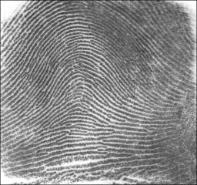
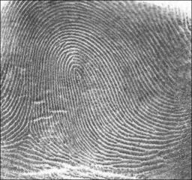
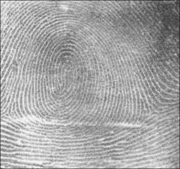
Fingerprint Pattern Type
There are three main fingerprint patterns:
ARCH
LOOP
WHORL
Notes:
Fingerprint Pattern Type
There are three main fingerprint patterns: arches, loops and whorls.

Slide 18
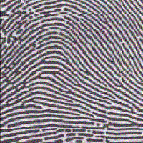
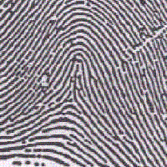
Fingerprint Pattern Type
Plain Arch
Arches are found in about 5% of fingerprint patterns encountered. The ridges run from one side to the other of the pattern, making no backward turn. Ordinarily, there is no delta in an arch pattern but where there a delta, no re-curving ridge must intervene between the core and delta points.
Tented Arch
Notes:
Fingerprint Pattern Type
Arches are found in about 5% of fingerprint patterns encountered. The ridges run from one side to the other of the pattern, making no backward turn. Ordinarily, there is no delta in an arch pattern but where there a delta, no re-curving ridge must intervene between the core and delta points.
There are four types of arch patterns: plain arches, radial arches, ulnar arches and tented arches. Plain arches have an even flow of ridges from one side to the other of the pattern, no “significant up thrusts” and the ridges enter on one side of the impression, and flow out the other with a rise or wave in the center. The ridges of radial arches slope towards the thumb, have one delta and no re-curving ridges.
On ulnar arches, the ridges slope towards the little finger, have one delta and no re-curving ridges. Tented arches have an angle, an up thrust, or two of the three basic characteristics of the loop. They don’t have the same "easy" flow that plain arches do and particularly have “significant up thrusts” in the ridges near the middle that arrange themselves on both sides of a spine or axis towards which the adjoining ridges converge and appear to form tents.

Slide 19
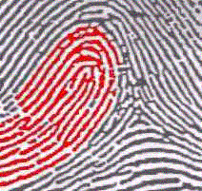
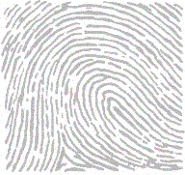
Fingerprint Pattern Type
Radial Loop
Loops occur in about 60-70 % of fingerprint patterns encountered. One or more of the ridges enters on either side of the impression, re-curves, touches or crosses the line running from the delta to the core and terminates on or in the direction of the side where the ridge or ridges entered.
Ulnar Loop
Notes:
Fingerprint Pattern Type
Loops occur in about 60-70 % of fingerprint patterns encountered. One or more of the ridges enters on either side of the impression, re-curves, touches or crosses the line running from the delta to the core and terminates on or in the direction of the side where the ridge or ridges entered.
Each loop pattern has is one delta and one core and has a ridge count. Radial loops are named after the radius, a bone in the forearm that joins the hand on the same side as the thumb. The flow of the pattern in radial loops runs in the direction of the radius (toward the thumb). Radial loops are not very common and most of the time radial loops will be found on the index fingers. Ulnar loops are named after the ulna, a bone in the forearm. The ulna is on the same side as the little finger and the flow of the pattern in an ulnar loop runs in the direction of the ulna (toward the little finger).

Slide 20
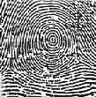
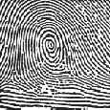
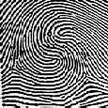
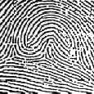
Fingerprint Pattern Type
Whorls are seen in about 25-35 % of fingerprint patterns encountered. In a whorl, some of the ridges make a turn through at least one circuit. Any fingerprint pattern which contains 2 or more deltas will be a whorl pattern. There are four types of whorl patterns.
Plain Whorl
Central Pocket Whorl
Double Loop Whorl
Accidental Whorl
Notes:
Fingerprint Pattern Type
Whorls are seen in about 25-35 % of fingerprint patterns encountered. In a whorl, some of the ridges make a turn through at least one circuit. Any fingerprint pattern which contains 2 or more deltas will be a whorl pattern.
There are four types of whorl patterns.
Plain whorls consist of one or more ridges which make or tend to make a complete circuit with two deltas, between which an imaginary line is drawn and at least one re-curving ridge within the inner pattern area is cut or touched.
Central pocket loop whorls consist of at least one re-curving ridge or an obstruction at right angles to the line of flow, with two deltas, between which when an imaginary line is drawn, no re-curving ridge within the pattern area is cut or touched. Central pocket loop whorl ridges make one complete circuit which may be spiral, oval, circular or any variant of a circle.
Double loop whorls consist of two separate and distinct loop formations with two separate and distinct shoulders for each core, two deltas and one or more ridges which make, a complete circuit. Between the two at least one re-curving ridge within the inner pattern area is cut or touched when an imaginary line is drawn.
Accidental whorls consist of two different types of patterns with the exception of the plain arch, have two or more deltas or a pattern which possess some of the requirements for two or more different types or a pattern which conforms to none of the definitions.

Slide 21








Fingerprint Pattern Type
Plain Arch Tented Arch Ulnar Loop Radial Loop
Plain Whorl Central Pocket Double Loop Accidental
Loop Whorl Whorl
Notes:
Fingerprint Pattern Type
Additional examples of each type compared together.

Slide 22
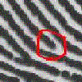

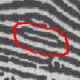

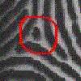

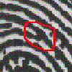

Ridge Characteristics
A single rolled fingerprint may have as many as 100 or more identification points that can be used for identification purposes. These points are often ridge characteristics.
Ending Ridge
Short Ridges (Islands)
Ridge Dots
Bifurcations
Notes:
Ridge Characteristics
A single rolled fingerprint may have as many as 100 or more identification points that can be used for identification purposes. These points are often ridge characteristics.
There are many different ridge characteristics, although some of them are more common than others. These points can be used as points of comparison for fingerprint identification. Depending on how prevalent the ridge characteristics, fewer or more points of comparison may be needed for a positive identification.

Slide 23
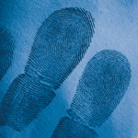
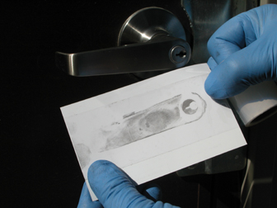
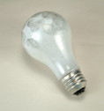
Latent prints
Latent prints are those that cannot be seen by the naked eye. They are
caused by the perspiration and other materials that may be on the ridges of
the skin. The method used for obtaining latent prints depends on the type of
surface to be examined, the manner in which the prints were left, and the
quantity of material taken to the crime lab.
They are compared to the prints of all persons known to have been at the
scene of the crime or who had legal access to the crime scene. This procedure
eliminates all but the criminal's prints. Making such prints visible is a matter of
both skill and luck.
Notes:
Latent prints
Latent prints are those that cannot be seen by the naked eye. They are caused by the perspiration and other materials that may be on the ridges of the skin. The method used for obtaining latent prints depends on the type of surface to be examined, the manner in which the prints were left, and the quantity of material taken to the crime lab.
They are compared to the prints of all persons known to have been at the scene of the crime or who had legal access to the crime scene. This procedure eliminates all but the criminal's prints. Making such prints visible is a matter of both skill and luck.

Slide 24
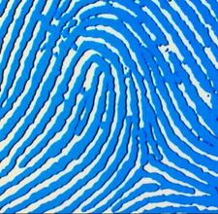
Latent prints
Latent fingerprint evidence is generally divided into two categories:
Porous evidence, such as cardboard, paper, and unfinished wood, that readily allows for the preservation of latent fingerprints because residue soaks into the surface
Non-porous evidence, such as glass , finished wood, and plastic, which does not easily permit the preservation of latent fingerprints because substances only lie on the surface and can be intentionally or accidentally wiped away.
Notes:
Latent prints
Latent fingerprint evidence is generally divided into two categories:
Porous evidence, such as cardboard, paper, and unfinished wood, that readily allows for the preservation of latent fingerprints because residue soaks into the surface
Non-porous evidence, such as glass, finished wood, and plastic, which does not easily permit the preservation of latent fingerprints because substances only lie on the surface and can be intentionally or accidentally wiped away.

Slide 25
Developing Powders
There are many types of powders available for processing, such as regular fingerprint powders, magnetic fingerprint powders and fluorescent fingerprint powders.
In selecting a powder, it is best to select a powder that is in contrast to the surface on which is being processed.
REGULAR FINGERPRINT POWDERS come in various colors such as black, gray, white, red, dual-use and super black to name a few.
MAGNETIC FINGERPRINT POWDERS come in various colors such as black, gray, white and dual-use to name a few.
FLUORESCENT MAGNETIC FINGERPRINT POWDERS come in various colors such as red and yellow to name a few.
REGULAR POWDERS may be used on any surface, which is relatively smooth and non-tacky. They are not suitable for use on surfaces that are wet, very rough or tacky.
MAGNETIC POWDERS are sometimes more effective on rough, grained or porous surfaces, which would otherwise become heavily coated with regular powder.
FLUORESCENT POWDERS are very strongly fluorescent and can be detected with a low power U-V lamp or an alternate light source such as the Blue Light Special or Blue Light Ultra. This is a very fine powder and is effective on multicolored surfaces, which would otherwise present a contrast problem.
Notes:
Developing Powders
There are many types of powders available for processing, such as regular fingerprint powders, magnetic fingerprint powders and fluorescent fingerprint powders.
In selecting a powder it is best to select a powder that is in contrast to the surface on which is being processed. One uses black lifters with gray powder and white lifters with black powder.
REGULAR FINGERPRINT POWDERS come in various colors such as black, gray, white, red, dual-use and super black to name a few.
MAGNETIC FINGERPRINT POWDERS come in various colors such as black, gray, white and dual-use to name a few.
FLUORESCENT MAGNETIC FINGERPRINT POWDERS come in various colors such as red and yellow to name a few.
REGULAR POWDERS may be used on any surface, which is relatively smooth and non-tacky. They are not suitable for use on surfaces that are wet, very rough or tacky.
MAGNETIC POWDERS are sometimes more effective on rough, grained or porous surfaces, which would otherwise become heavily coated with regular powder.
FLUORESCENT POWDERS are very strongly fluorescent and can be detected with a low power U-V lamp or an alternate light source such as the Blue Light Special or Blue Light Ultra. This is a very fine powder and is effective on multicolored surfaces, which would otherwise present a contrast problem.

Slide 26
Developing Powders
Pure Grey Powder | General materials
Black Powder | Paper, unglazed pottery, eggshells, synthetic resins
White Powder | Leather, rubber, oily fingerprints
Copper Powder | Plant stem and leaves, fruit rinds
Gold Powder | Rough surface metals, synthetic resins
Yellow Power | Leather, rubber
Lycopodium Powder | General materials, oily fingerprints
Dragon Blood Powder | Rough surface metals, stone
Indigo Powder | Synthetic resins, frosted glass, metal frames, eggshell
SP Black Powder | Aluminum building materials
Ultranium Powder | Synthetic resins
Aluminum Powder | Glass, ceramics, lacquer
Pure Aluminum Powder | Synthetic resins, plated metal
Lead Carbonate Powder | Synthetic resins, leather
Stone Powder | Leather, rubber, oily fingerprints
Fluorescence Powder | Color print paper (viewed under UV light)
Anthracene Powder | Leather, rubber
Magnetic Powder | Paper (works with brush or wand)
Notes:
Developing Powders
Pure Grey Powder General materials
Black Powder Paper, unglazed pottery, eggshells, synthetic resins
White Powder Leather, rubber, oily fingerprints
Copper Powder Plant stem and leaves, fruit rinds
Gold Powder Rough surface metals, synthetic resins
Yellow Power Leather, rubber
Lycopodium Powder General materials, oily fingerprints
Dragon Blood Powder Rough surface metals, stone
Indigo Powder Synthetic resins, frosted glass, metal frames, eggshell
SP Black Powder Aluminum building materials
Ultranium Powder Synthetic resins
Aluminum Powder Glass, ceramics, lacquer
Pure Aluminum Powder Synthetic resins, plated metal
Lead Carbonate Powder Synthetic resins, leather
Stone Powder Leather, rubber, oily fingerprints
Fluorescence Powder Color print paper (viewed under UV light)
Anthracene Powder Leather, rubber
Magnetic Powder Paper (works with brush or wand)

Slide 27
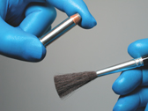
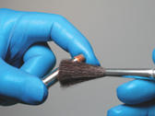
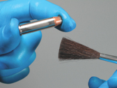
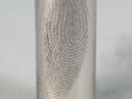
Latent prints
The following steps provide instructions on how to take latent fingerprints.
Dust the surface with the appropriate powder and lightly dust the area containing the print. (You can choose the appropriate powder by using a powder that will contrast with the surface of the print.)
After the print is developed, remove the excess powder by gently blowing or brushing it away. Be careful not to destroy the print with too hard a brush stroke.
Notes:
Latent prints
The following steps provide instructions on how to take latent fingerprints:
1. Dust the surface with the appropriate powder and lightly dust the area containing the print. (You can choose the appropriate powder by using a powder that will contrast with the surface of the print.)
2. After the print is developed, remove the excess powder by gently blowing or brushing it away. Be careful not to destroy the print with too hard a brush stroke.
Cleaning techniques that can improve the quality and clarity of powdered prints by removing excess powder
include:
A. Using a powder-free detail brush following the flow of the ridges of the print.
B. Tapping the item on edge.
C. Gently blowing on the print.
Porous items should be collected for future processing whenever possible. While it may be possible to develop prints through the use of powders on porous and semi-porous items, it is not recommended for optimal development. Other chemical techniques will provide better results on these items.

Slide 28
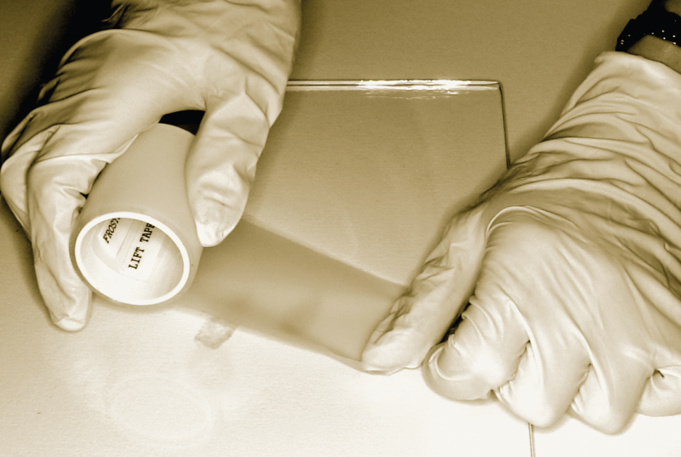
Latent prints
3. To lift the print from the dusted item:
Secure the end of the tape on the surface without covering the print(s) to be lifted to ensure the tape will not buckle .
Keeping the tape above the surface, slowly push the tape across the print(s) with your fingers until the print is covered.
Notes:
Latent prints
3. To lift the print from the dusted item:
Secure the end of the tape on the surface without covering the print(s) to be lifted to ensure the tape will not buckle.
Keeping the tape above the surface, slowly push the tape across the print(s) with your fingers until the print is covered.

Slide 29
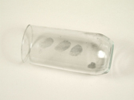
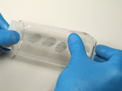
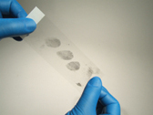
Latent prints
4. To lift the print from the dusted item to the index card, obtain a 3"-4" length of tape and place one end of tape to the right of the print and allow the tape to cover the whole print. Be sure that the tape is flat and has no air bubbles.
Notes:
Latent prints
4. To lift the print from the dusted item to the index card, obtain a 3"-4" length of tape and place one end of tape to the right of the print and allow the tape to cover the whole print. Be sure that the tape is flat and has no air bubbles.

Slide 30
Latent prints
5. Slide a finger over the tape and smooth it down over the print to force out all air bubbles.
Minimize or eliminate any resulting air bubbles or debris voids by rubbing with the flat surface of your fingernail.
Larger air bubbles can be eliminated by first poking a small hole in the tape before smoothing with your fingernail.
Notes:
Latent prints
5. Slide a finger over the tape and smooth it down over the print to force out all air bubbles.
Minimize or eliminate any resulting air bubbles or debris voids by rubbing with the flat surface of your fingernail.
Larger air bubbles can be eliminated by first poking a small hole in the tape before smoothing with your fingernail.

Slide 31
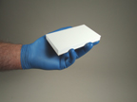
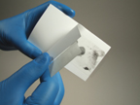
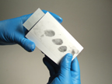
Latent prints
6. The print can be removed pulling up on one end of the tape and then placing it on the fingerprint card in the same manner as the tape was placed over the latent print.
Notes:
Latent prints
6. The print can be removed pulling up on one end of the tape and then placing it on the fingerprint card in the same manner as the tape was placed over the latent print.

Slide 32
Latent prints
Magna Brush
Is a specially designed magnet, which picks up finely divided metallic powder. The brush has no bristles, so only the powder touches the surface containing the latent print. This characteristic reduces the chance of destroying or damaging the ridge detail of the print, which can happen with a bristle brush.
This method also permits the use of the same powder over and over again, conserving the powder and leaving cleaner surfaces. Excellent latent prints have been developed on paper, wood, leather, and other slightly porous surfaces using the Magna Brush.
Notes:
Latent prints
Magna Brush
Is a specially designed magnet, which picks up finely divided metallic powder. The brush has no bristles, so only the powder touches the surface containing the latent print. This characteristic reduces the chance of destroying or damaging the ridge detail of the print, which can happen with a bristle brush.
This method also permits the use of the same powder over and over again, conserving the powder and leaving cleaner surfaces. Excellent latent prints have been developed on paper, wood, leather, and other slightly porous surfaces using the Magna Brush.

Slide 33
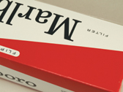
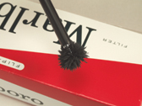
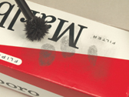

Latent prints
Magna Brush
Coated paper and paperboard surfaces such as cigarette packs and cartons present unique issues in processing with conventional chemicals and powders.
Because of the semi-porous nature of these surfaces, magnetic powders adhere to the ridge detail while reducing background contamination.
Gentle application of Dual Contrast Magnetic Powder reveals detailed latent fingerprints.
Dual contrast powders allow visualization on multi-colored surfaces.
Notes:
Latent prints
Magna Brush
Coated paper and paperboard surfaces such as cigarette packs and cartons present unique issues in processing with conventional chemicals and powders.
Because of the semi-porous nature of these surfaces, magnetic powders adhere to the ridge detail while reducing background contamination.
Gentle application of Dual Contrast Magnetic Powder reveals detailed latent fingerprints.
Dual contrast powders allow visualization on multi-colored surfaces.

Slide 34
Inked Prints
Inked prints are those taken directly from a person’s fingers through the use of an ink pad or block.
Most biometrics are taken using electronic scanners on the BAT, HIIDE or SEEK.
If these devices are broken or a unit does not have one, you will be required to take ink prints.
Post mortem prints can also be taken.
Notes:
Inked prints are those taken directly from a person’s fingers through the use of an ink pad or block
Most biometrics are taken using electronic scanners on the BAT, HIIDE or SEEK.
If these devices are broken or a unit does not have one, you will be required to take ink prints.
Post mortem prints can also be taken.
Ask the class why it is important to take prints of deceased personnel.

Slide 35
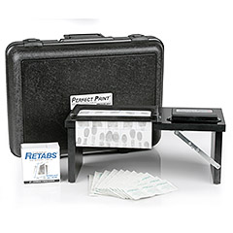
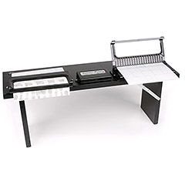
Fingerprinting Process
The recommended height for recording legible fingerprints is approximately 39 inches from the floor. This allows the forearm of an average adult to be parallel with the floor. This is the recommended position to record fingerprints.
Notes:
Fingerprinting Process
The recommended height for recording legible fingerprints is approximately 39 inches from the floor. This allows the forearm of an average adult to be parallel with the floor. This is the recommended position to record fingerprints.
Soap and water are preferred; however, rubbing alcohol may be substituted.
If hands are moist, wipe each finger with rubbing alcohol. If hands are dry or flaky use a small amount of hand lotion and wipe off any residue. The best method to moisten fingers is to have the person rub his/her fingers along their nose or behind the ears. These places on the person’s face produce the largest amount of natural oils.
If capturing fingerprints electronically, ensure the live scan fingerprint device is properly calibrated and the platen is free of dust, dirt, and any residual fingerprint images.

Slide 36
Fingerprinting Process
The individual's hands should be cleaned prior to printing:
Always stand at the individual’s left, whether you are rolling his left or right-hand fingers. The individual should stand at forearm’s length from the edge of the bench and should be slightly behind you.
Instruct the individual to look away from the fingerprint device, not to assist in the fingerprint process, and to relax. Grasp the individual's right hand at the base of the thumb with your right hand. Cup your hand over the individual's fingers, tucking under those fingers not being printed. Guide the finger being printed with your left hand.
If using the ink and paper method, roll the finger on the inking plate or pad so the entire fingerprint pattern area is evenly covered with ink. The ink should cover from one edge of the nail to the other and from the crease of the first joint to the tip of the finger. Using the correct amount of ink is vital.
More prints are ruined from too much ink rather than from too little
Notes:
Fingerprinting Process
The individual's hands should be cleaned prior to printing:
Always stand at the individual’s left, whether you are rolling his left or right-hand fingers. The individual should stand at forearm’s length from the edge of the bench and should be slightly behind you.
Instruct the individual to look away from the fingerprint device, not to assist in the fingerprint process, and to relax. Grasp the individual's right hand at the base of the thumb with your right hand. Cup your hand over the individual's fingers, tucking under those fingers not being printed. Guide the finger being printed with your left hand.
If using the ink and paper method, roll the finger on the inking plate or pad so the entire fingerprint pattern area is evenly covered with ink. The ink should cover from one edge of the nail to the other and from the crease of the first joint to the tip of the finger. Using the correct amount of ink is vital.

Slide 37
Fingerprinting Process
When taking the rolled impression, the side of the finger bulb is placed upon the card or platen. The finger is then rolled to the other side until it faces the opposite direction.
Care should be exercised so the bulb of each finger, from tip to below the first joint, is rolled evenly. Generally, the weight of the finger is the maximum pressure needed to clearly record a fingerprint. In order to take advantage of the natural movement of the forearm, the hand should be rotated from the more difficult position to the easiest position. This requires the thumbs be rolled toward and the fingers away from the center of the individual's body.
Roll each finger from nail to nail in the appropriate space, taking care to lift each finger up after rolling to avoid smudging.
Notes:
Fingerprinting Process
When taking the rolled impression, the side of the finger bulb is placed upon the card or platen. The finger is then rolled to the other side until it faces the opposite direction.
Care should be exercised so the bulb of each finger, from tip to below the first joint, is rolled evenly. Generally, the weight of the finger is the maximum pressure needed to clearly record a fingerprint. In order to take advantage of the natural movement of the forearm, the hand should be rotated from the more difficult position to the easiest position. This requires the thumbs be rolled toward and the fingers away from the center of the individual's body.
Roll each finger from nail to nail in the appropriate space, taking care to lift each finger up after rolling to avoid smudging.

Slide 38
Fingerprinting Process
When using the ink and paper method and a rolled impression is not acceptable, you may use an adhesive retab to cover the fingerprint in its space. (Only two retabs can be applied to each fingerprint block.)
For live scan, the image should be deleted and retaken.
Notes:
Fingerprinting Process
When using the ink and paper method and a rolled impression is not acceptable, you may use an adhesive retab to cover the fingerprint in its space. (Only two retabs can be applied to each fingerprint block.)
For live scan, the image should be deleted and retaken

Slide 39
Fingerprinting Process
For a Type-4, plain impressions are typically printed last. The technician simultaneously presses the individual's four fingers (of the right hand), keeping the fingers together on the surface of the card or live scan device (at a 45-degree angle) to capture all four fingers in the allotted space.
Repeat this process for the left hand and then print both thumbs. Type-14 capture protocol requires the technician to simultaneously press the individual's four fingers on the surface of the live scan device at a 90-degree vertical angle.
Care should be taken to capture all fingers in the allotted space. Repeat this process for the left hand and then print both thumbs simultaneously (4-4-2 method). Capturing all fingers and thumbs in a vertical position improves finger segmentation software accuracy.
Complete all required textual information. It is important to enter the appropriate data in all fields when known.
Notes:
Fingerprinting Process
For a Type-4, plain impressions are typically printed last. The technician simultaneously presses the individual's four fingers (of the right hand), keeping the fingers together on the surface of the card or live scan device (at a 45-degree angle) to capture all four fingers in the allotted space.
Repeat this process for the left hand and then print both thumbs. Type-14 capture protocol requires the technician to simultaneously press the individual's four fingers on the surface of the live scan device at a 90-degree vertical angle.
Care should be taken to capture all fingers in the allotted space. Repeat this process for the left hand and then print both thumbs simultaneously (4-4-2 method). Capturing all fingers and thumbs in a vertical position improves finger segmentation software accuracy.
Complete all required textual information. It is important to enter the appropriate data in all fields when known.

Slide 40
Fingerprinting Process
Worn fingerprints:
An individual, by the nature of their work or age, may have very thin or worn ridges in the pattern area. Apply light pressure and use very little ink to record these types of fingerprint impressions.
A technique known as "milking the finger" can be used to raise the fingerprint ridges prior to printing. This technique involves applying pressure or rubbing the fingers in a downward motion from palm to fingertip.
Notes:
Fingerprinting Process
Worn fingerprints:
An individual, by the nature of their work or age, may have very thin or worn ridges in the pattern area. Apply light pressure and use very little ink to record these types of fingerprint impressions.
A technique known as "milking the finger" can be used to raise the fingerprint ridges prior to printing. This technique involves applying pressure or rubbing the fingers in a downward motion from palm to fingertip.

Slide 41
Special Circumstances
Deformed or missing fingers:
If the finger is deformed, every attempt should be made to record the fingerprint in both the rolled and plain impression blocks. A postmortem kit, which is more commonly known as a spoon, can be utilized to assist in recording these images. If unable to record the image, simply place a notation in the fingerprint block (e.g., deformed, webbed) or electronically apply the Unable to Print (UP).
Missing fingers are fingers physically present but cannot be recorded at the time of capture due to injury. Each missing finger should be designated via a notation in the fingerprint block (e.g., bandaged, injured, crippled, paralyzed) or electronically apply the UP.
Notes:
Special Circumstances
Deformed or missing fingers:
If the finger is deformed, every attempt should be made to record the fingerprint in both the rolled and plain impression blocks. A postmortem kit, which is more commonly known as a spoon, can be utilized to assist in recording these images. If unable to record the image, simply place a notation in the fingerprint block (e.g., deformed, webbed) or electronically apply the Unable to Print (UP).
Missing fingers are fingers physically present but cannot be recorded at the time of capture due to injury. Each missing finger should be designated via a notation in the fingerprint block (e.g., bandaged, injured, crippled, paralyzed) or electronically apply the UP.

Slide 42
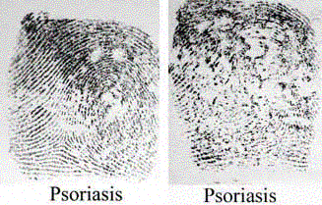
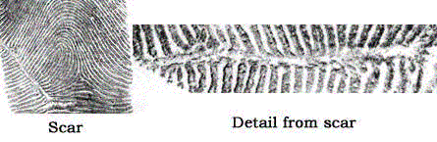
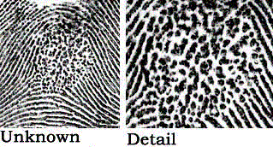
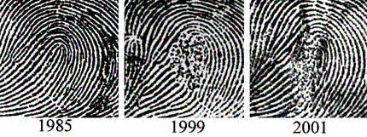
Unusual Fingerprints
Psoriasis
Scar Tissue
Fragmenting
Age
Notes:
Unusual Fingerprints
Psoriasis: Named from the Greek word for “itch”, psoriasis is a persistent skin condition. The skin becomes inflamed, producing red, thickened areas with silvery scales, most often found on the scalp, elbows, knees, and lower back.
Fragmenting: The center of the print is fragmenting.
Scar Tissue: A Scar on the finger interferes with print ridges, but creates a new unique print.
Age: When a person gets older the friction ridges are getting less visible.

Slide 43
Taking the Fingerprints
  1. Make sure the ink pad has a good supply of ink. If it is not a self-inking pad, use an ink roller to refill it before you take prints.
  2. Roll the subject's thumb pad (from the top knuckle to the tip) on the ink pad. Make sure the ink covers the entire pad of the thumb.
Notes:
Taking the Fingerprints
1. Make sure the ink pad has a good supply of ink. If it is not a self-inking pad, use an ink roller to refill it before you take prints.
2. Roll the subject's thumb pad (from the top knuckle to the tip) on the ink pad. Make sure the ink covers the entire pad of the thumb.

Slide 44
Taking the Fingerprints
  3. Roll the subject's inky thumb pad from right to left in the square you have labeled "Thumb." Make sure to do this slowly and carefully, and to do it only once. Rolling back and forth will smudge the print. Ensure that full contact has been made by visually inspecting the print.
Notes:
Taking the Fingerprints
3. Roll the subject's inky thumb pad from right to left in the square you have labeled "Thumb." Make sure to do this slowly and carefully, and to do it only once. Rolling back and forth will smudge the print. Ensure that full contact has been made by visually inspecting the print.

Slide 45
Taking the Fingerprints
  4. Repeat the process for each remaining finger on your subject's hand, making sure to match the prints with their correspondingly labeled boxes. Label the chart with which hand was fingerprinted after you have finished taking prints.
  5. Allow the prints to dry before moving or filing them. Repeat the process if you wish to take prints from both hands of your subject.
Notes:
Taking the Fingerprints
4. Repeat the process for each remaining finger on your subject's hand, making sure to match the prints with their correspondingly labeled boxes. Label the chart with which hand was fingerprinted after you have finished taking prints.
5. Allow the prints to dry before moving or filing them. Repeat the process if you wish to take prints from both hands of your subject.
Make sure everyone involved with the fingerprinting process washes their hands thoroughly afterward. Fingerprinting with ink is very messy. Some ink may leave a stain that will take a few washings to thoroughly get rid of.

Slide 46
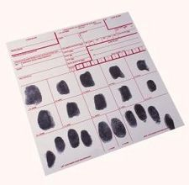
Fingerprinting Forms
Completion of Applicant Fingerprint Card:
1. Applicant’s Name: Last Name, First Name, Middle Name.
2. Aliases (AKA): Any other name you have used (Ex. - a maiden name or previous married name)
3. Citizenship (CTZ): Print the name of the country the individual is a citizen of. Remember it is illegal to take biometrics of US citizens.
4. Date of Birth (DOB): mm/dd/yyyy If unknown, list the approximate age or year of birth.
5. Place of Birth (POB): Include only the state or country of birth. If you don't know the two letter abbreviation, spell-out the state or country name.
6. Social Security Number (SOC): Most Afghans do not have a social security number. They may have an identification number. Put that number here.
7. Residence of Person Fingerprinted: Complete address including, Street, Apt.#, City, State, Zip Code.
8. To conform with the ACIC and NCIC Reporting System, the following Abbreviations are used for physical identification:
Notes:
Fingerprinting Forms
Completion of Applicant Fingerprint Card:
1. Applicant’s Name: Last Name, First Name, Middle Name.
2. Aliases (AKA): Any other name you have used (Ex. - a maiden name or previous married name)
3. Citizenship (CTZ): Print the name of the country the individual is a citizen of. Remember it is illegal to take biometrics of US citizens.
4. Date of Birth (DOB): mm/dd/yyyy If unknown, list the approximate age or year of birth.
5. Place of Birth (POB): Include only the state or country of birth. If you don't know the two letter abbreviation, spell-out the state or country name.
6. Social Security Number (SOC): Most Afghans do not have a social security number. They may have an identification number. Put that number here.
7. Residence of Person Fingerprinted: Complete address including, Street, Apt.#, City, State, Zip Code.
8. To conform with the ACIC and NCIC Reporting System, the following Abbreviations are used for physical identification:

Slide 47
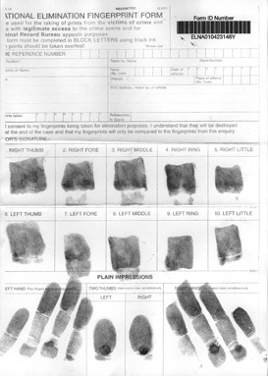

Fingerprinting Forms
Notes:
Fingerprinting Forms
Discuses the use of a variety of different forms.
Note that the 4 finger slaps are at a forty-five degree angle inwards.

Slide 48

Fingerprinting Forms
Notes:
Fingerprinting Process
Discuss the picture.

Slide 49

Fingerprinting Forms
Notes:
Fingerprinting Process
Discuss the picture.

Slide 50

Fingerprinting Forms
Notes:
Fingerprinting Process
Discuss the picture.

Slide 51

Fingerprinting Forms
Notes:
Fingerprinting Process
Discuss the picture.

Slide 52

Fingerprinting Forms
Notes:
Fingerprinting Process
Discuss the picture.

Slide 53

Fingerprinting Forms
Notes:
Fingerprinting Process
Discuss the picture.

Slide 54

Fingerprinting Forms
Notes:
Discuss the picture

Slide 55
Fingerprinting Process
Practical Exercise
Taking Inked Fingerprints
Assign partners or allow students to pick their own partner. Decide who will go first. The person taking the prints should stand to the left of the individual
Hold the individual’s right hand in your left hand, with all the subject’s fingers curled except the one you are inking and recording. We will start with the right thumb.
Grasp the extended thumb with your right thumb and index finger.
Roll the individual’s thumb on the inked surface, from nail to nail, keeping the finger flat on the plate from the first joint to the tip.
Roll the inked finger on the card as previously instructed, inward from right to left. Use gentle pressure in rolling the finger, to avoid smearing the ink. At the end of a roll, lift the finger upward to prevent smudging of the edge of the print.
Remember more prints are ruined from too much ink rather than from too little
Notes:
Fingerprinting Process Practical Exercise
Show the students in your class how to take good fingerprints and create a card that has all of their fingerprints on it.
Taking Fingerprints
Assign partners or allow students to pick their own partner. Decide who will go first. The person taking the prints should stand to the left of the individual
Hold the individual’s right hand in your left hand, with all the subject’s fingers curled except the one you are inking and recording. We will start with the right thumb.
Grasp the extended thumb with your right thumb and index finger.
Roll the individual’s thumb on the inked surface, from nail to nail, keeping the finger flat on the plate from the first joint to the tip.
Remember more prints are ruined from too much ink rather than from too little.
Reference: Saferstein, Richard, James, Richard E., Meloan, Clifton E. Lab Manual Criminalistics: An Introduction to Forensic Science. 8th Edition. 2004. Pearson Education, Inc. Upper Saddle River, New Jersey.

Slide 56
Fingerprinting Process
Practical Exercise
Taking Inked Fingerprints
Repeat this procedure for all the individual’s fingers on both hands.
Have the individual use a cleaning wipe to clean hands. Further cleaning can be done with soap and water.
Switch positions and repeat the procedures.
Once both individuals have been printed, observe the fingerprints and decide if the prints have a loop, whorl or arch pattern.
Have them determine whether they can come up with a classification system for fingerprints based on the fingerprints they've taken.
Notes:
Fingerprinting Process Practical Exercise
Repeat this procedure for all the individual’s fingers on both hands.
Have the individual use a cleaning wipe to clean hands. Further cleaning can be done with soap and water.
Switch positions and repeat the procedures.
Once both individuals have been printed, observe the fingerprints and decide if the prints have a loop, whorl or arch pattern.
Have them determine whether they can come up with a classification system for fingerprints based on the fingerprints they've taken.
Reference: Saferstein, Richard, James, Richard E., Meloan, Clifton E. Lab Manual Criminalistics: An Introduction to Forensic Science. 8th Edition. 2004. Pearson Education, Inc. Upper Saddle River, New Jersey.

Slide 57
Latent Prints
Practical Exercise
Part 1: Making a Latent Fingerprint Visible
Pick a ceramic tile from the table.
Place one of your fingers firmly on the object. If your finger is dry, rub it along side of your nose or behind your ears to pick up some oil.
Choose a fingerprint dusting powder of contrasting color. We will use black.
Obtain the black powder brush. ( Do not interchange brushes, as you will obtain poorly developed latent prints owing to the mixture of dusting powders.)
Tap the handle of the brush or twirl the brush between the fingers to remove excess powder from the bristles from previous use.
Notes:
Part 1: Making a Latent Fingerprint Visible
Pick a ceramic tile from the table.
Place one of your fingers firmly on the object. If your finger is dry, rub it along side of your nose or behind your ears to pick up some oil.
Choose a fingerprint dusting powder of contrasting color. We will use black.
Obtain the black powder brush. ( Do not interchange brushes, as you will obtain poorly developed latent prints owing to the mixture of dusting powders.)
Tap the handle of the brush or twirl the brush between the fingers to remove excess powder from the bristles from previous use.
Reference: Saferstein, Richard, James, Richard E., Meloan, Clifton E. Lab Manual Criminalistics: An Introduction to Forensic Science. 8th Edition. 2004. Pearson Education, Inc. Upper Saddle River, New Jersey.

Slide 58
Latent Prints
Practical Exercise
Part 1: Making a Latent Fingerprint Visible
Place some of the dusting powder in the lid or on a piece of paper, and dip the tip of the bristles of the brush in the dusting powder. It is poor technique to have the powder up in the center of the bristles, as one is unable to control the amount of powder deposited on the surface to be dusted and can easily ruin very clearly defined prints.
Using a circular, sweeping motion and just grazing the surface, brush across the surface until you see the print beginning to appear. Concentrate your brushing on the exposed fingerprints, taking care to continue to brush lightly.
If necessary, pick up additional dusting powder, using the same steps as you did before.
Once the ridges appear, the motion of the brush should follow the direction of the ridge flow. When the print is clearly developed, STOP BRUSHING.
Carefully remove any excess powder with a clean brush.
Notes:
Part 1: Making a Latent Fingerprint Visible
Place some of the dusting powder in the lid or on a piece of paper, and dip the tip of the bristles of the brush in the dusting powder. It is poor technique to have the powder up in the center of the bristles, as one is unable to control the amount of powder deposited on the surface to be dusted and can easily ruin very clearly defined prints.
Using a circular, sweeping motion and just grazing the surface, brush across the surface until you see the print beginning to appear. Concentrate your brushing on the exposed fingerprints, taking care to continue to brush lightly.
If necessary, pick up additional dusting powder, using the same steps as you did before.
Once the ridges appear, the motion of the brush should follow the direction of the ridge flow. When the print is clearly developed, STOP BRUSHING.
Carefully remove any excess powder with a clean brush.
Reference: Saferstein, Richard, James, Richard E., Meloan, Clifton E. Lab Manual Criminalistics: An Introduction to Forensic Science. 8th Edition. 2004. Pearson Education, Inc. Upper Saddle River, New Jersey.

Slide 59
Fingerprinting Process
Practical Exercise
Part 2: Lifting a Latent Print with Transparent Tape
Pick up the roll of transparent bookbinding tape and with a smooth motion pull off approximately 6-7cm from the roll. Do not cut the tape from the roll yet.
Place the free end of the tape about 6cm from the top of the developed print. Cover the print with the tape by smoothing the tape over the print with your finger, beginning from the free end and working slowly over the print. Do not simply lay the tape over the print! Air bubbles under the tape will partially ruin the lifted fingerprint—hence the necessity for slow, careful smoothing.
After the tape completely covers the print, and extends approximately 1cm past it, use the roll of tape as a handle and lift the tape with the developed print smoothly from the surface in one continuous, unbroken motion.
Cut the tape from the roll, trim any excess tape from the card and label it for future use.
Record the object from which the print was taken, your initials and the date on the card.
Notes:
Part 2: Lifting a Latent Print with Transparent Tape
Pick up the roll of transparent bookbinding tape and with a smooth motion pull off approximately 6-7cm from the roll. Do not cut the tape from the roll yet.
Place the free end of the tape about 6cm from the top of the developed print. Cover the print with the tape by smoothing the tape over the print with your finger, beginning from the free end and working slowly over the print. Do not simply lay the tape over the print! Air bubbles under the tape will partially ruin the lifted fingerprint—hence the necessity for slow, careful smoothing.
After the tape completely covers the print, and extends approximately 1cm past it, use the roll of tape as a handle and lift the tape with the developed print smoothly from the surface in one continuous, unbroken motion.
Cut the tape from the roll, trim any excess tape from the card and label it for future use.
Record the object from which the print was taken, your initials and the date on the card.
Reference: Saferstein, Richard, James, Richard E., Meloan, Clifton E. Lab Manual Criminalistics: An Introduction to Forensic Science. 8th Edition. 2004. Pearson Education, Inc. Upper Saddle River, New Jersey.

Slide 60
Fingerprinting Process
Practical Exercise
Part 2: Lifting a Latent Print with Hinged Lifters
Repeat the steps for developing latent prints.
Open the hinged lifter so that the arrow points to the upper right. Arrow and printing is on the plastic cover.
With the thumb and forefinger, peel off the transparent cover, starting at the upper right corner to where the arrow points. The plastic cover with printing and the arrow is thrown away. The adhesive sheet is now exposed.
The tacky side of the lifter is then carefully placed over the latent powdered prints. Rub the plastic sheet lightly, then lift off the powdered print. Note that the A is facing you when lifting the latent print.
The lifted print is then covered with the hinged cover. The best way to cover a latent print after being lifted is to place the lifter on its back (with adhesive side facing up), then form a curl in the hinged cover and roll on the cover.
Notes:
Part 2: Lifting a Latent Print with Hinged Lifters
Repeat the steps for developing latent prints.
Open the hinged lifter so that the arrow points to the upper right. Arrow and printing is on the plastic cover.
With the thumb and forefinger, peel off the transparent cover, starting at the upper right corner to where the arrow points. The plastic cover with printing and the arrow is thrown away. The adhesive sheet is now exposed.
The tacky side of the lifter is then carefully placed over the latent powdered prints. Rub the plastic sheet lightly, then lift off the powdered print. Note that the A is facing you when lifting the latent print.
The lifted print is then covered with the hinged cover. The best way to cover a latent print after being lifted is to place the lifter on its back (with adhesive side facing up), then form a curl in the hinged cover and roll on the cover.
Reference: Saferstein, Richard, James, Richard E., Meloan, Clifton E. Lab Manual Criminalistics: An Introduction to Forensic Science. 8th Edition. 2004. Pearson Education, Inc. Upper Saddle River, New Jersey.

Slide 61
Summary
Forensic Science
What is Battlefield Forensics
Joint Expeditionary Forensic Facilities (JEFF) Program
Crime Scene Evidence Collection
Potential Evidence
Six Forensic Functions
Fingerprint Identification
Fingerprint Pattern & Ridge Characteristics
Latent prints & Developing Powders
Fingerprinting Process
Special Circumstances
Unusual Fingerprints
Taking the Fingerprints
Fingerprinting Forms
Fingerprinting Process
Practical Exercises
Notes:
Summary:
What is Battlefield Forensics Latent prints
Forensic Science
Joint Expeditionary Forensic Facilities (JEFF) Program
Crime Scene Evidence Collection
Potential Evidence
Fingerprint Identification
Fingerprint Pattern & Ridge Characteristics
Latent prints & Developing Powders
Fingerprinting Process
Special Circumstances
Unusual Fingerprints
Taking the Fingerprints
Fingerprinting Forms
Fingerprinting Process
Practical Exercises

Slide 62
Questions?
Notes:
Questions?
Ask the students if there are any questions or input about the material just covered in this module.

Slide 63
PROPONENT
The proponent for this document FORSCOM G3 AW/CIED TF
Users are invited to send comments and suggested improvements on DA Form 2028, Recommended Changes to Publications and Blank Forms. Completed forms, or equivalent response, will be mailed or attached to electronic e-mail and transmitted to: FORSCOM HQ AW/C-IED TF G-3 4700 Knox Street Fort Bragg, NC 28310-5000

