Slide 1
Ground Sign Awareness
Notes:
Note for the Instructor/Facilitator (I/F)
Introduce yourself. Only needed for the first time delivering instruction to the students.
TWO Options for conducting this class.
OPTION 1. Conduct the entire class using problem based instruction IAW appendix C of this lesson plan and the Ground Sign Awareness Job Aid found in the student Course CD or ask your Team leader. Appendix C information is included in the note pages of the last slide (hidden) for your convenience.
a. You don’t have to use the power point slides but you must cover the academic portion (the first 50 min) of the class during the Ground Sign Awareness PE. You may even allow 30 minutes for the students to discuss the PPT slide in their groups prior to the PE.
b. You may have the students make notes on butcher paper or you may make key notes ahead of time.
c. If time permits, you may chose to make up a simple scenario to add realism to the PE. You should not give detailed instructions. The students should be able to determine how to solve the problem on their own.
Definition. Problem-based instruction is a method where learners review a realistic, ill-structured scenario, determine the problem, research the information they need to solve the problem, and determine the solution. Unlike case-based instruction, learners typically do not receive instruction on the topic prior to being presented the problem. However, the method can be modified based on the background and experience of the target audience.
OPTION 2. Conduct the class as shown in this presentation that includes:
a. 1 hour classroom presentation and
b. 4 hours hands on Practical Exercise IAW appendix C. Appendix C information is included in the note pages of the last slide (hidden) for your convenience.

Slide 2
Terminal Learning Objective
ACTION: | Identify ground signs in an Improvised Explosive Devices (IEDs) environment
CONDITION: | In a classroom setting and field environment, given PowerPoint presentation, students resources, instructional materials, and equipment
STANDARD: | Identify ground signs IAW ATP 3-90.37, STP 33-CIED-SM-TG and appendix C of this lesson. Must achieve a score of 80% or greater on course examination rubrics. The identification will include: 1. Review Observation Principles 2. Recognize Indicators of Ground Signs and IED Markers 3. Identify IED Emplacement Learning Domain: Cognitive Learning Level: Knowledge
Notes:
Note to the Instructor/Facilitator
1. You can use the below statement as motivator or make up your own based on current events or experiences.
Motivator. IEDs are the most dangerous and effective weapon system Coalition Forces (CF) face, inflicting
more casualties than all other weapon systems combined. The information in this brief was
compiled by the IED Task Force CONUS Advisory Team tasked by Army G-3. They have
teams that are dispersed throughout various operational environments to collect information as
it changes.
2. Let the students know that during the next 5 hours, they will Identify ground signs in an Improvised Explosive Devices (IEDs) environment including:
Review Observation Principles
Recognize Indicators of Ground Signs and IED Markers
Identify IED Emplacement
3. Let them know that there will be a 4 hour Practical Exercise later.

Slide 3
Review Observation Principles
General observation principles
Training the eyes requires training the mind.
Eyes must be trained to notice little things-bending of grass when there is no wind.
Learn to see things in proper perspective at distances.
Learn to look through vegetation, not at it.
When the sun is to your back, light will reflect from enemy’s optical equipment and visa versa.
Factors affecting vision: Lack of vitamin A, colds, headaches, fatigue, narcotics, alcohol, smoking, exposure to bright light, etc.
Notes:
Note to the Instructor/Facilitator
Rules of observation techniques
FIRST TEACHING POINT: Training the eye requires training the mind as well.
The eye must be trained to notice the little things such as, bending of grass when there is no wind or the unnatural shape of a shadow.
Even when you can’t see the enemy, little things will give away his position such as a window now open that wasn’t open before, a puff of smoke, signs of fresh soil, or disturbed undergrowth.
SECOND TEACHING POINT: An observer should keep the following rules in mind while observing.
Look for objects out of place, almost every object in the wild is vertical, if it is horizontal study it closer.\
Learn to see things in proper perspective at distances.
Learn to see movement, color, shape, and contrast in miniature.
Learn to look through vegetation, not at it.
THIRD TEACHING POINT: The sun is constantly changing the lighting conditions, contrast and shadows should be studied at all times of the day.
When the sun is to your back, light will reflect from the enemy’s optical equipment and visa versa.
It is more tiring for you when the light shines in your eyes, observer relief may be required more frequently, using shadow on the eyes may give some relief.
Smoking and lack of vitamin C reduces blood flow and thus negatively effects vision

Slide 4
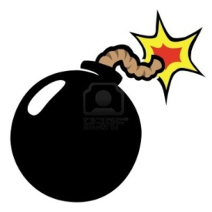
THE SLIDING SCALE
HUMAN ACTIVITY
PRESENCE
PATTERNS
DEVICE “SIGNATURES”
DEVICE TRAITS
EMPLACEMENT SITES
?
HUMAN ACTIVITY
DEVICE SIGNATURES
Where are you?
Notes:
LOCARD’S –
Explain theory of “exchange”
“insert proper quote”
Define Presence, patterns
Define Device Traits (in a nut shell) , emplacement sites

Slide 5
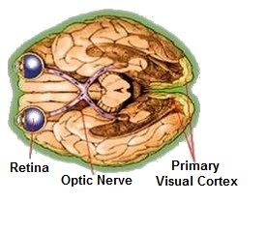
Eye and Brain Relationship
Eye/Brain relationship
Observation is a function of mentally processing images from the eyes
Mental filters are in place to prevent information overload
Can only “see” indicators for what they are after being exposed to them previously
Repetition allows indicators to be more easily detected
Notes:
Note to the Instructor/Facilitator
Observation Theory and Techniques.
Human Physiology and Eye/Brain Relationship.
Observation is a function of mentally processing images received by the eye.
The human eye is purely a receptor, it receives and focuses all light reflected off of objects located in the environment within its field of view.
This is far too much information for the brain to process all at once so mental filters must be emplaced and the visual information is prioritized by level of importance to the observer.
If the subconscious mind determines that a particular image is unimportant (regardless of its actual importance) it is automatically dismissed.
An example of this is noticing something in your normal, everyday, environment only after another individual points it out to you, it then becomes stunningly obvious (count the Fs exercise).
The same holds true for detection of IED indicators.
Through repetition and study of indicators their images become more important to the subconscious and thus easier to detect.
By understanding observation theory, human physiology, and the eye / brain relationship we can prevent the brain from making assumptions, and see things for what they are.

Slide 6
Observation Techniques
What is scanning?
What is searching?
A general and systematic examination of an area to detect any unusual or significant object or movement.
A thorough examination of a certain feature in the area.
Notes:
Note to the Instructor/Facilitator
We will utilize scanning and searching throughout the course specifically during the STX.
When talking about the area, relate it to a sector of fire or sector of scan and explain how to scan your sector i.e. near to far, right to left, up down or down up.
When talking a certain feature talk about using optics to help confirm or deny if what they are looking at is a possible IED.

Slide 7
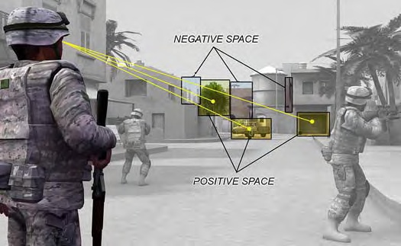
How do you explain positive space from this picture?
Positive space is space that is taken up by solid objects such as buildings, trees, signs, and vehicles.
Typically, you cannot shoot or see through positive space.
The human eye will naturally move from positive space to positive space as the eye is attracted to this.
For example, in tree lines, your eyes are attracted to trunks and prominent branches.
Notes:
Note to the Instructor/Facilitator

Slide 8
How do you explain negative space from this picture?
Negative Space is between positive spaces
The human eye subconsciously does not recognize or consider.
An Observation Post (OP) will try to operate in the negative spaces when feasible.
Open windows, between parked vehicles, alley ways, and other open spaces
Good camouflage resembles negative space.
Notes:
Note to the Instructor/Facilitator
1. Negative space, in art, is the space around and between the subject(s) of an image. Negative space may be most evident when the space around a subject, and not the subject itself, forms an interesting or artistically relevant shape, and such space is occasionally used to artistic effect as the "real" subject of an image.

Slide 9
Key Observation Points
Limited visibility/night observation principles
Eyes must be trained to recognize outline alone.
Eyes undergo changes which constantly cause the eyes to change focus-eyes tire quicker.
Night adaptation-allow approximately 30 minutes for eyes to adjust.
Maneuver to catch the light.
Place object between yourself and light.
Observer can pick up more light by lowering his body.
Off-center vision-resist looking directly at object.
Notes:
Note to the Instructor/Facilitator
When talking this slide explain how to conduct SLLS ( stop, look listen, and smell ) night adaption so your eyes can adjust.
Explain that you can see things at night better when there is a light source behind you but you want to keep something between you and the light so you don’t silhouette yourself.
Off center vision is using you peripheral vision to see at night instead of looking directly at the object.

Slide 10
Observation Exercise
Count the number of Fs in the following sentence
Finished files are the result of years of scientific study combined with the experience of years.
Notes:
Note to the Instructor/Facilitator
Have the class read to themselves the above sentence.
Keep the slide up for about 15‐30 seconds and black out the slide.
Ask the class how many “F’s” there are.
Bring the slide back up and have the class read it backwards.
Explain why you find more F’s when reading it backwards.
It’s because your eyes and brain are trained to read from left to right so you don’t have to read every word to know what the sentence says so that’s why you miss the F’s in the small words.
There’s 6 “F’s”

Slide 11
Keep In Memory (KIM) Game
KIM’s Game
History
Aids in establishing baselines
Develops awareness
Effective recording
Communication
Attention to detail
Following instructions
Functioning under stress
Notes:
Note to the Instructor/Facilitator
Kim’s games have been used since the days of British rule in India and were originally documented in the book Kim by Rudyard Kipling.
The story is set against the backdrop of the political conflict between Russia and Britain in central Asia.
Kim, Kimball O’Hara, is the orphaned son of a British soldier and because of his peculiar heritage as a white child gone native and his peculiar ability to remember, in great detail, nearly 20 items that were spilled from a valet and then covered, Kim is recruited as a spy in Britain’s struggle to maintain its colonial grip on India.
He is trained in espionage and a game of looking at a tray full of mixed objects and noting which have been added and taken away is used to develop his ability.
This technique was further developed by Canadian snipers to train their men in observation and recall. It is used today in military schools around the world to train snipers to observe situations for short periods of time, extracting as much detailed information as possible, and recalling and recording the event accurately for future use.
KIM is also an acronym for “Keep in Memory”. KIM’s games can be used to develop more than an ability to memorize.
Some of the additional skills developed through a properly conducted exercise are:
Awareness: Being constantly attuned to a particular fact.
The observer must be aware of his surroundings at all times, taking nothing for granted.
The observer must also account for elements that influence and distort his awareness.
Helps develop the environmental baseline for the area of operations.
Understanding: Understanding is derived from education, training, practice, and experience.
Understanding again ties into the “Realize” portion of the Six R's and enhances the observer’s knowledge about what should be observed, allows the observer to consider all possible aspects of the observation, and aids in the evaluation of available information.
Recording: Recording is the ability to save and recall what was observed.
The ability to record, retain, and recall information accurately depends on the mental capacity and alertness of the observer and his ability to recognize what is essential or necessary.

Slide 12
Observation Worksheet
 | APPEARS TO BE | SIZE/SHAPE | COLOR | CONDITION
1
2
3
4
5
6
7
8
9
10
Notes:
Note to the Instructor/Facilitator
1. Explain the columns (Appears to Be, Size/Shape, Color, and Condition) in the Observation Worksheet and how they need to be completed..

Slide 13
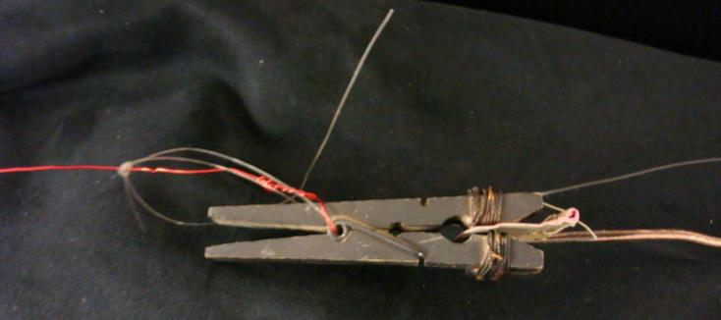
Observation Worksheet Example #1
 | APPEARS TO BE | SIZE/SHAPE | COLOR | CONDITION
1 | Clothespin Tripwire Initiator |  | OD Green with Copper Wires | Closed on Insulator
½”
2 ½”
Notes:
Note to the Instructor/Facilitator
1. Explain the contents that are included in Observation Worksheet (e.g., Appears to Be (Clothespin Tripwire Igniter), Size/Shape (.5" x 2.5") Color (OD Green w/copper wires), and Condition (Closed on Insulator).

Slide 14
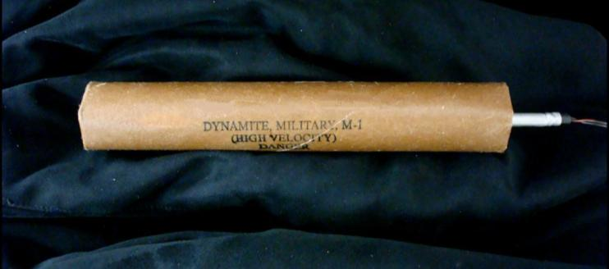
Observation Worksheet Example #2
 | APPEARS TO BE | SIZE/SHAPE | COLOR | CONDITION
2 | US Military Dynamite, M-1 |  | Brown w/ Silver Cap | El. Blasting Cap Inserted/ Primed
1”
10”
Notes:
Note to the Instructor/Facilitator
1. Explain the contents that are included in Observation Worksheet (e.g., Appears to Be (M‐1 Dynamite), Size/Shape (1.0" x 10.0") Color (Brown w/silver cap), and Condition (El. Blasting cap Inserted/Primed).

Slide 15
Observation Exercise
Prepare to Observe
Notes:
Note to the Instructor/Facilitator
Explain to students they are about to see a number of objects on the next slide.
Apply KIM's game and attempt to remember/recall all the objects they see.
Students have one (1) minute to view the slide.

Slide 16
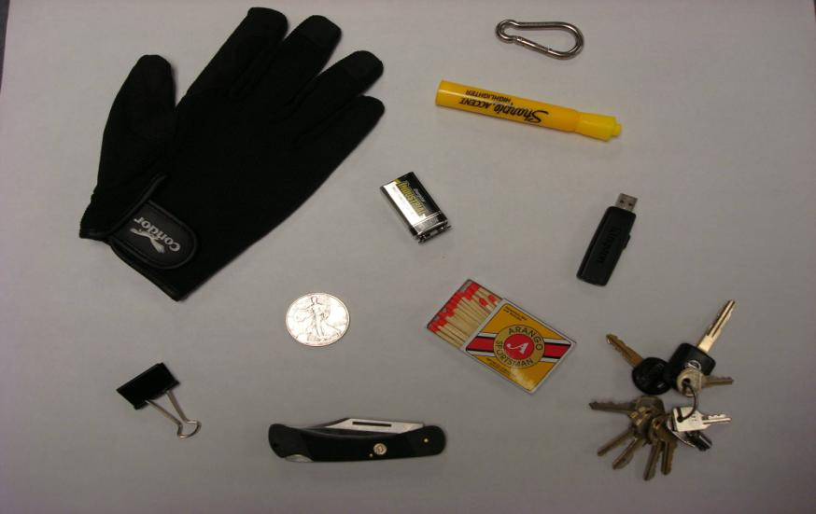
Observation Exercise
Notes:
Note to the Instructor/Facilitator
There are ten objects:
Black glove
USB Thumbdrive
Sharpie yellow highlighter
9v battery
Black metal binder clip
Box of wood matches
10 Keys on key ring
Black pocket knife
Silver coin
Metal carabineer

Slide 17
Observation Exercise
Record
Notes:
Note to the Instructor/Facilitator
List as many objects as you can recall in the Observation Worksheet.
Students have five (5) minutes to complete the worksheet.

Slide 18
Observation Exercise
Notes:
Note to the Instructor/Facilitator
There are ten objects:
Black glove
USB Thumbdrive
Sharpie yellow highlighter
9v battery
Black metal binder clip
Box of wood matches
10 Keys on key ring
Black pocket knife
Silver coin
Metal carabineer

Slide 19
Observation Exercises
Observation Lane
Application of observation theory
Variation of baseline
Ground Signs Awareness Lane
Search/scanning techniques
Ground signs awareness
Hasty/Deliberate Emplacement Lane
Identifying likely IED locations
Understanding enemy TTP
Notes:
Note to the Instructor/Facilitator
Explain the Observation Exercises that will be conducted on Day 4.
This is a cumulative practical exercise in observation incorporating skills learned in the classroom and developed during KIM’s games.
Proper search techniques must be used to complete the exercise with a passing score.
The goal is to detect variations in the baseline which lead to the discovery of threat objects or IED components.
The location and type of object must be properly recorded.

Slide 20
Check on Learning
Scanning is defined as the thorough examination of a certain feature in the area. True or False?
False
2. Observation is a function of mentally processing images from the eyes. True of False?
True
3. Approximately how long should you wait for eyes to adjust your night visions?
10 min c. 20 min
15 min d. 30 min
d. 30 min
Notes:
Note to the Instructor/Facilitator (I/F)

Slide 21
Recognize Indicators of Ground Signs
What are indicators of ground signs?
Small piece of the puzzle that help identify a possible threat.
Can be stacked rocks, disturbed earth, or parts of a road way that everyone seems to avoid.
Could be ground signs, markers, or anything that doesn’t seem to belong.
Indicators do not have to be on the ground.
Notes:
Note to the Instructor/Facilitator (I/F)
Ask the students for examples of indicators from their previous experiences.

Slide 22
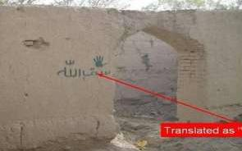
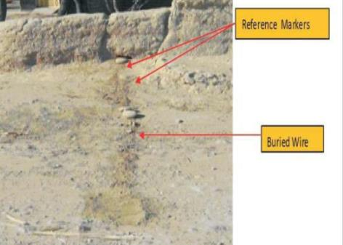
Scan for Indicators
Ground signs, markers, or anything that doesn’t seem to belong could be an indicator.
Reference
Markers
Buried
Wire
Translated as: I Give My Life
Notes:
Note to the Instructor/Facilitator (I/F)
Ask the students for examples of indicators from their previous experiences.
Discuss the importance of using your interpreter.

Slide 23
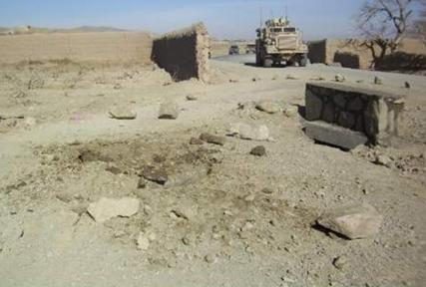
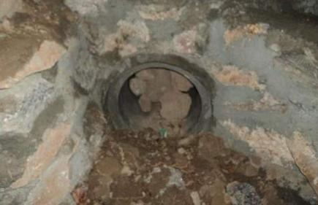
Make a Threat Assessment
Determine the enemy’s likely course of action using the Threat Triad.
Notes:
Note to the Instructor/Facilitator (I/F)
Ask the students to discuss the aspects of the threat triad. (Enemy Intent, Type of Threat, Location of Threat)
Bring up that they can get information from the CoIST or S-2.

Slide 24
Definition of a Ground Sign
Any evidence of change from the natural state that is inflicted upon the environment by the passage of man, animal, or machinery.
Concealment of an IED will inevitably leave an element of ground sign.
Markers and indicators can be left to warn others of the presence of an IED.
Environment plays a key part into the likely location of IEDs.
Notes:
Note to the Instructor/Facilitator (I/F)
Allow a few minutes for the students to read the definitions and ask if someone wants to share their interpretation.
To get a discussion going ask what the students think environment means, get students to start thinking about where the enemy would emplace IED’s.

Slide 25
Ground Signs
Identify all potential indicators of IED emplacement on your route.
Identifying these indicators left behind by the insurgents will enhance your threat assessment and target process
Notes:
Note to the Instructor/Facilitator (I/F)

Slide 26
Ground Signs
Identify all potential indicators of IED emplacement on your route.
Identifying these indicators left behind by the insurgents will enhance your threat assessment and target process:
Discardables
Color Changes
Regularity
Transference
Flattening
Disturbance
Markers
Notes:
Note to the Instructor/Facilitator (I/F)
During the patrol, threat assessments continue to change with the environment.
When you have identified every vulnerable point/area in your battle space you can plan and develop successful dismounted patrols and mitigate risk.
You must identify all potential Ground Signs of IED emplacements on your route.
Identifying these Ground Signs left behind by the enemy will enhance your threat assessment and target process.

Slide 27
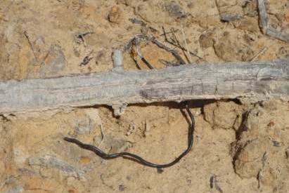
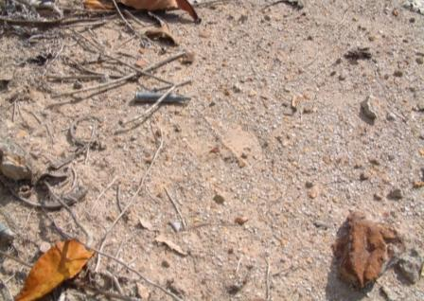
Common Discarded Articles
Common articles left behind at IED emplacement sites include:
Cigarette butts
Wire ends
Bits of tape
Notes:
Note to the Instructor/Facilitator (I/F)
Items the enemy may intentionally or unintentionally leave behind at the emplacement site of an IED.
Common articles left behind at IED emplacement sites are cigarette butts, wire ends, and bits of tape.
The enemy may also leave behind metal fragments or expended brass in order to confuse sweepers and give false hits with the metal detector.
The enemy has been known to leave “souvenir” type items that may be connected to an anti‐tamper device.
Items left behind include helmets, rifle magazines, weapons, and ammunition cans.

Slide 28
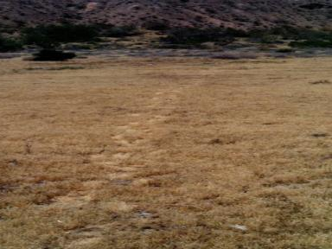
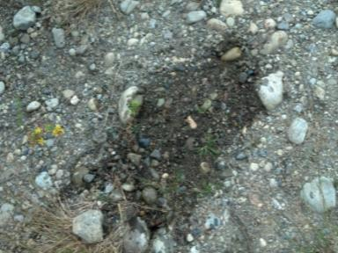
Ground Color Changes
Soil from the hole may differ in color from the surrounding area.
Known to pour water or urine on the top of the emplaced IED to pack soil back into the hole.
Notes:
Note to the Instructor/Facilitator (I/F)
Color change
Emplaced IEDs in the ground the soil from the hole may differ in color from the surrounding area.
Insurgents have been known to pour water or urine on the top of the emplaced IED in order to pack soil back into the hole.
Certain chemicals contained in HME can leak from their containers causing discoloration in the surrounding soil and vegetation.

Slide 29
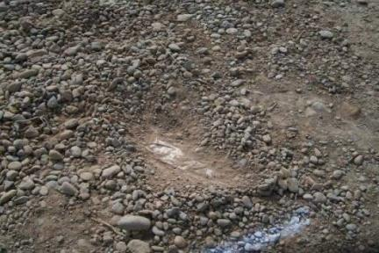
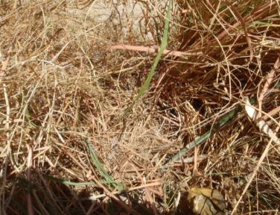
Regularity
Unnatural Ground Lines
Look for unnatural lines that may be in circular, rectangular, or square shape which may reveal the outlines of mines or pressure plates.
Wire
Notes:
Note to the Instructor/Facilitator (I/F)
Look for un‐natural lines that may be in circular, rectangular, or square shape which may reveal the outlines of mines or pressure plates.
When command wires, pull lines, or trip wires are buried or concealed, often a distinct line will appear that’s not natural to the area.
When insurgents try to conceal IEDs some things might appear out of place compared to nature soil, rocks, and vegetation. Look for un‐natural lines that may be in circular, rectangular, or square shape which may reveal outlines of mines or pressure plates.

Slide 30
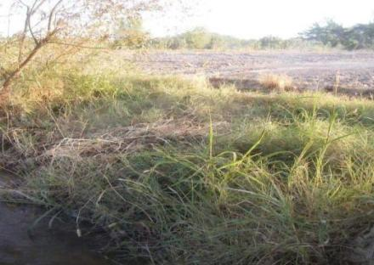
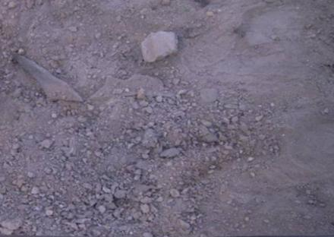
Ground Transference
Occurs when an insurgent takes soil or any other material from one area to conceal an IED.
Often the transferred material will not naturally blend in the surrounding area.
Main Charge / VOIED
Battery 4m away
Notes:
Note to the Instructor/Facilitator (I/F)
It’s when an insurgent takes soil or any other material from one area to conceal an IED
Often the transferred material will not naturally blend in the surrounding area

Slide 31
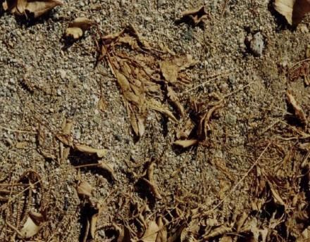
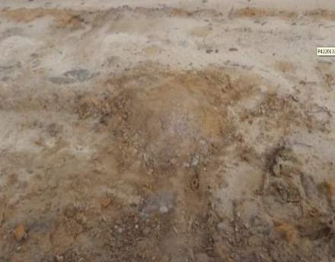
Flattening
Occurs after the hole is filled in.
Evident after it rains and after extended periods of time.
Notes:
Note to the Instructor/Facilitator (I/F)
This occurs after the hole is filled in.
Examples of flattening are evident after it rains and after extended periods of time.

Slide 32
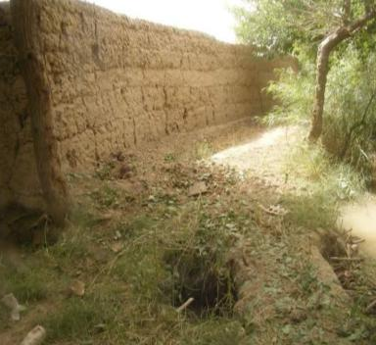
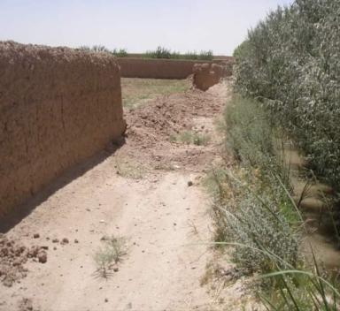
Ground Disturbance
Any evidence of change or rearrangement from the natural state caused by the passage of the target.
Notes:
Note to the Instructor/Facilitator (I/F)
See if the students have anything to add.

Slide 33
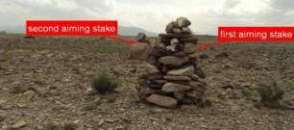
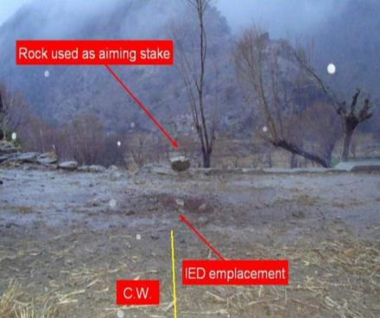
Markers
Insurgents use markers for multiple purposes
May be used as aiming stakes or may be used to warn locals about the presences of IEDs along routes or paths.
second aiming stake
Rock used as aiming stake
first aiming stake
CWIED emplacement
CW
Notes:
Note to the Instructor/Facilitator (I/F)
Common marker is stacked rocks as displayed in both of these pictures.
Explain that locals use rock piles for different things like property lines so that the insurgents will use rock piles already there for markers or aiming or timing markers.

Slide 34
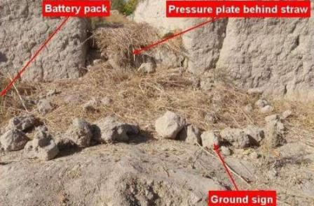
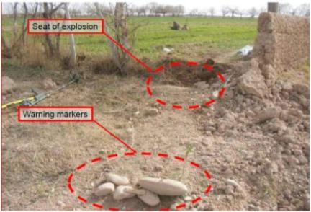
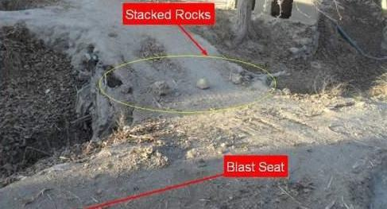
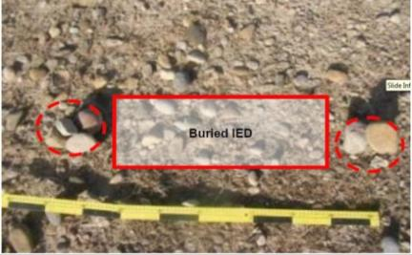
Examples of Markers
Battery Pack
Pressure Plate behind straw
Seat of explosion
Warning Markers
Ground Sign
Stacked Rocks
Blast seat
Notes:
Note to the Instructor/Facilitator (I/F)
Discuss the placement of the battery pack in relation to direction of travel.
Upper left image ‐ the ground sign used is a row or rocks.
Upper right image ‐ pile of rocks that are displaced about 2 meters before the IED.
Lower left image ‐ stacked rocks about 2 meters from blast seat.
Lower right image ‐ stacked rocks on each end that separates the IED.
Have the soldiers look at the slides and have them tell you what is common about the stacks of rocks. They are in choke points.

Slide 35
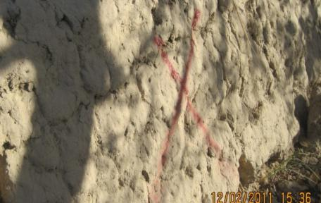
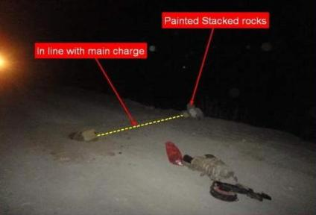
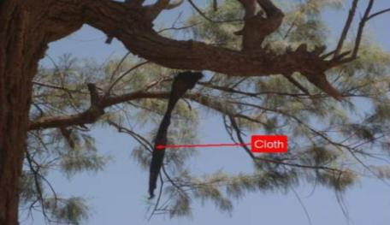
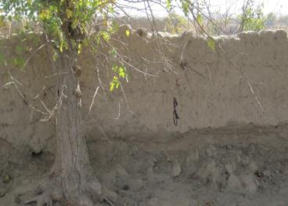
Examples of Markers (cont.)
Painted stacked rocks
Inline w/ main charge
Cloth
Notes:
Note to the Instructor/Facilitator (I/F)
Upper left image: a red X on wall marks location of IED.
Upper right image: painted stacked rocks in line with main charge.
Lower left image: piece of cloth hanging for tree limb indicates IED.
Lower right image: hanging cloth from limb designates IED.

Slide 36
Check on Learning
What is the definition of a ground sign?
Any evidence of change from the natural state that is inflicted upon the environment by the passage of man, animal, or machinery.
Indicators do not have to be on the ground. True of False?
True
3. Look for unnatural lines that may be circular, rectangular, or square shape that may revel the outlines of mines or pressure plates. True or False?
True
Notes:
Note to the Instructor/Facilitator (I/F)

Slide 37
Check on Learning
Markers are used only to warn the Taliban of the presence of IEDs along routes and paths. True or False?
False
A common marker is stacked rocks. True of False?
True
A piece of cloth hanging from a tree could be a marker. True or False?
True
Notes:
Note to the Instructor/Facilitator (I/F)

Slide 38
Identify IED Emplacement
Concealing an IED will inevitably leave an element of a ground sign.
Can be in the form of foot print or the signature left behind from concealment.
Different in any given area.
Ground signs may vary with enemy emplacements.
Hasty Emplacement
Deliberate Emplacement
Notes:
Note to the Instructor/Facilitator (I/F)
Get the students to start talking about hasty and deliberate before you go to the next slide.

Slide 39
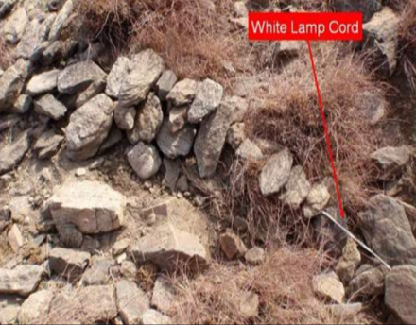
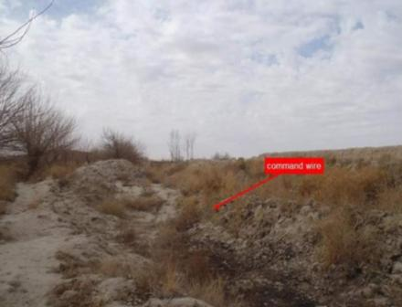
Hasty Emplacement – Site Prepared
Hasty Emplacement
Site prepared
Known movement route
Rapid employment of IED
White Lamp Cord
Command Wire
Notes:
Note to the Instructor/Facilitator (I/F)
Hasty Emplacement can be just laying command wire on top of the ground.
Another hastily emplaced IED. This is very easy to see, however if it were dusk or dark you may have some difficulty see this IED.
The rounds may blend in with background, you may mistake them for large rocks.

Slide 40
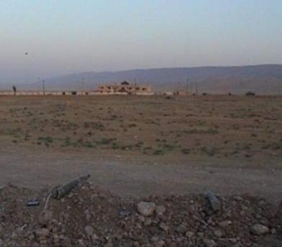
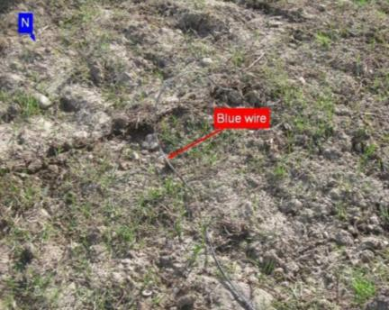
Hasty Emplacement with Device
Hasty Emplacement
Device Emplacement
Possible target of opportunity
Not as well camouflaged
107 rocket
Blue Wire
Notes:
Note to the Instructor/Facilitator (I/F)
Talk about the target of opportunity.
An insurgent watching a route that Coalition forces use and the insurgent can’t emplace the IED because of locals in the area so he waits to see a coalition force element to emplace his IED.

Slide 41
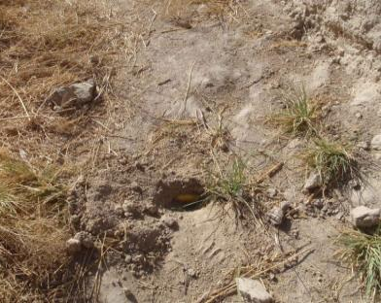
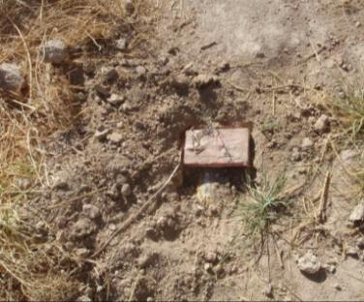
Deliberate Emplacement
Deliberate Emplacement
Site prepared
Pre-determined IED location, insurgent reconnaissance
Accomplished by unarmed personnel with plausible deniability
Notes:
Note to the Instructor/Facilitator (I/F)
Both pictures are the same emplacement.
The first picture was prior to discovery and second picture was after removal of soil.
Explain that the components aren’t together in the same hole.

Slide 42
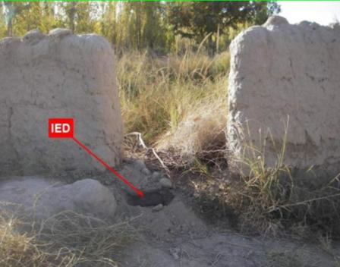
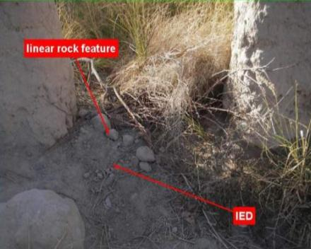
Deliberate Emplacement (cont.)
Deliberate Emplacement
Device emplacement
Better camouflage
Placed during CF inactivity
Linear rock feature
IED
IED
Notes:
Note to the Instructor/Facilitator (I/F)
These pictures are the same IED site.
Talk about the choke point ( VP ) and with the rocks that it is probably not hastily emplaced.

Slide 43
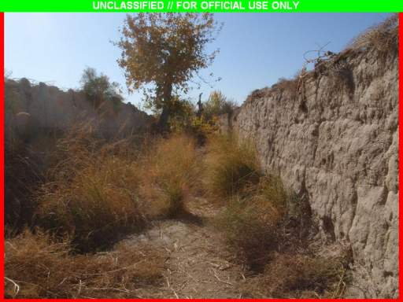
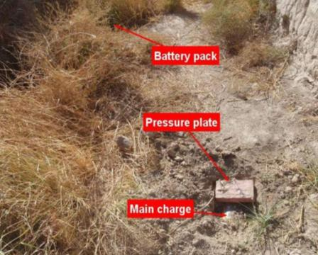
Deliberate Emplacement (cont.)
Limited by the imagination of the enemy
Exploits CF/HNSF Patterns
Set in stages
More complex
Battery Pack
Pressure Plate
Main Charge
Notes:
Note to the Instructor/Facilitator (I/F)
This slide is in the same area.
Victim Operated Improvised Explosive Device (VOIED) was found.
Notice the power source is away from the pressure plate and main charge.
Explain that that is how the insurgents try to defeat metal detectors.

Slide 44
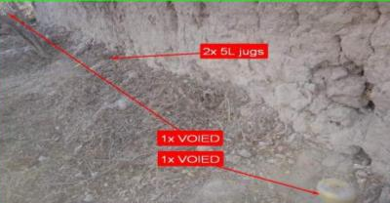
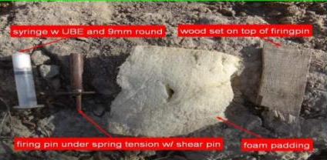
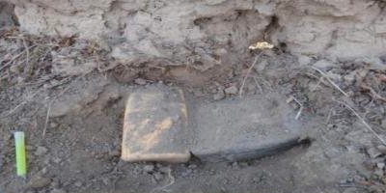
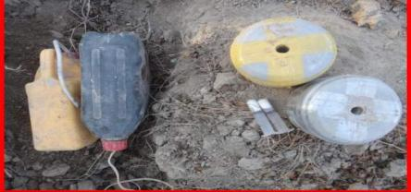
Deliberate VOIED Emplacement
Placement of the VOIEDs and 5L jugs
Initiation System on the VOIEDs
Syringe w UBE and 9mm round
Wood set on top of firing pin
2x 5l jugs
1x VOIED
1x VOIED
Firing pin under spring tension w/ sheer pin
Foam padding
Items found on scene
2x 5l jugs
2x VOIED
2x 5l jugs
2x syringes w/HME
Notes:
Note to the Instructor/Facilitator (I/F)
Upper left image ‐ placement of VOIED with 5L jugs.
Upper right image‐items used initiation of VOIED.
Lower left image‐2 X 5L jugs.
Lower right image‐2 X 5L jugs with syringes, HME and rounds.

Slide 45
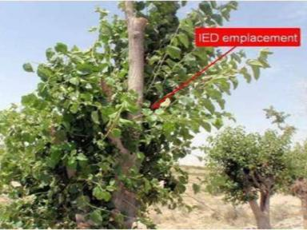
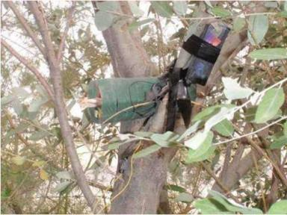
Elevated Emplacement
It’s important to know that not all IEDs are placed on the ground.
IED Emplacement
Notes:
Note to the Instructor/Facilitator (I/F)
Explain to the class that IEDs are sometime elevated to cause mass casualties while dismounted.
Talk about making sure when scanning that you must scan where the insurgents can emplace IED’s.

Slide 46
Check on Learning
The two types of emplacements are referred to as ___ and ___ . Deliberate .
Hasty and Deliberate
Hasty emplacement can be just laying command wire on top of the ground. True of False?
True
All IEDs are placed in the ground. True or False?
False

Slide 47
Summary
During this lesson we covered:
1. General observation principles
a. Training the eyes requires training the mind.
b. Learn to see things in proper perspective at distances.
c . Factors affecting vision: Lack of vitamin A, colds, headaches, fatigue, narcotics, alcohol, smoking, exposure to bright light, etc.
2. Recognize Indicators of Ground Signs
a. Small piece of the puzzle that help identify a possible threat.
b. Can be stacked rocks, disturbed earth, or parts of a road way that everyone seems to avoid.
3. Identify IED Emplacement
a. Concealing an IED will inevitably leave an element of a ground sign.
b. Can be in the form of foot print or the signature left behind from concealment.

Slide 48
Ground Sign Awareness Hands on PE
The next 4 hours you will be broken down in groups and will be outside in a ground sign awareness PE.
This PE is designed for three stations:
Station 1. Observation
Station 2. Hasty/Deliberate IED Emplacement
Station 3. Ground Sign
Notes:
1. Note to the Instructor/Facilitator (I/F)
Make sure to get a copy of Appendix C, PE of this lesson plan for detail instructions on how to prepare the stations.
The job aid found in the course CD can complement appendix C.
2. Note to the Instructor/Facilitator (I/F). Inform the students of the following before you start the PE: 1. This part of the Ground Sign Awareness class can be presented through Problem Based Instruction (PBI) method. 2. The 40 minutes academic material of the class can be covered at the beginning of this PE. 3. The following is a simple/generic scenario that can be issue to the students in order to add realism to the training. 4. The 5Ws for this PE are as follows: a. Who: Team TF of which you are a member b. What: Establish safe conditions which include identifying potential IED threats. c. Where: Designated area starting approximately 1000 meters before the town entrance d. When: In the next 24-36 hours e. Why: For the a convoy transporting high ranking US diplomats to meet with local town officials 5. Background. You are a DCT-MT member of a Tm TF tasked with establishing safe conditions for a convoy that transports US Diplomats into a local town. US Troops have experienced several IED related attacks and incidents in that particular area in the last 10 months. You know that your life, the life of senior US official and your career it’s at stake. Today you are preparing to rehearse what you learned in the Ground sign awareness class when you attended the DCT-MT course which includes: a. Review Observation Principles b. Recognize Indicators of Ground Signs c. Identify the Markers of IEDs d. Identify IED Emplacement 6. Feel free to modify this PBI or create your own as long as you are meet the objective of this exercise.

Slide 49
Questions
Notes:
Note to the Instructor/Facilitator (I/F)
Ensure that all students met the objective

