Slide 1
Insider Threat
162nd Infantry Brigade
Security Force Assistance / Security Cooperation
(SFA/SC)
“TIGERLAND”
Training Advisors and Security Force Assistance for the Army and for Joint Force Commanders to Build Security Capacity in Designated Countries
“Every One a Tiger”

Slide 2
Agenda
Insider Threat Types
TTPs for Advisors and the ANSF
Observable Indicators
Insider Threat Prevention Model
Threat Mitigation
Notes:
Simply state the agenda

Slide 3
Insider Threat Types
ENEMY
TACTICS
CO-OPTION
PERSONAL MOTIVATION
INFILTRATION
COERCION
PERCEIVED GRIEVANCE
IMPERSONATION
RECRUITMENT
CULTURAL INTOLERANCE

Slide 4
Insider Threat Types
Infiltration:
Insurgent enlists in the ANSF with the intent of collecting intelligence or conducting high profile attacks against Coalition or Afghan Forces.
The actual number of events is disputed by analysts.
Impersonation:
Insurgents use ANSF uniforms to gain access to Coalition or ANSF facilities in order to conduct attack.
This TTP is increasing in frequency.
ANSF are not involved.

Slide 5
Insider Threat Types
Co-Option:
Perpetrator recruited or coerced by insurgents.
Insurgents use physical intimidations, financial incentives, ideological appeal and family ties.
Personal Motivation:
Perpetrator acts on their own accord.
Motivated by personal dispute, combat stress, jihadist ideology, mental illness and cultural insensitivity of international forces.
Insurgents are not involved.
Notes:
Go over briefly each one and how it applies to the students.
This information comes from LTC Hough, Pentagon J5, his job is to track all the insider threats from Afghanistan.
LTC Hough was also a Team Chief for the ABP in RC South.

Slide 6
Insider Threat TTPs for Advisors
The advisor team leader and non-commissioned officer in charge (NCOIC) must ensure their team is thoroughly aware of both enemy tactics and potential “friendly” hostile action, including causation, risk, indicators, mitigation and countering techniques.
Conduct continuous personnel risk assessment with respect to the ANSF unit in an effort to identify both enemy tactics and potential “friendly” hostile actions.
Effectively incorporate insider threat hostile action scenarios into pre-deployment training, which will inform more comprehensive tactical standard operating procedures (TACSOPs).

Slide 7
Insider Threat TTPs for ANSF
Inform the ANSF to be proactive in recognizing and communicating typology of attacks.
Conduct continuous personnel risk assessment with respect to the ANSF unit in an effort to identify both enemy tactics and potential “friendly” hostile actions.
Promote the mechanisms and staff functions within the ANSF that mitigate and counter such tactics and actions.
Influence ANSF leadership to promote cohesion among the ranks of Coalition and ANSF personnel after an attack.
Discuss with the ANSF leadership the advantages of proactive information campaigns that counter insurgent tactics with a positive message toward the populace.

Slide 8
Observable Indicators
OBSERVE
Possible Threat
FLAG
Prior to Violent Event
Indicators that should be observed for the
subjects predisposition to become a threat
Actions conducted by the subject that would
indicate violent or terroristic planning
Category I Indicators
Complains about other nations or religions
Advocates violence beyond what is the accepted norm
Abrupt behavioral shift
Desires control
Socially withdraws in some occasions
Appears frustrated with partner nations
Experiences personal crisis
Demonizes others
Lacks positive identity with unit of country
Reclusive
Strange Habits
Peculiar discussions
Category II Indicators
Verbally defends radical groups and/or ideologies
Speaks about seeking revenge
Associates with persons who have extremists beliefs
Exhibits intolerance
Personally connected to a grievance
Cuts ties with unit, family, or friends
Isolates self from unit members
Intense ideological rhetoric
Attempts to recruit others
Choice of questionable reading materials in personal areas
Category III Indicators
Advocates violence as a solution to problems
Shows a sudden shift from “upset” to normal
Takes suspicious travel or unauthorized absences
Stores or collects ammunition of other items that could be used to injure to kill multiple personnel
Verbal hatred of partner nation or individual from partner nation
Exhibits sudden interest in partner nation headquarters or individual living quarters
Makes threatening gestures it verbal threats

Slide 9
Insider Threat Prevention Model (ITPM)
Trust
Mutual understanding
Partnership
Recognize IT indicators, take action to de-escalate
Insider Threat Disrupts the Coalition-ANSF Bond; Understand and Prepare for It
Combine FP TTPs and basic cultural awareness. Prepare, Anticipate, De-escalate, Deter, Prevent , Mitigate
Communication
Communicate with and not about them
Reliability & Professionalism
Do what you say and say what you mean
Do not over-promise or under-deliver
Patience, Listening & Respect
Treat them as you want to be treated. Master the basics; understand the culture and human terrain in your AO, know the red lines
Expert
Expert
Cross-Cultural Understanding
Situational Awareness
Level of Understanding
Level of Understanding
Notes:
Principle 1: Insider threat disrupts the Coalition ANSF bond; understand and prepare for
it - The combination of basic cultural awareness and force protection TTP is the way to achieve
mission readiness.
Principle 2: Patience, Listening and Respect - This key principle to insider threat prevention
is squarely based on common principles of human interaction centered on kindness,
understanding and empathy.
Principle 3: Reliability and Professionalism - Reliability is a pre-cursor of trust and a leading
indicator of professionalism.
Principle 4: Communication – Surveillance detection and information gained from
interacting with Afghan partners will ultimately enhance insider threat prevention.
Principle 5: Partnership - One Mission – One Goal (Yak Hadaf) – The feeling of a partnership
is the result of practicing the first three principles where partners see each other as fellow team
members.

Slide 10
Insider Threat Mitigation: 8-Step Vetting Process
1) Valid Tazkera (Afghan identity card)
2) Two letters from village elders or other guarantors
3) Personal information, including name, father's name, village, and two photos
4) Criminal records check through MoI, supplemented with an Army G2-record check by MoD
5) Application with validation stamp from recruiting authority
6) Drug screening
7) Medical screening
8) Biometric collection; can use “access badge” requirements for purpose of ensuring all ANSF are enrolled in biometrics systems

Slide 11
Insider Threat Mitigation: Guardian Angel
Guardian Angel plan is having all members of the team passively and actively conducting security who are engaged with Host Nation Representatives. This plan is to protect American’s ONLY and only YOU should know what the details are.
This function will be performed discretely by the team or overtly depending on the situation. (Roughly 85% passive, 15% active)
During sudden acts of violence, this plan may go into effect immediately.
Once you initiate this plan, everyone knows
IAW CJTF-1 Policy Letter #45, FRAGO 421, dtd 23 Nov 2012: Guardian Angels will conduct their duties with a weapons readiness posture of “RED” regardless of the battledress uniform state.

Slide 12
Questions
12

Slide 13
BACK-UP SLIDES

Slide 14
Historical Situations
19 August 2012, an SFA-AT member was killed by an AUP member at the Spin Boldak District Police Center, when he entered the SFA-AT’s living quarters. Atmospherics at the center had recently changed when the AUP (Afghan Uniform Police) were instructed to use their logistics process in the Ministry of Interior (MOI) to obtain their fuel. This caused disparity in the quality of life for the AUP members there and the SFA-AT members who lived and worked with them at the District Center.
09 August 2012, an ANA soldier walked into the U.S. side of OP Hashenkhel and opened fire with a M249. Coalition Forces (CF) returned fire and the shooter dropped the weapon and fled. Shooter was not located.
Notes:
Rogue Afghan soldier shoots dead at least one Nato serviceman in Helmand province
A "rogue" Afghan soldier has shot and killed at least one Nato soldier in southern Helmand province, a senior police source said.
British soldier on patrol in Helmand province Photo: Cpl Rupert Frere
2:47PM BST 16 Jul 2011
The latest in a series of "rogue" shootings by members of the country's security forces occurred barely 15 miles from the city of Lashkar Gah, where next week security control will be handed to Afghan forces.
It is one of seven places in Afghanistan chosen for the first phase of a years-long transfer due to be completed only by the end of 2014.
"The shooting happened during a joint security patrol ... he ran away after," said the senior police detective, who asked not to be named as he was not authorized to speak to the media.
The Nato-led International Security Assistance Force said it was investigating an incident in southern Afghanistan.
"An individual wearing an Afghan National Army uniform turned his weapon against International Security Assistance Force service members in southern Afghanistan today, killing one service member," ISAF said in a statement.
Related Articles
TA reserves could replace 5,000 regular soldiers
16 Jul 2011
Suicide attack at funeral for Karzai's brother
14 Jul 2011
Related Links
You might like: Russian elections: in pictures05 Dec 2011(Telegraph News)
Campaign to boost treatment of post-traumatic stress disorder05 Dec 2011(Telegraph News)
Iran capture of US spy drone 'would be significant blow to military'05 Dec 2011(Telegraph News)
From the Web
FORM THE WEB
: Mini-Missile Promises to Shrink the Drone War01 Dec 2011(Wired)
Samar Hassan at 5 screamed after her parents were killed by U.S. soldiers in Iraq in 2005. She's now 12-years-old.29 Nov 2011(The Daily)
'Addiction' drove Scarlett Johansson's nude photo hacker14 Oct 2011(Naked Security – Sophos)
[what's this]
Taliban spokesman Qari Mohammad Yousuf said an ANA (Afghan National Army) soldier surrendered to the Taliban after killing five foreign soldiers outside Lashkar Gah this morning.
"He wasn't one of us, he asked for protection and we agreed," Mr Yousuf told Reuters by phone from an undisclosed location. The hardline Islamists often exaggerate death tolls and battlefield exploits.
US and Nato forces are ramping up efforts to train the Afghan army and police for the gradual transition.
Highlighting the difficulty of that task, however, have been a series of incidents over the past 18 months where Afghan police and soldiers, or insurgents who have infiltrated security forces, have turned their weapons on their mentors.
There was another such incident in Helmand in May, when two US troops were killed at a police compound.
http://www.defensenews.com/story.php?i=4999550
KABUL - NATO and Afghan officials on Nov. 6 were probing reports a rogue Afghan soldier shot dead foreign troops - said to be two U.S. Marines - on a base in the volatile south of the country, the alliance said.
A NATO official said that two U.S. Marines had been killed in the incident, which took place in Helmand province late at night on Nov. 4.
Related Topics Middle East & Africa
Speaking on condition of anonymity, the official told AFP the Marines had been shot by an Afghan soldier who had been on the base for two to three weeks and was now missing.
Referring to it as a "green-on-green" incident, he said the Marines "weren't shot in their beds, they must have been on guard duty".
"Rounds were fired within the FOB (forward operating base) and an Afghan soldier was found to be missing the next morning," he said.
NATO's media office did not immediately confirm the details, saying it was aware of "the incident in Helmand province".
A team from ISAF and the Afghan government "is investigating the incident," it said. No further details were available.
The incident was initially reported early Saturday by Pakistan-based Afghan news agency Afghan Islamic Press (AIP).
AIP is not generally regarded as reliable and often publishes Taliban propaganda, including exaggerated claims of battlefield operations.
It quoted a Taliban spokesman saying an Afghan soldier had "shot and killed three foreign troops at a base in Sangin district of Helmand".
"The ANA soldier opened fire on foreign troops at a base in Tamirano area close to the headquarters of Sangin last night, killing three foreign soldiers, Qari Muhammad Yousuf Ahmadi, spokesman of Taliban, told Afghan Islamic Press," the report said.
It quoted Ahmadi saying the "soldier fled the base and joined Taliban".
Defense ministry official Mohammed Azim Mujahid was quoted by the German news agency DPA saying the killings happened when an Afghan soldier mistakenly opened fire on a NATO patrol.
"The soldier didn't have any contact with the Taliban. It was only an accident," he said.
Sangin has been labeled the most dangerous area in Afghanistan's long war, with British forces fighting there from 2006 until September, when they handed over to U.S. Marines.
The British lost more than 100 troops in Sangin, around a third of the total number of military casualties the country has suffered in Afghanistan since the current insurgency began in late 2001.
Helmand's governor Gulabuddin Mangal, during a visit to London earlier this week, said that security in the area had improved since the Marines moved in, as they were better manned and equipped than their predecessors.
Sangin has a population of around 20,000 and is a key distribution and supply point for Taliban money and men, as well as the drugs cartels that dominate the area.
Afghanistan supplies 90 percent of the world's opium, most of it produced in Helmand. The Taliban supply muscle to protect growers and distributers.
Drugs money in turn helps fund the insurgency.
Incidents in which Afghan soldiers or police officers turn on Western troops are rare, but raise questions about the multi-billion-dollar international effort to train and mentor Afghanistan's security forces.
In July a renegade Afghan soldier shot and killed three British army Gurkhas and wounded several others on a base in Helmand province.
In August, an Afghan police officer killed two Spanish paramilitary police officers and a Spanish interpreter during a training session at a base in Badghis province.
On Nov. 6 Spain's Prime Minister Jose Luis Rodriguez Zapatero made a surprise visit to Afghanistan, telling Spanish radio: "We are not here to stay but we have a firm commitment until the Afghans can guarantee their own security."
U.S. President Barack Obama has set a deadline of July 2011 to begin drawing down combat troops as public opinion in the United States and its NATO partners turns against continued engagement in Afghanistan.
Integral to a withdrawal is the ability of Afghanistan's military and police to take over responsibility for national security.
The United States and NATO have more than 150,000 troops in Afghanistan fighting the insurgency. More than 620 foreign soldiers have died this year.
http://www.france24.com/en/20111109-rogue-afghan-soldier-shoots-three-australians
09 November 2011 - 06H56
Rogue Afghan soldier shoots three Australians
Photo illustration of an Afghan National Army (ANA) soldier. A rogue Afghan soldier was on the run Wednesday after shooting and wounding three Australian troops, days after a similar incident left three Australians dead, the defense department said.
an Afghan National Army soldier opened fire with an automatic weapon and a grenade launcher at a joint base at Charmistan in Uruzgan province, wounding three Australian troops.
File photo of Australian soldiers on an operation in southern Afghanistan. The country's troops were first deployed to Afghanistan in late 2001 before being pulled out in 2002. They were redeployed in 2005 and have been training Afghan soldiers in Uruzgan.
AFP - A rogue Afghan soldier was on the run Wednesday after shooting and wounding three Australian troops, days after a similar incident left three Australians dead, the defense department said.
The men suffered serious wounds but all were in a stable condition after an Afghan National Army soldier opened fire with an automatic weapon and a grenade launcher at a joint base at Charmistan in Uruzgan province on Tuesday.
Two Afghan soldiers were also wounded before the man fled in an Afghan army vehicle.
The incident comes less than a fortnight after another Afghan soldier killed three Australians and wounded seven others when he opened fire during a parade in Kandahar province.
"It is too early to speculate that the two incidents are linked," defense force chief David Hurley told reporters, adding that nine or 10 Australians and about 30 Afghans were at the base when the latest attack occurred.
"I stress that there is no simple one-line explanation to this incident or the previous incident.
"We need to do some digging, further digging," he added when asked whether he knew of the motive. "It could be personal grievance, it could be religious ideology. We don't know, there was no indication."
It was the third such shooting to affect Australian troops this year, after an Afghan soldier killed an Australian lance corporal in May as they shared guard duties at a patrol base in the Chora Valley.
The latest incident took place just days after Australian Prime Minister Julia Gillard visited Afghanistan, making an unannounced stopover to meet troops in the restive southern province of Uruzgan.
She said Wednesday that Australians would continue to train Afghan National Army soldiers, despite the risk.
"I'm very conscious that this attack, coming so soon after the dreadful attacks of October 29, will... cause Australians to question our mission in Afghanistan and the trust we have in Afghan National Army soldiers," she said.
"As distressing as these incidents are, as dreadful as these incidents are, our mission in Afghanistan does need to continue.
"Training is pivotal to that mission and our purpose in Afghanistan is to deny Afghanistan as a country in which terrorists can train to wreak violence around the world," she added to reporters.
Australia has 1,550 troops stationed in the strife-torn country, with 32 so far killed in the conflict.
The country's troops were first deployed to Afghanistan in late 2001 before being pulled out in 2002. They were redeployed in 2005 and have been training Afghan soldiers in Uruzgan.
Canberra intends to keep troops in the central Asian nation until 2014.

Slide 15
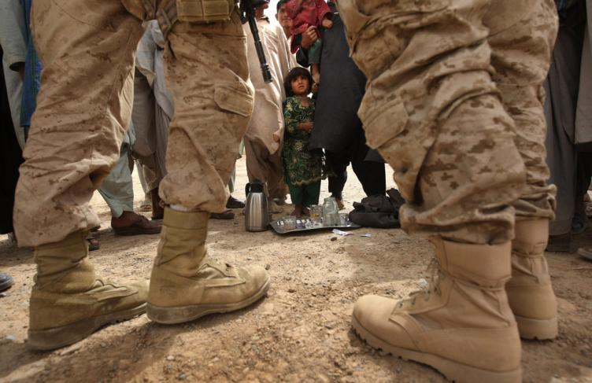
Perceptions How They See Us
Often conduct night raids and home
searches instead of ANSF
Don’t respect women or their privacy
Set up road blocks and traffic/refuse
to let sick pass
Convoys not allowing traffic to pass, even ANSF convoys
If attacked, they shoot indiscriminately
They cause many civilian and ANSF casualties
They curse constantly
Extremely arrogant; Fail to listen to or take advice from ANSF
Publicly search ANSF when they enter joint base- this is insulting and humiliating
Notes:
This slide is intended to show the students that they may have unfair and biased traits attributed to them before they show up in country to partner with their counterpart. Some good questions to ask on this slide include ‘What little changes can you make to easily change these issues?’ or ‘Which issues would you have if you were in their shoes?’
Bordin pg 12
Bordin pg 12
Bordin pg 12
Bordin pg 13
Bordin pg 13
Bordin pg 13
Bordin pg 14
Bordin pg 14
Bordin pg 14

Slide 16
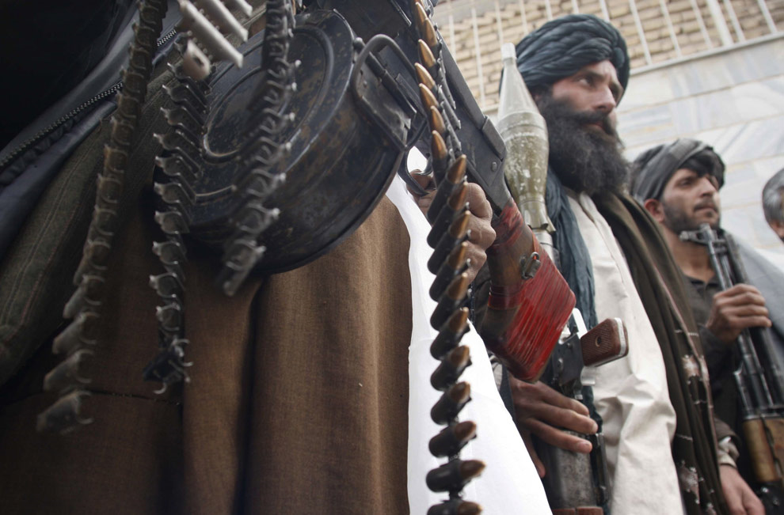
Perceptions How We See Them
Drug Abusers
Corrupt
Thieves
Traitorous
Dangerous/ Unstable
Incompetent
Poor Leadership
Poor/ Unsafe Weapons Handling Discipline
Poor Fire Control During Fire Fights
No Buy-In to War Effort/ Gutless
Dysfunctional Logistics/ Supply Systems
Brutal Treatment of Dogs
Poor Hygiene
Lazy
Notes:
This slide focuses on negative views which many of the US soldiers reported. The idea here is to both warn the student that these issues may persist and to show the common themes reported by US soldiers. Good questions to ask here include ‘Are all ANSF units like this’? or ‘Which of these issues would cause you as an advisor the most problems and why?’
Bordin pg 24
Bordin pg 24
Bordin pg 24
Bordin pg 25
Bordin pg 25
Bordin pg 25
Bordin pg 26
Bordin pg 26
Bordin pg 26
Bordin pg 26
Bordin pg 26
Bordin pg 27
Bordin pg 27

Slide 17
Insider Threat Principles
Principle 1: Insider threat disrupts the Coalition ANSF bond; understand and prepare for it – Basic cultural awareness and tactical proficiency of FP TTPS is the way to achieve mission readiness. The proper usage for the “Guardian Angel” concept, developing a force protection plan, employing a FP officer and cultural advisor, and proper vetting procedures all contribute to IT mitigation
Principle 2: Patience, Listening and Respect – Key ingredients to IT prevention are common courtesy, kindness, understanding, and empathy. Tell your Afghan partners that you are their guests and feel privileged to be in their home, and act as such; this may lead to a sense of obligation by Afghans to protect you per their adherence to Pashtunwali. Master your COIN basics. Your effort and respect will set a positive tine for the nature of your working relationship with the Afghans and communicate to them a sense of equality, respect, and tolerance
Principle 3: Reliability and Professionalism – Reliability is a precursor of trust and a leading indicator of professionalism. Be truthful and do not promise what you cannot deliver
Principle 4: Communication – Information gained from interacting with Afghan partners will enhance IT prevention. The objective of the first two principles of this model is to build trust based on an understanding of equality among Coalition Forces (CF) and ANSF partners; in contrast, inequality erodes trust. Most of insurgent activities are attempts to destroy this trust.
Principle 5: Partnership – When team members work together with mutual respect, professionalism, communication, and genuine partnerships are formed. Through visible and consistent practice, awareness, discipline, and action, it will improve the working relationship between CF and ANSF, improve forewarning, and reduce IT incidents.
Result: Trust – Working together with our ANSF partners will enable us to negate the effectiveness of the insurgent tactics that attempt to fracture the partnership between CF and ANSF. Equally important is how trust is critical during the aftermath of an insider attack. Successfully combating IT requires a Green AND Blue solution.

