Slide 1
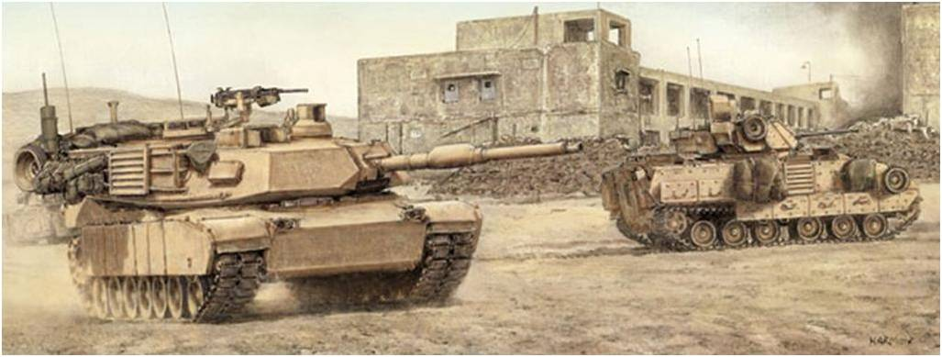
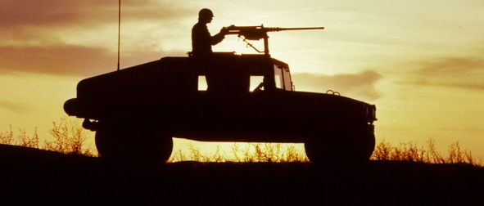
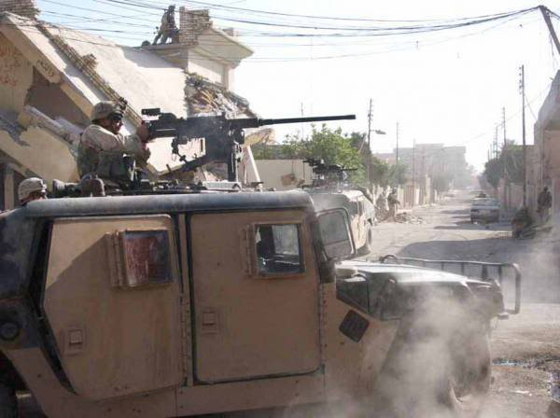
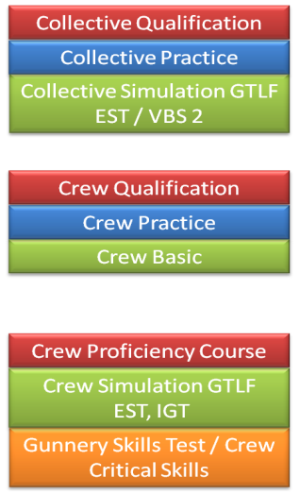
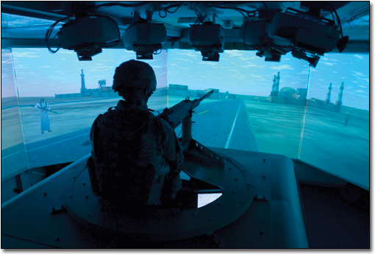
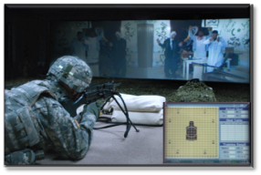
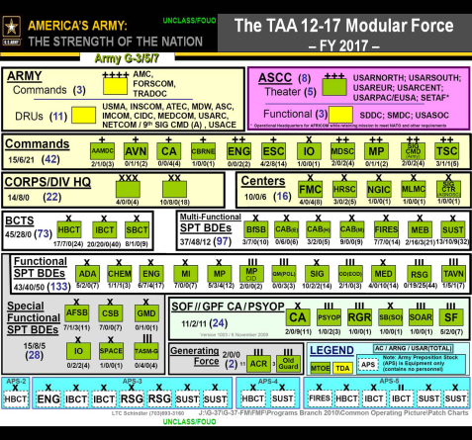
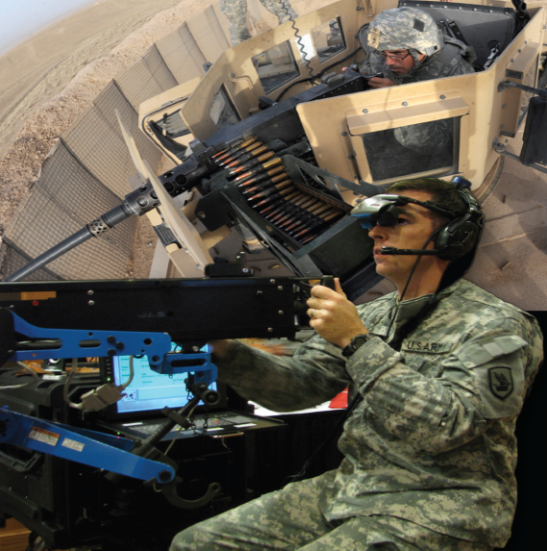
Revised Gunnery & Marksmanship Training Strategies
TRADOC Capability Needs Assessment 13-17 recognized the Army lacked a feasible gunnery strategy that includes unstabilized platforms to fully integrate fires and maneuver.
To assess ranges, ammunition, TADSS, and OPTEMPO to gain a complete picture…
That creates a more effective, efficient, and comprehensive Gunnery across the Army that allows greater flexibility for Commanders and provides trained and ready soldiers
Revised Gunnery and Small Arms Marksmanship Strategies that are holistic and fully leverage LVC-G capabilities synchronized with the ARFORGEN Cycle
With a progressive, gated training strategy integrated with simulations…
MCoE was tasked to conduct an Analysis of Alternatives to resource a gunnery training strategy that can be implemented across the entire force...
Synchronized with the ARFORGEN Cycle…
To be implemented Army wide…
That leverages Live, Virtual, Constructive, and Gaming capabilities…
Notes:
A holistic look that considers the systemic nature of gunnery training

Slide 2
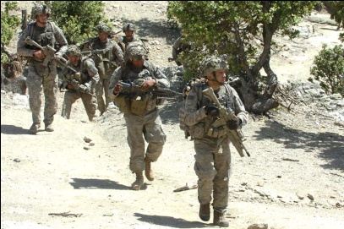
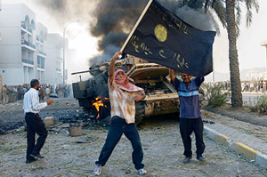
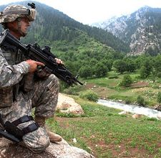
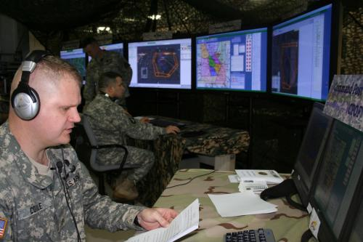
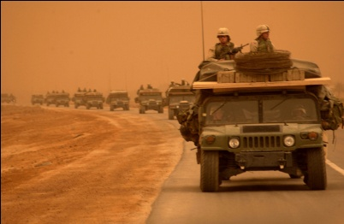
The Right Time for an Analysis of Alternatives
The Right Time for New Gunnery and Marksmanship Training Strategies
Lessons learned from the past 10 years show that weapons proficiency requires more than simple “qualification”, but, a gunnery program that builds and sustains the required skill sets.
By integrating simulations and synchronization within the ARFORGEN cycle…
AOC: Operational Adaptability to maintain the initiative
The Fight has changed
Operational Environment changed: Wide Area Security
Improved Virtual simulation capabilites
Non contiguous Battle Field
360 Degree Fight
Enemy has changed: multi-tiered, decentralized cells to maximize opportunities
Strategies will enable more effective, efficient, and comprehensive training in gunnery and marksmanship across the Army that allows greater flexibility for Commanders and provides trained and ready Soldiers.
Notes:
So why is the AoA important? From the past 10 months, we realized that conducting this AoA is probably being done for the Army at the right time.
LL over last decade show that weapons proficiency requires more than the simple qualification, but, a gunnery program that builds and sustains
The Fight has changed – requires better weapons proficiency from all echelons/organizations – non-contiguous battlefield, a 360 degree fight
The Enemy has changed – sees our rear areas as their front lines and is now comfortable fighting decentralized
An Enemy so adaptable that the US. Army has identified a new Core Competency, WAS, to deal with this threat because OE has changed
Army identified the fact that all organizations need to have operational adaptability – maintain the initiative
New strategies will enable more effective, efficient, and comprehensive training in gunnery and marksmanship across the Army that allows greater flexibility for Commanders and provides trained and ready Soldiers.

