Slide 1
Recon Council
19 OCTOBER 2016
The Recon Council meets once per quarter to provide partners across the Reconnaissance and Security Community the opportunity to collaborate and share information about observed trends, changes and updates to doctrine, and current DOTMLPF-Po efforts effecting cavalry and infantry Reconnaissance and Security operations across all formation types.

Slide 2
Agenda
Opening Comments
316th Cavalry Brigade Commander
3rd Squadron, 16th Cavalry Squadron Commander
Maneuver Warfighter Conference 2016 Working Group
R&S Training at the BDE Level and Below
Recommendations and Way Ahead
Discussion – Focus: R&S Sustainment Operations
MCOE (TCM-Recon, DOT-D Recon, MCOE LNOs, 5-15 CAV OSUT, NCOA)
CTCs (JMRC, JRTC, NTC)
3-16 CAV Department of Reconnaissance Courses
FORSCOM Units
Active Duty
ARNG
USMC LAR
Alibis
Closing Comments
Next Meeting: 25 January 2017

Slide 3
2016 Maneuver Warfighter Conference Work Group #7 – R&S Training at the BDE Level and Below
Problem Statement: Ongoing US Military engagement world-wide creates a dynamic environment within which the US Army must develop (train and educate) leaders at all levels to conduct effective R&S Operations to enable supported Brigade Combat Teams to fight and win in complex operating environments.
Key Participants:
COL Miseli
LTC Albrecht
LTC Gunnison
LTC Hubbard
LTC O’Steen
LTC Wilson
MAJ Palisca
- CSM Woodson
- 1SG McCracken
Key Note Speakers:
COL Feltey, CDR, 316th Cavalry BDE
US Army War College Fellow
CDR 3d SQDN, 16th Cavalry
NTC Cobra 07
MCOE Concepts Development Division
Chief, MCOE TCM-Recon
CDR 5-15 Cavalry OSUT
Chief, Directorate of Training and Doctrine
CSM 2d SQDN, 16th Cavalry
Branch Chief, Armor ALC
Main Discussion Points:
1 – Understand recent updates to R&S doctrine, current R&S O/Os, and Cavalry/Scout Leader and Soldier Competencies
2 – Provide lessons learned and observations from the field and CTCs
3 – Understand and discuss current institutional R&S training methods.

Slide 4
2016 Maneuver Warfighter Conference Work Group #7 – R&S Training at the BDE Level and Below
Recommendations and Way Ahead
Key Recommendations:
Create institutional R&S training forum for MAJs and staff proponents in the operational force.
Continue developing doctrinal definitions of R&S roles and responsibilities at PLT, SQDN, and BDE echelons.
Engage ICoE and FCoE to develop the synchronization of IC planning efforts and execution between Maneuver, Intel, and Fires.
Ensure widest dissemination to cavalry formations of updated R&S doctrine including recently released Cavalry Squadron and Scout Platoon manuals.
Pursue creation and approval of badge to be awarded upon completion of the Army Reconnaissance Course (ARC)
Milestones:
Execute quarterly Recon Council on 19OCT16
Resources needed from MCoE:
- N/A

Slide 5
TCM (Recon)
Mission: TCM Recon performs as both a formation TCM and a functional TCM. As a formation TCM, it serves as the DOTMLPF integrator for the future Reconnaissance and Security BCT (R&S BCT). As a functional TCM, it serves as the DOTMLPF integrator for reconnaissance and security functions, across all echelons to include maneuver battalion scout platoons, BCT cavalry squadrons and long range surveillance (LRS). TCM Recon also serves as the Capability Developer for the Close Access Targeting System (CATR).
https://www.milsuite.mil/book/groups/tcm-recon
Team Chief – LTC Darrell O’Steen (706) 626-2444
Capabilties Development and Integration Directorate
Notes:
Mission: The TRADOC Capability Manager for Reconnaissance serves as the Reconnaissance Soldier’s user representative for all DOTMLPF integration of current and future force capabilities and requirements pertaining to Reconnaissance formations and assists with the implementation of solutions to ensure a trained and ready force.

Slide 6
RECON COUNCIL
TCM Recon Update
Scout Platoon O&O
HQDA Armored Cavalry Regiment (ACR) Design Task
Refinement from Senior Leader Staffing
Defines the Scout Squad
CAV SCT Leader and Soldier Competencies
MILSUITE URL: Scout Platoon O&O
A. COA 1 Cavalry Regiment (directed):
(1) ACR that closely resembles the L-Edition ARC TOE.
(2) Design not to exceed 4,850 TOE positions.
(3) Updated ACR should be able to conduct similar reconnaissance and security missions similar to those of legacy "Army of Excellence" ACRs.
B. COA 2 Enhanced Cavalry Regiment:
(1) Refine ACR organization based on years of learning and analysis.
(2) Design not to exceed 4,850 TOE positions.
(3) Integrate select new capabilities to address extremely high risk capability gaps against peer competitors.
C. COA Objective Reconnaissance and Security Strike Group (RSSG).
(1) Objective design based on the campaign of learning and the Russia New Generation Warfare Study.
(2) Integrate capabilities that improve deterrence/assurance in as well as address RNGW gaps, EUCOM IPL and USAREUR gaps at EAB (e.g. long range fires, EW/Cyber, engineer mobility/countermobility; SIGINT/ELINT; enhanced sustainment, etc.).
(3) Design unit to conduct decentralized operations; fight across multiple domains; receive attachments; detach units; and perform recon and security missions at either division or corps levels.
(4) Design to accomplish the above with minimal feasible TOE strength.
Sustainment at Squadron and Below
(*What four locations, why is this different than previous req’ts?)
Sustain high tempo Reconnaissance and Security operations overs increased operating distances
Simultaneously provide resupply, maintenance, recovery, and evacuation at up to four distinct locations
Cavalry Squadron lack the ability to support Army aviation operations using Squadron sustainment capabilities
(*why is this significant? Aviation requires additional sustainment capabilities when task org’d. Same argument for any of the enablers.)
Notes:
Source Cavalry Squadron O&O (appendix A)
A.12 Sustain high tempo reconnaissance and security operations. The squadron must be able to simultaneously provide sustainment at four distinct locations, the three dispersed Cavalry troops and the HHT, during continuous and decentralized operations at the end of extended and contested lines of communication to enable reconnaissance and security operations. At a minimum, the squadron and its supporting sustainment assets must be able to:
A.12.1 Simultaneously provide resupply (including Class I/III/V) at four distinct locations, the three Cavalry troops and the primary elements of the squadron HHT (Main CP and combat trains). Concurrently, maintain emergency resupply (Class III/V) for one scout platoon and one mortar platoon and maintain the ability to defuel/refuel and down load/upload Class V.
A.12.2 Simultaneously provide maintenance support at four distinct locations. The squadron must have the capability to conduct battle damage assessment (BDA) and appropriate on-site repairs for the three dispersed Cavalry troops, and concurrently conduct battle damage assessment and repair (BDAR) at a maintenance control point (MCP).
A.12.3 Simultaneously provide recovery and evacuation at four distinct locations. The squadron must have the capability to recover and evacuate any troop vehicle from the three distinct troop areas of operation, and concurrently support the MCP by further evacuating vehicles or supporting maintenance operations.
A.12.4 Simultaneously evacuate casualties (CASEVAC) from four distinct locations (the three Cavalry troop areas of operation and the HHT), and concurrently replace each ambulance departing the troop area of operations. The squadron positions ground CASEVAC with each troop combat trains to provide immediate response. The squadron combat trains immediately replaces CASEVAC vehicles transporting casualties from the troop AOs. All echelons from the scout squad to the squadron must have the capability to coordinate, request, identify and mark landing zone (LZ)/pickup zone (PZ) for aerial CASEVAC. The squadron must surge an additional ambulance into one troop AO and provide a replacement for this ambulance. Concurrently, the squadron aid station (SAS) provides Level I medical care (triage, emergency medical treatment (EMT), advanced trauma management (ATM), sick call services, combat stress control, preventative measures) for squadron casualties; establishes and operates forward aid stations in direct support of the troops.
Source: R &S CBA
Cavalry Squadrons in the ABCT and the SBCT do not have sufficient recovery and evacuation capacity. The ABCT Cavalry Squadron has a total
of four recovery vehicles capable of recovering the BFV. This is insufficient to provide both forward recovery, maintenance support and evacuate vehicles during mobile operations. The SBCT Cavalry Squadron does not have any recovery vehicles capable of recovering a Stryker vehicle. They rely on like vehicle recovery which results in the loss of additional combat power during recovery and evacuation. In both cases there is a risk of losing needed combat power which places platoon and troop mission accomplishment at risk.
Cavalry organizations do not have the capability to refuel supporting Army rotary wing aircraft during the conduct of reconnaissance and security operations. This limits the flexibility in employing Army aviation, has the potential of decreasing aircraft station time, increasing aircraft turn-around time, and may create gaps in support or coverage.

Slide 7
DOT-D RECON
Branch Chief – MAJ Nate Palisca (706) 545-8840
Directorate of Training and Doctrine - Cavalry Branch
Notes:
Mission: The TRADOC Capability Manager for Reconnaissance serves as the Reconnaissance Soldier’s user representative for all DOTMLPF integration of current and future force capabilities and requirements pertaining to Reconnaissance formations and assists with the implementation of solutions to ensure a trained and ready force.

Slide 8
Cavalry Doctrine Branch Update
FM 3-98 Reconnaissance and Security Operations
Published 1 July 2015 (on APD website)
ATP 3-20.96 Cavalry Squadron
Published May 2016 (on APD website)
ATP 3-20.97 Cavalry Troop
Published September 2016 (on APD website)
ATP 3-20.98 Scout Platoon
Revision began in August 2016; Socializing table of contents with 3-16 CAV
6x36 organization across all formations (includes IBCT interim 9x36 design)
Will NOT include standard scout squad
Increased detail and emphasis of fundamental tasks (movement, emplacing OPs, reporting, etc)
Additional reference material for complex tasks (FPOL, EA Development, etc)
Need input from the operating force NCOs
Anticipate publishing Feb/Mar 2018 (T)
Branch Chief – MAJ Nate Palisca (706) 545-8840
Directorate of Training and Doctrine - Cavalry Branch

Slide 9
LNO

Slide 10
5-15 Cav
Mission: The 5th Squadron, 15th Cavalry Regiment transforms volunteers into disciplined, fit and competent Scouts who are ready to contribute as members of a team that will fight and win the nation's wars.

Slide 11
Non-Commissioned Officers Academy (NCOA)
Mission: Provide excellent academic and performance based evaluations in an institutional training environment to develop smart, fast, lethal, and precise small unit leaders. Students will leave here having the educational experience of their life ready to reenergize their units with the knowledge gained at this institution.

Slide 12
Joint Multinational Readiness Center Hohenfels, Germany
Mission: The Grizzly Cavalry OCT Team trains U.S. and Multinational Cavalry / Scout Squadrons in reconnaissance and security tasks during Unified Land Operations, while executing Decisive Action Training Environment (DATE) exercises.

Slide 13
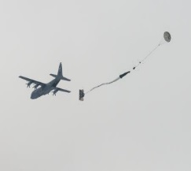
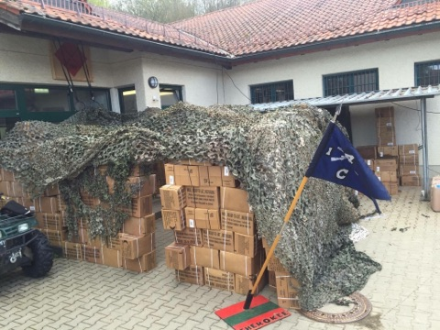
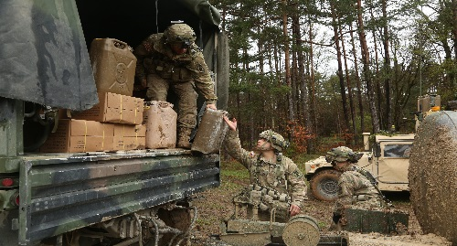
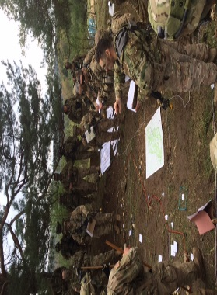
JMRC Sustainment Trends
Planning
“Plan from the OP back” must include sustainment
Roles and responsibilities of sustainment stakeholders not defined or clearly understood
Lack of sustainment overlays and sustainment rehearsals
Impacts of task organization changes and command support relationships not understood or accounted for
Lack of planning at the SQDN level resulted in OPFOR capturing supplies after remaining on the DZ for over 48hrs
Planning Considerations:
What reports are required?
To whom must they be submitted?
How to submit reports (PACE)?
Synchronization at all levels
Execution
Lack of rehearsals combined with inadequate PACE translates to sustainment challenges
Lack of storage capability requires anticipated resupply, units struggle to synchronize with operations
CTCP, FTCP, UMCP, and LRP site selection
Reactive vs. proactive logistics heavily influenced by LOGSTATs (not submitted or inaccurate)

Slide 14
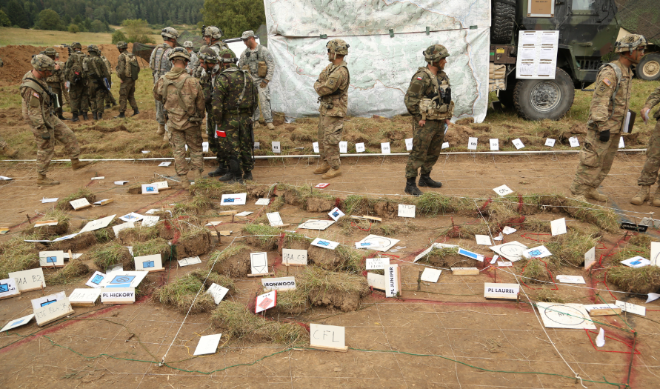
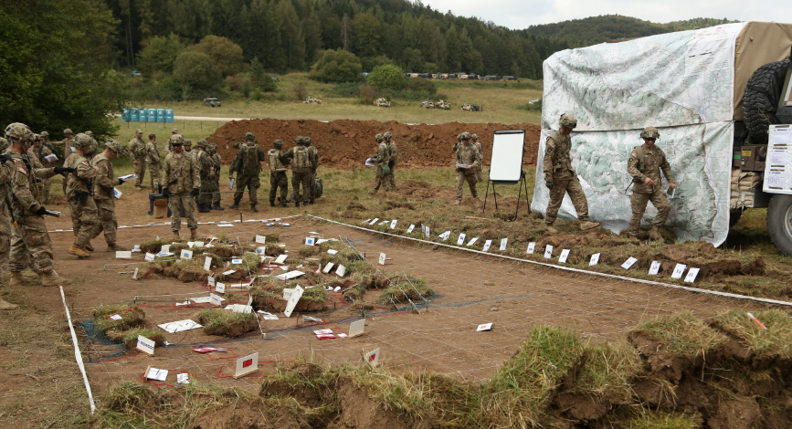
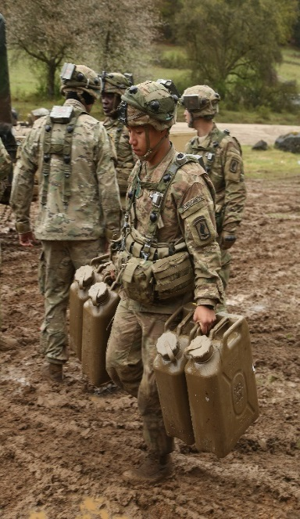
Sustainment Challenges in a Multinational Environment
Multinational Sustainment Challenges
Fully understand task organization, relationships, capabilities, and requirements
Establish and maintain a LOGCOP
Poor Assumptions
Expeditionary sustainment vs. National Support Element (NSE) concept; multinational sustainment assets
Interoperability: Capacity and Consumption
Ok, four cans down and the allies need 3,600 liters per day…
Units unable to maintain the tempo and endurance with inaccurate LOGSTAT/PERSTAT/SLANT reporting
Planning + COP + Rehearsal = Leads to successful transitions and mission success
Way Ahead
Sustainment stakeholders included in planning and understand task organization, capability, capacity and unique requirements of each element
Always make time for sustainment rehearsals
Reporting enforced; LOGSYNC chaired by SQDN XO
Capture LRP procedures in SOP; rehearse at home station
…. What do your Allies need?

Slide 15
Joint Readiness Training Center Fort Polk, LA
Mission: The JRTC OPSGRP is capable of providing America’s military forces and JIIM-partners relevant, rigorous, multi-echelon training in a Decisive Action and mission rehearsal exercise (MRE) environment to develop adaptive leaders, confident units, and robust capabilities across the range of military operations achieving Army readiness.

Slide 16
JRTC Observations of Sustainment Operations
Positive Trends
Negative Trends
1. Breaking the paradigm of contracted life support
2. Use of CTCP and FTCP
3. Execution of CASEVAC
1. Sustainment execution is reactionary instead of using
the planning process to generate predictive methods
as part of an integrated staff process
2. LRP activities are typically not executed
3. Lack of appropriate Graphic Control Measures to
indicate CSS assets
4. Lack of a thorough CSS / CASEVAC plan and
rehearsal
IBCT Challenges
Common Recon Squadron Challenges
1. Dismounted Recon Troop is significantly challenged in
Re-supply of water
2. CASEVAC planning for the Dismounted Recon Troop
is typically a significant challenge
3. Limited amount of combat power poses a unique
challenge of maintaining appropriate security on
multiple Mission Command and Sustainment nodes.
Most SQDNs choose to co-locate the CTCP with the
TOC.
1. Planning and executing resupply on the screen line
2. Forecasting requirements for Class I, III, and V
3. Extended lines of communication

Slide 17
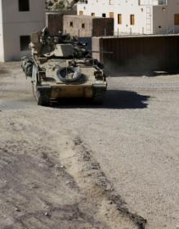
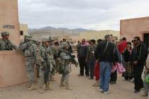
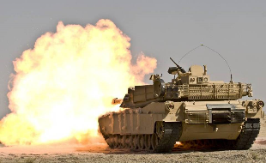
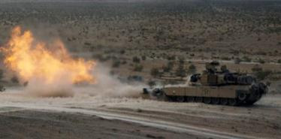
UNCLASSIFIED//FOUO
Operations Group
National Training Center
Cavalry Council JUL 16
Mission: The Cobra Team Trains Armor Task Forces and Cavalry Squadrons based on U.S. Army doctrine, tactics, techniques and procedures, in order to improve their war fighting capabilities, and enabling them to leave the NTC better trained than when they arrived.
UNCLASSIFIED//FOUO

Slide 18
NTC Observations of Reconnaissance Sustainment
Positive Observations
Negative Observations
1. Planning of commodities on LOGPAC is divorced from data received from troop/company LOGSTATs
2. Execution of CASEVAC is hampered by poor MEDCOP and long lines of communication
3. FSC commander is the planner for logistical operations instead of the S4
1. Use of Logistics Release Points are common although not always effectively executed
2. “Fix Forward” concept is utilized with Troop/Company Field Maintenance Teams
3. Utilization of the Modular Fuel System to enable the squadron to remain self-sufficient for up to 72hrs
ABCT Challenges
Common Recon Squadron Challenges
1. Units continually have an insufficient amount of H8 qualified individuals to operate recovery vehicles (2 for tracked recovery AR 750-1)
2. BDE sustainment plan does not account for the squadron’s unique challenges
3. Poor 5988E flow resulting in CL IX shortfalls and loss of combat power
1. Executing resupply during continuous reconnaissance operations
2. Location of the FTCP that enables coordination between both the squadron and the BSB
3. Extended lines of communication
Notes:
Notes for Each Bullet Positive Trends Use of Logistics Release Points are common although not always effectively executed SQDRNs understand the LRP concept and utilize it but the execution at the troop level varies in effectiveness due to lack of emphasis during homestation training. 2. “Fix Forward” concept is utilized with Troop/Company Field Maintenance Teams The best SQDRNs use their FMTs effectively forward with the troop trains to “fix forward” instead of pooling all maintenance at the UMCP or evacuating to the BSB who does not have the capability or personnel to repair tracked vehicles. 3. Utilization of the Modular Fuel System to enable the squadron to remain self-sufficient for up to 72hrs Having the entire MFS (consisting of one M978 and one Tank Rack Module TRM) gives the sqdrn enough capacity to go 72 hrs without resupply while also having the capability to flex assets where needed most (D Tank when maneuvering). Negative Trends 1. Planning of commodities on LOGPAC is divorced from data received from troop/company LOGSTATs LOGSTATs are not received in a timely and consistent manner. When they are they are not being used to build the daily troop/company LOGPACs at the FTCP or CTCP. Instead the FSC uses historical data as their running estimates which do not take into consideration current operations and troop on hand commodities. 2. Execution of CASEVAC is hampered by poor MEDCOP and long lines of communication CASEVAC at the troop level suffers from an extended distance from the FLOT to role 1 and SQDRN suffers from distance to role 2. Also troop leaders do not have an understanding of locations of adjacent role 1 facilities due to the LOGCOP not being disseminated and lack of sustainment rehearsals at the sqdn and troop levels. 3. FSC commander is the planner for logistical operations instead of the S4 The S4 should be the planner and coordinator for logistics in the sqdn. At the CTCP S4 should be receiving LOGSTAT, analyzing it and then synchronizing resources to conduct LOGPAC to include coordinating LRP time and location. Instead the FSC commander does this more often then not ABCT Challenges 1. Units continually have an insufficient amount of H8 qualified individuals to operate recovery vehicles (2 for tracked recovery AR 750-1) From AR 750-1 Army Material Maintenance under FIELD MAINTENANCE e. Recovery vehicle policy— (1) Wheeled and tracked recovery vehicles will be operated by properly trained and certified recovery personnel. (2) At a minimum, there must be at least one ASI H8 certified recovery operations individual in the vehicle while performing recovery missions using wheeled recovery vehicles, and at least two for tracked recovery vehicles. This is largely “hand waved” by many BDE’s 2. BDE sustainment plan does not account for the squadron’s unique challenges Many but not all bde’s plan for sustaining the sqdrn like they were just another CAB if at all. Their extended distance from the BSA and role 2 is seldom mentioned during pre role out Sustainment Rehearsals but improves from phase to phase at the bde level. 3. Poor 5988E flow resulting in CL IX shortfalls and loss of combat power This is a problem across most ABCTs here. PMCS along with accurate reporting are usually the first casualties of an increased op tempo Common Recon Squadron Challenges 1. Executing resupply during continuous reconnaissance operations SQDRNs are challenged to synch LRP times and locations when troops are far apart. Also troops have trouble with the idea of displacing vehicles of the screen in a synchronized fashion to execute logpac at the troop trains 2. Location of the FTCP that enables coordination between both the squadron and the BSB SQDRNs place the FTCP either to far from the FLOT ie in the BSA or to far forward ie collocating with CTCP. This results in effective coordination with either sqdrn OR BSB instead of both. 3. Extended lines of communication Distance from direct support in the BSA and area support from EAB units

Slide 19
3rd Squadron,16th Cavalry
ARC
CLC
RSLC
SUAS-MT
DCT-MT
ASA-A/B
Mission: 3rd Squadron, 16th Cavalry Regiment develops future leaders to command, lead and train Reconnaissance organizations and supports the training and preparation of Initial Entry Training Soldiers in order to enable our combined arms formations to defeat any threat and accomplish their mission in current and future conflict.
3-16 Cavalry Squadron Home

Slide 20
Sustainment in R&S Operations
Notes from COL Clint Taylor, MCoE Deputy Chief of Staff, Sustainment
Many weaknesses and gaps in sustainment of maneuver formations in general are only exacerbated and amplified for R&S formations given their forward deployment
The challenge is optimizing the employment of Forward Support Companies (FSCs)
Training tactical logistics operations must be as intensive as a Troop attack or other highly intensive live fire training. It must be integrated into the tactical scheme of operations, i.e. the R&S plan
Logistics is not just for the logistician. 1SGs run LRPs and resupply runs. Troop XOs and the Squadron XO head logistics in formations.
It is a complex event that requires a lot of rehearsal, practice and integration into the tactical training plan.
The TACSOPs from the 2nd and 3rd ACRs are a wealth of knowledge of “a way” to sustain R&S formations.

Slide 21
The Optimal Employment Of The Forward Support Company In Decisive Action
Problem Statement: In Decisive Action (DA) operations, many Forward Support Companies (FSCs) in Brigade Combat Teams (REGs), are not providing maximum operational reach and proactive sustainment for the REG Commander because they are not optimally organized across the different sustainment echelons of the battlespace.
TF S4 and FSC CDR Friction (Roles and Responsibilities)
Overuse of FSC Distribution PLT and underuse of Alpha Company Transportation PLT
Technical Abilities of FSC Mechanics
(Not Fixing Forward) Evacuating repairs to FMC in SQDN
Terms of Reference WRT command and support relationship between the SQDN and Maneuver BN
Forecasting and Conducting Logistics Estimates
Determining the Optimal FTCP Composition at the BSA
Determining the Optimal CTCP Composition and Function
Recommended Solutions to Achieve Proactive Sustainment and Maximize Operational Reach
FTCP Operations
CTCP Operations
Select the right mix of commodity experts on the FTCP team. A food operations NCO, ammo handler, fuel handler, and supply specialist can provide the expertise needed for commodity management to organize the requested items for push/pull to the CTCP or LRP
Use LRPs to facilitate simultaneous vice sequential distribution operations
Use flat rack, HIPPO, and MFS exchange to decrease turnaround time
Relationships
Clearly define command and support relationships between the SQDN, FSC and maneuver battalions with a formal MOA and Terms of Reference
SQDN and FSC elements must routinely train together to include low-density MOS training for maintainers
Locate the FTCP at the SQDN to share communications assets and security
Use the TF S4 as the sustainment planner and the FSC CDR as the executer
Use FSC Maintainers to Fix Forward
Logistics Planning
Enforce production of accurate and continuous logistics running estimates to determine what is needed where and when
Use the A CO Trans PLT to conduct distribution missions to provide occasional relief to the FSC Distribution PLT
Produce a Concept of Support with a Logistics Task Organization (LTO) that optimally positions the SQDN and FSC sustainment assets between the FLOT, CTCP, FTCP, and the BSA
Place elements of the battalion S1, S4, Role I aid station, the Unit Maintenance Collection Point (UMCP), and the FSC distribution platoon.
Conduct a Sustainment Rehearsal
Enforce accurate LOGSTAT reporting to forecast future requirements

Slide 22
FSC Battlefield Geometry
A Way
FLOT
FLD MAINT TM AR (x2)
FLD MAINT TM INF (x2)
PERSONNEL:
1-E7,91A
1-E6,91A
3-E5,91AH8
1-E4,91AH8
2-E1-4,91A
3-E3,91AK4
1-E4,92A
EQUIPMENT:
2-JCR-LOG
1-SAMS-1E
2-HMMWV
1-SECM
1-MTV w/TRL
1-PLS w/TRL
1-FRSH
1-M88
COMPANY ECHELON TRAINS
PERSONNEL:
1-E7,91M
1-E6,91M
2-E5,91MH8
1-E5,91M
1-E4,91MH8
2-E4,91M
1-E4,92A
1-E3,91MH8
1-E3,91M
EQUIPMENT:
2-JCR-LOG
1-SAMS-1E
1-HMMWV
1-SECM
1-MTV w/TRL
1-PLS w/TRL
1-FRS
1-M88
The FSC establishes a LRP where 1SGs and Supply SGTs link up with Distro PLT for transfer to Company Trains
LRP
The CTCP receives battalion configured loads from the FTCP and breaks them into company configured loads that are pushed forward to a LRP
REAR
The FTCP team gathers the requested commodities, breaks bulk materiel, and configures loads for the FSC distribution platoon to pick up, or A CO to deliver to an LRP. They also serve as a direct liaison to the BSB SPO and receive all FSC convoys arriving at the BSA.
CTCP
CTCP
PERSONNEL:
BN S1
BN S4
FSC CDR
FSC 1SG
FIELD FEEDING SECTION
DISTRO PLT (-)
MAINT PLT (-)
EQUIPMENT:
JCR TOC KIT
1-CK
1-MTRC
1-CAMEL
1-BUFFALO
ALL CLIII(B)
7-PLS w/TRL
4-LHS w/TRL
SATS + FRS
1-HEMT WRKR
2-LMTV WRKR
4-M88
VSAT
TASK: The CTCP coordinates and executes sustainment operations between the FTCP and Company Trains
PURPOSE: The CTCP is the closest sustainment node owned by the maneuver battalion to the Forward Line of Troops (FLOT) and serves as the forward focal point for all logistics functions for the maneuver battalion.
FSC
CTCP
UMCP
COMBAT
TRAINS
BSB
SPT
BSB
FTCP
FTCP
FTCP
TASK: The FTCP serves as the supported BN CDR’s primary direct coordination element with the BSB in the BSA.
PURPOSE: The FTCP coordinates requirements with the BSB SPO, configures push or pull LOGPACs for the FSC Distro PLT or A CO Trans PLT to push to the CTCP or direct to LRP
PERSONEL:
1-FSC XO,O2,88A
1-MAINT CTL OFF, O2,91A, 1-E6,92Y, 1-E3,92Y1K, 1-E6,92G, 1-E4,89B, 1-E5,88M
1-E3,88M
EQUIPMENT:
2-JCR-LOG
4-VRC-92F
2-HMMWV w/TRL
1-LMTV w/TRL
1-PLS w/TRL
BSA
FIELD
TRAINS
X
OSC
Reserve

Slide 23
U.S. Army Divisional and Regimental Units

Slide 24
1ST LAR
3RD LAR
2ND LAR
4TH LAR
U.S. Marine Corps
Light Armored Reconnaissance (LAR) Battalions

Slide 25
ALIBIS

Slide 26
Final Comments
Next Recon Council: 25 JANUARY 2017

Slide 27
CTCs in Rotation Spring 2017 (August and September)
NTC:
17-03 JAN 2017 1-25 ID SBCT CDR: COL Donn H. Hill, donn.h.hill.mil@mail.mil
5-1 CAV CDR: LTC James A. Hayes, james.a.hayes.mil@mail.mil
17-04 FEB 2017 2 ABCT, 1st CAV CDR: COL Steve J. Adams, steven.j.adams10.mil@mail.mil
JRTC:
JAN 2017 1/1 AD SBCT(-) CDR: In transition
6-1 CAV CDR: LTC Mark Hoovestol, mark.h.hoovestol.mil@mail.mil
FEB 2017 4-25 ABN CDR: COL Scott A. Green, scott.a.green36.mil@mail.mil
1-40 CAV CDR: LTC Mark D. Federovich, mark.d.federovich.mil@mail.mil
JMRC:
25 JAN-25 FEB 2017 GEO MRE – USMC and Republic of Georgia (Grizzly Team not involved)
08 MAR-30 MAR 2017 Allied Spirit 6 – Multinational (US 173rd ABN, US FA BN; Latvian BN and
HQ; Dutch BN, BEB)

Slide 28
Timeline
Recon Council
19 October 2016
18 October2016
17 October 2016
Final Rehearsal/Comms Check and Walkthrough
17 October 2016
Tech Rehearsal
IPR #2: Progress update, products check
12 October 2016
Recon OBJ/NLT Final Submission of Slides
07 October 2016
IPR #1: Progress Update
05 October 2016
04 October 2016
DCS conference, Thurman Room reserved
29 SEP
2016
Council announced, agenda and template slides released to audience
Develop Agenda, Discussion Topics and Timeline, outreach to the force

