Slide 1
3rd Brigade Combat Team
1-505 PIR
2-505 PIR
1-319 FA
5/73 CAV
3-BSTB
82D BSB
Scheduled Services

Slide 2
SCOPE
Scheduled maintenance services are the heart of any effective maintenance program. When scheduled services are slipped, missed, or otherwise not accomplished, the very foundation of our overall maintenance program is threatened.

Slide 3
REFERENCES
AR 750-1
DA Pam 750-1
DA Pam 750-3
DA Pam 750-8
PS MAG

Slide 4
The Army Maintenance Standard AR 750-1
The Army has one maintenance standard, TM XX-10/20.
Scheduled services are performed at the service interval required by the applicable technical publication.
The Army maintenance standard applies to all equipment except equipment used as training aids that require frequent disassembly and assembly.

Slide 5
Scheduled Services
A training program that results in leaders, supervisors, and operators being fully qualified and dedicated to performing or supervising PMCS tasks correctly.
Sufficient time blocked in the unit’s training schedule specifically for the performance of field level PMCS (-20 level scheduled services) based on time estimates provided by the maintenance officer/NCOIC.
As few as possible unscheduled distractions that take equipment operators, maintenance personnel, and supervisors away during scheduled services.
The establishment of Standard Operating Procedures for scheduled services.

Slide 6
 |  |  |  |  |  |  | Service Schedule
11/17/11 |  |  |  | 15:16 |  |  |  |  |  |  |  |  |  |  |  |  |  |  |  |  | Page |  | 1 |  | of |  | 1
UIC: |  |  | WG6CF0 |  |  |  |  |  | F co 2-505 PIR |  |  |  |  |  |  |  |  |  | AWCMF450/452/454
FROM: |  |  | 20111201
TO: |  |  | 20111231
MODEL |  |  |  |  |  |  |  |  | ADMIN NUM |  |  |  | TYPE DUE |  |  | DATE DUE |  | READING DUE
M1085A1P2WOW |  |  |  |  |  |  |  |  | F119 |  |  |  | A |  |  | 20111201 |  | M |  |  | 6202
M1081 |  |  |  |  |  |  |  |  | F134 |  |  |  | A |  |  | 20111201 |  | M |  |  | 8917
M1093A1WOW |  |  |  |  |  |  |  |  | F312 |  |  |  | A |  |  | 20111203 |  | M |  |  | 8892
M500 |  |  |  |  |  |  |  |  | F12G01 |  |  |  | Q |  |  | 20111206 |  |  |  |  | 0
M500 |  |  |  |  |  |  |  |  | F12G02 |  |  |  | Q |  |  | 20111206 |  |  |  |  | 0
M240B |  |  |  |  |  |  |  |  | F240B01 |  |  |  | Q |  |  | 20111206 |  |  |  |  | 0
M240B |  |  |  |  |  |  |  |  | F240B02 |  |  |  | Q |  |  | 20111206 |  |  |  |  | 0
M240B |  |  |  |  |  |  |  |  | F240B03 |  |  |  | Q |  |  | 20111206 |  |  |  |  | 0
M240B |  |  |  |  |  |  |  |  | F240B04 |  |  |  | Q |  |  | 20111206 |  |  |  |  | 0
M240B |  |  |  |  |  |  |  |  | F240B05 |  |  |  | Q |  |  | 20111206 |  |  |  |  | 0
M240B |  |  |  |  |  |  |  |  | F240B06 |  |  |  | Q |  |  | 20111206 |  |  |  |  | 0
M240B |  |  |  |  |  |  |  |  | F240B07 |  |  |  | Q |  |  | 20111206 |  |  |  |  | 0

Slide 7
EQUIPMENT DATA
ADMIN NUM: |  |  |  |  |  |  | F119 |  |  |  |  |  |  |  |  |  |  |  |  |  |  |  |  |  |  |  | EQUIP SERIAL NUM: |  |  |  |  |  |  |  |  |  | P-D709411EHBW
MODEL: |  |  |  |  |  |  | M1085A1P2WOW |  |  |  |  |  |  |  |  |  |  |  |  |  |  |  |  |  |  |  | REGISTRATION NUM: |  |  |  |  |  |  |  |  |  | NL26RA
EQUIP NOUN: |  |  |  |  |  |  | TRK CARGO LWB |  |  |  |  |  |  |  |  |  |  |  |  |  |  |  |  |  |  |  | EQUIP READY CDE: |  |  |  |  |  |  |  |  |  | A
EQUIP NSN: |  |  |  |  |  |  | 2320015527773 |  |  |  |  |  |  |  |  |  |  |  |  |  |  |  |  |  |  |  | TYPE INSPECTION: |  |  |  |  |  |  |  |  |  | D
 |  |  |  |  |  |  |  |  |  |  |  |  |  |  |  |  |  |  |  |  |  |  |  |  |  |  | CURRENT READING: |  |  |  |  |  |  |  |  |  | M |  | 3,667
NUMBER |  |  |  |  |  |  |  |  |  |  |  |  |  |  |  | DATE |  |  |  |  |  |  |  |  | CHANGE NUMBER
TM 9-2320-333-10-1 |  |  |  |  |  |  |  |  |  |  |  |  |  |  |  | 01/10
TM 9-2320-333-10-2 |  |  |  |  |  |  |  |  |  |  |  |  |  |  |  | 01/10
INSPECTORS LIC# : |  |  |  |  |  |  |  |  |  |  |  |  |  |  |  |  | TIME: |  |  |  |  |  |  | SIGNATURE: |  |  |  |  |  |  |  |  |  |  |  |  |  |  |  |  |  | TIME:
SERVICE DUE DATA
Service Description |  |  |  |  |  |  |  |  |  |  |  |  |  |  |  |  |  |  |  |  | TYPE |  |  |  |  | DATE |  |  |  |  |  |  | MI/KM/HR
Annual |  |  |  |  |  |  |  |  |  |  |  |  |  |  |  |  |  |  |  |  | A |  |  |  |  | 12/1/11 |  |  |  |  |  |  | M |  |  | 6202
Biennial |  |  |  |  |  |  |  |  |  |  |  |  |  |  |  |  |  |  |  |  | B |  |  |  |  | 12/1/12 |  |  |  |  |  |  | M |  |  | 12202
Semiannual |  |  |  |  |  |  |  |  |  |  |  |  |  |  |  |  |  |  |  |  | S |  |  |  |  | 6/1/12 |  |  |  |  |  |  | M |  |  | 2528

Slide 8
Prerequisites for service
All equipment will be cleaned inside and out before reporting to maintenance.
A thorough PMCS will be conducted by the operator and verified by their supervisor. This PMCS will accompany the equipment throughout the service.
Platoon Leader/Sergeant will assign an operator to assist maintenance with the service that is exempt from all duties for the duration of the service.
The Motor Sergeant will ensure that a service packet is put together prior to the vehicle reporting for service.
A Quality Control NCO will be responsible for verifying the service upon completion.

Slide 9
SERVICE PACKETS
Service packets. When field maintenance personnel performs a scheduled service on a piece of equipment, they should return with the equipment the following forms to the operator/crew as part of the service packet:
Original DA Form 5988–E used for Field Level PMCS (-20 with signatures and corrective action initials) (-10 operators submit with equipment to be serviced).
Original DA Form 5988–E used for quality control inspection to close out service (with signatures and corrective action initials).
Updated DA Form 5988–E with all uncorrected faults and parts required entered in SAMS–1E upon completion of the scheduled service.
Copy of closed dispatch form for road test upon completion of the scheduled service (for motor vehicles only).

Slide 10
SERVICE INTERVALS
Unit maintenance, assisted by operator/crew, will perform checks and services contained in table at the following intervals:
(1) Semiannually. Every 6 months or 3,000 miles (4,828 km), whichever comes first.
(2) Annually. Every 12 months or 6,000 miles (9,656 km), whichever comes first.
(3) Biennially. Every 24 months or 12,000 miles (19,310 km), whichever comes first.
Lubrication services coincide with the vehicle’s preventive maintenance service.
All faults are identified following prescribed intervals using the “items to be checked” column of the applicable TM XX–10 and XX–20 series PMCS tables.

Slide 11
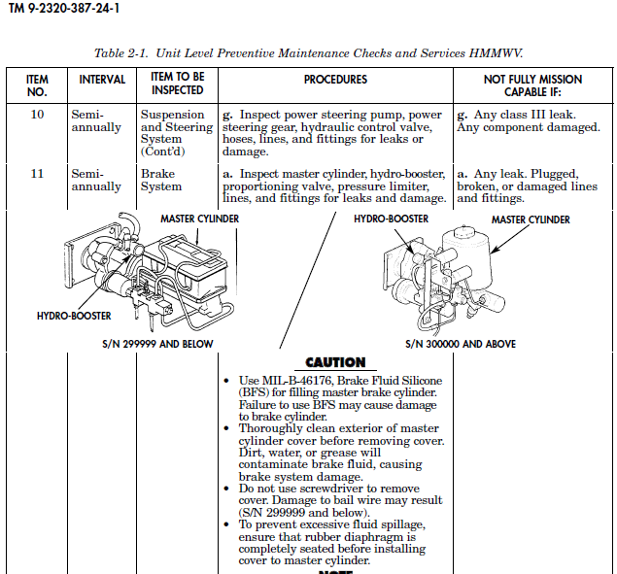

Slide 12
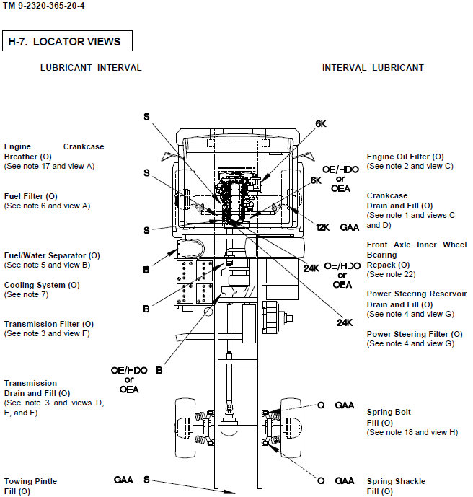

Slide 13
10% VARIANCE
DA PAM 750–8
A service may not always be pulled when scheduled, so a 10 percent variance before or a 10 percent variance after the schedule of days, miles, or hours, is allowed. If the action is within the variance, the service is treated as if it was done on the day/miles/hours schedule.
Some services may be too critical to have a variance. The equipment maintenance manual states if no variance is allowed.
When the service is done within the variance, the equipment’s miles, kilometers, or hours are recorded on the date service was scheduled. When a service outside the variance is completed, data is recorded on the actual day the service was completed. The computer schedules the next service from the new date.
When the service exceeds the 10 percent variance, the equipment is administratively designated NMC until the service is completed.

Slide 14
ENROLLMENT / DISENROLLMENT LOW USAGE
AR 750–1
Maintenance of low usage equipment
Services for equipment that have accumulated or are anticipated to be less than 65 percent of the forecasted annual mileage/hours of operation may have Field (TM XX–20/23 series) and Field/Sustainment (XX–24 and XX–40 series) services extended.
Use of low-usage criteria does not relieve commanders of the responsibility for adequate maintenance of their equipment.
All service and lubrication tasks in the equipment’s TM XX–20, XX–34, XX–40 series LOs must be performed before the equipment is placed in low-usage status. The date, miles, kilometers, or hours when the equipment was placed into low-usage status will be entered on DD Form 314 (Preventive Maintenance Schedule and Record) or the (SAMS-1E) equivalent
Equipment that exceeds the specified criteria at any time during the year will be immediately returned to scheduled servicing at normal TM/LO intervals from the date and usage data that was entered in SAMS–E or DD Form314.
Operator/crew level (TM XX–10 series) maintenance intervals in TMs/LOs will not be changed to low usage.

Slide 15
LOW USAGE MEMORANDUM

Slide 16
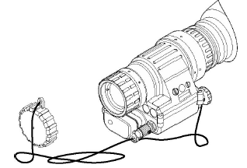
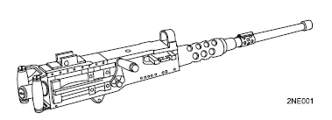
PURGING/GAGING
Electronic units require purging every 180 days, when unit is opened for maintenance or when evidence of moisture is present.
All weapons must be inspected and gaged at least once annually for safety and serviceability.

Slide 17
TEST, MEASUREMENT, AND DIAGNOSTIC EQUIPMENT
The objective of the Army’s TMDE program is to ensure accurate and serviceable TMDE is available for Army use with measurement accuracies traceable to the National Institute of Standards and Technology (NIST).
Your IMRF listing should contain 100% of all the TMDE in your unit.
Calibration Intervals Range from 90 Days to 3 Years
The full listing of all TMDE needing calibration is found in TB 43-180.
Ensure that all organizational maintenance has been performed on TMDE.
Obtain a copy of your master list from your Coordinator to determine what TMDE was not submitted as scheduled and initiate action to obtain calibration services.

Slide 18
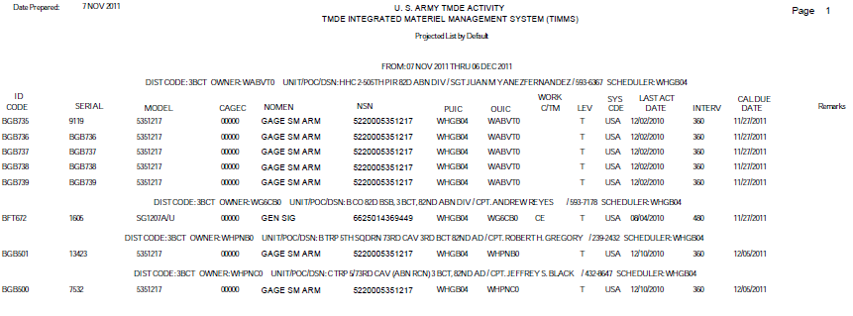
TEST, MEASUREMENT, AND DIAGNOSTIC EQUIPMENT

Slide 19
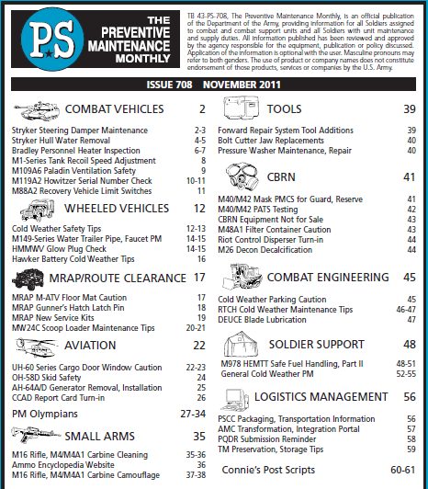

Slide 20
QUESTIONS ?

