Slide 1
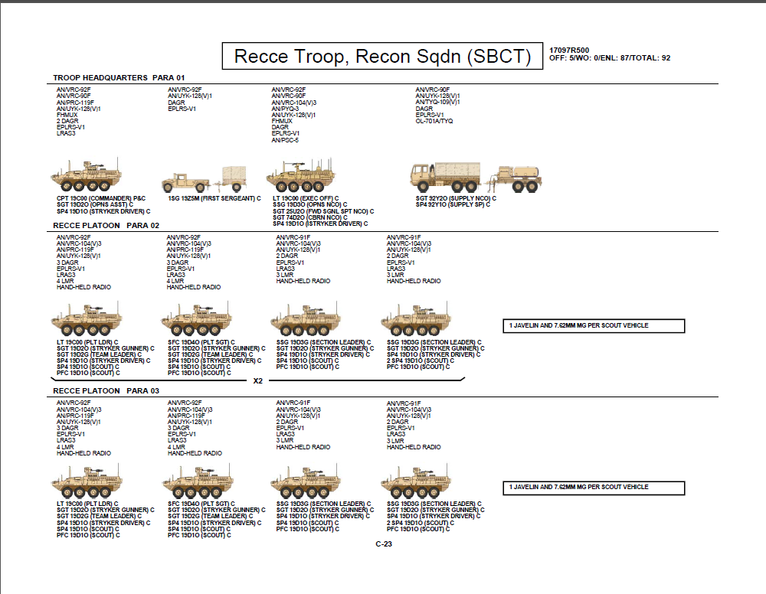
x3

Slide 2
800 gal “Camel” Water tank
Ammo:
.50 cal- 4,400
53 gal
330 mi /531 km
25 gal
250 mi/ 402 km
53 gal
330 mi /531 km
58 gal
300 mi/ 483 km
Fuel Total:
184
PLT Ammo:
.50 cal- 8,800
Mk-19- 2,000
Javelin- 8
7.62mm- 12,000
x3
53 gal
330 mi /531 km
53 gal
330 mi /531 km
53 gal
330 mi /531 km
53 gal
330 mi /531 km
Fuel Total:
212
Ammo:
Mortar- 120
7.62mm- 4,000
58 gal
300 mi/ 483 km
53 gal
330 mi /531 km
Fuel Total:
164
x2

Slide 3
Typical Attached Support Assets
154 gal
300 mi/ 483 km
53 gal
330 mi /531 km
25 gal
250 mi/ 402 km
413 gal
154 gal
300 mi/ 483 km

