Slide 1
Enabling Learning Objective 1.19.5
Provide information on the Dual Status Commander concept

Slide 2
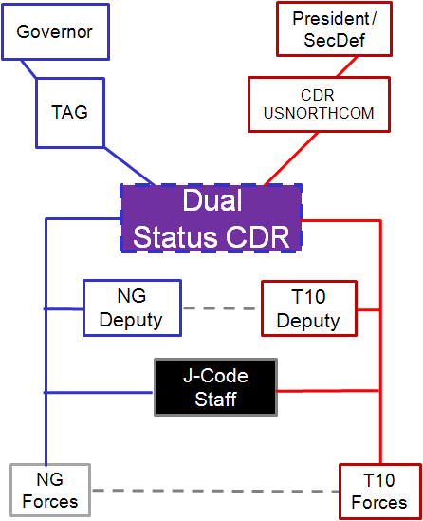
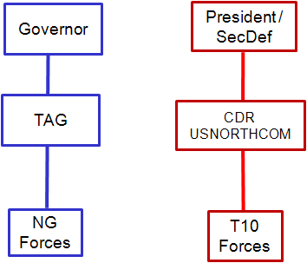
Title 10 C2 Options
Parallel
DSC

Slide 3
Why DSC
Joint Action Plan for Developing Unity of Effort
(Approved by Council of Governors, Secretary of Defense and Secretary of Homeland Security on March 1, 2011)
When a State requests support from the Federal government, it is vital to acknowledge both the sovereign status of Governors in managing and directing the response to emergencies within their States…and the responsibility of the President and Secretary of Defense in ensuring legal, safe, and effective employment of Federal forces when requested
NDAA FY12 (Public Law 112-81: December 31, 2011)
When the Armed Forces and the National Guard are employed simultaneously in support of civil authorities in the United States…a dual-status commander…should be the usual and customary command and control arrangement, including for missions involving a major disaster or emergency
When a major disaster or emergency occurs…the Governor of the State affected normally should be the principle civil authority supported by the primary Federal agency and its supporting Federal entities, and the Adjutant General of the State…normally should be the principle military authority supported by the dual-status commander

Slide 4
DSC Context (Disaster Response)
(High)
DSC
Incident
Probability
Of
Incident
(Low)
Response:
STATE
EMAC
FEDERAL
LOCAL
(Less)
Severity of Incident
(More)
Lives
Suffering
Property Loss

Slide 5
Previous DSC Events
National Special Security Events (NSSEs) / Special Events
2004: G-8 Summit, RNC, DNC
2008: RNC and DNC
2009: G-20 Summit
2010: National Scout Jamboree (SEAR)
2011: Asian Pacific Economic Summit
2012: NATO Summit, RNC and DNC
2013: National Scout Jamboree (SEAR)
Consequence Management events
2011: Hurricane Irene (5 DSCs)
2012: Colorado Wildfires, California Wildfires, Hurricane Isaac (2 DSCs), Hurricane Sandy (6 DSCs)
2013: Colorado Wildfires, California Wildfires,
Colorado Flooding
T10 Forces Employed Under DSC
DSC Established, No T10 Forces Employed

Slide 6
MOA Status & DSC-Certified Officers
As of 26 Sept13
AK
3/0
WA
3/0
NH
4/0
MT
2/0
VT
3/0
ME
3/0
ND
4/0
OR
4/0
MN
4/0
ID
2/0
SD
4/0
WI
3/0
NY
3/0
MA
5/0
WY
2/0
MI
1/0
RI
3/0
NE
3/0
IA
3/0
PA
5/0
CT
3/0
NV
4/0
OH
3/1
NJ
3/0
CA
2/0
UT
3/0
IL
4/0
IN
6/0
DE
3/0
WV
3/0
VA
4/0
MD
4/0
CO
2/0
KS
2/0
MO
4/0
KY
2/1
NC
4/0
OK
2/0
TN
2/0
DC
3/0
AZ
4/0
NM
4/0
AR
3/0
SC
5/0
MS
3/0
AL
3/0
GA
4/0
HI
4/0
TX
5/2
LA
1/0
PR
5/0
GU
2/0
FL
5/0
VI
3/0
MOA Status & Qualified DSC Legend
T10 DSC-Trained
MOA signed by SecDef and Governor : 52
Totals
Certified: 180
In Training: 4
JFHQ-NCR | 1
JTF-CS | 1
USAR | 1
MOA signed by Governor – awaiting SecDef signature: 0
MOA not signed by SecDef or Governor : 2
#/# First number is DSC-certified officer, Second number is officer in DSC training

Slide 7
DSC Establishment
If the Governor consents
If the President (SecDef) authorizes
3
Appointment
Letter
(Consent)
Appointment
Letter
(Authorization)
GOVERNOR
CONSENT
AUTHORIZE
PRESIDENT
(delegated to SECDEF)
2
4
DSC
1
Recommendation
5
Recommendation
THE
ADJUTANT
GENERAL
Standing
Memorandum
Of Agreement
Between
State and DOD
3

Slide 8
Typical DSC C2 Model
President
Governor
Secretary of
Homeland Security
Secretary of
Defense
The Adjutant General
State/ Territory Emergency
Management Agency
Federal Emergency Management Agency
ASD
Joint Staff
Secretary of
the Army
Secretary of
the Air Force
U.S. Northern Command
National Guard Bureau
Joint Force Headquarters-State
IOF/
JFO
SCO
FCO
DCO
Dual Status
Commander
Incident Commander
Title 10
Deputy
Title 32
Deputy
Incident Commander
JFLCC
JFACC
JFMCC
Incident Commander
Title 10
Staff
Title 32
Staff
Joint Task Force Federal (T10)
Joint Task Force State
(T32)
Joint Task Force State
(SAD)
Support

Slide 9
T-10 Deputy Commander Assignments As of 26 Sep 13
UNCLASSIFIED/FOUO
Title 10 Deputy Assignment | State/Region | State/Region | State/Region | State/Region | State/Region
Col Jed Hudson, N/NC J82 W: 719-554-4436 BB: 719-646-9885 H/C: 520-979-4797 Jed.Hudson@northcom.mil | Texas/VI | Pennsylvania/III | Vermont/I | Kentucky/IV | Oregon/X
COL John Cushman NC J36 W: 719-554-4247 BB: 719-492-4627 C: 585-802-4058 John.Cushman@northcom.mil | California/IX | West Virginia/III | New Hampshire/I | Illinois/V | Puerto Rico/II
COL Rowells N/NC Reserve Forces W: 719-556-5711 BB: TBD C: TBD michael.rowells@northcom.mil | Mississippi/IV | New York/II | Washington/X | Nebraska/VII | Wisconsin/V
Col Tarn Abell, NC Reserve Forces W: 719-554-8904 BB: 719-243-6871 H: 719-219-9579 Tarn.Abell@northcom.mil | Alabama/IV | Connecticut/I | South Dakota/VIII | Nevada/IX | Kansas/VII Dist of Col III
Lt Col Mark Williamson, NC J33 (LNO to STRATCOM) W: 402-232-4292 BB: 719-332-0113 H: 402-932-0741 PC: 530-301-3331 Williams@stratcom.mil | Tennessee/IV | Rhode Island/I | Montana/VIII | Virginia/III | U.S. Virgin Islands/II
COL Dwayne Dickens, N/NC J6 W: 719-554-4008 BB: 719-337-8942 dwayne.dickens@northcom.mil | Georgia/IV | Colorado/VIII | Indiana/V | Arizona/IX | New Jersey/II
Col Daniel Miller, NC J33 (LNO to NCR) W: 719-554-4068 C: 719-466-9888 Daniel.Miller@northcom.mil | South Carolina/IV | Missouri/VII | Massachusetts/I | Utah/VIII | Michigan/V
COL Mark Quartullo, N-NC/J1 W: 719-554-2215 BB: 719-243-3667 C: 301-204-4234 mark.quartullo@northcom.mil | North Carolina/IV | Maine/I | Arkansas/VI | Idaho/X | Minnesota/V
Col Jeff Crehan, NC J33 (LNO to TRANSCOM) W: 618-220-7589 BB: 719-659-7554 C: 618-531-5155 Jeffrey.Crehan@ustranscom.mil | Delaware/III | Oklahoma/VI | Florida/IV | Wyoming/VIII | Ohio/V
COL Chris Johnson, NC J36 W: 719-556-8705BB: 719-243-6257 H: 719-574-9797 christopher.johnson2@northcom.mil | Maryland/III | Louisiana/VI | Iowa/VII | North Dakota/VIII | New Mexico/VI
Col Kevin Masterson, NC J33 (LNO to AK) W: 907-552-4874 BB: 907-227-1554 H: 907-622-0611 Kevin.Masterson@northcom.mil | Alaska/X | Alternate | Alternate | Alternate | Alternate
T-10 Deputy Commanders Alternates and/or In Training
COL Keith Ladd, NC J36 W: 719-556-1582 BB: 719-440-1688 Keith.Ladd@northcom.mil
Col Richard Warmbold, NC LNO H: (786) 452-1465 C: (435) 659-1745 warmbold@hotmail.com
Col David Olszowy, JTF-CS W: 757-501-7869 BB: 757-232-5526 david.olszowy@jtfcs.northcom.mil

