Slide 1
Stryker Course Summary
As of: 18AUG 2015
STRYKER CREWMAN
STRYKER LEADER
SBCT MASTER GUNNER
Audience: Junior Enlisted, TM Leaders en route to SBCT as first duty station or as first SBCT assignment
Purpose: The SBCT Crewman Course is a R4 additional skill identifier (ASI) producing course designed to train Soldiers on 10 level
and selected 20/30 level tasks applicable to the Stryker Brigade Combat Team (SBCT) formation and Stryker Mobile Gun System, Reconnaissance Vehicle, Infantry Carrier Vehicle, Mortar Carrier Vehicle, and the Anti-Tank Guided Missile Vehicle.
Outcomes:
1. Demonstrate technical competence at skill level 10.
2. Demonstrate driver/crew proficiency.
3. Demonstrate ability to apply skill level 10 and select skill level 20 and 30 tasks associated with the Stryker vehicle.
Duration ASI
2 weeks R4
Audience: Platoon and Company Leadership en route to SBCT as first duty station or as first SBCT assignment
Purpose: This is a career progression and a leader development course designed to provide Stryker Brigade Combat Team designated Soldiers the ability to perform the technical and tactical capabilities of a future Stryker leader.
Outcomes:
1. Sustainment: Understand platforms, service support and maintenance assets available to sustain the fight in a SBCT.
2. Training: Understand METL crosswalk and create unit METL; training management for a PLT/CO/TRP; understand BN level training concepts.
3. Tactics: Demonstrate fundamental employment of a PLT/CO/TRP; understand tactical limitations and organic assets of a SBCT.
Duration ASI
3 weeks NO
Audience: Command selected NCOs currently serving in or en route to SBCT with previous Stryker experience
Purpose: Train and educate select Noncommissioned Officers to assist unit leaders in the planning and implementation of gunnery training programs to train unit combat vehicle crews and platoons in direct fire engagements and to perform Unit level maintenance on the Stryker family of vehicles fire control and weapon systems.
Outcomes:
1. Demonstrate technical competence and mastery of fire control and weapons systems.
2. Demonstrate the ability to make appropriate use of TADSS available to an SBCT
3. Develop a gunnery training plan to imbed in a Unit Training Plan using the Army Training Management process.
Duration ASI
7 weeks R8/TBD
MGCC is prerequisite
1
Notes:
STRKYER CREWMAN:
Complete Task Analysis performed for new course development.
New LPs developed for :
Stryker SBCT Organization
Stryker Characteristics & Capabilities
Vehicular Movement Signaling Techniques
Stryker Common Machine Guns
Stryker ATGM & Stryker MCV
Stryker MGS Boresight & Armament Accuracy Checks (AACs)
STRYKER LEADER:
Prerequisites adjusted to support high learning continuum (SFC-MAJ) preparation for first assignment to SBCT.
Readjust course to support Leader tasks (i.e. TRNG Mgt, Logistics, Maintenance Mgt, Crew Mgt, Tactics offensive and defensive (DFP/Integration of obstacles)
Integration of LVCG (VBS3)
Integration of exponential learning methodology
SBCT MG:
Gain efficiencies by combining shared curriculum of MGS MG and SMTC while providing force with a SMG that can provide skill set beyond the MGS to the whole SBCT formation.
Realign current MG curriculum to mirror shared touch points between all MG programs offered in the MCoE so that MGs in the force provide a doctrinally sound and standardized method of planning regardless of platform

Slide 2
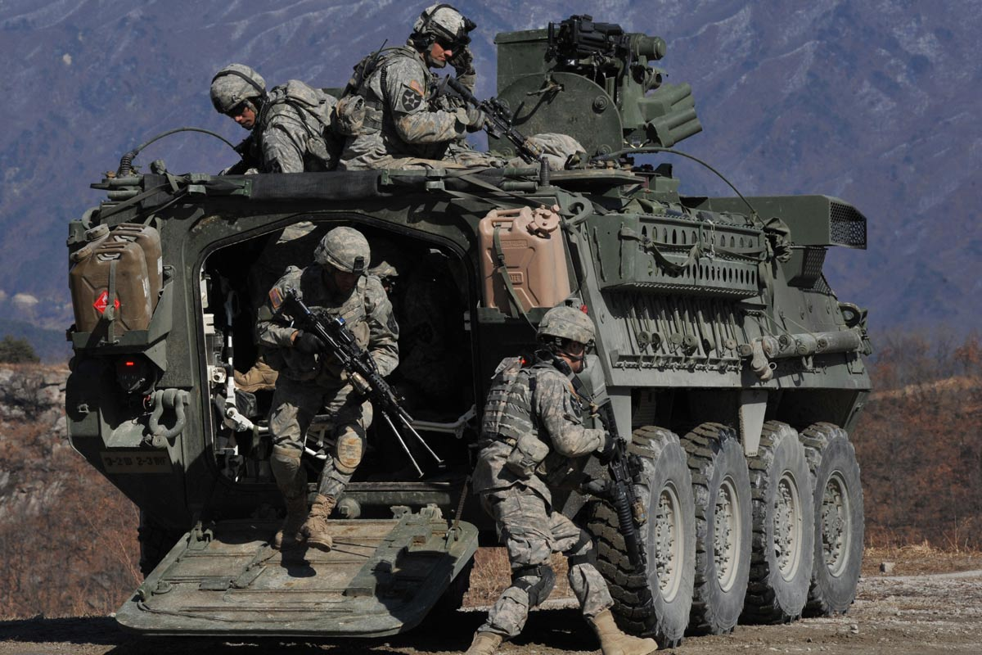
Stryker Crewman Course Purpose, Scope, and Outcomes
Course Scope
To provide small group instruction on Stryker vehicle common components and variant specific characteristics. These include lessons applicable to the Mobile Gun System (MGS), Reconnaissance Vehicle (RV), Infantry Carrier Vehicle (ICV), Mortar Carrier Vehicle (MCV), and the Anti-Tank Guided Missile (ATGM) Vehicle. Instruction covers topics on preventative maintenance checks and services (PMCS) and troubleshooting, operator maintenance of Stryker guns including familiarization of variant specific gunnery skills, operations of the driver, gunner, and commander stations, crew drills, remote weapon station (RWS), Long-Range Advanced Scout Surveillance System (LRAS3) and the Tube-Launched Optically Tracked Wire-Guided (TOW) system.
Course Purpose
Target Audience
The SBCT Crewman Course is a R4 additional skill identifier (ASI) producing course designed to train Soldiers on 10 level
and selected 20/30 level tasks applicable to the Stryker Brigade Combat Team (SBCT) formation and Stryker Mobile Gun System, Reconnaissance Vehicle, Infantry Carrier Vehicle, Mortar Carrier Vehicle, and the Anti-Tank Guided Missile Vehicle.
Outcomes:
1. Demonstrate technical competence at skill level 10.
2. Demonstrate driver/crew proficiency.
3. Demonstrate ability to apply skill level 10 and selected skill level 20/30 tasks associated with the Stryker vehicle.
Primary
Junior Enlisted, 11 and 19 series TM Leaders en route to SBCT as first duty station or as first SBCT assignment.
General Course Information
Class Size:
Minimum-6 Optimum-24 Maximum-24
Instructors Earned: 7
Last POI Approved Date: CAD Approved 11MAY15

Slide 3
Stryker Crewman
Course Map
Day 1
Day 2
Day 3
Day 4
Day 5
Day 6
SBCT Organization, Variants & Capabilities
Stryker PMCS
Stryker PMCS
Stryker Driver’s Station, Controls & Instruments
Sel SGST Tasks
Stryker
C4ISR
Sel SGST Tasks
Stryker Emergency Drills
Stow Equipment
Veh Mvmt Signaling Techniques
Stryker Driver’s Trainer (Sim)
Stryker Recovery Ops
Drive a Stryker
Stryker Common
Machine
Guns
SGST Tasks 1-3
Day 9
Day 8
Day 7
ATGM
TOW Target Acquisition
MCV
RMS6-L Mortar System
Sel SGST Task
ICV Training
RWS Orientation
Mount & Dismount primary weapon on RWS
Boresight
SGST Tasks 4-15
RV Training
LRAS3
Primary Weapon
Smoke Grenade Launcher
SGST Tasks 16-17
SBCT
End of Course Exam
Written/Practical/
Modified SGST
Outprocessing/Graduation
MGS
105mm Main Gun Boresight
Armament Accuracy Checks (AACs)
MGS
Commander’s Station/Turret
Misfire Procedures; Load Manually; NBC Ops
MGS Training
Ammo Handling, Main Gun Bore Evacuator, Smoke Grenade Launcher; Breechblock
Graduation
2d wk Stryker multi-variant breakout
Stryker Variant Training
RV / ICV / ATGM / MCV
Stryker Gunner Skills Test focused on fire control system; however select variants include drivers station and commo tasks for testing. Course covers 17 of 19 ICV SGST tasks.
Mobile Gun System (MGS)
Specific
3
Notes:
First week trains all students on safety, hull maintenance, drivers station operations, and common weapons.
Second week trains students on weapon systems with 19K students receiving MGS training and all others receiving training on the RV, ICV (RWS), ATGM, and MCV.

Slide 4
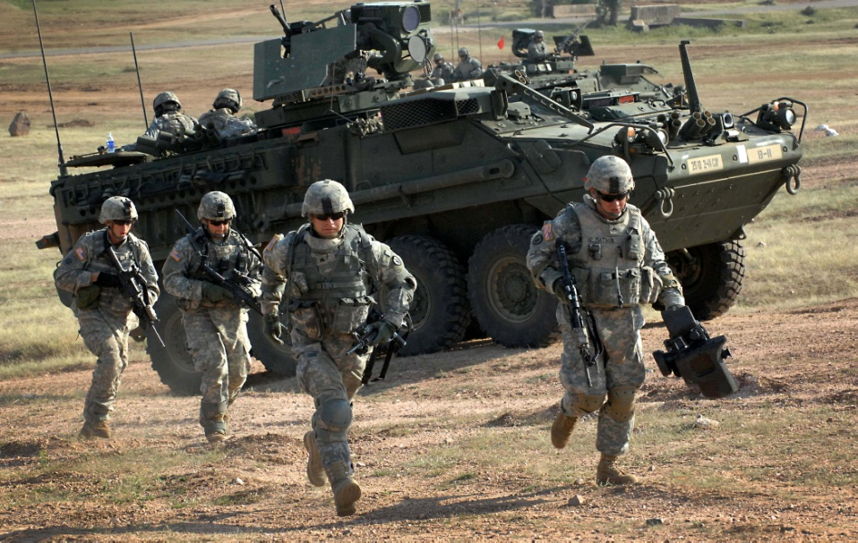
Stryker Leader Course Purpose, Scope, and Outcomes
Course Scope
During this three week course, the future Stryker leader is trained in three areas. The Maintenance module includes; History of the Stryker, Vehicle Capability, Vehicle Formations and tactics, Maintenance Supervision, Acquisition Process, Order Process, Exception Reports, Service Schedule, and Tactical considerations. The Training Management module includes: SBCT Doctrine, ARFORGEN Cycle, Principle of Training, CATS, METL Development, UTP, Leader Development, Tactics and Doctrine, Tactics consideration, EA Development, and Fire (echelon). The Tactics/Execution module includes: Tactical Vignettes, OPORD, and VBS3 Scenarios of Offense and Defense. The Exams module includes: SBCT Familiarization Exam, SBCT Maintenance Exam, and Training Management Exam. Upon completion of this course, the graduates will be fully capable of performing in a Stryker unit and leadership position. The course is a 3-week resident course taught and uses hands-on performance oriented training and simulations as the primary teaching methods.
Course Purpose
Target Audience
This is a career progression and a leader development course designed to provide Stryker Brigade Combat Team designated Soldiers the ability to perform the technical and tactical capabilities of a future Stryker leader.
Outcomes:
1. Sustainment: Understand platforms, service support and maintenance assets available to sustain the fight in a SBCT.
2. Training: Understand METL crosswalk and create unit METL; training management for a PLT/CO/TRP; understand BN level training concepts.
3. Tactics: Demonstrate fundamental employment of a PLT/CO/TRP; understand tactical limitations and organic assets of a SBCT
Active or Reserve Component Commissioned Officers in the rank of Second Lieutenant to Major with a Branch Component of Infantry (11) and Armor (19). Active or Reserve Component Noncommissioned Officers in the rank of Sergeant First Class through Master Sergeant / First Sergeant in Career Management Field (CMF) 11 (Infantry) and CMF 19 (Armor). All other CMFs will require a waiver.
Class Size:
Minimum-20 Optimum-40 Maximum-40
Instructors Earned: 9
Last POI Approved Date: CAD Approved 01APR15

Slide 5
Stryker Leader Course
Course Map
Maintenance &Sustainment
DAY 1 | DAY 2 | DAY 3 | DAY 4 | DAY 5
In processing The SBCT Stryker Safety Vehicle Familiarization Vehicle Capabilities SWfF Brief (JBLM) | Remote Weapons Station Introduction Boresight RWS .50 CAL & MK19 (Hands On) | TM-10 Issue and review PMCS – practical exercise and process review (maintenance information flow) 5988E practical exercise Review | Test Point 1 – Written Stryker Capabilities and Practical PMCS test TADSS – Embedded trainer, AGST, TESS, MILES CDT – driver station familiarization | Test Point 2 – Written PMCS 5988E reissue with maintenance codes and part status. Property Accountability Service Schedules Maintenance Supervision
Training Management
DAY 10 | DAY 9 | DAY 8 | DAY 7 | DAY 6
IPB/Intel SBCT Fires Engineers IED Threat brief (SBCT) | Network Lethality | Integrated Weapons Training Strategy Combined Arms Training Strategy/ METL Development Unit Training management | SBCT Sustainment Load plans BII Load plans Crew Drills Stryker Formation/ Employment | Stryker Recovery (Hands on) HMS/Operate Under Adverse Conditions Tire Change/ Securing hub Tactical Vignette 1 Homework Review
Tactics
DAY 11 | DAY 12 | DAY 13 | DAY 14 | DAY 15
Receive OPORD Conduct TLPs Tactical Vignette 2 (Homework Review) | FBCB2 Basic Functions Build Overlay (Prep for VBS3) | VBS3 Execution Day 1 | VBS3 Execution Day 2 | VBS3 Execution Day 3 Graduation
 | Test Point 4 – Performance Evaluation
5
Notes:
Summary of changes:
Day 2 will now introduce students to all crew compartments and the weapon stations for the RWS, MGS, MCV, and ATGM (once received). This supports requisite knowledge for maintenance SGST. Minor adjustments to instructional hours of other material to account of the added training.
Day 11 will incorporate CO level vignettes for discussion in addition to the PLT vignettes to support CO level leadership attendance.
Day 13 will allow students to input overlays, mission data, and any other control measures planned into the VBS3 FBCB2 systems so they have them for execution over the next two days. This supports training on the C4ISR suite in the Stryker family of vehicles, reinforces previous FBCB2, and ties it to the troop leading procedures for the tactics week. Provides a forcing function for using the systems during VBS3 execution.

Slide 6
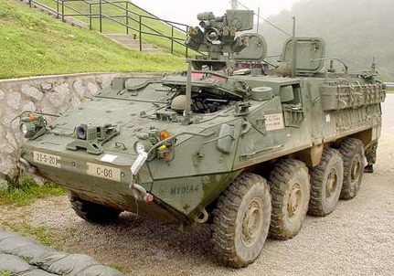
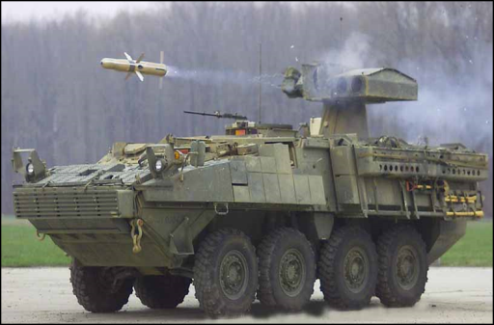
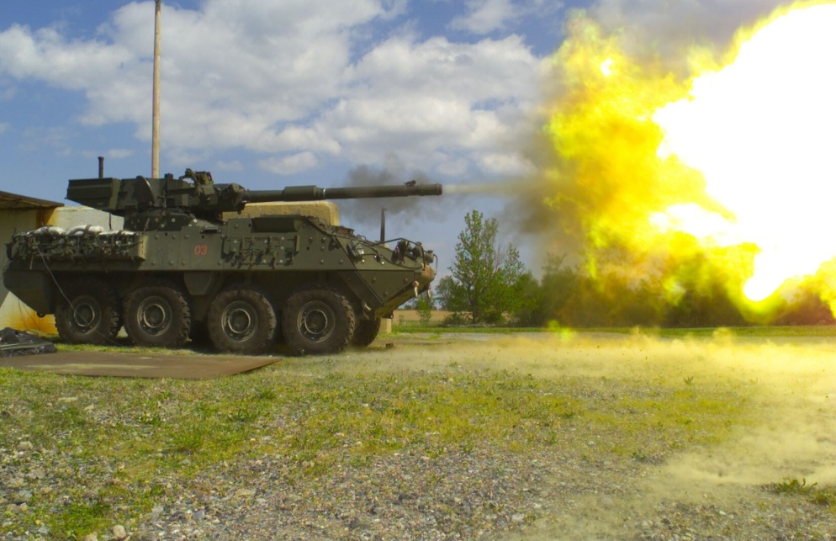
Stryker Master Gunner Purpose, Scope, and Outcomes
Course Scope
The curriculum focuses on the following training areas:
Weapon System Technology: perform diagnostic maintenance procedures to identify, troubleshoot, and repair complex malfunctions that occur in the weapon systems of Stryker vehicles; train ammunition capabilities to develop baseline data used in the analysis of weapons function.
Gunnery Training Management: assess a unit gunnery program and develop effective training plans through the use of supervised decentralized preliminary gunnery training, and integration of TADSS. Trains students on advanced gunnery methodology to identify crew procedural errors that may lead to missed engagements, and training strategies to improve overall unit/crew gunnery performance.
Course Purpose
Train and educate select Noncommissioned Officers to assist unit leaders in the planning and implementation of gunnery training programs to train unit combat vehicle crews and platoons in direct fire engagements and to perform Unit level maintenance on the Stryker family of vehicles fire control and weapon systems.
Outcomes:
Demonstrate technical competence on fire control and weapons systems.
Demonstrate the ability to make appropriate use of available TADSS.
Develop a Direct Fire Sustainment Plan to imbed in a Unit Training Plan using the Army Training Management process.
Target Audience
Primary
Active Army and National Guard Noncommissioned Officers who are assigned to an SBCT unit.
General Course Information
Class Size:
Minimum-6 Optimum-18 Maximum-18
Instructors Earned: 11
Last POI Approved Date: New Course

Slide 7
Stryker Platform Track
Day 01
Day 02
Day 03
Day 04-06
Day 07-09
MG Intro/ MG Program/ Computer Issue | Maint Orientation/ Stryker Cap Brief | Basic Electricity and Schematics | Remote Weapon System | Anti Tank Guided Missile
Day 19
Day 18
Day 12-17
Day 11
Day 10
Maint Exam II | MGS Seminar | Mobile Gun System | Maint Exam I | RWS ATGM Seminar
Day 20
Day 21
Day 22
Day 23
Day 24-26
Ammo Cap / Chara 7.62 - TOW | Adv Conduct of Fire | SBCT TADSS | Prep to Fire Checks TADSS Cont | Combined Arms Stryker Live Fire Range
Day 35 -36
Day 29-34
Day 28
Day 27
Exam IV Graduation | Gunnery Training Management | Weapon System Tech Exam | Weapon System Tech Seminar

Slide 8
MGS Commander Course Purpose, Scope, and Outcomes
Course Scope
This is a systems-intensive course that trains the student to function as a Mobile Gun System Commander. Instruction will consist of training crew stations and duties, boresighting and synchronization, ammunition, crew maintenance, turret / hull troubleshooting and safety. Students will be trained using conventional training methods, stand-alone training devices, simulators, and simulations culminating with a live fire exercise.
Target Audience
Primary
Active Army or Reserve Component Commissioned Officers (BC 19A) and Noncommissioned Officers (SPC(P) to SFC) (MOS 19K), who are assigned to, or may be assigned to an MGS-equipped unit.
Course Purpose
To train Noncommissioned Officers and Commissioned Officers to be technically and tactically proficient on the Mobile Gun System
Outcomes:
Able to perform all critical tasks of operating the Ammunition Handling System, commander’s station, gunner’s station, and live fire gunnery skills training.
Able to operate, maintain, troubleshoot, and service the Mobile Gun System.
Knowledge of MGS vehicle Safety.
General Course Information
Class Size:
Minimum-4 Optimum-8 Maximum-8
Instructors Earned: 1
Last POI Approved Date: 15 July 2009

Slide 9
MGS Commander Course Map
DAY X
DAY 1
DAY 2
DAY 3
Report
IN-Processing /MGS-VCC Intro/ MGS Safety
Description and Function
Operate Commander Station
DAY 9
DAY 8
DAY 7
DAY 5-6
DAY 4
Perform AAC’s/ Troubleshooting Procedures/Crew Evac
Perform Boresight Procedures
Perform PMCS on a MGS
Ammunition Handling System
Operate Gunner Station
DAY 10
DAY 11
DAY 12
DAY 13
DAY 14
Target Acquisition/
MGS Conduct of Fire
Plan Conduct Gunnery Training
Operate Machine Guns
Crew Gunnery Skills Test
Operate
TESS
DAY 20
DAY 19
DAY 18
DAY 15-17
Graduation
Out-Process/
AAR
Seminar/Final Examination
Service Main Gun
AGTS
 | FY 13 | FY 14 | FY 15 | FY 16 | FY 17
SMDR | 20 | 30 | 20 | 15 | 24
Trained (total) | 0 | 24 | 22 | NA | NA

