Slide 1
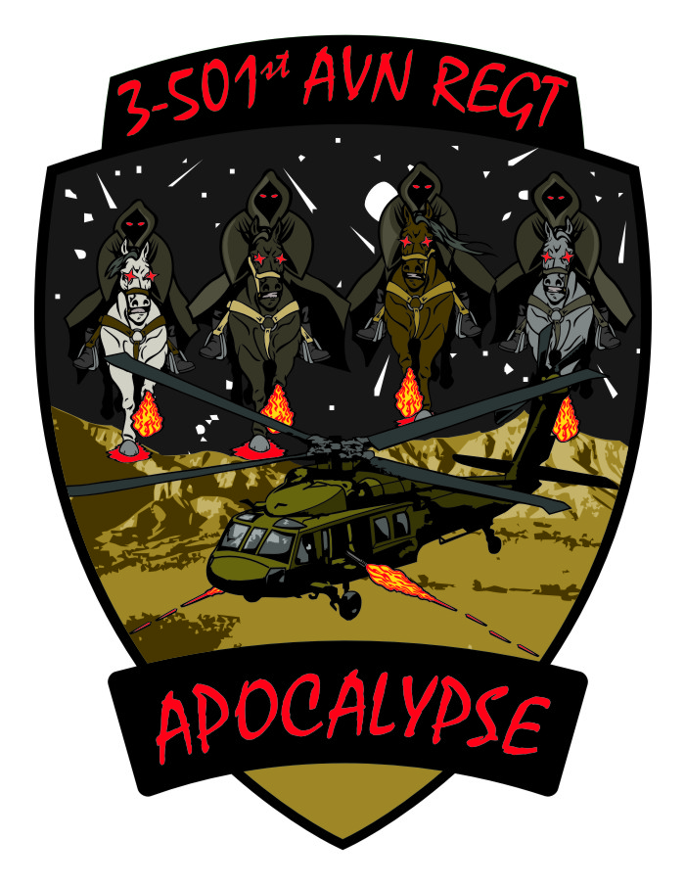
Mission Analysis Brief

Slide 2
Agenda
Higher Headquarters Mission & Commander’s Intent
Problem Statement
Intelligence Preparation of the Battlefield
Facts & Assumptions
Constraints
Specified, Implied, & Essential Tasks
Mission Statement
Available Assets & Resource Shortfalls
Initial Risk Assessment
Information Themes & Messages
CCIRs & EEFIs
Planning Timeline

Slide 3
2 Levels Up Mission
Determine how the unit—by task and purpose—contributes to the mission, commander’s intent, and concept of operations of the higher headquarters. Seek to understand:
The higher headquarters’:
  Commander’s intent.
  Mission.
  Concept of operations.
  Available assets.
  Timeline.
The missions of adjacent, supporting, and supported units and their relationships to the higher
headquarters’ plan.
The missions of interagency, intergovernmental, and nongovernmental organizations that work
in the operational areas.
The area of operations.
When analyzing the higher order, you may identify difficulties and contradictions . Seek immediate clarification. Liaison officers or collaborative planning with the higher headquarters facilitates this task. Use requests for information to clarify or obtain additional information from the higher headquarters.

Slide 4
2 Levels Up Commander’s Intent
Purpose: Purpose.
Key Tasks:
Key Tasks
End State: End state.

Slide 5
Higher HQ Mission
Mission.

Slide 6
Higher HQ Commander’s Intent
Purpose: Purpose.
Key Tasks:
Key Tasks
End State: End state.

Slide 7
Problem Statement
Problem framing involves understanding and isolating the root causes of conflict—defining the essence of a complex, ill-structured problem. Problem framing begins with refining the evaluation of tendencies and potentials and identifying tensions between existing conditions and the desired end state. It articulates the expectation of how the operational variables can resist or facilitate transformation and how you can leverage environmental inertia to ensure achievement of the desired conditions.
The problem frame is a refinement of the environmental frame that defines, in text and graphics, the area for action that will transform existing conditions toward the desired end state. The problem frame extends beyond analyzing interactions and relationships in the operational environment. It identifies areas of tension and competition—as well as opportunities and challenges—that commanders must address to transform current conditions to achieve the desired end state.
A concise problem statement clearly defines the problem or problem set to solve.

Slide 8
Intelligence Preparation of the Battlefield
Step 1: Define the operational environment
Step 2: Describe environmental effects on operations
Step 3: Evaluate the threat
Step 4: Determine threat COAs
Refer to F 3-24.2, Tactics in Counterinsurgency (COIN), for a thorough discussion on IPB in COIN operations.

Slide 9
Staff Section
Facts
Assumptions
A fact is a statement of truth or a statement thought to be true at the time. Facts concerning the operational and mission variables serve as the basis for developing situational understanding, for continued planning, and when assessing progress during preparation and execution.
An assumption is a supposition of the current situation or a presupposition of the future course of events , either or both assumed to be true, necessary to complete an estimate of the situation and conduct planning.
Assumptions generate a request for information to a higher headquarters. Continually attempt to replace them with facts.

Slide 10
Constraints
A constraint is a restriction placed on the command by a higher command. A constraint dictates an action or inaction, thus restricting freedom of action. The operation overlay, for example, may contain a restrictive fire line or no fire area. Constraints may also be issued verbally, in WARNOs, or in policy memoranda.
Constraints may also be based on resource limitations within the command, such as organic fuel transport capacity, or physical characteristics of the operational environment, such as the number of vehicles that can cross a bridge in a specified time.
Coordinate with the Staff Judge Advocate for a legal review of perceived or obvious constraints, restraints, or limitations in the OPLAN, OPORD, or related documents.

Slide 11
Staff Section
Specified Tasks
Implied Tasks
A specified task is a task specifically assigned to a unit by its higher headquarters. Paragraphs 2 and 3 of the higher headquarters’ order or plan state specified tasks. Some tasks may be in paragraphs 4 and 5. Specified tasks may be listed in annexes and overlays. They may also be assigned verbally during collaborative planning sessions or in directives from the higher commander.
Be prepared or on-order missions are specified tasks. A be-prepared mission is a mission assigned to a unit that might be executed. Generally a contingency mission, they are used when something planned has or has not been successful. In planning priorities, plan a be-prepared mission after any on-order mission. An on-order mission is a mission to be executed at an unspecified time. A unit with an on-order mission is a committed force.
An implied task is a task that must be performed to accomplish a specified task or mission but is not stated in the higher headquarters’ order. Implied tasks are derived from a detailed analysis of the higher headquarters’ order, the enemy situation, the terrain, and civil considerations. Additionally, analysis of doctrinal requirements for each specified task might disclose implied tasks.

Slide 12
Essential Tasks
An essential task is a specified or implied task that must be executed to accomplish the mission. Essential tasks are always included in the unit’s mission statement.

Slide 13
Mission Statement
A mission statement is a short sentence or paragraph that describes the organization’s essential task (or tasks) and purpose—a clear statement of the action to be taken and the reason for doing so. The mission statement contains the elements of who, what, when, where, and why, but seldom. The five elements of a mission statement answer the questions:
Who will execute the operation (unit or organization)?
What is the unit’s essential task (tactical mission task)?
When will the operation begin (by time or event) or what is the duration of the operation?
Where will the operation occur (AO, objective, grid coordinates)?
Why will the force conduct the operations (for what purpose)?
Use tactical mission tasks or other doctrinally approved tasks contained in combined arms field manuals or mission training plans. These tasks have specific military definitions that differ from dictionary definitions. FM 3-90 describes each tactical task. FM 3-07 provides a list of primary stability tasks which military forces must be prepared to execute. Commanders and planners should carefully choose the task that best describes the commander’s intent and planning guidance.
For example:
1-509th Parachute Infantry Regiment (who) seizes (what/task) JACKSON INTERNATIONAL AIRPORT (where) not later than D-day, H+3 (when) to allow follow-on forces to air-land into AO SPARTAN (why/purpose). On order (when), secure (what/task) OBJECTIVE GOLD (where) to prevent the 2d Pandor Guards Brigade from crossing the BLUE RIVER and disrupting operations in AO SPARTAN (why/purpose).

Slide 14
Available Assets
Examine additions to and deletions from the current task organization, command and support relationships, and status (current capabilities and limitations) of all units. Include capabilities of civilian and military organizations (joint, special operations, and multinational) that operate within the AO. Consider relationships between specified, implied, and essential tasks and available assets.

Slide 15
Resource Shortfalls
Determine if the assets needed to complete all tasks are available. If shortages occur, identify additional resources needed for mission success to the higher headquarters.

Slide 16
Initial Risk Assessment
Risk management is the process of identifying, assessing, and controlling risks arising from operational factors and making decisions that balance risk costs with mission benefits. See FM 5-19 for a detailed discussion of the four steps of composite risk management.

Slide 17
Information Themes & Messages
An information theme is a unifying or dominant idea or image that expresses the purpose for military action. Information themes tie to objectives, lines of effort, and end state conditions. They are overarching and apply to capabilities of public affairs, military information support operations, and leader and Soldier engagements. A message is verbal, written, or electronic and supports an information theme focused on a specific actor or the public and in support of a specific action (task).

Slide 18
CCIRs
FFIRs
PIRs
Commander’s Critical Information Requirements (CCIRs) are information elements required for the successful conduct of operations.
Friendly force information requirements are needed to understand the status of friendly force and supporting capabilities.
Priority information requirements are those intelligence requirements stated as a priority for intelligence support needed to understand the adversary or the operating environment.

Slide 19
EEFIs
Essential elements of friendly information (EEFIs) establish an element of information to protect rather than one to collect. EEFIs identify those elements of friendly force information that, if compromised, would jeopardize mission success. Like CCIRs, EEFIs change as an operation progresses.

Slide 20
Planning Timeline

Slide 21
Command Sergeant Major

Slide 22
Battalion Commander

