Slide 1
Tow Bar Inspections
Check all surfaces of the tow bar assembly, especially the welds, for corrosion and cracks; if found, do not use the tow bar.
Check for wearing or deformation on the lunette. Measure different points of the lunette and compare them; If there is more than a 10% difference in the measurements, replace the lunette or do not use the tow bar.
Check for bent or bowed tow bar legs; if found, do not use the tow bar.
Inspect tow bar pins for signs of wear. Tow bar pins should not have any play when installed. If they do, they should be replaced.
Inspect tow bar pin holes for deformation. If found, replace the component or do not use the tow bar.
Tow bar adapters should not have more than ¼ to ½ inch side play when connected to vehicle tow provisions.
Extracted from Tow Bar Smart Book 2014

Slide 2
Typical weld areas
lunette
hitch pin
clevis
pin

Slide 3
Cracked Weld

Slide 4
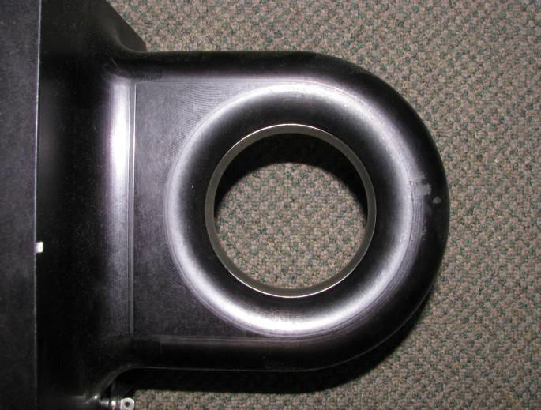
Lunette Checks
Material wear
Roundness of hole – diameter should be constant

