Slide 1
“Affecting Introductions”: Tools to Tools…

Slide 2
“Affecting introductions”: It is what I do…it’s my job.
…among people, processes, organization, and tools.
Ask questions…it teaches imagination
“What does that really mean…?
“What do you actually mean by that…?
“Would you please explain that one more time?”

Slide 3
“Affecting introductions:” MS Outlook and MS Sharepoint (webparts)
See this in MS Outlook…
…from MS Sharepoint.
Notes:
https://www.milsuite.mil/book/people/guy.h.buice/blog/2015/04/28/km-technique-in-90-seconds-or-less-interact-with-an-authoritative-sharepoint-task-list-via-msoutlook
Connect to OUTLOOK and

Slide 4
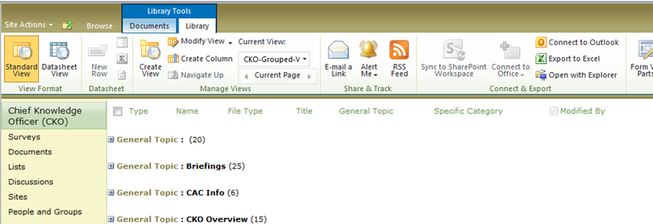
“Affecting introductions:” MS Sharepoint and MS Outlook (documents)
Do this in Sharepoint…
Observe this in OUTLOOK.
Notes:
By “connecting to OUTLOOK” one is able to interact with Sharepoint Documents.
…not copies of them.
This alleviates some concern over version control.

Slide 5
“Affecting introductions:” MS Sharepoint and MS Outlook…(calendars)
Do this from SharePoint…
Observe the association with your own calendar in OUTLOOK.

Slide 6
“Affecting introductions:” MS Sharepoint and MS Outlook (Contacts)
Do this in SharePoint…
Observe this in Outlook

Slide 7
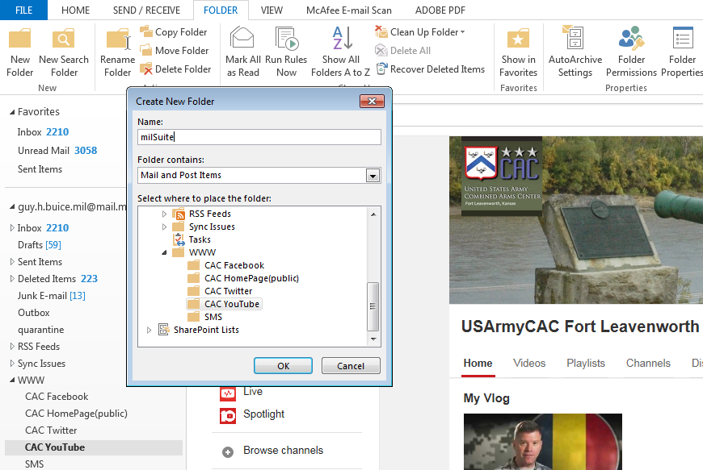
“Affecting introductions:” MS Outlook and the WWW…
Do this in OUTLOOK…
Observe this WEBlink from OUTLOOK folders.
1
2)
3 (give it a name)
4) <click> OK
Notes:
https://www.milsuite.mil/book/people/guy.h.buice/blog/2015/05/03/new-km-technique-in-90-seconds-or-less-interact-with-browser-and-webpages-from-ms-outlook-may-2015

Slide 8
“Affecting introductions:” MS Outlook signature block and milSuite…
Signature block in OUTLOOK…
…to your profile in milSuite.
Notes:
https://www.milsuite.mil/book/people/guy.h.buice/blog/2015/07/07/km-technique-in-90-seconds-hyperlink-ones-milsuite-profile-page-to-your-ms-outlook-signature-block

Slide 9
“Affecting introductions:” MS Outlook and SMS…

Slide 10
“Affecting introductions:” MS SharePoint and SMS…
Establish a link in Sharepoint…
…observe this in SMS

Slide 11
“Affecting introductions:” SMS and documentation in milSuite…
Click this in SMS…
…arrive at this in milSuite.

Slide 12
“Affecting introductions:” milSuite and SMS…
From this in milSuite…
…access this in SMS

Slide 13
Questions? Fragen? Preguntas?

