Slide 1
High Frequency (HF) NVIS
04 December 2014

Slide 2
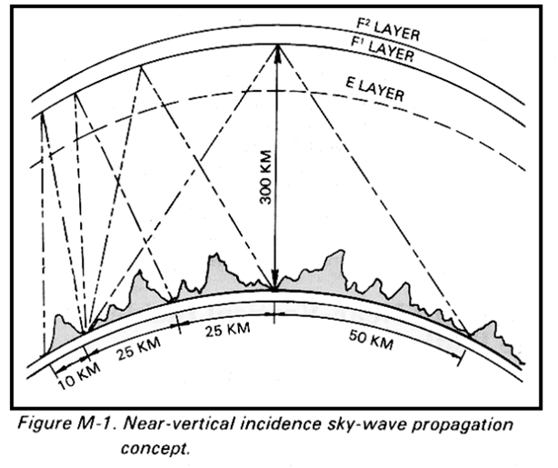
What is NVIS?
NVIS stands for Near Vertical Incidence Skywave.
NVIS is a form of HF propagation which consists of properly configured antennas, and correctly chosen frequencies so as to allow for signal reflection from the earths ionosphere.
As the picture to the right shows, by having a high take off angle (roughly 50 to 90 degrees) NVIS allows for communication to take place beyond LOS (Ground Wave) range of the receiving stations.
The HF frequency range is from 1.6 to 30 MHz. However; NVIS is normally conducted from 2.0 to 10 MHz (based on atmospherics)
NVIS Rule of Thumb:
Night Time: 2 - 4 MHz
Day Time: 5 – 8 MHz
(This can and will change based on current atmospherics)

Slide 3
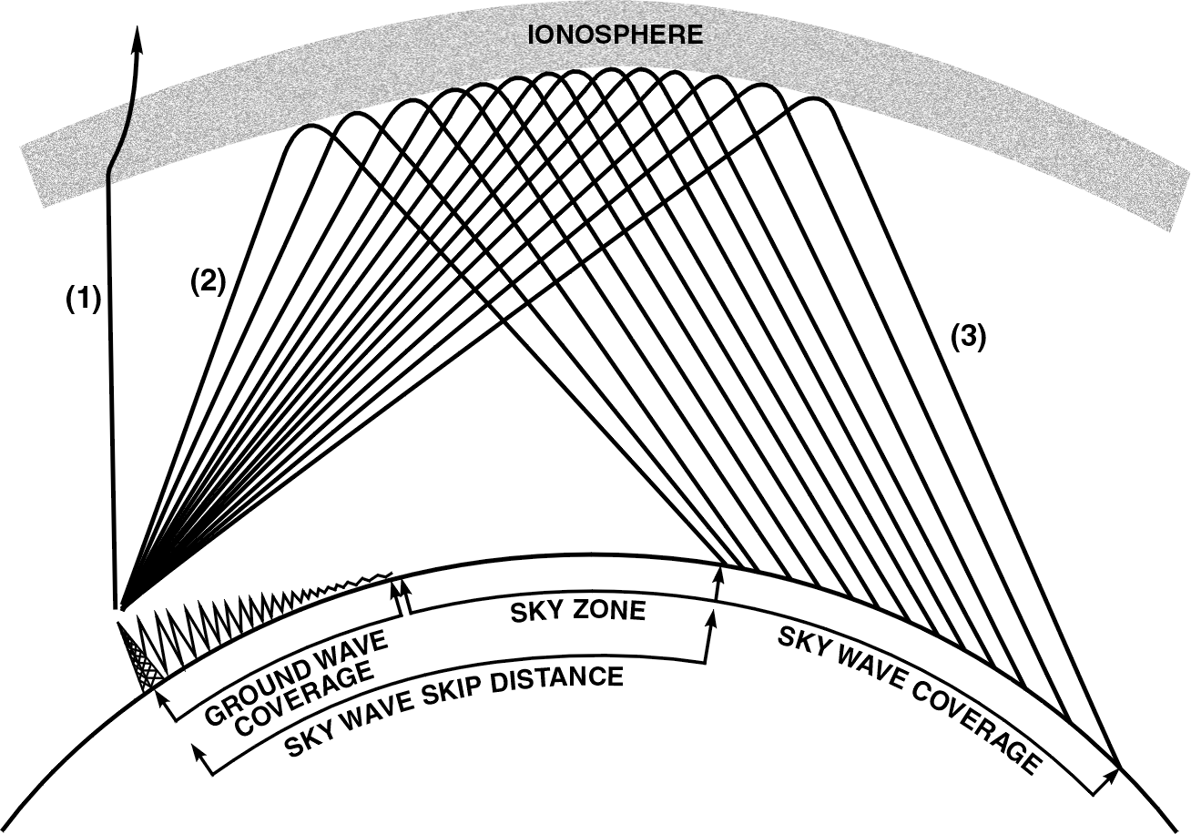
What is NVIS?
As illustrated by the picture on this slide; HF communications can comprise of
both Ground wave Sky Wave signals.
As shown, a Sky Wave skip zone is created if the height of the antenna is
Not not carefully planned out.
If a dipoles height is ½ a
wavelength above ground the
propagation becomes directional;
thereby, creating a skip zone.
The skip zone is required if medium
to long Range communications
(500 miles or more) is desired; not
when operating NVIS
Key take away: There is no Skip
Zone Unless you as the user
creates it!

Slide 4
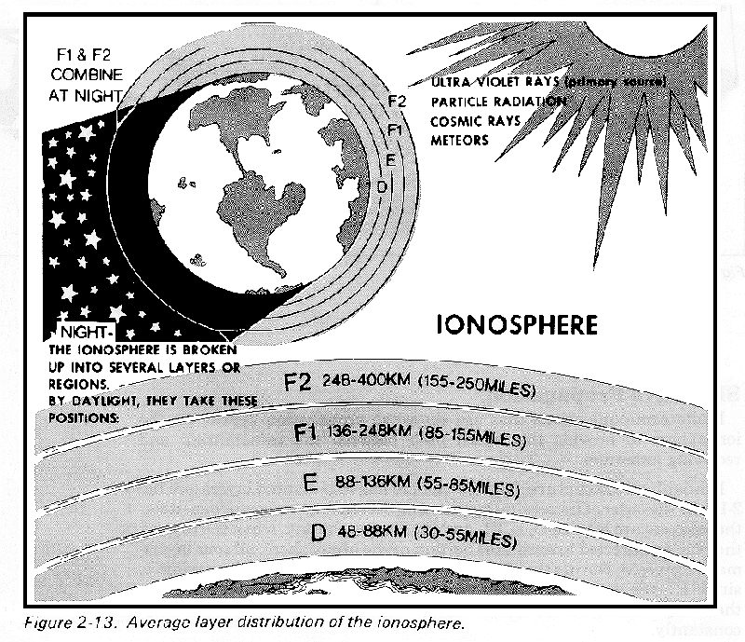
The Ionosphere
Earth has 4 ionospheric layers
that affect HF communications, they
are D, E, F1 and F2.
NVIS signals are reflected by the
F2 layer, therefore, during daylight
hours the single needs to be high
enough to travel though the D and E
layers and not be totally absorbed.

Slide 5
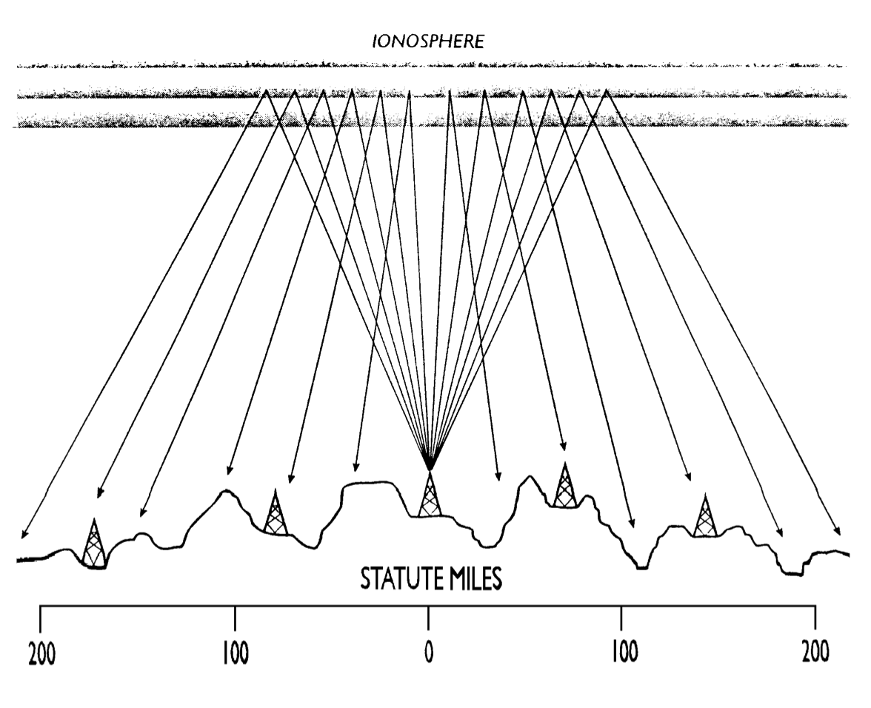
Typical NVIS HF Net
NVIS allows for reliable communication
between distant stations with low power.
20 watts is more than
enough power to reach out
to roughly 200 to 400 miles
+/- 50 miles.
A properly generated
NVIS signal has a limited
ground wave signal; therefore,
the vertically propagating signal
is very difficult for an enemy
to Direction-Find.

Slide 6
Advantages of NVIS
NVIS propagation requires no external infrastructure. Two or more stations properly using NVIS techniques can establish reliable communications without any third party support.
Properly employed NVIS can dramatically reduce noise and interference, resulting in an improved signal/noise ratio (SNR).
NVIS works well with low power due to low noise levels and its inherently improved SNR.
NVIS propagation can overcome communication obstacles, such as valleys and mountainous terrain with relative ease.
Antennas optimized for NVIS are usually low. Simple ½ wavelength dipoles work very well. A good NVIS antenna can be erected easily, in a short amount of time.
The optimum height for a dipole is anywhere from 7 to 15 feet above ground; however, lower & higher antennas can still propagate NVIS.

Slide 7
NVIS and HF Propagation terms
HPF = Highest Probable Frequency: The highest frequency at which ionospheric propagation between specific locations will be available 10% of the time.
MUF = Maximum Usable Frequency: The highest frequency at which ionospheric propagation between specific locations will be available 50% of the time.
LUF = Lowest Usable Frequency: The lowest frequency at which ionospheric propagation between specific locations and using specific power levels, receiving equipment and antennas will be available 50% of the time.
FOT = Frequency of Optimum Traffic: The highest frequency at which ionospheric propagation between specific locations will be available 90% of the time.
The best operating frequency is usually 15 to 25% below the MUF. Propagation is affected by the time of year, day, and solar activity.
FC = Critical Frequency: is the highest frequency that if above the waves penetrate & pass though the ionosphere and if below which the waves are reflected back from the ionosphere.
One propagation tool that can be used when planning for NVIS is VOACAP. VOACAP will calculate your MUF, LUF and FOT; thereby allowing you as the planner, to properly plan and request frequencies that will meet your needs.
It can be downloaded from either www.voacap.com or from the Harris radio website (includes Harris radio enhancements. i.e. Harris antennas added)

Slide 8
HF NVIS Antenna Types & Configuration
½ Wave Length dipole
234/freq = one leg of the dipole
468/freq = total dipole length
Inverted V
Inverted L
End fed Random Wire Antenna
Terminated Folded dipole (Barker & Williamsons)
Vehicle Whip (Next two slides display take off angle of vehicle mounted whips)

Slide 9
Vehicle whip to the rear propagation pattern

Slide 10
Vehicle whip forward propagation pattern

Slide 11
Classic ½ Wave Center fed Dipole Cut to lowest used frequency
1/2 wave length
¼ wave length
¼ wave length
Insulator or wire winder
1:1 Current Balun
or RF Choke
PRC 150

Slide 12
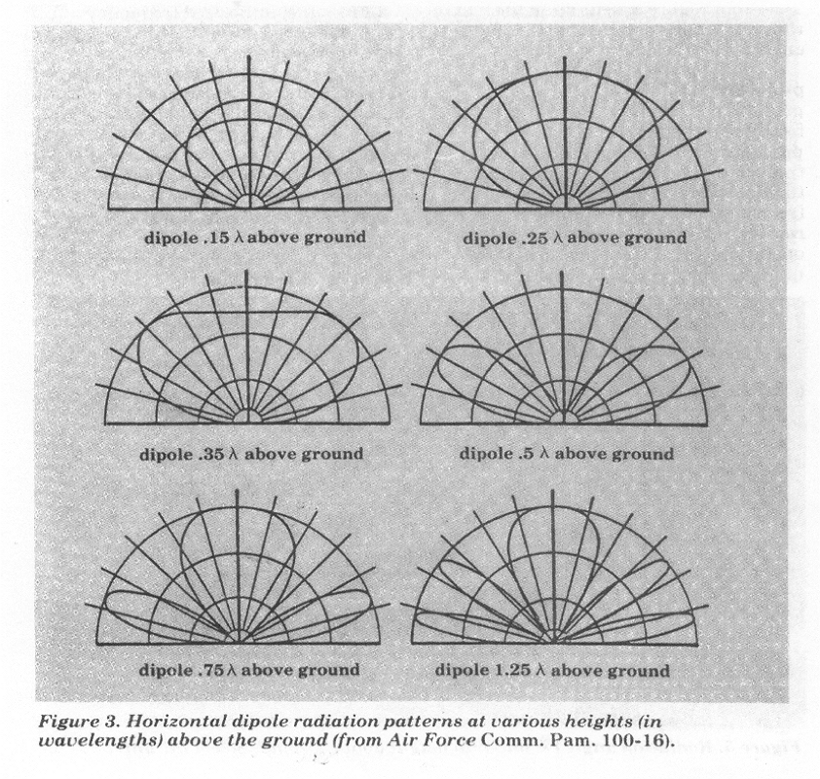
Typical dipole radiation patterns
These radiation patters are what one
could expect as they changed their
dipoles height.
This image only shows the radiation
patterns and not the antennas gains or loss.
As you lower the antenna the impedance
of a resonate dipole also changes. If a
Dipole is roughly 1/4 wave length or less
above ground its feed point impendence will
drop and be around 50 Ohms.
Having an antenna impendence of 50
Ohms will easily match that of the standard
50 Ohm Coax cable, along with the 50 ohms
that the RT tuner is expecting.
Key Note: the closer the impendence is to
50 Ohms the less likely it is that your VSWR
Will be above 2.0:1.

Slide 13
Inverted V
PRC 150

Slide 14
Inverted L (Not the best for NVIS but provides both a Monopole and dipole radiation pattern)
15 to 20 feet high
Horizontal Radiating
Vertical Radiating
Coax
4:1 or 9:1 unun
Ground and or Counterpoise(s)
(Optional based on specifics)
PRC 150

Slide 15
End fed Wire Antenna
2 to 4 feet pole,
Humvee, building etc.
4:1 or 9:1 unun
60 to 75 feet long
Ground rod
(Optional based on specifics)
Counterpoise(s)
(Optional based on specifics)
Coax (can act as a
Counterpoise) if used
As Counterpoise it is
recommended to add an
RF choke 1:1 balun, to
eliminate common mode
current.
PRC 150

Slide 16
B&W Terminated Folded dipole
600 Ohm non-inductive resistor
12:1 Balun
Frequency coverage 1.8 to 30 MHz
(Very quiet antenna system and only
90 feet long)
PRC 150

Slide 17
AN/PRC 150 ALE Operations
ALE (Automatic Link Establishment): The AN/PRC 150 currently uses both ALE 2G and ALE 3G.
ALE 3G is the most current version and offers the best performance; however, it requires that all radios within the net to be synced (time) to operate.
A GPS can be used for timing, or you can configure a single radio in the NET to act as a TOD server
ALE 3G can only have 10 channels within a single channel plan; unlike ALE 2G which can accept more than 10 per channel group.
ALE 2G can be fully programed at the radio, while ALE 3G needs to be programed on a computer using Harris’s radio programing software.

Slide 18
VOACAP HF Propagation
Dec 2014 SSN = 100. Minimum Angle= 0.100 degrees
Ft Irwin West side Ft Irwin East AZIMUTHS N. MI. KM
35.42 N 117.39 W - 35.41 N 116.33 W 90.36 270.97 51.9 96.0
XMTR 2-30 HARRIS99 [harris\1940@5M.ANW ] Az= 0.0 OFFaz= 90.4 0.020kW
RCVR 2-30 HARRIS99 [harris\1940@5M.ANW ] Az=271.0 OFFaz=360.0
3 MHz NOISE = -145.0 dBW REQ. REL = 90% REQ. SNR = 73.0 dB
GMT LMT FOT HPF MUF LUF
18.0 10.2 8.63 11.44 10.03 -10.03
19.0 11.2 9.19 12.18 10.69 -10.69
20.0 12.2 9.51 12.61 11.06 -11.06
21.0 13.2 9.61 12.74 11.17 -11.17
22.0 14.2 9.46 12.53 11.00 -11.00
23.0 15.2 8.95 11.86 10.40 -10.40
24.0 16.2 8.07 10.70 9.39 -9.39

