Slide 1
Role of the Noncommissioned Officer (NCO)
SGM Michael K. Hackett, BDE Operations SGM, 361st Civil Affairs BDE

Slide 2
Agenda
Army Leaders
Relationships
Enhancing the Relationship
NCO Support Channel
We all have a Sergeant
NCO Creed
Roles by Rank
Authority
Commissioned / Noncommissioned Officer a comparison

Slide 3
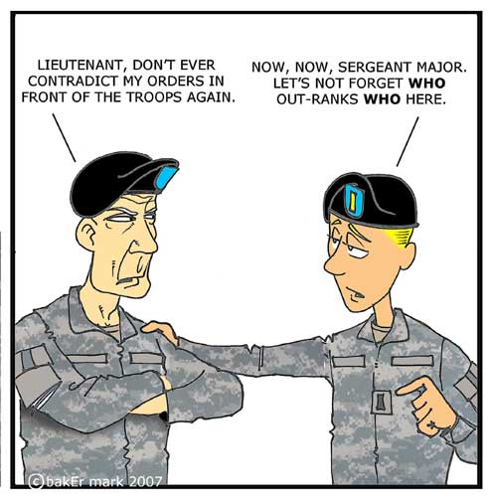
Some Humor

Slide 4
Army Leaders
“When the Army speaks of Soldiers, it refers to officers, NCOs and enlisted men and women. The roles and responsibilities of Army leaders overlap and complement each other. Formal Army leaders come from three different categories two of which are: Commissioned officers, and Noncommissioned Officers. Collectively, these two groups work toward a common goal and follow a shared value system.”

Slide 5
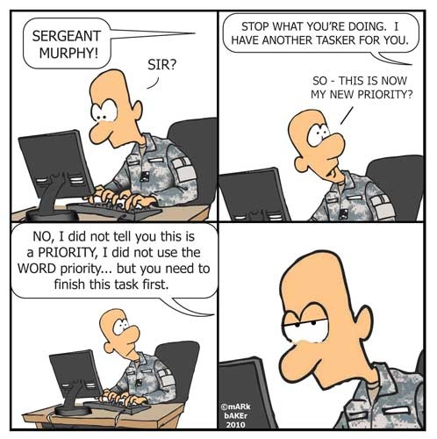
Some Humor

Slide 6
Relationships
Mutual trust and common goals are the two characteristics that enhance the relationship between Officers and NCOs. For instance, “NCOs have roles as trainers, mentors, communicators, and advisors. When junior officers first serve in the Army, their NCO helps to train and mold them. Doing so ensures Soldier safety while forming professional and personal bonds with the officers based on mutual trust and common goals” NCOs are “the backbone of the Army” and are the senior enlisted advisors who assist Commanders with knowledge and discipline for all enlisted matters.

Slide 7
NCO Support Channel
The NCO Support Channel (leadership chain) parallels and complements the chain of command. It is a channel of communications and supervision from the Command Sergeant Major (CSM) to 1SG and then to other NCOs and enlisted personnel of the unit.
Commanders define responsibilities and authority of their NCOs to their staff and subordinates by:
Transmitting, instilling, and ensuring the efficacy of the professional Army ethic
Planning and conducting day-to-day unit operations within prescribed policies and directives
Training of enlisted Soldiers in their MOS as well as in the basic skills and attributes of a Soldier.
Supervising unit physical fitness training and ensuring that unit Soldiers comply with the weight and appearance standards of AR 600–9, and AR 670–1.

Slide 8
NCO Support Channel Cont.
Teaching Soldiers the history of the Army, to include military customs, courtesies, and traditions.
Caring for individual Soldiers and their Families, on and off duty.
Teaching Soldiers the mission of the unit and developing individual training programs to support the mission.
Accounting for and maintaining individual arms and equipment of enlisted Soldiers and unit equipment under their control.
Administering and monitoring the Noncommissioned Officer Development Program
Achieving and maintaining courage, candor, competence, commitment, and compassion.

Slide 9
We all have a Sergeant
Every Soldier has a Sergeant. Officers are no exception. Platoon Sergeants, First Sergeants, Sergeants Major and Command Sergeants Major at all levels serve as their respective officer’s Sergeant.

Slide 10
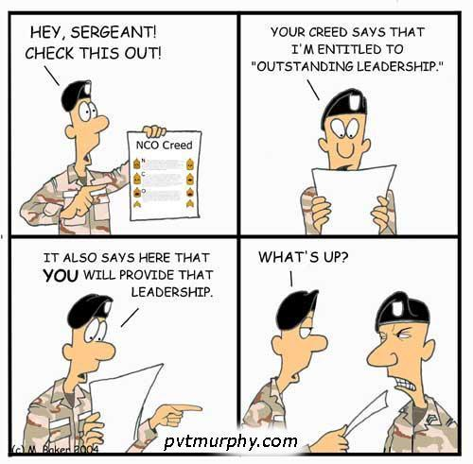
Some Humor

Slide 11
NCO Creed
No one is more professional than I. I am a noncommissioned officer, a leader of Soldiers. As a noncommissioned officer, I realize that I am a member of a time honored corps, which is known as "The Backbone of the Army". I am proud of the Corps of noncommissioned officers and will at all times conduct myself so as to bring credit upon the Corps, the military service and my country regardless of the situation in which I find myself. I will not use my grade or position to attain pleasure, profit, or personal safety.
Competence is my watchword. My two basic responsibilities will always be uppermost in my mind—accomplishment of my mission and the welfare of my Soldiers. I will strive to remain technically and tactically proficient. I am aware of my role as a noncommissioned officer. I will fulfill my responsibilities inherent in that role. All Soldiers are entitled to outstanding leadership; I will provide that leadership. I know my Soldiers and I will always place their needs above my own. I will communicate consistently with my Soldiers and never leave them uninformed. I will be fair and impartial when recommending both rewards and punishment.
Officers of my unit will have maximum time to accomplish their duties; they will not have to accomplish mine. I will earn their respect and confidence as well as that of my Soldiers. I will be loyal to those with whom I serve; seniors, peers, and subordinates alike. I will exercise initiative by taking appropriate action in the absence of orders. I will not compromise my integrity, nor my moral courage. I will not forget, nor will I allow my comrades to forget that we are professionals, noncommissioned officers, leaders!

Slide 12
Sergeant (SGT)
Actions of Sergeants determine the outcome of battles and issues during home station operations
First line Leaders having the most direct impact on Soldiers
Supervision at the team level
Responsible for counseling, training and care of Soldiers
First line of the NCO Support Channel

Slide 13
Staff Sergeant (SSG)
Leads Squads and Sections
Live and work with Soldiers everyday
Responsible for health, welfare and safety
Ensure Soldiers meet standards of personal appearance
Teaches Soldiers to maintain and account for individual and unit equipment and property
Enforces standards, develops and trains Soldiers in MOS skills and unit missions
Secondary role is support to the Chain of Command through the NCO Support Channel

Slide 14
Sergeant First Class (SFC)
Platoon Sergeant is a duty not a rank
Helps the Commander to train the Platoon Leader
Has an enormous effect on how young officers perceive NCOs for the remainder of their career
Takes charge of the Platoon in the absence of the Platoon Leader
Teaches and trains collective and individual tasks to Soldiers in squads, crews and small units
May serve as NCOIC of a section with Platoon Sergeant responsibilities
Has extensive military experience and is capable of making informed decisions in the best interest of the mission and Soldier

Slide 15
First Sergeant/Master Sergeant (1SG/MSG)
1SG is the Senior NCO in companies, batteries and troops
Position is similar to CSM in importance, responsibility and prestige
Requires extraordinary leadership and professional competence
Maintains daily contact with and responsible for training and ensuring health and welfare of the entire unit and Families
Enforces discipline
Fosters loyalty and commitment in their Soldiers
Maintains duty rosters
Performs drills
Makes morning reports to the Company Commander
MSG serves as principle NCO in Battalion or higher level staffs
Just as professional as the 1SG in dispatching leadership and executing duties

Slide 16
Command Sergeant Major/Sergeant Major (CSM/SGM)
CSM is the Senior NCO of the Command at Battalion or higher levels
Carries out policies and standards on performance, training, appearance and conduct enlisted personnel
Provides advice and make recommendations to the Commander and staff in matters pertaining to the organization
Directs activities of the NCO Support Channel
Administers the NCO Development program (NCODP)
The training professional of the unit the CSM drives and oversees the entire training program
Assists the Commander in determining leader tasks and training for NCOs
SGM is the key enlisted member of staff elements at Battalion and higher levels
Experience and ability equal to the CSM with leadership limited to those in his/her charge
Expert in his/her technical field, primary advisor on policy development, analytical reviewer of regulatory guidance and when absent fulfills the duties of the CSM

Slide 17
Authority
Commissioned officer
Noncommissioned officer
Holds a commission from the President of the United States.
Authorized to act as the President’s representative in certain military matters.
Carries out the orders of the Commander-in-Chief as handed down through the Chain of Command
Commissioned officers get considerable help, assistance and advice from NCOs.
Obtains authorities as agents of the Secretary of the Army outlined in Army regulations.
Supports the Command Authority of Commissioned Officers
As the Secretary of the Army’s representatives, Noncommissioned Officers carry out the orders of the Commander-in-Chief through the chain of command.
In carrying out orders, Noncommissioned Officers provide support, assistance and advice to officers.

Slide 18
Commissioned / Noncommissioned Officers a Comparison
Commissioned officer
Noncommissioned officer
Commands and establishes policy, plans, and programs the work of the Army
Must be technically and tactically proficient in his/her MOS and that of the organization
Concentrates on collective training of the unit to accomplish the mission
Attention to the standards of performance, training and professional development of officers as well as NCOs
Creates conditions – make time and other resources available – so the NCO can do the job.
Supports the NCO
Conducts the daily business of the Army within established orders, directives and policies
Focuses on individual training, which develops the capability to accomplish the mission
Primarily involved with training and leading Soldiers and teams
Ensures each subordinate team, NCO and Soldier is prepared to function as an effective unit and each member is well trained, highly motivated, ready and functioning
Concentrates on standards of performance, training, and professional development of NCOs and enlisted Soldiers
Follows orders of officers and NCOs in the support channel
Subject matter expert in their MOS, able to provide clear and concise input relevant to MDMP
Effective trainer, must develop foresight and keep standards high and possesses the courage to act
Gets the job done

Slide 19
Role of the NCO Summary
NCOs conduct the daily operations of the Army. NCOs are relied on to execute complex tactical operations, make intent-driven decisions and operate in joint, interagency, and multinational environments. NCOs are responsible for maintaining and enforcing standards and a high degree of discipline. NCOs process Soldiers for enlistment, teach basic Soldier Skills, are accountable for the care of Soldiers, and set the example. NCOs are trainers, mentors, advisors, and communicators.
SGM Michael K. Hackett, OPS SGM, 361st CA BDE

