Slide 1
Threat Assessment
Notes:
Instructor/Facilitator’s Note.
Introduce yourself if it is the first time you address these students.
Present the following MOTIVATOR:
It is extremely important that you identify the enemy's most likely and most dangerous Course
of Action (COA) and communicate it to your leadership in a timely manner. Your failure to do
this could result in placing everyone involved in extreme danger.
Note: Use this statement or develop one of your own relating to the material.
3. Make sure that students review the Treat Assessment Rubric prior to this class.

Slide 2
Terminal Learning Objective
ACTION: | Integrate Counter Improvised Explosive Device (C-IED) threat assessment into mission planning and execution
CONDITION: | In a classroom and field environment setting, given student resources, lesson plan, and current reference materials, operations order, and dismounted operation during a Situational Training Exercise (STX).
STANDARD: | Integrate C-IED threats IAW ATP 2-19.4, dismounted CIED Smart Book and achieve a score of 80% or greater on threat assessment rubrics during tactical mission planning 1, 2 and 3. The integration includes: 1. Integrate Counter C-IED threats assessment into mission planning and execution. 2. Interpret the threat assessment triad. Learning Domain: Cognitive Learning Level: Synthesis
2
Notes:
Instructor/Facilitator’s Note.
Let students know that at the end of mission planning 1, 2 and 3, they will be able to: Integrate Counter Improvised Explosive Device (C-IED) threat assessment into mission planning and execution. To include the two LSAs:
a. Integrate Counter C-IED threats assessment into mission planning and execution.
b. Interpret the threat assessment triad.

Slide 3
Intelligence Tasks During Mission Analysis
Troop Leading Procedures
Mission
S-2 or CO Intel Rep provides input on specified/ implied/ essential tasks.
Terrain
AO / AI / AOI
Terrain
Obstacles
Avenues of approach
Key Terrain
Observation/ Fields of fire
Cover & Concealment
Weather
Visibility
Wind
1. Receive the mission
Initial timeline, possible mission
2. Issue the WARNO
5 Paragraph format (min info)
3. Make a tentative plan
a. Mission analysis
b. COA development
c. COA analysis
d. COA comparison
e. COA selection
4. Initiate Movement
XO, 1SG
5. Conduct Reconnaissance
6. Complete the plan
Orders Production
7. Issue the Order
Verbal, Terrain Model, Paper
8. Supervise and Refine
Confirm Briefs
Back Briefs
Rehearsals
PCC-1 down
PCI-2 down
Location-
Identify all
VA / VPs
Threat background
Analyzes the higher HQ order to determine how the higher commander views the enemy
Students will be evaluated when they apply this knowledge during the 2d week in tactical mission 1, 2 and 3 planning & execution.
Current Situation
To include IED specific threats
Time
Higher Times
Hard Times
Company/ Platoon TLPs
Light Data
Enemy Data
1/3, 2/3 rule
Evaluate effects of the enemy, terrain & weather, and civil/troops
HOPE
Enemy (THREAT ASSESSMENT TRIAD)
General Situation
Disposition
Composition
Strength
Capabilities by WFF
PCOA & MDCOA
Enemy Intent
Type of threat
Location of
threat
Civil/Troops
Leadership
Morale
Training & Experience
Capabilities by WFF
Special
Equipment
Ref. Chapter 3, section II, ATP 2-19.4
COA/Recommendation
Enemy’s most likely & most dangerous COA
Notes:
Instructor/Facilitator’s Note. This is Learning Step Activity 1 (LSA 1).
1. This class has direct link with the “Develop a Unit Training Program” class, which covers planning unit training and tactical mission planning IAW Troop Leading Procedures (TLP).
2. This slide covers the points listed in the “Threat Assessment Rubric”, and students will be evaluated against this rubric when students apply what they’ve learn in tactical mission 1, 2 and 3 planning and execution during the second week
3. The Bde S-2, BN S-2 or Company Intel representative conducts mission analysis simultaneously and in support of the S-2 or company commander in order to provide the enemy threat assessment view throughout the planning process.
4. Reference. Chapter 3, section II ATP 2-19.4 (FM 2-19.4), Brigade Combat Team Intelligence Techniques. This manual describes specific techniques used by the BCT and battalion intelligence cells for each step of the MDMP. This manual is written at Bde/BN level but it provides the basis for smaller unit intelligence/threat assessment process during mission planning.
5. RECEIPT OF MISSION. Paragraph 3-17. The commander identifies the unit’s mission, commander’s intent, area of operations, area of interest, and intelligence requirements.
Table 3-2. - Intelligence support to receipt of mission . Use intelligence reach to collect updated or additional enemy, terrain and weather, and civil considerations data.
6. Paragraph 3-21. Generally, the intelligence portion of mission analysis is an evaluation of the effects of the enemy, terrain and weather, and civil considerations within the area of operations. Additionally, the intelligence portion includes an analysis of the higher headquarters plan or order to determine critical facts and assumptions; specified, implied, and essential tasks; and constraints that affect operations.
7. THREAT BACKGROUND.
Analyze The Higher Headquarters Order
Paragraph 3-24. The S-2 analyzes the higher headquarters order to determine how the higher commander views the enemy and which higher command intelligence assets support operations. Specifically, the S-2 evaluates the following information:
● Threat characteristics.
● Enemy templates and COA statements for enemy COAs.
● Event templates and matrices.
● High-payoff target lists (HPTLs) and high-value target lists (HVTLs).
● Target packages on areas, structures, and individuals.
● Terrain analysis products showing the effects on friendly and enemy operations—natural and urban.
● Analysis of civil considerations, especially socio-cultural aspects of the local population in the BCT area of operations.
● Information operations, civil affairs, and military information support operations assessments.
8 The enemy Threat Assessment TRIAD will be discussed later during this class.
9. Students will be evaluated when they apply this knowledge during the 2d week in tactical mission 1, 2 and 3 planning & execution.

Slide 4
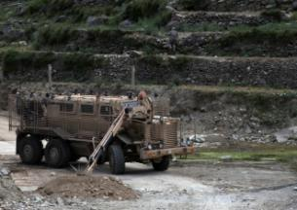
Nine Principles of IED Combat
Maintain an offensive mindset
Stay observant
Avoid setting patterns
Maintain standoff
Develop and maintain situational awareness
Utilize blast/fragmentation protection
Maintain 360–degree security
Maintain tactical dispersion
Utilize technology
Notes:
Instructor/Facilitator’s Note.
Review and give an example of the 9 principles. If possible, use student experiences to expand on each principle.
Maintain an Offensive Mindset: Every leader must be prepared to rapidly develop the situation in order to gain and maintain contact with the enemy and advance his unit by fire and maneuver to ultimately kill or capture his adversaries. Keep in mind that aggressive, rapid pursuit is good but it can lead you to a baited ambush.
Develop & Maintain Situational Awareness: Good Situational Awareness (SA) is key to seeing, understanding, and then acting on pre-attack indicators to deny the enemy's advantage of surprise.
Stay Observant: Most IEDs found before detonation are located by the naked eye. Every Soldier should continuously scan their assigned sector in search of IED indicators. Be deliberate - speed greatly diminishes the likelihood of finding an IED before it finds you…know where/when to use speed.
Avoid Setting Patterns: Watching and waiting - the two tactical disciplines insurgents have mastered to target Coalition Forces. What are they watching and waiting for? Always vary your distance when conducting your dismounted 5/25/200 meter checks. Move your vehicles forward or backward when 5/25/200 meter checks are complete and troops remounting. Vary your patterns regularly - The insurgents regularly watch for patterns and complacency to emerge prior to attacking.
Maintain Standoff: When practical, avoid or keep a safe distance from locations most likely to conceal an IED, e.g. canalized engagement areas, irrigation canal crossings, shoulders of roadways, medians, intersections, static vehicles along the route, etc.
360-Degree Security: Enemy activity that blends with the local populace is hard to detect and can threaten the unit from any direction. Therefore it is imperative that vigilant 360-degree security be maintained at all times, regardless of whether the convoy is mounted or dismounted. This includes your 5/25/200 meter checks.
Maintain Tactical Dispersion: In order to reduce risk, convoys must maintain adequate separation between vehicles and personnel as the situation dictates. Leaders must fight the tendency to close formations during halts. (METT-TC dependant).
Utilize Blast / Fragmentation Protection: Armor saves lives - use it, but don't become tied to it. Dismount when the situation allows. It is the most effective technique for spotting IEDs, along with meeting and developing a rapport with local communities.
Utilize your available technology: Know the capabilities and limitations of your CREW devices, their impact on other electronic systems, tactical employment techniques, and "no commo" procedures. Regularly monitor your CREW system to ensure it is turned on as well as your Passive Infrared Receiver (PIR) defeat systems. Scan using thermal imager, if available.

Slide 5
Threat Assessment
IEDs are the weapon of choice for the enemy.
  Responsible for the majority of combat casualties
A detailed threat assessment of your area of operation results in a successful operation
Think like an insurgent when conducting dismounted patrols.
For a threat to be viable there must be intent, capability, and a suitable location.
Notes:
Instructor/Facilitator’s Note.
Threat assessment is a continuous process that begins during mission analysis in your intelligence preparation of the operational environment and must be updated throughout the execution of the operation.

Slide 6
Check on Learning
What are the 9 Principles
of IED Combat?
5. 360 Degree Security
6. Maintain Standoff
7. Maintain Tactical Dispersion
8. Utilize Blast/Fragmentation Protection
9. Utilize Your Available Technology
Maintain an Offensive Mindset
Develop and Maintain Situational Awareness
Stay Observant
Avoid Setting Patterns
2. IEDs are responsible for the majority of all combat related casualties. True or False?
TRUE
3. Threat assessment is a one time process that begins in the mission planning phase. True of False?
FALSE
6
Notes:
Instructor/Facilitator’s Note.
1. Ensure all 9 Counter IED Principles are stated.

Slide 7
Interpret the Threat Assessment Triad
What are the three elements of the Threat Assessment Triad?
Enemy Intent
Type of Threat
Location of Threat
Notes:
Instructor/Facilitator’s Note.
The threat triad combines the three most important aspects of what we need to understand to identify what the enemy is trying to accomplish, how he is going to achieve his goals, and the locations that have an increased probability of success.

Slide 8
Enemy Intent
Determine what the enemy is trying to achieve by their actions.
  Disrupt, embarrass, intimidate, or gain publicity
  Kill and injure Coalition Forces/Host Nation Forces
    Target specialized patrols (Route Clearance Patrols - RCPs)
    Target first responders (Explosive Ordnance Disposal – EOD and Casualty Evacuation - CASEVAC)
    Targets of opportunity (logistic convoys, vehicle recovery)
Enemy Intent
Type of Threat
Location of Threat
Notes:
Instructor/Facilitator’s Note.
Examples of what the enemy’s intent can be.
The Threat Triad is a way to look at the enemy’s intent and capabilities and the ground factors. These will be looked at separately. First the enemy intent is examined.
This will be based on what is known about the enemy’s wider objectives as well as what the enemy might be trying to achieve in your local area. Aim of Enemy Kill or maim Disrupt, Distract, and Discredit
4. Who is the target? US or coalition?

Slide 9
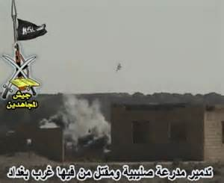
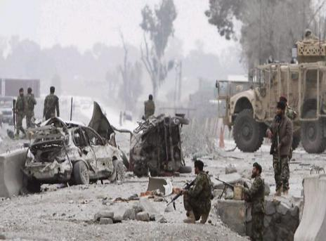
Enemy Intent (cont.)
  Disrupt, embarrass, intimidate, or gain publicity
Enemy Intent
Type of Threat
Location of Threat
Notes:
Instructor/Facilitator’s Note.
Discuss each picture and ask the students what they think the enemy intent is and explain why.
Just by placing a row of rocks across a road could be enough to disrupt a convoy.

Slide 10
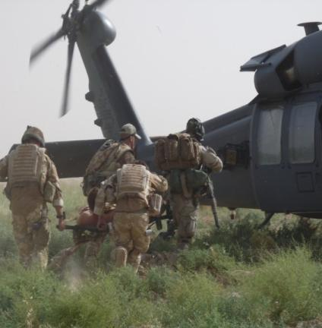
Enemy Intent (cont.)
Kill and injure
  CF/HNSF and Joint/Partnered Patrols
Enemy Intent
Type of Threat
Location of Threat
Notes:
Instructor/Facilitator’s Note.
Discuss each picture and ask the students what they think the enemy intent is and explain why.
We have looked at who the enemy is and what their objectives are. Now we will look at whom their intended targets are.
CF and HNSF is the primary target.
Modify pictures to better illustrate (possible MEDEVAC picture)

Slide 11
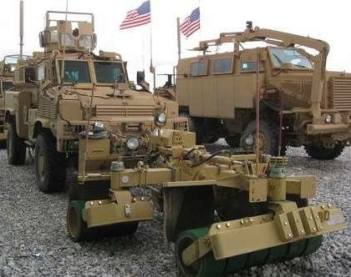
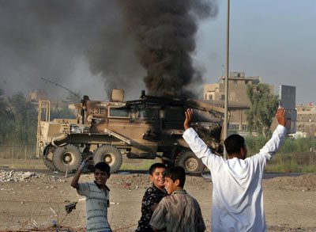
Enemy Intent (cont.)
Target specialized patrols
  Route Clearance Patrols (RCP)
Enemy Intent
Type of Threat
Location of Threat
Notes:
Instructor/Facilitator’s Note.
Ask the students why the route clearance patrols would be targeted by the enemy.
RCPs sole purpose is to find IEDs and clear routes for logistical support and CF patrols.
Therefore, targeting the RCPs allows the enemy freedom of maneuver in the battle space.

Slide 12
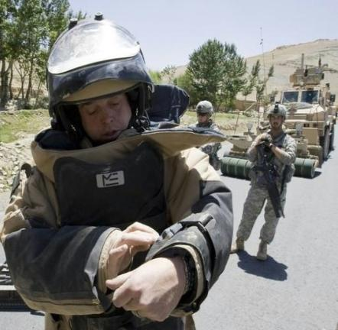
Enemy Intent (cont.)
Target first responders
  CASEVAC and EOD
Enemy Intent
Type of Threat
Location of Threat
Notes:
Instructor/Facilitator’s Note.
EOD and Medical assets are a target. Always remember that the initial attack or IED may not be the real target.
CASEVAC conducted in restricted terrain will limit the available HLZs.
Proper analysis of previous activities along the route is required to prevent utilizing the same HLZs repetitively and establishing a pattern the enemy can target.

Slide 13
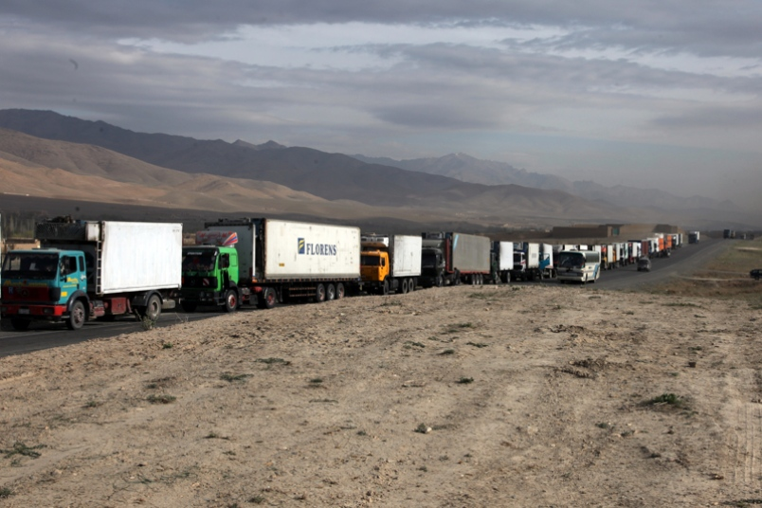
Enemy Intent (cont.)
Targets of opportunity
  Logistic convoys and vehicle recovery
Enemy Intent
Type of Threat
Location of Threat
Notes:
Instructor/Facilitator’s Note.
The enemy know that targeting logistic supplies can hamper operations.
This was a common tactic of the Afghan Mujahedeen during the Soviet Afghan War and was the main source of the Mujahedeen supplies.

Slide 14
Type of Threat
Determine the likely method of attack
  Public Disorder
  Hoax
  Shoot/Sniper/Indirect Fire
  IED
    Victim Operated IED (VOIED)
    Command IED (RCIED/CWIED)
    Time
Determine the current enemy Tactics, Techniques, and Procedures (TTP)
Enemy Intent
Type of Threat
Location of Threat
Notes:
Instructor/Facilitator’s Note.
The type of threat the enemy will employ is based on his capabilities and limitations.
Explain that current TTPs are different in different regions of their AO.
By knowing the TTPs you can know the likely method of attack to be expected

Slide 15
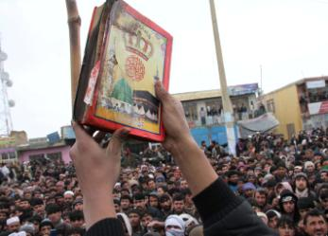
Type of Threat (cont.)
Public Disorder
  Food/fuel shortages
  Bad media
  Aggressive operations
  Anniversaries of significant events
  Not understanding the culture:
    Burning the Koran
    Searching females
    Using dogs
Enemy Intent
Type of Threat
Location of Threat
Notes:
Instructor/Facilitator’s Note.
An example of bad media coverage is coalition forces engaging insurgents/Taliban, especially with air assets and the resulting detonation from our ordnance kills local civilians.
Aggressive operations can cause public order situations because if we disturb the way of life of a normally quiet area and run around arresting every military aged male simply because of what he is, the population may turn against us to voice its disapproval.
Anniversaries of significant events can lead or even cause public order. It can range from significant religious holidays to events in history like 9‐11 or when the Russians were defeated in the 1980’s.
By not understanding the culture, civil unrest happens. Recently the burning of the Korans by U.S. Forces caused major riots which lead to Blue on Green violence.
Males searching female is the Islamic culture.
Using dogs in people’s homes.
An enemy may instigate a public order situation to shield the whereabouts of an attack that is taking place. For example, when there is an angry demonstration taking place and weapons are being fired into the air, it can be very difficult to determine where a true shoot type attack is coming from.
Public order during search operations; if a village sees a search being conducted, the situation could turn into a public order issue, so keep the occupants inside the building and keep the doors and windows closed if possible.

Slide 16
Type of Threat (cont.)
Hoax
  Opportunity to observe TTPs
  Can be used to distract and divert attention from their activities
  Can draw or divert CF/HNSF to a certain area
  Causes significant disruption, panic, or unrest in the local population
Enemy Intent
Type of Threat
Location of Threat
Notes:
Instructor/Facilitator’s Note.
A huge cause of casualties can be complacency. If many hoaxes are used within a particular area of operations, we need to assume that real attacks will be taking place.
No matter how many hoaxes have taken place, we must treat every incident as a true threat because sooner or later the device will be functional. The hoax is an excellent intelligence gathering tool for the enemy.
While responding to the threat of a real hazard, the enemy is gathering information and intelligence on our tactics, techniques and procedures. This method of attack can also allow a real attack to be coordinated while we and our resources are diverted to the perceived threat.
Even with no true attack taking place, huge financial costs can be incurred. Let’s use a major airport such as Kabul International as an example. Another example of a hoax causing panic and unrest can be someone in a crowd stating that a suicide bomber is amongst them. This can lead to panic within a mass of people causing injury and death by nothing more than the spoken word.

Slide 17
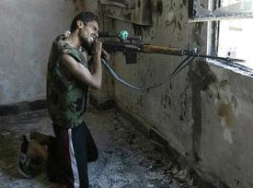
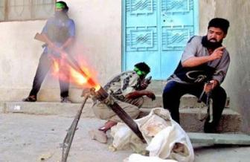
Type of Threat (cont.)
Shooting
  Direct (Line of sight)
    Long range (Sniper)
    Short range (Small arms/Rocket Propelled Grenade - RPG)
  Indirect Fire (IDF)
    Long range
    Short range
Enemy Intent
Type of Threat
Location of Threat
Notes:
Instructor/Facilitator’s Note.
This is simply line of sight versus shooting over a wall or object type shots.
An example of a direct fire weapon would be the M4 rifle whereas an indirect example is the 60mm mortar system.
The statement saying a trigger man is generally required is worded as such because a weapon system can be set up to fire via time delay or other device so the attacker has time to exit the area thus gaining a measure of deniability for the attack.
This is especially true for electrically initiated weapon systems but can also work with mechanical initiation.
Shooting can be used to draw troops into a kill zone. It is essential that a threat estimate is conducted before taking cover to ensure troops don’t move into an IED kill zone.

Slide 18
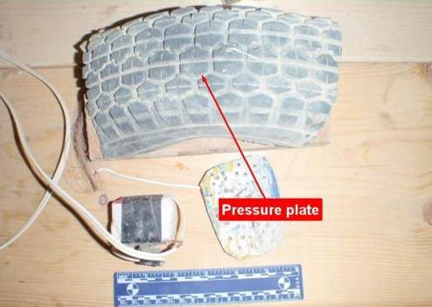
Type of Threat (cont.)
  Victim Operated IED (VOIED)
    Use of a stand alone device initiated by the actions of its victim(s)
Pressure Plate
Enemy Intent
Type of Threat
Location of Threat
Notes:
Instructor/Facilitator’s Note.
Talk about VOIEDs, re‐enforce why the Insurgent would want to use this type of switch.
VOIEDs use the victims patterns against them, the victim will be in close proximity, can be disguised as any item, simple to operate and does not require the enemies presence for activation.

Slide 19
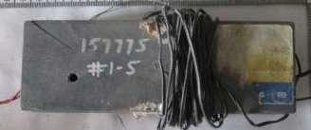
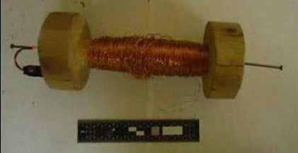
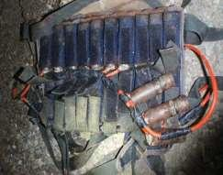
Type of Threat (cont.)
  Command IED
    Radio Controlled IED (RCIED)
    Command Wire IED (CWIED)
    Suicide (PBIED/SVBIED)
Enemy Intent
Type of Threat
Location of Threat
Notes:
Instructor/Facilitator’s Note.
Talk about Command IEDs, re‐enforce why the Insurgent would want to use this type of switch.
Command IEDs allow the trigger man to function the device when the target is present, provide standoff for the triggerman and can be used to arm multiple devices.

Slide 20
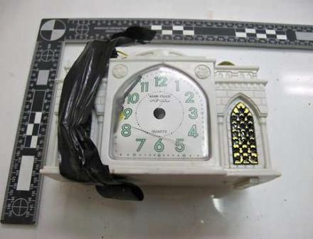
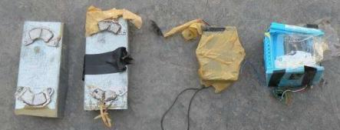
Type of Threat (cont.)
  Specific IED Time
    Safe separation
    Pre-set delay
    Arming
Enemy Intent
Type of Threat
Location of Threat
Notes:
Instructor/Facilitator’s Note.
Time IEDs are extremely hard to employ against CF unless we have advertised that we will be in a specific location at a specific time.
Time initiation has predominately been used for indirect fire and rocket attacks.

Slide 21
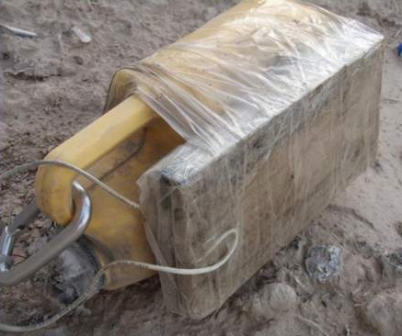
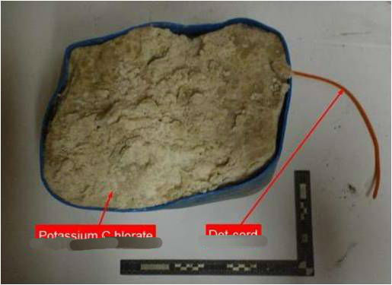
Type of Threat (cont.)
  Progression of unknown or homemade bulk explosive versus military grade explosives
Enemy Intent
Type of Threat
Potassium Chlorate
Det-Cord
Location of Threat
Notes:
Instructor/Facilitator’s Note.
One reason for this progression is the reduced amount readily available military grade explosives.
A second reason for the progression is the increased use of metal detectors by CF.
HME offers the insurgent a powerful explosive without the metal signature.
Different regions use different types of Homemade Explosive (HME).
It’s important to know the precursors of the HME that’s found.
How and where are they getting their military grade munitions? Are they Unexploded Ordnance (UXO) or munitions smuggled?

Slide 22
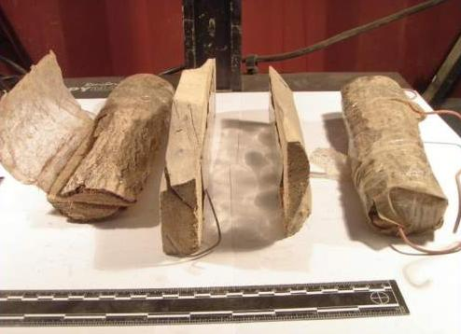
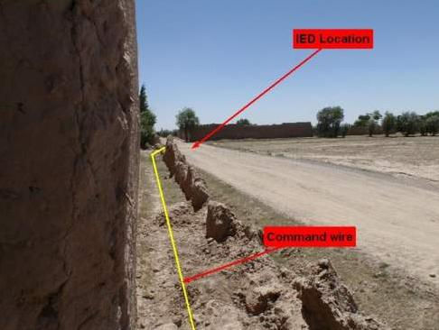
Type of Threat (cont.)
  Use of more victim operated (VOIED) and command wire (CWIED) versus radio controlled (RCIED)
IED location
Enemy Intent
Command Wire
Type of Threat
Location of Threat
Notes:
Instructor/Facilitator’s Note.
Insurgents are employing VO and CW due to the effectiveness of CF CREW devices.

Slide 23
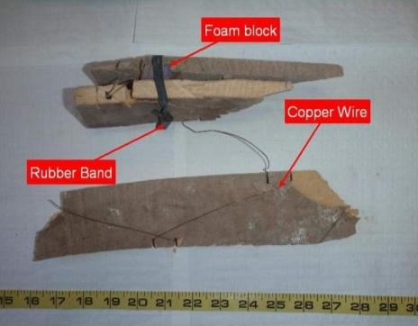
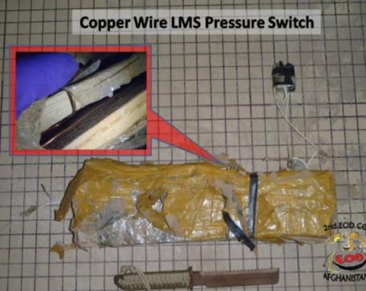
Type of Threat (cont.)
  Low metal content in IEDs
Foam Block
Copper Wire LMS Pressure Switch
Copper Wire
Rubber Band
Enemy Intent
Type of Threat
Location of Threat
Notes:
Instructor/Facilitator’s Note.
The insurgents have observed us employing our HHD with metal detection capability and understand they must reduce the metal content to avoid detection.
Explain why this type of device is dangerous.
It is dangerous because standard metal detectors may not indicate the presence of low metal content of an IED (the use of GPR or low conductivity detection devices are required).

Slide 24
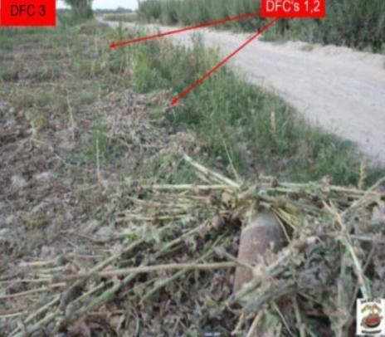
Type of Threat (cont.)
  Complex IED array consisting of two or more IEDs and anti-personnel mines
DFC 3
DFCs 1,2
Enemy Intent
Type of Threat
Location of Threat
Notes:
Instructor/Facilitator’s Note.
Explain why the Insurgent uses complex attacks.
Complex attacks are normally the result of CF establishing predictable patterns.
When given the opportunity the enemy has the ability to develop prime engagement areas, which allows them to maximize all of their capabilities.

Slide 25
Type of Threat (cont.)
Enemy Intent
Type of Threat
Location of Threat
Notes:
Instructor/Facilitator’s Note.
Play video. (Last approx. 3.5 minutes)
At the conclusion of video discuss the different aspects of this particular complex attack.
The key take away of this video is if forced to take an undesirable route all available enablers need to be considered.

Slide 26
Characteristics of a Cmd Threat IED Location
Location of Threat
IED hotspots/engagement areas have seven things in common
Coalition traffic
Workable soil
Line of sight
Obstacles between emplacement location and firing point
Egress route
Population sympathetic to their cause
Un-observable by coalition forces/ISR assets
Enemy Intent
Type of Threat
Location of Threat
Notes:
Instructor/Facilitator’s Note.
The enemy does not randomly place IEDs.
He thinks tactically as we do and will employ his available resources in areas with the highest probability of success.
We will know talk about VA/VPs and how they relate to the enemies employment process. Our ability to think like the enemy and see the terrain from his perspective will further highlight these high threat areas.
4. All IED engagement areas that use a command switch, either Radio Controlled (RC) or Command Wire (CW), have seven factors/principles in common. (instructor can use his own words to explain the slide)
Coalition traffic – why would the enemy just randomly emplace an IED, without Coalition traffic the enemy wouldn’t even target this area.
Workable soil – IEDs are usually placed in the ground, and insurgents look for area where it will be easier to dig, emplace, and camouflage there IED emplacements.
Line of sight – To properly use any Command Initiated IED, the enemy must have line of sight from the firing point to the engagement area.
Obstacles between emplacement location and firing point – Obstacles prevent coalition forces from pursuing the enemy after an engagement. The obstacle will usually be between the firing point and the engagement area.
Egress route – this route will allow the enemy to withdrawal from the firing point after an engagement. The Egress Route will usually have cover and concealment back to a built up area so the insurgent can blend in with the population.
Population sympathetic to there cause – its always nice to have population that will the other way or actively support you while you attack coalition forces.
Un-observable by coalition forces/ISR assets - IED engagement areas that allow the insurgent to emplace the IED without being observed by coalition forces ISR assets will usually have a higher success rate, because coalition forces will not have prior knowledge of the emplacement.
5. Violating the 9 Principles of IED defeat, Setting Patterns will always allow the enemy to target coalition forces with VOIEDs as well.
6. These factors when combined with a MCOO (Modified Combined Obstacles Overlay), and Honest Traces will allow your unit to predict where the enemy will target you forces with a degree of certainty.

Slide 27
Location of Threat (cont.)
Danger Areas in C-IED operations are described as Vulnerable Points (VP) and Vulnerable Areas (VA).
  Vulnerable Points (VP)
    Terrain restricts maneuver of the patrol through areas where there is no other way around
    Places particularly advantageous for the enemy to position an IED
  Vulnerable Areas (VA)
    Areas where pattern setting allows insurgents to predict with certainty that troops will use them again
Enemy Intent
Type of Threat
Location of Threat
Notes:
Instructor/Facilitator’s Note.
Compare Danger Areas, Vulnerable Points, Vulnerable Areas in terms of linear danger area and danger areas as referenced in patrolling.

Slide 28
Location of Threat (cont.)
VP/VAs are identified to avoid and/or mitigate.
Current Doctrine calls both of these dangers areas. VAs and VPs are more descriptive.
Enemy Intent
Type of Threat
Location of Threat
Notes:
Instructor/Facilitator’s Note.
Compare Danger Areas, Vulnerable Points, Vulnerable Areas in terms of linear danger area and danger areas as referenced in patrolling.

Slide 29
Location of Threat (cont.)
Vulnerable Points (VP)
  Terrain restricts maneuver of the patrol through areas where there is no other way around
  Places particularly advantageous for the enemy to position an IED
Vulnerable Points (VP) Examples
  Wadi crossings
  Intersections
  Culverts and bridges
  Mouse holes
  Previous IED engagement areas
  Obvious support by fire positions and positions that provide cover
Enemy Intent
Type of Threat
Location of Threat
Notes:
Instructor/Facilitator’s Note.
This is a list of examples of VP, however not all inclusive.

Slide 30
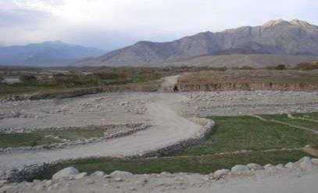
Location of Threat (cont.)
Vulnerable Point (VP)
  Wadi crossings
    Canalized with limited maneuverability
Enemy Intent
Type of Threat
Location of Threat
Notes:
Instructor/Facilitator’s Note.
Wadi: Anywhere a track crosses a Wadi, vehicles are canalized with limited maneuverability.
While IEDs can be placed in avenues of approach or anywhere else within the Wadi, the narrowest point is the area of highest threat.
Although Wadi's are VP for mounted elements, dismounted elements have the freedom to chose their crossing points and limit the enemies ability to target.

Slide 31
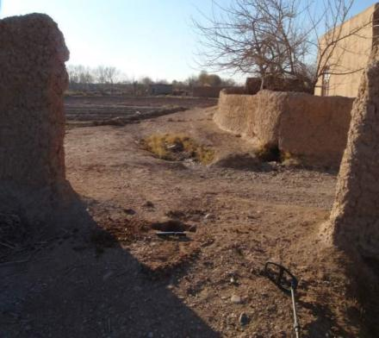
Location of Threat (cont.)
Vulnerable Point (VP)
  Road junctions
    Mounted and dismounted
Enemy Intent
Type of Threat
Location of Threat
Notes:
Instructor/Facilitator’s Note.
Traffic, mounted and dismounted, concentrates at track junctions and often has limited options to negotiate the turn; both are easily targeted by burying a device either on the track or to the side.
The road junctions are natural slow down points that allows the enemy to more effectively target with command initiated IEDs.

Slide 32
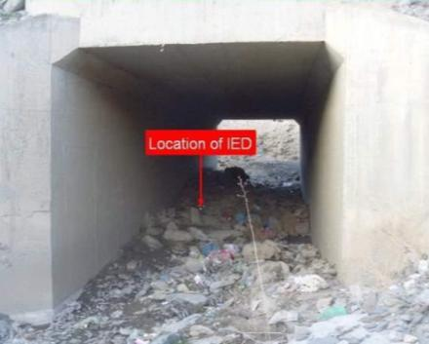
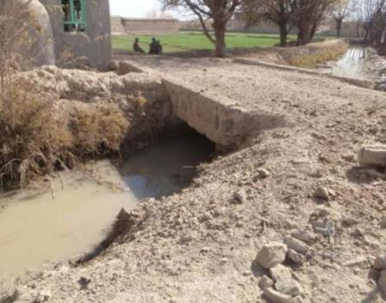
Location of Threat (cont.)
Vulnerable Point (VP)
  Culverts and bridges
    Footbridges over irrigation ditches and their approaches
Location of IED
Enemy Intent
Type of Threat
Location of Threat
Notes:
Instructor/Facilitator’s Note.
Culverts and bridges are ideal places to hide a device; the target is channeled into crossing where there is the opportunity to place a large device underneath; this is equally applicable for footbridges over irrigation ditches‐and their approaches.
If dismounted elements are willing to get wet they can reduce the enemy's ability to target them.

Slide 33
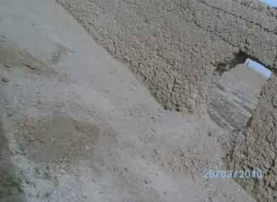
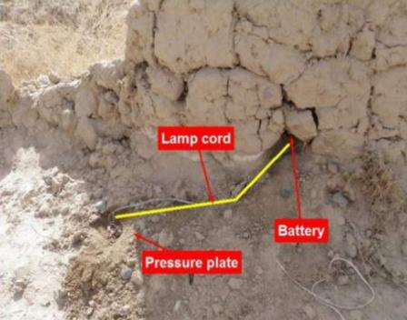
Location of Threat (cont.)
Vulnerable Point (VP)
  Mouse holes
    Typically placed within a few meters inside the compound
Battery Pack
Battery pack
Main Charge
Main charge/PP
Lamp Cord
Enemy Intent
Battery
Location of Threat
Pressure Plate
Type of Threat
Notes:
Instructor/Facilitator’s Note.
Devices and tripwires can be laid where holes have been created in walls.
They are typically placed a few meters inside the compound.
As soldiers become fatigued after patrol, they are more likely to take the path of least resistance.
Discipline is required to ensure safety at all times.

Slide 34
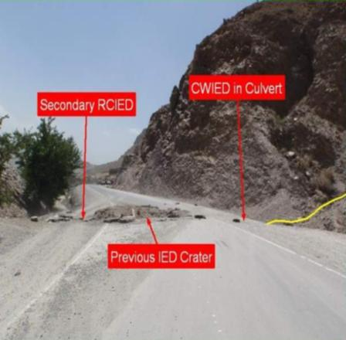
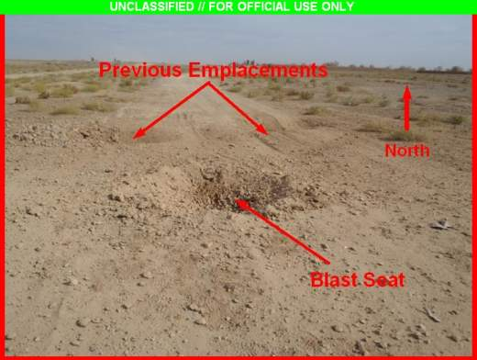
Location of Threat (cont.)
Vulnerable Point (VP)
  Previous IED engagement areas
CWIED in Culvert
Previous Emplacements
Secondary RCIED
Previous IED crater
Blast Seat
Enemy Intent
Type of Threat
Location of Threat
Notes:
Instructor/Facilitator’s Note.
Anywhere an IED had been placed or a previously used position by International Security Assistance Force (ISAF).
Previous engagement areas that resulted in successful attacks will be used again.

Slide 35
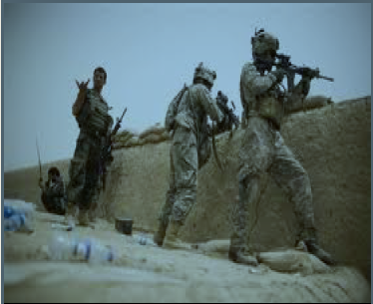
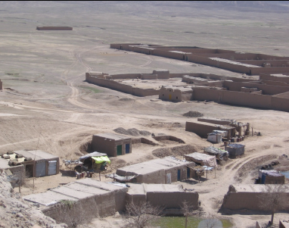
Location of Threat (CONT)
Vulnerable Point (VP)
  Obvious support by fire positions and positions that provide cover
Enemy Intent
Type of Threat
Location of Threat
Notes:
Instructor/Facilitator’s Note.
If the position obviously provides cover or over watch the enemy will target the location.

Slide 36
Location of Threat (cont.)
Vulnerable Areas (VA)
  Areas where pattern setting allows insurgents to predict with a degree of certainty that troops will use them again
  Vulnerable Areas (VA) Examples
    Linear features
    Previously used trails and patrol routes
    Frequently used positions
    Long open stretches of road
    Compound interiors
    Channelized routes
Enemy Intent
Type of Threat
Location of Threat
Notes:
Instructor/Facilitator’s Note.
Describe VA using your experiences and the VAs you have encountered in your tenure.

Slide 37
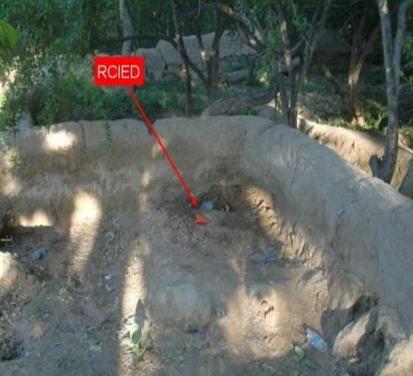
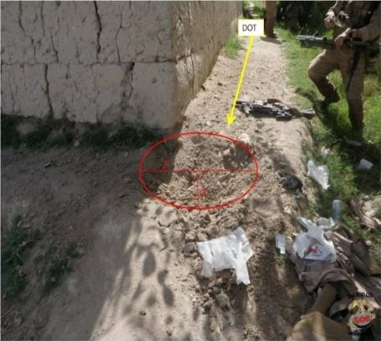
Location of Threat (cont.)
Vulnerable Areas (VA)
  Linear features
    Often used to assist in navigation on patrols
Direction Of Travel
RCIED
Enemy Intent
Type of Threat
Location of Threat
Notes:
Instructor/Facilitator’s Note.
1. American forces are creatures of habit and will habitually "handrail" linear features such as walls and roads.

Slide 38
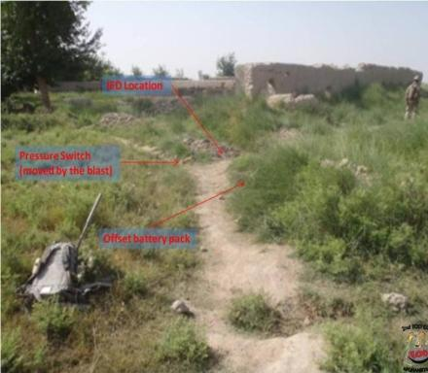
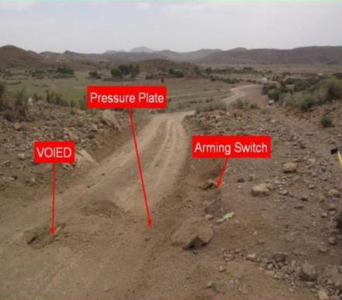
Location of Threat (cont.)
Vulnerable Areas (VA)
  Previously used trails and patrol routes
    Good indicator where Coalition Forces may travel again
IED Location
Pressure Switch
(moved by blast)
Pressure Plate
VOIED
Arming Switch
Offset Battery pack
Enemy Intent
Type of Threat
Location of Threat
Notes:
Instructor/Facilitator’s Note.
Avoid natural lines of drift.
Utilize honesty traces to prevent reusing the same path.

Slide 39
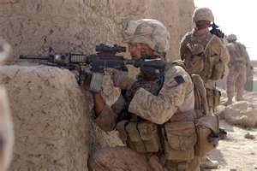
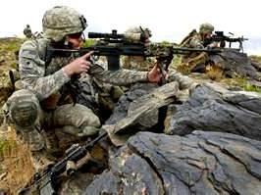
Location of Threat (cont.)
Vulnerable Areas (VA)
  Frequently used positions
    Over watch positions are regularly targeted
Enemy Intent
Type of Threat
Location of Threat
Notes:
Instructor/Facilitator’s Note.
The enemy sees the terrain the same way as we do.
If the positions are obvious they will target them. Select a position that provides a 90 percent solution.
If required use more than one position to cover the area.

Slide 40
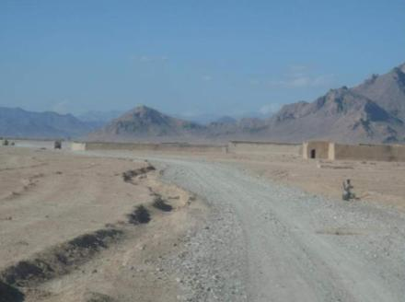
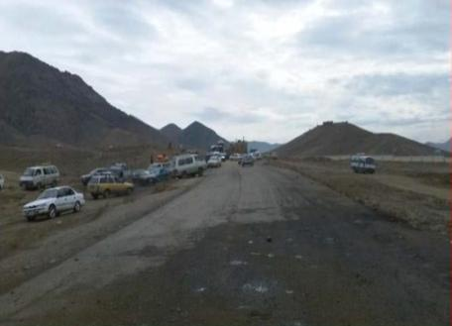
Location of Threat (cont.)
Vulnerable Areas (VA)
  Long open stretches of road
    Where insurgents can see Coalition Forces (CF/HNSF) approach from a distance
    More of a Command IED threat
Enemy Intent
Type of Threat
Location of Threat
Notes:
Instructor/Facilitator’s Note.
Where insurgents can see Coalition Forces (CF) approach from a distance More of a Radio Controlled IED (RCIED) threat.

Slide 41
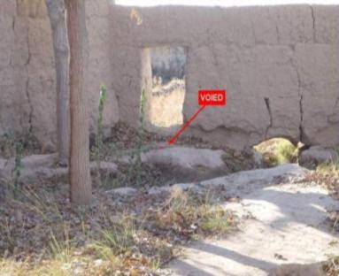
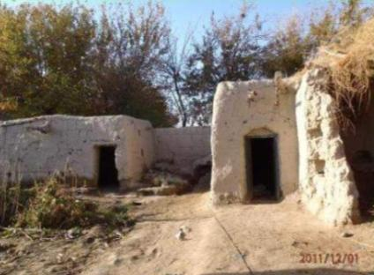
Location of Threat (cont.)
Vulnerable Areas (VA)
  Compound interiors
    Unoccupied compounds pose a higher threat
    Devices can be placed where CF/HNSF are likely to go after entry
VOIED
Enemy Intent
Type of Threat
Location of Threat
Notes:
Instructor/Facilitator’s Note.
Abandoned compounds beyond the entrance, the devices can be placed where CF are likely to go after entry:
Roof
Viewpoints
Steps or stairs

Slide 42
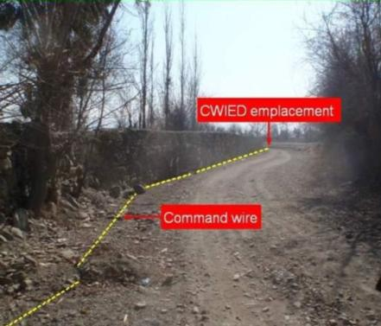
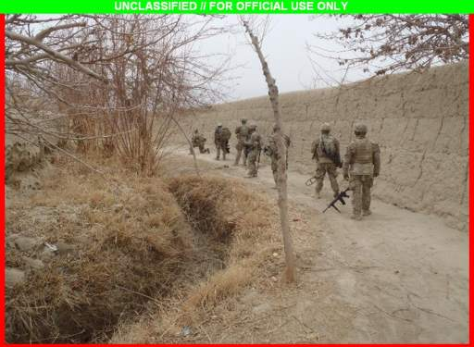
Location of Threat (cont.)
Vulnerable Areas (VA)
  Canalized routes
    Areas where patrols are restricted by natural or manmade features
CWIED emplacement
Command Wire
Enemy Intent
Type of Threat
Location of Threat
Notes:
Instructor/Facilitator’s Note.
Route recon prior to execution will allow you to avoid channelized routes.

Slide 43
Threat Assessment Triad
Analyze together = a picture of the enemy's most like COA
Enemy Intent
Type of Threat
Location of Threat
Notes:
Instructor/Facilitator’s Note.
Each of the factors in the Threat Triad is considered in isolation at first.
As you can see these factors overlap.
It is by considering them together that you build a picture of the enemy's most like course of action.

Slide 44

Threat Assessment Triad (cont.)
Determine the enemy’s likely course of action during Mission Planning
Enemy Intent
Type of Threat
Location of Threat
Notes:
Instructor/Facilitator’s Note.
During mission analysis and the intelligence preparation of the operational environment a detailed threat assessment will be conducted. Mission analysis results in an understanding of the enemies most probable COA.
Once we have this COA we can then develop our own COA accounting for all aspects of METT‐TC.

Slide 45
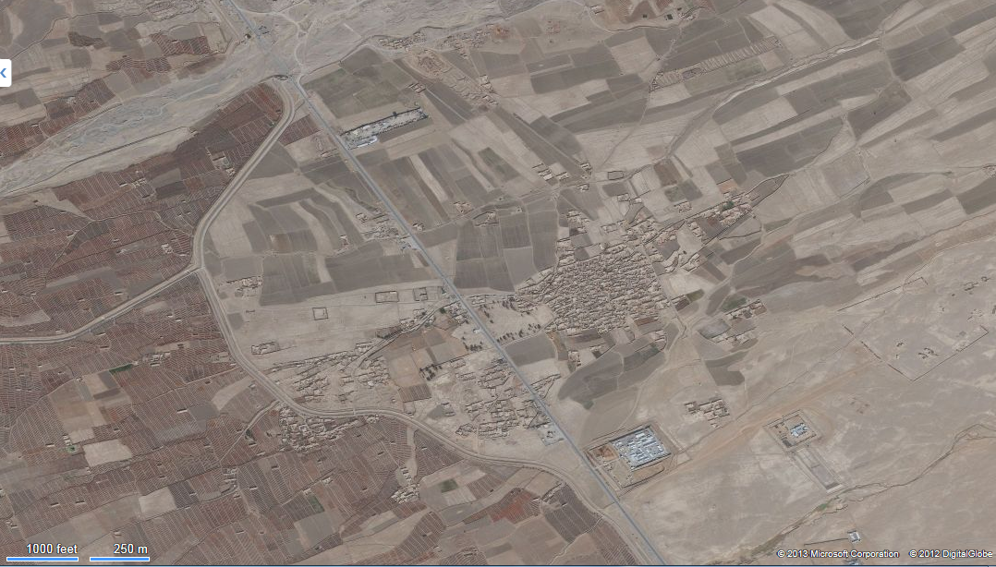
Demonstration
281600APR2013
RCIED
10 lbs UBE
1 ANA truck, 3 KIA
60 day IED Activity
Use C-IED History Slide from Germany ****
251200MAR2013
Carbon Rod PP
5 lbs ANAL
Found, EOD
Rendered Safe
170800APR2013
CWIED
DFFC
1 US KIA, 2 WIA
051900MAY2013
RCIED
10 lbs UBE
1 ANA truck, 1 KIA
Enemy Intent_____________________________________________________
Type of Threat____________________________________________________
Location of Threat_________________________________________________
Notes:
Instructor/Facilitator’s Note.
- Have the students share their thoughts for each data group listed for the 60 day activity.

Slide 46
Check on Learning
1. Which of the following is not part of the Threat Triad?
  Enemy Intent
  Location of Threat
  Type of Threat
  Local Threat
Local Threat
2. The aim of the enemy's intent is to Kill, Injure, Disrupt, Distract, and Discredit. True or False ?
TRUE
3. What is a common enemy tactic?
Target CF and HNSF
Target first responders
Target logistic convoys
All the above
d. All the above
46
Notes:
Instructor/Facilitator’s Note.

Slide 47
Check on Learning (cont.)
4. Which of the following are considered a type of threat?
a. IED b. Hoax
c. Public Disorder d. All of the Above
d. All of the Above
5. Which of the following is a command IED?
  Radio Controlled IED (RCIED)
  Command Wire IED (CWIED)
  Suicide (PBIED, SVBIED)
  All of the Above
  d. All of the Above
6. Insurgents are using low metal content in IEDs to avoid detection. True or False?
TRUE
47
Notes:
Instructor/Facilitator’s Note.

Slide 48
Check on Learning (cont.)
7. Vulnerable areas are where pattern setting allows insurgents to predict with a degree of certainty that troops will use them again. True or False ?
TRUE
8. A wadi crossing is considered a vulnerable area. True of False?
FALSE
9. The enemy’s likely course of action is determined during Mission Planning. True or False?
TRUE
48
Notes:
Instructor/Facilitator’s Note.

Slide 49
Summary
1. Lesson: Threat Assessment
2. During this lesson we discussed how to C-IED threat assessment into mission planning and execution. It includes:
a. Intelligence tasks during mission analysis.
b. Nine principles of IED combat.
c. Threat assessment
3. How to interpret the threat assessment triad which includes:
a. Enemy intent.
b. Type of threat.
c. Location of threat.
Notes:
Instructor/Facilitator’s Note.
1. Lesson: Threat Assessment
2. During this lesson we discussed how to Integrate Counter Improvised Explosive Device (C-IED) threat assessment into mission planning and execution. It includes:
a. Intelligence tasks during mission analysis.
b. Nine principles of IED combat.
c. Threat assessment
NOTE.
1. The Bde S-2, BN S-2 or Company Intel representative conducts mission analysis simultaneously and in support of the S-2 or company commander in order to provide the enemy threat assessment view throughout the planning process.
2. We also discussed how to interpret the threat assessment triad. It includes:
a. The triad is composed of: enemy intent, type of threat and location of threat.
b. Determine enemy intent on dismounted operations
c. Identify types of threats posed during dismounted operations
d. Identify location of threats, danger areas (Vulnerable Points (VP) and Vulnerable Areas (VA))
NOTE. The threat triad combines the three most important aspects of what we need to understand to identify what the enemy is trying to accomplish, how he is going to achieve his goals, and the locations that have an increased probability of success.

Slide 50
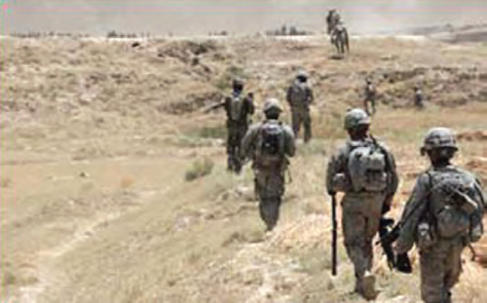
Questions
Notes:
Instructor/Facilitator’s Note.

