Slide 1

Regionally Aligned Forces
HQDA G-3/5 (DAMO-SSC)
As of 10 August 16

Slide 2




RAF Defined
“Globally responsive…
… Regionally engaged”
“…accessible, scalable, and tailorable forces”
Those Army units Assigned to a Combatant Command (CCMD), Allocated to a CCMD and those capabilities Service Retained CCMD Aligned and prepared by the Army for CCMD regional missions. They are drawn from the Total Force including the Active Army, Army National Guard, and the Army Reserve.

Slide 3
The Theory of Engagement
Peace
Range of Military Operations
War
Military Engagement, Security Cooperation , Deterrence
Crisis Response and Limited Contingency Ops
Major Operations and Campaigns
Event Line
Crisis Line
Posture
Develop
interoperability
Influence
COIN
Risk Differential
Build Partner
Capacity
Military Expenditure ($ and human)
NEO
Build/ Maintain
Relationships
Proactive/sustained engagement (“Warm Start”)
1
Peace
keeping
Risk Differential
Access
Little to no engagement
(“Cold Start”)
HA/DR
2
Time
“Show me the data!”
How to measure the effects of “military diplomacy” a.k.a. security cooperation
Have to have an accurate common operating picture …G-TSCMIS

Slide 4
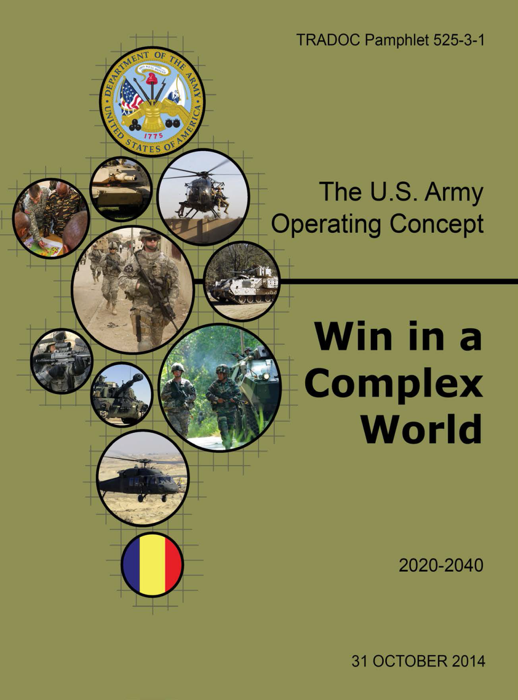

Army Vision
AOC 2014:
The Army, engages regionally to prevent conflict, shape security environments, and create multiple options for responding to and resolving crises.
Army forces engage regionally to ensure interoperability, build relationships base on common interest, enhance situational awareness, assure partners, and deter adversaries.
The Army Vision:
The Army of 2025 and Beyond will effectively employ lethal and non-lethal over-match against any adversary to prevent, shape, and win conflicts and achieve national interests. It will leverage cross-cultural and regional experts to operate among populations, promote regional security, and be interoperable with the other Military Services, USG agencies and allied and partner nations.
As it applies to organizations, improving expertise will require increased mastery of political-military affairs and institutional strategy throughout our tactical and operational headquarters. Additionally, we must build on the success the Army has enjoyed with Regionally Aligned Forces and expand the expertise of whole units, not just individual Soldiers, which possess a mastery of regions, languages, countries, and cultures.
Enhanced country access and theater presence is necessary to support the Army’s expeditionary capability. Therefore, even as we re-establish a greater presence within the continental United States, we must maintain a rotational presence with pre-positioned military equipment to expedite readiness in the event of crisis abroad. These deployments, and their associated operations, shape regional theaters of operation, promote interoperability, and shorten response times in the event of crisis. We must capitalize on our success with Regionally Aligned Forces to further augment this capability.

Slide 5
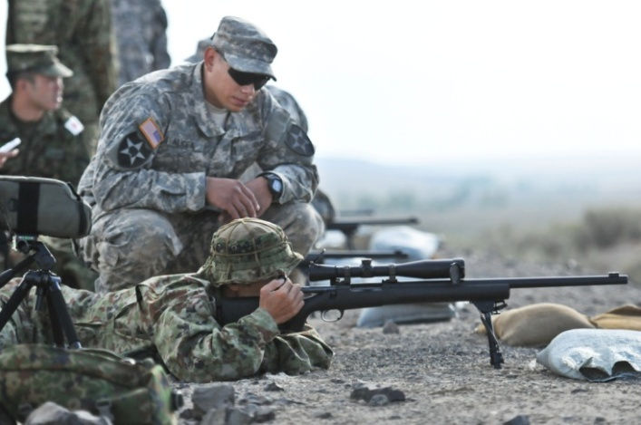

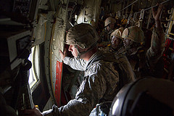
What is RAF?
The U.S. Army’s regional alignment of forces provides Combatant Commanders (CCDRs) with tailored,
trained, responsive and consistently available Army forces, to include JTF capable headquarters.
RAF is a way to support CCMD requirements.
  Includes the Total Army—Active, Guard, Reserve
  Includes Assigned, Allocated, Service Retained-CCMD Aligned (SRCA)
  Includes operations, operations support, force sustainment
  Includes the Institutional, Generating, and Operating forces
RAF training:
  Baseline of Decisive Action (CTC rotation)
  Augmented by CCMD-specific training requirements
  Augmented by Cultural, Regional, Language (CReL) training
RAF Employment
  Tailored as required (individuals/ teams/ units)
  Expeditionary/ Forward Presence
  Focus on PREVENT/SHAPE (Sustained Engagement)
  Prepared to WIN (Crisis Response/ MCO)
Tailored to Need
(range of options)
Trained for range of ops
CCMD-focused
Globally Responsive, Regionally Engaged

Slide 6
Misconceptions:
What it isn’t…
Misconception: RAF is merely attempt to preserve force structure.
Clarification: RAF is the best way to employ the force, regardless of size.
Misconception: RAF is Army’s way to compete with SOF, USMC, ASB.
Clarification: RAF underpins Army contributions to Joint Force.
Misconception: RAF is an idea, a concept.
Clarification: RAF is grounded in guidance, policy, and strategy.
Misconception: Readiness: Army will lose its ability to conduct Decisive Action.
Clarification: RAF = DA (O, D, SO/DSCA) + CCMD-Specific Training + CREL.
Misconception: “Send the RAF.”
Clarification: RAF is not an isolated unit, RAF is a Total Army policy; it represents a transformation in how Army forces are sourced to CCDRs.

Slide 7
Misconceptions:
What it isn’t…
Misconception: RAF is only a TSC mission.
Clarification: RAF is NOT a mission, RAF is more than TSC; Regionally aligned forces are conducting U.S.C § 10 / 22 missions ISO CCDR’s Campaign Plan and/or to respond to emerging crises.
Misconception: RAF is expensive and unsustainable in a fiscally austere era.
Clarification: Engagement costs money up front as an investment to prevent and shape in order to win.
Misconception: RAF is cost-neutral to the Army.
Clarification: Partially true. Shifts in policy can incur shifts in budget. Commands must consider the effective utilization of their regionally aligned forces when submitting their POM.

Slide 8
Enduring Challenges
Managing the narrative to articulate and clarify RAF terminology, value, process
Working within GFM ‘business rules’ to provide the requested capabilities
Assignment or habitual allocation of sufficient forces (C2, setting the theater, etc)
Leveraging talent while managing training and experience (Return on Investment)
Effectively integrating the Total Force (USAR/ARNG, SOF–GPF integration)
Defining readiness to encompass the full range of military operations
Support to ASCCs (operational, institutional, regional equipment sets, etc)
Closing the gap between “Intent” and “Reality”

Slide 9
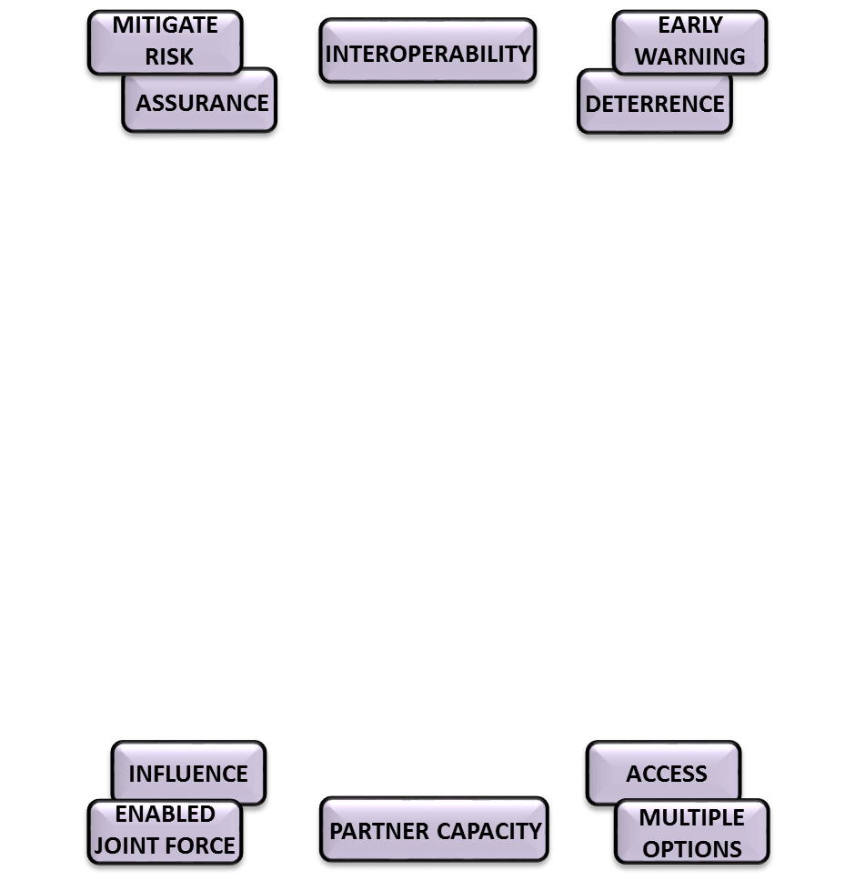
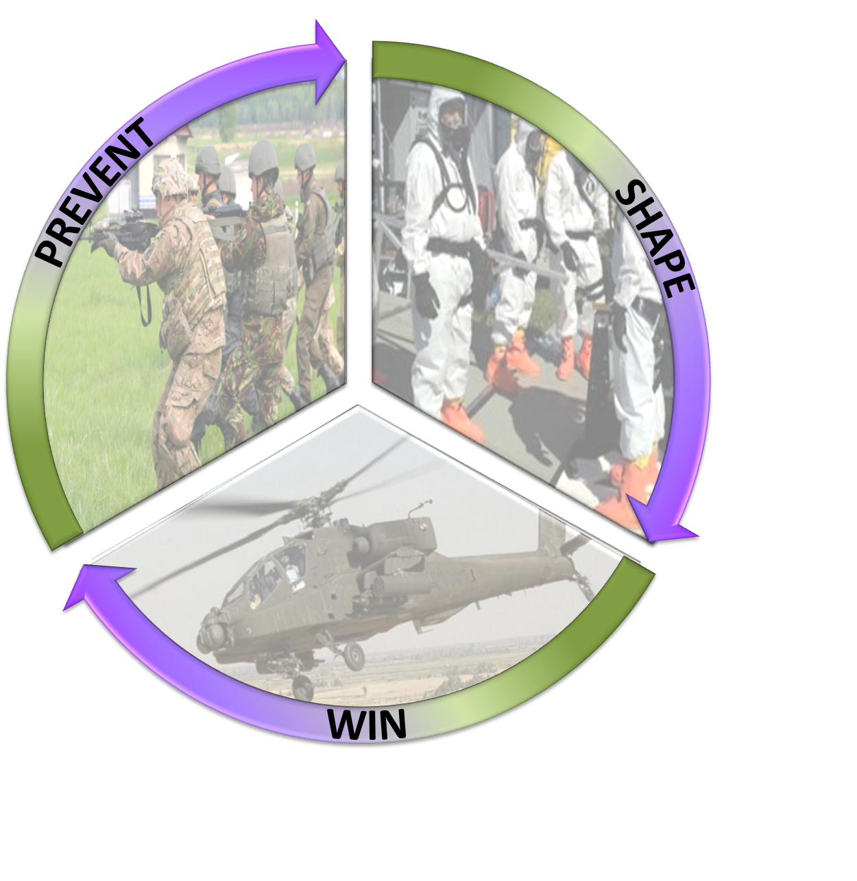
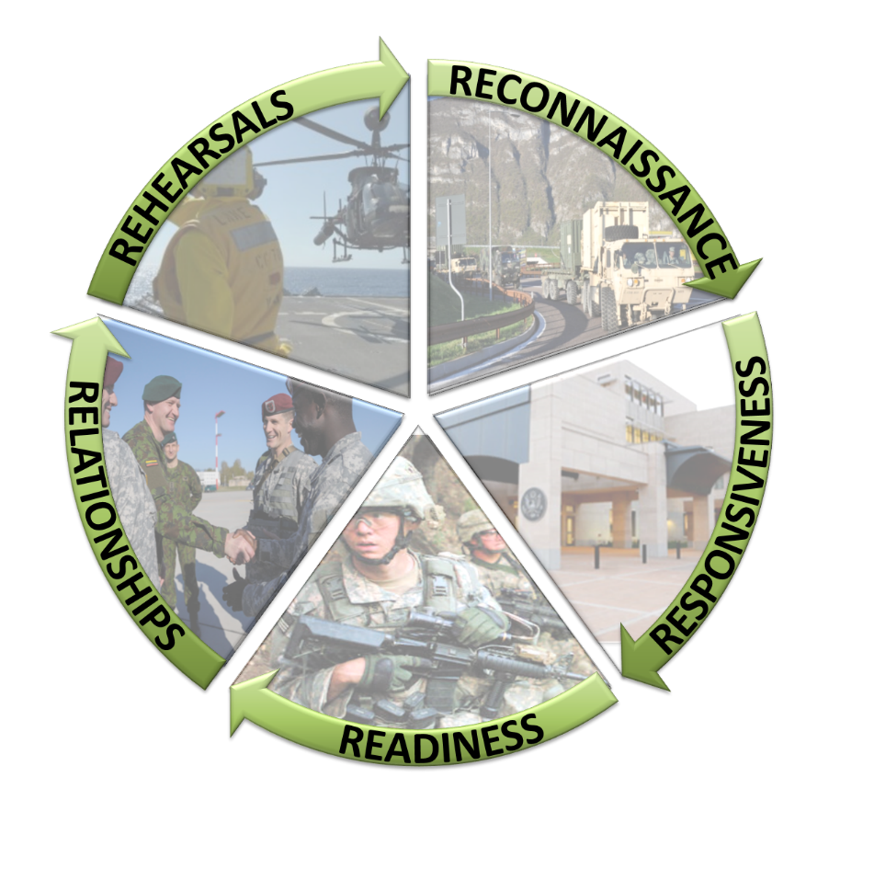
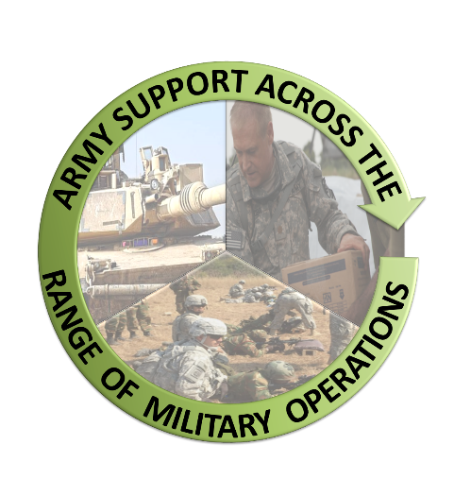

Impact of Engagement
Through RAF

Slide 10
Questions?

