Slide 1
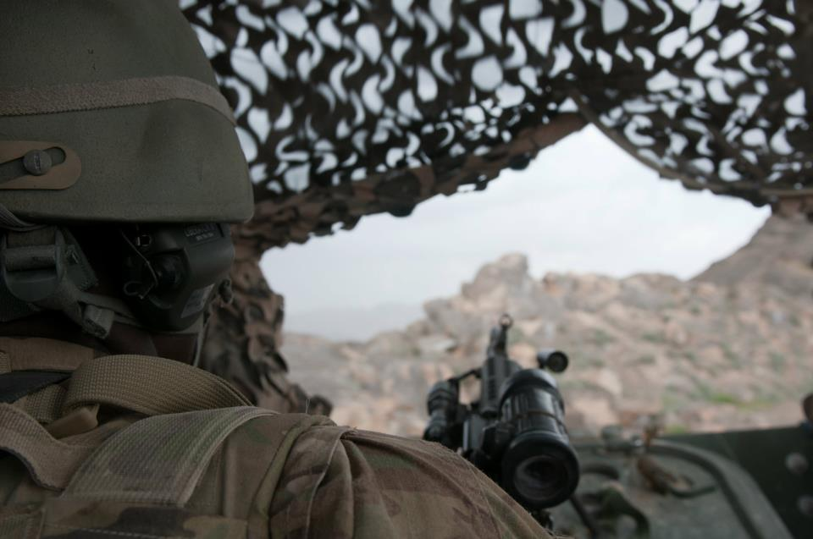
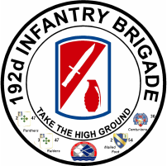
Fort Benning, Home of the MCOE
Warrior Athletic Training Program Update
2
3
2-46th IN BN
2-47th IN BN
3-47th IN BN
30th AG BN
JoEllen Sefton, PhD, ATC, CMT
2012 3rd QTR HGR
We Build the World’s Best Soldiers!

Slide 2
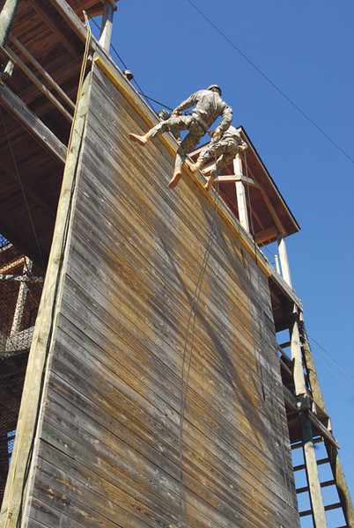
WAT Update
WAT Afternoon Program
Pilot trials – lessons learned
Key: Cadre Training (all)
ATs assist
Remedial PT – 3 phases
Harder than it looks
Can make a difference
Let us know what you’re doing, where and when
Afternoon Treatments
Event Coverage

Slide 3
WAT Afternoon Program
BLUF:
Second Treatments
1700 - 1800: Mon at 3-47, Wed at 2-47, Fri at 1-46
1) For new injuries (since morning) or 2nd tx as directed by ATs
2) Trainee from any BN can go to any session
3) Assessment of imbalances, tightness, weakness, run, etc
4) Con leave returns should report for initial eval/planning
Remedial PT Assistance
1600-1700 and 1800 -1930: (need additional times? – let us know)
1) Let us know where/when/what you are doing – we visit each BN
2) APFT section failures
3) Con leave returns that need general re-conditioning, etc
4) Injured individual APFT failures that FTU won't accept
5) 2nd cardio workout for non-running profiles as directed by ATCs

Slide 4
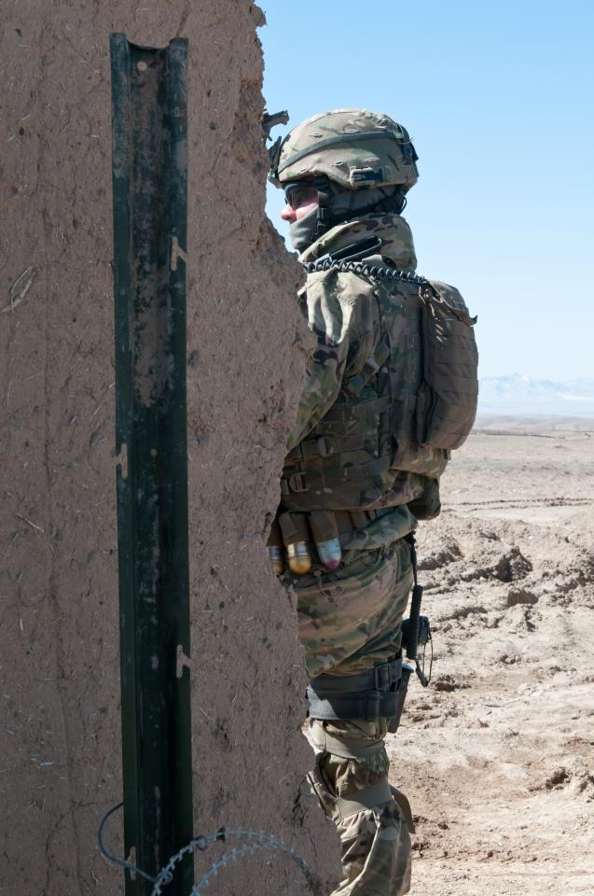
How are we doing?
Sustain
Companies doing the remedial PT are having success
Communication
Getting Trainees into tx soon after injury
Getting Trainees to us first thing in the am
Reminder:
Cadre TX daily 0800 - 0900

Slide 5
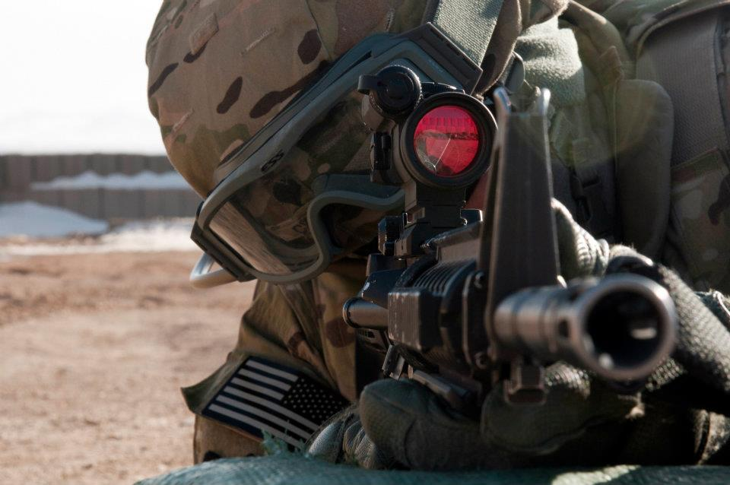
How are we doing?
Improve
Self RTD
No – shows
Communication is vital here
Afternoon program
Remedial PT Training Cadre off cycle works best
Afternoon PT - communication
Events – keep us in the loop
TXs – make use of this

Slide 6
Completed Cycles - Trends

Slide 7
Completed Cycles - Trends
Week 3 seems to stress hips

Slide 8
Stress Fractures: How are we doing?
(Stress Fx By BN)
Notes:
8
8

Slide 9
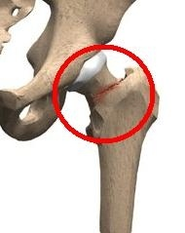
Femoral Neck Hip Stress Fracture
Fracture due to repetitive load (stress) on bone over time
New to 192d? This picture is required by law at every AT brief…..
Notes:
See Load force per step. I usually demonstrate this by walking and then jogging loudly across the stage. You can hear the difference. Units were conducting relay races in IBA at the height of the hip fracture epidemic.

Slide 10
FNSF Injury Trends
Injuries to date

Slide 11
FNSF data added through April only, will be some additions as injuries progress through the system
To date

Slide 12
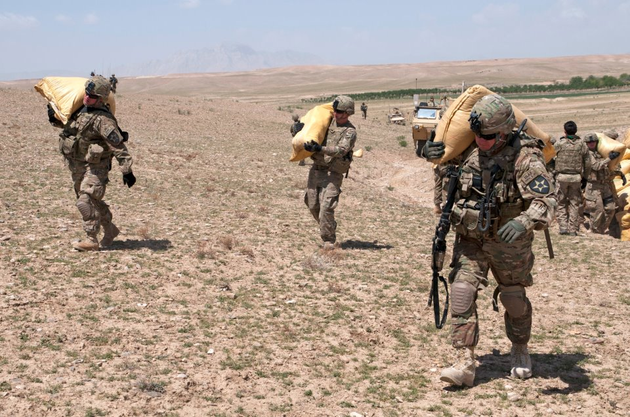
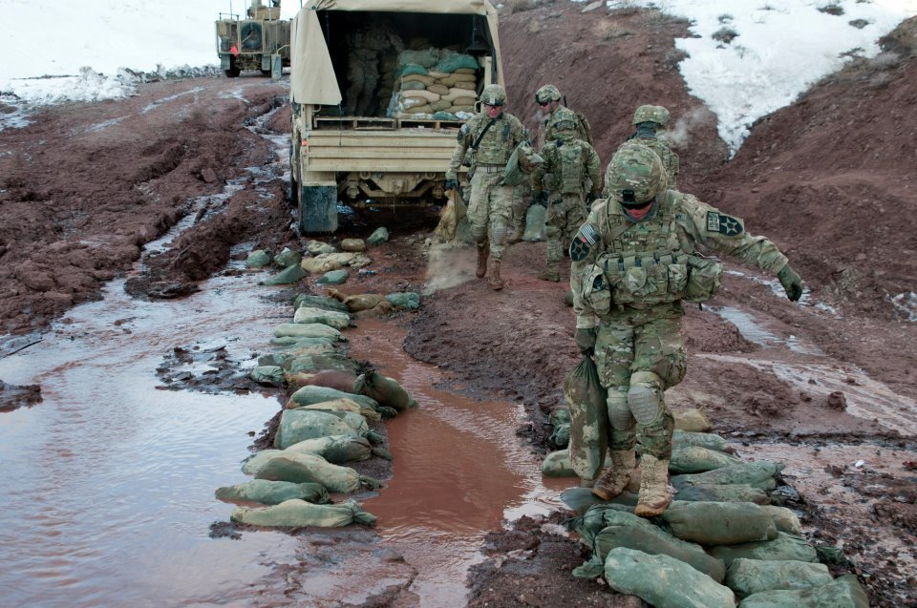
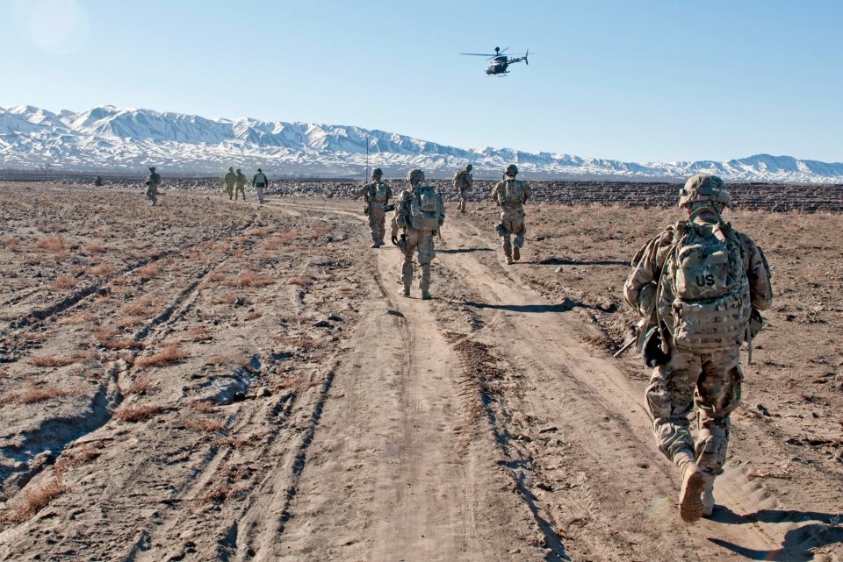
Remember the Goal
New research indicates that an injury sustained in BCT directly influences Army career advancement, longevity, retention and readiness.

Slide 13
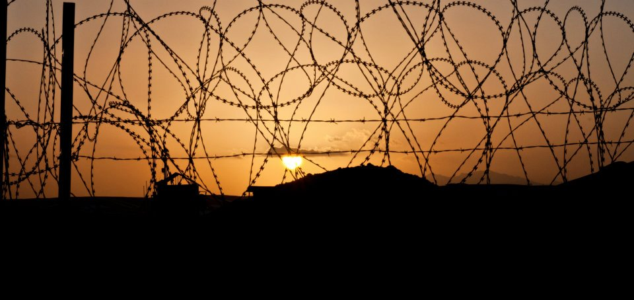
Summary
New afternoon program – take advantage!
Injuries:
Train new Cadre - Work on no-shows
Stay vigilant - Communication

