Slide 1








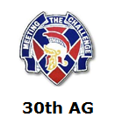
192d Infantry Brigade
Fort Benning, Home of the MCOE
High Ground Rendezvous
Safety Council
3QFY12
11 MAY 12
We Build the World’s Best Soldiers!

Slide 2
Abbreviated Ground Accident Reports (AGARs)
Notes:
Majority of AGARs are ankle injuries. (FY12 two vehicle mishaps: $1,114 and $1606)
Total cost includes property, vehicle, equipment and facility damage, however Class D accidents/damage under $2000 are not recordable IAW AR 385-10.
The estimated cost of damage (ECOD) may differ from the financial liability investigations of loss (FLIPLs) but the actual cost of damage (ACOD) / FLIPL amount will be reported for the accident date and NOT the repair/replacement or FLIPL date.

Slide 3



Composite Risk Management (CRM)
Heat Injury/Illness Reporting
Hearing Conservation
Hazardous Communication (HAZCOM)
Emergency Response Plan

Slide 4
Composite Risk Management
Develop
Controls & Make
Risk Decisions
2
Assess
Hazards
3
1
Identify
Hazards
4
Implement
Controls
Supervise
& Evaluate
5
FM 5-19
Notes:
The United States Army Safety Center developed the Risk Management Process shown here. It shows very clearly the continuousness of properly executed RM.

Slide 5
Outcome or Result
Hazard or Condition
Hot Weather Injury
100°Heat/ WBGT CAT V
Cold Weather Injury
Temperatures below 32°
Animal/Insect Bite
Disturbed Wildlife
Sprained Ankle
Uneven/Rocky Terrain
Cut/Laceration
Sharp Edges/Thorns
Electrocution
Exposed Electrical Wire
Fratricide
Stray Projectile
Vehicle Accident
Oil-slick Surface/Road
General Situational
Awareness
Complacency

Slide 6

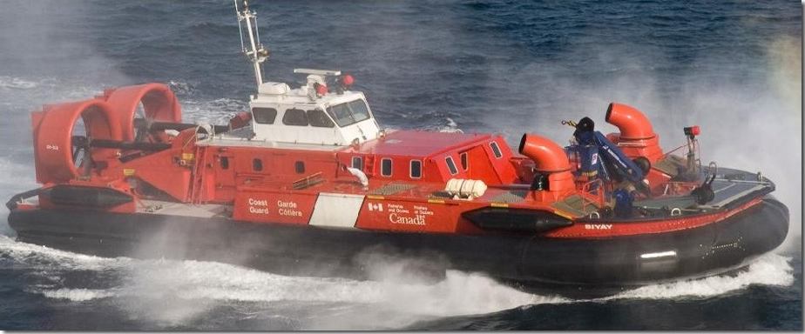
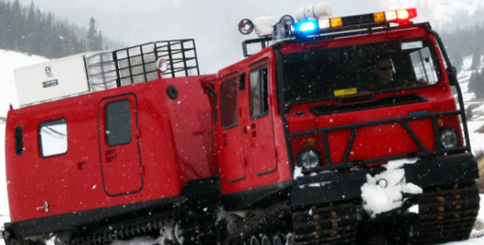
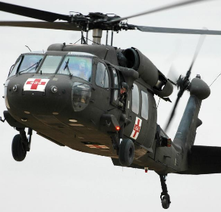
EMERGENCY RESPONSE
PLAN

Slide 7
