Slide 1


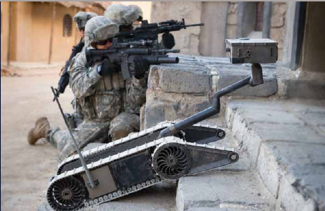
Menu Functions on SUGV

Slide 2
Terminal Learning Objective
ACTION: | Navigate Menu Functions on the SUGV.
CONDITIONS: | In an operational environment, provided with TM 9-2350-397-13 & P, SUGV Job Aid, SUGV Student Guide, and an operational SUGV system.
STANDARDS: | Identify menu functions for the SUGV in accordance with TM 9-2350-397-13&P by; Identifying Basic Menu Options, Identifying hand controller functions in menu mode, Identifying hand controller functions in drive mode with 80% accuracy.

Slide 3
Enabling Learning Objective A
ACTION: | Identify Basic Menu Functions.
CONDITIONS: | In an operational environment, provided with TM 9-2350-397-13 & P, SUGV Job Aid, SUGV Student Guide, and an operational SUGV system.
STANDARDS: | Identify menu functions for the SUGV in accordance with TM 9-2350-397-13&P, by Identifying Basic Menu Options with 80% accuracy.

Slide 4
WARNING
Do not get ahead of the instructor. Failure to follow instructor guidance may result in damage to the equipment or injury to yourself or others.

Slide 5
LOCK THE HAND CONTROLLER
WARNING
Always lock the hand controller when you are not using it. If the hand controller is unlocked, accidental pressing of the joysticks or buttons may cause damage to the robot or injury to personnel.

Slide 6
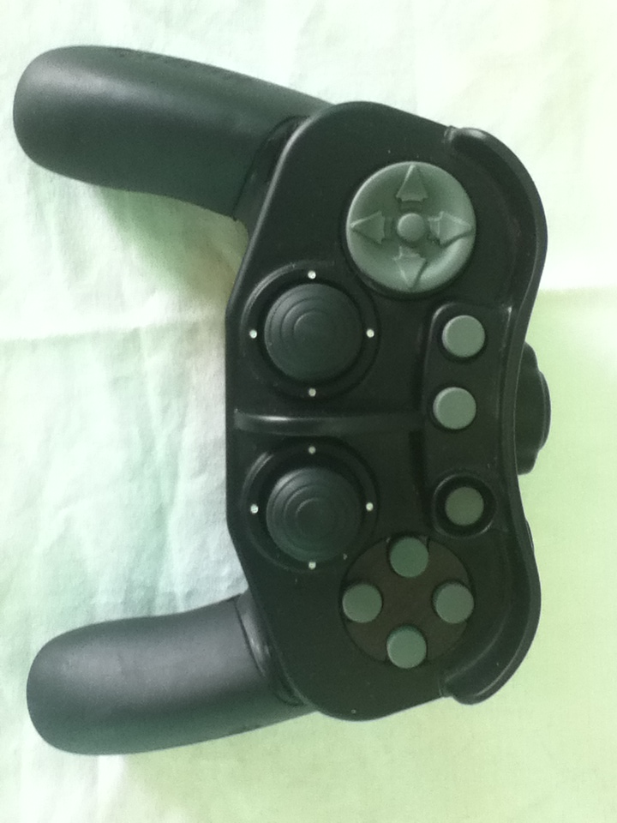
Locate the Lock/Unlock button on the
hand controller
Lock/ Unlock Button
NOTE
To prevent it from being pressed accidentally, the Lock/Unlock button is surrounded by a protective, raised ring.
When the hand controller is locked, all buttons (except for Lock/Unlock) are deactivated. This Lock mode prevents any unexpected movement of the robot.
If you lock the hand controller while the robot is connected and transmitting audio and/or video, it does not interrupt the transmission. Audio and video transmission are always available when the hand controller is locked.

Slide 7
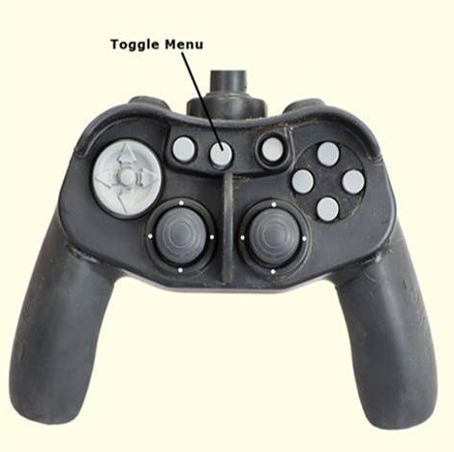
The ruggedized SUGV hand controller is similar to popular gaming controllers. One difference is that is has no markings which requires the Soldier to learn the hand controller mappings for each SUGV function. The hand Controller is used to operate the SUGV
Drive Mode: Allows you to drive and position the SUGV and switch between cameras.
Menu Mode: Allows you to access the menu commands.
Each mode has a unique had controller mapping. To switch modes, press the gray Toggle Menu button located in the center of the controller.
The following slides show the hand controller mapping in drive and menu mode

Slide 8
Enabling Learning Objective B
ACTION: | Identify hand controller functions in menu mode.
CONDITIONS: | In an operational environment, provided with TM 9-2350-397-13 & P, SUGV Job Aid, SUGV Student Guide, and an operational SUGV system.
STANDARDS: | Identify menu functions for the SUGV in accordance with TM 9-2350-397-13&P, by Identifying Menu Options with 80% accuracy.

Slide 9
NOTE
Ensure that the SUGV is in “Snail” mode for this block of instruction.

Slide 10
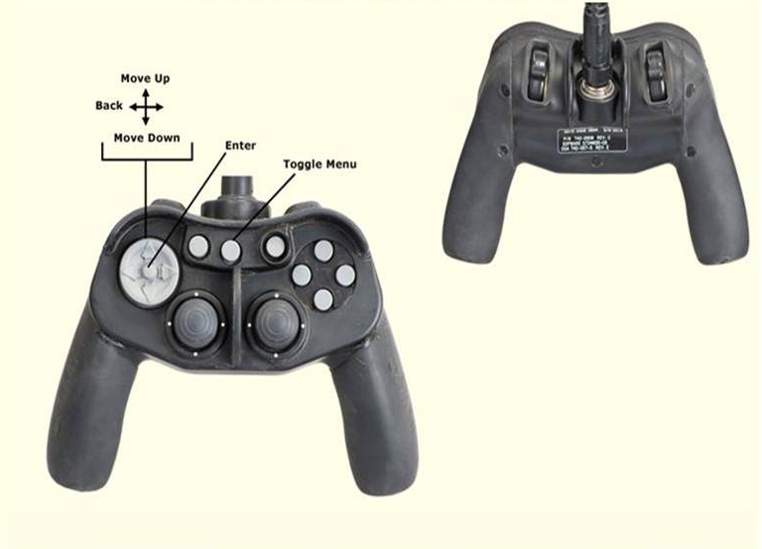
Hand Controller Mapping
Menu Mode

Slide 11
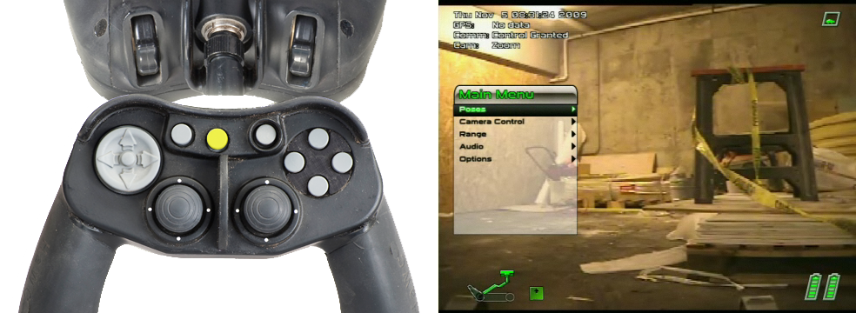
Main Menu Options
When you power on the SUGV, the control pad defaults to Drive mode. Press the Menu toggle button on the hand controller to switch between Drive and Menu mode.
There are five Main Menu Options to choose from:
  Poses
  Camera Control
  Range
  Audio
  Options

Slide 12
Submenus
Main Menu provides access to additional submenus
that enable you to:
Select poses for the robot.
Take and send pictures (future capability).
Control the cameras.
Calculate the distance between the robot and an object.
Control audio transmission and reception between the robot and the headset.
Set options that determine how the robot operates.
Shut down the robot or OCU.
Reboot the robot.

Slide 13
The Poses Menu enables you to select pre-programmed poses for the robot that place it in positions that facilitate specific actions such as driving, climbing and descending stairs, and looking over and under objects.
Poses Menu

Slide 14
Poses Menu Continued
Option | Description
Deploy | Takes the robot out of stow position. Use Deploy pose when driving the robot over rocky or difficult terrain.
Stow | Positions the robot to be stowed (packed). Also use Stow pose for driving the robot in situations that might cause it to fall or tumble.
Drive | Positions the robot for driving over reasonably flat terrain.
Ascend | Positions the robot for driving up stairs or steep inclines.
Descend | Positions the robot for driving down stairs or steep declines.
Peek Over | Positions the robot to look over tall obstacles.
Peek Under | Positions the robot to look under obstacles.
Self Inspect | Points the cameras at the chassis of the robot.
Extended Peek Over | Intended for future use.
Fiber Self Inspect | Intended for future use.

Slide 15
Camera Control Menu
The Camera Control Menu lets you focus the Zoom camera, take and send pictures, control the camera’s shutter speed, control the Infrared (IR) illuminators, and other secondary functions.
Notes:
Instructor note: lights should be dimmed for this portion of the class in order to demonstrate the capability.

Slide 16
Camera Control Menu
Continued
Option | Sub Menu | Description
Pictures | Take Picture | Takes a picture from the video that is being captured from the currently selected camera and stores it in the OCU computer.
Illuminator | Toggle Illuminator | Turns on and off the IR Illuminator for the Drive camera.
 | More Bright | Increases the level of light from the IR illuminator associated with the Drive camera. Also turns on this illuminator if it is not already on.
 | Less Bright | Reduces the level of light from the IR illuminator associated with the Drive camera. The lowest setting turns off this illuminator.
Notes:
Instructor note: lights should be dimmed for this portion of the class in order to demonstrate the capability.

Slide 17
Camera Control Menu Continued
Option | Sub Menu | Description
Shutter | Auto Shutter | Sets the shutter speed for the zoom camera to the default factory setting.
 | Shutter Slower | Reduces the zoom camera’s shutter speed.
 | Reset Faster | Increases the zoom camera’s shutter speed.
Focus | Reset Focus | Re-initializes the lens on the zoom camera if the focus seems “stuck” or is not functioning correctly.
 | Auto Focus | Instructs the robot to focus the zoom camera lens automatically.
 | Focus More | Zooms the focus in.
 | Focus Less | Zooms the focus out.
 | Fine Focus More | Zooms the focus in using smaller increments.
 | Fine Focus Less | Zooms the focus out using smaller increments.
IR Cut Filter | Auto Filter | Instructs the robot to control the IR cut filter automatically based on the lighting conditions under which the robot is working
 | Filter Off | Turns off the zoom camera’s IR cut filter. This is used for blocking IR light when the robot is operating under normal to bright lighting conditions. This allows more color to come through the picture.
 | Filter On | Turns of the zoom camera’s IR cut filter. This is used for blocking IR light When the robot is operating under normal to bright lighting conditions. This allows more color to come through the picture
Thermal | Zoom Level | Switches the zoom level of the thermal camera among three preset levels from low to high in the following order: 1 (low), 2 (high), and so on.
 | Toggle Polarity | Toggles the polarity of the thermal camera between black “hot” and white “hot”.

Slide 18
The Range Menu lets you use the IR distance-measuring device to calculate the distance between the robot and an object.
Range Menu
Option | Description
Get Range | Measures the distance between the robot’s IR distance-measuring device and an object.

Slide 19
The Audio Menu lets you control whether or not sound is transmitted from the robot microphone to the headset and from the headset microphone to the robot speaker.
Audio Menu
Option | Description
Audio Enable | Transmits sound from the robot microphone to the headset and from the headset microphone the robot speaker.
Audio Disable | Disables two-way transmission of sound between the robot and headset.

Slide 20
The Options Menu lets you modify joystick controller operations and display options. It also enables you to realign the joystick and robot and reboot and shut down both the robot and OCU.
Options Menu

Slide 21
Options Menu
Cont.
Option | Sub Menu | Description
Head Latch | Unlatch | Releases the head latch, so the head can be moved.
 | Latch | When in Stow position, locks the head into the chassis via the head latch. This prevents the head from being moved.
Control Options | Invert Drive Stick | Changes joystick drive control such that forward becomes reverse and reverse becomes forward. Inverting the drive stick again sets it to the default behavior
 | Invert Turn Stick | Changes joystick turn control such that left becomes right and right becomes left. Inverting the turn stick again sets it to the default behavior.
 | Invert Tilt Stick | Changes Head Pitch/Pan joystick control such that up becomes down and down becomes up. Inverting the pan stick again sets it to the default behavior.
 | Invert Pan Stick | Changes Head Pitch/Pan joystick control such that left becomes right and fight becomes left. Inverting the pan stick again sets it to the default behavior.
 | Calibrate Joysticks | Redefines the “dead zone” around the joysticks to compensate for “loose” joysticks.
 | Default Calibration | Re-establishes the default dead zone for the controller joysticks to the factory default.

Slide 22
Options Menu
Cont.
Option | Sub Menu | Description
Display Options | Flip Screen | Flips the image on the display screen.
 | More Bright | Increases the brightness of the image on the display screen.
 | Less Bright | Decreases the brightness of the image on the display screen.
 | More Contrast | Increases the contrast of the image on the display screen.
 | Less Contrast | Decreases the contrast of the image on the display screen.
 | Toggle GPS Format | Toggles the format used to display GPS data Between MGRS and geodetic (latitude / Longitude).
Audio Options | Increase OCU Mic Volume | Increases the volume of sound that is transmitted from the OCU microphone to the robot.
 | Decrease OCU Mic Volume | Decreases the volume of sound that is transmitted from the OCU microphone to the robot
Calibration | Calibrate Mode On | Turns on calibration mode so you can realign the neck.
 | Calibrate Mode Off | Turns off calibration mode. Be sure to exit calibration mode after you have finished realigning the neck.
 | Calibrate Latch | Realigns the head latch. This is useful if the latch is replaced of the robots head is opened up.
 | Calibrate Neck | Realigns the neck CAUTION Realign the neck only when the head is all the way down in the chassis, as in Stow mode. Otherwise, the neck is improperly realigned, which can result in collisions between the neck or head and the rest of the robot.
 | Calibrate Flipper | Realigns the flippers back to the factory standard.
 | Calibrate Audio | Adjusts the current background noise level of the QUIETPRO microphone. Adjust the audio only if you are having trouble hearing of sending audio.

Slide 23
Options Menu
Cont.
Option | Sub Menu | Description
Diagnostics | Next Screen | Displays the first diagnostic screen. Repeat to display subsequent diagnostic screens (up to four total). After the last screen, selecting Next Screen clears the diagnostic screens from the display. Tip: To see the details of the diagnostic screens, click the menu button to clear the menu.
Shut Down | Reboot Robot | Remotely reboots the robot.
 | Shutdown Robot | Turns off the robot.
 | Restart OCU | Reboots the OCU.
 | Shutdown OCU | Turns off the OCU.

Slide 24
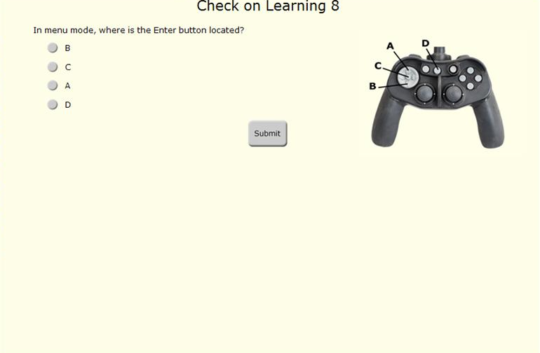
Check on Learning

Slide 25
Enabling Learning Objective C
ACTION: | Identify hand controller functions in drive mode.
CONDITIONS: | In an operational environment, provided with TM 9-2350-397-13 & P, SUGV Job Aid, SUGV Student Guide, and an operational SUGV system.
STANDARDS: | Identify menu functions for the SUGV in accordance with TM 9-2350-397-13&P, by identifying Basic Menu Options with 80% accuracy.

Slide 26
Drive Mode
When you power on the SUGV system and unlock the hand controller, the system is in Drive mode. In this mode, you can perform all mobility actions: drive the robot, position its head, neck and flippers, pan and tilt the head.

Slide 27
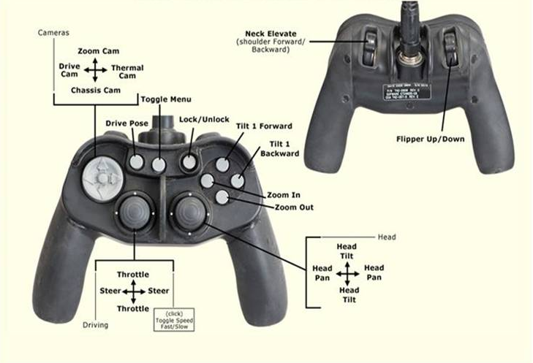
Hand Controller Mapping
Drive Mode

Slide 28
Drive Mode
Set the robot in an open area.
Stand at least 2.5 meters (m) (8.2 feet) away from it.
Press the Lock/Unlock button to unlock the hand controller.
With the hand controller in Menu mode select Poses > Deploy Pose.
After the robot moves into Deploy pose, press the Menu toggle button to switch the hand controller to Drive mode.
Check to see that the hand controller is in Drive mode by verifying that the Main Menu no longer appears in the display glasses.
Press the Drive Pose button (see figure on next slide) to move the robot into Drive pose.

Slide 29
Drive Pose ‘Hot’ Key

Slide 30
Controller Operations
in Drive Mode
Press the Throttle/Steer joystick forward (away from you) to move the robot forward.
Press the Throttle/Steer joystick backward (toward you) to move the robot in reverse.
Press the Throttle/Steer joystick to the left to turn the robot to the left.
Press the Throttle/Steer joystick to the right to turn the robot to the right.
Press the Flipper Up button to adjust the flippers up.
Press the Flipper Down button to adjust the flippers down.
Press the Tilt1 Forward and Tilt1 Backward buttons to move the neck.
Press the Neck Forward and Neck Backward buttons to move the head.
Press the Head Pan/Pitch joystick forward, backward, right, and left to move the head up, down, right, and left.

Slide 31
Summary
Terminal Learning Objective
Action: Menu Functions on SUGV.
Condition: In an operational environment provided with TM 9-2350-397-13&P, SUGV Job Aid, SUGV Student Guide, and an Operational SUGV System.
Standard: Identify menu functions for the SUGV in accordance with TM 9-2350-397-13&P by; Identifying Basic Menu Options, Identifying Hand Controller Functions in Menu Mode, Identifying Hand controller Functions in Drive Mode with 80% accuracy.
ELO A: Identify Basic Menu Functions.
ELO B: Identify hand controller functions in menu mode.
ELO C: Identify hand controller functions in drive mode.

Slide 32
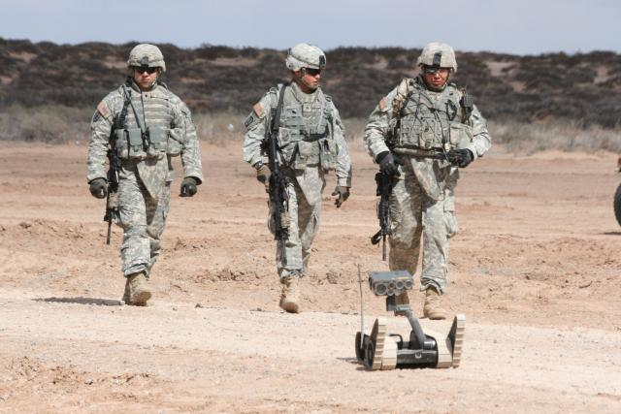
Basic Driving Operations

Slide 33
Terminal Learning Objective
Action: | Prepare the Small Unmanned Ground Vehicle (SUGV) for Basic Driving Operations.
Condition: | In an operational environment provided with TM 9-2350-397-13&P, SUGV Job Aid, SUGV Student Guide, and an operational SUGV system.
Standard: | Prepare the Small Unmanned Ground Vehicle (SUGV) for Basic Driving Operations, in accordance with TM 9-2350-397-13&P, by properly conducting pre-mission checks and maintaining speed appropriate for the operational environment with 80% accuracy.

Slide 34
Enabling Learning Objective A
Action: | Conduct pre-mission checks.
Condition: | In an operational environment provided with TM 9-2350-397-13&P, SUGV Job Aid, SUGV Student Guide, and an operational SUGV system.
Standard: | Prepare the Small Unmanned Ground Vehicle (SUGV) for Basic Driving Operations, in accordance with TM 9-2350-397-13&P, by properly conducting pre-mission checks with 80% accuracy.

Slide 35
CAUTION
When driving the robot in reverse, use the slowest driving speed (Snail mode) to prevent or minimize the impact of collision with any obstacle in its path.
Notes:
Instructor will execute all drive poses while talking the students through the exercise.

Slide 36
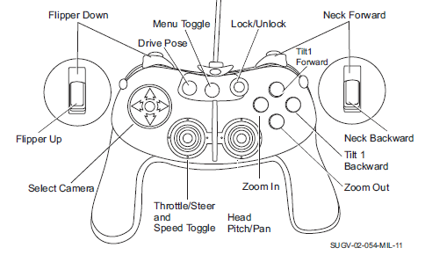
1. Press the Throttle/Steer joystick forward (away from you) to move the robot forward.
2. Press the Throttle/Steer joystick backward (toward you) to move the robot in reverse.
3. Press the Throttle/Steer joystick to the left to turn the robot to the left.
4. Press the Throttle/Steer joystick to the right to turn the robot to the right.

Slide 37
5. Press the Flipper Up button to adjust the flippers up.
6. Press the Flipper Down button to adjust the flippers down.
7. Press the Tilt1 Forward and Tilt1 Backward buttons to move the short neck extension.
8. Press the Neck Forward and Neck Backward buttons to move the long neck extension.
9. Press the Head Pan/Pitch joystick forward, backward, right, and left to move the head up, down, right, and left.

Slide 38
Enabling Learning Objective B
Action: | Maintain appropriate speed for operational environment.
Condition: | In an operational environment provided with TM 9-2350-397-13&P, SUGV Job Aid, SUGV Student Guide, and an operational SUGV system.
Standard: | Prepare the Small Unmanned Ground Vehicle (SUGV) for Basic Driving Operations, in accordance with TM 9-2350-397-13&P, by properly maintaining speed appropriate for the operational environment with 80% accuracy.

Slide 39
Locate the Speed toggle in the center of the Throttle/Steer joystick.
2. Press down on the Speed toggle to select a different speed mode.
3. Verify that the speed indicator changes from snail to tortoise to rabbit in the Heads Up Display (HUD).

Slide 40
Summary
Terminal Learning Objective
Action: Prepare the Small Unmanned Ground Vehicle (SUGV) for Basic Driving Operations.
Condition: In an operational environment provided with TM 9-2350-397-13&P, SUGV Job Aid, SUGV Student Guide, and an operational SUGV system.
Standard: Prepare the Small Unmanned Ground Vehicle (SUGV) for Basic Driving Operations in accordance with TM 9-2350-397-13&P by Properly conducting pre-mission checks; maintaining speed appropriate for the operational environment with 80% accuracy.
ELO A: Conduct pre-mission checks.
ELO B: Maintain appropriate speed for operational environment.

