Slide 1
Building an Engagement Area
The Seven Steps and The Seventeen Procedures
The Steps
The Procedures
1. Visualize how the enemy might attack
2. Select where and determine how to kill the enemy
3. Position obstacle groups to support direct fires*
4. Plan indirect fires to support direct fires and obstacles*
5. Position forces to kill the enemy with direct fires*
6. Complete the plan
7. Rehearse
1. Issue an initial warning order
2. Initiate movement
3. Initiate PCC / PCI
4. Initial reconnaissance of engagement area
with TF Cdr
5. Update co/tm warning order
6. Conduct co/tm leader’s recon
7. Develop initial co/tm fire plan
8. Finalize positions and obstacle locations
9. Occupy the battle position
10. Attend the TF OPORD
11. Complete the plan
12. Rehearse the co/tm fire plan
13. Finalize the co/tm fire plan
14. Prepare positions
15. Recon alternate and supplemental psns
16. Update changes and info w/ FRAGOs
17. Continue to prepare the EA and BP
“ A Way”
Notes:
6
The Seven Steps of Engagement Area Development
Identify likely enemy avenues of approach.
Identify the enemy scheme of maneuver.
Determine where to kill the enemy.
Plan and integrate obstacles.
Emplace weapons systems.
Plan and integrate indirect fires.
Conduct an engagement area rehearsal.

Slide 2
SEVEN STEPS OF THE DEFENSE
1. Know the Enemy and visualize how he will fight (enablers)
2. Select where and how to kill Enemy
5. Position Forces to kill
with Direct Fires
6. Complete the Plan
(site/emplace obstacles,
prepare positions,
develop CO / TF
Fire Plan)
7. Rehearse! (drive the
engagement area)
TRP 1
AD1001
Axis Enemy
3. Position obstacles to support Direct Fires
4. Plan indirect fires to support Direct Fires and Obstacles
Notes:
5

Slide 3
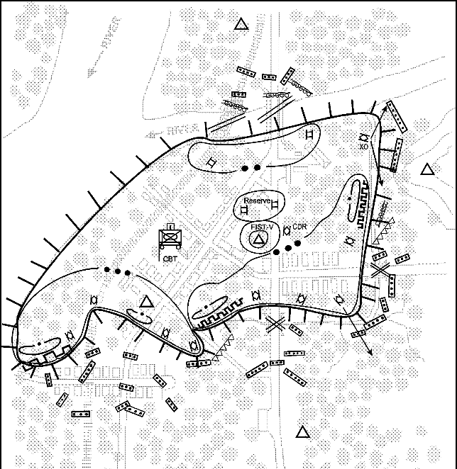
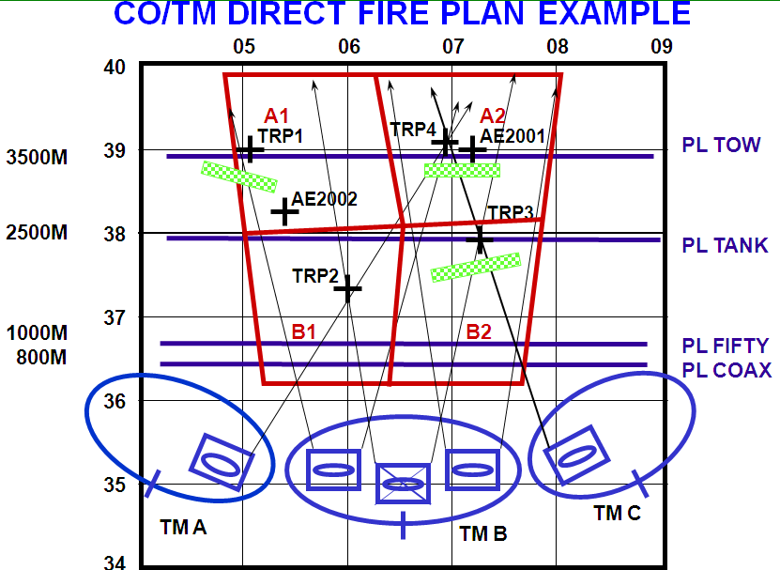
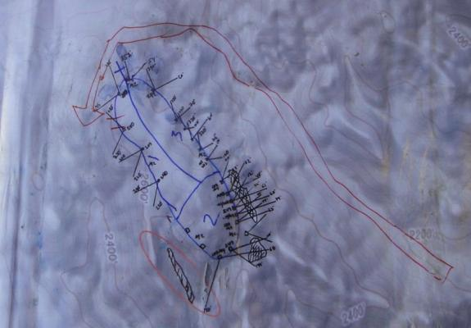
Engagement Area Development
1. Identify all likely enemy avenues of approach.
2. Determine likely enemy schemes of maneuver.
3. Determine where to kill the enemy.
4. Plan and integrate obstacles.
5. Emplace weapon systems.
6. Plan and integrate indirect fires.
7. Rehearse the execution of operations in the engagement area.
4
6
3
5
2
1
REF:FM 71-1
Resourcing Company COP Defenses
How do we enable Company Commanders to be successful in preparation for a COP attack?
EA Dev Steps 1-2:
AWT, LLDR, LLVI, scouts
Steps 3:
Where are you going to kill the enemy
Step 4:
ENG, Class IV, Spider, Claymores, CL V
Step 5-6:
CL V, SME, correct personnel
Step 7:
Have we provided the necessary equipment and personnel to allow the unit to get to this step?
COP 2 Company Fire Plan

Slide 4
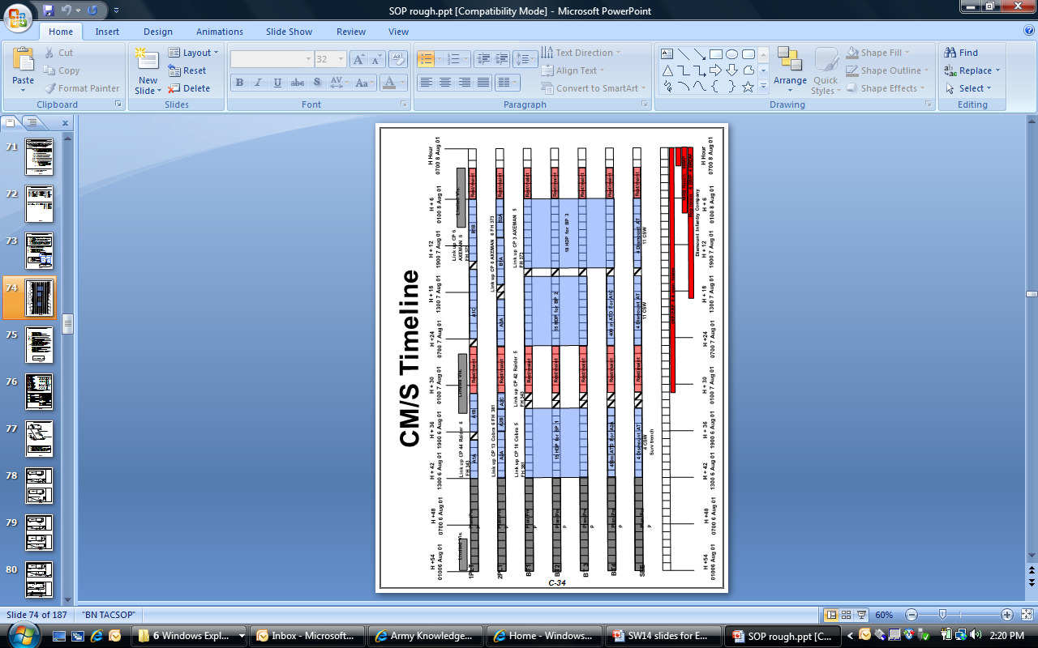
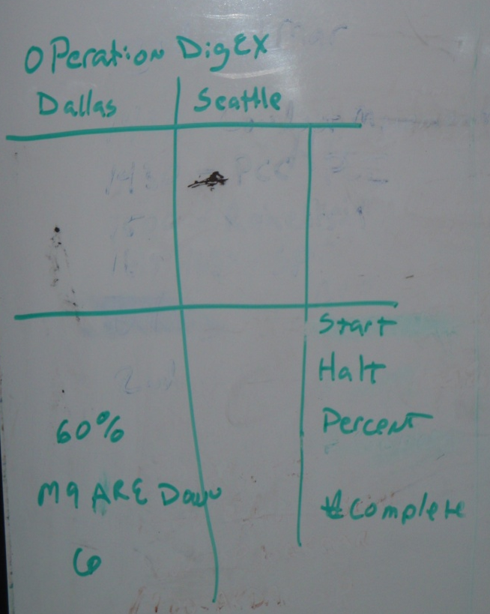
UNCLASSIFIED - FOUO
Operation Lions Shield (22MAR11: C/1-1 BSTB)
VS.
C/1-1 BSTB TACSOP
C/1-1 BSTB Tracking Board
How effectively did we resource and battle track the BCT’s survivability mission?
Did we understand all of our mission requirements?
SW14
UNCLASSIFIED – FOUO
Notes:
What level of planning did we go through at the company and battalion level to ensure we were prepared for digging operations?
How did this impact the quality of positions that were constructed for

Slide 5
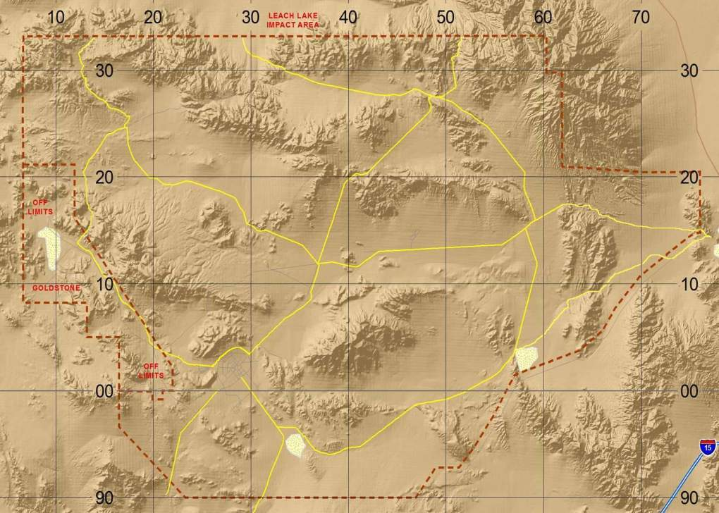
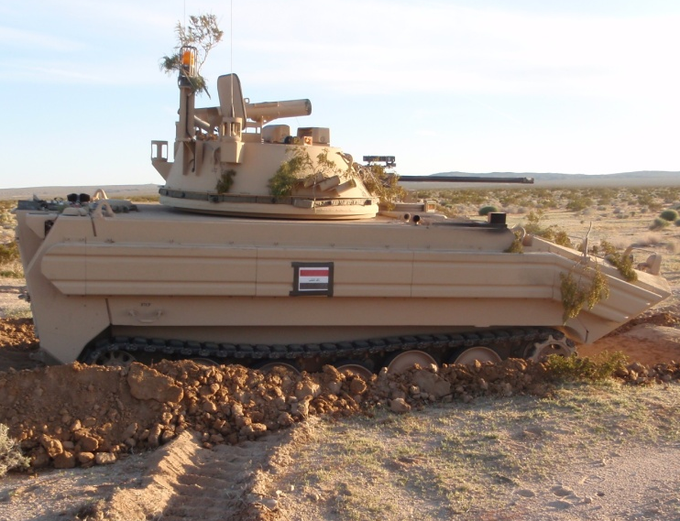
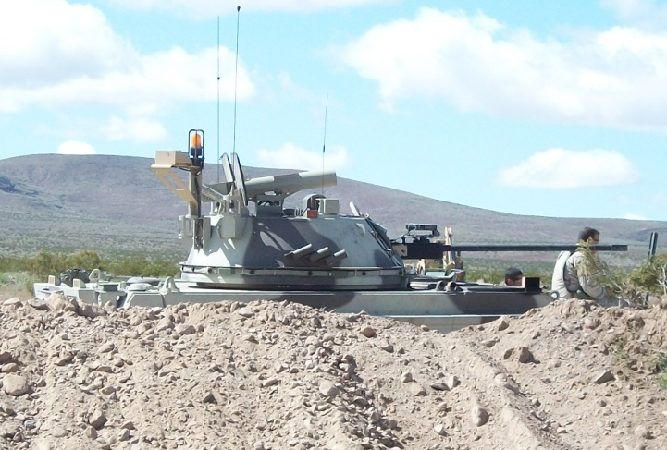
UNCLASSIFIED - FOUO
OP LION SHIELD SURVIVABILITY EFFORT
PLAN
21MAR/2300
BCT OPORD
22MAR/1500
BN MDMP
20MAR/1130
BCT WARNO
20MAR/1730
BN WARNO
22MAR/0800
1st BLADE in GROUND AT EA PATTON
20MAR/1500
BCT EBA
21MAR/0930
BN MDMP
PREPARE
22MAR/0800
1st ACE on SITE
22MAR/1706
1st BLADE in GROUND AT EA BRADLEY
22MAR/2225
M9 ACEs DISENGAGE
21MAR/2100
OPERATORS POSITIONED AT EAs
23MAR/0600
NLT DEFEND
22MAR/0530
ACEs LINE HAULED TO EAs
EXECUTE
EA BRADLEY
EA PATTON
 | Blade Team HRs | %
TOTAL TIME AVAILABLE | 170
TIME M9 ACE IDLE/MAINT | 144.5 | 85
TIME M9 ACE INTRANSIT | 7.5 | 4
TIME M9 ACE DIGGING | 18 | 11
AVG TIME PER HD POS | Blade Team HRs
M9 ACE BT STANDARD | 2.5
EA PATTAON | 1.6
EA BRADLEY | 0.12
M1/M2 HULL DEFILADE | 16 / 16 / 0
 | Planned/Executed/To Standard
UNCLASSIFIED - FOUO
SW3T

Slide 6
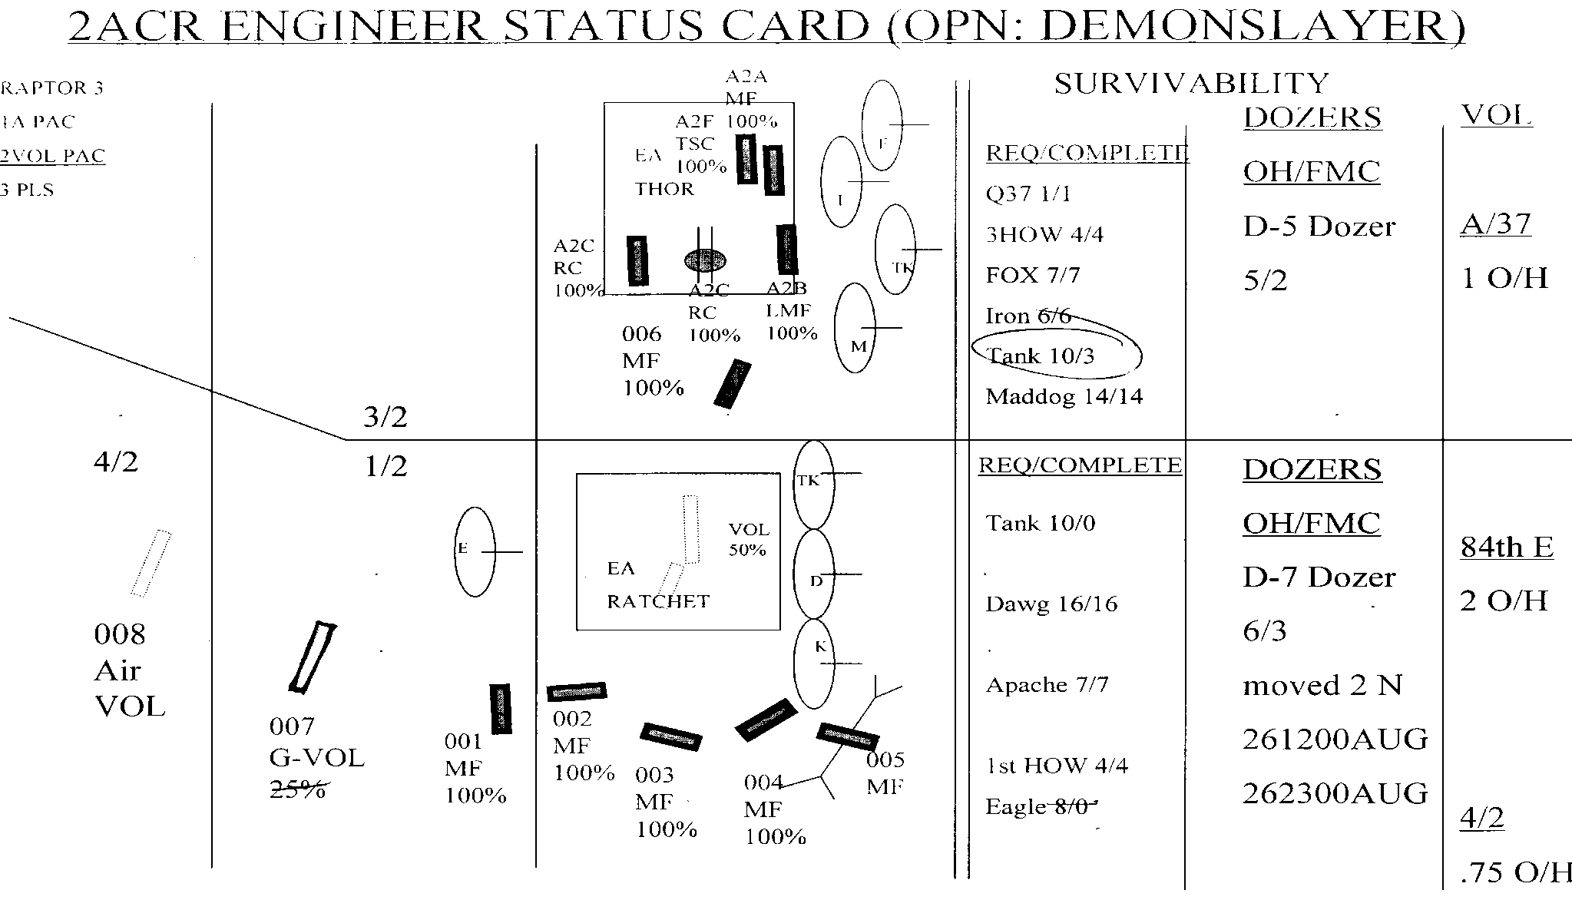
TRACKING ENGR PREP
48
40
32
24
16
8
SURV GLIDEPATH
TURRET POSTIONS
12
10
8
6
4
2
CMOB GLIDEPATH
OBSTACLES
H-21 H-18 H-15 H-12 H-9 H-6 H-3 H-HOUR
H-21 H-18 H-15 H-12 H-9 H-6 H-3 H-HOUR
Notes:
HOW DID WE TRACK OUR OBSTACLE EFFORT? [COMMANDER’S SKETCH CARD]
WHO TRACKED THIS INFORMATION [ONE AT THE RENG SECTION, AND A DUPLICATE AT THE BATTLEBOARD - GOOD!]
DOES THIS GIVE US THE ABILITY TO DO THE RUNNING ESTIMATE PROCESS? [NO] WHAT CAN WE USE?
STEP
[GLIDEPATH FOR SURVIVABILITY AND COUNTERMOBILITY TO ENSURE WE ARE KEEPING PACE WITH THE PLAN]

Slide 7
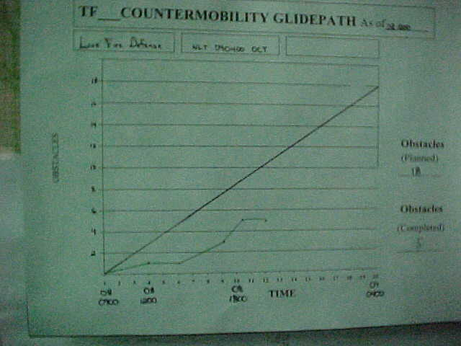
One glide path for entire BCT.
Doesn’t allow us to analyze
main vs. supporting efforts.
No identification of obstacles
by type. Essential in adjusting
priority of effort or support as
part of the running estimate
process.
Flat glide path does not reflect
changes in productivity for
daylight vs. night operations.
TYPICAL GLIDEPATH PROBLEMS

Slide 8
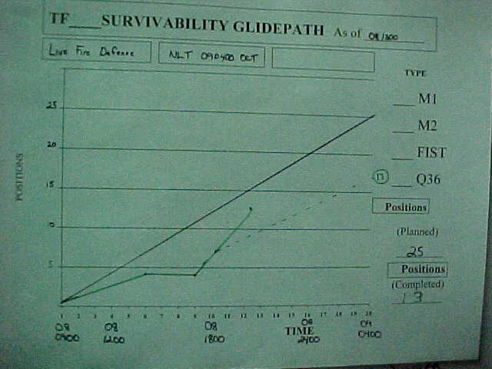
One glide path for entire BCT.
Doesn’t allow us to analyze
main vs. supporting efforts.
No identification of positions
by type. Essential in adjusting
priority of effort or support as
part of the running estimate
process.
Flat glide path does not reflect
changes in productivity for
daylight vs. night operations.
TYPICAL GLIDEPATH PROBLEMS

Slide 9
Countermobility Running Estimate TTP
Task Force North
TF North
MF - 2 / 5
WIRE - 2 / 4
10
8
6
4
2
0
As of: 090600
Planned
(9)
# Conventional Mine/Wire Obstacles
Projected
(6)
4
Actual
080600
081200
081800
082400
090600
091200
091800
Time
Defend NLT
091700

Slide 10
Countermobility Running Estimate TTP
2 BCT Sector
Team Blade
TF North - 420 / 800
TF South - 180 / 550
1500
1200
900
600
300
0
As of: 090600
Planned
(1350)
Meters Anti-Tank Ditch
Projected
(900)
600
Actual
080600
081200
081800
082400
090600
091200
091800
Time
Defend NLT
091700

Slide 11
Survivability Running Estimate TTP
TF North
BP1
M1 4/10
M2 2/4
FIST 1/1
BP2
M1 2/4
M2 5/10
FIST 1/1
BP3
M1 2/10
M2 0/4
FIST 0/1
OTHER
TLQ 1/1
TOTAL
M1 8/24
M2 7/18
FIST 2/3
TLQ 1/1
18/46
48
40
32
24
16
8
0
As of: 090600
Planned
(46)
Projected
(32)
# HULL-DOWN POSITIONS
18
Actual
080600
081200
081800
082400
090600
091200
091800
Time
Defend NLT
091700

Slide 12
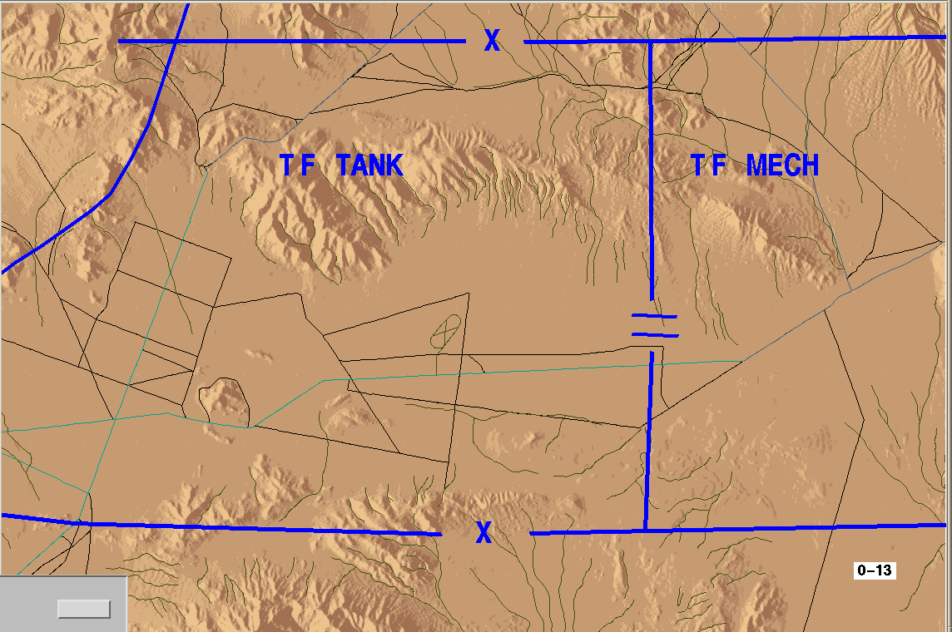
1/2 ACR
XX
COUNTERMOBILITY
RESOURCES
EBA (18 HRS)
MINES 1764
WIRE 864
PICKET 865
MF TOTAL: 3000 m
1
84
AO
84(-)
3
84
TOTAL CONVENTIONAL MINEFIELD EFFORT: 671 m
SURVIVABILITY
TDP 10
OR
HDP 24
Notes:
AGAIN, HOW MUCH TIME DID WE PLAN TO EXECUTE THIS PREP? [18HRS]
DID WE ALLOCATE SUFFICIENT RESOURCES (CLIV/V) GIVEN THIS AMOUNT OF TIME? [NO ACCORDING TO STANDARD PLANNING FACTORS; YES GIVEN THE SIZE OF OUR SECOTR (84 ENGR- AVERAGED 20% TRVEL TIME)
STEP
USING STANDARD PLANNING FACTORS FROM FM 5-71-2, THIS IS WHAT WE SHOULD HAVE BEEN ABLE TO ACCOMPLISH IN 18 HOURS.
3000M OF CONVENTIONAL OBSTACLE VS 671M ACTUALLY EXECUTED, + APPROX 1000M VOLCANO FRAT FENCE

Slide 13
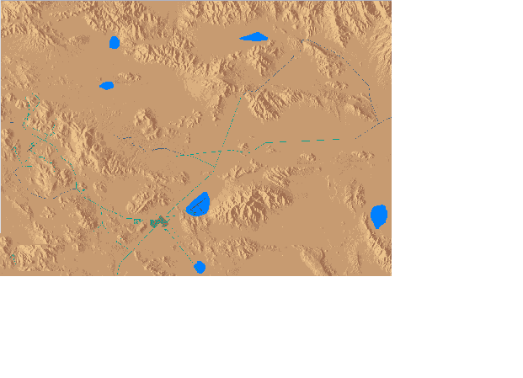
TF 3-8
RESOURCES
COUNTERMOBILITY
1
C/8
CSE
HHC/62
2
C/8
SURVIVABILITY
Notes:
PLANNED NUMBERS INDICATE RESOURCES REQUIRED BASE IN THE GROSS ESTIMATE. ACTUAL REQUIREMENT IS ABOUT 2200 MINES PER TASK FORCE (BALANCED EFFORT)
WHO WAS OUR MAIN EFFORT? [ABE THOUGHT 3-8 WAS COUNTERMOBILITY MAIN EFFORT, EN BN CDR THOUGHT 1-9 WAS THE MAIN EFFORT-A LACK OF CLEAR GUIDANCE EARLY IN THE PLANNING PROCESS]
DID WE WEIGHT THE MAIN EFFORT? [NO, BOTH TF’S GOT EQUAL ENGINEER SUPPORT AND EQUAL RESOURCES]

Slide 14
ACHIEVING COMMANDER’S INTENT
OBSTACLE
TYPE
CONVENTIONAL
- M21 AT-Mine
- M15 AT-Mine
- Concertina
AT DITCH / BERM
SCATTERABLE
- Volcano
- ADAM-RAAMS
- MOPMS
- Hornet
BDE
AVAIL/USED
/
/
/
-
/
( @ 48 HR)
( @ 4 HR)
/
/
AVAIL / USED
/
/
/
-
/
( @ 48 HR)
( @ 4 HR)
/
/
AVAIL / USED
/
/
/
-
/
( @ 48 HR)
( @ 4 HR)
/
/
AVAIL / USED
/
/
/
-
/
( @ 48 HR)
( @ 4 HR)
-
/

Slide 15
BRIGADE ENGINEER AND
STAFF INTEGRATION
DEVELOP AND MONITOR DEFENSIVE OPERATIONS TIMELINE - REVISE TIMELINE AS SITUATION DICTATES.
ENSURE COMMANDERS UNDERSTAND THE CURRENT STATUS OF M/CM/S OPERATIONS.
ENSURE THAT EBA REFLECTS FRIENDLY CAPABILITIES.
PASS EBA DOWN TO SUBORDINATES TO SUPPORT THEIR PLANNING.
IDENTIFY REQUIREMENTS FOR SCATMINES (SITUATIONAL OR DIRECTED).
REVIEW TF PLANS AND OVERLAYS TO ENSURE THAT Eas ARE PROPERLY DEVELOPED AND THAT COMMANDER’S INTENT IS ACHIEVED.
        FM 5-71-3, pg. 4-3/4-7

Slide 16
THE BRIGADE ORDER SHOULD:
____ ESTABLISH INTENT & PRIORITY
____ DIRECT TIME / LOCATION TO ESTABLISH CL IV / V POINTS.
____ DIRECT LINK-UP OF AUGMENTATION.
____ CONSIDER TASK FORCE PLANNING TIME.
____ SPECIFY BRIGADE DIRECTED CM / SURV EFFORT.
____ DIRECT ENGR TRANSITION TIME / CRITERIA BETWEEN BPs.
____ ESTABLISH SUSPENSES FOR OBSTACLE PLAN SUBMITTAL.
____ DIRECT ENGR DISENGAGEMENT CRITERIA BASED ON CRITICAL
____ EVENT (COULD BE FRIENDLY OR ENEMY).
____ DIRECT ENGR FOLLOW-ON MISSION.
____ ESTABLISH C2 FOR TRACKING THE EFFORT

Slide 17
DEFENSIVE PLANNING
RESPONSIBILITIES
BCT TF MANEUVER TM EN PLT
* SPECIFY BELTS TO
CONVEY AUTHORITY
* ESTAB OBSTACLE
BELT INTENT/PRIORITY
* RESOURCE MATERIAL,
MANPOWER, AND TIME
* DESIGN & RESOURCE
BRIGADE OBSTACLES:
- DIRECTED
- SITUATIONAL
- RESERVE
* CL IV / V PUSH /
RECOVERY
* TRANSITION / SHIFT
OF ENGR ASSETS
* DIRECT LINK-UP OF
AUGMENTATION
* TRACK TRIGGERS
* DISENGAGEMENT
PLAN / CRITERIA
* DESIGN OBSTACLE
GROUPS / FIRES BASED
ON CDR’S INTENT
* ESTABLISH PRIORITY
* ALLOCATE RESOURCES
* OPERATE TF CL IV / V
POINT (TF C3, LIFE SPT)
* LINK-UP AUGMENTATION
(MANPOWER, HAUL,LIFT)
* TRACK/REPORT STATUS
* SITE OBSTACLE
GROUPS AND VEH
POSITIONS
* PROVIDE SECURITY
* ASSIST EMPLACING
OBSTACLES
(FRAT FENCE)
* TURNOVER
* PROTECT OBSTACLE
* LANE CLOSURE
* OBSTACLE
RECOVERY
* SITE INDIVIDUAL
OBSTACLES
(MINI REHEARSAL)
* EMPLACE MF
* MARK MF
* RECORD MF
* TURNOVER
* REPORT STATUS
* LANE CLOSURE
* OBSTACLE
RECOVERY

Slide 18
VISUALIZING THE SCHEME OF OBSTACLES
2XADAM/RAAM
3X48 HR
VOLCANO
RESERVE
OBSTACLES
2X48 HR
VOLCANO
E
MOPMS
RES
E
BDE
RC
DIRECTED
2X48 HR
VOLCANO
E
RETAIN
1 X 4 HR
3X48 HR
VOLCANO
VOLCANO

Slide 19
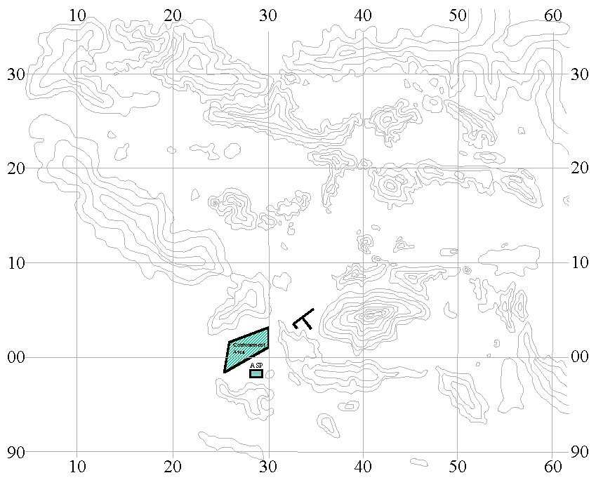
VISUALIZING THE SCHEME OF OBSTACLES
TECHNIQUE
XXX
KEY
ADAM/RAAMS
48 HR VOLCANO
4-HR VOLCANO
AT DITCH
FIX MF
NUISANCE MF
MOPMS
LANE BLUE
X

Slide 20
OBSTACLE PLAN
(TOP FED)
BCT / EN BN TF W/ EN CO MNVR EN PLT
* BELTS (BASED ON
TENTATIVE GRPS)
* CONVEY AUTHORITY
* EST OBSTACLE
PRIORITY
* RESOURCE MATERIAL,
MANPOWER, AND TIME
* DESIGN & RESOURCE
DIRECTED / SITUA-
TIONAL / RESERVE
OBSTACLE GRPS
* TRANSITION OF
ASSETS
* DISENGAGEMENT
PLAN
* TRACK TRIGGERS
* DIRECT LINK-UP OF
AUGMENTATION
* CL IV / V PTS
* DESIGN GRPS BASED ON
DF PLAN (TGT, EFFECT,
RELATIVE LOC)
* ESTABLISH PRIORITY
* ALLOCATE RESOURCES
* OPERATE CL IV / V
(UNCRATE MINES)
* LINK-UP AUGMENTATION
* SITE IN GRPS / VEH
PSNS
* RECEIVE TURNOVER
* PROTECT OBSTACLE
* PROVIDE SECURITY
* ASSIST
* SITE IN IND
OBSTACLES
(MINI REHEARSAL)
* EMPLACE MF
* MARK MF
* RECORD MF
* REPORT STATUS
* TURNOVER

Slide 21
OBSTACLE PLAN
(BOTTOM UP REFINEMENT)
EN PLT MNVR CO TF W/ EN CO BCT
* REPORT
* ADJUSTMENTS
WITHIN GROUPS
* FIRE PLAN TO
ACHIEVE HHQ
INTENT
* REFINE ARTY TGTS
* REFINED TIMELINES
* REVIEW GROUP
DESIGN
* REVIEW RESOURCES
* REVIEW PLANS
* ADJUST EFFORT

Slide 22
TOP DOWN - BOTTOM UP
TECHNIQUE
BCT/EN BN
TF/EN CO
BELT A1
MRR AA
GROUP A1A
MRB AA’s
FROM WARGAMING
GROUP A1B
- INTENT / AUTHORITY
- MANEUVER TF
- ENGINEER COMPANY
- PRIORITY
- MINES REQUIRED
- PLT HRS REQUIRED
- DF PLAN WITH OBST INTENT
(TGT, EFFECT, LOCATION)
- MANEUVER CO(s)
- ENGINEER PLT
- PRIORITY
- MINEFIELD ARRAY
- CONFIRM MINES / HOURS REQ’D
ANNEX D (ENGINEER)
SCHEME OF OBSTACLES OVERLAY

Slide 23
COMMANDER’S CARD TECHNIQUE
AS OF ( DTG )
1
C
TF TANK
3/3-MT
1/1-VOL (48 hr)
SURV 42%
14 / 28 M1
14 / 28 M2
0 / 4 FIST-V
0 / 6 MTR
CM 64%
7/11 OBST
C
3BCT EXEC / PLAN %
CM 9 / 20 45%
SURV 42 / 118 36%
D
START120900
COMP _______
4
2/4-MF
0/1-VOL (4 hr)
PRIORITY OF EFFORT
CM -
SURV - C
A
B
D
D
C
B
#
A
3
0/1-VOL (48 hr)
1/1-MB
A
D
TF MECH
SURV 21%
7 / 18 M1
7 / 24 M2
0 / 4 FIST-V
0 / 6 MTR
CM 45%
5/11 OBST
2/6-MF
0/1- VOL (4 hr)
B
5
START 121500
COMP _______
3/3-MT
0/1-VOL (48 hr)
B
2
Notes:
20
DID WE USE SOMETHING SIMILAR TO TRACK OUR DEFENSIVE PREP?
[YES, AND WHILE IT WAS KEPT GENERALLY UP TO DATE, IT DID NOT SHOW ALL OF THE PERTINENT DATA.
THE CARD SHOULD SHOW:
PRIORITIES FOR OBSTACLE AND SURVIVABILITY EFFORT TO ASSIST IN THE RUNNING ESTIMATE PROCESS WHEN RE-ALLOCATING AND REPRIORITIZING MISSIONS/ASSETS.
SURVIVABILITY STATUS BY TYPES OF POSITION, AGAIN TO ASSIST IN RE-ALLOCATION AND PRIORITIZATION.
TERRAIN FEATURES TO ASSIST IN IDENTIFING OBSTACLES AND HOW THEY RELATE TO THE SCHEME OF MANEUVER. IT MAKES IT EASIER TO SEE THAT A PARTICULAR AVENUE IS NOT CLOSED WHEN THE AVENUES ARE CLEARLY VISIBLE.
START AND COMPLETION TIMES TO HELP MATCH WITH GLIDEPATH

Slide 24
COMMANDER’S CM/SURV STATUS CARD
AS OF (DTG)
C
TF TANK
SURV 42%
14 / 28 M1
14 / 28 M2
0 / 4 FIST-V
0 / 6 MTR
CM 60%
6/10 MINEFIELD
BDE EXEC / PLAN %
3/3-MT
1/1-VOL
(48 hr)
CM 9 / 20 45%
SURV 42 / 118 36%
C
D
START120900
COMP _______
__/4-MF
__/1-VOL
(4 hr)
A
__/1-VOL
(48 hr)
1/1-MB
A
D
TF MECH
SURV 21%
7 / 18 M1
7 / 24 M2
0 / 4 FIST-V
0 / 6 MTR
2/6-MF
__/1- VOL
(4 hr)
B
CM 30%
3/10 MINEFIELD
1/3-MT
1/1-VOL
(48 hr)
START 121500
COMP _______
B
Notes:
20

Slide 25
DEFENSIVE PREPARATION
DECISION POINTS
DP
1
2
3
4
EVENT
Shift blades
from CM to
survivability
Shift blades
from TF___ to
TF____
Shift blades from
survivability to
countermobility
Shift
scatterable
mine assets
Friendly
* TF __ vehicle positions
sited and staked
* > 50% ATD complete
* NLT 211800 April
* 90% of M1, M2, BSFV
dug in @ 221800 APR
* <90% of ME TF dug in
@ 221800 April
>90 % of planned
survivability positions
complete; unable to
complete CM plan;
Volcano’s < 50% FMC
* Under CM Glidepath
Executed < 70% planned
CM effort on AA or EA
* Review at 230100 April
Enemy
No loss of blades
To enemy action
No loss of blades
To enemy action
Enemy Recon & FD/
RD fight is successful;
Expect both MRR in
2-Up/2-Back Formation
Enemy Recon & FD/
RD fight is successful;
Expect 2-Up/2-Back
Formation along a
specific AA
Action
Shift 75% of available
blade teams to begin
TF____ survivability;Shift
remainder > 90% ATD
Shift blades to
TF____
- Change standard
from two tier to one tier
Blades shift to
dig 1100m Type-2
Anti-Tank Berm
to reinforce TF___ @
expected penetration
Allocate 4-hr volcano
or ADAM/RAAMS based
on shortfall of effort.

Slide 26
DEFENSIVE PREPARATION
DECISION POINTS
DP
1
2
3
4
EVENT
CL IV/V PUSH
AIR VS GROUND
* NLT 042000 DEC
SHIFT BLADES
FROM ME
SHIFT BLADES
FROM CM TO
SURVIVABILITY
SHIFT
SCATTERABLE
MINE ASSETS
FRIENDLY
AVAILABILITY / WIND
UH60 < 45 KNOTS
CH47 < 30 KNOTS
UNABLE TO SLINGLOAD
* 90% OF M1, M2, BSFV
DUG IN @ 051200 DEC
* <90% OF ME TF DUG IN
@ 051200 DEC
* < 5 BLADE TEAMS FMC
* INABILITY TO SUSTAIN
* > 50% ATD COMPLETE
* NLT 051200 DEC
* ON GLIDEPATH TO
EXECUTE < 90% CM
EFFORT ON AA OR EA
* REVIEW AT 051200 DEC
ENEMY
NO LOSS OF BLADES
TO ENEMY ACTION
NO LOSS OF BLADES
TO ENEMY ACTION
ACTION
SHIFT CL IV/V
HAUL TO TRUCK
- SHIFT BLADES TO
TF ____
- CHANGE BRIGADE STD
FROM MODIFIED TWO
TIER TO ONE TIER
- TF __ POSITIONS SITED
ALLOCATE 4-HR VOLCANO
OR ADAM-RAAM BASED
ON SHORTFALL OF
EFFORT

Slide 27
OBSTACLE INTENT
TARGET
- ENEMY FORCE TO BE AFFECTED BY
OBSTACLE(S); IDENTIFY BY SIZE, TYPE,
ECHELON, TACTICAL GROUPING
OBSTACLE EFFECT
- DISRUPT, TURN, FIX, BLOCK
LOCATION
- WHERE ALONG AA; RELATIVE TO
MANEUVER / FIRE CONTROL MEASURES
“A-WAY” to establish Obstacle Intent:
- Identify WHERE the enemy wants to go
- Specify WHERE we want to kill the enemy
- Specify WHERE we want the enemy to go
- Specify WHERE we don’t want the enemy to go
Notes:
7

Slide 28
OBSTACLE EFFECTS
DISRUPT GROUP
BLOCK GROUP
FIX GROUP
TURN GROUP

Slide 29
SITUATIONAL
OBSTACLES

Slide 30
SITUATIONAL OBSTACLE
EMPLOYMENT PRINCIPLES
* IDENTIFY THE NEED.
* PLAN FOR APPROPRIATE RESOURCES.
* INTEGRATE THE OBSTACLE WITH FRIENDLY FIRES.
* PLAN THE OBSTACLE.
* IDENTIFY OBSTACLE EXECUTION TRIGGERS.
* WITHHOLD EXECUTION OF THE OBSTACLE UNTIL IT IS NEEDED.

Slide 31
SITUATIONAL OBSTACLE
EMPLOYMENT
DEFENSE
SHAPE THE BATTLESPACE FOR THE DEEP BATTLE
SEPARATE ATTACKING ENEMY ECHELONS
REINFORCE OR REPAIR TACTICAL OBSTACLES ALREADY EMPLACED
REINFORCE EXISTING OBSTACLES ON ENEMY AVE OF APPROACH
DEFEAT PENETRATIONS
EMPLACE ADDITIONAL OBSTACLES BASED ON PRODUCTION SHORTFALL
OFFENSE
INTERDICT COMMITMENT OF ENEMY RESERVES (CAS / JAAT)
ASSIST GROUND FORCES (FOLLOW AND SUPPORT) IN DEFEATING
ENEMY CATK’S THREATENING FLANKS OR PENETRATIONS
OBSTRUCT ENEMY WITHDRAWL OR ESCAPE ROUTE DURING
AN ENVELOPMENT
ISOLATE ADJACENT FORCES FROM INFLUENCING OR
REINFORCING THE MAIN EFFORT
TRANSITION TO A HASTY DEFENSE TO ALLOW FORCES TO REBUILD COMBAT
POWER OR ALLOW PASSAGE OF FOLLOW-ON FORCES

Slide 32
SITUATIONAL OBSTACLE PLANNING
TAI-1
Enemy Mvmt Time
Alternate
Observer
OP-2
Trigger
DP-1
NAI-1
Friendly
force or fires
cover TAI
Observer
OP-1
TAI-2
Enemy Mvmt Time
Time
Report Trigger
Decide to Execute
Order Execution
Commit Obstacle
Emplacement Asset
Move Obstacle Emplacement
Asset to Site
Time
Move friendly
force to
cover TAI
Occupy position
to cover TAI
or commit fires
Time
Time to Emplace Obstacle
Arming Time for SCATMINES

Slide 33
Situational Obstacle Planning
H+5
H+4
H+3
TAI-1
H+2
Enemy Mvmt Time
OP-2
Alternate
Observer
NAI-1
Trigger
DP-1
Friendly
force or fires
cover TAI
Observer
OP-1
TAI-2
NAI-2
Enemy Mvmt Time
H+4
H+2
H+3
H+5
NAI =>NAMED AREA OF INTEREST: A POINT OR AREA ALONG A PARTICULAR AVE OF APPROACH THRU WHICH
ENEMY ACTIVITY IS EXPECTED TO OCCUR. ACTIVITY OR LACK OF ACTIVITY WITHIN AN NAI WILL HELP CONFIRM
OR DENY A PARTICULAR ENEMY COA.
TAI => TARGETED AREA OF INTEREST: A LOCATION WHERE FRIENDLY FORCES CAN INFLUENCE THE ENEMY
DP => INVOLVES A DECISION OR AN EVENT/ACTION THAT MAY OR MAY NOT TAKE PLACE,
BASED ON FRIENDLY AND ENEMY CRITERIA
TRIGGER => INVOLVES AN ACTION OR EVENT THAT WILL HAPPEN, IT IS ONLY A MATTER OF TIME.
IT CAN BE AN ENEMY OR FRIENDLY EVENT. THERE IS NO DECISION RELATED TO YES OR NO, ONLY WHEN.

Slide 34
PLANNING FOR
OBSTACLE INTEGRATION
MDMP Points of Emphasis
Determine available systems, maintenance status, location, and available loads (EBA)
Use scatterable mines as directed, situational, or reserve obstacles
Must be part of COA - identify emplacing unit, overwatching force, and C2 structure (task & purpose of the obstacle and fires)
Synchronize during war gaming - include on overlay and conduct time/distance analysis to determine location of observers, NAIs, and decision points
Include as part of subordinate unit tasks in brigade OPORD - location, emplacing unit, overwatching force, observers, and triggers; Establish maneuver unit ownership.
Trigger/Execution included as part of every Combined Arms Rehearsal
Notes:
I think these are the keys to successful integration of scatterable systems

Slide 35
APPLYING TARGETING METHODOLOGY TO SITUATIONAL OBSTACLE PLANNING TECHNIQUE
1. FOCUS OF OBSTACLES. Determine WHAT you want obstacles and fires to do
to the enemy. Describes the effects needed to influence the enemy’s maneuver.
2. IDENTIFY THE TARGET. Specify WHO you want obstacles and fires to effect.
3. TARGETED AREAS OF INTEREST. WHEN? / WHERE?
4. INTEGRATE OBSTACLES AND FIRES with the scheme of maneuver.
(Task, Purpose, Method, Endstate).
5. TIME/DISTANCE ANALYSIS.
6. OBSERVER / TRIGGER PLAN. Position observers to link NAIs and
decision points with triggers.
7. SKETCH: VISUALIZE THE SCHEME OF OBSTACLES.
8. ESTABLISH OWNERSHIP.
9. REFINE. Apply targeting methodology to refine plan at the TARGETING MEETING.
10. DISSEMINATE AND REHEARSE. Disseminate the refined plan across the unit
to reduce risk of minefield fratricide. Include decision points, triggers, and
overwatch at the the combined arms rehearsal.

Slide 36
VISUALIZING THE SCHEME OF OBSTACLES
DP 1
XXX
NAI-1
TAI 12
H-HOUR
4
TAI 4
NAI-3
DP 3
8
DP 2
1
2
TAI 1
7
NAI-2
3
TAI 3
TAI 8
TAI 2
NAI-5
DP5
TAI 7
NAI-6
DP 4
6
5
TAI 6
KEY
X
ADAMS/RAAM
GROUND VOLCNO
MOPMS
MRB Mobility Corridor
Observation Post
1

Slide 37
PLANNING FOR OBSTACLE INTEGRATION
Notes:
Here we continue to look at using the correct asset in the right situation
Many of the fratricides I witnessed at the NTC were caused by using the wrong asset for the mission
An example is the employment of an air volcano to develop an EA overwatched by dismounted soldiers

Slide 38
SITUATIONAL OBSTACLE
SCHEME OF EMPLOYMENT
PLANNING FOR OBSTACLE INTEGRATION:
Identify battlefield conditions that trigger target execution.
  Friendly criteria.
  Enemy criteria.
Check Commander’s Criteria.
Reverse Plan from the target location.
  Scheme of maneuver.
  Time to confirm situation.
  Move to and emplace obstacle.
  Maneuver and integrate fires.
Right asset to the right target at the right time.
Combination of both
Notes:
The next two slides discuss using scatterable systems as situational obstacles
As you saw in the trends we showed you earlier, we are having difficulty developing triggers for situational obstacles
This is the general approach laid out in 90-7
Integrate during COA development
Synchronize during war gaming
Verify during rehearsals

Slide 39
PLANNING FOR OBSTACLE INTEGRATION
Time requirements for situational obstacles:
  (T) Enemy movement from NAI to TAI.
  (M) Commit resource to target.
  (E) Emplacement of target.
  (A) Arming time.
  (C) Integration of fires.
  M + E + A < T AND T > C
Notes:
Here is a formula for us engineers
Situational obstacles should be part of every CA rehearsal
Review:
- task and purpose
-DP/triggers
-observer plan
-C2
rehearse physically on the ground
FXXI rehearse by simulation

Slide 40
ADAM-RAAMS CONSIDERATIONS
WHAT ARE OUR TACTICAL AND SITUATIONAL OBSTACLE REQUIREMENTS?
WHAT ARE OUR OBSTACLE CAPABILITIES?
  CONVENTIONAL
  MOPMS
  VOLCANO (AIR & GROUND)
  ARTILLERY -DELIVERED SCATTERABLE MINES
  HORNET MUNITIONS
DELTA BETWEEN CAPABILITY AND COUNTER-MOBILITY NEEDS
CONSIDERATIONS FOR EMPLOYING ARTILLERY DELIVERED SCATTERABLE MINES
  ARTILLERY -- WHERE I CANNOT EMPLACE
  TOO DANGEROUS TO GET TOO
  PUT IN AFTER THE COMPLETION OF OTHER EFFORTS
  ENEMY THREAT
ARTILLERY-DELIVERED SCATTERABLE MINE CONSIDERATIONS
  TIME TO PUT IN
  TRIGGER FOR EMPLACING
  ENEMY ACTION
COVER ALL OBSTACLES WITH DIRECT & INDIRECT FIRES
FOR A TYPICAL 400 X 400 = 10 TARGETS (RAAMS & 4 ADAMS)
  REQUIRES REHEARSAL & TECHNICAL SOLUTION
ARTILLERY-DELIVERED SCATTERABLE MINEFIELDS: A TARGET OF OPPORTUNITY IS NOT A SINGLE GRID. IT IS MULTIPLE TARGETS REQUIRING COMPUTATION, COORDINATION, AND TECHNICAL REHEARSALS

Slide 41
FA DELIVERY MINEFIELD PLAN SHEET

