Slide 1
Plan a Tactical Mission IAW
Troop Leading Procedures (TLP)

Slide 2
Terminal Learning Objective
ACTION: | Recommend Dismounted Counter-IED Training to Unit Leaders
CONDITION: | In a classroom or field environment, acting as a CIED member of a team tasked to prepare a unit maneuver training plan. Also tasked to plan a tactical mission. Given proper Counter IED enablers. Given multimedia presentation, with references including ADP and ADRP 7-0 Training Units and Developing Leaders, rubrics, and access to DTMS, UTM and ATN.
STANDARD: | Recommend D-CIED training IAW Chapter 10, ATTP 5-0.1, Ch. 6, ADRP 6-22, Instructor facilitation skills rubric, ADRP 7-0, Ch. 3, paragraph 3-33 to 3-68 including the eight steps of the TLP and tactical missions must be planned IAW TLP as listed in Ch. 10, FM 6-0 and must score 80% or better on examinations/tests and includes: 1. Apply Instructor/Facilitator Facilitation Skills. 2. Conduct a Unit Mission. Learning Domain: Cognitive Level of Learning: Synthesis
2
Notes:
NOTE.
The standard reflects the lesson ELOs:
ELO A = 1. Apply Instructor/Facilitator Facilitation Skills.
ELO B = 2. Conduct a Unit Mission.
This presentation covers ELO A only.

Slide 3
ELO B- LSA 2
ACTION: | Plan a Unit Mission
CONDITION: | In a classroom or field environment, acting as a CIED member of a team tasked to prepare a unit maneuver training plan. Also tasked to plan a tactical mission. Given proper Counter IED enablers or equipment. Given multimedia presentation, with references including ADP and ADRP 7-0 Training Units and Developing Leaders, rubrics, and access to DTMS, UTM and ATN.
STANDARD: | Plan unit training missions and unit tactical missions IAW ADRP 7-0, chapter 3, paragraph 3-33 to 3-68 including the eight steps TLP, chapter 10 of FM 6-0, and chapter 6 of ADRP 6-22 and must score a minimum of 80% in tests assessed with rubrics and includes: 1. Conduct Unit Training IAW TLP. 2. Plan a Tactical Mission IAW TLP. Learning Domain: Cognitive Level of Learning: Analysis
3
Notes:
NOTE.
This presentation only covers LSA 2 of ELO B only (Plan a Tactical Mission IAW TLP).

Slide 4
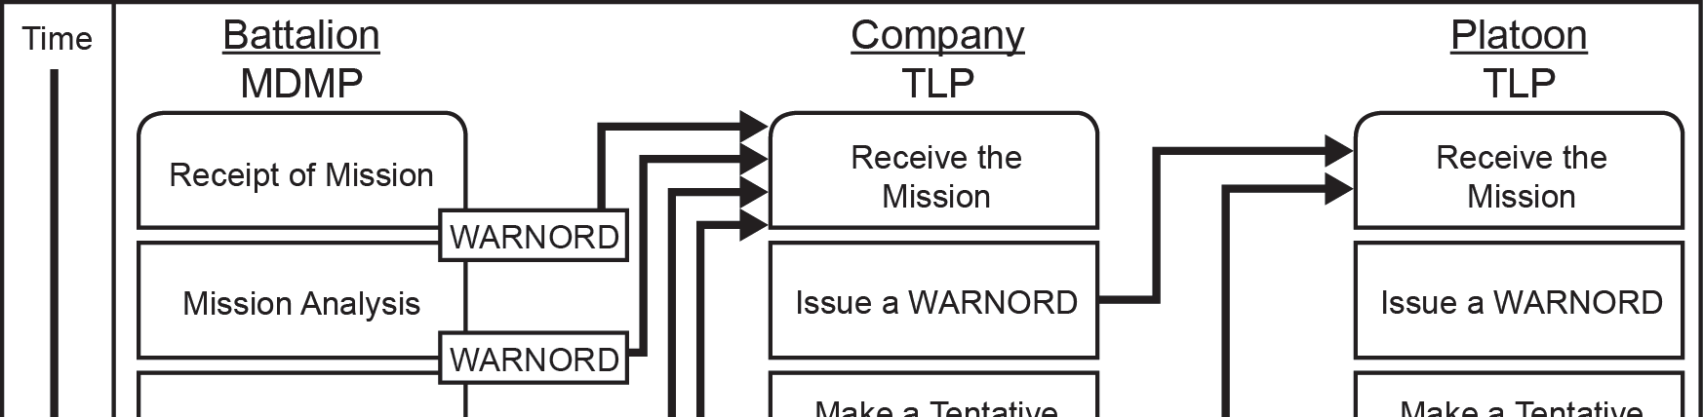
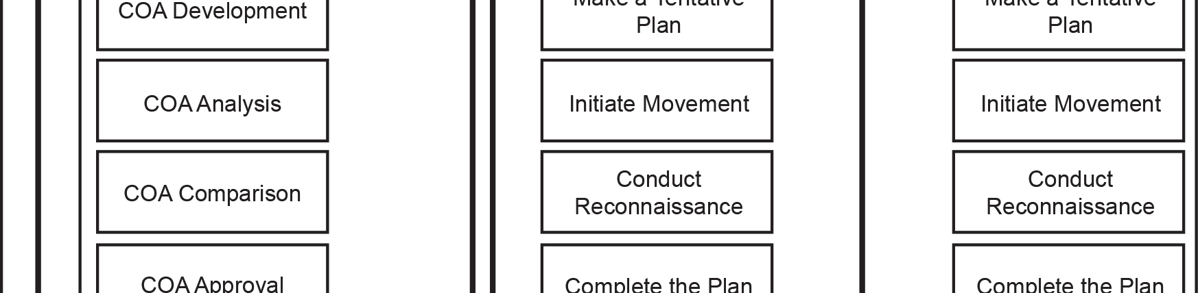
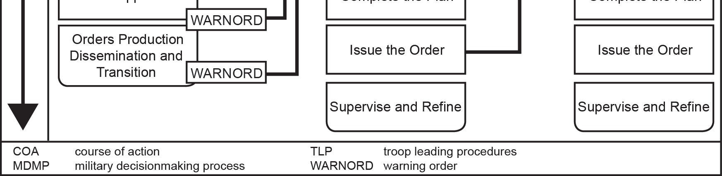
When should we use MDMP vs TLP?
MDMP is used at Battalion and higher
TLP is used at Company-level and smaller
FM 6-0, Chapter 10
Notes:
What are some of the tools that are available for planning?
NOTE.
1. The students may bring up several different tools such as problem solving process, MDMP, TLP, The Eight Step Training Model etc..
2. Make sure that you center the discussion around Troop Leading Procedures (TLP)
For the purpose of this LSA we will concentrate on TLP
When should we use MDMP Vs TLP?
1. MDMP is used at BN and higher. Commanders with a coordinating staff use the MDMP as their primary planning process.
2. TLP is used at Company-level and smaller. These units lack formal staffs and use TLP to plan and prepare for operations.
Military Decision Making Process (MDMP):
The MDMP is more appropriate for headquarters with staffs. It provides a logical sequence of interactions and decisions between the command and staff for developing estimates and effective plans and orders.
Troop Leading Procedures (TLP):
At lower tactical echelons, company commanders and below use TLPs to plan and prepare for an operation.
Both planning processes provide a logical sequence of understanding the situation, developing and analyzing the Course of Action (COA), deciding on the best COA, and producing a plan or order to accomplish the mission.
For the purpose of this LSA we will concentrate on TLP
Reference FM 6-0, CH 10, para10-5. Normally, the first three steps (receive the mission, issue a WARNORD, and make a tentative plan)
of TLP occur in order. However, the sequence of subsequent steps is based on the situation. The tasks involved in some steps (for example, initiate movement and conduct reconnaissance) may occur several times. The last step, supervise and refine, occurs throughout.

Slide 5
Why do we use the TLP?
Provides small-unit leaders a framework for planning and preparing for operations
It is a tool that begins when the leader receives a mission and continues throughout the operations process (plan, prepare, execute and assess)
It is a sequence of actions that assist leaders to effectively and efficiently use available time to issue orders and execute tactical operations
Allows for flexibility; some steps are done concurrently and others steps are not
Notes:
1. Company and below elements should develop planning SOPs that clearly define the roles and responsibilities of each participant in order to expedite the process and ensure that the element is planning as effectively as possible. Describe how in the MDMP process the staff of larger organizations utilize a running estimate to be able to quickly provide the Commander with answers to their questions and ensure that the planning is not flawed by inaccurate information. At the company level and below there is not actual staff elements, but the commander, Platoon leader and Squad Leader can delegate these same areas of responsibility to ensure that they are not overloaded in the planning process.
2. The information provided to the planner from their higher headquarters dramatically effects the ability to develop sound plans. The higher Headquarters needs to pass information as quickly and as accurately as possible. This is also something that must be understood at the TLP level- providing the available information, even if it is limited, can have a significant positive impact on the subordinate elements ability to plan and prepare for the upcoming action.
3. Normally, the first three steps of the TLPs occur in order, but after that the given situation will dictate the exact order of execution.

Slide 6
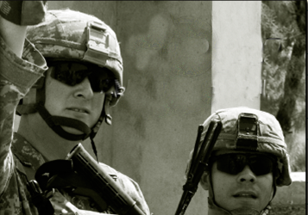
Is planning Science or Art?
The Science:
  Aspects of operations capabilities
  Techniques, and procedures that can be measured and analyzed
  physical capabilities
  realistic appreciation for time-distance factors
  how long it takes to initiate certain actions
  While not easy, the science of planning is straightforward
The Art
Experience
Responsibility
Two-way Communication
Good Listener
Observational Skills
Notes:
Planning is both Science and Art
1. There are three problem solving methods that the Army uses. Two of them are tactical and one is non-tactical. The Army Problem solving process is the non-tactical process while MDMP and TLPs are the tactical processes.
2. Analytic verses Intuitive Decision making:
a. The Analytic process approaches a problem systematically by analyzing the problem, generating several courses of action,
analyzing and comparing these COAs and them selecting the best available COA. This approach is methodical and is good in complex or unfamiliar situations- it ensures that all factors are considered.
b. Intuitive decision making is based on knowledge, judgment, EXPERIENCE, education, intelligence, boldness and perception. It is most often used with there is limited time available. It relies on the experienced leader’s ability to recognize the key elements an implications of a particular problem or situation. This technique doesn’t work well with inexperienced leaders or in unfamiliar conditions.
3. A combination of these two approaches is likely the best approach to planning.
====================
1.What is planning?
a. Planning is the process by which leaders translate the Commander’s visualization into a specific course of action for preparation and execution, focusing on the expected results. Planning is a learning activity that improves understanding of the situation and facilitates the exercise of judgment during execution. It involves developing an understanding of the current situation, envisioning a desired future, and conceptualizing an approach to achieve that future.
b. Planning is a continuous activity of the operations process. During preparation and execution the plan is continuously refined as situational understanding improves. Ultimately planning is thinking before acting.
c. Planning is based off imperfect knowledge and assumptions. It’s impossible to know everything and planning will not enable you to predict with absolute certainty what will unfold, but the knowledge gained as you think through the planning process with greatly enhance your understanding and prepare you for the unexpected.
d. Planning allows the leader to properly task organize the force and prioritize their efforts and further help the leader direct, coordinate and synchronize the actions of the element.
2. Remember, you’re not planning the Normandy invasion: simple, flexible plans work best!

Slide 7
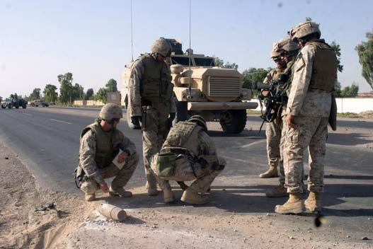
List the 8 Steps of Troop Leading Procedures?
Receive the Mission
Issue a Warning order
Make a Tentative Plan
Initiate Movement
Conduct Reconnaissance
Complete the Plan
Issue the Order
Supervise and Refine
NOTE. May show a 16 minute Troop Leading Procedures Video included in the CD (See notes in the Note page of this slide
Notes:
NOTE. YOU MAY OPT TO SHOW THE TLP VIDEO HERE.
Troop Leading procedures (video) (Video covers planning a tactical mission)
1. Assign the video as homework
2. Show the entire 16 minutes video at the beginning of the class
3. Show the entire video interactively as you conduct the class (pause- ask guided questions – play, etc.)
4. Show the entire 16 minutes video at the end of the class in lieu of the summary.
1. Prior to the list of TLPs being presented ask the class to identify the 8 steps.
2. The TLPS are ingrained in our military culture- even if we are not cognitively trying to use them to accomplish a task, most leaders with intuitively follow the process. Even though this is the case, understanding what each step is and how it relates to the overall accomplishment of the mission is very important. During the planning process a continuous review of where you stand in the TLPs will ensure that all of the required processes and activities are accounted for and nothing is being omitted.

Slide 8
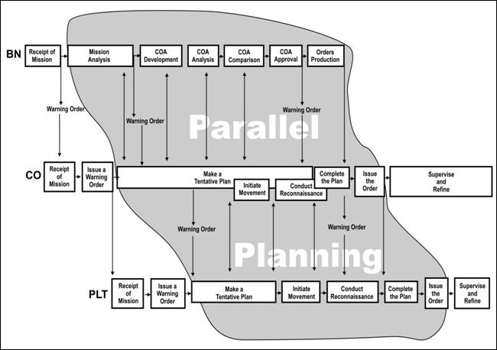
Troop Leading Procedures
Initial Mission Analysis
Identify CDR's intent 2 levels up
Determine specified, implied & essential tasks
Determine constraints and limitations
Restate your unit mission statement
5Ws:(Who, What, When, Where, Why)
Receive the Mission
Issue a Warning order
Make a Tentative Plan
Initiate Movement
Conduct Reconnaissance
Complete the Plan
Issue the Order
Supervise and Refine
What is the MISSION?
What is known about the ENEMY?
How will TERRAIN and weather affect the operation?
What TROOPS are available?
How much TIME is available?
What CIVIL MATTERS affect my mission?
BN
CO
PLT
What should one be looking for?
Initial Time Analysis
Backwards plan
Make a a tentative timeline;1/3 -2/3, parallel, HOPE-L
Initial request for assets
Request appropriate assets based on the information available (i.e. ISR, C-IED enablers, interpreters, air assets)
What is the leader supposed to do now?
Start parallel planning
Notes:
Receive a mission alert in the form of a Combat Order
Warning Order (WARNO)
Operations Order (OPORD)
Fragmentary Order (FRAGO)
The leader immediately begins a mission analysis using the factors of METT-TC and the Military Decision Making Process
Conduct an initial time
management analysis using
“One-third: Two-thirds” Rule
Backward Planning Process
2. This process will be used in the day 5 Mission Analysis Practical Exercise along with the mission planning for each of the squad and platoon missions executed on days 6-9 of this course.

Slide 9
Troop Leading Procedures
Receive the Mission
Issue a Warning order
Make a Tentative Plan
Initiate Movement
Conduct Reconnaissance
Complete the Plan
Issue the Order
Supervise and Refine
5 Paragraph Operations Order
A Basic Outline
Should follow 5 paragraph OPORD format
Provides advanced notice of operations and initial instructions in time for subordinates to begin their planning process
At a minimum must give:
    Mission or nature of the operation
    Time and place for issuing the OPORD
    Who are participating in the operation
    Specific tasks not addressed by unit SOP
    Time line for the operation
    Commander’s Critical Information Requirements (FFIR and PIR)
  Issue Second WARNO following Mission Analysis
  Issue Third WARNO after Course of Action (COA) is finalized
4. Service Support
  General
  Material and Services
    Supply
    Transportation
    Services
    Maintenance
    Medical Examinations
  Personnel
  Miscellaneous
5 Command and Signal
  Command
  Signal
1. Situation
  Enemy Forces
  Friendly Forces
  Attachments and Detachments
2. Mission
3. Execution
  Concept of the Operation
    Maneuver
    Fires
  Tasks to Maneuver Units
  Tasks to Combat Support Units
  Coordinating Instructions
What should be in the WARNO?
Notes:
FM 6-0 CH 10
STEP 2–ISSUE A WARNING ORDER
10-17. As soon as leaders finish their initial assessment of the situation and available time, they issue a
WARNORD. Leaders do not wait for more information. They issue the best WARNORD possible with the
information at hand and update it as needed with additional WARNORDs.
10-18. The WARNORD contains as much detail as possible. It informs subordinates of the unit mission
and gives them the leader’s timeline. Leaders may also pass on any other instructions or information they
think will help subordinates prepare for the new mission. This includes information on the enemy, the
nature of the higher headquarters’ plan, and any specific instructions for preparing their units. The most
important thing is that leaders not delay in issuing the initial WARNORD. As more information becomes
available, leaders can—and should—issue additional WARNORDs. By issuing the initial WARNORD as
quickly as possible, leaders enable their subordinates to begin their own planning and preparation.
10-19. WARNORDs follow the five-paragraph OPORD format. (See appendix C for the WARNORD
format.) Normally an initial WARNORD issued below battalion level includes—
● The mission or nature of the operation.
● The time and place for issuing the OPORD.
● Units or elements participating in the operation.
● Specific tasks not addressed by unit standard operating procedures (SOPs).
● The timeline for the operation.

Slide 10
Troop Leading Procedures
What is METT-TC?
Receive the Mission
Issue a Warning order
Make a Tentative Plan
  METT-TC
  COA
Initiate Movement
Conduct Reconnaissance
Complete the Plan
Issue the Order
Supervise and Refine
Mission
Mission, Intent, concept (2 levels up)
Tasks: Specified/ Implied/ Essential
Purpose
Constraints (require/limit action)
Restated Mission (Who, What, When, Where, and Why)
Enemy
General Situation
Disposition
Composition
Strength
Capabilities by WFF
PCOA & MDCOA
Terrain & Weather
Visibility
Wind
Precipitation
Cloud Coverage
Temp/ Humidity
Terrain
AO / AI / AOI
Terrain
Obstacles
Avenues of approach
Key Terrain
Observation/ Fields of fire
Cover & Concealment
Time / HOPE-L
Higher’s Timeline
Operational Timeline
Planning Timeline
Enemy’s Timeline
Light Data
1/3, 2/3 rule
Intent/
Capability
Troops
Leadership
Morale
Training & Experience
Capabilities by WFF
Location-
Identify all
VA / VPs
Civilian Considerations
Civilian Analysis includes:
Area (Key Civilian Areas)
Structures
Capabilities
Organizations
People
Events within the AO
Special
Equipment
Calculate additional time for VA / VPs
VA/VPs
Keep this information in mind during the Threat Assessment class that will be conducted later…
Notes:
The METT-TC factors are the variables whose infinite mutations always combine to form a new tactical pattern. They never produce exactly the same situation; thus, there can be no checklist that adequately addresses all the situations friendly forces may encounter. Each tactical problem is unique and must be solved on its own merits.
==========================
Reference, CH 10, Table 10-1. Mission variables, FM 6-0
Mission
Commanders and staffs view all of the mission variables in terms of their
impact on mission accomplishment. The mission is the task, together with
the purpose, that clearly indicates the action to be taken and the reason
therefore. It is always the first variable commanders consider during
decision-making. A mission statement contains the "who, what, when,
where, and why" of the operation.
Enemy
The second variable to consider is the enemy—dispositions (including
organization, strength, location, and tactical mobility), doctrine, equipment,
capabilities, vulnerabilities, and probable courses of action.
Terrain and weather
Terrain and weather analysis are inseparable and directly influence each
other’s impact on military operations. Terrain includes natural features (such
as rivers and mountains) and man-made features (such as cities, airfields,
and bridges). Commanders analyze terrain using the five military aspects of
terrain expressed in the memory aid OAKOC: observation and fields of fire,
avenues of approach, key and decisive terrain, obstacles, cover and
concealment. The military aspects of weather include visibility, wind,
precipitation, cloud cover, temperature, and humidity.
Troops and support available
This variable includes the number, type, capabilities, and condition of
available friendly troops and support. These include supplies, services, and
support available from joint, host nation, and unified action partners. They
also include support from civilians and contractors employed by military
organizations, such as the Defense Logistics Agency and the Army Materiel
Command.
Time available
Commanders assess the time available for planning, preparing, and
executing tasks and operations. This includes the time required to
assemble, deploy, and maneuver units in relationship to the enemy and
conditions.
Civil considerations
Civil considerations are the influence of man-made infrastructure, civilian
institutions, and activities of the civilian leaders, populations, and
organizations within an area of operations on the conduct of military
operations (ADRP 5-0). Civil considerations comprise six characteristics,
expressed in the memory aid ASCOPE: areas, structures, capabilities,
organizations, people, and events.

Slide 11
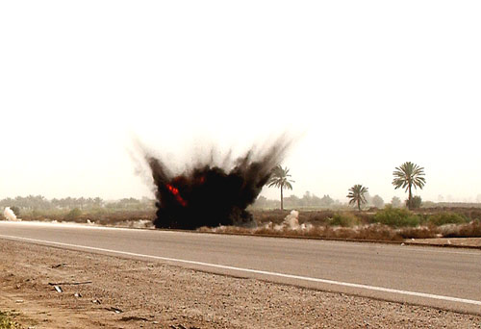
2of 2
Troop Leading Procedures
Receive the Mission
Issue a Warning order
Make a Tentative Plan
  METT-TC
  COA
Initiate Movement
Conduct Reconnaissance
Complete the Plan
Issue the Order
Supervise and Refine
What are the criteria for developing a good COA?
Usable COAs are suitable, feasible, acceptable, distinguishable, and complete
COA Process
Course of Action Development
Analyze Courses of Action (War-Game)
Course of Action Comparison and Selection
NOTE. in a time-constrained environment, lower echelons may develop only one COA
Notes:
Reference, FM 6-0, CH 10 pages 10-6 to 10-8
Course of Action Development
10-22. Mission analysis provides information needed to develop COAs. COA development aims to
determine one or more ways to accomplish the mission. At lower echelons, the mission may be a single
task. Most missions and tasks can be accomplished in more than one way. Normally, leaders develop two
or more COAs. However, in a time-constrained environment, they may develop only one. Leaders do not
wait for a complete order before beginning COA development. Usable COAs are suitable, feasible,
acceptable, distinguishable, and complete. Leaders develop COAs as soon as they have enough information
to do so. To develop COAs, leaders focus on the actions the unit takes at the objective and conduct a
reverse plan to the starting point.
Analyze Courses of Action (War-game)
10-31. For each COA, leaders think through the operation from start to finish. They compare each COA
with the enemy’s most probable COA. At the small-unit level, the enemy’s most probable COA is what the
enemy is most likely to do given what friendly forces are doing at that instant. The leader visualizes a set of
actions and reactions. The object is to determine what can go wrong and what decision the leader will likely
have to make as a result.
Course of Action Comparison and Selection
10-32. Leaders compare COAs by weighing the advantages, disadvantages, strengths, and weaknesses of
each, as noted during the war game. They decide which COA to execute based on this comparison and on
their professional judgment. They take into account—
● Mission accomplishment.
● Time available to execute the operation.
● Risks.
● Results from unit reconnaissance.
● Subordinate unit tasks and purposes.
● Casualties incurred.
● Posturing of the force for future operations.
=====================================================
NOTE. The following is additional preparation material for the instructor/facilitators:
1. To frame the tentative plan, leaders perform mission analysis. This analysis is a continuation of step 1 of the TLPs and follows METT-TC
a. Mission. Leaders analyze the mission to see how their actions fit into the overall mission of the higher headquarters. They must first understand the higher HQs mission, Commanders Intent, and Concept of the operation. Along with this information the leader must identify his specified, implied and essential tasks along with any constraints that will impact their mission (constraints can be in the form of a requirement or prohibition). The product of this part of the analysis is the elements restated mission. The mission statement is a simple, concise expression of the essential task the unit must accomplish and the purpose to be achieved. The mission statement consists of the who (unit), What (the task), when (time), Where, (location), why (purpose of operation).
b. Enemy. Leaders need to know about the enemy’s composition, disposition, strength, recent activities, ability to reinforce, and possible enemy COAs. Much of this information comes from the higher HQs and adjacent units, but the leader needs to be able to analyze the enemy on his own (discussed later in IPB). It is important in this process to identify what you do not know about the enemy and how that can impact your mission.
c. Terrain and Weather. This addresses the military aspects of terrain using OAKOC (described in later slide).
d. Troops and Support Available. Used to determine the combat potential of your element. Understanding the morale, experience, along with the strengths and weaknesses of subordinate leaders will give the leader a firm understanding of his own capabilities and limitations. Additionally this is where the leader accounts for any attachments or detachments and the impact on his capabilities.
e. Time Available. Understand the amount of time available. Analyze the time and space aspects of your mission for preparing, moving, fighting and sustaining.
f. Civil Considerations. These are how the man-made infrastructure, civilian institutions, and attitudes of the civilian leaders, populations, and organizations within an area of operations influence the conduct of military operations. The acronym used for this process is ASCOPE (Areas, Structures, Capabilities, Organizations, People, and Events).
2. MA provides the information required to execute COA development.
3. The purpose of COA development is to identify one or more ways to accomplish the mission. During TLPs one COA is normally what is developed, but if the time permits developing a second COA is advisable.
4. The steps in COA development are: Analyze relative combat power; Generate options; Array forces; Develop the concept of Operations; Assign Responsibility; Prepare COA statement and sketch.
5. Analyze Courses of Action. Think through the mission from start to finish. Compare each COA with the enemy’s most probably COA. The leader visualizes a set of actions and reactions. The objective is to determine what can go wrong and what decision the leader will need to make. In essence this develops contingency plans.
6. Compare COAs and make a decision. Develop a weighting scale based on the most important aspects of the mission and then weigh the advantages and disadvantages of each COA based on what was noted during the war-game process.

Slide 12
NOTE. Do not show this slide
unless you modify it for use
At this time you may break down the students into 3 or 4 groups.
Allow 15 or 20 min to debate in groups, 5 or 10 min to present
Group 1. Discuss Mission Analysis (Hidden slides 12-18)
  Mission analysis process
  Specified, Implied & essential tasks
Group 2. Discuss Enemy (IPOE) (Hidden slides 19-22)
  The IPOE process including the four steps
  Enemy Intent, type of threat, and location of threat
Group 3. Discuss Terrain (OAKOC) (Hidden slides 23-29)
a. Terrain - Indentify the area of operations and operating environment (OAKOC)
b. Weather – Impact on operations; enemy, friendly forces
Group 4. Discuss Time, Troop, & Civilian (Hidden slides 30-34)
a. Timeline
b. ASCOPE
c. Civil
NOTE. See note page for additional instructions.
Notes:
NOTE.
Provide hard and/or CD copies of:
The Conduct a Tactical Mission Rubric to the students
The slides that are hidden following this one
Dismounted- C-IED Smart-Book (JIEDDO)
FM 6-0, Commander and Staff Organization and Operations
The time allotted for group work and presentation/discussions will depend on your available time
You may develop a simple scenario that includes a mission order issue from higher to add more realism

Slide 13
Group 1 slides Mission Analysis
Troop Leading Procedures
1. Receive the mission
Initial timeline, possible mission
2. Issue the WARNO
5 Paragraph format (min info)
3. Make a tentative plan
a. Mission analysis
b. COA development
c. COA analysis
d. COA comparison
e. COA selection
4. Initiate Movement
XO, 1SG
5. Conduct Reconnaissance
6. Complete the plan
Orders Production
7. Issue the Order
Verbal, Terrain Model, Paper
8. Supervise and Refine
Confirm Briefs
Back Briefs
Rehearsals
PCC-1 down
PCI-2 down
Type of operation
General location of Operation
Initial operational timeline
Reconnaissance to initiate
Movement to initiate
Planning and preparation instructions
  To include planning timeline
Information requirements (IR & CCIR)
Terrain
AO / AI / AOI
Terrain
Obstacles
Avenues of approach
Key Terrain
Observation/ Fields of fire
Cover & Concealment
Weather
Visibility
Wind
Precipitation
Cloud Coverage
Temp/ Humidity
Location-
Identify all
VA / VPs
Mission
Mission, Intent, concept (2 levels up)
Tasks: Specified/ Implied/ Essential
Purpose
Constraints (require/limit action)
Restated Mission
Time
Higher Times
Hard Times
Company/ Platoon TLPs
Light Data
Enemy Data
1/3, 2/3 rule
HOPE
Calculate additional time for VA / VPs
Enemy
General Situation
Disposition
Composition
Strength
Capabilities by WFF
PCOA & MDCOA
Intent/
Capability
Troops
Leadership
Morale
Training & Experience
Capabilities by WFF
Special
Equipment
Notes:
1. Walk back through the TLPs along with providing additional detail related to the Mission Analysis process with an emphasis on C-IED aspects of planning. Make sure that you highlight enemy and terrain and how this is directly associated with the threat triad and the threat assessment process.
a. HOPE- (timeline)
(1) H-Higher
(2) O- Operational
(3) P- Planning
(4) E- Enemy
2. This process will be used in the day 5 Mission Analysis Practical Exercise along with the mission planning for each of the squad and platoon missions executed on days 6-9 of this course.

Slide 14
Mission Analysis
Mission
Enemy
Terrain
Time
Troops Available
Civil Consideration
The METT-TC factors are the variables whose infinite mutations always combine to form a new tactical pattern. They never produce exactly the same situation; thus, there can be no checklist that adequately addresses all the situations friendly forces may encounter. Each tactical problem is unique and must be solved on its own merits.
Notes:
1.The METT-TC factors are the variables whose infinite mutations always combine to form a new tactical pattern. They never produce exactly the same situation; thus, there can be no checklist that adequately addresses all the situations friendly forces may encounter.
2. Each tactical problem is unique and must be solved on its own merits.

Slide 15
Mission Analysis (cont.)
Mission
Mission, Intent, concept (2 levels up)
Tasks: Specified / Implied / Essential
Purpose
Constraints (require / limit action)
Restated Mission
Notes:
1. Walk back through the TLPs along with providing additional detail related to the Mission Analysis process with an emphasis on C-IED aspects of planning. Make sure that you highlight enemy and terrain and how this is directly associated with the threat triad and the threat assessment process.
a. HOPE- (timeline)
(1) H-Higher
(2) O- Operational
(3) P- Planning
(4) E- Enemy
2. This process will be used in the day 5 Mission Analysis Practical Exercise along with the mission planning for each of the squad and platoon missions executed on days 6-9 of this course.

Slide 16
5 Paragraph Operations Order
Situation:
  Enemy
  Friendly
Mission: 5 W's - (Who, What, Where, When, Why)
Execution
Service and Support
Command and Signal

Slide 17
Mission Analysis (cont.)
Unit Mission Statement:
Task:
Purpose:
Higher Mission:
Higher CDR’s Intent: Higher Concept of Operations (shown as a sketch)
Notes:
1. Show this slide as an example of a basic planning tool used during the planning process. By taking the time to fill this sheet out with some detail the leader will expedite the COA development process and ensure that each aspect of the mission is fully understood.
2. If there is information that is not known to the leader they should ask questions to gain the information.

Slide 18
Mission Analysis (cont.)
Tasks Specified Implied Essential
Constraints:
Notes:
1. Continuation of previous slide outlining the Mission Analysis worksheet. This is simply one example. Each leader should develop the tools they will need to be able to effectively execute detailed planning.

Slide 19
Mission Analysis (cont.)
Enemy
General Situation
Disposition
Composition
Strength
Capabilities by WFF
PCOA & MDCOA
Intent /
Capability
Notes:
1. Walk back through the TLPs along with providing additional detail related to the Mission Analysis process with an emphasis on C-IED aspects of planning. Make sure that you highlight enemy and terrain and how this is directly associated with the threat triad and the threat assessment process.
a. HOPE- (timeline)
(1) H-Higher
(2) O- Operational
(3) P- Planning
(4) E- Enemy
2. This process will be used in the day 5 Mission Analysis Practical Exercise along with the mission planning for each of the squad and platoon missions executed on days 6-9 of this course.

Slide 20
Group 2 slides Enemy Analysis
Troop Leading Procedures
1. Receive the mission
Initial timeline, possible mission
2. Issue the WARNO
5 Paragraph format (min info)
3. Make a tentative plan
a. Mission analysis
b. COA development
c. COA analysis
d. COA comparison
e. COA selection
4. Initiate Movement
XO, 1SG
5. Conduct Reconnaissance
6. Complete the plan
Orders Production
7. Issue the Order
Verbal, Terrain Model, Paper
8. Supervise and Refine
Confirm Briefs
Back Briefs
Rehearsals
PCC-1 down
PCI-2 down
Type of operation
General location of Operation
Initial operational timeline
Reconnaissance to initiate
Movement to initiate
Planning and preparation instructions
  To include planning timeline
Information requirements (IR & CCIR)
Terrain
AO / AI / AOI
Terrain
Obstacles
Avenues of approach
Key Terrain
Observation/ Fields of fire
Cover & Concealment
Weather
Visibility
Wind
Precipitation
Cloud Coverage
Temp/ Humidity
Mission
Mission, Intent, concept (2 levels up)
Tasks: Specified/ Implied/ Essential
Purpose
Constraints (require/limit action)
Restated Mission
Location-
Identify all
VA / VPs
Time
Higher Times
Hard Times
Company/ Platoon TLPs
Light Data
Enemy Data
1/3, 2/3 rule
HOPE
Enemy
General Situation
Disposition
Composition
Strength
Capabilities by WFF
PCOA & MDCOA
Calculate additional time for VA / VPs
Intent/
Capability
Troops
Leadership
Morale
Training & Experience
Capabilities by WFF
Special
Equipment
Notes:
1. Walk back through the TLPs along with providing additional detail related to the Mission Analysis process with an emphasis on C-IED aspects of planning. Make sure that you highlight enemy and terrain and how this is directly associated with the threat triad and the threat assessment process.
a. HOPE- (timeline)
(1) H-Higher
(2) O- Operational
(3) P- Planning
(4) E- Enemy
2. This process will be used in the day 5 Mission Analysis Practical Exercise along with the mission planning for each of the squad and platoon missions executed on days 6-9 of this course.

Slide 21
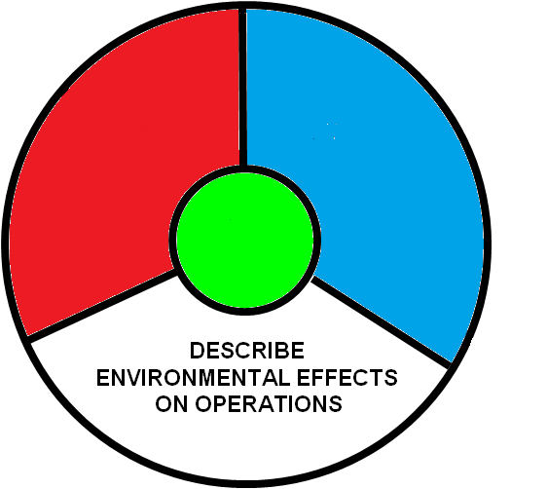
Intelligence Preparation of the
Operational Environment (IPOE) (cont.)
“BIG PICTURE”
- “Who are they?”
- “Where did they come from?”
- “What are they doing now?”
GENERAL SITUATION
DISPOSITION
- “Where are they/ how are they arrayed?’
- “Their Task and Purpose?”
COMPOSITION
What does he look like?
Do we have any information on the network
“What weapons & gear do they have?
DEFINE
THE
OPERATIONAL
ENVIRONMENT
CAPABILITIES
EVALUATE
THE
THREAT
What are his demonstrated methods of attack
What are the preferred TTPs in the AO
STRENGTH & WEAKNESS
Start to ID Vulnerabilities
DETERMINE
THREAT
COA’S
CONCEPT
(MPCOA)
- Form of Maneuver or Method of attack
What is his intent/ Task and Purpose
Anticipated Scheme of Maneuver
- Endstate
AO/AI/AOI
THREE CRITICAL QUESTIONS FROM TLPS CONCERNING THE ENEMY.
1. What does he look like? (Enemy Analysis)
2. How can he hurt us? (Capabilities)
3. How can we hurt him? (Weaknesses)
OAKOC
Notes:
1. Discuss the IPOE wheel and how the four steps relate to the enemy situation, disposition, composition, capabilities and limitations and how that in turn helps the leader understand the enemy most likely course of action.
2. When analyzing the enemy the IPOE process in conjunction with a continuous threat assessment based on the triad will give the leader and his element the best chance for a successful mission.

Slide 22
Intelligence Preparation of the
Operational Environment (IPOE)
The IPOE process consists of four steps:
Step 1. Define the Operational Environment
Step 2. Describe the Environmental Effects on Operations
Step 3. Evaluate the Threat
Step 4. Determine Threat COAs
Notes:
1. Understanding the enemy is one of the most important aspects of planning. You can have an outstanding plan, but failing to realize that the enemy has a significant say in your success or failure is a failure in and of itself.
2. For elements that have a staff, the S-2 maintains a running estimate of the enemy situation in the form of his Intelligence Preparation of the Operational Environment (IPOE). This document is continuously updated and current to allow him to answer the Commanders Questions and identify information gaps that require the use of available assets to close.
3. At the company level the CoIST, Commander, Platoon Leaders and subordinates are the ones that need to keep this evaluation current.
4. Discuss the 4 steps of IPOE.
5. Understanding that we will not be able to make you an intel analyst inside this short class, just understanding the various aspects and how they formulate to create the enemy COA is very important.

Slide 23
Intelligence Preparation of the
Operational Environment (IPOE) (cont.)
Enemy Intent
Type of Threat
Location of Threat
Notes:
1. Discuss the IPOE wheel and how the four steps relate to the enemy situation, disposition, composition, capabilities and limitations and how that in turn helps the leader understand the enemy most likely course of action.
2. When analyzing the enemy the IPOE process in conjunction with a continuous threat assessment based on the triad will give the leader and his element the best chance for a successful mission.

Slide 24
Group 3 slides Terrain & Weather Analysis
Troop Leading Procedures
1. Receive the mission
Initial timeline, possible mission
2. Issue the WARNO
5 Paragraph format (min info)
3. Make a tentative plan
a. Mission analysis
b. COA development
c. COA analysis
d. COA comparison
e. COA selection
4. Initiate Movement
XO, 1SG
5. Conduct Reconnaissance
6. Complete the plan
Orders Production
7. Issue the Order
Verbal, Terrain Model, Paper
8. Supervise and Refine
Confirm Briefs
Back Briefs
Rehearsals
PCC-1 down
PCI-2 down
Type of operation
General location of Operation
Initial operational timeline
Reconnaissance to initiate
Movement to initiate
Planning and preparation instructions
  To include planning timeline
Information requirements (IR & CCIR)
Terrain
AO / AI / AOI
Terrain
Obstacles
Avenues of approach
Key Terrain
Observation/ Fields of fire
Cover & Concealment
Weather
Visibility
Wind
Precipitation
Cloud Coverage
Temp/ Humidity
Mission
Mission, Intent, concept (2 levels up)
Tasks: Specified/ Implied/ Essential
Purpose
Constraints (require/limit action)
Restated Mission
Location-
Identify all
VA / VPs
Time
Higher Times
Hard Times
Company/ Platoon TLPs
Light Data
Enemy Data
1/3, 2/3 rule
HOPE
Enemy
General Situation
Disposition
Composition
Strength
Capabilities by WFF
PCOA & MDCOA
Calculate additional time for VA / VPs
Intent/
Capability
Troops
Leadership
Morale
Training & Experience
Capabilities by WFF
Special
Equipment
Notes:
1. Walk back through the TLPs along with providing additional detail related to the Mission Analysis process with an emphasis on C-IED aspects of planning. Make sure that you highlight enemy and terrain and how this is directly associated with the threat triad and the threat assessment process.
a. HOPE- (timeline)
(1) H-Higher
(2) O- Operational
(3) P- Planning
(4) E- Enemy
2. This process will be used in the day 5 Mission Analysis Practical Exercise along with the mission planning for each of the squad and platoon missions executed on days 6-9 of this course.

Slide 25
Mission Analysis (cont.)
Terrain
AO / AI / AOI
Terrain
Obstacles
Avenues of approach
Key Terrain
Observation/ Fields of fire
Cover & Concealment
Weather
Visibility
Wind
Precipitation
Cloud Coverage
Temp/ Humidity
Location-
Identify all
VA / VPs
Notes:
1. Walk back through the TLPs along with providing additional detail related to the Mission Analysis process with an emphasis on C-IED aspects of planning. Make sure that you highlight enemy and terrain and how this is directly associated with the threat triad and the threat assessment process.
a. HOPE- (timeline)
(1) H-Higher
(2) O- Operational
(3) P- Planning
(4) E- Enemy
2. This process will be used in the day 5 Mission Analysis Practical Exercise along with the mission planning for each of the squad and platoon missions executed on days 6-9 of this course.

Slide 26
Terrain Analysis
IDENTIFY THE AREA OF OPERATIONS AND OPERATING ENVIRONMENT
The AO is determined by graphic boundaries:
North Boundary:
South Boundary:
East Boundary:
West Boundary:
Establish the limits of the Area of Interest: The Area of Interest is an area of concern to the commander, including the area of influence, areas adjacent thereto, and extending to the objectives of current or planned operations.
Obstacles: Include reinforcing obstacles or existing terrain features that stop, impede, or divert military movement. Classify the terrain into unrestricted, restricted, and severely restricted areas- taking into account Mounted and Dismounted movement.
Avenues of Approach: Identify mobility corridors for mounted and dismounted movement and for aviation assets (RW/FW). Categorize mobility corridors by size of force will it accommodate & the speed at which the force can move through the mobility corridor. Group mobility corridors that are mutually supporting and lead to the objective into an Avenue of Approach.
AoA 1:
AoA 2:
AoA 3:
Notes:
1. Talk about each of the military aspects of terrain.
2. Tie each of these aspects to the C-IED fight and how the terrain works for and against both the enemy and friendly forces.
3. Take the time to discuss how these aspects are directly tied to Danger Areas (Vulnerable Points and Vulnerable Areas).

Slide 27
Terrain Analysis (cont.)
Key Terrain: Key terrain is any location or area whose seizure, retention, or control gives a marked advantage to either combatant. If you do not intend on going to a location or using a piece of terrain, then it is probably not key.
Observation and Fields of Fire: Indentify locations along each avenue of approach that provide clear observation and fields of fire for both the attacker and the defender. Analyze the area surrounding key terrain, objectives, engagement areas (EAs), and obstacles. Locate intervisibility (IV) lines. Assess the ability of the attacking force to overwatch or support movement (with direct fire). In analyzing fields of fire, consider the friendly and enemy potential to cover avenues of approach and key terrain, in particular, with direct fires. Analyze whether or not vegetation will affect the employment or trajectory of weapons systems.
Cover & Concealment: Analyze the terrain, foliage, structures, and other features along avenues of approach (and on objectives or key terrain) to identify sites that offer cover (protection from the effects of direct and indirect fire) and concealment (protection from observation). Consider cover and concealment effects on enemy and friendly forces.
Weather Analysis:
Visibility:
Winds:
Precipitation:
Cloud Cover:
Temperature and Humidity:
Notes:
1. Discuss the 5 military aspects of weather and their impact on the planning.

Slide 28
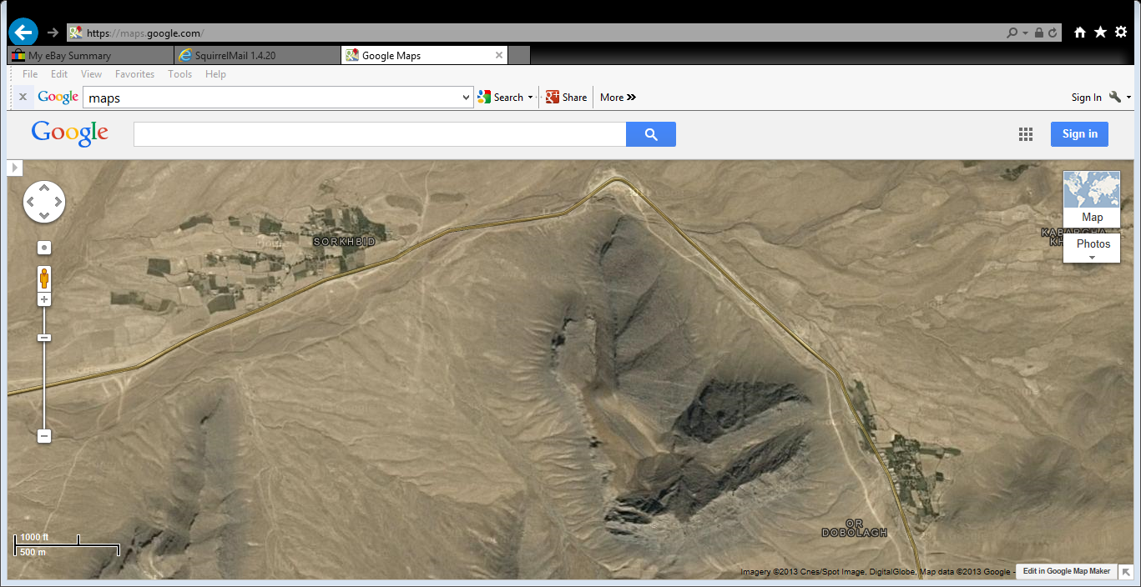
Terrain Analysis (cont.)
Obstacles
IED
Avenues of Approach
IED
Key Terrain
Observation and Fields of Fire
KLE Location
Cover and Concealment
IED
FOB
Notes:
OAKOC – use this slide to help the Soldiers understand OAKOC.
Obstacles - IEDs, known or suspected IED engagement areas. The obstacles decide our avenues of approach.
Avenues of Approach – avenues of approach avoid the obstacles. Our avenues of approach decide our key terrain.
Key Terrain – terrain that gives a marked advantage to who ever controls it. Key terrain decides Observation Fields of Fire and Cover and Concealment.

Slide 29
Mission Analysis (cont.)
Troop Leading Procedures
Terrain
AO / AI / AOI
Terrain
Obstacles
Avenues of approach
Key Terrain
Observation/ Fields of fire
Cover & Concealment
Weather
Visibility
Wind
Precipitation
Cloud Coverage
Temp/ Humidity
1. Receive the mission
Initial timeline, possible mission
2. Issue the WARNO
5 Paragraph format (min info)
3. Make a tentative plan
a. Mission analysis
b. COA development
c. COA analysis
d. COA comparison
e. COA selection
4. Initiate Movement
XO, 1SG
5. Conduct Reconnaissance
6. Complete the plan
Orders Production
7. Issue the Order
Verbal, Terrain Model, Paper
8. Supervise and Refine
Confirm Briefs
Back Briefs
Rehearsals
PCC-1 down
PCI-2 down
Type of operation
General location of Operation
Initial operational timeline
Reconnaissance to initiate
Movement to initiate
Planning and preparation instructions
  To include planning timeline
Information requirements (IR & CCIR)
Location-
Identify all
VA / VPs
Mission
Mission, Intent, concept (2 levels up)
Tasks: Specified/ Implied/ Essential
Purpose
Constraints (require/limit action)
Restated Mission
Time
Higher Times
Hard Times
Company / Platoon TLPs
Light Data
Enemy Data
1/3, 2/3 rule
HOPE
Calculate additional time for VA / VPs
Enemy
General Situation
Disposition
Composition
Strength
Capabilities by WFF
PCOA & MDCOA
Intent/
Capability
Troops
Leadership
Morale
Training & Experience
Capabilities by WFF
Special
Equipment
Notes:
1. Walk back through the TLPs along with providing additional detail related to the Mission Analysis process with an emphasis on C-IED aspects of planning. Make sure that you highlight enemy and terrain and how this is directly associated with the threat triad and the threat assessment process.
a. HOPE- (timeline)
(1) H-Higher
(2) O- Operational
(3) P- Planning
(4) E- Enemy
2. This process will be used in the day 5 Mission Analysis Practical Exercise along with the mission planning for each of the squad and platoon missions executed on days 6-9 of this course.

Slide 30
Mission Analysis (cont.)
Time
Higher Times
Hard Times
Company / Platoon TLPs
Light Data
Enemy Data
1/3, 2/3 rule
HOPE
Calculate additional time for VA / VPs
Notes:
1. Walk back through the TLPs along with providing additional detail related to the Mission Analysis process with an emphasis on C-IED aspects of planning. Make sure that you highlight enemy and terrain and how this is directly associated with the threat triad and the threat assessment process.
a. HOPE- (timeline)
(1) H-Higher
(2) O- Operational
(3) P- Planning
(4) E- Enemy
2. This process will be used in the day 5 Mission Analysis Practical Exercise along with the mission planning for each of the squad and platoon missions executed on days 6-9 of this course.

Slide 31
Group 4 slides Time, Troops, Civilian Analysis
Troop Leading Procedures
1. Receive the mission
Initial timeline, possible mission
2. Issue the WARNO
5 Paragraph format (min info)
3. Make a tentative plan
a. Mission analysis
b. COA development
c. COA analysis
d. COA comparison
e. COA selection
4. Initiate Movement
XO, 1SG
5. Conduct Reconnaissance
6. Complete the plan
Orders Production
7. Issue the Order
Verbal, Terrain Model, Paper
8. Supervise and Refine
Confirm Briefs
Back Briefs
Rehearsals
PCC-1 down
PCI-2 down
Type of operation
General location of Operation
Initial operational timeline
Reconnaissance to initiate
Movement to initiate
Planning and preparation instructions
  To include planning timeline
Information requirements (IR & CCIR)
Terrain
AO / AI / AOI
Terrain
Obstacles
Avenues of approach
Key Terrain
Observation/ Fields of fire
Cover & Concealment
Weather
Visibility
Wind
Precipitation
Cloud Coverage
Temp/ Humidity
Mission
Mission, Intent, concept (2 levels up)
Tasks: Specified/ Implied/ Essential
Purpose
Constraints (require/limit action)
Restated Mission
Location-
Identify all
VA / VPs
Time
Higher Times
Hard Times
Company/ Platoon TLPs
Light Data
Enemy Data
1/3, 2/3 rule
HOPE
Enemy
General Situation
Disposition
Composition
Strength
Capabilities by WFF
PCOA & MDCOA
Calculate additional time for VA / VPs
Intent/
Capability
Troops
Leadership
Morale
Training & Experience
Capabilities by WFF
Special
Equipment
Notes:
1. Walk back through the TLPs along with providing additional detail related to the Mission Analysis process with an emphasis on C-IED aspects of planning. Make sure that you highlight enemy and terrain and how this is directly associated with the threat triad and the threat assessment process.
a. HOPE- (timeline)
(1) H-Higher
(2) O- Operational
(3) P- Planning
(4) E- Enemy
2. This process will be used in the day 5 Mission Analysis Practical Exercise along with the mission planning for each of the squad and platoon missions executed on days 6-9 of this course.

Slide 32
Timeline
Higher
Operational
Planning
Enemy
Light Data
Notes:
1. This is one example of a mission timeline that can help the leader identify the various critical times. This method is referred to as HOPE:
a. Higher,
b. Operational,
c. Planning, and
d. Enemy.
2. It can also be helpful to identify the periods of darkness since this will have a significant impact on the planning and execution.

Slide 33
Mission Analysis (cont.)
Troop Leading Procedures
Terrain
AO / AI / AOI
Terrain
Obstacles
Avenues of approach
Key Terrain
Observation/ Fields of fire
Cover & Concealment
Weather
Visibility
Wind
Precipitation
Cloud Coverage
Temp/ Humidity
1. Receive the mission
Initial timeline, possible mission
2. Issue the WARNO
5 Paragraph format (min info)
3. Make a tentative plan
a. Mission analysis
b. COA development
c. COA analysis
d. COA comparison
e. COA selection
4. Initiate Movement
XO, 1SG
5. Conduct Reconnaissance
6. Complete the plan
Orders Production
7. Issue the Order
Verbal, Terrain Model, Paper
8. Supervise and Refine
Confirm Briefs
Back Briefs
Rehearsals
PCC-1 down
PCI-2 down
Type of operation
General location of Operation
Initial operational timeline
Reconnaissance to initiate
Movement to initiate
Planning and preparation instructions
  To include planning timeline
Information requirements (IR & CCIR)
Location-
Identify all
VA / VPs
Mission
Mission, Intent, concept (2 levels up)
Tasks: Specified/ Implied/ Essential
Purpose
Constraints (require/limit action)
Restated Mission
Time
Higher Times
Hard Times
Company/ Platoon TLPs
Light Data
Enemy Data
1/3, 2/3 rule
HOPE
Calculate additional time for VA / VPs
Enemy
General Situation
Disposition
Composition
Strength
Capabilities by WFF
PCOA & MDCOA
Intent/
Capability
Troops
Leadership
Morale
Training & Experience
Capabilities by WFF
Special
Equipment
Notes:
1. Walk back through the TLPs along with providing additional detail related to the Mission Analysis process with an emphasis on C-IED aspects of planning. Make sure that you highlight enemy and terrain and how this is directly associated with the threat triad and the threat assessment process.
a. HOPE- (timeline)
(1) H-Higher
(2) O- Operational
(3) P- Planning
(4) E- Enemy
2. This process will be used in the day 5 Mission Analysis Practical Exercise along with the mission planning for each of the squad and platoon missions executed on days 6-9 of this course.

Slide 34
Mission Analysis (cont.)
Troops
Leadership
Morale
Training & Experience
Capabilities by WFF
Special
Equipment
Notes:
1. Walk back through the TLPs along with providing additional detail related to the Mission Analysis process with an emphasis on C-IED aspects of planning. Make sure that you highlight enemy and terrain and how this is directly associated with the threat triad and the threat assessment process.
a. HOPE- (timeline)
(1) H-Higher
(2) O- Operational
(3) P- Planning
(4) E- Enemy
2. This process will be used in the day 5 Mission Analysis Practical Exercise along with the mission planning for each of the squad and platoon missions executed on days 6-9 of this course.

Slide 35
Civil Considerations
ASCOPE
  Area (Key Civilian Areas)
  Structures
  Capabilities
  Organizations
  People
  Events within the AO

Slide 36
Mission Planning
Dismounted Considerations:
  All personnel must be familiar with:
    Hand Held detection equipment/sweeping techniques
    Movement Order
    Rally Points
    Immediate Action Drills
    Communication equipment/procedures
    Hand and arm signals
    Brevity codes
    CREW systems (THOR III)
  PPE-Present, serviceable, and worn properly
36
Notes:
1. This is a short list of some, but not all, of the Dismounted planning Considerations.
a. PPE is present, serviceable, and worn properly.
b. Weapon systems are operational and properly maintained.
c. Personnel are familiar with additional duties of operating crew-served weapons, CREW equipment, etc.
d. Personnel are familiar with the overall concept of the mission to include movement order, rally points, immediate action drills, and communication procedures.
2. During the RIP/TOA the incoming unit should be exchanging information with the outgoing unit to refine their planning products and SOPs. Over the course of their deployment the unit should continue to update these products and fine tune their processes to ensure that all aspects of planning and preparation are captured in an SOP. This data should be used to create continuity books that can be used as they transition to the next element that assumes control of the AOR.

Slide 37
Mission Planning (cont.)
Review
  Rules of Engagement (ROE)
  After action reviews from prior patrols
  Enemy TTPs
  Current intelligence and maps
  Mined areas
  Current friendly TTPs
  Quick Reaction Force (QRF)/Explosive Ordnance Disposal (EOD)/CASEVAC locations, response times
  Weather conditions
  Procedures for exit and entry of friendly lines
37
Notes:
1. Review and be familiar, at a minimum, these items prior to mission.
2. Cover the importance of reviewing each with the students and not falling into the trap of just saying “as per SOP.”
3. The review of this information arms the soldiers involved in the mission with the knowledge they need to be able to make a detailed threat assessment as well as being able to make sound and timely informed decisions.

Slide 38
Mission Planning (cont.)
Rehearsals
  Security halt
    Actions during short security halt/long security halt
  Enemy contact
    Train to react immediately (assault or break contact)
    Return effective fire
    Actions for an IED before and after detonation
  Failed communications (PACE)
  Mission specific drills
  Crossing vulnerable points/vulnerable areas
  Sweeping techniques
38
Notes:
1. Rehearsals are the thing that sets good units apart from great units. Do not let complacency set in!!!
2. Leaders at all levels should take advantage of the time available to execute training and rehearsals.
3. PACE (Primary, Alternate, Contingency, and Emergency) communication plans.

Slide 39
Mission Planning (cont.)
Requirements
  Pre-combat Checks/Inspections
  Carry everything you need for the fight
  Carry NVGs and mounts
  Carry individual tactical radio
  Medical equipment
  Thorough map reconnaissance
You must have items to fight, survive, communicate, and provide medical aid on your body at all times!
39

Slide 40
Common TTP violations
  Failure to focus outward
  Failure to conduct rehearsals
  5/25/200 meter checks are not conducted
  Failure to conduct Pre-combat Checks/Inspections (PCC/PCI)
  Soldiers are not cross trained
  Poor management of planning timelines
  Establishing patterns
    Routes, immediate actions, and compound occupation
  Not conducting a proper threat assessment
  Failure to sweep for secondary's after find
  Not staying in cleared lanes
  Over confirmation of the IED
40
Notes:
1. Common TTP violations.
a. Failure to focus outward.
b. Beyond the immediate area after enemy contact.
2. Recent enemy video demonstrates that they may remain in position after an attack if they are not identified, pursued or eliminated.

Slide 41
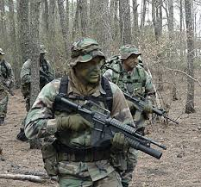
What happens during step 4?
Receive the Mission
Issue a Warning order
Make a Tentative Plan
  METT-TC
  COA
Initiate Movement
Conduct Reconnaissance
Complete the Plan
Issue the Order
Supervise and Refine
Can be conducted by subordinate leaders
May occur at any point after the WARNO is given
Movements may be to an assembly area, a battle position, a new area of operations, or an attack position
Notes:
FM 6-0 CH 10
STEP 4–INITIATE MOVEMENT
10-33. Leaders conduct any movement directed by higher headquarters or deemed necessary to continue
mission preparation or position the unit for execution. They do this as soon as they have enough
information to do so or the unit is required to move to position itself for a task. This is also essential when
time is short. Movements may be to an assembly area, a battle position, a new area of operations, or an
attack position. They may include movement of reconnaissance elements, guides, or quartering parties.

Slide 42
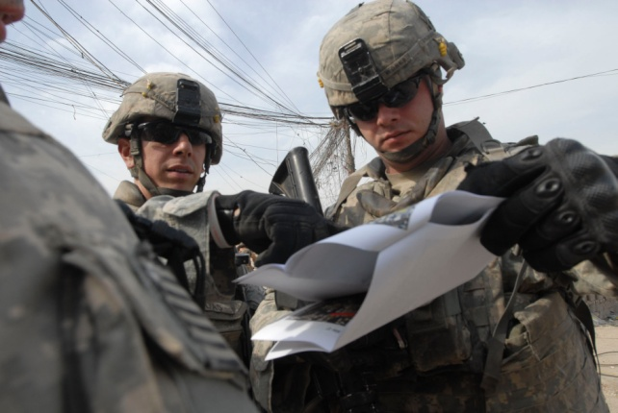
Why is it important to conduct reconnaissance?
Receive the Mission
Issue a Warning order
Make a Tentative Plan
  METT-TC
  COA
Initiate Movement
Conduct Recon
Complete the Plan
Issue the Order
Supervise and Refine
Recon is used to confirm terrain and/or enemy analysis and tactical options
Situation and time available dictate the type and detail of recon
  Map, aerial photo, ground
  Interview others with direct and recent knowledge to area of operations
Plan and conduct a leader’s recon for every mission
Consider risk inherent in moving forward of friendly lines, or into unoccupied areas
Notes:
FM 6-0 CH 10
STEP 5–CONDUCT RECONNAISSANCE
10-34. Whenever time and circumstances allow, or as directed by higher headquarters, leaders personally
observe the area of operations for the mission prior to execution. No amount of information from higher
headquarters can substitute for firsthand assessment of the mission variables from within the area of
operations. Unfortunately, many factors can keep leaders from performing a personal reconnaissance. The
minimum action necessary is a thorough map reconnaissance supplemented by imagery and intelligence
products. As directed, subordinates or other elements (such as scouts) may conduct reconnaissance while
the leader completes other TLP steps.
10-35. Leaders use results of the war game to identify information requirements. Reconnaissance tasks
seek to confirm or deny information that supports the tentative plan. They focus first on information gaps
identified during mission analysis. Leaders ensure their leader’s reconnaissance complements the higher
headquarters’ information collection plan. The unit may conduct additional reconnaissance tasks as the
situation allows. This step may also precede making a tentative plan if commanders lack enough
information to begin planning. Reconnaissance may be the only way to develop the information required
for planning.

Slide 43
What should happen during step six?
Develop OPORD based on tentative plan, recon & additional guidance
Review plan to ensure that the mission and Commander’s intent is satisfied
Consider whether reconnaissance and changes to current situation may change or alter the tentative plan
Use five paragraph format & common tactical language in the development of the OPORD/WARNO
Receive the Mission
Issue a Warning order
Make a Tentative Plan
  METT-TC
  COA
Initiate Movement
Conduct Reconnaissance
Complete the Plan
Issue the Order
Supervise and Refine
Notes:
FM 6-0 CH 10
STEP 6–COMPLETE THE PLAN
10-36. During this step, leaders incorporate the results of reconnaissance into their selected COA to
complete the plan or order. This includes preparing overlays, refining the indirect fire target list,
coordinating sustainment with signal requirements, and updating the tentative plan because of
reconnaissance. At lower levels, this step may entail only confirming or updating information contained in
the tentative plan. If time allows, leaders make final coordination with adjacent units and higher
headquarters before issuing the order.

Slide 44
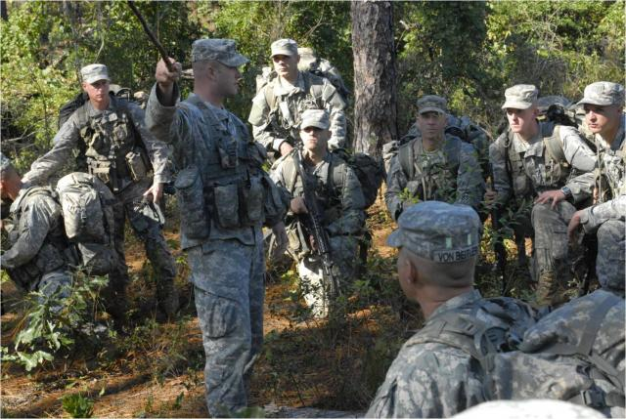
How should the order be issued?
Can be issued either orally or written
The ideal location for issuing the order is a point in the area of operations
Aids that supplement to OPORDs:
    Terrain models
    Sand Table
    Map boards/Overlays
    Sketches
    Fire Support Matrix
All Soldiers MUST understand the plan
    Use back-briefs to check knowledge of key tasks
Receive the Mission
Issue a Warning order
Make a Tentative Plan
  METT-TC
  COA
Initiate Movement
Conduct Reconnaissance
Complete the Plan
Issue the Order
Supervise and Refine
Notes:
FM 6-0 CH 10
STEP 7–ISSUE THE ORDER
10-37. Small-unit orders are normally issued verbally and supplemented by graphics and other control
measures. An order follows the standard five-paragraph OPORD format. (See appendix C for the OPORD
format.) Typically, leaders below company level do not issue a commander’s intent. They reiterate the
intent of their higher and next higher commanders.
10-38. The ideal location for issuing the order is a point in the area of operations with a view of the
objective and other aspects of the terrain. The leader may perform a leader’s reconnaissance, complete the
order, and then summon subordinates to a specified location to receive it. Sometimes security or other
constraints make it impractical to issue the order on the terrain. Then leaders use a sand table, a detailed
sketch, maps, and other products to depict the area of operations and the situation.

Slide 45
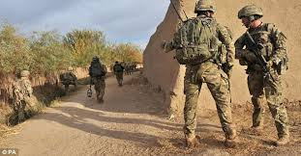
Why are PCCs & PCIs important?
Why do rehearsals during step 8?
Receive the Mission
Issue a Warning order
Make a Tentative Plan
  METT-TC
  COA
Initiate Movement
Conduct Reconnaissance
Complete the Plan
Issue the Order
Supervise & Refine
  It allows leaders to assess their subordinates preparation
    Weapons and ammo: test fire
    Uniforms and equipment
    Mission Essential Equipment
    Soldiers understanding of mission and their specific responsibilities
    Communications: radios, frequencies, batteries
    Rations and water
    Camouflage; personnel and equipment
  Practice essential tasks. Clarifies Commander’s intent
  Reinforce scheme of maneuver
  Foster confidence among Soldiers
  Provide feedback and exposes problems in the plan
  Identify weaknesses or problems in the plan.
  Coordinate subordinate elements actions
Pre-Combat Checks (PCCs) & Pre-Combat Inspections (PCIs)
FM 6-0 CH 10
Notes:
FM 6-0 CH 10
STEP 8–SUPERVISE AND REFINE
10-39. Throughout TLP, leaders monitor mission preparations, refine the plan, coordinate with adjacent
units, and supervise and assess preparations. Normally, unit SOPs state individual responsibilities and the
sequence of preparation activities. To ensure the unit is ready for the mission, leaders supervise
subordinates and inspect their personnel and equipment.
10-40. A crucial component of preparation is the rehearsal. Rehearsals allow leaders to assess their
subordinates’ preparations. They may identify areas that require more supervision. Leaders conduct
rehearsals to—
● Practice essential tasks.
● Identify weaknesses or problems in the plan.
● Coordinate subordinate element actions.
● Improve Soldier understanding of the concept of operations.
● Foster confidence among Soldiers.
10-41. Company and smaller sized units use four types of rehearsals, and they are discussed in chapter 12:
● Back brief.
● Combined arms rehearsal.
● Support rehearsal.
● Battle drill or SOP rehearsal.

Slide 46
Check on Learning
What was the part that was easier to understand?
What is the part that was the hardest to understand?
Is there anything that needs to be clarified?
46
Notes:
1. Review and be familiar, at a minimum, these items prior to mission.
2. Cover the importance of reviewing each with the students and not falling into the trap of just saying “as per SOP.”
3. The review of this information arms the soldiers involved in the mission with the knowledge they need to be able to make a detailed threat assessment as well as being able to make sound and timely informed decisions.

Slide 47

Summary
Lesson: Tactical Planning
During this lesson we covered the 8 steps of the TLP:
  Receive the Mission
  Issue a Warning order
  Make a Tentative Plan
  Initiate Movement
  Conduct Reconnaissance
  Complete the Plan
  Issue the Order
  Supervise and Refine
Notes:
FM 6-0 CH 10

Slide 48
Questions?
48

Slide 49
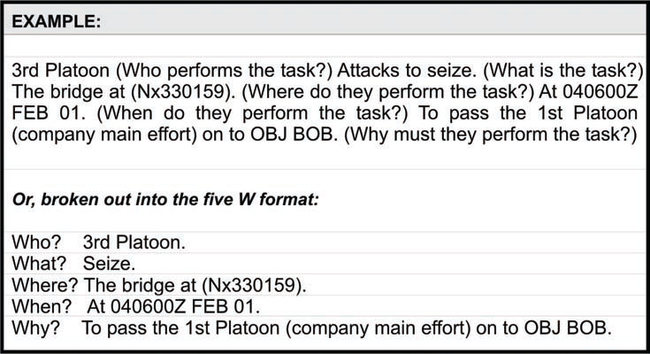
Terminal Learning Objective
49
Notes:
1. Although we will not discuss the MDMP process in any detail, it’s important to understand that the outcomes of both the MDMP and the TLPs is the same. The major difference is the amount of time and resources required to execute each.
2. Understanding that parallel planning is the key to ensuring maximum time for subordinates to properly plan it is important for Company and Platoon leadership to understand the MDMP process so they know when they should be receiving additional information that is developed as part of the BN MDMP process. Each staff element has important information that may be critical to the execution of a company or platoon mission and if they are not effectively pushing the information to their subordinates, the lower level leadership need to know where to go to get the data they need to properly plan for their portion of the overall mission.
3. Compare the two tactical planning processes. (IE explain the different Back briefs and how you can replicate them at Company and Platoon level.

Slide 50
Mission Analysis (cont.)
Troop Leading Procedures
Terrain
AO / AI / AOI
Terrain
Obstacles
Avenues of approach
Key Terrain
Observation/ Fields of fire
Cover & Concealment
Weather
Visibility
Wind
Precipitation
Cloud Coverage
Temp/ Humidity
1. Receive the mission
Initial timeline, possible mission
2. Issue the WARNO
5 Paragraph format (min info)
3. Make a tentative plan
a. Mission analysis
b. COA development
c. COA analysis
d. COA comparison
e. COA selection
4. Initiate Movement
XO, 1SG
5. Conduct Reconnaissance
6. Complete the plan
Orders Production
7. Issue the Order
Verbal, Terrain Model, Paper
8. Supervise and Refine
Confirm Briefs
Back Briefs
Rehearsals
PCC-1 down
PCI-2 down
Type of operation
General location of Operation
Initial operational timeline
Reconnaissance to initiate
Movement to initiate
Planning and preparation instructions
  To include planning timeline
Information requirements (IR & CCIR)
Location-
Identify all
VA / VPs
Mission
Mission, Intent, concept (2 levels up)
Tasks: Specified/ Implied/ Essential
Purpose
Constraints (require/limit action)
Restated Mission
Time
Higher Times
Hard Times
Company/ Platoon TLPs
Light Data
Enemy Data
1/3, 2/3 rule
HOPE
Calculate additional time for VA / VPs
Enemy
General Situation
Disposition
Composition
Strength
Capabilities by WFF
PCOA & MDCOA
Intent/
Capability
Troops
Leadership
Morale
Training & Experience
Capabilities by WFF
Special
Equipment
Notes:
1. Walk back through the TLPs along with providing additional detail related to the Mission Analysis process with an emphasis on C-IED aspects of planning. Make sure that you highlight enemy and terrain and how this is directly associated with the threat triad and the threat assessment process.
a. HOPE- (timeline)
(1) H-Higher
(2) O- Operational
(3) P- Planning
(4) E- Enemy
2. This process will be used in the day 5 Mission Analysis Practical Exercise along with the mission planning for each of the squad and platoon missions executed on days 6-9 of this course.

Slide 51
Review of Troop Leading Procedures
Steps 1-2 must be followed in sequence | Receive the Mission Issue a Warning Order
Steps 3-7 do not have to be followed in a rigid sequence. Preferably, the leader waits until the recon is complete before completing the plan. | 3. Make a Tentative Plan 4. Initiate Movement 5. Conduct Reconnaissance 6. Complete the Plan 7. Issue the Order
Step 8 occurs throughout the process. | 8. Supervise and Refine
Notes:
FM 6-0 CH 10

