Slide 1
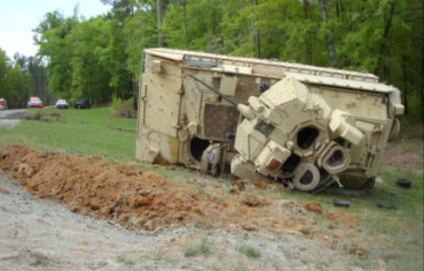
MCoE Safety Alert
Facts:
At approximately 221005APR13, while conducting Bradley M3A3 CFV (Combat Fighting Vehicle) Advanced Drivers training in the vicinity of TTB Falcon (Loraine and Buena Vista roads), a rollover occurred. The driver was preparing to negotiate 90-degree turn at the bottom of a down hill slope. The Bradley driver caught the inner left side of the concrete pad while transitioning from crush and run gravel to concrete. The driver lost control and rolled the Bradley, 270-degrees, landing the M3A3 onto its left side. Soldiers were evacuated by EMS and taken as ambulatory patients to Martin Army Community Hospital for care. The vehicle commander (Cadre) sustained a sprained neck and bruised knee. The driver and gunner (OSUT trainees) were evaluated, cleared, and returned to duty.
For further prevention Commanders, Leaders, and Soldiers must adhere to the following:
Soldiers:
Ensure adherence of commands at all times
Compliance of daily vehicle PMCS conducted prior to each training event
Leaders:
Establish internal communication at all times
- Lost communication; stop vehicle and re-establish
Ensure range speed limits are adhered and speed reduced for hazard mitigation
Enforce consistent adherence of all standards
Maintain rehearsals of crew rollover and evacuation drills prior to training
Commanders:
Ensure Daily Risk Assessments are conducted prior to and throughout training to include AAR
Review of Risk Management Plan prior to training
Monitor driver selection process

