Slide 1
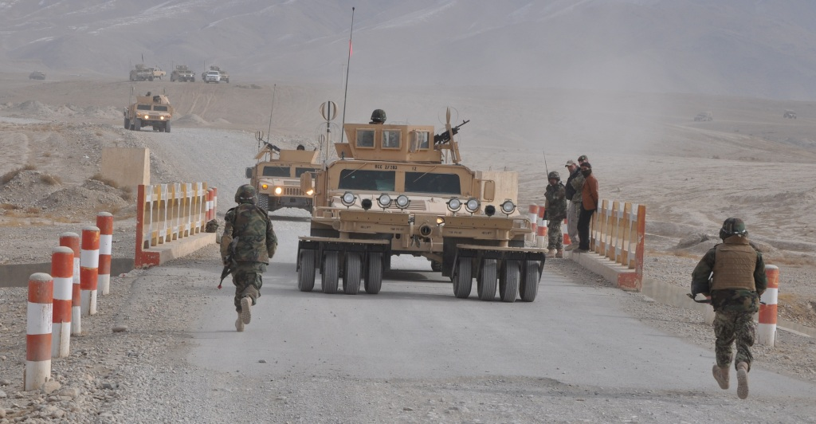
Afghan National Army
Route Clearance Company
Partnership Desk Side Brief

Slide 2
Purpose: To inform and gain support for early identification of suitable coalition force units (Partners) in order to enhance the reception and integration of newly fielded ANA RCC units deploying from the CFC to Corps locations from Afghan National Army Corps, Coalition, and Regional Command leadership.

Slide 3
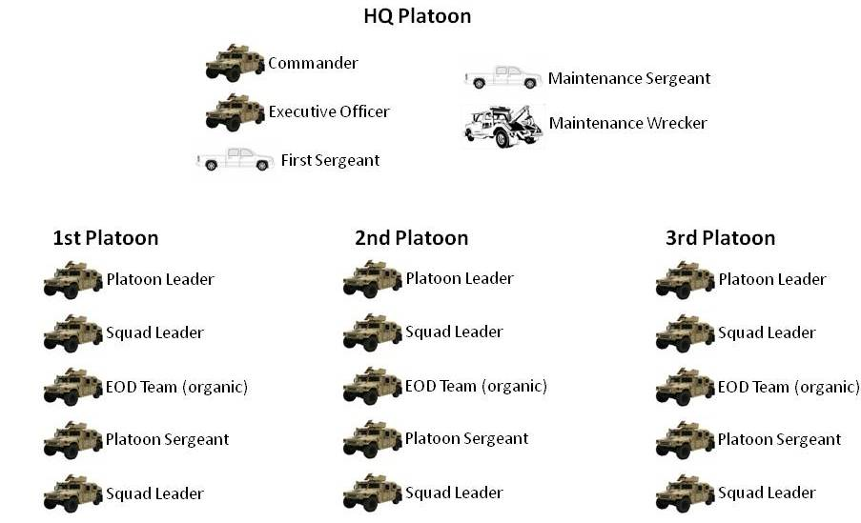
RCC Task Organization

Slide 4
RCC Personnel Tashkil
100 - Route Clearance Company Headquarters
Company Commander | 1
Assistant Company Commander | 1
First Sergeant | 1
Operations Sergeant | 1
Supply Sergeant | 1
Armorer | 1
Radio Telephone Operator | 2
Signal Systems Maintainer | 1
Clerk / Vehicle Driver | 2
200 - Route Clearance Platoon X 3
Platoon Leader | 3
Platoon Sergeant | 3
Squad Leader | 6
Combat Engineer Team Leader | 12
Combat Engineer | 9
Combat Engineer / Driver | 12
Combat Engineer / Gunner | 12
EOD Team Chief | 3
EOD Team Tech | 3
EOD Team Driver | 3
300 - Maintenance Section
Maintenance Section Sergeant | 1
Maintenance Team Leader | 1
Wheeled Mechanic | 2
Officer: 8
NCO: 33
Soldier: 40

Slide 5
Experience has shown that early interaction
between coalition partners
and the RCC being formed
improves relationships and fosters an
accelerated unit achievement of self sufficiency.

Slide 6
Partner Unit Skill Set and Recommendations
Route Clearance Mission
Three Platoon Organization with Company Headquarters
Battalion Support network to assist
EOD partnering assets
Become involved at beginning of unit fielding and training

Slide 7
Route Clearance Mission
The coalition partner must share the route
clearance mission in order to continue the development
of the ANA RCC for future independent operations

Slide 8
Three Platoon Organization
with Company Headquarters
The greatest success will be achieved through partnership at the lowest level to improve junior leader development

Slide 9
Battalion Support Network
Experience has shown that the intensive nature of sustaining
the ANA RCC requires support from the coalition at battalion level
ANA Brigade’s are not yet capable of fully supporting
the Route Clearance unit due to their OPTEMPO
and mission requirements
The ANA RCC will require mentoring of maintenance, medical,
and logistics personnel in addition to tactical operations

Slide 10
EOD Partnering Assets
The ANA RCC is task organized with organic EOD assets.
Each platoon is assigned an EOD team consisting of
1 EOD Lieutenant and two operators
Currently fielded ANA RCC’s will not deploy with EOD teams
The EOD soldiers are pre-screened, receive introductory training,
and are assigned to the EOD school following CFC
(they will rejoin the ANA RCC approx. 22 weeks after deployment)
These individuals will require intensive mentoring during their
development to improve their survivability and experience level

Slide 11
Become involved at beginning
of unit fielding and training
Identify Mentor Team from within partnering organization
Mentor Team should be assigned to CFC for duration of training
(1 ea. Captain and 1 ea. Sergeant First Class)
Plan to rotate additional partner unit personnel to CFC
to assist with training beginning with Week 11 of the POI
Partner unit should assist and support the ANA RCC during
deployment phase

Slide 12
CFC RCC Training Plan Weeks 1-7
DAY | Sat | Sun | Mon | Tue | Wed | Thu | Fri
WEEK ZERO | Orientation | Personnel and Accountability | Staff Functions | After Action Review | Range Familiarization (with maps) | Review | Non -Training Day
 | Oreintation | Leadership and responsibilities | S1 and S4 Specifics | Map Orientation
DAY | 14-May-11 | 15-May-11 | 16-May-11 | 17-May-11 | 18-May-11 | 19-May-11 | 20-May-11
Leader Week 1 | Route Clearance Task Organization and Equipment | IED Principles | COIN | COIN | Range Conduct Briefing | Range Brief (Range Control) | Non -Training Day
 |  | IED Principles (Enemy Template) |  |  | Map Reading
DAY | 21-May-11 | 22-May-11 | 23-May-11 | 24-May-11 | 25-May-11 | 26-May-11 | 27-May-11
Leader Week 2 | Troop Leading Proceedures | Troop Leading Proceedures | Troop Leading Proceedures | Troop Leading Proceedures | Troop Leading Proceedures | Basic Skills | Non-Training Day
 | Map Reading | Map Reading | Map Reading | Map Reading | Map Reading
DAY | 28-May-11 | 29-May-11 | 30-May-11 | 31-May-11 | 1-Jun-11 | 2-Jun-11 | 3-Jun-11
Week 3 | Troop Leading Proceedures | Troop Leading Proceedures | IED Detection | Troop Leading Proceedures | IED Detection | Co Tng Mtg 0900 | Non-Training Day
 | Map Orientation | Map Orientation
 | Drivers Training
DAY | 4-Jun-11 | 5-Jun-11 | 6-Jun-11 | 7-Jun-11 | 8-Jun-11 | 9-Jun-11 | 10-Jun-11
Week 4 | PMI- M16 / M240 / M2 | PMI- M16 / M240 / M2 | PMI- M16 / M240 / M2 | PMI- M16 / M240 / M2 | PMI- M16 / M240 / M2 | Co Tng Mtg 0900 | Non-Training Day
DAY | 11-Jun-11 | 12-Jun-11 | 13-Jun-11 | 14-Jun-11 | 15-Jun-11 | 16-Jun-11 | 17-Jun-11
Week 5 | Rng Week | Rng Week | Rng Week | Rng Week | Rng Week | Co Tng Mtg 0900 | Non-Training Day
 | IED Recognition Lane, Bino's, Scanning Techniques, Dismounted Movement Techniques
DAY | 18-Jun-11 | 19-Jun-11 | 20-Jun-11 | 21-Jun-11 | 22-Jun-11 | 23-Jun-11 | 24-Jun-11
Week 6 | Firing systems (Demolition) | Firing systems (Demolition) | Firing systems (Demolition) | Knots & Priming | Knots & Priming | Co Tng Mtg 0900 | Non-Training Day
 | Mine Detector performance / cluster lanes | Mine Detector performance / cluster lanes | Mine Detector performance / cluster lanes | Mine Detector performance / cluster lanes | Mine Detector performance / cluster lanes
DAY | 25-Jun-11 | 26-Jun-11 | 27-Jun-11 | 28-Jun-11 | 29-Jun-11 | 30-Jun-11 | 1-Jul-11
Week 7 | DEMO refresher | Demolition Range (Inert) | Demolition Range | Demolition Range (Inert) | Demolition Range | Co Tng Mtg 0900 | Non-Training Day
 |  | Breaching mult-secondary devices | Breaching mult-secondary devices | Breaching mult-secondary devices | Breaching mult-secondary devices
 |  | EOD Screening / Testing

Slide 13
CFC RCC Training Plan Weeks 8-10
DAY | 2-Jul-11 | 3-Jul-11 | 4-Jul-11 | 5-Jul-11 | 6-Jul-11 | 7-Jul-11 | 8-Jul-11
Week 8 | Basic Communication | Symphony ECM | HMMWV Maintenance | Ground Guiding | SDR- Back up with Gunner | CMD Maintenance | Non-Training Day
 |  |  |  |  | Vehicle Roll Over Drills | Training Meeting
Leaders | Orientation, Rock Drills, Rehearsals | Rally Points and Proceedures | Terrain and Enemy Analysis TEWT | React to Ambush | React to Indirect Fire
EOD | Overview | Basic Ordnance Safety | Safety Precautions | Terms and Definitions | Blast and Frag
DAY | 9-Jul-11 | 10-Jul-11 | 11-Jul-11 | 12-Jul-11 | 13-Jul-11 | 14-Jul-11 | 15-Jul-11
Week 9 | Evaluate a Casualty | Open Head Wound | Dismounted Movement Techniques | Search Techniques | Search Techniques | CMD Maintenance | Non-Training Day
 | Open Chest Wound | Severed Extremity
 | Open Abdominal Wound | Suspected Fracture |  |  |  | Training Meeting
 | Control Shock | Transport a Casualty
Leaders | React to Found IED (while traveling) | CASEVAC / Recovery | CASEVAC / Recovery | React to IED Strike | React to IED Strike
EOD | Fuze ID | Fuze ID | Color codes and markings | UXO-Dropped | UXO-Placed
DAY | 16-Jul-11 | 17-Jul-11 | 18-Jul-11 | 19-Jul-11 | 20-Jul-11 | 21-Jul-11 | 22-Jul-11
Week 10 | IED Overview, IED Principles, and IED Detection | 5 / 25 Drill | PE- Dismounted IED Recognition Lane | PE- Mounted IED Recognition Lane | PE- Mounted IED Recognition Lane | Command Maintenance | Non-Training Day
 |  |  |  |  |  | Training Meeting
Leaders | Hasty Route Clearance | Hasty Route Clearance | Deliberate Route Clearance | Deliberate Route Clearance | Deliberate Route Clearance
EOD | UXO-Projected | UXO-Thrown | IED Safety | IEDs | Recon Procedures

Slide 14
CFC RCC Training Plan Weeks 11-16
DAY | 23-Jul-11 | 24-Jul-11 | 25-Jul-11 | 26-Jul-11 | 27-Jul-11 | 28-Jul-11 | 29-Jul-11
Week 11 | Rally Points & TAA | React to Ambush and Indirect Fire | Rehearsal- CASEVAC / Recovery | React to Found IED (while traveling) | React to IED Strike | Command Maintenance | Non-Training Day
 |  |  |  |  |  | Training Meeting
EOD | IED/UXO 9 Line Report | Recon Procedures PE | Recon Procedures PE | Recon Procedures PE | Recon Procedures PE
DAY | 30-Jul-11 | 31-Jul-11 | 1-Aug-11 | 2-Aug-11 | 3-Aug-11 | 4-Aug-11 | 5-Aug-11
Week 12 | Traffic Control Points | C-IED Drills | C-IED Drills | Hasty Route Recon/Clearance Drills | Hasty Route Recon/Clearance Drills | CMD Maintenance | Non-Training Day
 |  |  |  |  |  | Training Meeting
EOD | Bombsuit Class | Bombsuit PE | Robot Class | Robot PE | EOC TEST
DAY | 6-Aug-11 | 7-Aug-11 | 8-Aug-11 | 9-Aug-11 | 10-Aug-11 | 11-Aug-11 | 12-Aug-11
Week 13 | Route Clearance Battle Books | Route Clearance Battle Books | Deliberate Route Recon/Clearance Drills | Deliberate Route Recon/Clearance Drills | Deliberate Route Recon/Clearance Drills | Command Maintenance | Non-Training Day
 |  |  |  |  |  | Training Meeting
 | Re-introduce EOD Candidates into Route Clearance Drills
DAY | 13-Aug-11 | 14-Aug-11 | 15-Aug-11 | 16-Aug-11 | 17-Aug-11 | 18-Aug-11 | 19-Aug-11
Week 14 | Troop Leading Proceedures | Mission | Troop Leading Proceedures | Mission | Medevac Proceedures | Command Maintenance | Non-Training Day
 |  |  |  |  |  | Training Meeting
 | Re-introduce EOD Candidates into Route Clearance Drills
DAY | 20-Aug-11 | 21-Aug-11 | 22-Aug-11 | 23-Aug-11 | 24-Aug-11 | 25-Aug-11 | 26-Aug-11
Collective Week 15 Rehearsals | Troop Leading Proceedures | Mission | Troop Leading Proceedures | Mission | SOP Refinement Final AAR | Command Maintenance | Non-Training Day
 |  |  |  |  | Validation Brief | Training Meeting
 | Re-introduce EOD Candidates into Route Clearance Drills
DAY | 27-Aug-11 | 28-Aug-11 | 29-Aug-11 | 30-Aug-11 | 31-Aug-11 | 1-Sep-11 | 2-Sep-11
Collective Week 16 Validation | TLP- 203rd | TLP- 205th | TLP-215th | PAI/AAR | Graduate | Deploy
 |  | Validation Mission-203rd | Validation Mission-205th | Validation Mission-215th | CMD Maintenance
 |  |  | AAR-203rd | AAR-205th | AAR-215th
 | Pre-dep 205th | Pre-dep 215th |  | Pre-dep 203rd
 | Re-introduce EOD Candidates into Route Clearance Drills

Slide 15
Keys to Success
Co-locate ANA RCC with Partner Unit
Always have same platoons work together
Be prepared to assist with logistical sustainment
Focus on respect and positive relationships
Interpreter support
Partnering Assistance Visit
T3 Development

Slide 16
Co-locate ANA RCC with Partner Unit
The more interaction between units, the stronger the
relationship
Accessibility will improve support and sustainment
Coalition support and attention will accelerate unit
development

Slide 17
Always have same platoons work together
Junior leaders will develop their own relationships
Use collective rehearsals to prepare for missions
Develop teamwork and cohesion between coalition partner
and the ANA

Slide 18
Be prepared to assist with logistical sustainment
The more support the ANA RCC receives,
the more engaged they will become
ANA logistics can not support the OPTEMPO that
route clearance requires to gain the experience necessary
for independent operations
Coalition support will result in a team oriented environment
Request coalition fund support early, have the system in
place when the unit deploys

Slide 19
Focus on respect and positive relationships
Make the ANA RCC feel like an integrated part of the coalition
Respect will gain trust and build a strong partnership
Immediately identify and eliminate all negative interactions
Toxic personalities will destroy any positive progress

Slide 20
Interpreter Support
Maximize interpreters with partnering unit
Must have Dari and Pashtu speaking interpreters
Consider interpreter input and recommendations
Remember, communication is critical

Slide 21
T-3 Development
Unit level T3 trainers are key to transition
Following graduation and operational time, 2 junior NCOs from
fielded RCC return TDY to CFC and act as assistant trainers
This can greatly enhance training at CFC while gaining valuable
experience as instructors (Become unit master trainers)
Relationships between RCCs within each Corps are key to success

Slide 22
QUESTIONS?
Mark Wasson MPRI-RCC Program Manager
0702254118
mark.s.wasson@gmail.com
Leo Clark MPRI-RCC Deputy Program Manager
079 847 7889
leo.clark@L-3Com.com

