Slide 1
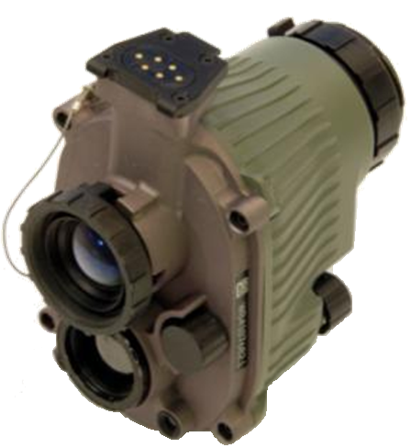
AN/PSQ-20A NIGHT VISION DEVICE (NVD)
Notes:
Title: NVD (AN/PSQ-20A
Task Number(s) /Title(s): task number task title
Effective Date: 24 Jan 13
Supersedes TSP(s): N/A
TSP User: Use this TSP in Unit Sustainment and individual training.
Proponent: The proponent for this document is the Advanced Infantry Marksmanship Strategies and Standards committee, C Company 2/29th IN Regt, Ft. Benning GA. 31905 and DOTD MCOE.
Comments/ Recommendations: Send comments and recommendations directly to ron.shoemaker@us.army.mil or post your comment on the Warrior University forum and someone will address the issue.
Foreign Disclosure Restrictions: The material contained in this course has been reviewed by course instructors, DOTD MCOE and the company that manufactured this piece of equipment. This is releasable to military students from all requesting foreign countries without restriction.
Motivator should be presented during the presentation of this slide.
Instructors Introduction: Your ability to actively and effectively engage and enclose with and destroy the enemy at night is the difference between life and death on the battle field. It is vital to Soldier security and safety to have the ability to see the enemy at night. The ENVG is the premier night vision device that combines I² with thermal technology to give you the best quality night vision in the world.
(NEXT SLIDE)

Slide 2
TERMINAL LEARNING OBJECTIVE:
Action: Operate the NVD system.
Condition: Given student handouts, TM 11-5855-335-10, NVD system and taught in a classroom environment.
Standard: In accordance with this lesson material and TM 11-5855-335-10, students will demonstrate the skills taught to effectively operate the NVD system.
Notes:
State the Action, condition and standard.

Slide 3
ADMINISTRATION
Safety Requirements: General
Specific Safety Hazards:
Optical Material: The thermal lens contains a small amount of germanium. Do not touch, ingest, or inhale particles of a broken lens.
Lithium Battery: May release flammable or noxious gas if crushed, punctured, or otherwise mutilated if brought into contact with water. Gas may cause a fire or injury to personnel.
Risk Assessment: Low
Environmental Considerations: It is the responsibility of all Soldiers and DA civilians to protect the environment from damage, IAW TC 3-34.489 Appendix A and FM 3-100.4, in all considerations during military operations.
Evaluation: At the end of this lesson you will be required to take a 20 question written exam with a passing score of 14 or higher.

Slide 4
Agenda
FUSED OPERATION
CHARACTERISTICS
PUT INTO OPERATION
MOUNTING
OPERATIONS IN ADVERSE CONDITIONS
PMCS AND TROUBLESHOOTING
PREPERATION FOR STORAGE
Notes:
PRACTICAL APPLICATION IS A COMBINATION OF DUSK FAMILIARIZATION AND USE WITH THE INSTRUCTORS DURING THE FIRST NIGHT.
Terminal Learning Objective (TLO) - Operate the ENVG
ELO 1 - Fused Theory - Will be provided by MCOE
ELO 2 - Characteristics - hands off overview of system capabilities and description
ELO 3 - Put into Operation - Step by step (in order) process to put system into operation from opening the bag and inventorying to storing.
ELO 4 - Mounting - cover the installation of the system to the helmet and all stow positions
ELO 5 - Operations in Adverse Conditions
ELO 6 – PMCS

Slide 5
ELO A Fused Operation
ACTION: Discuss basic concepts of Fused Operation.
CONDITION: Given student handout(s) and taught in a classroom environment.
STANDARD: In accordance with the lesson materials, students will demonstrate a basic understanding of the principles of combining thermal and image intensifier imaging which influence image optimization for target detection and recognition.
Notes:
State the Learning Objectives -The Instructor will discuss:
The basic concepts of thermal imaging, including:
What is Infrared energy? (light energy and one of three forms of heat transfer).
How TIR imaging is accomplished with radiated not reflected energy.
How to use thermal imagery to form images
How Atmospheric and other mediums affect on IR transmission
Operational benefits & limitations of TIR

Slide 6
Why a Fused System?
Fused Operation
This Night Vision Device combines Thermal and I² technology to provide a fused image. It will give the following benefits to the soldier:
Greater situational awareness
Expanded viewing capability from daylight conditions to total darkness and through most battlefield obscurants such as fog and smoke
Rapid cueing to dangers (Thermal) without losing the ability to see detail (I²)
No need for multiple devices

Slide 7
Fused Operation
Notes:
Illustration of the spectrum showing where the TWS operates compared to other devices within the IR spectrum
TIR is electromagnetic energy in the optical band and consists of TIR, Visible and Ultraviolet (UV) radiation.
TIR is at the low frequency (longer wavelengths) end of this band,
UV is at the high frequency end and
Visible in the middle. Unaided, our eyes can only sense a small part of optical spectrum and cannot see TIR
Each different frequency of light represents a different color.
Infrared light energy is past the visible red that humans can detect (red to violet)
Different frequencies or wavelengths of light interact with matter differently. Different colors of visible light react with matter differently. (i.e. leaves reflect green wavelengths very well while absorbing other colors, making leaves appear green to the human eye.)
TIR band contains more frequencies (colors) than the visible. Each of these colors interact with matter differently.
The TIR spectrum is broken into sub bands based upon some of these differing characteristics. The current TWS is sensitive between 7.5-14µm in the far IR, known as the thermal infrared.
I2 (Image Intensification, or “I-squared”) devices (e.g. Night Vision Goggles) are sensitive in NEAR IR band.
I2 devices cannot see TIR and Thermal Sights cannot detect aiming lasers (quiz question).
In the TIR, the majority of the light we use to form an image is directly radiated or emitted from those objects.
Basically “glowing” in the infrared.
In the visible spectrum the light we see is primarily reflected. We need light from an external source such as the sun or a light bulb in order to form images
In the TIR, no external light source is required and can form TIR images in complete darkness.
No need exists to transmit or radiate anything, (which might give our position away to an enemy), to illuminate the target.
I2 devices rely primarily on reflected light and require some ambient light or a source of active illumination.
Earlier TISs (AN/PAS-13(V), -13A(V) and -13B(V) operate in the 3–5 µm, in the Mid IR. In some circumstances, these earlier systems can see through glass.
Current TISs (AN/PAS-13C through AN/PAS-13G) operate in the 8-12 µm, in the Far IR. Systems cannot see through glass, but are much smaller, lighter, use less power and have better performance through battlefield obscurants.

Slide 8
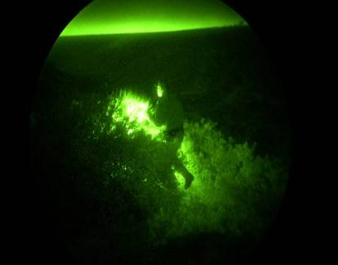
Fused Operation – I²
The I² system collects, amplifies and displays reflected light in low light conditions. The I² system can be used with an illuminator for short-range scenes that might be at or near total darkness.

Slide 9
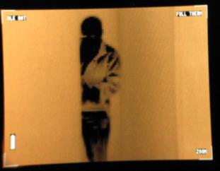
Fused Operation - Thermal
The Thermal imaging system collects and displays the scenes thermal energy in white hot or black hot. Thermal works in all light conditions including daylight, total darkness, most smoke, fog, dust, haze and other conditions of limited visibility.

Slide 10
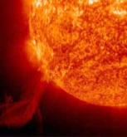
Fused Operation - Thermal
EXPOSURE - AMOUNT OF EXPOSURE to:
Radiation - Sun, human beings/animals
Conduction - Earths core, man made machinery
Convection - Wind (hot or cold)
ABSORPTION - AMOUNT OF ENERGY ABSORBED DUE TO EXPOSURE
Some materials absorb the energy they are exposed to very well
Some materials reflect most of the energy they are exposed to
Exposure time directly affects the amount of energy absorbed
EMISSIVITY - RATE AN OBJECT RELEASES ABSORBED ENERGY
Some objects emit absorbed energy slowly - low thermal signature
Some objects emit absorbed energy quickly – high thermal signature
Absolute zero (-459.6° Fahrenheit) is the lowest possible temperature, at which point the atoms of a substance transmit no thermal energy - they are completely at rest.
All objects above absolute zero emit thermal energy.
Notes:
Absolute Zero.
Everything above absolute zero (i.e. everything on Earth) emits Thermal light.
Absolute zero (-459.6 degrees Fahrenheit) is the theoretical temperature at which no energy is emitted and molecular motion virtually stops.
Even if an object has a temperature of -40ºC, it is still considered hot compared to absolute zero
Exposure: There are three types of exposure; radiation, conduction and convection.
Radiation such as heat from the Sun or the heat from human beings/animals
Conduction such as heat from the earths core or friction from man made machinery
Convection such as heat differences from blowing wind (i.e. a convection oven)
Absorption: The more exposure an object has to radiation, conduction or convection, the more energy it will absorb.
Two objects with the same amount of exposure may absorb energy very differently and have very different thermal signatures
Some objects absorb energy well/fast, while other objects reflect energy and absorb energy poorly/slowly
Amount of energy an object absorbs is completely dependent upon the amount of exposure and the objects absorption characteristics
Humans and animals generate their own heat, but they can also absorb energy through exposure to radiation, conduction and convection.
All materials that have been exposed to radiation, conduction or convection will absorb energy and then emit some of that energy based on their individual emissivity characteristics
Emissivity: Rate that an object releases the energy that it absorbed while being exposed to radiation, conduction or convection
Some materials absorb energy slowly and emit that energy very slowly. These materials will generally absorb slowly and emit their energy for a long period of time during hours of limited exposure (nighttime).
Some materials absorb energy quickly and emit that energy quickly. These materials will generally absorb quickly and emit their energy for a short period of time during hours of limited exposure (nighttime).
Some materials will absorb energy quickly but emit that energy very slowly. These materials will also emit their energy for a long period of time during hours of limited exposure (nighttime)
Materials that have different temperatures can appear to be the same temperature in a thermal scene, due to their emissivity rates.
Humans/animals will emit a steady amount of energy regardless of how much energy they have absorbed. They will almost always be visible through a thermal imaging system unless they are behind cover or are near objects close to their body temperature.
How well an object/material can be seen in a thermal imaging system is determined by how long it was exposed under the conditions of radiation, conduction, or convection.

Slide 11
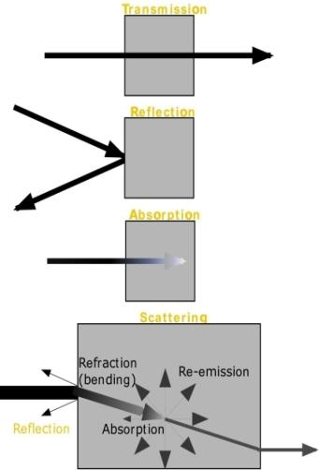
Fused Operation - Thermal
All matter (solid, gas, liquid) will exhibit, to varying degrees, the following properties when light shines on them:
Transmission
Degree to which light passes through a medium
Few good Thermal Infrared (TIR) transmitters, e.g. Germanium
Reflection
Degree to which light bounces off of a medium
Good TIR reflectors include
Metals
Glass
Water
Absorption
Degree to which light is absorbed by a medium
Many good TIR absorbers
Water and Water vapor have greatest impact
Smoke and Dust (dirty battlefield)
Scattering
Light travels straight in a vacuum
Light traveling through or between mediums may be bent or deflected due to:
Reflection
Absorption & re-emission
Refraction (bending)
Notes:
Transmission - degree to which light passes through a medium
Medium – A substance through which something else (IR energy) passes(air, glass, water, etc).
Light passing through the atmosphere or other obscurants will be degraded by reflection, absorption and scattering (i.e. fog , smoke with a high oil content, or burning tires.
Germanium lens on TWS filters out all of the electromagnetic spectrum except middle and far IR.
Reflection – degree light bounces off a material. Polished metals are very good reflectors. When viewing objects with high reflectivity (Metals, Glass or Water) ensure you are aiming at the target and not a reflection.
Absorption - degree to which light is absorbed by a material.
Good absorbers are generally also good emitters (concrete, human skin, rain, and foliage).
Energy absorbed by an object is generally subject to be retransferred by conduction, convection or re-radiation. Energy re-radiated will be released at the same or longer wavelength.
Most objects are good absorbers/emitters in the TIR.
Absorbed energy will be released by emission, conduction or convection.
Note: Materials that are good transmitters, absorbers or reflectors in the visible may exhibit completely different characteristics in the TIR.
Scattering - combined effect of transmission, reflection and absorption. Scattering reduces signal strength, diffuses the image and reduces range.
Heat transfer (Thermal Energy): 1. Conduction, 2. Convection, 3.Radiation.
As an object becomes hotter, it’s molecular activity increases causing object to radiate more TIR light.
Emissivity – efficiency that a material emits radiation – a perfect emitter has an emissivity of 100%.
– Emissivity of a material generally varies with wavelength.
TIR intensity is a function of Temperature and Emissivity of an object.
Objects with different emissivity radiate different amounts of TIR at the same temperature.
Objects with different emissivity can radiate the same amount of TIR at different temperatures.

Slide 12
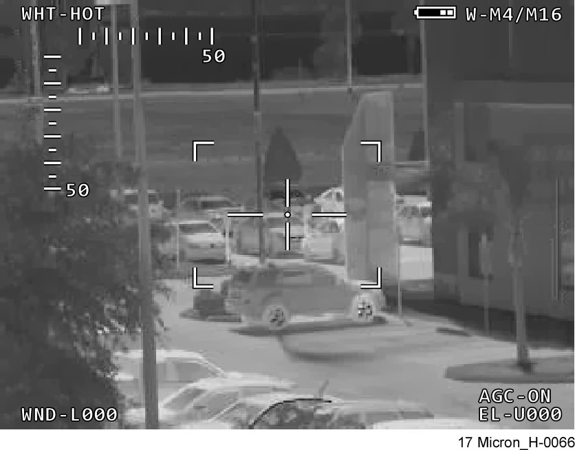
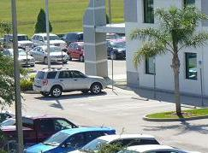
Fused Operation - Thermal
Scene
Radiated TIR Light
Thermal Imaging System
Reflected Visible Light
Thermal – receives TIR energy radiated from a scene and:
Senses differences in apparent temperatures of the scene
Converts the differences to a visible image
Visible Image
Notes:
Acronyms:
TIR – Thermal Infrared (energy radiated as light)
TIS – Thermal Imaging System (any system designed to detect and display TIR)
A viewed Scene consists of visible light and non-visible energy, including infrared radiation.
The function of a Thermal Imaging System (TIS) is to receive Thermal IR (TIR) energy radiated from a scene and use this energy to sense and convert apparent temperature differences in a scene to a visible image.
It is important to note that we are “seeing” temperature differences. The contrast differences (shades of gray between black and white) we perceive in the resulting image are representative of apparent temperature differences of the scene. These temperature contrasts are visible using a TIS even in total darkness.
If all objects in the scene had the same apparent temperature there would be no contrast differences in the resulting image

Slide 13
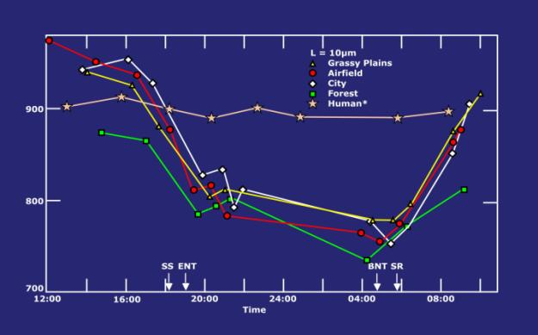
Fused Operation - Thermal
IR Radiation Intensity
Diurnal TIR radiance variations
SS= Sunset, SR = Sunrise
ENT=end of nautical twilight, BNT=beginning of nautical twilight
Scene objects heat and cool at different rates throughout the day and year.
As a result:
TIR scene contrast varies.
Scene objects relative temperatures may invert.
Periods will exist in these cycles where minimal TIR contrast exists (crossover points).
Notes:
Diurnal Thermal Cycle - daily heating and cooling cycle of scene objects
Objects absorb solar thermal energy during the day and heat up
Objects release thermal energy at night and cool off
Seasonal Thermal Cycle - annual heating and cooling cycle of scene objects
Summer - more solar energy causes greater thermal energy absorption and higher scene temperatures
Winter - less solar energy causes greater thermal energy release and lower scene temperatures
Illustration shows relative intensities of different scene objects through a diurnal cycle.
Heating and cooling cycle day to night is demonstrated by the different slopes of each curve.
Some objects had large thermal contrasts at certain times and other periods where little to no thermal contrast exists (cross over points). E.g., at ≈ 15:00 and 05:00 there were brief periods were no contrast existed between the airfield and the city.
Cross over periods can be brief and dramatic or very gradual dependent upon scene, season and weather conditions.
Note: Around sunrise there was little contrast difference between many of the objects in the scene.
Check on learning: Based upon the graph, a hypothetical mission required you to discriminate the city from the forest with your TIS, when would be a poor choice of times to conduct the mission and why? Just before 2200 and 0600 hours due to poor thermal contrast.
Check on learning: Based upon the graph, you are monitoring an airfield with a TIS. Just after sunset the airfield runway and surrounding grassy plains fade into one another and you can no longer discriminate the runway from the grassy plain no matter how much you adjust your TWS. Is something wrong with your TIS? What should you do? Based upon the graph, a cross over period between the grassy plain and airfield occurred just after sunset meaning there was no thermal contrast between these scene objects. This is a scene condition. Adjusting the TIS controls will help to a point but cannot overcome zero scene contrast. Nothing is wrong with the TIS. If you wait, a thermal contrast between these objects will reappear and you will once again be able to discriminate them.

Slide 14
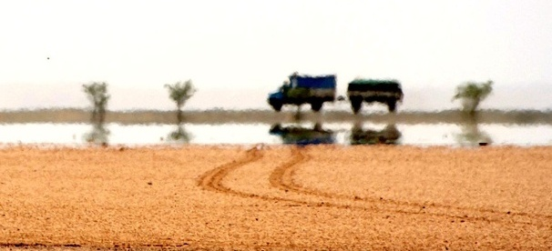
Fused Operation - Atmospheric Turbulence
Twinkling or shimmering (Mirage)
Affects line-of-sight through air near heated surfaces (such as air above a road heated by sunlight).
Affects stability and clarity of image (may cause image to appear to move or be unfocused).
To avoid atmospheric turbulence move to a higher position or, if possible, wait for temperatures to cool.
Notes:
On hot, sunny days, rising hot air at the surface can cause atmospheric turbulence. Most of us have experienced this effect in the visible. The effect is the same in the TIR. The effect is less pronounced when the sun sets, the ground cools or when viewing a scene from a high angle
Atmospheric turbulence causes variations in the density of the air, which can bend or refract light radiated or reflected from the scene, causing:
shimmering
twinkling
degradation of image clarity.
Avoiding atmospheric turbulence
Move to a higher position (operating conditions permitting) to reduce the affects
Wait for temperatures to cool.

Slide 15
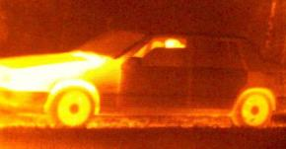
Fused Operation - Signatures (1 of 2)
Thermal imagers reveal temperature differences between objects and these differences lead to thermal cues
Engines burn fuel, produce heat of the vehicle and the nearby surroundings (ground)
Friction, produces heat and creates warm footprints and tire tracks
Shadows reduce sunlight absorption and can show recent presence of objects
Shiny = Poor emissivity!
Notes:
Thermal shadowing – the hot or cold thermal “shadow” left by an object after it has been moved.
May persist from seconds to hours after the object that originally cast them has moved
Useful thermal cue
May be either hot or cold shadow. Shadowing may occur from a warm object leaving an image on a cooler background surface or a cool object on a warmer background surface
An example of a cold shadow is a row of 10 aircraft parked on a sunlit flight line. The sun heats the tarmac around the aircraft but the tarmac remains much cooler in the shadow under the aircraft. 4 of the aircraft take off. However, a TIS observing the flight line may be able to detect not only the 6 remaining aircraft but also a thermal shadow of the other 4 aircraft long after they have departed. The size and shape of the shadow may even be distinct enough to recognize the type of aircraft that had departed.
An example of a hot shadow (hot object leaves a residual heat signature behind). A parked running vehicle heating the cold ground underneath. After the vehicle leaves, the hot shadow on the ground might remain for some time. Additionally, people can create thermal shadows where their body parts have been in contact with solid objects such as chairs.
Check on Learning Demonstration: Using the demo TWS and an external video monitor, demonstrate thermal shadowing by placing your hand on the wall to warm it up then removing it and observing the residual thermal shadow of your hand.

Slide 16
Fused Operation - Signatures (2 of 2)
Suicide Vest – Thermal/Visible Images
Western Male w/PVC Pipe
Western Female w/Metal Pipe
Middle Eastern Female w/PVC Pipe
Notes:
Thermal devices have the capability to detect individuals wearing suicide vest; made of different materials.
Detection will vary depending on the layers of clothing and what the material from which the clothing is made
Similar detection may be possible for IEDs on the side of roads or trails.

Slide 17
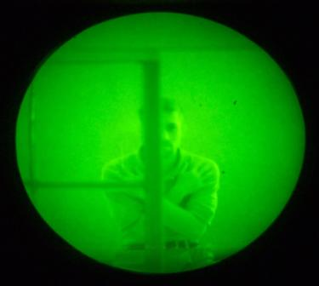
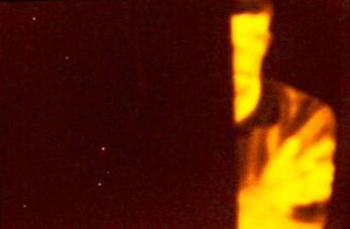
Fused Operation – Pros and Cons
Pros and Cons of I² and Thermal
I²
Will see through glass
Requires reflected light
THERMAL
Will not see through glass
Reflects the images on the near side of the glass (like a mirror)
Does not require reflected light
Notes:
Point out that man on bottom is half way behind a piece of glass.

Slide 18
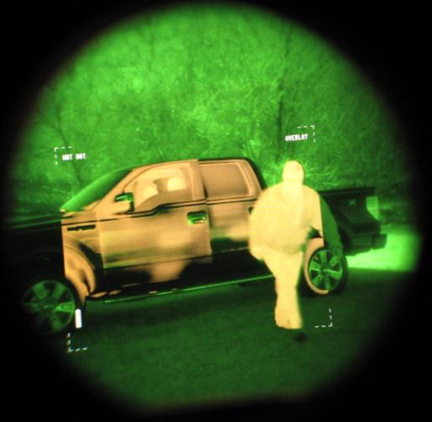
Fused Operation
With the AN/PSQ-20
The images from I² or Thermal can be viewed independently or can be combined into a single, fused image.
Fused – I² and Thermal images are optically overlaid as a single displayed image.
Thermal Only
I² Only
Fused

Slide 19
Check on Learning
Q: What advantage’s does image intensifier provide over thermal?
A: It can see through glass
Q: What advantage does Thermal have over Image Intensifier?
A: Can be used in total darkness?
Q: What’s the advantage in having both I² and Thermal?
A: Provides for better situation awareness for any given area of interest in any condition.
Notes:
Summary
In this lesson you learned:
Basic principles of Image Intensification and Thermal energy detection
Advantages in using Image Intensification
Advantages in using Thermal Imaging
Advantages in using both.
In the next lesson we will learn the characteristics of the AN/PSQ-20 .

Slide 20
ENABLING LEARNING OBJECTIVE B
Action: Overview the characteristics of the NVD system.
Conditions: Given student handout(s) and taught in a classroom environment.
Standards: In accordance with the lesson materials, students will view the characteristics of the NVD system.
Notes:
ELO B - Characteristics - hands off overview of system capabilities and description

Slide 21
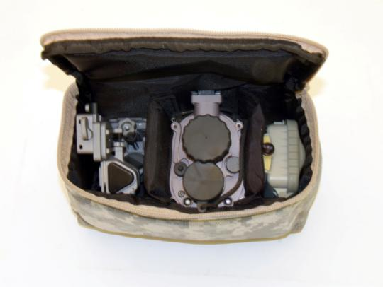
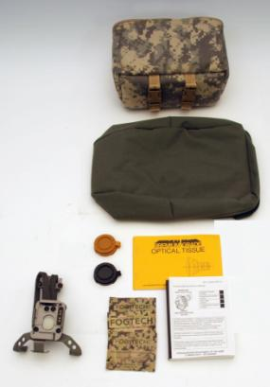
CHARACTERISTICS
In the Carrying Case you will have:
NVD system
Battery pack
Helmet mount (Rhino)
QRC
In the Green Shipping & Storage Case you will have:
Carrying Case
HMWA
LIF & Sacrificial Window
Demist Towelette
Lens paper
Operator TM
Notes:
LIF is usually installed on the NVD (Sacrificial can be installed instead of LIF for sand or dusty conditions that would damage LIF)
LIF has a blue/green tint
Demist towelettes to reduce fogging
Explain where each item is stored but do not have them open up and remove anything. That will be done in “Put into Operation”.

Slide 22
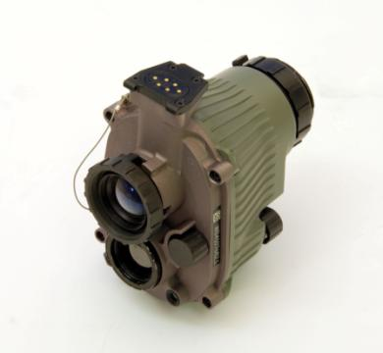
CHARACTERISTICS
WEIGHT: 2 LBS
BATTERIES: 3 L91 AA LITHIUM (1.5V ea.)
BATTERY LIFE (23º C/74º F) >15 HRS
7.5 HRS FUSED OR THERMAL ONLY
FOLLOWED BY 7.5 HRS I²
WATER RESISTANT TO 1M FOR 30 MIN.
USING ALKALINE AA BATTERIES SIGNIFICANTLY REDUCES OPERATIONAL TIME
Notes:
NVD is no more difficult to operate than a digital watch.
Fused operation is seeing the Thermal image overlaid on the I² image.
Reiterate battery safety, never mix different types of batteries, never use rechargeable batteries.

Slide 23
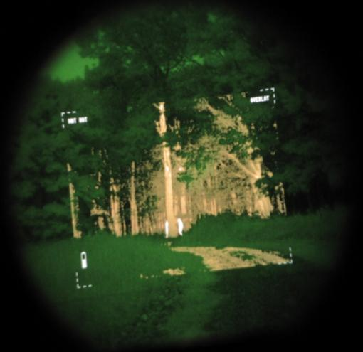
CHARACTERISTICS
FIELD OF VIEW
40° (I²)
30° (THERMAL)
USE SCANNING TECHNIQUE TO MAINTAIN AWARENESS OF YOUR SURROUNDINGS

Slide 24
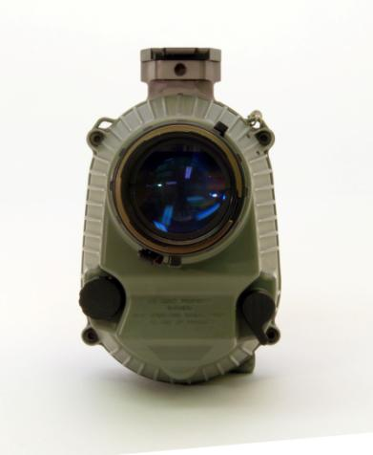
THE NVD POWER KNOBS ARE MULTI-FUNCTIONAL
CHARACTERISTICS
IMAGING SYSTEM REAR
DIOPTER FOCUS RING
Eyepiece Lens
THERMAL ON/OFF KNOB
(ALSO THERMAL POLARITY SWITCH)
IR ILLUMINATOR LEVER
Notes:
Describe how both Thermal and I² knobs are also push buttons.
I² selects mode when I² is on.
I² selects zoom when in Thermal only.
Diopter focus ring allows you to set +1 to -2. This adjust the eyepiece so the image of the display you see through it looks nice and sharp. Since everyone's eyes (and any prescriptions that go with them) tend to be a little different, this is put in place to help compensate.

Slide 25
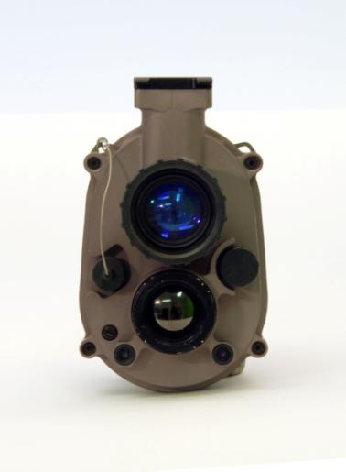
CHARACTERISTICS
IMAGING SYSTEM FRONT
I² OBJECTIBVE FOCUS RING
Hotshoe
I² Power Knob
(Also Thermal mode selector
& Thermal Zoom)
I² OBJECTIVE LENS
THERMAL OBJECTIVE LENS
I/O Port
HIGHLIGHT CUT OFF
IR ILLUMINATOR
WARNING: THERMAL OBJECTIVE LENS IS MADE OF GERMANIUM
Notes:
I² Objective focus– adjustable 25 cm(9.8 in.) to infinity.
Thermal Objective –fixed >7m (22.9 ft.) to infinity (don’t eat or inhale chips because it is toxic)
Explain highlight cutoff then move on to how 70 sec of continuous light will cause the goggle to power down to save the image intensifier. Direct flashlight or sun can cause it to turn off.
The Highlight cutoff lens is octagonal so you can identify it by feel, if exposed to too much light it will shut off the NVD to protect it from damage.
I/O Port – Used for maintenance and to receive the display from a thermal weapon sight (TWS) via a cable provided with the TWS.
IR illuminator – LED that emits IR light for viewing in very low light levels.
Hotshoe – attaches to helmet mount or battery pack.
I2 power knob – Turns I2 image on/off and the farther you turn it the brighter it will get, if in fused mode, when pushed in it will change provide mode and zoom options.

Slide 26
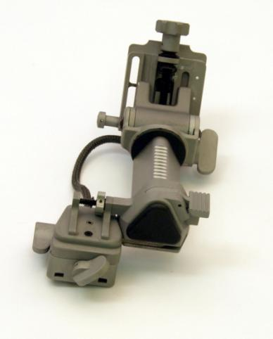
CHARACTERISTICS
HELMET MOUNT (RHINO)
“Rhino” Adjustable for:
Height
Left or Right eye
Eye Relief
Tilt
Horizontal
Notes:
WALK THRU TALK THRU ONE FUNCTION AT A TIME
These will be described and practiced in “Mounting”.
For now, all they are checking is that each adjustment moves.
Press down Eye Relief Lever to unlock eye relief and slide
Tilt (rotate knob to adjust)
Vertical adjustment knob (rotate to adjust)
Eye shift lock used to position R or L.

Slide 27
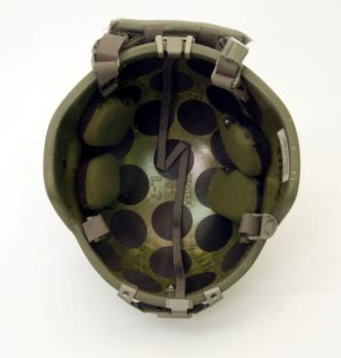
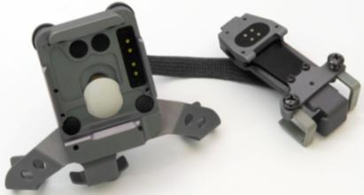
CHARACTERISTICS
HELMET MOUNT WIRING ASSEMBLY (HMWA)
HOTSHOE
KEEPER
Top of the Helmet Mount Bracket
WARNING: Ensure the pads in the front and rear cover the HMWA hooks.
Notes:
Check to ensure the helmet mount wiring assembly fits snug against the helmet and that there are NO breaks.
For safety, ensure that the front and rear pad are positioned so they keep the head from striking the helmet mount wiring assembly hooks during a fall or blow to the helmet.

Slide 28
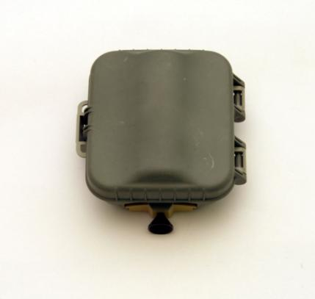
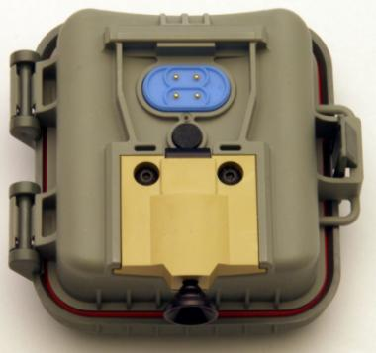
CHARACTERISTICS
BATTERY PACK ASSEMBLY
BATTERY PACK
RELEASE
LANYARD LOOP
SPRING LOADED CONTACTS
HOTSHOE RECIEVER
BATTERY PACK COVER LATCH
NOTE: RECOMENDED 3 L91 AA LITHIUM BATTERIES
Notes:
Contacts
Release lever
hotshoe
NOTE THE SHAPE OF THE hotshoe ATTACHMENT AREA. Hotshoe (imaging system or Helmet Mount Wiring Assembly, HMWA) hooks fit to wide end.
Battery cover latch
Battery pack release (pull up to release)
3 lithium battery NVD will also work with the NVD 4-battery pack

Slide 29
Check on Learning
Question: What type of batteries are recommended?
Answer:
Question: Where can you find the I² knob?
Answer:
Question: Where can you find the Thermal knob?
Answer:
L91 AA Lithium Batteries.
In the front of the Imaging System at the center right.
At the rear of the Imaging System on the bottom left.
Notes:
ELO 2 - Characteristics - hands off overview of system capabilities and description
Instructional Lead in: Now that you know the characteristics of the NVD we will go over how to put it into operation.

Slide 30
ENABLING LEARNING OBJECTIVE C
Action: Put NVD system into operation.
Conditions: Given student handout(s), NVD system, and taught in a classroom environment.
Standards: In accordance with the lesson materials, students will demonstrate a basic understanding of how to put the NVD system into operation.
Notes:
ELO 3 - Put into Operation - Step by step (in order) process to put system into operation from opening the bag and inventorying to storing.

Slide 31
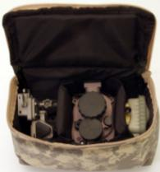
PUT INTO OPERATION
INVENTORY
In the Carrying Case you will have:
NVD system
Battery pack
Helmet mount (Rhino)
QRC
In the Green Shipping & Storage Case you will have:
Carrying Case
HMWA
LIF & Sacrificial Window
Demist Towelette
Lens paper
Operator TM
Operator Action:
Take NVD system out of carrying case
Notes:
Students should have not taken anything out yet. Now the students should take out the system.

Slide 32
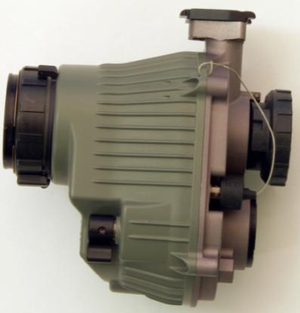
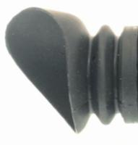
PUT INTO OPERATION
IMAGING SYSTEM
Eyecup comes installed.
Eyecup will protect the eye from lasers and conceal green glow.
Operator Action:
Take off eyecup and reinstall
Notes:
If the eyecup comes off for any reason place it on the eyepiece and press around the edge to ensure it is secure.

Slide 33
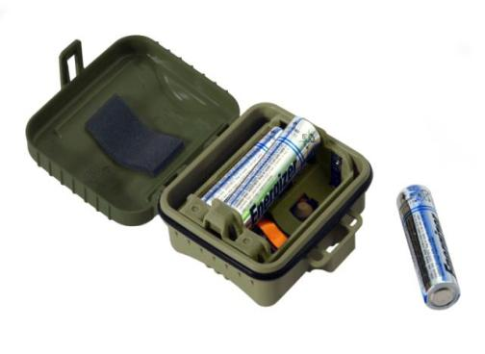
PUT INTO OPERATION
BATTERY INSTALLATION
INSERT BATTERIES (-) END FIRST, (+) END UP.
THEY ALL GO ONE WAY
INSERT THE CENTER
BATTERY LAST
TO REMOVE BATTERIES, PRESS THE (-) END OF THE TWO OUTSIDE BATTERIES AND THEN PULL OUT BATTERIES
Operator Action:
Place batteries into battery pack
Notes:
Describe how to open cover.
Install batteries (note that all batteries with “+” end pointing upward
Remove batteries then reinsert
Inspect o-ring and cover
Close cover after batteries are inserted.
*Recommend Lithium Batteries
*Never mix battery types because it may lead to failure of the lower capacity battery type
L91 batteries are Lithium/Iron Disulfide (Li/FeS₂)
These are safer then the liquid cells but you need to follow Material Safety Data Sheets when shipping large quantity.
Batteries are configured in this way in order to have all batteries touch, this will prolong the life of the batteries in cold weather enviroments because the batteries will keep each other warm.

Slide 34
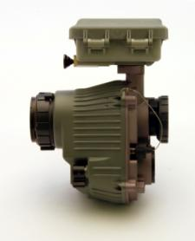
PUT INTO OPERATION
INSTALL BATTERY PACK
Place wide part of battery pack hotshoe receiver over front of imaging system hotshoe.
Engage hooks and rotate down until the latch clicks into place.
Gently pull to ensure it is secure.
BATTERY PACK RELEASE
Operator Action:
Install battery pack onto NVD system
Notes:
Battery pack release will be up when you start.

Slide 35
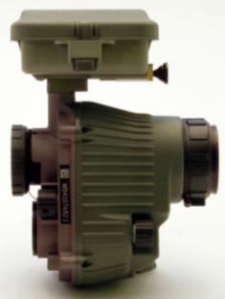
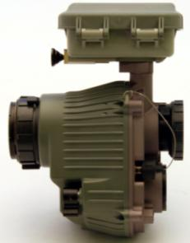
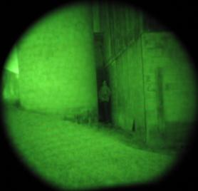
PUT INTO OPERATION
I² OPERATION
I² ON / OFF / GAIN (Rotate)
IR ILLUMINATOR LEVER
HIGH LIGHT CUTOFF
Operator Action:
Turn on I² and adjust the gain
Operate the IR Illuminator
Notes:
Gain check by viewing change in display brightness as the power knob is rotated.
Check to insure operator is not covering I² Illuminator port.
Check I² illuminator by asking another NVG equipped Soldier to look at you, or looking into a reflective surface.
Check high light cutoff by shining a white flashlight into the sensor for 100 seconds.

Slide 36
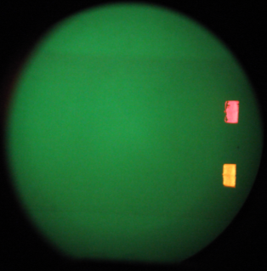
PUT INTO OPERATION
I² INDICATORS
IR ILLUMINATOR
ON
I² Low
Battery
NOTE: IF YELLOW LED IS PRESENT, REPLACE BATTERIES WITHIN 30 MINUTES
Notes:
Flashing yellow rectangle indicates 30 min I² only operation remains.
(1) Thermal Low Battery Indicator (LOW BAT). LOW BAT indicates approximately 30 minutes of fused operation remaining. At the end of 30 minutes fused operation, if the thermal camera is turned off there is approximately 7.5 hours of I² only operation remaining. LOW BAT will be displayed for 10 seconds at 10 minute intervals or whenever a control is pressed.
(2) Thermal Critical Battery Indicator (CRIT BAT). CRIT BAT replaces LOW BAT and flashes in the display for 20 seconds. If CRIT BAT appears, the thermal camera SHOULD be turned off to maintain 7.5 hours of I² operation. If you continue to operate in fused mode, the I² will remain on and the thermal camera will shut off on its own. The I² only operation time will be decreased dramatically. In warmer climates, the NVD may continue to operate in fused mode in excess of 1 hour, but with a reduced I² operational time.
(3) I² Low Battery Indicator. The I² LBI is visible through the eyepiece as a flashing yellow LED indicating that the battery voltage is low and batteries should be replaced at the first opportunity. The flashing LED indicates 30 minutes of I² only operation remaining.

Slide 37
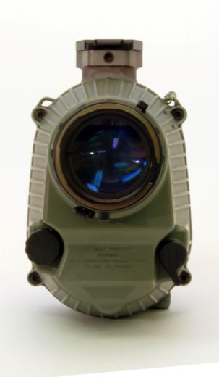
PUT INTO OPERATION
I² DIOPTER FOCUS
Leave the objective lens cover on.
Find an object and rotate the diopter focus until it is in clear view.
You should adjust through “best” focus and then back.
Operator Action:
Adjust diopter focus ring
Notes:
Objective lens cap has a pinhole in it. When viewing a well lit object through the pinhole you do not need to adjust objective focus.
The diopter focus process will adjust the eyepiece for your eye corrective lens prescription.
Do this again in thermal in 4 slides.

Slide 38
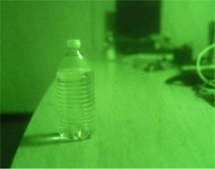
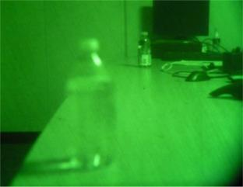
PUT INTO OPERATION
I² OBJECTIVE FOCUS
With the objective focus ring you can adjust from 25cm to Infinity.
Find a close object and rotate the objective focus ring until it is in clear view.
Find a far object and rotate the objective focus ring until it is in clear view.
Operator Action:
Remove objective lens cover and adjust I² objective focus ring to near and far objects
Turn off I²

Slide 39
PUT INTO OPERATION
THERMAL OPERATION
3X
(PRESS)
THERMAL ON / OFF (Rotate)
DISPLAY BRIGHTNESS (Rotate)
POLARITY (PRESS)
CALIBRATE
(PRESS BOTH TOGETHER)
Notes:
Students should not turn on the system yet, this slide is just an over view of the buttons.
Take off Lens Cover and turn on thermal.
Check display by viewing change in display brightness as the power knob is rotated.
With I² off, press I² power knob to view 1X to 3X.
Press Thermal power knob to switch between White hot and Black hot. Default is White hot when system is turned on.
Calibrate by simultaneously pressing both Thermal & I² power knobs to center.
System does not automatically calibrate except for initial turn on.

Slide 40
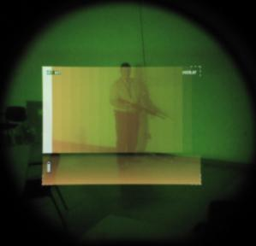
THERMAL START-UP SCREEN
PUT INTO OPERATION
White identifies the hottest object and black is the coldest.
This reverses for Black Hot.
Everything in between is a shade of amber.
Operator Action:
Turn on thermal operation
Notes:
Soldiers should now turn on the Thermal.
*This has a color display based on shades of Amber, bound by black and white.
Gamma table can be factory set to change relative brightness, starting with White, ending in Black, with 15 amber shades in between.
This table will only display when thermal is first turned on and it always comes up in White Hot.
Practical application – A clear night sky is always the coldest object and will change the relative differences the rest of the display shows.
To minimize the impact of the start up screen blocking the available I² image, keep thermal display brightness low for 15-20 seconds or until the start-up screen appears a second time.

Slide 41
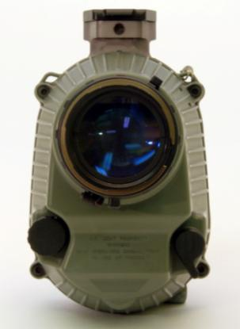
PUT INTO OPERATION
THERMAL DIOPTER FOCUS
Leave the objective lens cover on.
Look at the symbology displayed for the thermal image and adjust the diopter focus ring for clarity.
You should adjust through “best” focus and then back.
The symbology will remain on for 10 seconds push any thermal control to see it again.
Operator Action:
Adjust diopter focus ring
Notes:
Thermal knob – POLARITY
I² knob – 3X-1X
Both – CALIBRATION
This was done in I² four slides back, but instead of looking at the I2 scene have the Soldiers focus the thermal symbology on the display and have them notice the difference. For some it will insignificant, but for others that will not be the case.

Slide 42
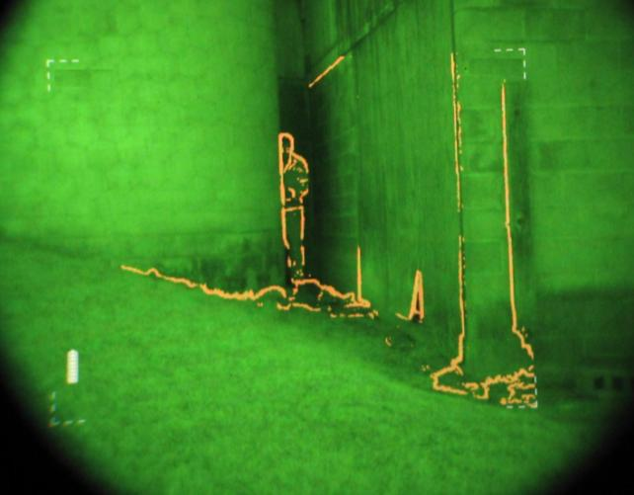
PUT INTO OPERATION
WHITE HOT
OVERLAY
OUTLINE
BLACK HOT
FULL THERM
LOW BATT
CRIT BATT
ZOOM
CALIBRATION
NOTE: NOT ALL INDICATORS ARE DISPLAYED AT THE SAME TIME
Notes:
“Low Batt” indicates you have about 30 min of fused remaining but you should change batteries or plan to go to I² only as soon as possible to preserve 7.5 hours of I² capability.
“Crit Batt” will flash for 20 seconds and indicates you are about to loose thermal or fused operation. System will automatically turn off the thermal camera. I² capability will remain on if in fused operation.
Depending on the environmental conditions you have 7.5 hours or less of I² operating time. In some warmer climates, fused operation may be extended with significant reduction in I² only operating time.
“Calibration “appears when the system is calibrating.
Symbology only appears for 10 seconds and will reappear when any thermal function is activated.

Slide 43
PUT INTO OPERATION
FUSED IMAGE
I² and Thermal images align at 45m.
The operator can adjust either knob to set preferred brightness.
Operator Action:
Keep thermal on and turn on I²
Notes:
Turn on both Thermal & I²
Depending on the light level and knob position the brightness of each channel will interact. Find the balance to get the most information out of each scene.
From zero to 44 meters it is normal to see some misalignment of the thermal and I2 images, the images should be very close from 45 meters to infinity.

Slide 44
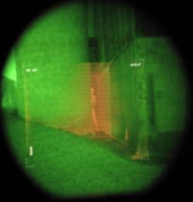
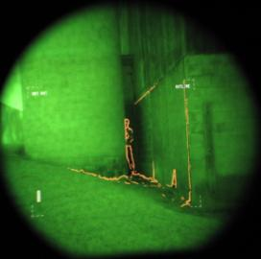
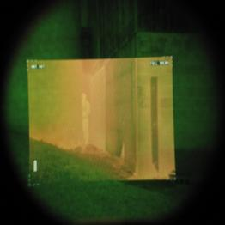
PUT INTO OPERATION
FUSED IMAGERY
1. OVERLAY
2. OUTLINE
THERMAL - On
I² & Thermal Mode Selection
3. FULL THERMAL
Operator Action:
Use the I² button to cycle through the modes
Notes:
Talk class through the display modes starting with turning off I². Select each mode and discuss which are possible only in fused and why they are available.
Overlay – some thermal sources but primary need is mobility and detection. The more thermal scene present the harder it is to run or move rapidly while viewing through the NVD. Overlay outlines thermal objects and fills them in as shown above. Aiming lasers can still be seen, the lower the thermal is set the easier the I2 aiming laser is to see.
Outline – some thermal sources but primary need is mobility and detection. Outline mode on near targets make the I2 aiming laser easier to see because only the outer edge of the thermal object is highlighted and the center is not filled in.
Full Thermal – Provides all available thermal information on the display, difficult to see I2 aiming laser in this mode when the thermal setting is at its brightest, lowering the brightest of the thermal will make the I2 aiming laser more visible.
I² only – battery conservation and no need for thermal; no need to detect heat source early. Thermal viewing provides better detection because it stands out but I2 viewing provides the means to identify or discriminate objects more clearly.
Thermal only – Aiming lasers are not being used, when running or quick movement is not expected, day operations.
Turn goggle off.

Slide 45
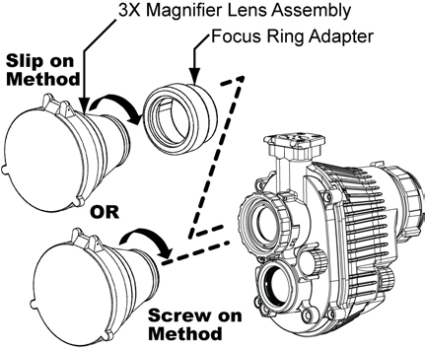
PUT INTO OPERATION
INSTALLING A 3X MAGNIFIER
Standard 3X Magnifier can attach to I² Objective.
For quick use install with focus ring adapter
For long observations the 3X Magnifier can replace LIF
Operator Action:
Turn off NVD system and remove battery pack
Notes:
The 3X for I² and Thermal should not be used at the same time. If used together the images are impossible to overlay and are distracting.
Just like binoculars, it is very difficult to walk while looking through magnification.
If installed, the LIF or sacrificial window must be removed to screw in 3X. They may remain on if using the focus ring adapter.
When the focus ring adaptor is used, the 3X Magnifier is not securely fastened to the NVD and may fall off when shaken or pointed down.

Slide 46
Check on Learning
Question: If the I² yellow Low Battery Indicator appears, what should you do?
Answer:
Question: How do you recalibrate the Thermal sensor?
Answer:
Question: What does the red LED on the right side of your I² scene mean?
Answer:
Change batteries within 30 minutes.
Simultaneously press both the Thermal & I² power knobs together.
The IR Illuminator is on.
Notes:
ELO 3 - Put into Operation - Step by step (in order) process to put system into operation from opening the bag and inventorying to storing.
Instructor Lead in: Now that we know how to put it into operation we will look at the mounting system for the NVD.

Slide 47
ENABLING LEARNING OBJECTIVE D
Action: Place Helmet Mount Wiring Assembly (HMWA) onto helmet and NVD system onto HMWA.
Conditions: Given student handout(s), NVD system and taught in a classroom environment.
Standards: In accordance with the lesson materials, students will mount the Helmet Mount Wiring Assembly onto their helmet.
Notes:
State the Action, Condition and Standard
Cover the installation of the system to the helmet and all stow positions

Slide 48
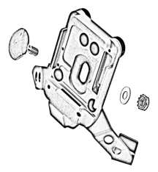
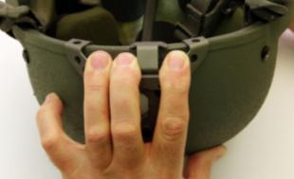
MOUNTING
HELMET MOUNT WIRING ASSEMBLY (HMWA)
Ensure the rear bracket is flush to ACH brim and tighten with cross-tip screwdriver in multi-tool.
Place the plate on the front of the helmet & line up the hole with the oval opening in the plate.
Insert the bolt through the Front Plate.
Place the washer and nut on the threaded bolt and tighten.
Keep the front plate tight to the brim of the helmet.
HELMET MOUNT BRACKET
WASHER
NUT
BOLT
Operator Action:
Secure HMWA to helmet
Notes:
Loosen the cross-tip screws.
Press the bracket over the center rear of the helmet brim with the mount facing out.
Keeping pressure on the center of the bracket to hold it in contact with the brim, tighten the screws. Pay attention to finger placement.
Gently rock the bracket to ensure it is tight.
Nut is 3/16.
Installs just like the -7 & -14 mount.
Apply pressure with fingers as shown in picture while tightening nut.
Gently rock side to side and back and forth to ensure it is on securely.

Slide 49
MOUNTING
HELMET MOUNT WIRING ASSEMBLY (HMWA)
Fold excess cable into “S”.
Check that the pads in the helmet cover the cable.
The pads should be placed to protect the head from contact with the HMWA hooks.
Always check that the HMWA is tight before use.
Operator Action:
Fold excess cable and replace pads
Notes:
Point out Rear Bracket & Front Bracket.

Slide 50
MOUNTING
BATTERY PACK TO HELMET
Place the battery pack hotshoe receiver over HMWA hotshoe as shown.
Rotate forward until it locks in place.
Gently pull to ensure it is locked.
Operator Action:
Secure battery pack to HMWA
Notes:
Release is pointed up.
Point out the option of attaching the loop to a lanyard .
Will also work with ENVG 4 Battery Pack.

Slide 51
MOUNTING
HELMET MOUNT (RHINO)
Helmet Release Button
Imaging System Release
Interpupillary Adjustment (IPA)
Vertical Adjust Knob
Tilt
Fore & Aft Adjust
Eye Shift Lock Nut
Triangular Monorail
Notes:
Fore & Aft adjustment will change eye relief
Triangular monorail is what the hotshoe moves back and forth on
Vertical adjust will center eyepiece up or down.
The Inter Pupillary Adjustment lever rotates 360º and should be locked at 90º or 180º. It only unlocks 0º.
Recommend “tilt” be slightly down for mobility.
Make sure they understand what feature is being addressed.

Slide 52
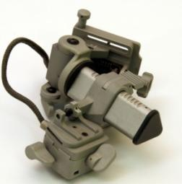
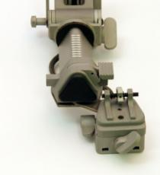
MOUNTING
HELMET MOUNT (RHINO)
After removing the Rhino from the carrying case you can unfold it by pulling and turning the triangular monorail.
Select right or left eye by
Push the Fore & Aft adjust lever to move the carriage to the end of the rail.
Loosen the Eye Shift Lock Nut.
Pull the Swing Arm out and away from the Triangular Monorail.
Rotate to the preferred side.
Tighten the Eye Shift Lock Nut.
Fore & Aft Adjustment
Eye Shift Lock Nut
Swing Arm
Right
Left
Operator Action:
Unfold rhino and select preferred eye
Notes:
Press the release on the right to remove.
Just like the -7 & -14.

Slide 53
MOUNTING
HELMET MOUNT ASSEMBLY
Place the top edge of the helmet mount under the “keeper” on the Helmet Mount Bracket.
Rotate the bottoms together till you hear the latch engage.
Gently pull to ensure it is locked in place.
Operator Action:
Install rhino into HMWA
Notes:
Press the release on the right to remove
Just like the -7 & -14
The PVS-7&14 metal helmet mount will fit this front bracket.

Slide 54
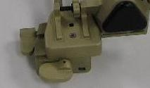
MOUNTING
IMAGING SYSTEM TO RHINO
Insert the front of the hotshoe into the mount and rotate up until the latch engages.
Press up on the latch to ensure it is locked.
Operator Action:
Install NVD system to rhino
Notes:
Discuss the option of removing lanyard from one side and tie to equipment.

Slide 55
MOUNTING
CHECK YOUR EYE POSITION
From WP 0014 Operator TM

Slide 56
MOUNTING
ALIGN TO YOUR EYE
1
1.Vertical Adjustment
2.Tilt Adjustment
3.Interpupillary Adjustment
4.Eye Relief Adjustment
4
3
2
Operator Action:
Adjust NVD system to your eye
Notes:
Talk quickly about slide and then walk students through it.
Put Carrier all the way forward.
Move lens cover to side, but covering the I².
Check elevation first to make sure the NVD will go all the way down
Leave the slide out to make initial adjustment.
Instruct the class to don their helmet
Note: If the Eye relief is all the way back to the eye and you tilt it down to better see the ground, you may hit the brim with the top of the imaging system. When you tip the system out of the way and then bring it back in front of the eye, it may not go back down enough to turn on.
Need to go back and forth between this and the next slide to achieve proper view.

Slide 57
MOUNTING
STOWED POSITIONS: QUICK STOW TO THE LEFT OR RIGHT
Grasp the NVD system and rotate to the side.
CAUTION: There is no power savings when in Thermal or Fused standby.
Operator Action:
Place NVD system into left or right stow
Notes:
If you are using on your right eye flip to the right, left eye to the left.
Thermal imager stays on in standby and still continues to use power. This is so it comes on immediately when returned to the viewing position. There are no power savings when in Thermal or Fused standby.
I² shuts off and no power is used in this position.

Slide 58
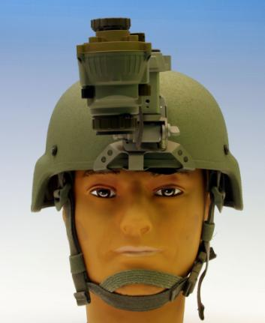
MOUNTING
STOWED POSITIONS: QUICK STOW UP
Grasp the imaging system and rotate up.
CAUTION
You may damage the thermal and I² sensors if they are left pointing towards bright light sources like the sun without using the lens cover.
Operator Action:
Place NVD system into quick stow
Notes:
SHORT EYE RELIEF POSITIONS MAY INTERFERE WITH HELMET BRIM WHEN BROUGHT BACK TO “ON” POSITION
If you are using on your right eye flip to the right, left eye to the left
Thermal imager stays on in standby and still continues to use power. This is so it comes on immediately when returned to the viewing position. There are no power savings when Thermal is in standby.
I² shuts off and no power is used in this position.

Slide 59
MOUNTING
STOWED POSITIONS: FULL STOW
Combines both motions.
Move the NVD system to the side and then upward.
Move NVD system forward for the tightest stow position.
Operator Action:
Place NVD system into full stow
Notes:
If you are using on your right eye flip to the right, left eye to the left
Thermal imager stays on in standby and still continues to use power. This is so it comes on immediately when returned to the viewing position. There are no power savings when Thermal is in standby.
I² shuts off and no power is used in this position.

Slide 60
MOUNTING
STOWED POSITIONS
How the NVD system is stowed in use is up to the individual.
Consider the height of the NVD system over the helmet when passing through doors or overhangs.
When the NVD system is stowed the display and tube are dark. The NVD system is in standby mode and will continue to draw power until it is returned to operation, turned off, or the battery pack is disconnected.

Slide 61
Check on Learning
Demonstrate to the Instructor or the student next to you the location of:
Vertical Adjust Knob
Interpupillary Adjust Lever
Tilt Lever
Image Intensifier Power Knob
Thermal Power Knob
Thermal 3X button
Question: Where does the excess wiring from the HMWA go?
Answer:
Question: How many stowed positions are there and what are they?
Answer:
Folded into an S pattern underneath the center pads.
Three. Quick stow right/left, quick stow up, and full stow.
Notes:
ELO 4 - Mounting - cover the installation of the system to the helmet and all stow positions
Instructor Lead in: So far we’ve covered putting the NVD into operation and how to mount it to you ACH, now were going to cover operations in adverse conditions.

Slide 62
ENABLING LEARNING OBJECTIVE E
Action: Discuss how to operate the NVD system in adverse conditions.
Conditions: Given student handout(s) and taught in a classroom environment.
Standards: In accordance with the lesson materials, students will demonstrate a basic understanding of what steps to take when operating the NVD system in adverse conditions.

Slide 63
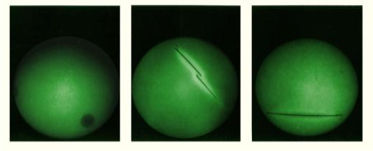
OPERATION IN ADVERSE CONDITIONS
LASER THREAT ENVIRONMENTS
Install the LIF into the I² objective lens to protect the I² tube from laser damage.
Using the ridged side of the storage container as a wrench, hand tighten the LIF.
Do not remove the LIF unless instructed by your unit CDR.
Adjust the eyecup to properly protect the eye from lasers.
DAMAGE CAUSED TO THE I² TUBE IF THE LIF IS NOT INSTALLED.
Notes:
NVD WILL NOT PROTECT THE UN-AIDED EYE. It protects the tube, not your eyes from laser damage.
Remind the students that just like they use eyewear to protect against lasers, blowing sand or shooting problems, the NVD needs to have protective lenses to protect it from laser damages or scratches.
Ideally, use the LIF at all times to protect the system from damage. In blowing sand and dust, replace the LIF with the sacrificial window to protect the LIF from scratches. Laser threats are unlikely to penetrate very far in sand or dust storms.

Slide 64
OPERATION IN ADVERSE CONDITIONS
SACRIFICIAL WINDOW
Operation in dusty and sandy areas.
Install the sacrificial window to protect the objective lens.
Using the ridged side of the storage container as a wrench, hand tighten the sacrificial window.
LIF and sacrificial window cannot be used together.
Ridged side
Notes:
Remind them that both the LIF and sacrificial window are not expected to be waterproof. If moisture collects on either inside or outside surface the Soldier should wipe them dry as necessary.
Ideally, use the LIF at all times to protect the system from damage. In blowing sand and dust, replace the LIF with the sacrificial window to protect the LIF from scratches. Laser threats are unlikely to penetrate very far in sand or dust storms.

Slide 65
OPERATION IN ADVERSE CONDITIONS
DEMIST TOWELETTES
OPERATION IN RAINY OR HUMID CONDITIONS
One application will last several days.
NOTE:
Towelettes are used on eyepiece lens only. Do not use on any objective lens. Towelettes leave a film that reduces the light entering the objective lenses.
Notes:
ONE TOWELETTE CAN TREAT SEVERAL OPTICS AT ONE TIME. THEY DO NOT REMAIN MOIST ONCE OPENED.

Slide 66
OPERATION IN ADVERSE CONDITIONS
OPERATION IN SALT WATER AREAS
Rinse NVD system with fresh water if necessary and dry thoroughly.
Clean lenses with lens paper (and water) if necessary.

Slide 67
OPERATION IN ADVERSE CONDITIONS
EXTREME DARKNESS
I² requires some ambient light to work.
Sparkling or snowy image indicates that an I² device is operating at or near minimum illumination.
In total darkness, the IR Illuminator or thermal sensor can be used.
Notes:
Possibly demonstrate by leaving lens cap on and room lights off.

Slide 68
OPERATION IN ADVERSE CONDITIONS
FOG AND SMOKE
Thermal will see through most types of smoke and fog.
I² night vision is degraded by fog or smoke.
Under most circumstances, I² visibility is similar to daytime unaided vision.
If supplemental IR illumination is used, it will be reflected back and could washout the image.

Slide 69
OPERATION IN ADVERSE CONDITIONS
HALO EFFECT (I² ONLY)
Bright lights may cause a “halo,” which can obscure the area around a light source.
Adjusting the brightness may reduce the halo effect.
THERE IS NO HALO EFFECT IN THERMAL MODE.
Black Hot / Overlay White Hot / Full Outline
Notes:
All though there is no halo in thermal mode there is less detail in the back ground due to the brightness level.
Notice how the image is effected by the windows. Reflecting, blocking, and passing the image.

Slide 70
RETAINING LANYARD FOR LOSS PREVENTION
OPERATION IN ADVERSE CONDITIONS
If wrapping the Retaining Lanyard around you interferes with performing the mission you can untie the left side (without the cap) and tie it to your equipment.
There are two loops on the battery pack that are designed for security cord attachment points if necessary.

Slide 71
Check on Learning
Question: When should you remove the LIF and replace it with the sacrificial window?
Answer:
Question: Can the sacrificial window be used with the LIF?
Answer:
Question: When do you use the Demist Towelettes on the objective lenses?
Answer:
In sandy or dusty conditions.
No.
Never.
Notes:
ELO 5 - Operations in Adverse Conditions
Instructional Lead in: We’ve covered all the operations of the NVD now we’re going to move onto how to take care of your NVD in PMCS.

Slide 72
ENABLING LEARNING OBJECTIVE F
Action: Perform PMCS and troubleshooting procedures on NVD system.
Conditions: Given student handout(s), NVD system, and taught in a classroom environment.
Standards: In accordance with the lesson materials, students will demonstrate the ability to perform a PMCS and troubleshoot the NVD system.

Slide 73
IMAGE INTENSIFIER DEFECTS
PMCS AND TROUBLESHOOTING
Edge glow/shading indicates tube failure and should be reported to maintenance before use.
Fixed pattern noise or honeycomb shaped pattern that interferes with image.
Bright/dark spots
Chicken wire
If fault is not edge glow/shading no action is required unless it interferes with your ability to perform the mission.
Notes:
Bright problems indicate future fatal problems with the tube (Emission points, edge glow)
Dark problems are a little more long term and can be ignored if they don’t grow.
Edge glow shading indicates tube failure, turn into maintenance ASAP.
Fixed pattern or honeycomb is from the boundaries between the fiber optic bundles used to multiply incoming light, this is normal.
Chicken wire is from broken fibers in the tube fiber optic screen, no action required unless you can’t complete your mission.

Slide 74
THERMAL DEFECTS
PMCS AND TROUBLESHOOTING
Defective pixels
Row/column outage
Image Static
Bright/dark center
Water spots
Problems associated with temperature change should go away with calibration.
In an emergency, if you do not hear the shutter during calibration, and the problem persists, place your hand or lens cover over the thermal lens as you calibrate.

Slide 75
PMCS AND TROUBLESHOOTING
WHAT IF THE DEFECT DOESN’T GO AWAY WHEN YOU CALIBRATE?
No action is required as long as dead pixels or rows do not interfere with your ability to complete the mission.
DEFECTIVE PIXELS
DEAD ROW

Slide 76
PMCS AND TROUBLESHOOTING
FUSED IMAGE ALIGNMENT CHECK
Are both I² and Thermal images aligned at 45m?
You may use it as long as it does not interfere with your ability to complete the mission. You should notify maintenance as soon as possible.
Notes:
Turn on both Thermal & I²
I² is always correct. Thermal is adjusted to overlay I². Should not be more than ½ a head off at 45 meter (worse case).

Slide 77
PMCS AND TROUBLESHOOTING
Horizontal line in I² image Edge of beam combiner. Adjust tilt mechanism to minimize problem, this is normal.

Slide 78
PMCS AND TROUBLESHOOTING
HELMET MOUNT WIRING ASSEMBLY (HMWA)
Check security of HMWA before each use.
If loose, tighten with cross-tip screwdriver in multi-tool.
Notes:
Loosen the cross-tip screws
Press the bracket over the center rear of the helmet brim with the mount facing out.
Keeping pressure on the center of the bracket to hold it in contact with the brim, tighten the screws
Gently rock the bracket to ensure it is tight

Slide 79
Check on Learning
Question: What does edge shading or glow indicate?
Answer:
Question: At what distance should the I² and thermal image align?
Answer:
Question: At 45 meters, how far off can the alignment be?
Answer:
Imminent tube failure, NVD needs to be turned in ASAP.
45m and beyond.
½ a head.
Notes:
ELO 5 - Operations in Adverse Conditions
Now that you know how to operate, mount, use and conduct a PMCS it is now time to prepare the NVD for storage.

Slide 80
ENABLING LEARNING OBJECTIVE G
Action: Prepare the NVD system for storage.
Conditions: Given student handout(s), NVD system, and taught in a classroom environment.
Standards: In accordance with lesson materials students will prepare the NVD system for storage.

Slide 81
PREPARATION FOR STORAGE
Turn off NVD prior to removing
Stow components as shown
Operator Action:
Prepare NVD for storage and place into the carrying case
Notes:
Remove batteries prior to
Install the objective lens cover for protection.
Ensure the system is clean and dry.
Open the battery pack and remove the batteries.
Close the battery pack cover.
Place the following components into the carrying case: NVD system (w/ eyecup), rhino, and the battery pack.

Slide 82
PREPARATION FOR STORAGE
Question: Before you disconnect the NVD system from the battery pack what should you do?
Answer:
Question: What items belong in the carrying case?
Answer:
Turn off the NVD system.
Rhino, NVD system, Battery Pack.

Slide 83
SUMMARY
Fused operation – Advantages/disadvantages of I2 only,
thermal only and fused operation
Characteristics of the AN/PSQ-20A NVD
How to put the AN/PSQ-20A into operation
Mounting procedures
Operation in adverse conditions
PMCS and troubleshooting
Preparation for storage
Questions?

