Slide 1
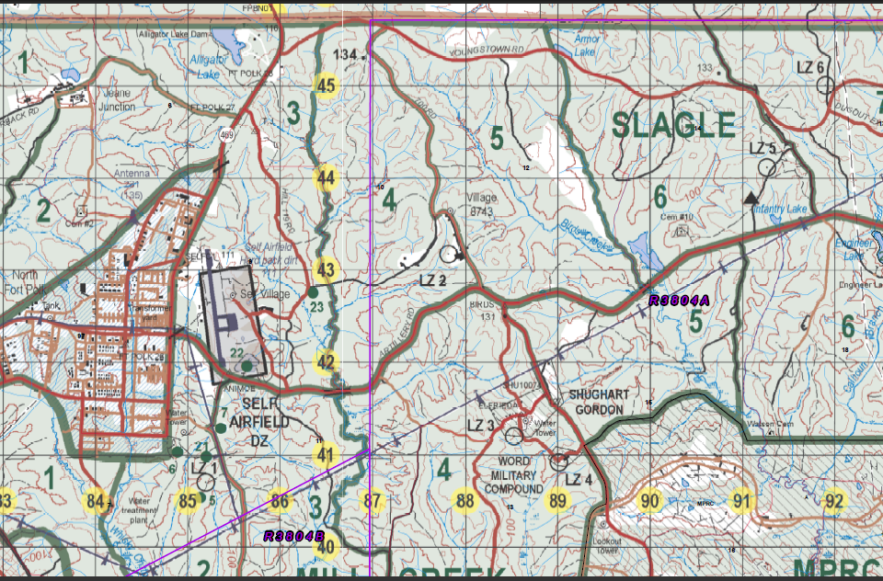
TASK: conduct clearance of compound
PURPOSE: in order to facilitate a KLE……….
FOB North Fort
OBJ

Slide 3
VOIED
Detonated
CWIED (350M)
45 lbs UBE
1xWIA
300400JAN2013
VOIED
Find VOIED (NMC)
50 lbs ANAL
151450JAN2013
Detonated
VOIED (LMC)
90 lbs UBE
2x WIA
041500FEB2013
VOIED
Detonated
CWIED (300M)
1xKIA 3xWIA
60 lbs UbE
210500OCT2012
CWIED
Find VOIED (LMC)
45 lbs ANAL
170930JAN2013

Slide 4
Requirements
Threat Assessment
Identify Vulnerable Points
Identify Vulnerable Areas
Routes Mounted and Dismounted / Why

Slide 5
Detonated
CWIED (350M)
45 lbs UBE
1xWIA
300400JAN2013
FOB North Fort
FOB North Fort
VOIED
Find VOIED (NMC)
50 lbs ANAL
151450JAN2013
Detonated
VOIED (LMC)
90 lbs UBE
2x WIA
041500FEB2013
VOIED
OBJ
VOIED
OBJ
Detonated
CWIED (300M)
1xKIA 3xWIA
60 lbs UbE
210500OCT2012
CWIED
Find VOIED (LMC)
45 lbs ANAL
170930JAN2013

