Slide 1
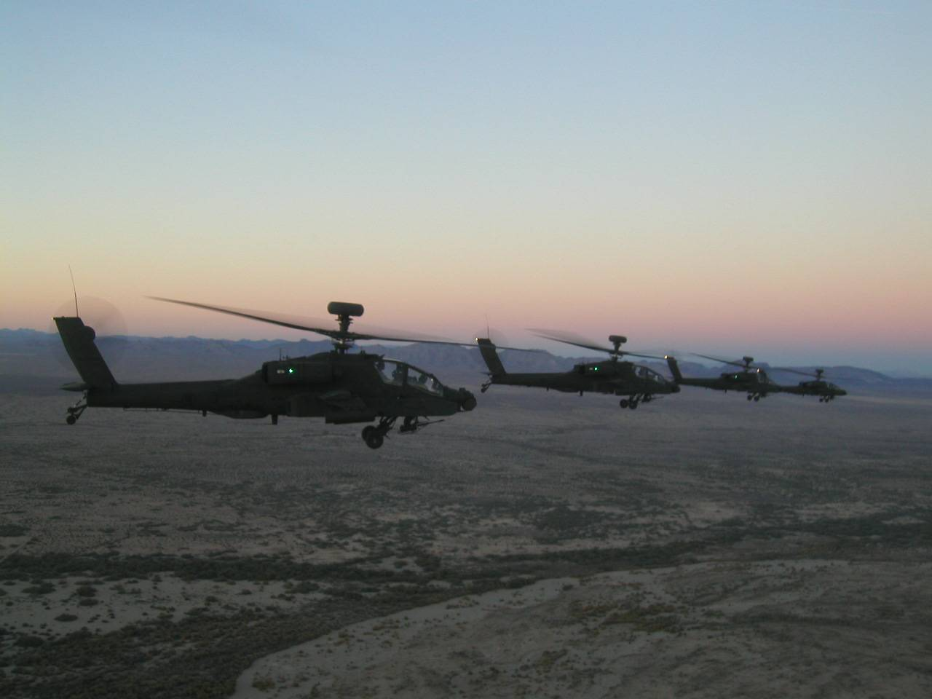
INTERDICTION ATTACK (formerly Deep Attack, Mobile Strike)

Slide 2
Definition
An attack by Army aircraft to divert, disrupt, delay, degrade, or destroy enemy combat power before it can be used effectively against friendly forces.
At any point in the operational environment
Hasty or deliberate. (hasty does not mean ‘without planning’)
At such a distance from friendly forces that detailed integration with ground forces is not needed.
Combines ground based fires, attack aviation, unmanned systems, and joint assets to mass effects
Deliberate IAs are focused on key objectives and fleeting high value targets.
doesn’t have to be “Deep”
FM 3-04.126 Attack Reconnaissance Helicopter Operations (16 Feb 07) pg 3-63
Notes:
An IA is an attack by Army aircraft to divert, disrupt, delay, degrade, or destroy enemy combat
power before it can be used effectively against friendly forces. It can take place at any point in the
operational environment and can be hasty or deliberate. IA is conducted at such a distance from friendly
forces that detailed integration with ground forces is not needed. IA combines ground based fires, attack
aviation, unmanned systems, and joint assets to mass effects, isolate and destroy key enemy forces and
capabilities. Deliberate IAs are focused on key objectives and fleeting high value targets such as enemy C2
elements, AD systems, mobile, long-range surface missiles, surface-to-surface missiles (SSMs), artillery,
and reinforcing ground forces. Hasty IAs are the result of sudden enemy contact or as a result of enemy
attack. The purpose of a IA is to deny the enemy freedom of action, support friendly maneuver, and
destroy key enemy forces and capabilities. (FM 3-04.126 Attack Reconnaissance Helicopter Operations (16 February 2007) pg 3-63)

Slide 3
Description
The interdiction attack capability of the aviation brigade, particularly when coupled with Army and joint fires and effects, extends the battle to the maximum range of organic and supporting sensors. The aviation brigade headquarters is most appropriate for the planning of interdiction attacks. The aviation brigade normally requires OPCON or DS long range fires and supporting joint assets.
Higher HQ still plans for, prioritizes, synchronizes, and resources. No unsupported trolling.
FM 3-04.111 Aviation Brigades, (Dec 2007) pg 3-6
Notes:
This does not absolve the Division of planning, prioritization, synchronization, or resource requirements.

Slide 4
Decide, Detect, Deliver, Assess
Track
v
Decide, detect, deliver, and assess (D3A) methodology facilitates attack of the right target or objective with the right asset at the right time. For aviation, D3A is much more than targeting.
Army Aviation “Delivers” by fire and maneuver
FM 3-04.126, pg 2-23

Slide 5
Decide
Decide is the most important step because it provides the overall focus and prioritizes attack planning. It helps the targeting team decide which targets must be acquired and attacked, which attack option to use, and who will engage the target at the prescribed time.
Mission Analysis
Intelligence Preparation of the Battlefield (IPB)
Enemy situation and potential courses of action
Friendly courses of action
Wargaming
Operations Order to subordinate units
PIR
Decision Points
Notes:
A high-value target (HVT) is a target the enemy commander requires for successful completion of
the mission. The loss of HVTs seriously degrades important enemy functions throughout the friendly
commander’s area of interest.
A high-payoff target (HPT) is a target whose loss to the enemy will significantly contribute to
success of the friendly COA. HPTs are those targets, identified through wargaming, which must be
acquired and successfully attacked for the success of the friendly commander’s mission.

Slide 6
Decide
What targets must we acquire and attack?
In what priority should we attack the targets?
When and where are we likely to find the targets?

Slide 7
Detect
The detect process finds the HPTs to attack for each phase of an operation. Target acquisition assets and agencies execute the intelligence collection plan and focus on specific areas of interest.
Where are the targets?
Who or what can locate the targets?
What target location accuracy is required to attack the target?
How long will the target remain in its location once acquired?
If the HPT is mobile, how do we track it?
Develop Plan to Answer PIR
FM 3-04.126, pg 2-24
Notes:
The G2 is the main figure in directing the effort to detect HPTs identified in the decide function. He determines accurate, identifiable, and timely requirements for collection systems. The detect function involves locating HPTs accurately enough to engage them. It primarily entails execution of the intelligence collection plan.
Target acquisition assets gather information. From this information, targets are validated and tracked. Targets may be impossible to attack (out of range) or undesirable to attack (in range but moving to a more advantageous location for attack). Critical targets that cannot or are not attacked must be tracked to insure they are not lost. Tracking targets may make assets unavailable for acquiring other targets. As targets are tracked, appropriate attack systems are tasked.

Slide 8
Deliver
Both tactical and technical decisions affect selection of the attack system and the unit to conduct the attack. The decisions are reflected in the staff’s earlier development of the attack guidance matrix, schemes of maneuver, and FS plans for planned targets.
When to attack the target?
What’s the desired effect?
What attack system (lethal, nonlethal) to use?
Which unit(s) will conduct the attack?
How to conduct the attack (number, type munitions)?
What’s the response time of the attacking unit?
Notes:
Deliver: the main function is to attack targets in accordance with the Commander’s attack guidance. The tactical situation drives a technical solution including specific attack unit, ordnance, and time of attack.

Slide 9
Assess
BDA – the timely and accurate estimate of damage
Did we achieve the desired effects on the target?
If not, what are the enemy’s combat effectiveness, capabilities, and intentions now?
Is a re-attack necessary?
Notes:
Assess: provides feedback on the question: "Has the Commander’s guidance been met?" If the commander's guidance has not been met, then the detect and deliver functions of the targeting cycle must continue to focus on the targets involved. The feedback may also result in changes to decisions made during the Decide step.
Munitions effectiveness assessment occurs concurrently with BDA and is the basis of recommendations for changes to increase effectiveness of—
Method and timing of attack.
Tactics.
Weapons systems.
Munitions.
Weapon delivery parameters.
Reattack and other recommendations should address operational objectives relative to the following:
Target.
Target critical elements.
Target systems.
Enemy combat force strengths.

Slide 10
Translation to MDMP

Slide 11
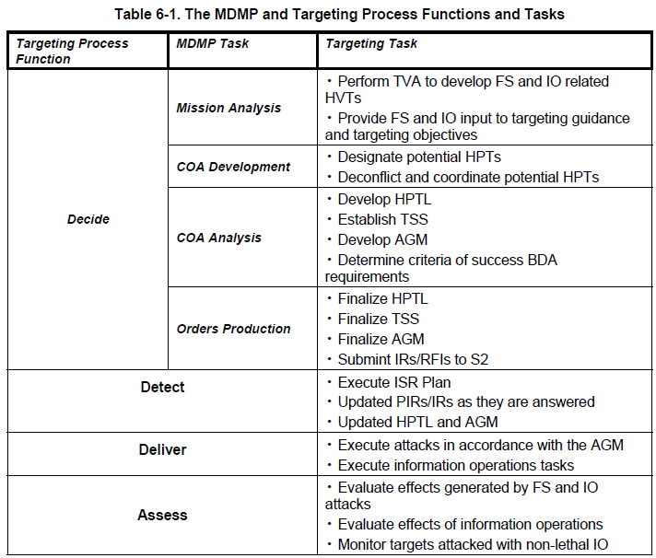
MDMP and Targeting Process
Though the chart only lists FS and IO, the process is the same when considering Army Aviation.
Develop PIR and Collection Plan to answer PIR
ID Decision Points
Answer PIR
FM 3-09.42 (Initial Draft) 27 June 2005, pg 6-2
Notes:
For integration of the targeting process with MDMP see FM 3-09.22, Chapter 6
high-payoff target – (DOD) A target whose loss to the enemy will significantly contribute to the success of the friendly course of action. High-payoff targets are those high-value targets that must be acquired and successfully attacked for the success of the friendly commander’s mission. Also called HPT. See also high value target; target. See FM 6-20-10.
high-value target – (DOD) A target the enemy commander requires for the successful completion of the mission. The loss of high-value targets would be expected to seriously degrade important enemy functions throughout the friendly commander’s area of interest. Also called HVT. See also high priority target; target. See FM 60-20-10.
TARGET SELECTION STANDARDS
Target selection standards (see the format below) are comprised of the essential elements listed below:
HPT. This refers to the designated HPTs that the collection manager is tasked to acquire.
TIMELINESS. Valid targets are reported to attack systems within the designated timeliness criteria.
ACCURACY. Valid targets must be reported to the attack system meeting the required TLE criteria. The criteria are the least restrictive TLE considering the capabilities of available attack systems. (FINAL COORDINATING DRAFT *FM 3-60 (6-20-10))

Slide 12
Mission Analysis
To help the commander visualize the parameters of his mission…
The G2 identifies high value targets (HVTs) from his analysis of the enemy courses of action.
Other staff members review their WFF assets and identify any that can assist in the detect, deliver, or assess functions.
All this information helps to confirm, deny, or modify the commander’s visualization of the tactical situation.
Notes:
high-payoff target – (DOD) A target whose loss to the enemy will significantly contribute to the success of the friendly course of action. High-payoff targets are those high-value targets that must be acquired and successfully attacked for the success of the friendly commander’s mission. Also called HPT. See also high value target; target. See FM 6-20-10. (FM 1-02)
high-value target – (DOD) A target the enemy commander requires for the successful completion of the mission. The loss of high-value targets would be expected to seriously degrade important enemy functions throughout the friendly commander’s area of interest. Also called HVT. See also high priority target; target. See FM 60-20-10. (FM 1-02)

Slide 13
Commander’s Guidance
The commander provides the staff with an understanding of how he visualizes the situation and what he believes is the decisive point of the mission.
Identifies high payoff targets (HPTs) – those enemy targets he believes will contribute the most to the success of the mission if successfully attacked.
Issues attack guidance specifying what effects he wants to achieve on each HPT and what risk he’ll accept. This focuses the staff during COA development.

Slide 14
MDMP and Targeting Process
Though the chart only lists FS and IO, the process is the same when considering Army Aviation.
Risk
Management
FM 3-09.42 (Initial Draft) 27 June 2005, pg 6-2
Notes:
high-payoff target – (DOD) A target whose loss to the enemy will significantly contribute to the success of the friendly course of action. High-payoff targets are those high-value targets that must be acquired and successfully attacked for the success of the friendly commander’s mission. Also called HPT. See also high value target; target. See FM 6-20-10.
high-value target – (DOD) A target the enemy commander requires for the successful completion of the mission. The loss of high-value targets would be expected to seriously degrade important enemy functions throughout the friendly commander’s area of interest. Also called HVT. See also high priority target; target. See FM 60-20-10.
TARGET SELECTION STANDARDS
Target selection standards (see the format below) are comprised of the essential elements listed below:
HPT. This refers to the designated HPTs that the collection manager is tasked to acquire.
TIMELINESS. Valid targets are reported to attack systems within the designated timeliness criteria.
ACCURACY. Valid targets must be reported to the attack system meeting the required TLE criteria. The criteria are the least restrictive TLE considering the capabilities of available attack systems. (FINAL COORDINATING DRAFT *FM 3-60 (6-20-10))

Slide 15
Course of Action Development
During COA development the staff can recommend to add, delete, or modify the HPTs and attack guidance the Cdr has given. Within each COA, forces are arrayed and assigned mission type orders (task and purpose) to acquire, attack, and assess these HPTs to meet the Cdr’s guidance.

Slide 16
MDMP and Targeting Process
Though the chart only lists FS and IO, the process is the same when considering Army Aviation.
Risk
Management
FM 3-09.42 (Initial Draft) 27 June 2005, pg 6-2
Notes:
high-payoff target – (DOD) A target whose loss to the enemy will significantly contribute to the success of the friendly course of action. High-payoff targets are those high-value targets that must be acquired and successfully attacked for the success of the friendly commander’s mission. Also called HPT. See also high value target; target. See FM 6-20-10.
high-value target – (DOD) A target the enemy commander requires for the successful completion of the mission. The loss of high-value targets would be expected to seriously degrade important enemy functions throughout the friendly commander’s area of interest. Also called HVT. See also high priority target; target. See FM 60-20-10.
TARGET SELECTION STANDARDS
Target selection standards (see the format below) are comprised of the essential elements listed below:
HPT. This refers to the designated HPTs that the collection manager is tasked to acquire.
TIMELINESS. Valid targets are reported to attack systems within the designated timeliness criteria.
ACCURACY. Valid targets must be reported to the attack system meeting the required TLE criteria. The criteria are the least restrictive TLE considering the capabilities of available attack systems. (FINAL COORDINATING DRAFT *FM 3-60 (6-20-10))

Slide 17
Targeting Output
High-Payoff Target List (HPTL) - targets whose loss to the enemy will contribute to the success of the friendly COA.
Attack Guidance Matrix (AGM) - which targets will be attacked, how, when, and the desired effect.
Target Selection Standards (TSS) - standards (accuracy, other specific criteria) that must be met before targets can be attacked.
Requirements for BDA.

Slide 18
COA Analysis
Wargame the COA(s) to ensure all WFF elements are fully integrated and synchronized.
Prioritize the HPTs (this becomes the basis for the G2’s collection plan), and which systems to use to achieve the desired effects on each HPT.
Determine target selection standards, which identify the time, accuracy, and observer requirements necessary to launch attacks on HPTs.
Identify all requirements to assess the results of each attack. The results of the wargaming are reflected in the targeting synchronization matrix.

Slide 19
MDMP and Targeting Process
Though the chart only lists FS and IO, the process is the same when considering Army Aviation.
Risk
Management
FM 3-09.42 (Initial Draft) 27 June 2005, pg 6-2
Notes:
high-payoff target – (DOD) A target whose loss to the enemy will significantly contribute to the success of the friendly course of action. High-payoff targets are those high-value targets that must be acquired and successfully attacked for the success of the friendly commander’s mission. Also called HPT. See also high value target; target. See FM 6-20-10.
high-value target – (DOD) A target the enemy commander requires for the successful completion of the mission. The loss of high-value targets would be expected to seriously degrade important enemy functions throughout the friendly commander’s area of interest. Also called HVT. See also high priority target; target. See FM 60-20-10.
TARGET SELECTION STANDARDS
Target selection standards (see the format below) are comprised of the essential elements listed below:
HPT. This refers to the designated HPTs that the collection manager is tasked to acquire.
TIMELINESS. Valid targets are reported to attack systems within the designated timeliness criteria.
ACCURACY. Valid targets must be reported to the attack system meeting the required TLE criteria. The criteria are the least restrictive TLE considering the capabilities of available attack systems. (FINAL COORDINATING DRAFT *FM 3-60 (6-20-10))

Slide 20
The Targeting Process During Execution
because no plan survives first contact

Slide 21
Synchronization and Targeting
During execution it is necessary to evaluate the current fight to determine if the concept of operations needs modification. This is typically done at a synchronization meeting (e.g. targeting meeting). This meeting is nothing more than a very compressed MDMP during which the commander and staff walk through the D³A methodology to verify that the ongoing operations and resources are focused toward finding, attacking, and assessing valid HPTs.

Slide 22
Targeting Meeting
This meeting verifies and updates the HPTL; verifies, updates, and retasks available collection assets for each HPT; verifies and reallocates delivery systems to engage each HPT; and confirms which assets are tasked to verify BDA.
Notes:
Meeting success requires focused participation by all WFF representatives, preparation by all participants, and the rapid development and dissemination of products.
Purpose: To validate subordinate’s PTLs and Tgt Noms for next 72 hrs and to select Targets to set conditions
Facilitated by: FSE Targeting Officer
Attendees: G-2 Targeting Officer, G-3 Plans, G-3 Current OPS, IO, SOCOORD, AVN, ENG, ALO, SJA, AVN, subordinate LNOs

Slide 23
Sample Targeting Meeting Agenda
WHAT | WHO | WHY
CURRENT SITREP / CCIR | G3 OPERATIONS | SITUATION UPDATE
CURRENT ENEMY SITUATION | G2 Ops | PROVIDE PLANNING BASELINE
SPECIAL STAFF CONSIDERATIONS | SPECIAL SITUATION | AS REQUESTED
AIR STATUS | ALO | UPDATE ALLOCATIONS
ARMY AVIATION STATUS | G3 AVN | REVIEW STATUS AND MISSION
COLLECTION PLAN | CM&D | PROJECTED 72-HOUR FOCUS
EW STATUS | EWO | REVIEW BASELINE PRIORITIES
24, 48, 72, AND 96-HOUR FORECAST | G3 PLANS G2 Rep TARGETING OFFICER | PROJECTED DIVISION OPERATIONS PROJECTED ENEMY SETS TARGET NOMINATIONS
APPROVE NOMINATIONS: INTERDICTION TARGET FOCUS | CHIEF OF STAFF | DECISION
REVIEW ATTACK GUIDANCE / HPTs | DFSCOORD | VALIDATE; RECOMMEND CHANGES
FINAL GUIDANCE | CHIEF OF STAFF
NOTE: 24, 48, 72, and 96-hours correspond to the ATO cycle. The 24-hour forecast is the current ATO.
Final Coordinating Draft FM 3-60 , pg J-7

Slide 24
“BATTLE RHYTHM”
TIME EVENT LOCATION PARTICIPANTS
0600 REH FOR MORNING UPDATE BRIEFING RM SBO, ALL BRIEFERS, LNO’s
0630 SHIFT CHANGE BRIEF (45 MIN) TOC ALL STAFF SECTIONS
0715 CG MORNING UPDATE (30 MIN) BRIEFING RM CG, CoS, G3, G2, FSE
0730 TARGETING MEETING ____ TGT BOARD MEMBERS
0815 PLANS UPDATE TO CG (45 MIN) PLANS AREA CG, G3, G2, FSE, PLANS
0930 CG VTC WITH COMMANDERS VTC ROOM CG, DIV CDRS
1000 BMC MTG PLANS AREA BMC MEMBERS
1200 DAILY PRESS BRIEF PAO LOCATION CG’s REP
1400 TARGETING BOARD BRIEFING RM CoS, REPS
1545 INFO OPS COORD CELL TBD CA, PAO, SJA, G2,G3, G6, ACE, FSE
* Deep Ops CONDITIONS CHECK TBD CG, CoS, FSE, J3, J2, AVN REP
1530 REH FOR EVENING UPDATE BRIEFING RM SBO, ALL BRIEFERS, LNO’s
1700 CG EVENING UPDATE (45 MIN) BRIEFING RM CG, CoS, STAFF BRIEFERS
1800 MSC SITREP INPUT DUE TOC MSCS
1830 SHIFT CHANGE BRIEF TOC ALL STAFF SECTIONS
2000 BMC MTG PLANS AREA BMC MEMBERS
2200 SITREP TO HIGHER HQ’s TOC G3/REPORTS OFFICER

Slide 25
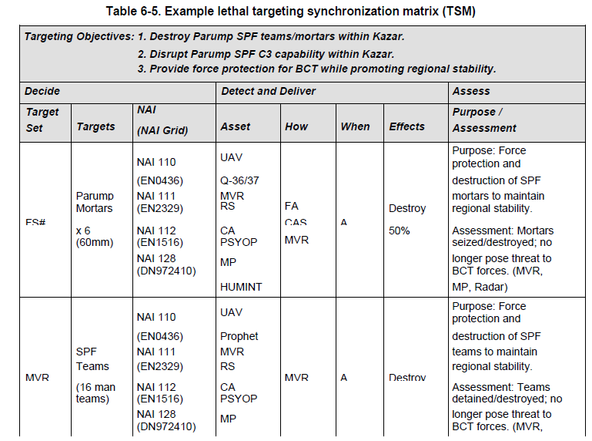
Target Synch Matrix
FM 3-09.42 (Initial Draft Jun 05) pg 6-11
Notes:
A target synchronization matrix visually indicates
The prioritized HPTs.
The HPTs’ known, suspected, or templated locations.
The asset tasked to detect and track each HPT.
The asset or delivery means tasked to attack each HPT.
The desired effects.
Any requirement for assessment and the asset tasked to conduct BDA.

Slide 26
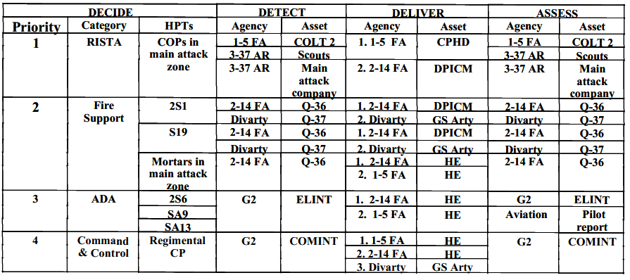
Another Sample Target Synch Matrix
FM 3-09.31, TACTICS, TECHNIQUES, AND PROCEDURES FOR FIRE SUPPORT FOR THE COMBINED ARMS COMMANDER (Oct 02) pg A-6

Slide 27
Sample Target Synch Matrix
FM 6-20-10 TTP for the Targeting Process (May 96) pg C-11

Slide 28
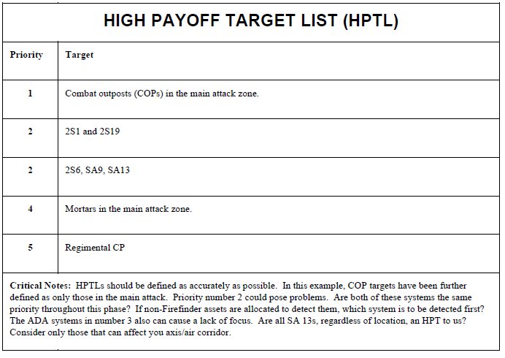
HPTL
FM 3-09.31, TACTICS, TECHNIQUES, AND PROCEDURES FOR FIRE SUPPORT FOR THE COMBINED ARMS COMMANDER (Oct 02) pg A1

Slide 29
Attack Guidance Matrix
Return to Targeting Output
More Information
FM 3-09.42 (Initial Draft Jun 05) pg 6-9

Slide 30
Attack Guidance
The staff recommends and the commander approves attack guidance, distributing it via the attack guidance matrix. The guidance should detail when, how, desired effects, SPINS, and required BDA of the HPTL. The G3 or FSCOORD recommends the attack system for each target. All attack assets, including ground forces, should be considered. The attack should optimize the capabilities of—
Ground and SOF forces.
Helicopters.
Armed UAS.
Indirect fire assets.
Countermobility (aerial and artillery-delivered mines)
CAS and air interdiction
AD artillery
Cruise missiles
EW
PSYOPS
CA
Deception
More Information
FM 3-04.126, pg 2-24

Slide 31
Effects
Target criteria should be given in quantifiable terms. Criteria may be expressed as a percentage of casualties, destroyed elements, time on target (TOT), duration of fires, number of tubes or launchers, allocation or application of assets. Identify accuracy or time constraints, required coordination, limitations on amount or types of ammunition, use of ground forces, and BDA requirements.
How do you quantify “schwack”?
Return to Targeting Output
FM 3-04.126, pg 2-24, 2-25

Slide 32
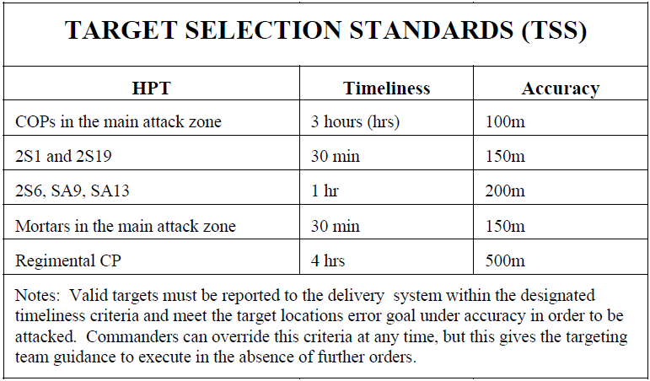
TSS
TLE
FM 3-09.31, TACTICS, TECHNIQUES, AND PROCEDURES FOR FIRE SUPPORT FOR THE COMBINED ARMS COMMANDER (Oct 02) pg A3

Slide 33
Target Location Error
The definition of TLE is the difference between the coordinates generated for a target and the actual location of that target. TLE is expressed primarily in terms of circular and vertical errors, or infrequently, as spherical error.
(2) In order to facilitate the communication of targeting accuracy, TLE is characterized in six categories (CATs). The first row presents the categories of TLE which range from best (CAT 1) to worst (CAT 6) and are used to classify the accuracy of any coordinate generating system. See table 1 below.
FM 3-09.32/MCRP 3-16.6A/NTTP 3-09.2/AFTTP(I) 3-2.6 20 (Dec 2007), pg 11-12
Notes:
7.f.(2)(a) Proper coordinate generation procedures must be followed when stating that a given system is capable of a specific TLE category. In reality, variables such as slant range, altitude, beam divergence of the laser spot, and aim point on the target all have significant effects on the accuracy of the coordinate generated.
(b) Aim point is a significant factor in the TLE of all coordinate generation systems. As an example, Precision Strike Suite for Special Operations Forces is capable of CAT 1 coordinates, but a JTAC may not be able to produce a CAT 1 solution for a vehicle parked in a field that is not adequately depicted in his / her system. Likewise, a fixed-wing aircraft / targeting pod combination may be capable of CAT 2 coordinates, but not able to generate a CAT 2 solution for a target / aim point that is not sensor significant such as a bunker, trench line, or emplacement with overhead cover and concealment.
(3) There are currently no requirements to transmit TLE categories during any CAS transmission, and this data is presented for situational awareness only. If TLE categories are transmitted during a CAS mission, it should be done at the time of coordinate generation, based on the real-time assessment of aircraft TLE capabilities in accordance with (IAW) paragraph 7.f.(2)(a). NOTE: Expect USAF aircrews to communicate TLE category capability upon check-in and whenever target coordinates are generated by the aircrew. This information should be considered a tool that can be used if time/conditions permit in a given tactical situation and is not intended to alter standard procedures for CAS employment.
FM 3-09.32/MCRP 3-16.6A/NTTP 3-09.2/AFTTP(I) 3-2.6 20 (Dec 2007), pg 12

Slide 34
Sample PRIORITIZED TARGET LIST ATO AF 070600 - 080559 “DTG”

Slide 35
CORPS TARGETING BOARD
Purpose: to approve PTLs for next 72 hrs and issue targeting guidance for 96 hrs out
Chaired by: Corps Chief of Staff
Facilitated by: FSE Lead Planner
Attendees: G2, G3, FSE, G2/G3 Plans, IO, SOCOORD, AVN, ENG, ALO, SJA, ADA, ACE, DIV LNOs

Slide 36
Combat Service Support “The Cost of Doing Business”
# Of Aircraft X Burn Rate X Ordinance X MSRs X Cube X Bulk
Surge Operations: 24 / 36 / 72 hour period

Slide 37
Joint Suppression Measures
Plan early, get a package.
Destructive Means
Disruptive Means
Bombs
Artillery
Camouflage
Air and
Surface-
to-Surface
Missiles
Passive
Means:
Emission
Control
Active
Means:
Electronic
Attack
Air
Scatterable
Mines
JP 3-01.4, “JTTP FOR JOINT SUPPRESSION OF ENEMY AIR DEFENSES (J-SEAD)” 19
Notes:
19
19
19
During J-SEAD operations, suppression requirements vary according to mission objectives, system capabilities, and threat complexity. Major employment considerations include overall air defense system architecture, capabilities of system components, geography and terrain, disposition and density of defenses, weather, resupply and repair capabilities, and friendly force organization, training, and equipment. J-SEAD operations can be accomplished through destructive and disruptive means and using sound combinations of the two can maximize their effectiveness.
Destructive means seek the destruction of the target system or operating personnel. The effects are cumulative and increase aircraft survivability, but destructive means may place large demands on the available combat capabilities and/or forces. Examples of destructive SEAD capabilities are bombs, air and surface-to-surface missiles, air scatterable mines, and artillery.
Disruptive means temporarily deny, degrade, deceive, delay, or neutralize enemy air defense systems to increase aircraft survivability. Disruptive means may be either active, such as electronic attacks or passive, such as emissions control and camouflage.
Joint air operations may require support for suppression of enemy air defenses from resources other than aircraft. The JFC may direct components to support joint air operations with assets, capabilities, or forces, in addition to the air capabilities and/or forces provided. Some measures a commander may request include reconnaissance and target-acquisition support and EW.
Deception can support SEAD activities by causing confusion for the enemy as to the location and/or timing of friendly air operations. Electronic deception can be especially effective when the enemy is attempting to conduct air operations in the vicinity of their own air defenses. In this situation, electronic degradation of enemy identification friend or foe can create a dilemma for the enemy by forcing them to choose between increased risk of fratricide and imposing restrictions on their own air operations. In either case, enemy operations are degraded. As an economy of force action, drones, decoys, and unmanned aerial vehicles, as well as manipulative, simulative, and imitative communications or actions, should be used wherever suitable. JP 3-01.4, Chapter I, para 4

Slide 38
Lessons Learned: Planning Considerations by WFF

Slide 39
Intelligence
Determine how terrain and weather impact deep operations. Weather and terrain affect not only the enemy's movement but our ability to detect, deliver, and assess as well. No one staff section or system can provide all the answers. The staff must work as a team and also consult higher headquarters. The Staff Weather Officer (SWO) plays a vital role and must be included. Automated systems like Terrabase and the Aviation Mission Planning Station (AMPS) are valuable assets for terrain analysis. A topographical analysis detachment, if available, can also provide information.
The G2 section, by determining enemy intentions and decision points, greatly influences the deep operations planning process. Wargaming does not end with publication of the OPORD though. It is a continuous process, the results of which the G2 or his representative will brief daily during targeting meetings.
INTSUMs an INTREPs are vital to the targeting process. Intelligence staff members must constantly stay abreast of current INTSUMs and INTREPs and provide pertinent information to the targeting meetings. Interdiction attacks are inherently high risk. The commander must have all available intelligence when weighing the risk versus payoff. Intelligence sections should not wait for higher to push information to them - ask for it often! Likewise, higher headquarters should make every effort to be aware of subordinate information requirements and feed reports as quickly as possible.
The intelligence section must answer the commander's BDA requirements. Accurate interpretation of BDA data will influence the decision to re-attack and/or may adversely impact the close fight. Fulfilling BDA requirements is more than just reporting the number of systems destroyed. The G2 must analyze the data (numbers, types, and location) to determine if the correct target was attacked and what its current disposition is. The key is assessment.
Staffs must conduct continuous IPB to support the targeting process. Targeting planning sometimes diverges from G2 and G3 planning. If the G2 planner and the ACE do not coordinate, the Target Working Group (TWG) and Plans may end up working with two different intelligence estimates. Similarly, if the G3 Plans and TWG do not coordinate, their efforts will be unsynchronized.

Slide 40
Movement and Maneuver
Synchronize with division, corps, and the joint headquarters. The targeting board must be clear on which targets they need to strike and which targets their higher headquarters is attacking. Liaison between headquarters is critical. Close coordination between headquarters prevents duplication of effort and airspace conflicts. Also, Target Working Group (TWG) planners must have current graphics. Automated systems can help deconflict graphics between headquarters, but transmission may be unacceptably slow due to limited communications infrastructure.
Avoid predictable attack battle rhythm. This refers to conducting attacks at the same time repeatedly. Use of multiple attack helicopter battalions, if available, allows the commander flexibility to attack at various times or in multiple locations at the same time. Planners should also consider daylight attacks (keeping in mind the increased risk).
The TWG needs to keep abreast of the close fight. It may be necessary at times to cancel or divert an interdiction attack in order to assist in the close fight. The overall goal of interdiction is to support the commander's scheme of maneuver - if that scheme is better supported at the FLOT than beyond it then so be it.

Slide 41
Army Aviation
Engagement areas and battle positions versus zone of attack. The traditional control measures for deep attacks are battle positions and engagement areas. These restrictive control measures greatly facilitate deconfliction of fires and airspace. Though not doctrinal, some units have used zones of attack instead. This method is particularly useful when the target is moving or is spread across a large area. The downside is the additional difficulty in deconflicting fires and airspace.

Slide 42
Engagement Area vs. Zone of ATK
LOA
EA SHARK
Targets
PL BLUE
PL RED
Company battle positions and an engagement area.
Attack battalion entering zone of attack.

Slide 43
Attack Employment Methods
CONTINUOUS ATTACK METHOD To exert constant pressure on the enemy force. This method ensures at least one ARC will be in the battle at all times. While one company is engaged in the battle, the other two companies prepare to relieve the engaged company by positioning at the HA or FARP, or maneuvering to the BP or ABF. The continuous attack method provides the commander with the most flexibility as well as the most efficient operation of the FARP.
PHASED ATTACK To exert increased initial firepower of the battalion on the enemy force, the battalion commander employs one ARC to begin attacking the enemy and then quickly phases in the second ARC from a different BP or ABF. The third ARC is phased into the fight when either of the other companies is low on fuel or ammunition. The commander may choose to modify this method of employment, for example, one ARC may be employed to set the conditions for the other companies to exploit the attack. During the phased attack, it is important to minimize aircraft turnaround time at the FARP. Generally, due to the FARP limitations, the phased attack will eventually revert to the continuous attack method.
MAXIMUM DESTRUCTION To exert maximum combat power on the enemy force, the battalion commander will employ the maximum destruction method. To overwhelm the enemy force with massed fires, the battalion will attack with all three companies simultaneously. While employing this method, it is important for the supported commander to understand the entire battalion may be out of the fight for 20 to 90 minutes at the completion of the initial attack. The time away from the fight will be dependent on the distance to the FARP and time required for refueling and rearming after the initial engagement.

Slide 44
Target Location Error (TLE)
For aviation TLE should be based on the ability of the pilot to find the target. This will depend on weather, terrain, enemy activity (ie, moving or stationary), and the type of target (armor, artillery, etc). So for aviation, TLE is going to change based on the conditions - it should be a commander's call based on thorough IPB and knowledge of the aviation unit. It is a subjective call that should be incorporated with discipline into the D³A methodology and incorporated into a go-no go decision for each mission. Too often, units begin the go/no go brief with poor intelligence on the target, and because they don't have a disciplined approach, end up launching on what can be called a 'deep movement to contact' - greatly increasing risk and reducing chances for success.

Slide 45
Dwell time
Enemy units have known doctrinal times established for survivability moves, refuel stops, etc. Applying this information (target selection standard) into the planning process and at the go/no go decision can greatly improve the discipline and success rate of deep missions. Planners should ask the question, “What is the established dwell time for the type of target?”, then ask, “How current is the last position report of the target?” This will help prevent sending aviation units (or indirect fires) after a target that is no longer there.
Bypass Criteria
Deep attack orders for attack helicopter units should include bypass criteria. Executing units should know what to do if they encounter other high payoff targets enroute to or from the primary target.

Slide 46
Personnel Recovery
In-depth planning guidance may be found in the FM 3-50.1. Some basic elements to consider are—
The primary mission continues parallel to the recovery effort.
The goal is recovery of the isolated, missing, detained, captured (IMDC) person.
Plan a system that enforces accurate reporting.
Ensure the system provides for accurate record keeping without degrading the PR effort.
Prevent the IMDC event.
Prepare for the IMDC event.
Design the PR architecture within the C2 system.
Organize, train, and equip for PR.
Integrate contractor and DA civilians into OPLAN/OPORD.
Transition the PR capability (IMDC events may occur early in the deployment).
Plan for integrated rehearsals.
Employ the recovery force based on METT-TC.
Develop the plan from receipt of the report to reintegration of the IMDC.
FM 3-04.111 (7 December 2007) pg C-2

Slide 47
Synchronize and Deconflict Fires
Since no plan survives the first contact, staff should expect the need to deconflict fires "on the fly". Several techniques are useful in doing this. Fire support coordination measures and airspace control measures should facilitate the expected and the unexpected. These should encompass alternate routes, engagement areas, and the accompanying SEAD target sets. The staff should have automated as well as alternate voice means of turning control measures on and off as needed. Additionally, the deeper an attack goes, the more difficult it becomes to maintain communications. Planners should consider sources available to relay transmissions (ABCCC, JSTARS, AWACS, E-2C, etc.)

Slide 48
Airspace Command and Control
Integrating Army airspace requirements into the joint community is difficult and confusing for the uninitiated. Planning for contingencies well in advance can make airspace deconfliction much smoother and more flexible. Most units plan multiple routes, ROZs, and airspace coordination areas (ACAs) and submit them to higher well before their expected or planned use. This allows the A²C² cell the ability to rapidly "turn on" a new route or open airspace for the close fight if the situations changes suddenly.

Slide 49
JOINT AIR ATTACK TEAM
A JAAT is an engagement technique using a combination of attack reconnaissance aircraft and FW CAS aircraft operating together to locate and attack high priority targets and other targets of opportunity. The JAAT normally operates as a coordinated effort supported by FS, ADA, NSFS, ISR systems, EW systems, and ground maneuver forces against enemy forces (JP 3-09.3). The overall goal of JAAT planning is to apply constant, overwhelming firepower from multiple sources against the enemy. This goal must be tempered with the need to maintain proper coordination to avoid fratricide.
Appendix C of FM 3-04.126 provides detailed procedures for JAAT planning and execution.

Slide 50
Fire Support
Know the capabilities of Joint SEAD and use it. These assets may sometimes mean the difference between GO or NO GO or between success and failure. Not all assets deliver lethal SEAD, but nonlethal attack may be just as effective.
Establish a cutoff time for SEAD planning to allow for dissemination, rehearsal and execution. Cutoff time is normally between H-3 and H-2. If it includes a rehearsal, then H-4 (TTP, not doctrine).
Incorporate templated targets and ADA associated with known maneuver units along ingress and egress routes.
Be ready for last minute targeting and targets of opportunity. No SEAD plan will be 100% accurate. Planners anticipate last minute targets by establishing "pre-cleared" fires using the appropriate fire support coordination measures in conjunction with airspace coordination measures. In other words, if the friendlies are within specified boundaries, anything that pops up outside of those boundaries is fair game. Fire supporters should also establish a quickfire net for rapid sensor-to-shooter calls for fire.

Slide 51
Mobility/Countermobility/Survivability
Don't forget to include enemy engineer systems on the HPTL when warranted. The division or corps engineer planner plays a vital role during the targeting process. With his knowledge of engineer capabilities he can help the G3 and commander determine which enemy assets are high payoff targets and when.
Don't put GATOR mines on the ATO just to check the block. Every deep operation, whether it's an AH-64 attack or air delivered mines, must support the commander's scheme of maneuver. GATOR mines, when planned appropriately, may be a valuable tool to shape the battlefield to support the scheme of maneuver.

Slide 52
Command and Control
The Joint Force Commander's battle rhythm drives the ATO cycle. When working in a joint environment, interdiction attack planning must be synchronized with the higher headquarters and sister services. When it comes to interdiction operations the ATO is the key to synchronization. It may be difficult for Army planners to understand at first, but it provides the best means for synchronization of effort and deconfliction of airspace. As such, Army planners must ensure their requests and submissions are in cycle with the theater ATO.

Slide 53
“The Higher HQ Responsibilities”
Prioritize! (HPTL, PIR = Decide)
Develop and execute a collection plan (Detect)
Articulate TASK and PURPOSE and
Clearly describe the desired EFFECTS
Establish bypass, engagement, and success criteria
Provide & synch resources and supporting units (INTEL, FS, JSEAD, CAS, III/V, etc)
Establish trigger (Decision Point tied to PIR & FFIR) [Go / No-Go]
Plan for BDA (Assess)

Slide 54
Sample GO/NO-GO CRITERIA
O
AVN
•
CORPS APPROVED ROUTES
•
MISSILE/TARGET LAYDOWN
•
HELO/PILOT STATUS
G2
FSE
•
JSEAD PLANNED & REHEARSED
•
SUCCESS CRITERIA
VALIDATION/TRACK OF TGT
•
•
•
TIME TO RE-LOAD IF
ADA VALIDATION ALONG ROUTE
NECESSARY
•
•
ALL FS ASSETS INTEGRATED
ACQUISITON ASSETS FOR BDA
•
ALL FSCMs ESTABLISHED
G3
EW
•
IA SYNCHRONIZED WITH
Approval
Authority
“GO/NOGO”
CURRENT AND FUTURE
•
EW COVERAGE STATUS
CLOSE FIGHTS
•
DEADSPACE
•
CORPS AND DIV ATKs ARE
MUTUALLY SUPPORTING
SOCOORD/LRSCOORD
FIRES BRIGADE
•
TGT AREA CLEAR OF SOF
•
STATUS OF SEAD FIRE PLAN
PR
•
SOF EYES ON / BDA AVAILABILITY
•
STATUS OF ATACMS FIRING UNIT
WEATHER
ENEMY SITUATION
FRIENDLY ASSETS
DAY VS NIGHT
CROSS - FLOT
AMMO STATUS
•
SWO
AC2
•
WEATHER UPDATE
AIRSPACE DECONFLICTION
•
•
EFFECTS ON
FOR HELOS & MISSILES
FRIENDLY/ENEMY

Slide 55
Time Required
Battalion Deliberate Attack: 16-20 hours from receipt of mission (ARTEP 1-126-MTP (Mar 06))
Applying ¹/₃ – ²/₃ rule equates to 24-30 hours from higher HQ
Time varies depending on complexity
Getting a tailored support package from the JFACC (on the ATO) requires time and or command involvement (prioritization)
Fast aircraft ≠ fast plans

Slide 56
As We Get Closer to LD…
“The Domino Effect”
Flexibility in planning does not translate to flexibility in execution.
Risk
To Self
To Synchronization
LD
Changes to the Plan

Slide 57
The “911” Call
Oh, crap! Where’d that come from?
Risk
To Self
To Synchronization
LD
Changes to the Plan
Notes:
LTG Bell - Given the scenario that I just described, how do we assess risk as we make last minute changes such as I described before.
MAJ Fisher - What do we take away from the executing unit when we make these last minute changes?

Slide 58
Notional Interdiction Attack Scenario

