Slide 1
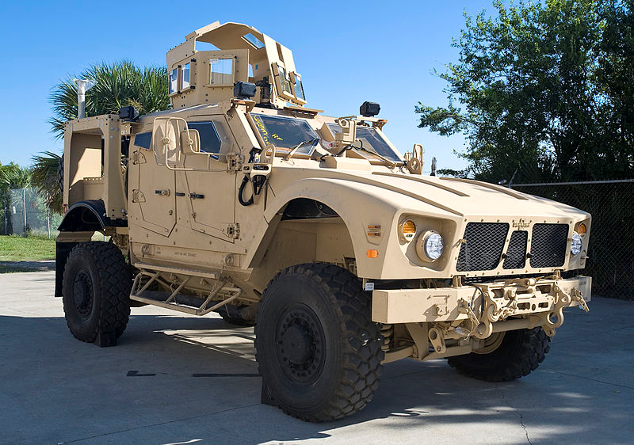
INTEGRATED PLAYER UNIT
INSTALLATION GUIDE
FOR THE MATV PLATFORM AT THE
DIGITAL MULTI-PURPOSE
RANGE COMPLEX
FORT RILEY, KS
(August 2011)

Slide 2
MATV PRE-INSTALLATION CREW ACTIONS
CLEAR EXCESS MILITARY GEAR FROM THE FLOOR AND SEATS AROUND THE DRIVER, CO-DRIVER/GUNNER AND OTHER PASSENGER POSITIONS.
DURING THE INITIAL INSTALLATION PROCESS, ALL POWER TO THE VEHICLE MUST BE TURNED OFF.
Once the initial installation has been completed, any vehicle returning to the Install Pad for maintenance, batteries, etc., should have the radios on and operational.

Slide 3
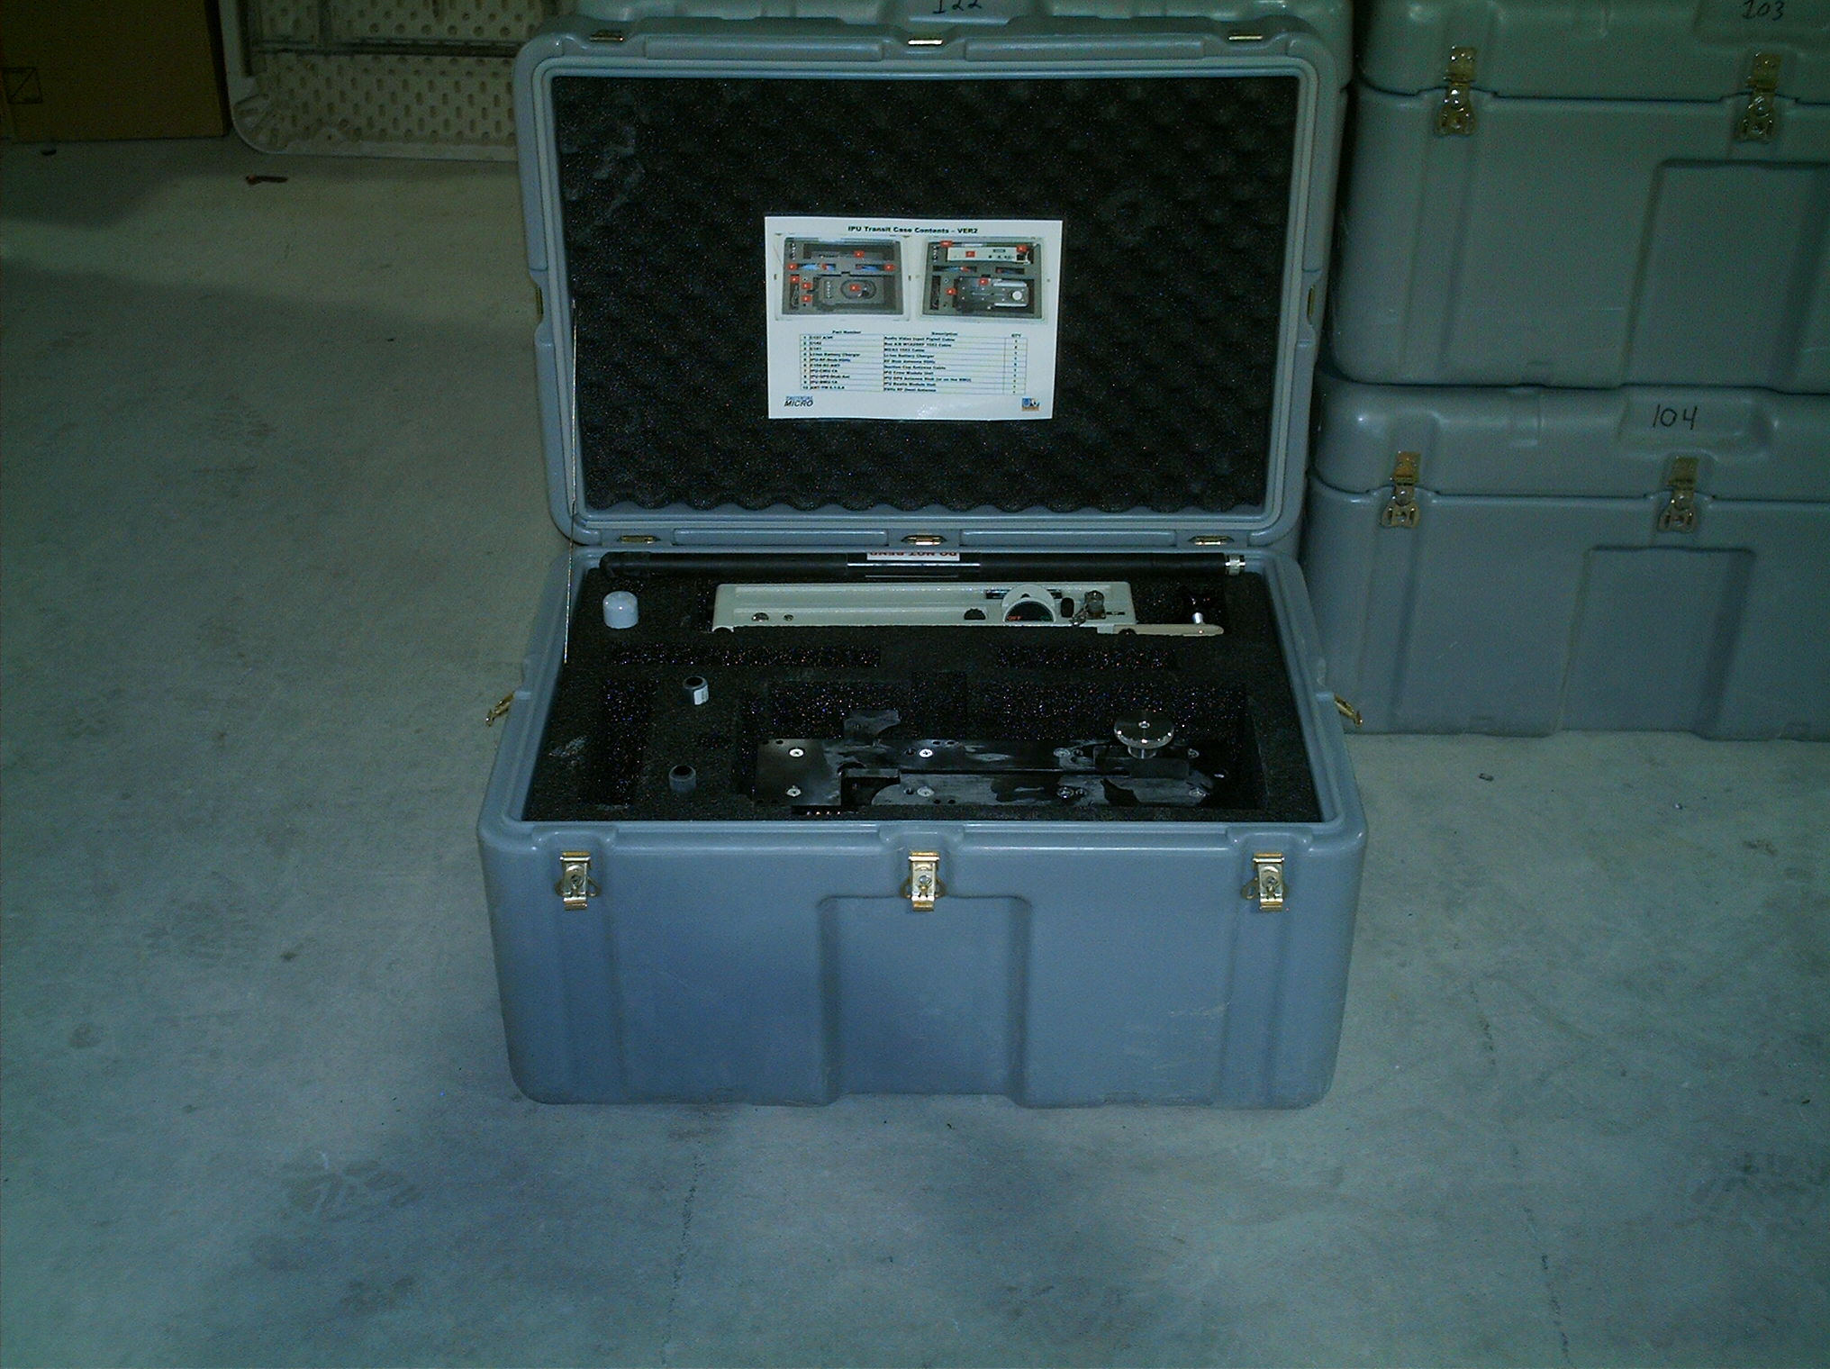

GRAY TRAVEL CASE FOR THE BUSTLE AND CREW MODULES FOR THE INTEGRATED PLAYER UNIT

Slide 4
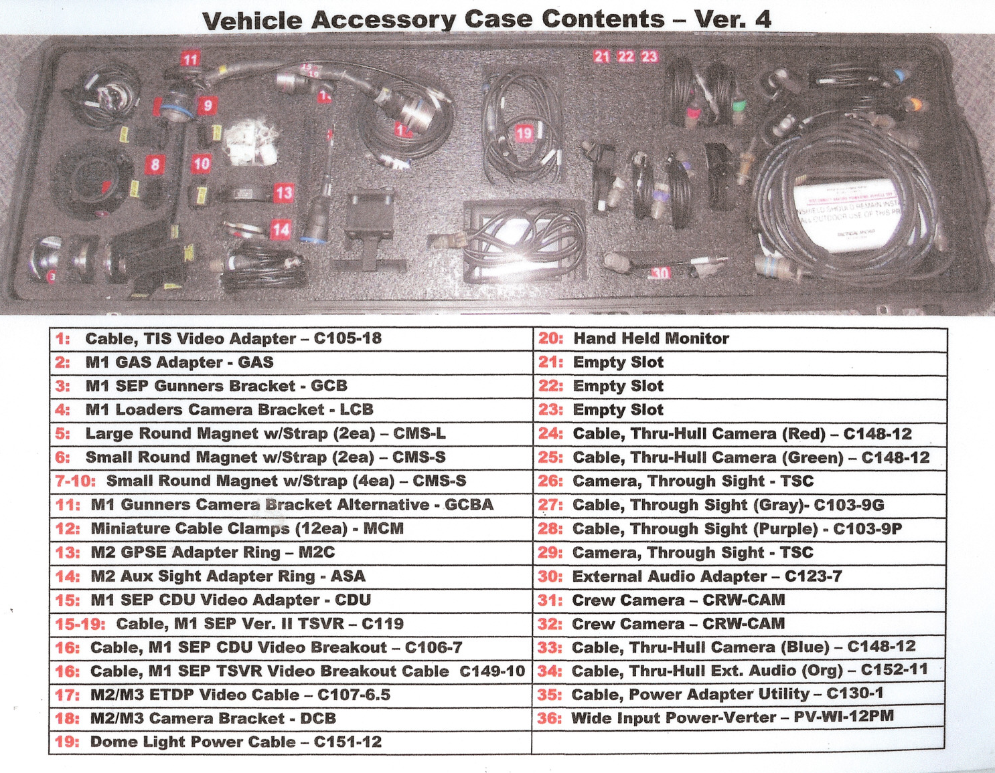
The black travel case houses various cables, connectors, cameras and mounting hardware for the IPU. The contents of the case are listed inside on the lid.

Slide 5
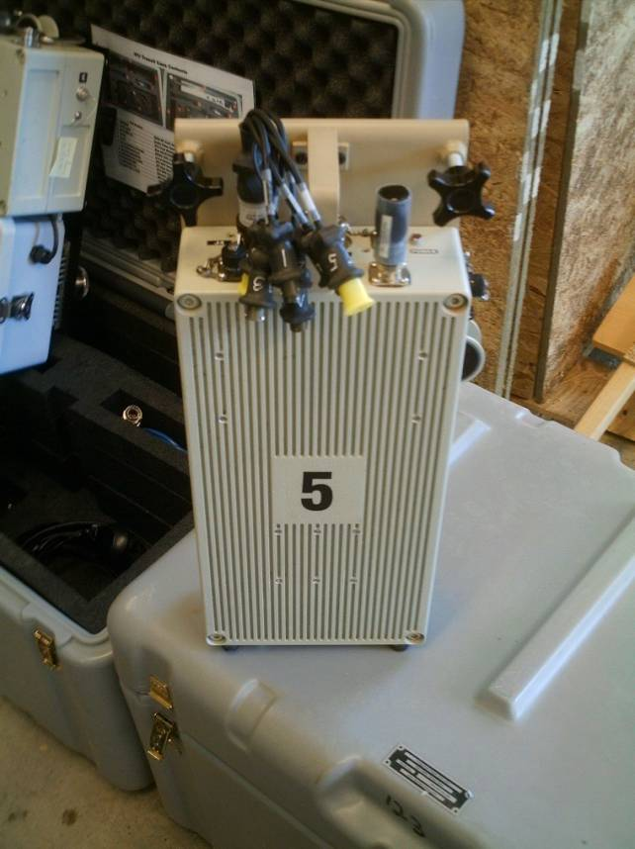
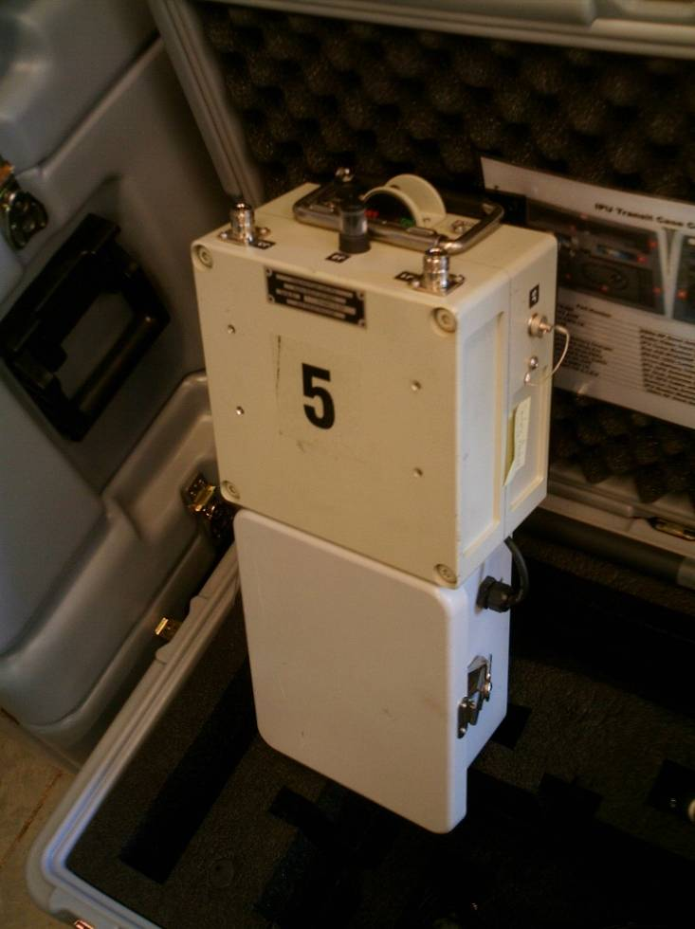
The Integrated Player Unit (IPU) consists of two main components. The Crew Module Unit (CMU) replaces the A/V Breakout Box, A/V Interconnect Cable, BIM and the Vehicle Power Supply box. It is designed to receive the Audio and Video input as well as the 1553 data from the vehicle and wirelessly transfer it to the Bustle Mounted Unit (BMU). The MATV does not use the 1553 Data Cable. The BMU provides GPS tracking and sends data to the Tower via access points/nodes and relay points.
CMU
BMU

Slide 6
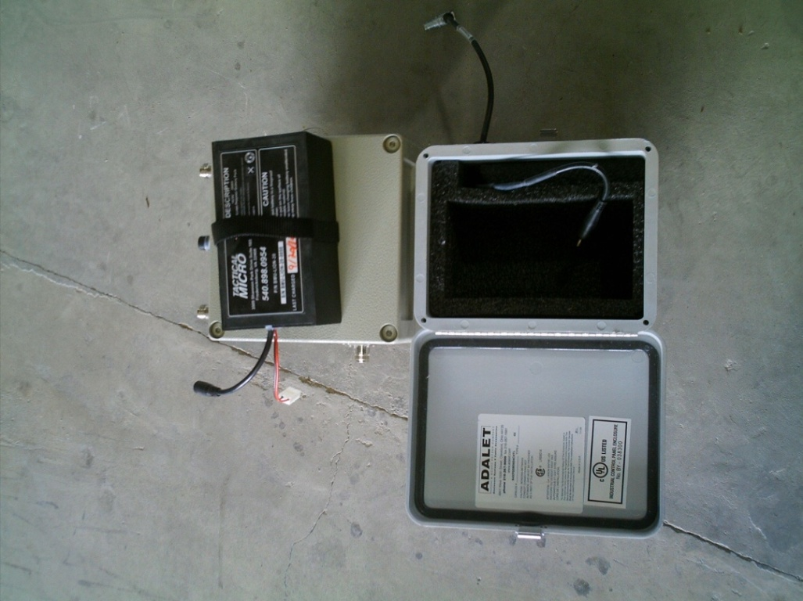
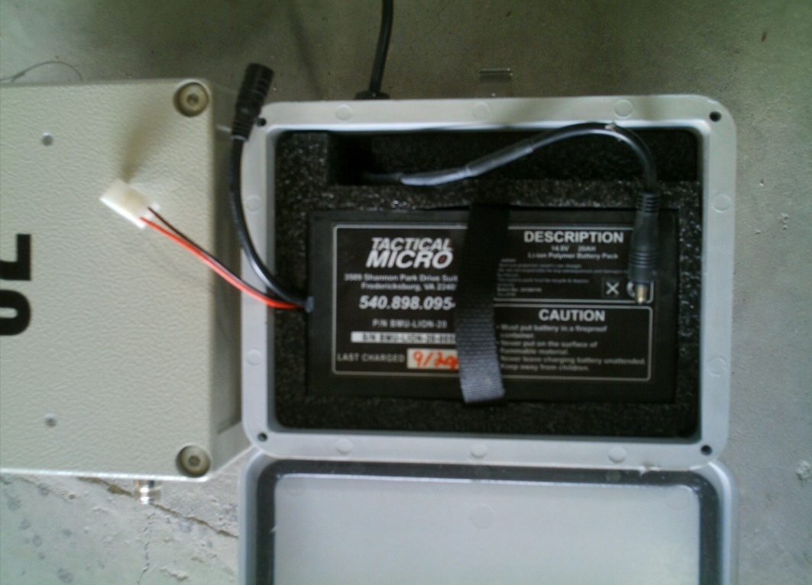
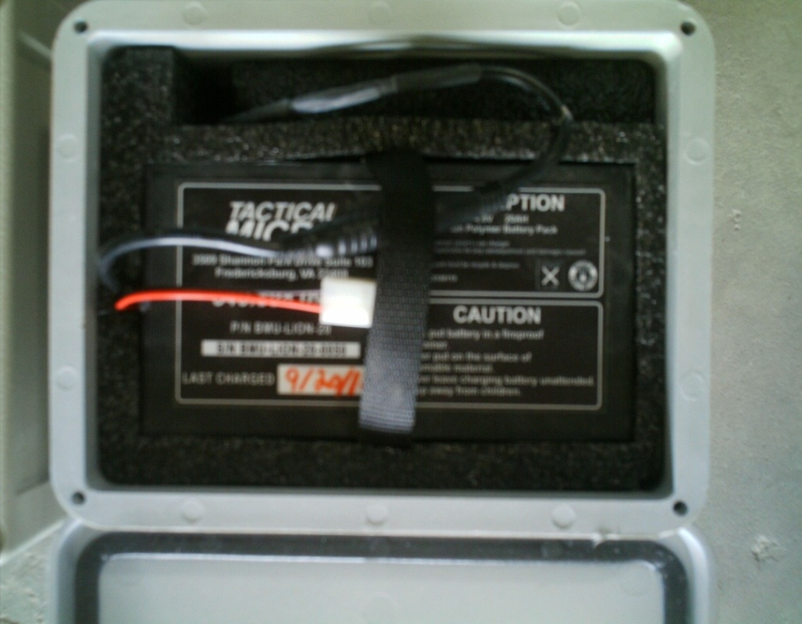
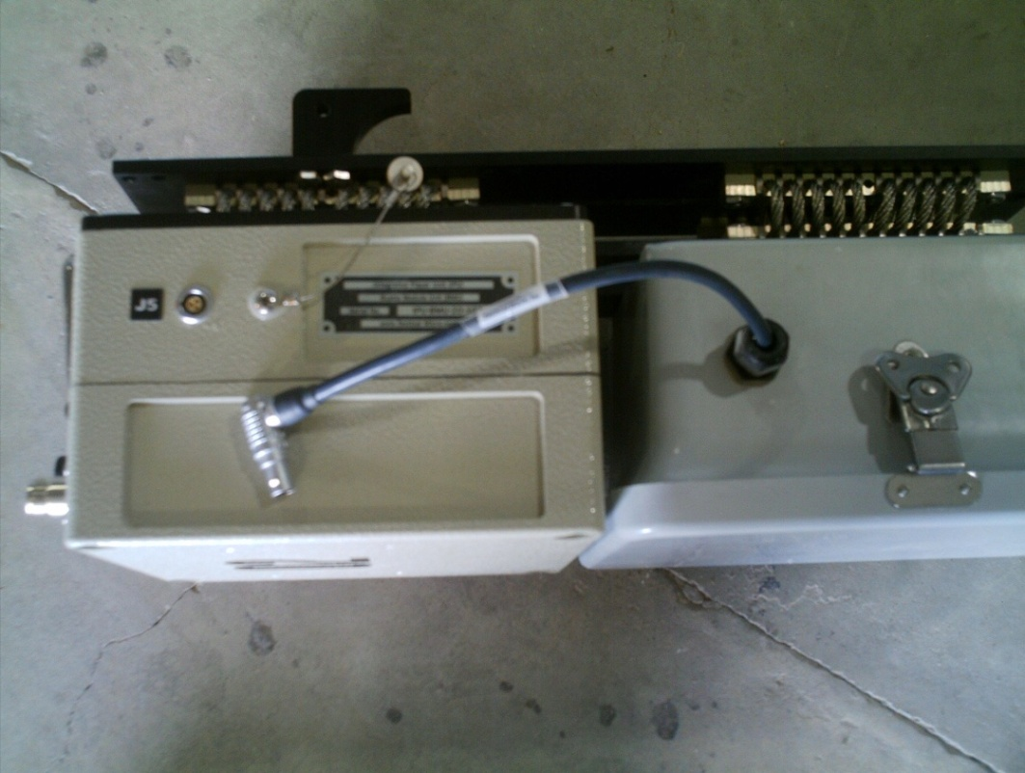
The BMU is powered by a 14.8V LI-ION Battery Pack
CAUTION: THE CABLE TO THE J5 PORT SHOULD BE DISCONNECTED WHEN NOT IN USE OR IN THE STORAGE CASE.

Slide 7
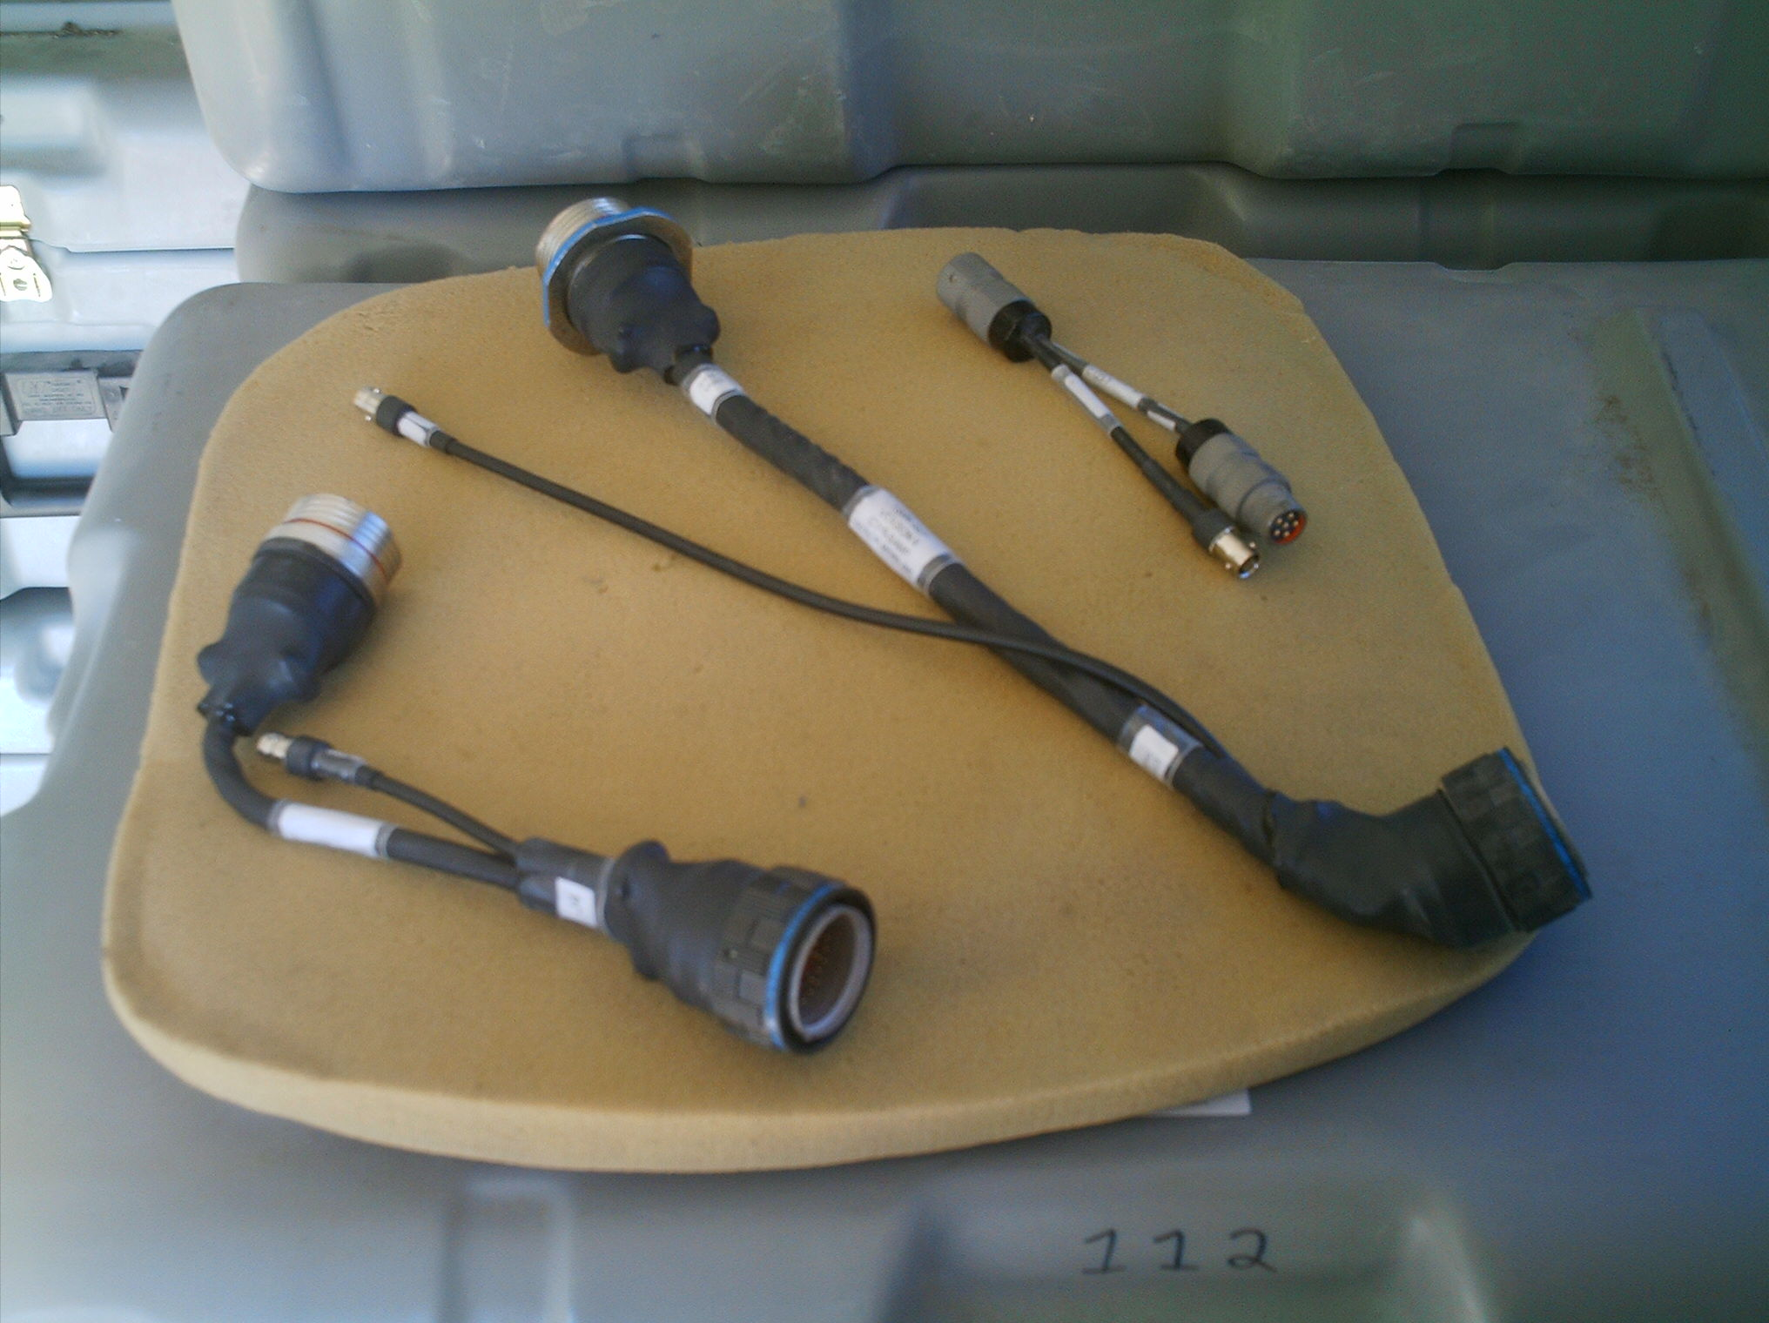
Left to right: CDU Adapter (new model), TSVR V2, and External Audio Adapter

Slide 8
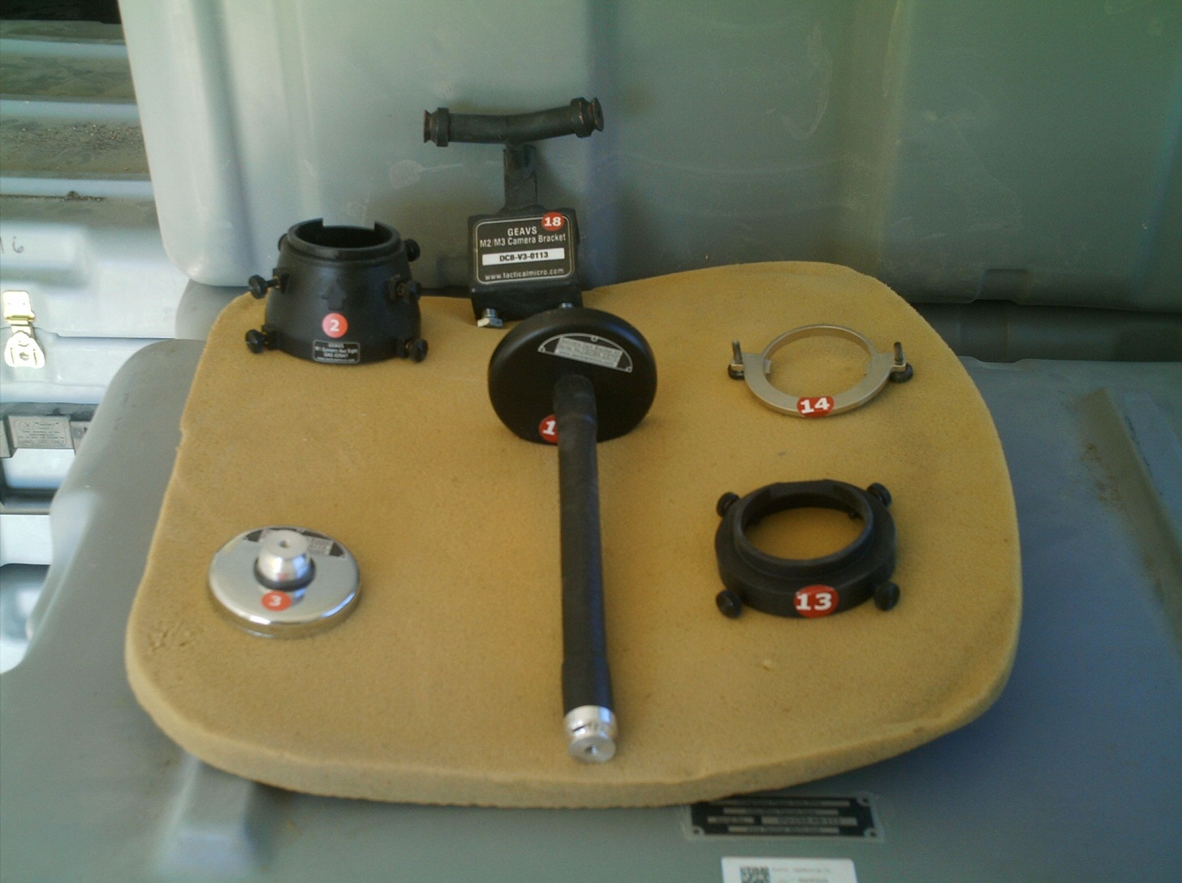
C
E
A
B
D
F
A- M1 GAS Adapter for Gunner’s Through Sight B – M1 Crew Camera Loader’s Mounting Bracket C – M2/3Crew Camera Mount for Gunner and Commander’s Cameras D – M1 Gunner’s Camera Bracket Alternative E – M2/3 GAS Adapter for the Commander’s Auxiliary Through Sight F – M2 GPSE Mounting bracket for use on the M2 ODS (*Item B and D are the only mounts that are used on the MATV)

Slide 9
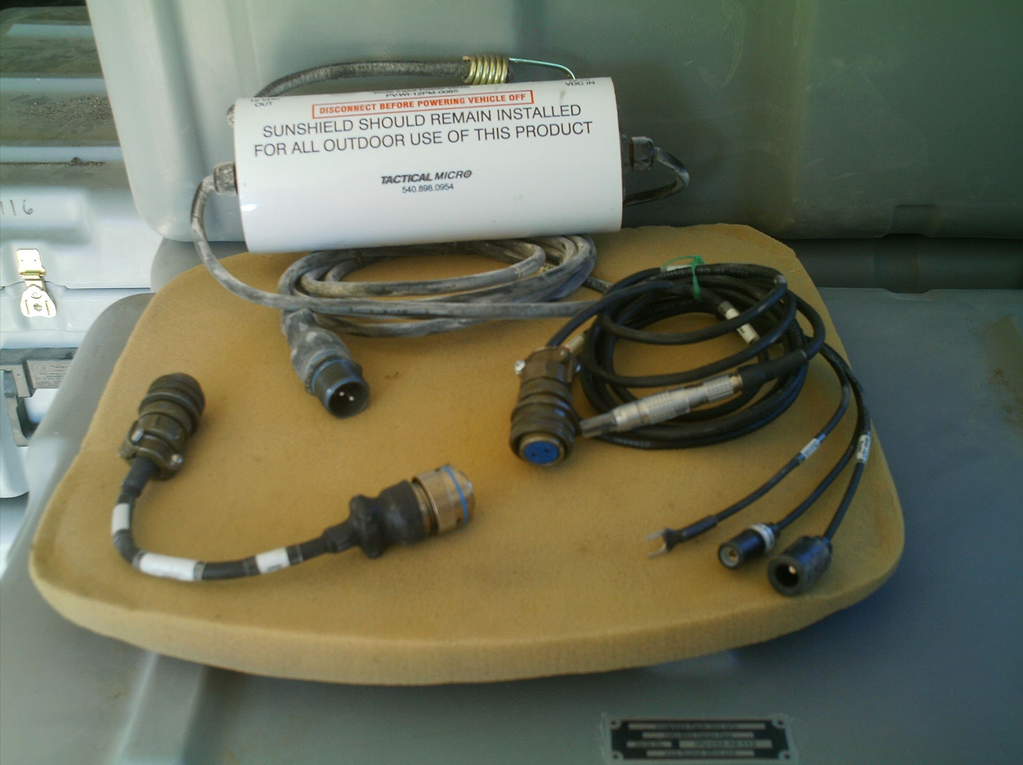
A
C
B
A - Voltage Regulator (Power-Verter) used with all IPU platforms
B – M1 Power Adapter
C – M2/3 Power Adapter & MATV

Slide 10
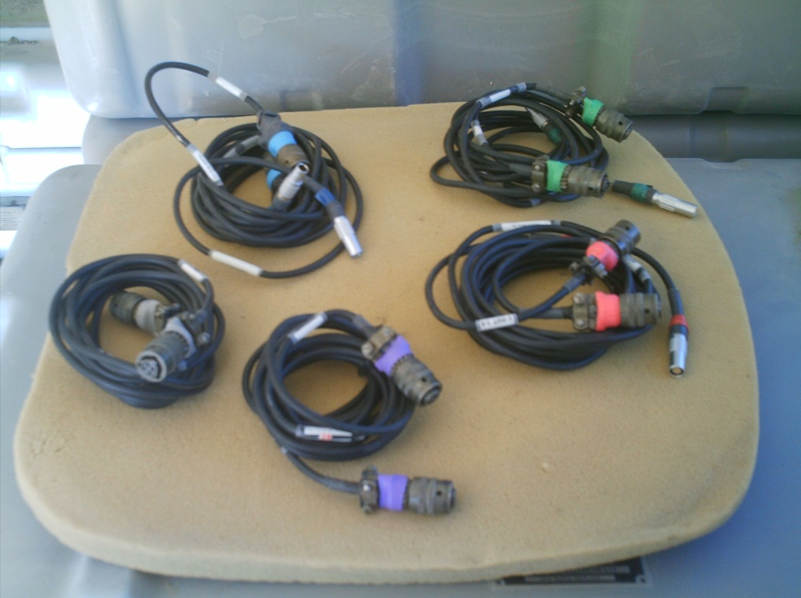
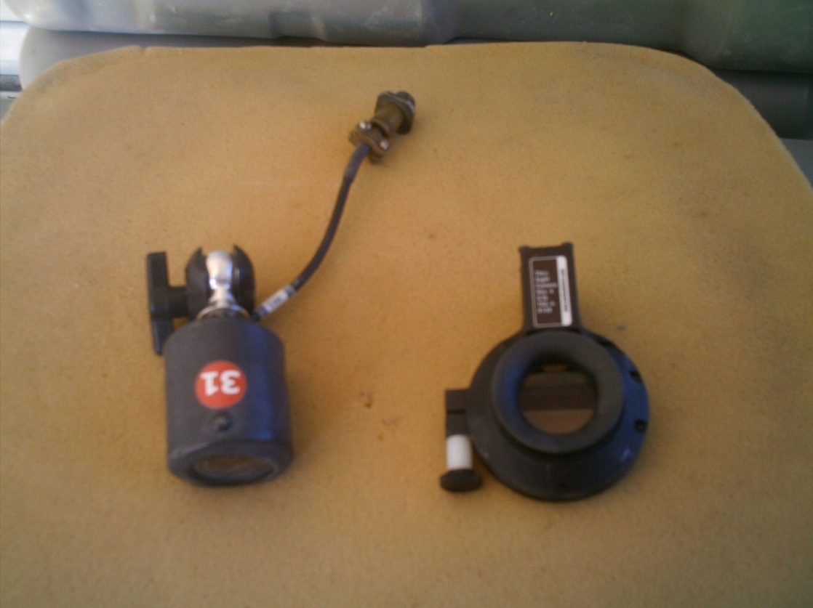
Five color coded camera cables are in each VAB.
Shown are The Crew and Through Sight Cameras. The Through Sight Cameras are not used on the MATV, only 1 Crew Sight Camera is used.
Crew
Through Sight

Slide 11
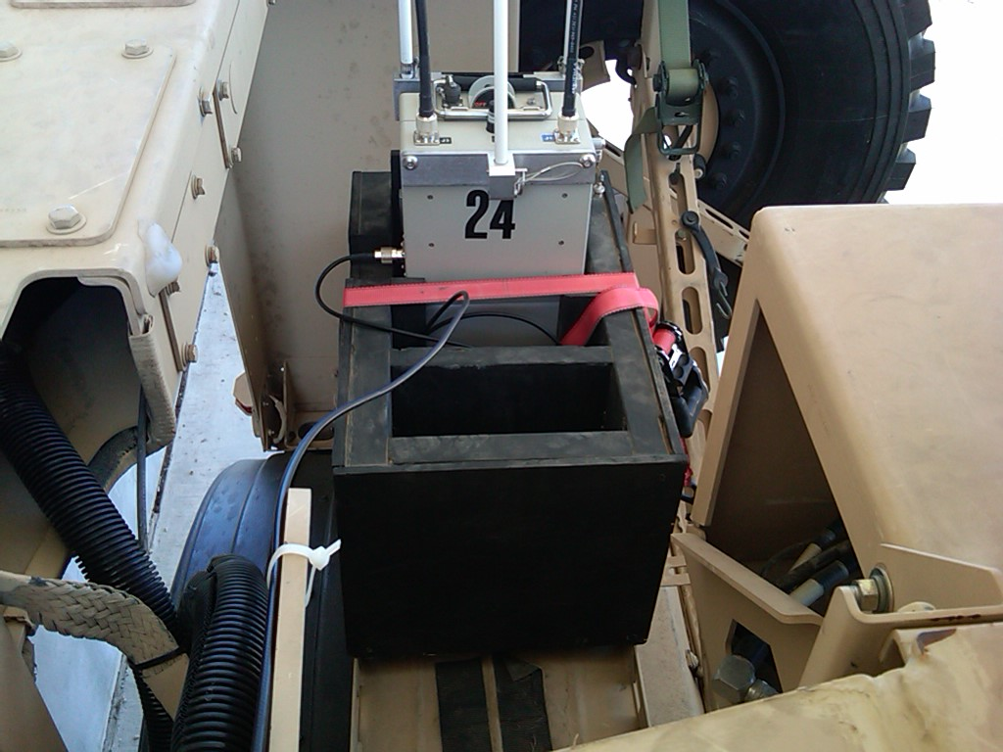
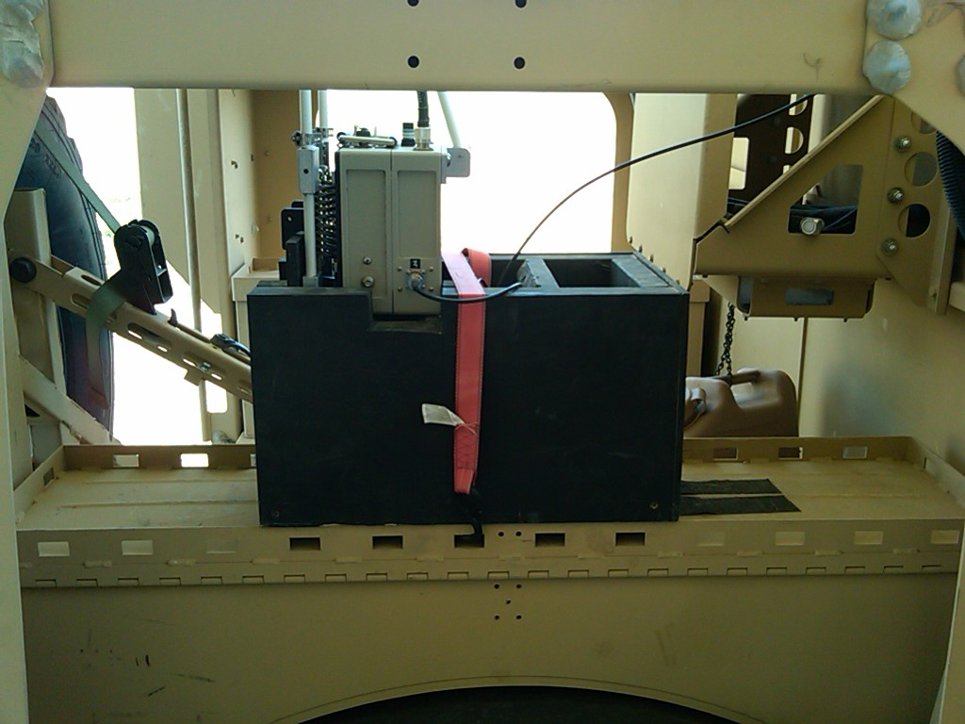
The BMU is installed on top, the right side of the MATV above the tire. These views show the BMU placed inside a wooden box that was designed by the Tech Dept at the DMPRC.

Slide 12
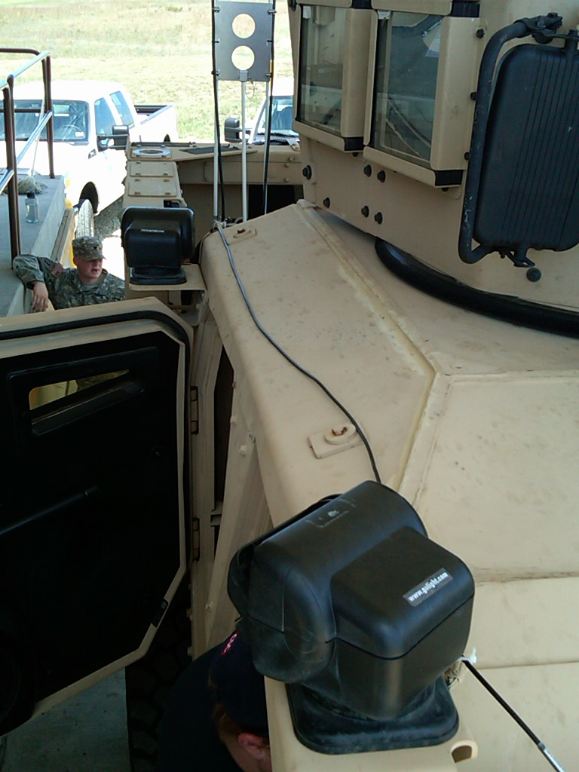
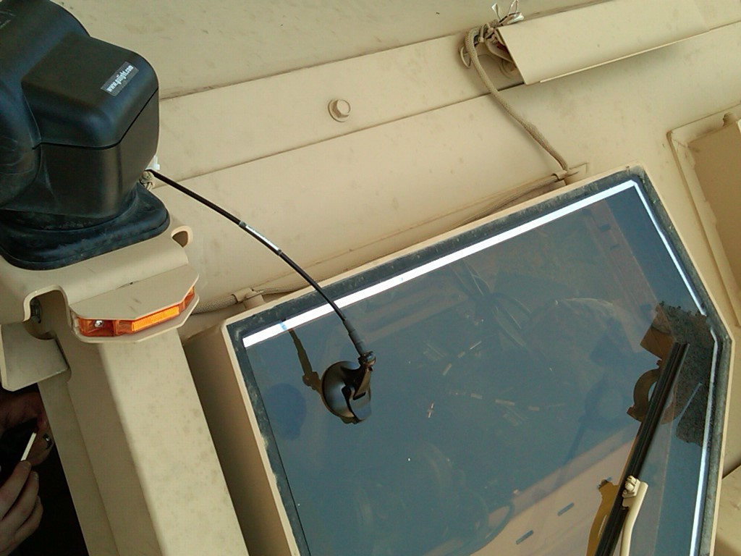
The optional antenna assembly is attached to the windshield, on the Co-Driver side using the suction cup attachment. The cable is run down the right side/top of the vehicle to the BMU J4 Port. (The Suction Cup sticks better if moistened before attaching)

Slide 13
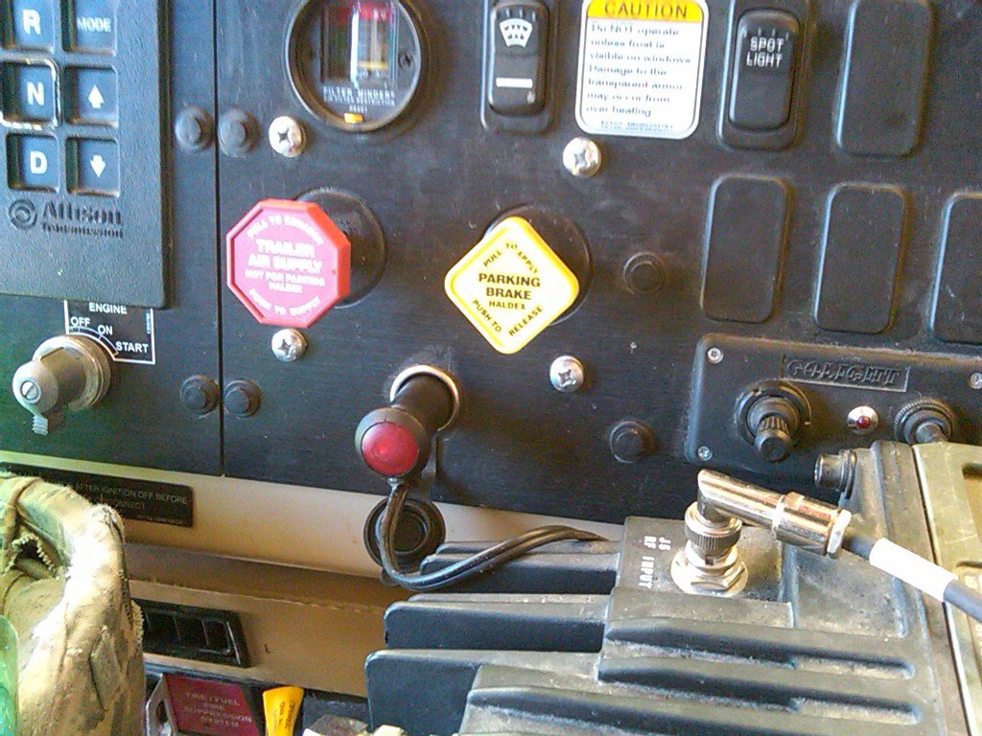
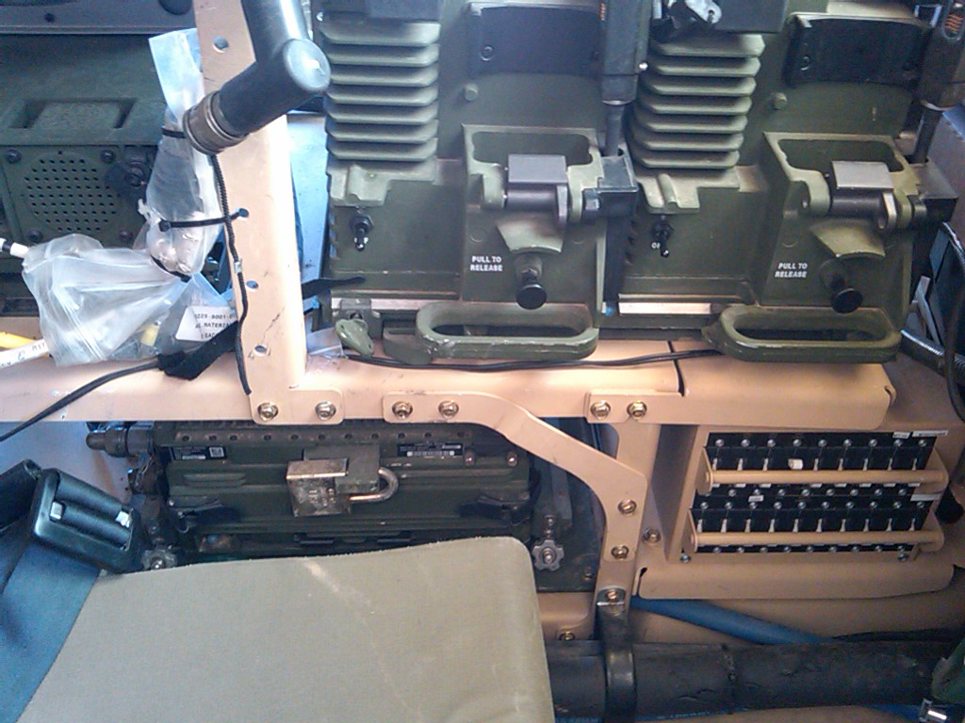
Power is supplied to the CMU using the Power Adapter Cable and the Voltage Regulator (Power-Verter) used with all IPU platforms. The Power Adapter Cable is plugged into the vehicles power port located on the dash board. The power cable is then ran below the vehicles radio mount and to the CMU located in the right side rear seat.

Slide 14
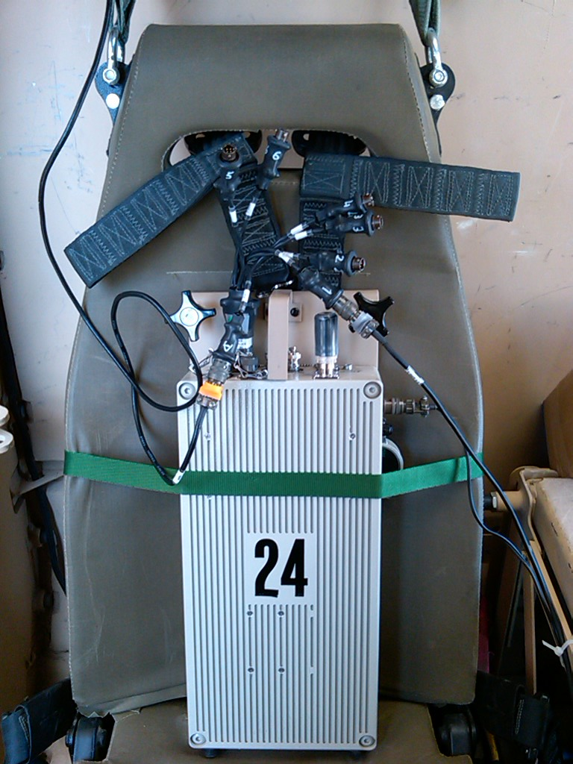
The Power Adapter Cable is to the CMU and connects into the J-1 Port on the located just behind the 5GHz Antenna.

Slide 15
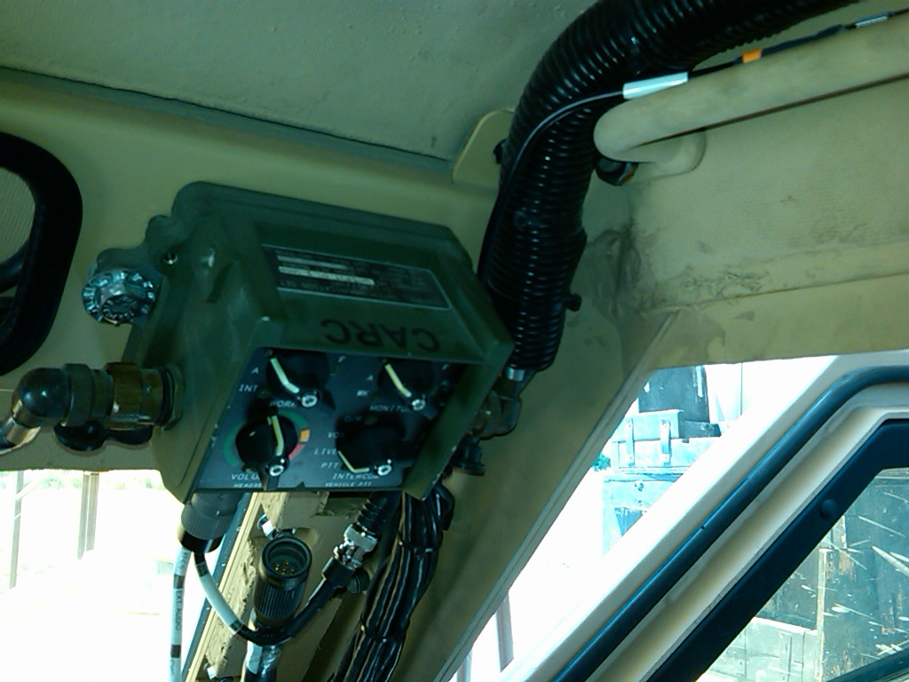
A
The External Audio Adapter (EAA) (A) attaches to the FFCS located in the front of the Co-Driver. The crews headset audio cable then connects to our EAA Cable.

Slide 16
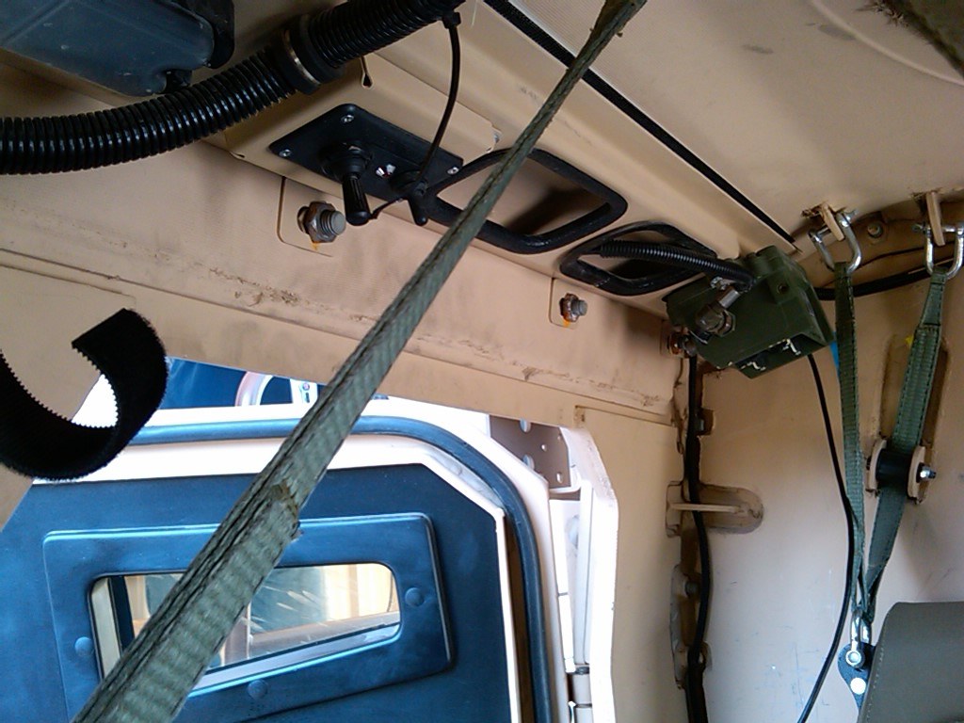
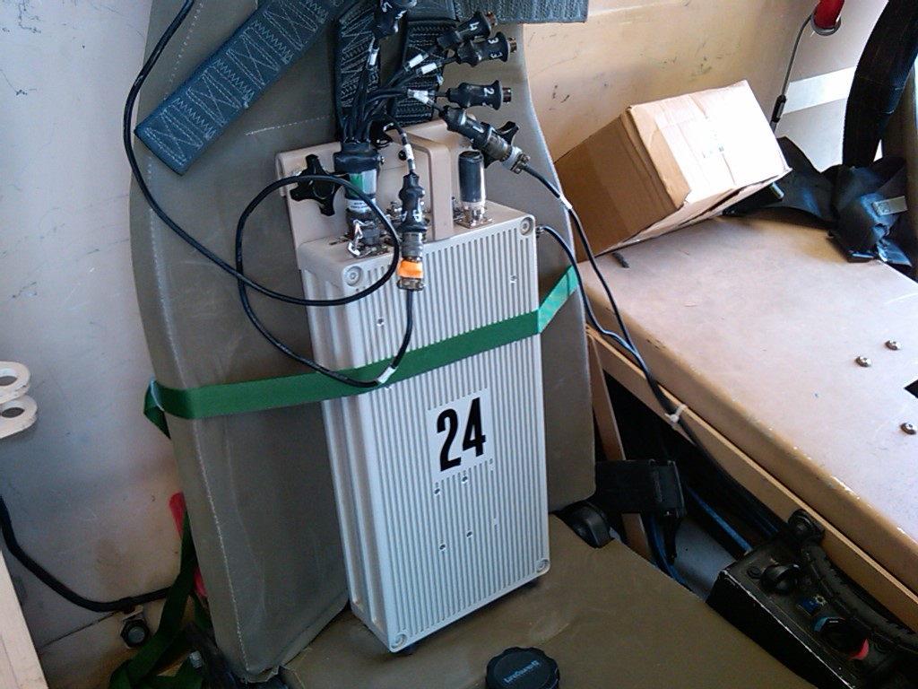
A
B
C
The External Audio Adapter (EAA) (A) attaches to the FFCS located in the front of the Co-Driver. The Audio cable is then ran above the door, and under the Vel-cro Plate on the upper right side of vehicle (B). It then comes down and attaches to the audio port on the Octopus Cable attached to the CMU (C).

Slide 17
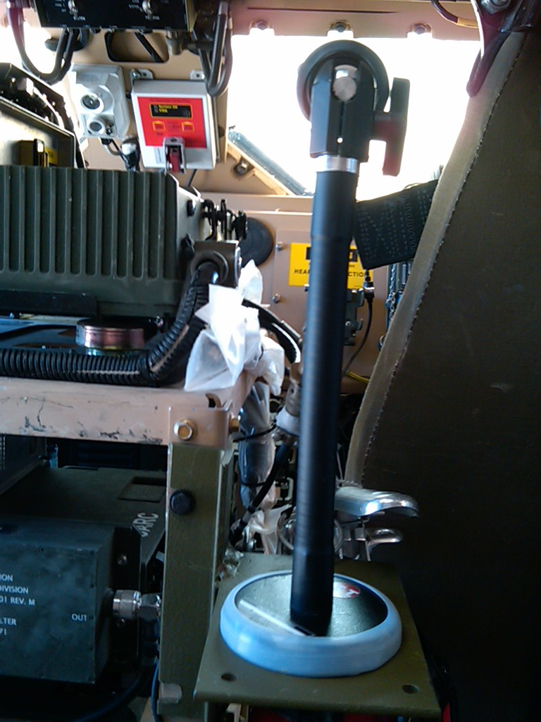
The single Crew Camera is located just behind the Co-Driver, and is mounted on a metal plate which is attached to the front radio rack. It is faced to the front of the vehicle.

Slide 18
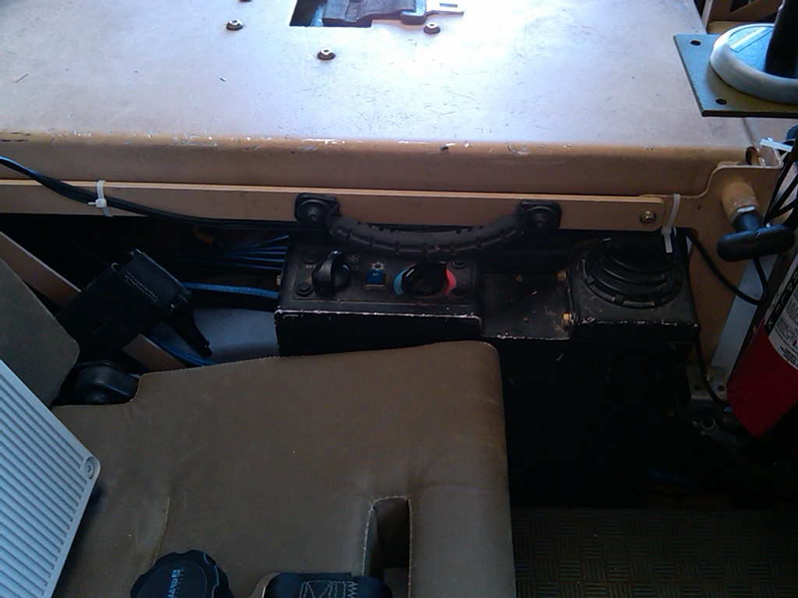
The cable is then ran just next to the AC/Heat Box behind the Co-Driver. It is then connected to the #1 Camera line on the Octopus cable.

Slide 19
Risk Assessment Considerations:
IPU mount is secure and proven with legacy system.
The Voltage Regulator (Power-Verter) is used as a protection for both the vehicle and the Player Unit. Ensuring any power surge from the vehicle would not be transferred to the Player Unit, Also it would prevent any electrical shorts from damaging the vehicles systems.
The risk is low to the vehicle and equipment due to the fuse system in the Voltage Regulator (Power-Verter) and the fuse on the CMU. The fuse on the CMU is accessible on the CMU without opening the box. The BMU is powered by its own battery system, therefore provides no risk on this family of vehicles due to power concerns.
With proper installation and education of the crew on the equipment, the instrumentation of this family of vehicles with the IPU poses no more risk to the crew or equipment than when this family of vehicle is instrumented with the legacy player unit.

