Slide 1
RIP/TOA Overview
1st Armored Division and Fort Bliss

Slide 2
Enabling Processes/Activities

Slide 3
Fiscal and Training Management
ANNUAL
MAY: FISCAL YEAR 2014/1st QUARTER
OCTOBER
EMERGING FISCAL GUIDANCE
JANUARY
APRIL
JULY
SENIOR LEADER SEMINAR 1 (FEB 13)
Initial ANNUAL MISSION GUIDANCE
Final ANNUAL MISSION GUIDANCE
SENIOR LEADER SEMINAR 2 (AUG 13)
INITIAL BUDGET GUIDANCE
FINAL BUDGET GUIDANCE
QUARTERLY
ASRC
1st MONTH
2nd MONTH
3rd MONTH
PROGRAMMED BUDGET ADVISORY COMMITTEE MEETING
QUARTERLY MISSION GUIDANCE
QUARTERLY MISSION BRIEF
COST ESTIMATES
ECARB
COMPREHENSIVE BUDGET BRIEF
MONTHLY
WEEK 1
WEEK 2
WEEK 3
WEEK 4
TRAINING MEETING
TRAINING RESOURCE MEETING
TRAINING MEETING
TRAINING RESOURCE MEETING
REVIEW UNIT SPEND PLANS
REVIEW MONEY SPENT VERSUS ALLOCATED
REVIEW UNIT SPEND PLANS
REVIEW MONEY SPENT VERSUS ALLOCATED

Slide 4
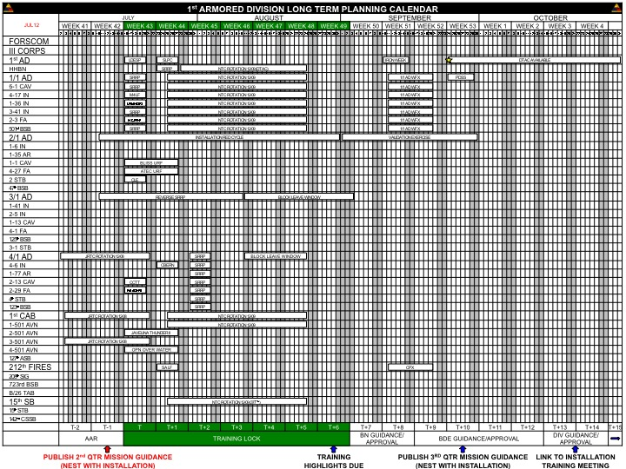
Fiscal and Training Management
VISUALIZE
FEEDBACK
LONG TERM PLANNING CALENDAR (FUTURE PLANS)
T-27 and Beyond
PLAN
SHORT TERM PLANNING CALENDAR (FUTURE PLANS)
T-14 to T-26
PREPARE
MISSION ESSENTIAL TRAINING
NEAR TERM TRAINING CALENDAR
(CURRENT OPERATIONS)
T to T13
EXECUTE
FEEDBACK
DIRECT
TRAINING MANAGEMENT PROCESS INFORMS/DRIVES PROGRAM AND BUDGETING DECISIONS
Training/Training Resource Meeting
(Unit Spend Plan; 1-N List Review)
Unit Spend Plan Confirmation with G8, Fort Bliss/1st Armored Division
G8,1st Armored Division Spend Plan Confirmation (Forces Command)
Forces Command Unit Spend Plan Confirmation to 1st Armored Division
Forces Command Fund Allocation in support of Unit Spend Plans
Units Confirm Funds Spent versus Allocated
Quarterly Unit Spend Plan Review
Program Budget Advisory Committee Meeting (CG)
WEEKLY
MONTHLY
MONTHLY
MONTHLY
MONTHLY
MONTHLY
QUARTERLY
QUARTERLY
KEY TASKS: (1) CONTINUOUS (RE)ASSESSMENT; (2) CONSTANT COMMUNICATION; (3) ANTICIPATION; (4) ‘SEE OURSELVES’

Slide 5
Division and Below Training Management Task Cross-Walk
Long Range Planning
1st Quarter |  |  |  |  |  |  |  |  |  |  |  |  | 2nd Quarter |  |  |  |  |  |  |  |  |  |  |  |  | 3rd Quarter |  |  |  |  |  |  |  |  |  |  |  |  | 4th Quarter
1 | 2 | 3 | 4 | 5 | 6 | 7 | 8 | 9 | 10 | 11 | 12 | 13 | 14 | 15 | 16 | 17 | 18 | 19 | 20 | 21 | 22 | 23 | 24 | 25 | 26 | 27 | 28 | 29 | 30 | 31 | 32 | 33 | 34 | 35 | 36 | 37 | 38 | 39 | 40 | 41 | 42 | 43 | 44 | 45 | 46 | 47 | 48 | 49 | 50 | 51 | 52
OCT |  |  |  |  | NOV |  |  |  | DEC |  |  |  | JAN |  |  |  |  | FEB |  |  |  | MAR |  |  |  | APR |  |  |  | MAY |  |  |  |  | JUN |  |  |  | JUL |  |  |  |  | AUG |  |  |  | SEP
JAN Ammo Forecast |  |  |  |  | FEB Ammo Forecast |  |  |  | MAR Ammo Forecast |  |  |  | APR Ammo Forecast |  |  |  |  | MAY Ammo Forecast |  |  |  | JUN Ammo Forecast |  |  |  | JUL Ammo Forecast |  |  |  | AUG Ammo Forecast |  |  |  |  | SEP Ammo Forecast |  |  |  | OCT Ammo Forecast |  |  |  |  | NOV Ammo Forecast |  |  |  | DEC Ammo Forecast
2nd QTR MTB Cycle |  |  |  |  |  |  |  |  | DIV 3rd QMG |  |  |  | 3rd QTR MTB Cycle |  |  |  |  |  |  |  |  | DIV AMG/ 4th QMG |  |  |  | 4th QTR MTB Cycle |  |  |  |  |  |  |  |  | DIV 1st QMG |  |  |  | 1st QTR MTB Cycle |  |  |  |  |  |  |  |  | DIV 2nd QMG
 |  |  |  |  |  |  |  |  | BDE 3rd QTR Planning Conference |  |  |  |  |  |  |  |  |  |  |  |  | BDE 4th QTR Planning Conference |  |  |  |  |  |  |  |  |  |  |  |  | BDE 1st QTR Planning Conference |  |  |  |  |  |  |  |  |  |  |  |  | BDE 2nd QTR Planning Conference
Short Range Planning
 |  | Company Locked In |  |  |  |  |  | CO Planning |  | BN Planning |  |  |  | BDE Planning |  |  |  | DIV Planning
-1 | T | +1 | +2 | +3 | +4 | +5 | +6 | +7 | +8 | +9 | +10 | +11 | +12 | +13 | +14 | +15 | +16 | +17 | +18 | +19 | +20 | +21 | +22 | +23
AAR/ Plan Re-Training | Event |  | 581 NLT |  |  | CO OPORD/ Resources Complete |  | CO WARNO/ Request Resources |  | BN OPORD |  | BN WARNO |  | BDE OPORD |  | BDE WARNO |  | DIV OPORD |  | DIV WARNO
MTB Cycle
D-14 | D-13 | D-12 | D-11 | D-10 |  | D-9 | D-8 | D-7 | D-6 | D-5 |  | D-4 | D-3 | D-2 | D-1 | D |  | D+1 | D+2 | D+3 | D+4 | D+5
MTB Guidance | METL Assessment/ Quarterly Training Plan |  |  |  |  |  |  | Initial Slices Due | Comms Check | Pre-Brief CDR |  | Revised Slides Due | Revised Slide Approval | MTB Rehearsal | Final Slides Due / Final Comms Check | MTB |  | Revise Quarterly Training Plan |  |  |  | AAR Complete/ Long-Term Resource Requests

Slide 6
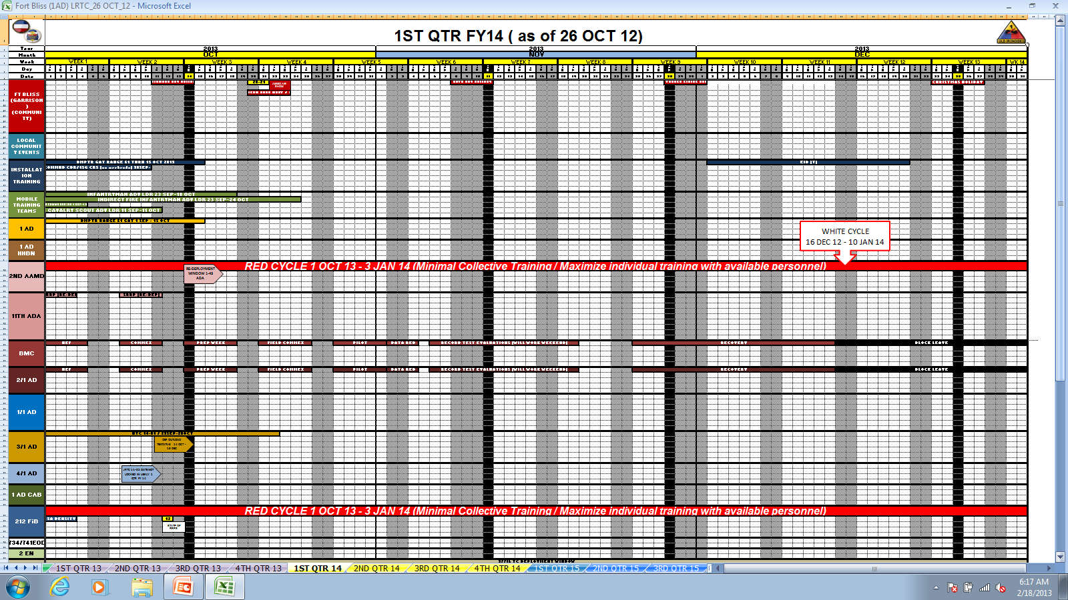
Framework Products (1 of 4): Long Range Training Calendar
Updated Weekly; Published Quarterly

Slide 7
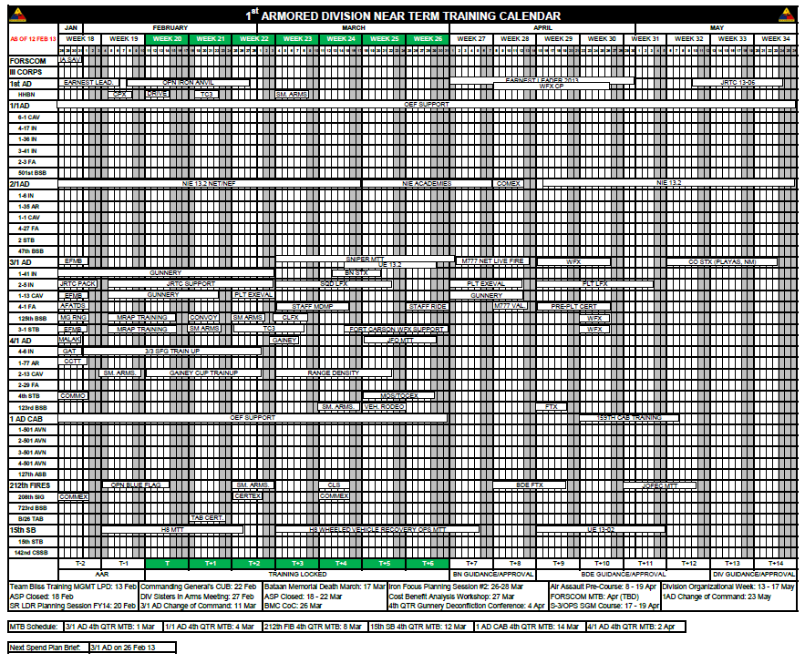
Framework Products (2 of 4): Near Term Training Calendar (T to T26)
Updated Weekly; Published Weekly

Slide 8
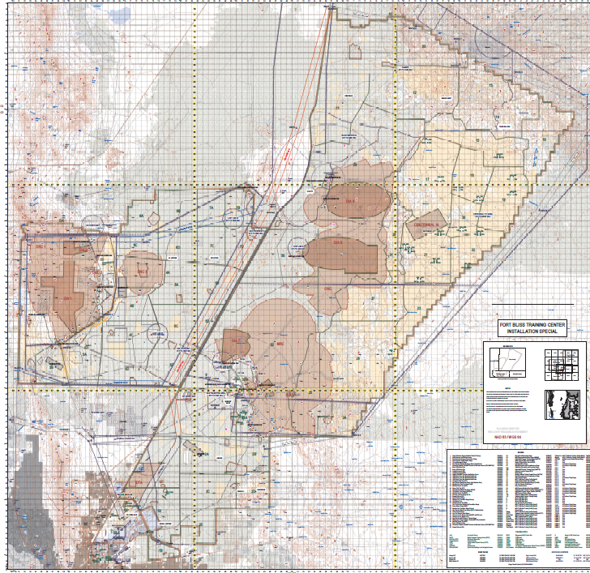
Framework Products (3 of 4): Current Situation Report (T Week)
SITUATION
TASK ORGANIZATION (NO CHANGE, AS OF 27SEP 12)
CURRENT OPERATING ENVIRONMENT (INCLUDES WEATHER, THREAT UPDATES)
29 SEP 84 F/ 59 F |  | 30 SEP 85 F/ 59 F | 1 OCT 85 F/ 57 F |  | 2 OCT 84 F/ 58 F |  | 3 OCT 89 F/ 59 F
OPEN SOURCE INTELLIGENCE HEADLINES Iraq Militants Attack Tikrit Prison, Freeing 90 Inmates (BBC News) 8 El Paso, Las Cruces-area Residents Arrested in Drug Case (Local News)
FRAGOS RECEIVED (HIGHER HEADQUARTERS, LAST 72 HOURS) - None
1st ARMORED DIVISION MISSION
1st ARMORED DIVISION REMAINS PREPARED TO DEPLOY, AS DIRECTED, AS CENTCOM’S DESIGNATED CONTINGENCY EXPEDITIONARY FORCE
EXECUTION
ORDERS ISSUED (LAST 24 HOURS) OPORD 12-09-48 Office of the Assistance Secretary of the Army (Financial Management and Comptroller) (OASA(FM&C) Audit
TRAINING HIGHLIGHTS (NEXT 72 HOURS)
 | HIGHLIGHTED TRAINING |  |  | DATE(S) |  | LOCATION
HHBN | CJTF Training |  |  | 27-28 SEP |  | SIM Center
1/1 AD | PDSS |  |  | 01-02 OCT
2/1 AD | NIE 13.1 |  |  | 01-02 OCT |  | Building 20500
3/1 AD | Umbrella Week |  |  | 01-02 OCT |  | 3/1 AD BDE HQs
4/1 AD | Senior Leader Stress Shoot |  |  | 01-02 OCT |  | RNG 5&6
1st CAB | Gunnery |  |  | 01-02 OCT |  | Ranges 50, 39
212th FIB | Red Cycle Tasking/State of CMD Brief |  |  | 01-02 OCT |  | 212th FiB Footprint
15th SB | Convoy Training |  |  | 01-02 OCT |  | Range 37
DIVISION STAFF HIGHLIGHTS (NEXT 72 HOURS) Chief Of Staff Update-FuOPS: 0830-0900 01 OCT DHQ-3049 Decision Brief: Deployment Validation Report Layout-1100-1130 01 OCT, COS Office
VISITORS (NEXT 72 HOURS) 27SEP – 5OCT: BG Phillip Churn, CG for 333rd MP BDE 27SEP – 29SEP: SMA Mario Bagaric, Sergeant Major of the Army from Bosnia-Herzegovina 27SEP – 29SEP: MG Lawarren Patterson, CG of the Signal Center of Excellence (Ft. Gordon)
3
4
1
2
Updated Daily; Briefed/Distributed Daily
SUSTAINMENT
1st AD PERSONNEL STATUS (TRA UNITS)
 | ASSIGNED |  | ATTACHED | DETACHED | OPCON |  | TOTAL
OFFICERS | 1932 |  | 30 | 0 | 0 |  | 1962
WARRANT | 524 |  | 5 | 0 | 0 |  | 529
ENLISTED | 18050 |  | 357 | 13 | 0 |  | 18394
OTHER | 4 |  | 0 | 0 | 0 |  | 4
TOTAL | 20510 |  | 392 | 13 | 0 |  | 20888
SUSTAINMENT STATUS
MISSION COMMAND
DCO CONNECT (NIPR) |  | CPOF (SIPR) |  | FM (FH/CT, CHANNEL 100) |  | CELL PHONE (BLACKBERRY)
No Issues |  | 15th SB Connectivity Completed |  | No Issues |  | No Issues
NOTES/OTHER:
1
2
3
4

Slide 9
Framework Products (4 of 4): ARFORGEN/USR Synchronization
Assigned Mission
A-Level
AMM
AME
Brigade
FY 13 |  |  |  |  |  |  |  |  | FY 14 |  |  |  |  |  |  |  |  |  |  |  | FY 15
2nd Jan - Mar |  |  | 3rd Apr - Jun |  |  | 4th Jul - Sep |  |  | 1st Oct - Dec |  |  | 2nd Jan - Mar |  |  | 3rd Apr - Jun |  |  | 4th Jul - Sep |  |  | 1st Oct - Dec |  |  | 2nd Jan - Mar
J | F | M | A | M | J | J | A | S | O | N | D | J | F | M | A | M | J | J | A | S | O | N | D | J | F | M
1
3
2
4
TRAIN / READY
ALLOCATED
Reintegrate
RESET
1
TRAIN / READY
2
3
4
ALLOCATED
Reintegrate
RESET
Updated Monthly; Briefed Monthly; Framework Product for Semi-Annual Senior Leader Planning Session
TRAIN / READY
2
3
4
1
ALLOCATED
Reintegrate
R
Aiming Point (AP) / Manning Target (MT)
Aim Point 1
MANNING | Unit Actual
AG 80% | AS
CG 80% | CG
FG60% | FG
ENL 80% | ENL
42A 80% | 42A
92Y 80% | 92Y
AMM-4
AME-4
A-4
Manning Target 4
MANNING | Unit Actual
AG 105% | AS
CG 95% | CG
FG 90% | FG
SNC>95% | SNC
NC 100% | NC
AMM-1
AME-1
A-1
1
Aim Point 2
MANNING | Unit Actual
AG 90% | AS
CG 80% | CG
FG60% | FG
ENL 80% | ENL
AMM-3
AME-3
A-3
2
3
Manning Target 3
MANNING | Unit Actual
AG> 90% | AS
CG 95% | CG
FG 80% | FG
ENL>90% | ENL
AMM-2
AME-2
A-2
4
UNCLASSIFIED//For Official Use Only
UNCLASSIFIED//For Official Use Only

Slide 10
Leader Development: Fort Bliss Field Grade/Sergeant Major Course

Slide 11
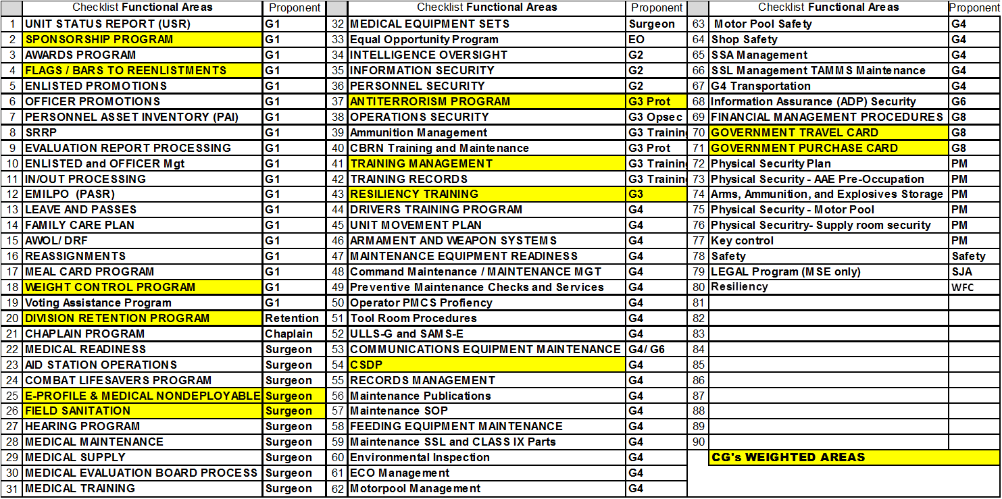
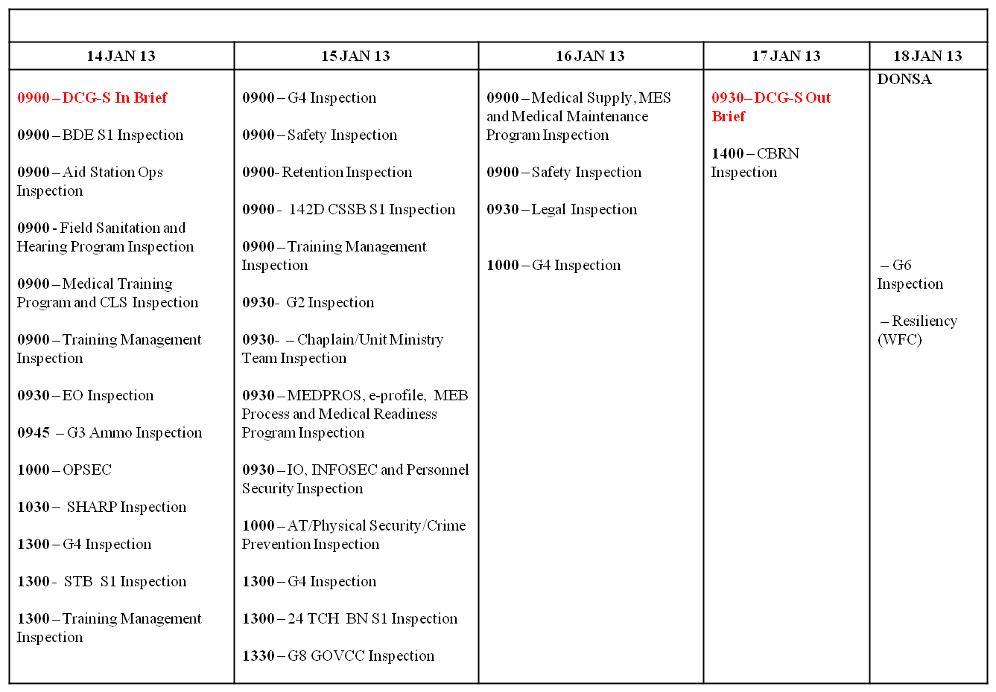
Organizational Inspections
Not Later Than 90 Days After Change of Command/Transition
Overview:
Unit receives full In Brief from Inspectors, DCG lead
Standards published in advance
Inspection checklists distributed/understood
Inspectors highlight sustains/improves
Inspectors provide written feedback on how to best fix problems
Staff lead identifies trends/shares across our Division/Installation
Sample Summary of Inspected Areas and Unit Schedule
Concept:
CG identifies ‘weighted areas’ (areas of emphasis)
Schedule developed with unit input/verified at In Brief
Unit receives daily feedback on progress/issues
Unit Command is pre-briefed on results
Final Out brief is Commanding General, or designated representative
Re-inspections scheduled at the Out Brief (as needed)

Slide 12
Relief in Place/Transfer of Authority Brief
1st Armored Division and Fort Bliss

Slide 13
RIP/TOA Brief
Commanding General receives Brigade level RIP/TOA briefs
Deputy Commanding General(s) receive Battalion level RIP/TOA briefs (Commanding General by exception, if directed)
RIP/TOA Brief:
Long Range Training Calendar Review
Mission Essential Task Review
Summary Status of Transitions Tasks
Unit Transition Calendar
Transition Task Overview
Issues
Issues inserted into appropriate task management process (training management; comprehensive budget review; manpower board; sustainment board – as examples)
Directed tasks to Current Operations team are tracked/briefed as part of recurring Operations Updates
Commanding General approves every transition

Slide 14
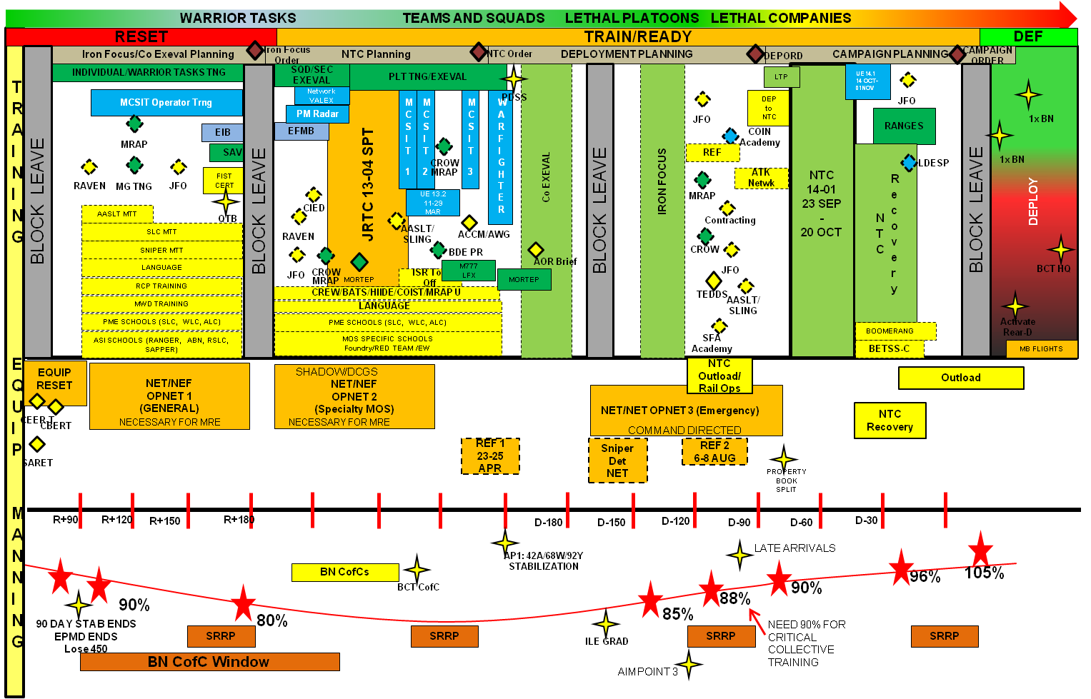
Long Range Training Calendar Review
Sample Unit Long Range Training Calendar

Slide 15
Summary Status of Transition Tasks
Task Status Remarks
General
Post Orientation and Key Personnel Introductions
Review Policy Letters
Review Brigade and Battalion level Battle Rhythms
Overview Social Engagements (Hail and Farewells, etc)
Overview of FRG Organization & Operations (including funds & audits)
Review Change of Command Ceremony
Review previous month’s USR
Review BN SDO/CQ Policies
Review Cup & Flower Fund
Personnel
Review BN Officer Slate & Rating Scheme/OER Status
Review BN Legal Actions to include EO Violations
Review MEB/MAR2 candidates and Non Deployable Soldiers
Review Outstanding Awards
Review Reenlistment Contracts (Promises made)
Review Retention Mission (RPI Budget/Expenditures)
Review Command Master Religious Program (Strong Bonds)
Review of 30/60/90 Day Gain/Loss Projections
Review of Battalion High Risk Soldiers
Review Unit Wounded Warriors and Gold Star Family Listings
Meet Military Family Life Consultants (MFLC)
Training and Operations
Review Training Guidance (Division down to Battalion)
Review last QTB/RESET Brief
Overview of Gunnery and LFX Programs
Review DPTMS Inbrief and Range Recon (visit on post training facilities)
Review Unit Battle Rosters
Review Company Command Post SOP
Review Unit SOP’s: (GARSOP, TOCSOP, TACSOP, and other SOP’s as applicable)
Review BN Safety Program
Logistics
Review Maintenance Overview (Reset, Services, Maintenance Status)
Review Outstanding FLIPLs
Review Budget (Classes of Supply, GPC, coin status, etc.)
Review of PBO Inventory Status
Review UME Draw
Status of Property Book mergers and LBE
Sample Unit Transition Task Summary Status

Slide 16
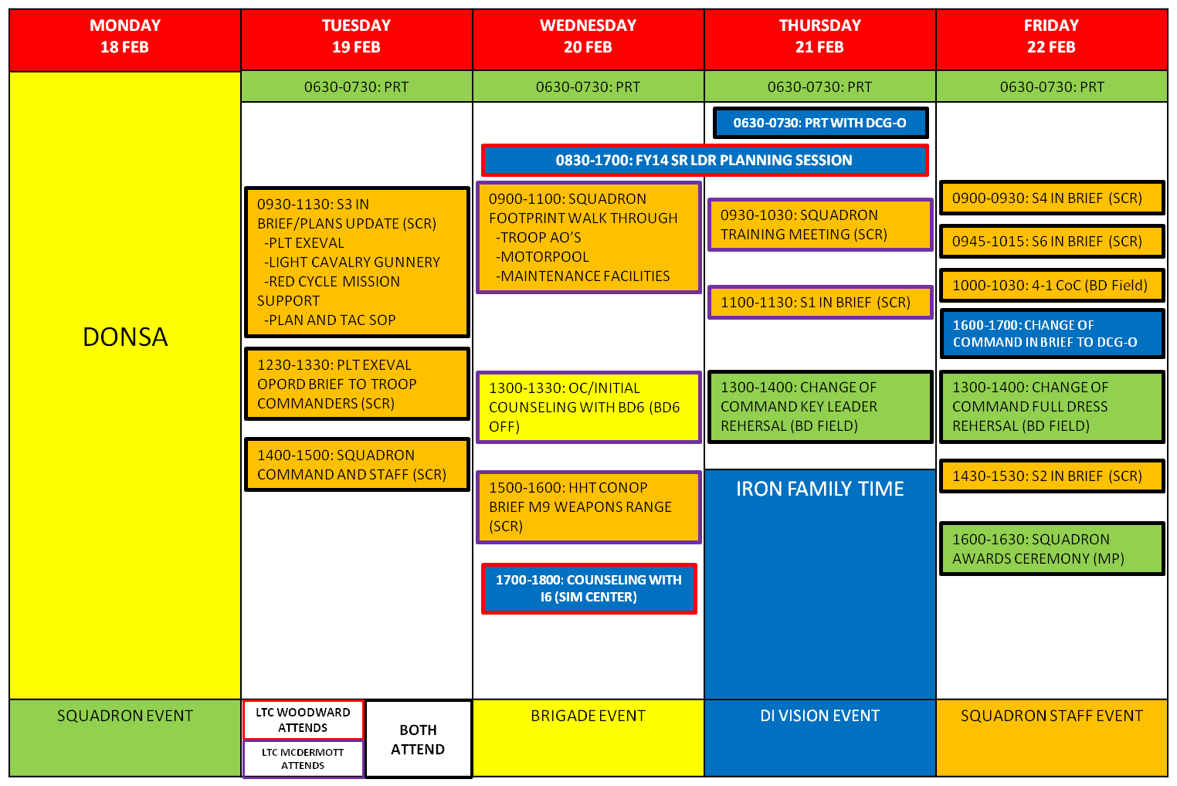
Unit Transition Calendar Review (1 of 2)
Sample Unit Transition Calendar

Slide 17
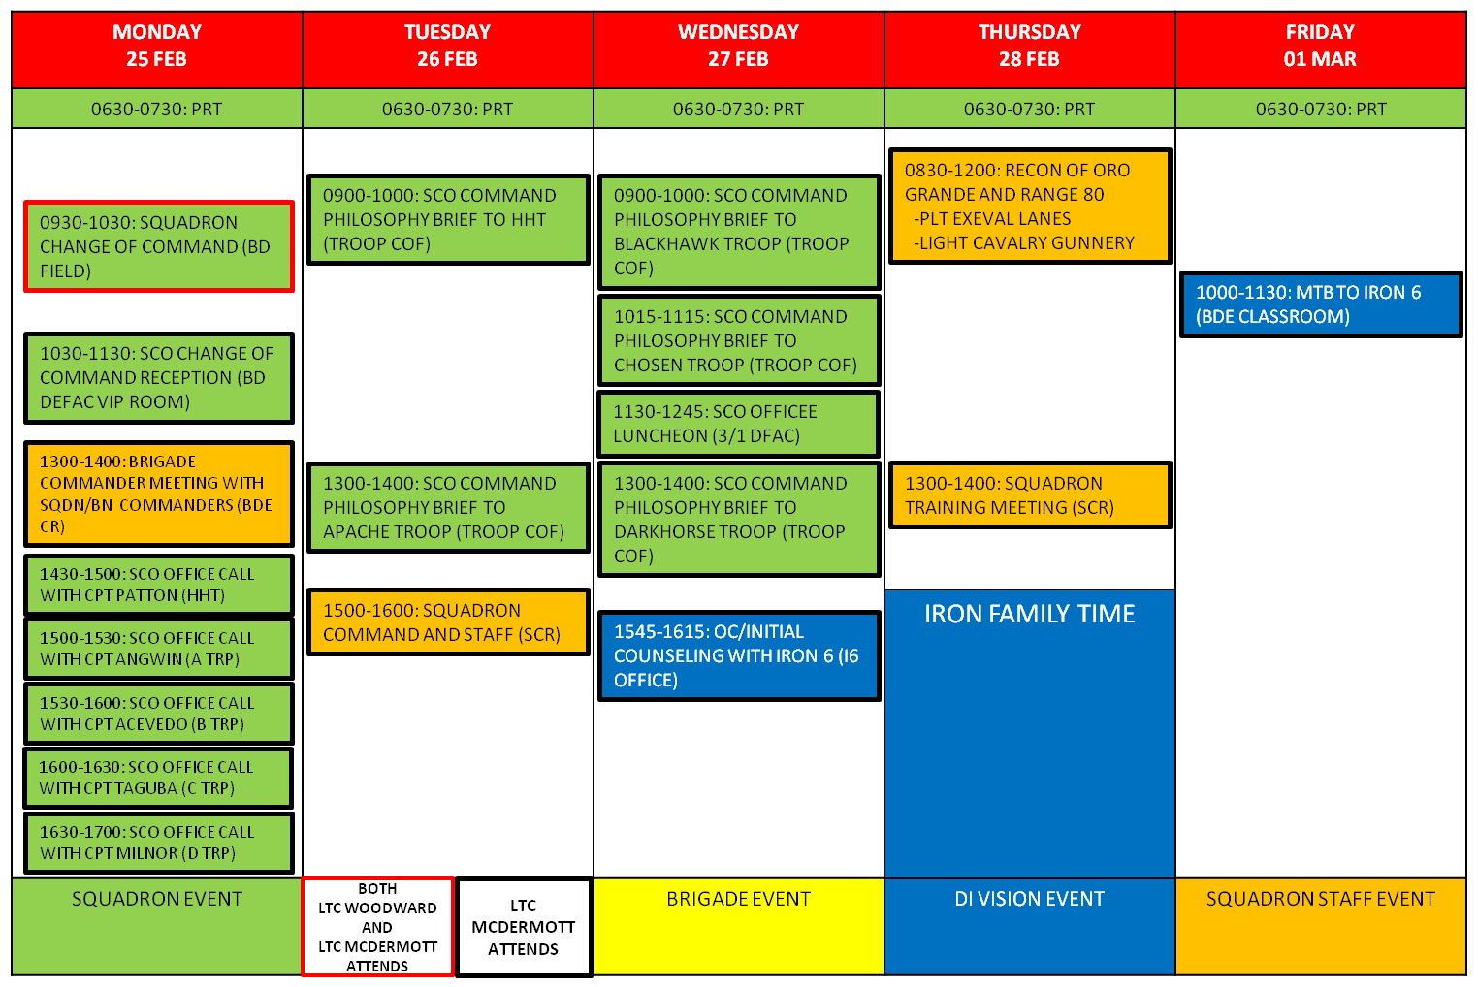
Unit Transition Calendar Review (2 of 2)
Sample Unit Transition Calendar

Slide 18
Unit Transition Task Overview (1 of 2)
Event | Description | Date | Status
Initial Coordination | Establish Contact, Provide Long Range Training Calendar and Initial Timeline to Incoming Commander | 1 JAN 13
Commander’s Dinner and Meet and Greet | Meet Incoming Commander once arrived at Fort Bliss | 24 JAN 13
Brigade In Processing | BDE and Battalion Sign-In, Begin Division In Processing at BLDG 505, SRRP @ BLDG 60 | 14-25 JAN 13
ASSIST TNG | Two Day Mandatory Training | 27-28 MAR 13
PRT Assessment | 0730 @ Hope Chapel (BLDG 2498) | 23 JAN 13
Resiliency Training | BLDG 2400 | 22 JAN 13
Finance In Processing | BLDG 505 | 16 JAN 13
Unit Meetings | Incoming Commander attends unit Battle Rhythm event meetings | 19, 21 FEB 13
Office Call Brigade Commander | Initial Counseling | 19 FEB 13
Tour of Unit Footprint | Walk-Through of Motor Pool, Unit Common Areas | 19 FEB 13
Leader Luncheon | Incoming Commander meets with all Officers in the Squadron | 27 FEB 13
Training Area Tour | Windshield Tour of Fort Bliss Training Areas and Continuity Book Review | 21-25 JAN 13
Sample Summary of Unit Transition Tasks

Slide 19
Unit Transition Task Overview (2 of 2)
Event | Description | Date | Status
Plans Update | S3 Section reviews upcoming Operations and status of Contingency Planning with Incoming Commander | 19 FEB 13
Unit Command Team Office Calls | Unit Commanders review Training Plans through T+6, Task Organization and Key Issues for the Incoming Commander | 21, 25 FEB 13
Unit Command Group Office Calls | Initial Counseling from Incoming Commander | 24 JAN 13
Reconnaissance of Dona Ana and Oro Grande | Tour of Training Areas outside of driving distance from the BN Footprint | 28 FEB 13
CoC Rehearsals | Staff, Key Leader and Full Dress Rehearsals for the Change of Command | 21-22 FEB 13
Initial Counseling with CG | Office Call with CG at Division Headquarters | 27 FEB 13
Command Photo | Coordinate Command Photo at Building 1022 | 14 FEB 13
DCG-O Outbrief on BN CoC | Outbrief the DCG-O on Completion of Change of Command Tasks | 19 FEB 13
Sample Summary of Unit Transition Tasks

Slide 20
Questions/Guidance

