Slide 1
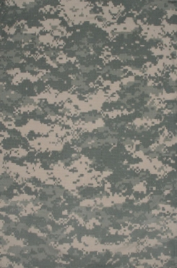

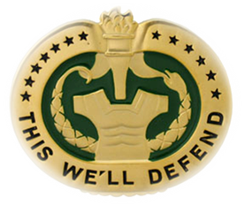
Control Bleeding and Treat Burns
First Aid 2
M1302
Version 6.0
COURSE: 012-SQIX
TITLE: DRILL SERGEANT SCHOOL
Notes:
Soldiers continue to die on the battlefield today the same way they died during the civil war. Even 150 years later Soldiers are bleeding to death from shrapnel and gunshot wounds. So whether you were hit by a musket ball or a round from an AK-47 the cause of death is the same.

Slide 2
Terminal Learning Objective
Action: | Control Bleeding and Treat Burns
Conditions: | Given a casualty who is bleeding, or has been burned
Standards: | Control the bleeding, prevent or control shock, and treat the burns, without further harming the casualty

Slide 3
Introduction
The leading preventable cause of death on the battlefield is bleeding from an extremity wound. Bleeding from an arm or leg can usually be controlled by applying an emergency bandage, and applying manual pressure
In combat, a rapidly applied tourniquet is the initial method to control life-threatening bleeding from an extremity injury.
Notes:
Hemorrhage has been and continues to be the leading cause of death in combat. Extremity wounds are the predominate site of wounds today. Modern body armor protects our torso pretty well, but extremities are still exposed. Bleeding to death from an extremity wound is considered a preventable cause of death. The tactical situation will dictate when and how much time you have to treat these injuries.

Slide 4
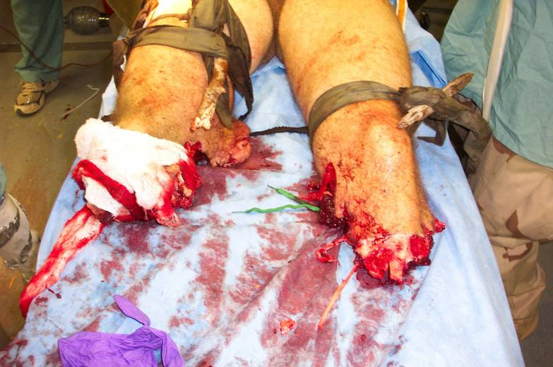
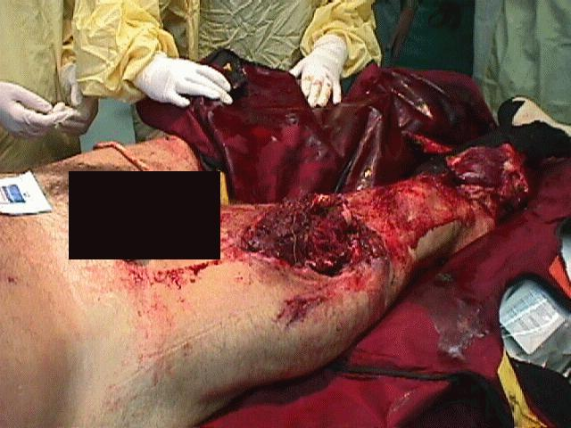
Introduction (cont.)
If your initial efforts do not control the bleeding, a tourniquet can be applied to stop the flow of blood below the tourniquet band.
Notes:
A rapidly applied tourniquet is now our primary means to control life-threatening extremity hemorrhage. This device has saved hundreds of lives.

Slide 5
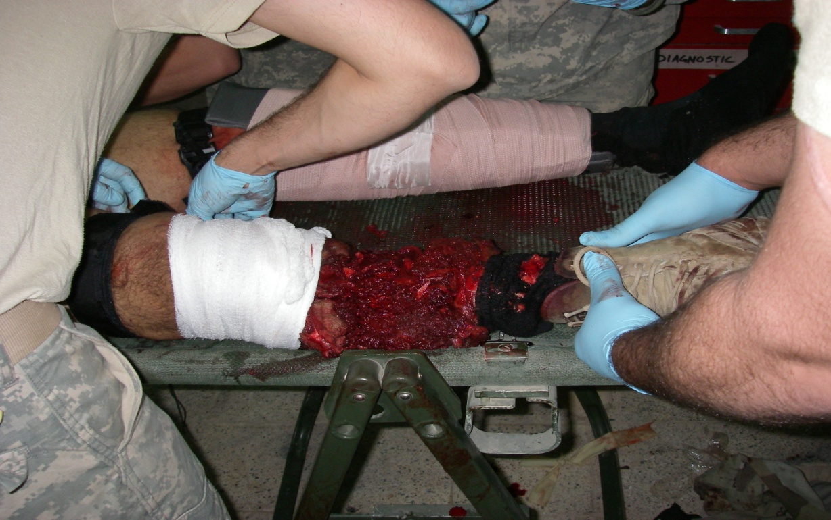
Introduction (cont.)
In some situations, such as an amputation of an arm or leg, a tourniquet is always applied first since the other methods will not be adequate to control the bleeding.
Notes:
Tourniquets used to be considered the last resort but are now the initial means to control life threatening extremity hemorrhage.

Slide 6
Introduction (cont.)
The tactical situation may limit the time you have to treat your casualty. If the tactical situation requires; place the tourniquet high on the limb over the uniform and quickly move yourself and the casualty to cover.
With training this can be done quickly in a dangerous situation.
Notes:
When time is limited by the tactical situation you may not have time to expose the wound and evaluate the injury. In these situations you should look for blood on the sleeve or pant leg of the injured Soldier as you approach them. Apply a tourniquet as high on the extremity as possible, over the uniform, tighten, and move yourself and your casualty to cover. This can be done quickly when time is limited.

Slide 7
Expose the Wound
Once the tactical situation permits expose the wound first by pushing or cutting away loose clothing around the casualty's wound. Scissors from the aid bag or a strap cutter can be used to cut or tear clothing.
Exposing the wound will enable you to better view the extent of the injury.
Determine what method of bleeding control is needed (tourniquet, pressure bandage, hemostatic agent, etc.)
Notes:
Once behind cover with more time available, you can expose the wound and determine if a tourniquet is actually needed to control the bleeding. If so then apply a second tourniquet directly to the skin of your casualty 2-3 inches above the wound and tighten it. Then remove the original tourniquet applied over the uniform. Observe the wound for additional bleeding. If you determine the wound does not require a tourniquet, apply a pressure bandage with gauze or hemostatic agent packing to the wound. Once complete remove the tourniquet and observe the wound for additional bleeding. If necessary reapply the tourniquet directly on the skin 2-3 inches above the wound.

Slide 8
Expose the Wound (cont.)
Examine the casualty to determine if there is more than one wound. A missile may have entered at one point and exited at another point.
The exit wound is usually larger than the entrance wound.
If there is an entrance wound and an exit wound, both wounds need to be bandaged.
Notes:
All wounds must be addressed and bandaged to prevent additional bleeding and contamination.

Slide 9
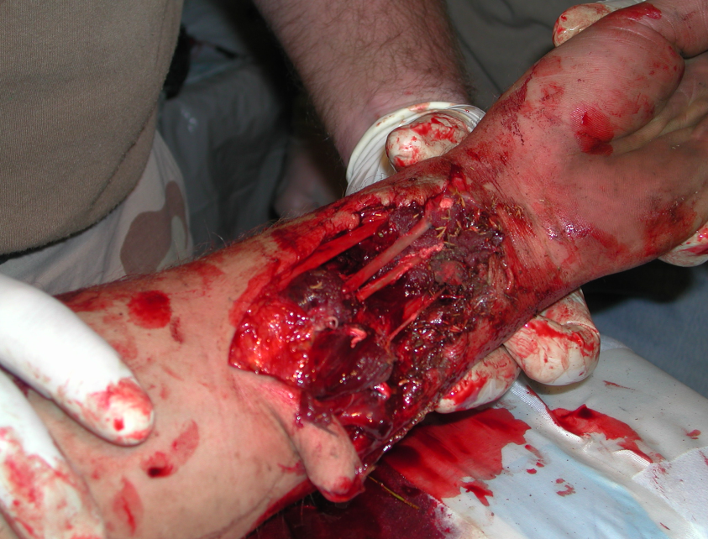
Expose the Wound (cont.)
Do not attempt to clean the wound.
Do not attempt to probe the wound in order to remove an object from the wound.
Do not attempt to remove
an object impaled in the
wound.
Notes:
Do not attempt to clean the wound. Apply bandages to control bleeding and prevent further contamination. Getting the casualty to the surgeon is your priority. They will clean and debride the wound as necessary.

Slide 10
Apply an Emergency Bandage
This bandage applies additional, continuous pressure to the wound, so it also acts as a pressure dressing. Each soldier should have an emergency bandage in his individual first aid kit. You have two emergency bandages in your combat lifesaver aid bag.
Use the casualty's emergency bandage first in order to conserve your supply.
Notes:
The Emergency bandage is the current bandage in every Soldier’s IFAK. This bandage is a pressure bandage. It is much more effective in covering and controlling bleeding than the old first aid dressing.

Slide 11
Apply an Emergency Bandage (cont.)
Remove the emergency bandage package from the casualty's IFAK .
Place the pad (dressing) on the wound.
Wrap the elastic bandage tightly around the wounded extremity.
Insert the elastic bandage completely into the pressure bar.
Notes:
Apply the bandage as directed by the instructions on the package. Make sure every Soldier in your unit is familiar with and has had a chance to practice with this bandage.

Slide 12
Apply an Emergency Bandage (cont.)
Pull the elastic bandage back over the top of the pressure bar, in the opposite direction forcing the bar down onto the pad.
Wrap the elastic bandage tightly over the pressure bar.
Continue to wrap the elastic bandage tightly around the limb so that all edges of the pad are covered.
Secure the hooking end of the closing bar into the elastic bandage to secure the bandage.

Slide 13
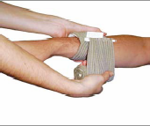
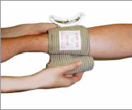
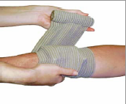
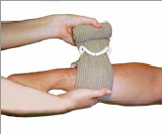
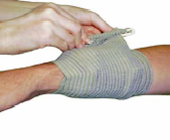
Apply an Emergency Bandage (cont.)
Notes:
The manufacturer states that this bandage can be used as a tourniquet. This bandage is a good pressure bandage but a terrible tourniquet. If a tourniquet is needed to control bleeding apply a combat application tourniquet to the extremity.

Slide 14
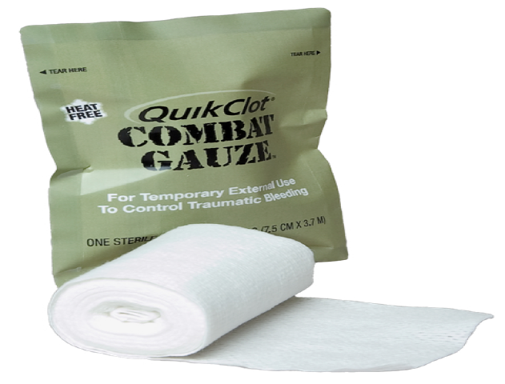
New Hemostatic Agents
Combat Gauze
Notes:
Combat gauze is the newest hemostatic agent available to Soldiers. Every Soldier should have a roll in their IFAK and the CLS should have three rolls in their bag.

Slide 15
What is QuikClot® Combat Gauze™?
Combat Gauze™ is a 3-inch x 4-yard roll of sterile Hemostatic Gauze.
Combat Gauze™ is impregnated with kaolin which is an advanced hemostatic agent.
It controls moderate to severe blood loss by rapidly promoting coagulation.
Combat Medical Systems, LLC, Tel: 910-426-0003, Fax: 910-426-0009, Website: www.combatgauze.com
Notes:
Combat gauze is rolled gauze similar to kerlix but is impregnated with kaolin which helps promote blood clotting. In laboratory testing it performed much better than previous agents such as the HemCon bandage or QuikClot powder.

Slide 16
Apply Combat Gauze
Combat Gauze is applied to the wound just like a regular roll of gauze would be used to pack a wound.
Pressure must also be applied to the wound for three minutes after the application of Combat Gauze.
If bleeding is controlled apply a pressure bandage over the wound and evacuate the casualty.
Notes:
Combat gauze is packed into the wound just like plain gauze. However, like all hemostatic agents you must apply direct pressure to the wound for a period of time to make the hemostatic agent work. For combat gauze that time is three minutes.

Slide 17
Combat Gauze Directions
Attempt to control bleeding temporarily from the wound by applying pressure to a pressure point proximal to the wound.
This allows you to visualize the wound and where the bleeding is coming from.
Open the package and remove the roll of Combat Gauze.
Notes:
Using a pressure point proximal to the wound helps when applying a hemostatic agent. This allows you to visualize the wound better identify the source of the bleeding and pack the combat gauze directly onto the bleeding source. (see movie)

Slide 18
Apply Combat Gauze (cont.)
Pack Combat Gauze into the wound using one of the following techniques:
  Tease out the center part of the roll of Combat Gauze and begin packing this strip of material into the wound. Continue packing the material into the wound until the wound is full. This may require more than one roll of Combat Gauze.
  Unroll the material from the roll and pack this strip of material into the wound. Continue packing the wound until it is full . This may require more than one roll of Combat Gauze.
Notes:
Packing combat gauze is the same technique as packing regular gauze into a wound. Some individuals like to tease the gauze out from the center of the roll and some like to unroll the gauze off the roll. Either is fine. Fill the wound up with combat gauze even if more than one roll is required.

Slide 19
Apply Combat Gauze (cont.)
Apply direct pressure over the wound for three minutes.
If bleeding has stopped apply a pressure bandage over the wound.
Evacuate the casualty, send the empty package with the casualty.
Notes:
Apply direct pressure to the wound for three minutes. Check to insure bleeding has been controlled and then apply a pressure bandage to the wound.

Slide 20
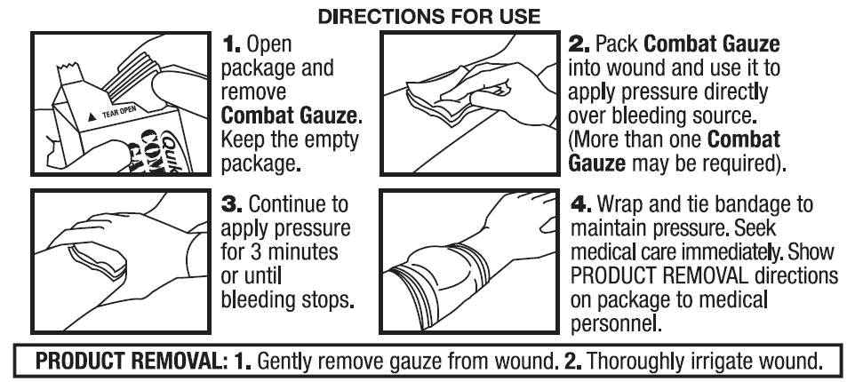
Apply Combat Gauze (cont.)
Read Package Directions Before Use
(Directions are on the product package)
Combat Medical Systems, LLC, Tel: 910-426-0003, Fax: 910-426-0009, Website: www.combatgauze.com
Notes:
Direction on the package.

Slide 21
Apply Digital Pressure
Applying digital pressure to “pressure points” is another method of controlling bleeding temporarily until a definitive treatment is applied. It allows you to visualize the wound better.
This method uses pressure from the fingers, thumbs, knee, or the heel of the hand to apply pressure to an artery supplying the wounded area.
Notes:
When attempting to control bleeding pressure points can help you to better visualize the wound and to determine where the bleeding is coming from. If it becomes necessary to hold pressure for a long time it is easier to kneel down on the site rather than try and hold pressure with your hands. In addition, by kneeling on the site it leaves your hands free to gather supplies or perform other tasks.

Slide 22
Apply Digital Pressure (cont.)
The pressure collapses or restricts the artery to control blood flow to the wounded area.
It is used in combination with pressure and elevation.

Slide 23
Apply Digital Pressure (cont.)
Temporal
Carotid
Brachial
Radial
Femoral
Posterior/ Anterior Tibialis
Notes:
Different pressure point on the body.

Slide 24
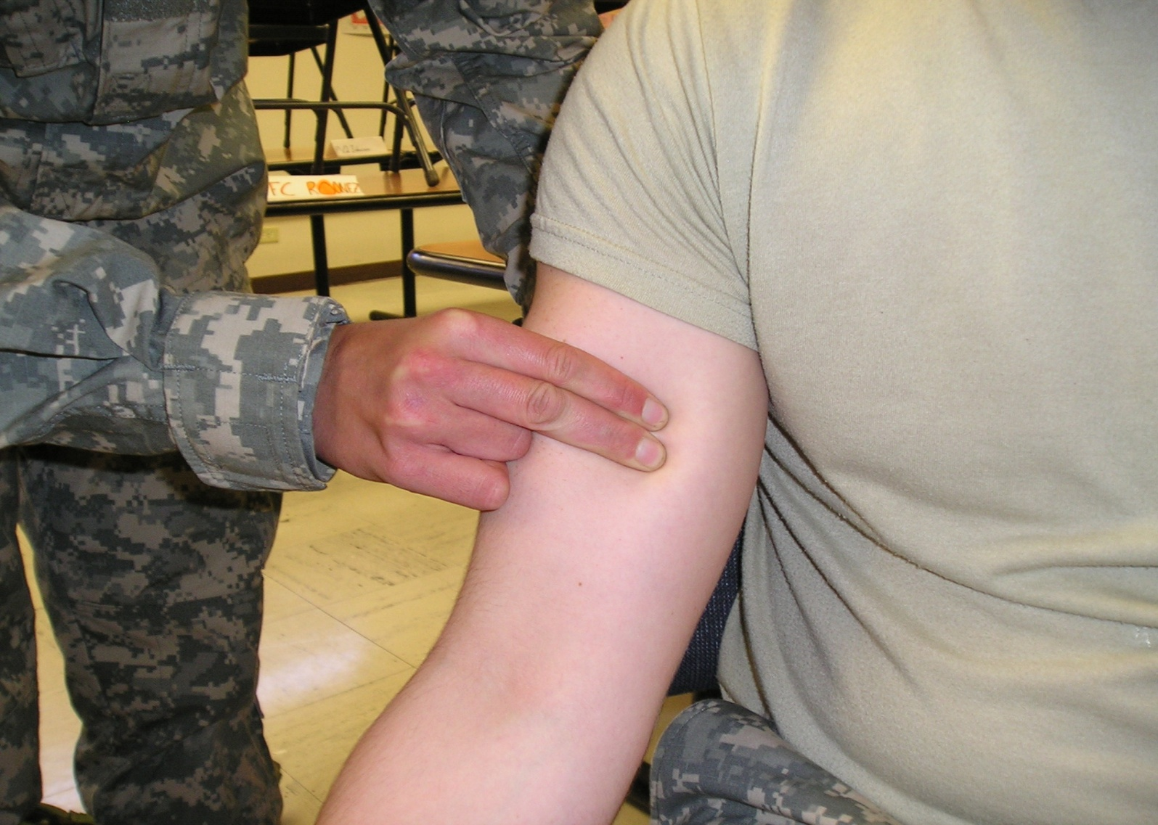
Brachial Pressure Point
Notes:
Helps control bleeding to the lower portion of the upper extremity.

Slide 25
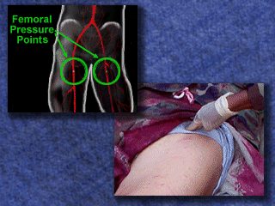
Groin Pressure Point
Notes:
This is an important site for any severe bleeding to the lower extremity.

Slide 26
Applying a Tourniquet to Control Bleeding
A tourniquet is a constricting band placed around an extremity to stop arterial bleeding by stopping blood circulation to the part of the limb below (distal to) the tourniquet.
A tourniquet is only used on an arm, forearm, thigh, or leg.
A tourniquet can be left in place for two hours without major complications.
Notes:
We have previously discussed how tourniquets are used primarily now as means to control serious extremity bleeding. Tourniquets are used daily in surgery to allow the surgeon see the wound better. They are commonly left in place for up to two hours with any complications. Consequently, a tourniquet applied in the field can be safely left on for two hours. Hundreds of tourniquets have been applied during OIF and OEF, and no one has lost a limb from a tourniquet being applied to an extremity. However, the longer it stays in place the more risk of complications.

Slide 27
Applying a Tourniquet To Control Bleeding (cont.)
On a battlefield when there is not time to control bleeding by use of dressings and bandages.
When other methods of controlling bleeding have failed.
When there is an amputation of the arm, forearm, thigh, or leg.
Notes:
Reasons for applying a tourniquet.

Slide 28
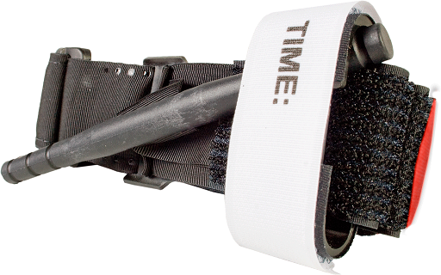
Combat Application Tourniquet
Notes:
The Combat Application Tourniquet (CAT) is the approved tourniquet recommended for all Soldiers in the Army. It is carried in every Soldier’s IFAK. You must insure every Soldier in your unit know when and how to apply it.

Slide 29
Applying a Combat Application Tourniquet to an Arm
A Combat Application Tourniquet (CAT) is the tourniquet of choice.
It is effective and can be applied quickly.
Use the CAT from the soldier's individual first aid kit (IFAK).
Notes:
Remember to use the individuals IFAK equipment before your CLS gear.

Slide 30
Applying a Combat Application Tourniquet to an Arm (cont.)
Remove the CAT from its pouch.
Slide the wounded extremity through the loop of the self-adhering band.
Position the CAT 2-3 inches above the wound, not over a joint.
Notes:
Apply as directed.

Slide 31
Applying a Combat Application Tourniquet to an Arm (cont.)
Pull the free running end of the self-adhering band tight and securely fasten it back on itself.
Do not adhere the band past the windlass clip.
Twist the windlass rod until the arterial bleeding has stopped.
Notes:
For application to an upper extremity the self adhering band only has to pass through one side of the friction adapter buckle. Upper extremities do not require as much pressure to compress the blood vessel in the arm and can be sufficiently tightened with the velcro on the self adhering band. This is not true for lower extremity bleeding. They require much more pressure to compress the blood vessels and stop the bleeding.

Slide 32
Applying a Combat Application Tourniquet to an Arm (cont.)
Lock the rod in place with the windlass clip.
Secure the windlass rod with the windlass strap.
Secure the self-adhering band under the windlass strap.
Continue winding the self-adhering band around the extremity and over the windlass rod.
Notes:
Twist the windlass rod until bleeding has stopped. Insure the rod is locked under the windlass clip. Frequently recheck this to insure it has not come undone.

Slide 33
Applying a Combat Application Tourniquet to an Arm (cont.)
Grasp the windlass strap, pull it tight, and adhere it to the Velcro on the windlass clip.
If the tactical situation permits, check for a distal pulse, if present, attempt to tighten the tourniquet more.
If unable to tighten the original tourniquet more, apply a second CAT side by side and above the first one. Recheck pulse.
Notes:
After applying the tourniquet, and when the tactical situation permits you will need to check for a distal pulse on the wounded extremity. Rarely will a tourniquet be applied and it is not tight enough to stop the arterial blood flow. When this happens blood gets past the tourniquet into the distal limb but cannot get bask in the veins past the tourniquet. This causes an increased pressure in the lower part of the extremity and can create a “compartment syndrome”. This increased pressure can crush vital structures in the limb and compromise the extremity. If the extremity has a distal pulse after you have applied the tourniquet you must attempt to tighten the original tourniquet more and if unsuccessful apply a second tourniquet just above the original side by side and tighten the second tourniquet until the pulse disappears. These two tourniquets together create a wider tourniquet which helps to block the arterial blood from past the tourniquets, preventing a compartment syndrome/

Slide 34
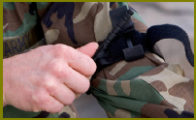
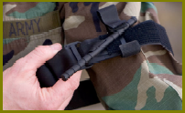
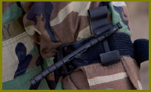
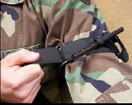
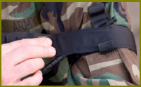
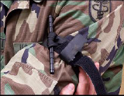
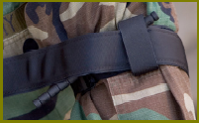
Applying a Combat Application Tourniquet to an Arm (cont.)
Notes:
CAT Directions

Slide 35
Applying a Combat Application Tourniquet to a Leg
The steps for applying a combat application tourniquet to a thigh, and sometimes the lower leg, are somewhat different because you are dealing with a larger limb that may require more pressure in order to stop the blood flow.
Notes:
When applying the CAT to a lower extremity it is important to remember that the self adhering band must pass through both sides of the friction adapter buckle. This allows more pressure to be exerted on the extremity and better compression of the blood vessels in the limb.

Slide 36
Applying a Combat Application Tourniquet to a Leg (cont.)
Remove the CAT from its pouch.
Slide the wounded extremity through the loop of the self-adhering band.
Position the CAT 2-3 inches above the wound.
Route the self-adhering band strap through both sides of the friction adaptor buckle.
Notes:
CAT directions

Slide 37
Applying a Combat Application Tourniquet to a Leg (cont.)
NOTE: The friction adaptor buckle must be used as added protection when using two hands to apply the CAT to a leg.
Pull the free running end of the self-adhering band tight with both hands and securely fasten it back on itself.
Do not adhere the band past the windlass clip.

Slide 38
Applying a Combat Application Tourniquet to a Leg (cont.)
Twist the windlass rod until the arterial bleeding has stopped.
Lock the rod in place with the windlass clip.
Secure the windlass rod with the windlass strap.
Notes:
Once the tourniquet is in place you need to insure it will not loosen or come undone. Some like to apply tape to the windlass rad and secure it to the extremity. Frequently re check the tourniquet and limb to insure bleeding has not restarted.

Slide 39
Applying a Combat Application Tourniquet to a Leg (cont.)
If the tactical situation permits, check for a distal pulse, if present, attempt to tighten the tourniquet more.
If unable to tighten the original tourniquet more, apply a second CAT side by side and above the first one.
Notes:
Pulse check is a new step after applying the tourniquet. This is to prevent compartment syndrome. In the past we said to tighten the tourniquet until bleeding stopped. However, now we must do a distal pulse check when the tactical situation allows.

Slide 40
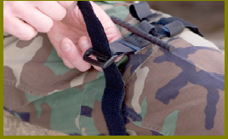
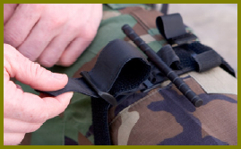
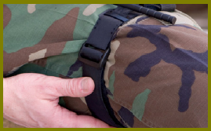
Applying a Combat Application Tourniquet to a Leg (cont.)

Slide 41
Applying an Improvised Tourniquet
A Combat Application Tourniquet is the tourniquet of choice. However, you also need to know how to apply an improvised tourniquet in case a CAT is not readily available.
Notes:
Every Soldier has a CAT tourniquet in his IFAK. However, if for some reason you cannot find one you can make an improvised tourniquet.

Slide 42
Applying an Improvised Tourniquet (cont.)
Gather materials:
Rigid object (windlass) such as a strong stick
Tourniquet band (cravat) at least two inches wide
Securing material (cravat)
Notes:
Gather material.

Slide 43
Applying an Improvised Tourniquet (cont.)
Select a site at least two inches above the edge of the wound or amputation site.
Do not place a tourniquet over a joint or over a fracture site.
Place the tourniquet band material around the tourniquet site.
Notes:
Select a site just as you would if applying a premade tourniquet.

Slide 44
Applying an Improvised Tourniquet (cont.)
Tie the band with a half-knot.
Place the windlass on top of the half-knot.
Tie a full knot (square knot) over the windlass.
Notes:
Wrap the cravat around the limb and tie an overhand knot. Places the windlass on the half know and tie a full (square) knot.

Slide 45
Applying an Improvised Tourniquet (cont.)
Twist the windlass either clockwise or counterclockwise until the tourniquet is tight and the bright red bleeding has stopped.
Wrap the second cravat around the limb.
Notes:
Twist the windlass until bleeding stops. Wrap the second cravat around the limb and secure one end of the windlass.

Slide 46
Applying an Improvised Tourniquet (cont.)
Wrap the tails around one end of the windlass so that the tourniquet band will not unwind.
Tie the tails of the securing material in a nonslip knot.
Check for a distal pulse.
Notes:
Make sure you use a nonslip (square) knot. You must insure this tourniquet will not come undone. Frequent checks are recommended. These tourniquets are less reliable than a premade tourniquet and should be used as a last resort.

Slide 47
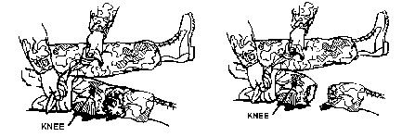
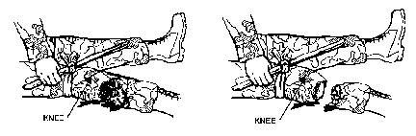
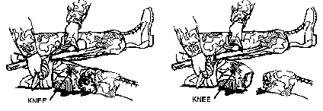
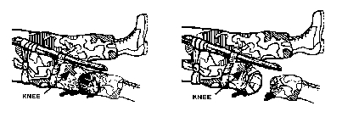
Applying an Improvised Tourniquet (cont.)

Slide 48

Marking the Casualty
Write the time of application on the tourniquet itself, the casualty card, or the casualty with an indelible marker.
This alerts medical personnel that a tourniquet has been applied.
Notes:
Insure the time of tourniquet application is recorded somewhere on the casualty, or the casualty card. The new version of the CAT has a place for tourniquet time on the windlass securing strap.

Slide 49
Dressing an Amputation
If you applied the tourniquet to an amputation, place a dressing made of soft, absorbent material (Kerlix™) over the end of the stump and secure the dressing with bandages. The dressing will help to prevent additional contamination of the wound and will also help to protect the wound from additional injury.
Notes:
If your casualty has a traumatic amputation apply a stump dressing using roller gauze and an ace wrap to protect and pad the extremity.

Slide 50

Dressing an Amputation (cont.)

Slide 51
Prevent Shock, Hypothermia
Take measures to control shock.
Hypovolemic shock results when there is a sudden decrease in the amount of fluid circulating in the casualty's circulatory system. Although heat stroke, diarrhea, and dysentery can also cause hypovolemic shock, we are chiefly concerned about hypovolemic shock due to blood loss from a wound.
Notes:
Most battlefield shock is hypovolemic shock secondary to blood loss. The primary goal is to stop the bleeding. Try to keep the casualty comfortable as much as possible.

Slide 52
Prevent Shock, Hypothermia (cont.)
The first step in preventing or controlling shock is to stop the bleeding. You have already taken steps to control bleeding by applying dressings and tourniquets as needed to control external bleeding, that is, bleeding that you can see on the outside of the body. The casualty may also have internal bleeding, such as bleeding into the abdominal or chest cavities, which you cannot treat. This requires rapid evacuation.
Notes:
Internal bleeding is best controlled by a surgeon in an operating room. These casualties need rapid evacuation.

Slide 53
Prevent Shock, Hypothermia (cont.)
Control bleeding.
Position casualty in position of comfort or on back.
Elevate legs if able.
Keep warm (Blizzard Blanket, Ready Heat blanket).

Slide 54
Prevent Shock, Hypothermia (cont.)
Position casualty on back or position of comfort (chest wound)
Elevate legs slightly higher than level of heart
Do not elevate legs if:
  They are unsplinted
  Suspected spinal injury
  Open chest wound –casualty may feel better sitting up or on side
Notes:
If casualty exhibits signs of shock (pale cool clammy skin, rapid pulse):
- Place on back
- Wrap in blanket to keep warm (Blizzard Blanket ready Heat Blanket)
- Elevate legs (if not contraindicated)
- Send someone for the medic

Slide 55
Preventing/Treating Shock (cont.)
Do not elevate legs if:
  Abdominal wound (flex knees)
  Head injury
  Casualty is unconscious
Cover entire casualty with blanket to keep warm (Blizzard Blanket, Ready Heat Blanket).
Reassure Casualty.
Notes:
Reassurance is very important. When Soldiers are scared it raises their blood pressure and heart rate which can cause them to bleed more. Talk to them and reassure them they will be OK.

Slide 56
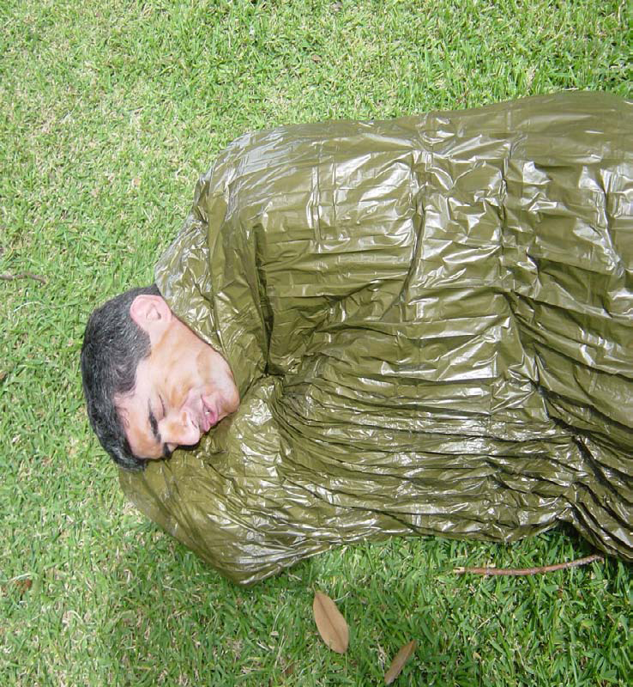
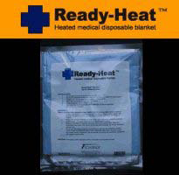
Blizzard Blanket & Ready-Heat
Notes:
Insure the patient is kept warm by removing wet clothing and covering the casualty with a blanket. There is a new Blizzard blanket as a component of the CLS Bag along with a Ready Heat blanket. This Ready Heat blanket automatically heats up when taken out of its plastic wrapper and exposed to the air. It will remain warm for up to 8 hours. It should be used to cover the torso section of your casualty. You must determine based on the environmental conditions whether your casualty needs both the outer shell and the heating blanket or is it sufficient to just keep them covered with the shell, because it is already hot outside.

Slide 57
Terminal Learning Objective
Action: | Control Bleeding and Treat Burns
Conditions: | Given a casualty who is bleeding, or has been burned
Standards: | Control the bleeding, prevent or control shock, and treat the burns, without further harming the casualty
SUMMARY

Slide 58
Control Bleeding and Treat Burns
First Aid 2
QUESTIONS
M1302
Version 6.0
Notes:
Soldiers continue to die on the battlefield today the same way they died during the civil war. Even 150 years later Soldiers are bleeding to death from shrapnel and gunshot wounds. So whether you were hit by a musket ball or a round from an AK-47 the cause of death is the same.

