Slide 1


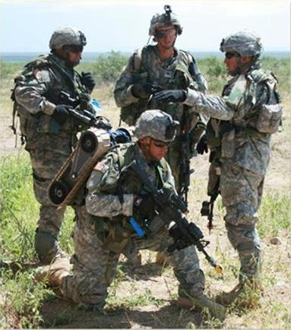
Transporting the SUGV

Slide 2
Terminal Learning Objective
Action: | Prepare the Small Unmanned Ground Vehicle (SUGV) for transport.
Condition: | In an operational environment provided with TM 9-2350-397-13&P, SUGV Job Aid, SUGV Student Guide, and an operational SUGV system.
Standard: | Prepare the Small Unmanned Ground Vehicle (SUGV) for transport in accordance with TM 9-2350-397-13&P by: properly configuring the SUGV for Hand-Carry transport; properly configuring the SUGV for the MOLLE Ruck transport; properly configuring the SUGV for Hard-Case transport with 80% accuracy.

Slide 3
Enabling Learning Objective A
Action: | Configure the SUGV for Hand-Carry transport.
Condition: | In an operational environment provided with TM 9-2350-397-13&P, SUGV Job Aid, SUGV Student Guide, and an operational SUGV system.
Standard: | Prepare the Small Unmanned Ground Vehicle (SUGV) for transport in accordance with TM 9-2350-397-13&P by properly configuring the SUGV for Hand-Carry transport with 80% accuracy.

Slide 4
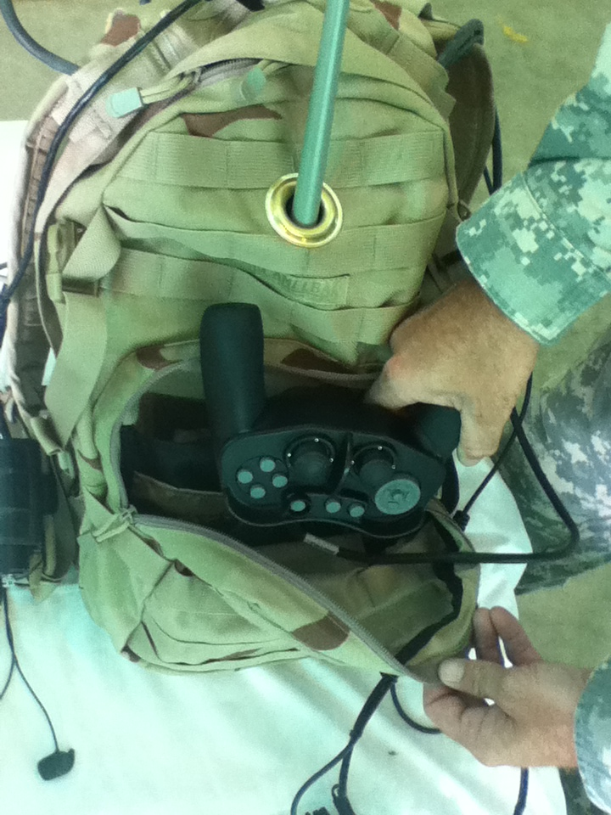
Packing the OCU Backpack
1. Place the hand controller handles up into the front pouch of the OCU backpack.

Slide 5
CAUTION
Failure to store heads-up display unit properly may cause damage.

Slide 6
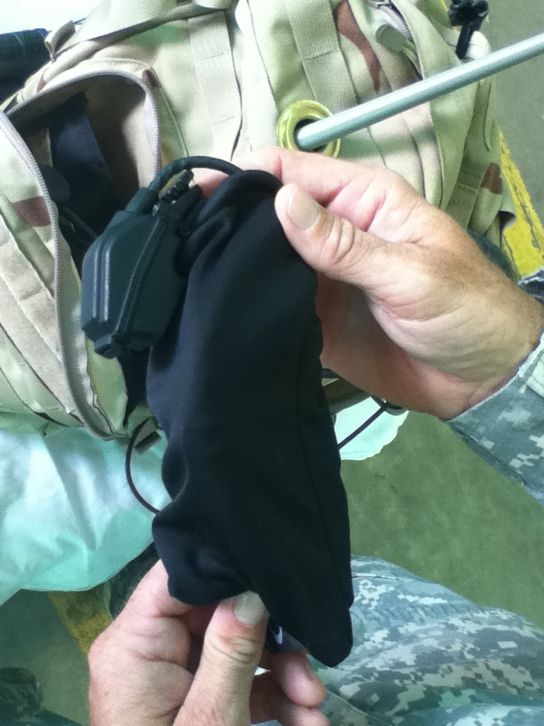
Packing the OCU Backpack
2. Place the heads-up display unit in the protective fabric sleeve ensuring that the sleeve is between the lenses and the heads-up display.

Slide 7
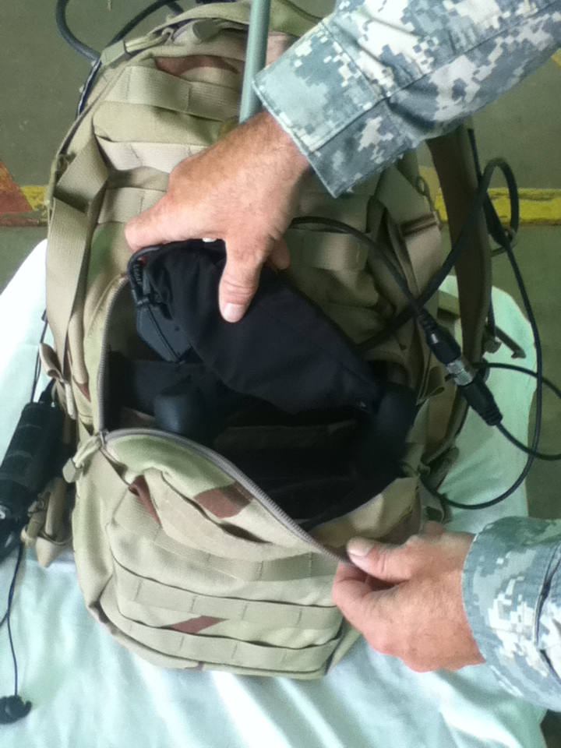
Packing the OCU Backpack
3. Place the heads-up display unit on top of the hand controller in the front pouch of the OCU backpack.

Slide 8
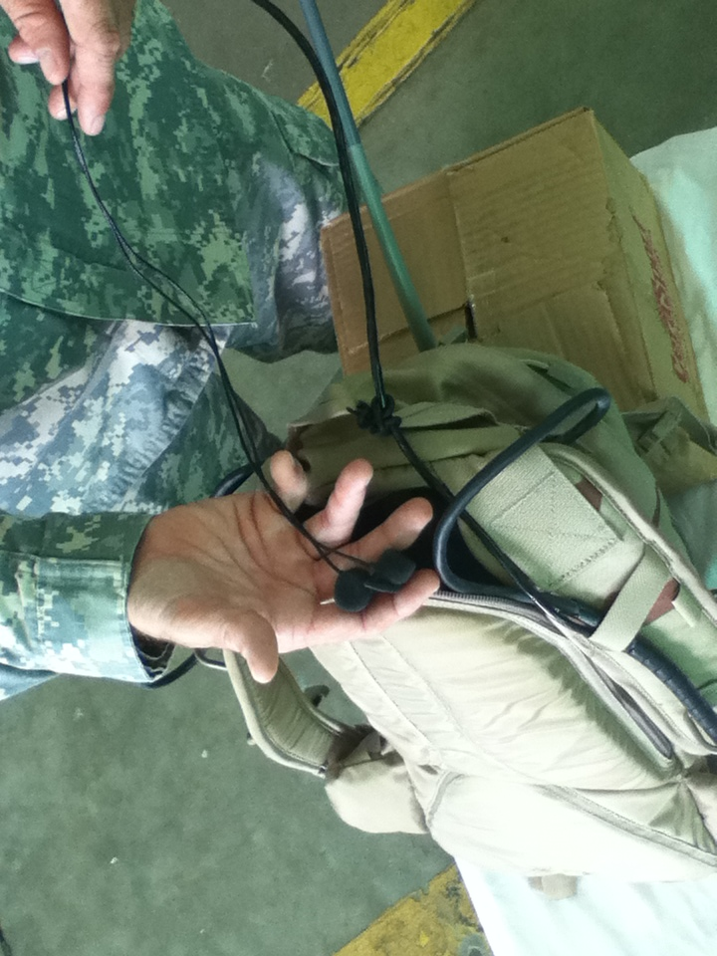
Packing the OCU Backpack
4. Tuck the audio headset earpieces into the rear compartment of the OCU backpack.

Slide 9
WARNING
Never pick up the robot by its tracks or flippers. Tracks and flippers can move and pinch fingers. Injury may occur. Use the handle.
CAUTION
Never pick up or carry the robot by its tracks, flippers, antenna, head, or neck. Damage to the robot may occur.
NOTE
Ensure the Hand Controller is locked before transporting SUGV.

Slide 10
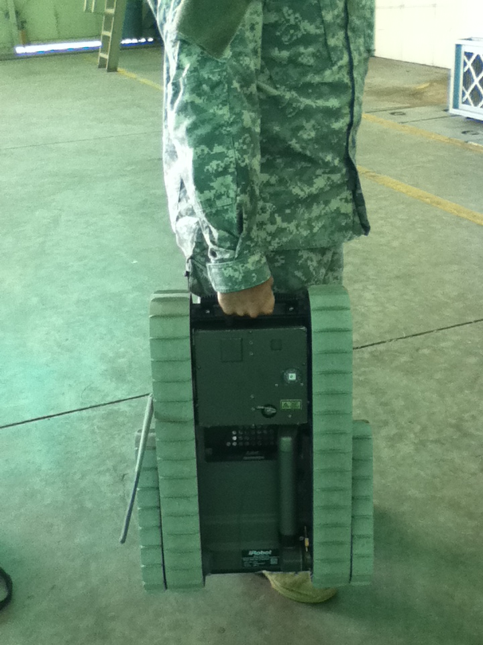
Hand-Carry the SUGV
1. Visually inspect to make sure the head is latched.
2. Grasp the handle.

Slide 11
Enabling Learning Objective B
Action: | Configure the SUGV for MOLLE Ruck transport.
Condition: | In an operational environment provided with TM 9-2350-397-13&P, SUGV Job Aid, SUGV Student Guide, and an operational SUGV system.
Standard: | Prepare the Small Unmanned Ground Vehicle (SUGV) for transport in accordance with TM 9-2350-397-13&P by properly configuring the SUGV for MOLLE Ruck transport with 80% accuracy.

Slide 12
CAUTION
The antenna is flexible and should slide into the pack with the robot. Make sure the robot antenna does not get bent or kinked.

Slide 13
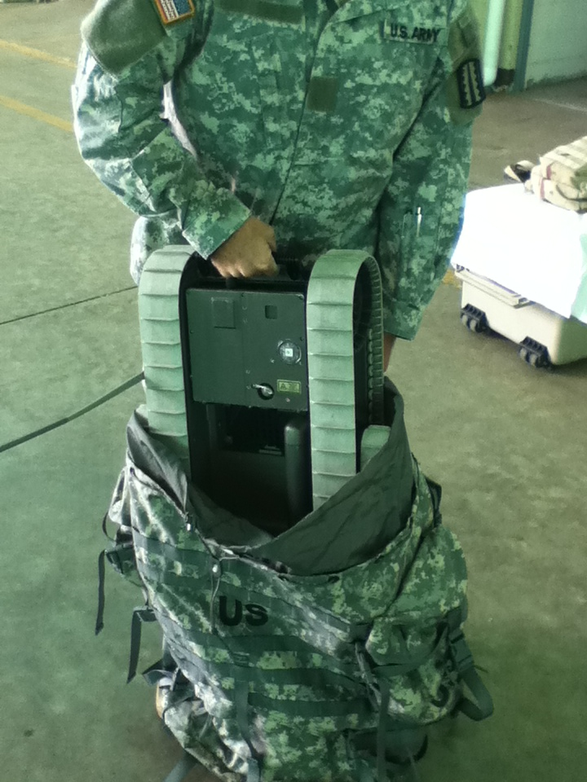
Transport the SUGV using the MOLLE Ruck
1. Visually inspect head to ensure it is latched.
2. Holding on to the handle, place the robot into the MOLLE pack, with the bottom of the robot against the frame of the MOLLE pack.

Slide 14
Transport the SUGV using the MOLLE Ruck
3. Place the hand controller in the front pouch of the OCU backpack without disconnecting it from the OCU.
4. Place the heads-up display unit into the protective fabric sleeve.
5. Place the heads-up display unit on top of the hand controller in the front pouch of the OCU backpack without disconnecting them.
6. Zip closed the front pouch of the OCU backpack as far as possible without damaging the cables.
7. Tuck the audio headset earpieces and cables for the heads-up display unit and hand controller into the rear compartment of the OCU backpack.
8. Zip closed the rear pouch of the OCU backpack as far as possible without damaging the cords.

Slide 15
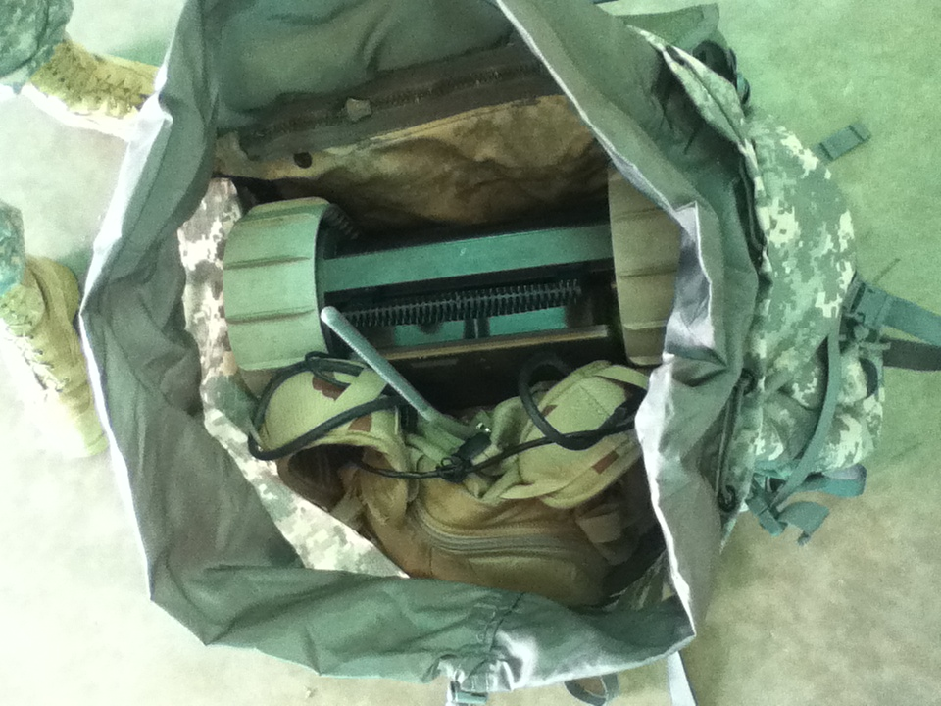
Transport the SUGV using the MOLLE Ruck
9. Put the OCU backpack into the MOLLE pack, placing it in front of the robot.

Slide 16
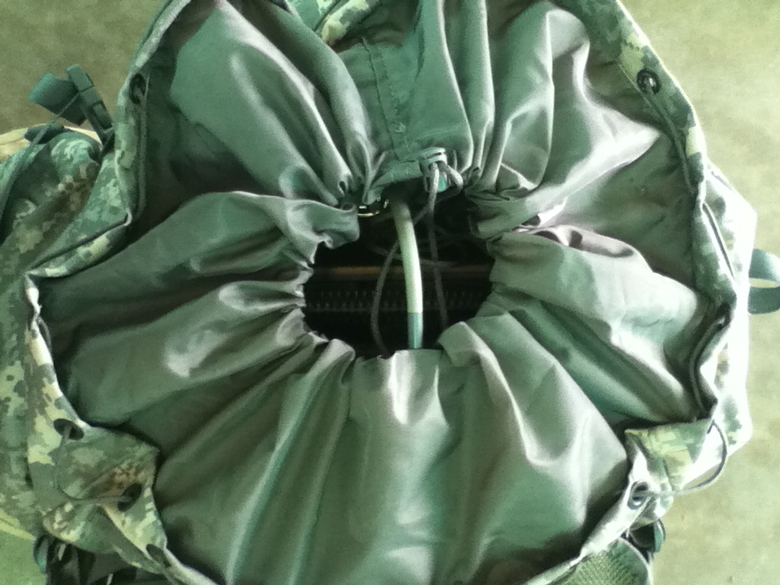
Transport the SUGV using the MOLLE Ruck
10. Cinch the drawstring on the MOLLE pack.
11. Gently bend the OCU antenna down and tuck it inside the top of the MOLLE pack.
12. Fold over the pack’s flap and secure it in place.

Slide 17
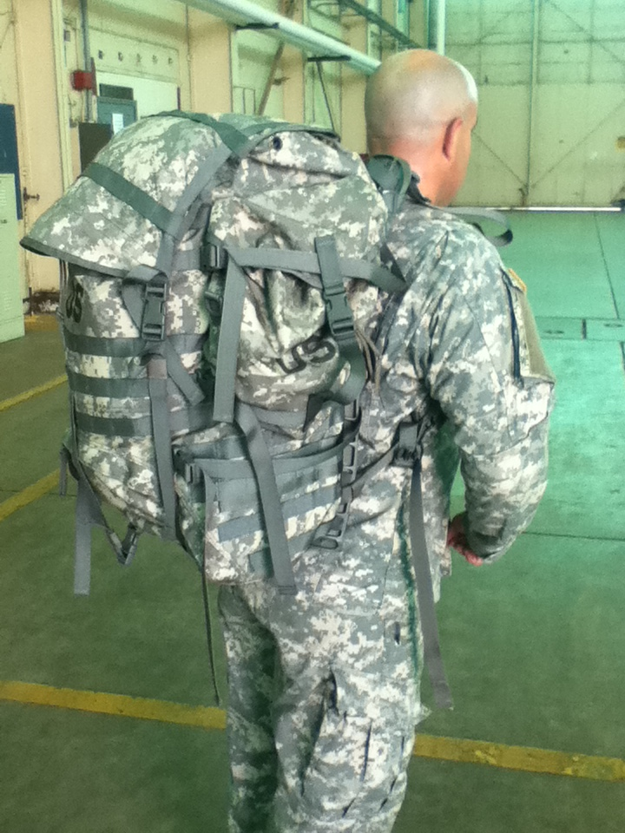
Transport the SUGV using the MOLLE Ruck

Slide 18
Enabling Learning Objective C
Action: | Configure the SUGV for Hard-Case transport.
Condition: | In an operational environment provided with TM 9-2350-397-13&P, SUGV Job Aid, SUGV Student Guide, and an operational SUGV system.
Standard: | Prepare the Small Unmanned Ground Vehicle (SUGV) for transport in accordance with TM 9-2350-397-13&P by properly configuring the SUGV for Hard-Case transport with 100% accuracy.

Slide 19
NOTE
Verify that the ID labels on the robot and OCU match the ID label inside the top half of the container to ensure that the SUGV system is packed into the proper container.

Slide 20
Configure the SUGV for
Hard-Case transport
1. Set the shipping container on a level surface.
2. Visually inspect the head to ensure it is latched.
3. Remove the batteries from the robot.
4. Open the shipping container.
5. Grasp handles and lift to remove the interior top layer of the container.

Slide 21
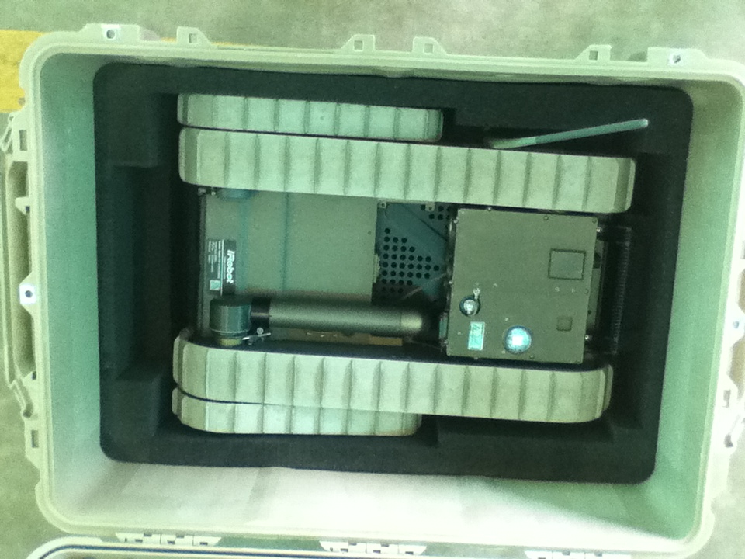
Configure the SUGV for
Hard-Case transport
6. Set the robot (with flipper assembly attached) down into the opening in the bottom of the container.

Slide 22
CAUTION
Do not force the heads-up display into the fabric sleeve with the heads-up display unit. This can scratch the display making it difficult to read.

Slide 23
Configure the SUGV for
Hard-Case transport
7. Replace the top layer of the container, making sure that the chassis assembly antenna protrudes through the opening in the layer.
8. Gently press chassis assembly antenna under plastic retainer to secure it.
9. Disconnect the hand controller from the hand controller connector.
10. Disconnect the heads-up display unit from the heads-up display unit connector.
11. Place the heads-up display unit in the protective fabric sleeve.
12. Remove the battery from the OCU backpack.

Slide 24
CAUTION
Make sure that both antennas are clear of the container lid before closing the lid. Severe damage to an antenna can occur if the lid is closed on it.

Slide 25
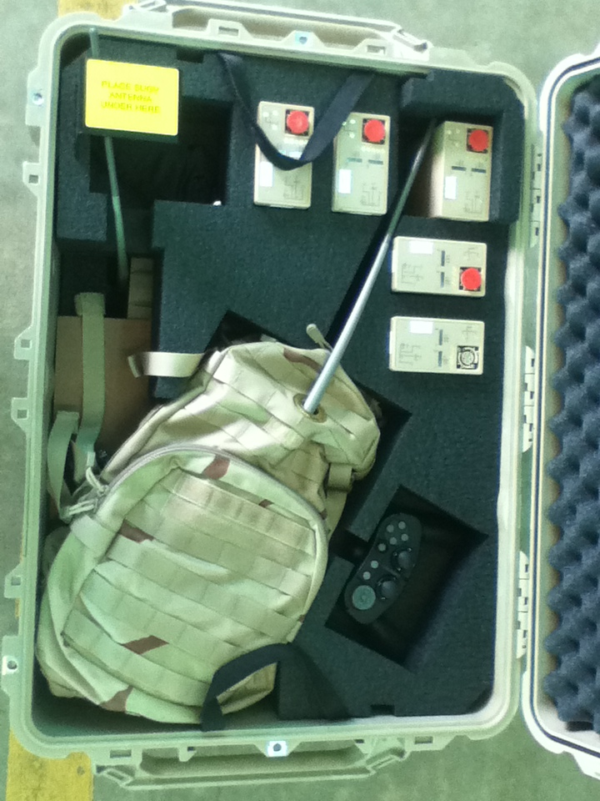
Configure the SUGV for
Hard-Case transport
Hand Controller
OCU Antenna
OCU and Backpack
Batteries
HUD w/ Glasses
SUGV Antenna
13. Fit the OCU backpack, heads-up display unit, hand controller, batteries, and any other components into the preformed depressions in the top foam layer.
14. Close the cover of the container and secure it.

Slide 26
Summary
Terminal Learning Objective
Action: Prepare the Small Unmanned Ground Vehicle (SUGV) for transport.
Condition: In an operational environment provided with TM 9-2350-397-13&P, SUGV Job Aid, SUGV Student Guide, and an operational SUGV system.
Standard: Prepare the Small Unmanned Ground Vehicle (SUGV) for transport in accordance with TM 9-2350-397-13&P by properly configuring the SUGV for Hand-Carry transport; properly configuring the SUGV for the MOLLE Ruck transport; properly configuring the SUGV for Hard-Case transport with 80% accuracy.
ELO A: Configure the SUGV for Hand-Carry transport.
ELO B: Configure the SUGV for MOLLE Ruck transport.
ELO C: Configure the SUGV for Hard-Case transport.

Slide 27
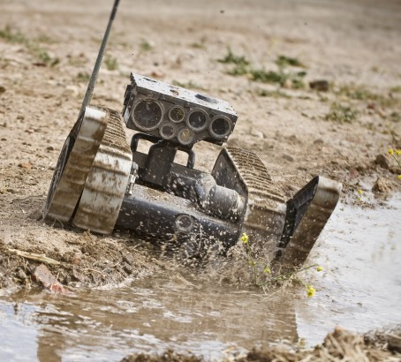
Line of Sight Maneuvers

Slide 28
Terminal Learning Objective
Action: | Conduct Small Unmanned Ground Vehicle (SUGV) Line of Sight (LOS) Maneuvers.
Condition: | In an operational environment provided with TM 9-2350-397-13&P, SUGV Job Aid, SUGV Student Guide, Mission Oriented Equipment, and an operational SUGV system.
Standard: | Conduct Small Unmanned Ground Vehicle (SUGV) Line of Sight (LOS) Maneuvers in accordance with TM 9-2350-397-13&P by properly executing all drive poses; properly traversing obstacles; properly recovering from a degraded position during line-of-sight maneuvers with 80% accuracy.

Slide 29
Enabling Learning Objective A
Action: | Execute all drive poses.
Condition: | In an operational environment provided with TM 9-2350-397-13&P, SUGV Job Aid, SUGV Student Guide, Mission Oriented Equipment, and an operational SUGV system.
Standard: | Properly execute all drive poses for the Small Unmanned Ground Vehicle (SUGV) with 100% accuracy in accordance with TM 9-2350-397-13&P.
Notes:
Instructor will execute drive poses while the students observe the poses/techniques used.

Slide 30
Execute Drive Poses
Press the lock/unlock button
Press the menu toggle button and enter the pose menu
Select deploy pose
Select stow pose
Select drive pose
Select ascend pose
Select descend pose
Select peek over pose
Select peek under pose
Select self inspect pose
Notes:
Instructor will execute drive poses while the students observe the poses/techniques used.

Slide 31
Enabling Learning Objective B
Action: | Traverse obstacles.
Condition: | In an operational environment provided with TM 9-2350-397-13&P, SUGV Job Aid, SUGV Student Guide, Mission Oriented Equipment, and an operational SUGV system.
Standard: | Properly traverse obstacles for the Small Unmanned Ground Vehicle (SUGV) with 80% accuracy in accordance with TM 9-2350-397-13&P.
Notes:
Instructor will traverse obstacles while the students observe the poses/techniques used.

Slide 32
Enabling Learning Objective C
Action: | Recover from a degraded position.
Condition: | In an operational environment provided with TM 9-2350-397-13&P, SUGV Job Aid, SUGV Student Guide, Mission Oriented Equipment, and an operational SUGV system.
Standard: | Properly recover Small Unmanned Ground Vehicle (SUGV) with 100% accuracy in accordance with TM 9-2350-397-13&P.

Slide 33
Instructor Demonstration
Instructor will now demonstrate how to properly recover the SUGV from a degraded position.
Notes:
Instructor will execute all drive poses while talking the students through the exercise.

Slide 34
Recovering from a Degraded Position
Press the lock/unlock button
Press the menu toggle button and enter the pose menu
Select the stow pose
Press the flipper up button to position the flippers up Continue to rotate the flippers up until the SUGV in positioned correctly
Select the drive pose

Slide 35
Summary
Terminal Learning Objective
Action: Conduct Small Unmanned Ground Vehicle (SUGV) Line of Sight (LOS) Maneuvers.
Condition: In an operational environment provided with TM 9-2350-397-13&P, SUGV Job Aid, SUGV Student Guide, Mission Oriented Equipment, and an operational SUGV system.
Standard: Conduct Small Unmanned Ground Vehicle (SUGV) Line of Sight (LOS) Maneuvers in accordance with TM 9-2350-397-13&P by properly executing all drive poses; properly traversing obstacles; properly recovering from a degraded position during line-of-sight maneuvers with 80% accuracy.

Slide 36
Summary Cont.
Enabling Learning Objectives
ELO A: Execute all drive poses.
ELO B: Traverse obstacles
ELO C: Recover from a degraded position.

Slide 37
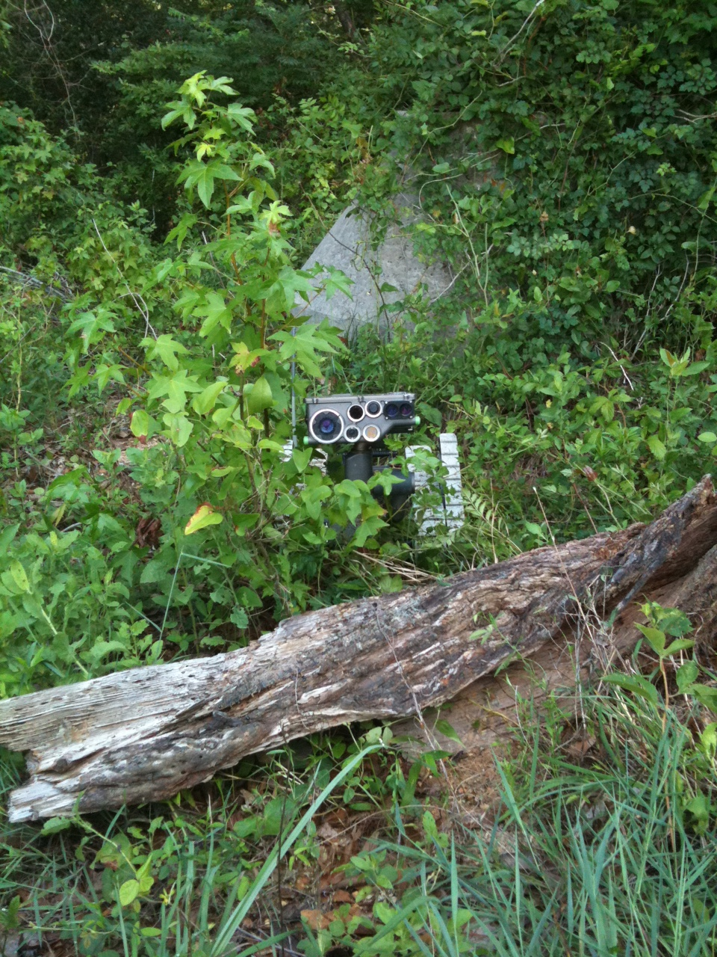
Non-Line of Sight Maneuvers

Slide 38
Terminal Learning Objective
Action: | Conduct Small Unmanned Ground Vehicle (SUGV) Non-Line of Sight (NLOS) Maneuvers.
Condition: | In an operational environment provided with TM 9-2350-397-13&P, SUGV Job Aid, SUGV Student Guide, Mission Oriented Equipment, and an operational SUGV system.
Standard: | Conduct Small Unmanned Ground Vehicle (SUGV) Non-Line of Sight (NLOS) Maneuvers in accordance with TM 9-2350-397-13&P by properly executing all drive poses; properly traversing obstacles; properly recovering from a degraded position during non-line of sight maneuvers with 80% accuracy.

Slide 39
Enabling Learning Objective A
Action: | Execute all vehicle poses.
Condition: | In an operational environment provided with TM 9-2350-397-13&P, SUGV Job Aid, SUGV Student Guide, Mission Oriented Equipment, and an operational SUGV system.
Standard: | Properly execute all vehicle poses for the Small Unmanned Ground Vehicle (SUGV) with 100% accuracy in accordance with TM 9-2350-397-13&P.

Slide 40
Execute all Drive Poses
Press the lock/unlock button
Press the menu toggle button and enter the pose menu
Select deploy pose
Select stow pose
Select drive pose
Select ascend pose
Select descend pose
Select peek over pose
Select peek under pose
Select self inspect pose
Notes:
Instructor will execute all drive poses while the students observe the poses.

Slide 41
Enabling Learning Objective B
Action: | Traverse obstacles
Condition: | In an operational environment provided with TM 9-2350-397-13&P, SUGV Job Aid, SUGV Student Guide, Mission Oriented Equipment, and an operational SUGV system.
Standard: | Properly traverse obstacles for the Small Unmanned Ground Vehicle (SUGV) with 80% accuracy in accordance with TM 9-2350-397-13&P.

Slide 42
Enabling Learning Objective C
Action: | Recover from a degraded position.
Condition: | In an operational environment provided with TM 9-2350-397-13&P, SUGV Job Aid, SUGV Student Guide, Mission Oriented Equipment, and an operational SUGV system.
Standard: | Properly recover Small Unmanned Ground Vehicle (SUGV) with 100% accuracy in accordance with TM 9-2350-397-13&P.
Notes:
Instructor will demonstrate the proper way to recover the SUGV from a degraded position talking the students through the process, step-by-step.

Slide 43
Recovering from a Degraded Position
Press the lock/unlock button
Press the menu toggle button and enter the pose menu
Select the stow pose
Press the flipper up button to position the flippers up Continue to rotate the flippers up until the SUGV in positioned correctly
Select the drive pose
Notes:
Instructor will demonstrate the proper way to recover the SUGV from a degraded position talking the students through the process, step-by-step.

Slide 44
Summary
Terminal Learning Objective
Action: Conduct Small Unmanned Ground Vehicle (SUGV) Non-Line of Sight (NLOS) Maneuvers.
Condition: In an operational environment provided with TM 9-2350-397-13&P, SUGV Job Aid, SUGV Student Guide, Mission Oriented Equipment, and an operational SUGV system.
Standard: Conduct Small Unmanned Ground Vehicle (SUGV) Non-Line of Sight (NLOS) Maneuvers in accordance with TM 9-2350-397-13&P by properly executing all drive poses; properly traversing obstacles; properly recovering from a degraded position during non-line of sight maneuvers with 80% accuracy.

Slide 45
Summary Cont.
Enabling Learning Objectives
ELO A: Execute all drive poses.
ELO B: Traverse obstacles
ELO C: Recover from a degraded position.

