Slide 1
Hand Held Detector (HHD)
Compatibility With CREW/COMS
Notes:
Note for the Instructor/Facilitator (I/F)
1. TWO Options for conducting this class.
a. OPTION 1. Conduct the entire class outside a classroom environment i.e. a training area using actual HHD equipment.
1) You don’t have to use the power point slides but you must cover the learning material and ensure that you meet the objective for this class.
2) You may have the students make notes on butcher paper or you may make key notes ahead of time.
3) If time permits, you may chose to make up a simple scenario to add realism to the PE. You should not give detailed instructions. The students should be able to determine how to solve the problem on their own.
4) This class may be taught in conjunction with another class that requires the use of HHDs as long as the class learning objectives are met.
b. OPTION 2. Conduct the one hour class as shown in this presentation.
2. Present the following motivator statement:
“IEDs will continue to be a highly-effective weapon against dismounted and mounted patrols and will be used with impunity. Dismounted patrols are a primary function in the contemporary operating environment for Counter-IED operations and rely on the observation skills of the Troops to identify possible IED threats. Changing enemy Tactics, Techniques, and Procedures (TTPs) however, have reduced the visual signature of IEDs and made them more difficult to detect and locate”.
3. Use this statement or make up your own based on recent events.

Slide 2
Terminal Learning Objective
Action | Recognize CREW/COMMS equipment and Electromagnetic Environment (EME) interference with HHDs
Conditions | In a classroom or training area environment, given actual HHD equipment and/or presentation, student resources, lesson plan, and current reference material.
Standards | Recognize CREW/COMMS equipment and EME interference with HHDs IAW HHD manuals and unit SOPs. Must score 80% or higher on examinations/rubrics. Recognition includes: 1. Discuss compatibility issues when using HHDs in an Electromagnetic Environment. 2. Recognize sources of interference for the HHDs. Learning Domain: Cognitive Learning Level: Knowledge
Notes:
Note for the Instructor/Facilitator (I/F)
Tell the students that at the end of this one hour class they should be able to recognize CREW/COMMS equipment and Electromagnetic Environment (EME) interference with HHDs. We will cover two LSAs:
a. LSA 1 - Discuss compatibility issues when using HHDs in an EME
b. LSA 2 - Recognize sources of interference for the HHDs
2. Instructional Lead-in.
a. The purpose of this lesson is to provide Soldiers and leaders with the knowledge to effectively employ Hand Held Detectors (HHDs) in support of dismounted IED missions.
b. Note: Use this statement or develop one of your own relating to the material.

Slide 3
Discuss Compatibility Issues When Using HHDs in an EME
The use of any HHD requires that it be compatible with the Electromagnetic Environment (EME) in which it is operated to include:
mounted and dismounted CREW/Communications (COMMS)
military electric generation equipment
other HHDs when deployed together
EME interference of HHDs may occur for a variety of reasons.
There are mitigation strategies dependent on the source of the interference.
Notes:
Note for the Instructor/Facilitator (I/F)
Highlight that the primary interference source to HHDs are CREW/COMMS and other HHDs in close proximity there are other sources native to the environment that can cause interference.
Examples of the these sources are: power lines, generators, transmission towers, vehicle engines etc.
HHD interference can be mitigated to some extent depending on the source.
Discuss EME. Define and explain sources

Slide 4
Discuss Compatibility Issues When Using HHDs in an EME (Cont.)
The AN/PSS-12 and AN/PSS-14 are the Program of Record (POR) for HHDs in the United States Army.
The AN/PSS-12 is a metal detector
The AN/PSS-14 is a dual sensor HHD with a GPR slaved to a MD
There are five HHDs fielded by JIEDDO that are used by US Forces Globally.
CEIA CMD 2.0, 2.04, 2.06 are continuous wave (CW) MD
Vallon VMC1 (Gizmo) is a pulse-induction MD
Vallon VMR2+ (Minehound) is a dual sensor, HHD incorporating a GPR and a MD (same as Gizmo)
DSP-27 / STRIDER
There are a variety of other HHDs in use around the world that are inferior to those above either due to performance deficiencies or compatibility deficiencies.
Notes:
Note for the Instructor/Facilitator (I/F)
AN/PSS-12 and AN/PSS-14 are included here because, as the POR, it is equipment available to operational units. However, the focus of this brief is on the JIEDDO fielded HHDs.
A CW MD provides a continuous signal to the detector coil in the form of a Sine wave (or multiple Sine waves for multi-frequency systems). The Sine wave will be centered at 0 and have both a negative and positive peak. It detects by subtracting the CW signal from any return signals to make detection declarations. Very effective for material discrimination but struggles with mineralized soils.
A PI system provides periodic signals to the coil in the form of short rectangular pulses; systems are often bipolar meaning positive and negative pulses are alternated in the coil. It detects by measuring any return signal during the time when no signal is provided to the coil. Very effective in mineralized ground and salt water and detecting larger metal at deeper depths.

Slide 5
Discuss Compatibility Issues When Using HHDs in an EME (Cont.)
All HHDs are susceptible to interference from any radiation source depending on the generated EME and power.
All JIEDDO HHDs have been tested multiple times for compatibility with CREW/COMMS devices and loadsets.
Four Eyes compatibility assessments occur annually
Interference has never damaged an HHD though error codes may occur during the interference event.
Current US CREW loadsets cause minimal interference.
DUKE and EGON are worst case for Minehound
Current THOR III loadset is compatible with all HHDs
Vehicle engines (generators/alternators) are worst case for MDs.
Notes:
Note for the Instructor/Facilitator (I/F)
Over the course of testing the past 4 years interference has occurred for all HHDs by a variety of CREW/COMMS equipment.
There are many factors influencing whether interference occurs, foremost being the load set employed by the CREW system and waveform employed by the COMMS system. Other factors include terrain, proximity of other EME sources, Minehound detector head height above the ground, and the Minehound GPR parameter values.
Vehicle engines generate low frequency signals that are similar to both CW and PI MDs. Gasoline engines have spark plugs that spark ~ 250 times per second, multiply this by 6 or 8 cylinders and you have pulse rates similar to the Gizmo. The stators in any alternator have brushes that generate both pulse and CW signals that have frequencies similar to both CEIA and Gizmo.

Slide 6
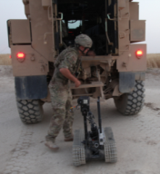
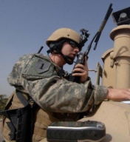
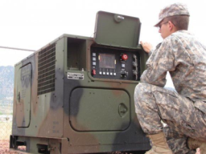
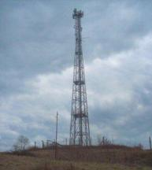
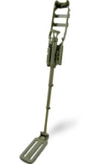
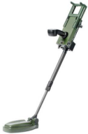
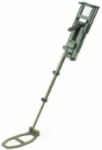
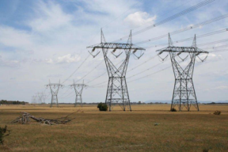
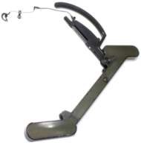
Discuss Compatibility Issues When Using HHDs in an EME
If it radiates electromagnetic energy it could be a source of interference
Notes:
Note for the Instructor/Facilitator (I/F)
Any source of electromagnetic radiation in the environment could be a cause for interference depending on frequency, power and proximity.
Always be aware of potential threats in the immediate area.
This could include native sources such as power lines, generation stations or transmission towers (to include cell towers) or transient sources such as Coalition CREW/COMMS systems operating within your AO.
In the same way radios can conflict with each other if transmit/receive frequencies are not coordinated, EME can cause interference to an HHD.

Slide 7
Check on Learning
What are some of the interference sources associated with HHDs?
CREW, HHDs, Power Lines, Generators, Transmission towers (cell Towers)
HHDs are required to be compatible with other electronic equipment utilized by CFs. True or False?
TRUE
Interference can cause damage to an HHD. True or False?
FALSE
7
Notes:
Note for the Instructor/Facilitator (I/F)

Slide 8
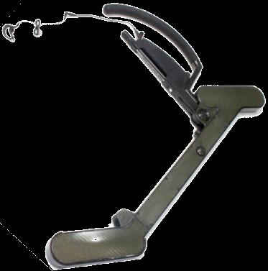
Recognize sources of interference for the HHDs
DSP-27 Interference
Source | Effect | Mitigation
COMMS on transmit | None observed
Vehicle CREW | Erratic or continuous alert < 5 m | Maintain Stand-off
Vehicle engine | Erratic or continuous Alert < 5 m | Maintain Stand-off or Turn-off engine
THOR III/Manpacks | None observed
Other handhelds | Erratic or continuous alert < 5 m | Maintain Stand-off
Notes:
Note for the Instructor/Facilitator (I/F)
DSP-27 is most susceptible to any electronic device in close proximity to one antenna pod or the other.
Interference is not distinct but generates the same sound as a detection alert.
Typically, a radio, cell phone or other pocket device carried on the same side of the body as the DSP-27 can cause these false alarms (FA).
HHDs operated in close proximity can also generate FAs.
Tactical spacing should mitigate any of these FAs.
Remedy changed to mitigation

Slide 9
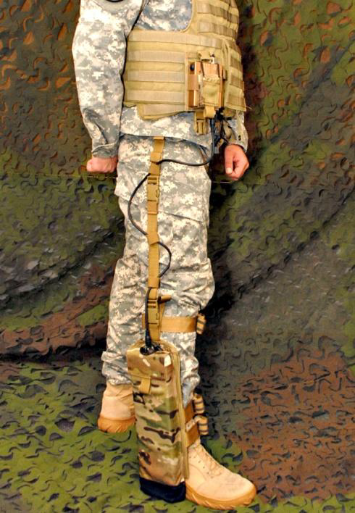
Strider
System Interoperability: Separation Distances
The Strider system must never be switched on or used within proximity of the following systems:
5 meters
Blue Force Tracker
Comms Equipment
HHD (CEIA, VMC-1, VMR-2, DSP-27)
Man Pack CREW systems (THOR III, BALDR)
Cell phones
10 meters
Mounted CREW systems (except Duke v3)
35 meters
Duke v3 mounted CREW system
Notes:
Note for the Instructor/Facilitator (I/F)
DSP-27 is most susceptible to any electronic device in close proximity to one antenna pod or the other.
Interference is not distinct but generates the same sound as a detection alert.
Typically, a radio, cell phone or other pocket device carried on the same side of the body as the DSP-27 can cause these false alarms (FA).
HHDs operated in close proximity can also generate FAs.
Tactical spacing should mitigate any of these FAs.
Remedy changed to mitigation

Slide 10
VMC1 (GIZMO) Interference
Source | Effect | Mitigation
COMMS on transmit | Noisy alert burst < 5 m | Avoid transmit while sweeping
Vehicle CREW | Pulsed tone < 5 m | Maintain Stand-off
Vehicle engine | Erratic alerts < 5 m | Maintain Stand-off or Turn-off engine
THOR III/Manpacks | None observed
Other handhelds | Erratic or continuous alert < 5 m | Maintain Stand-off
In all instances of interference the auto and/or manual channel
select feature should be utilized to mitigate effects
Notes:
Note for the Instructor/Facilitator (I/F)
VMC1 interference generates the same sound as an alert but is distinguished by the erratic nature of the FAs.
Interference from vehicle mounted CREW is distinct in the periodic pulsing of the alert that it generates.
Discuss working with other GIZMO

Slide 11
CEIA CMD 2.0x Interference
Source | Effect | Mitigation
COMMS on transmit | None observed
Vehicle CREW | Continuous alert < 5 m | Maintain Stand-off
Vehicle engine | Continuous alert < 5 m | Maintain Stand-off or Turn-off engine
THOR III/Manpacks | None observed
Other handhelds *CEIA HHDs | Erratic or continuous alert < 5 m *18m | Maintain Stand-off
*CEIA MDs are fielded with 1 of 5 channels, any 2 with the same channel must
be 18 m apart otherwise 2 m. Channel indicated by last digit of SN
0 & 5, 1 & 6, 2 & 7, 3 & 8, 4 & 9 are equivalent channels
Notes:
Note for the Instructor/Facilitator (I/F)
CEIA interference generates the same sound as either a metal or carbon rod alert, though it is typically the metal alert.
It can be distinguished by an erratic warble rather than the consistent whistle.
Interference may also present as both alarms alerting erratically.
4. working with multiple CEIA and compatibility

Slide 12
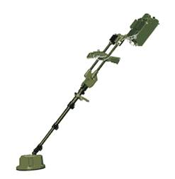
AN/PSS-14 – GPR Interference
Source | Effect | Mitigation
COMMS on transmit | None observed
Vehicle CREW | < 20 m | Maintain Stand-off
Vehicle engine | None observed
THOR III | None observed
Other handhelds | None observed
The MD performance is similar to the VMC1 with <10 m stand-off required
Notes:
Note for the Instructor/Facilitator (I/F)
Discuss sources of interference

Slide 13
VMR2 (Minehound) – GPR Interference
Source | Effect | Mitigation
COMMS on transmit | None observed
Vehicle engine | < 20 m | Maintain Stand-off Adjust GPR Parameters
THOR III | None observed
Vehicle CREW | None observed
Other handhelds | None observed
Detect through Interference
The MD performance is the same as the VMC1
Notes:
Note for the Instructor/Facilitator (I/F)
The VMR2 MD interference presents the same as the VMC1.
The GPR interference is a distinguishable by the jumble of sounds, such as a flock of turkeys, rather than a unique tone that correlates with the sweep of the detector head.
It is possible to detect through the interference because of these features

Slide 14
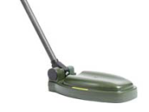
VMR2 – GPR Parameter Summary
LED | Adjustment | Range | Default
11 | Start Point (Top Down) | 30 – 80 | 30
11F | Stop Point (Bottom Up) | 255 – 100 | 255
12 | Linear Gain | 1 – 60 | 28
11 + 12 | Time Variable Gain (TVG) | 1 – 10 | 1
Uneven Surface
Standing
Water
Snow
Vegetation
30
T
Start Point
11
12 – Amplifies Shallow Targets
80
D
100
U
Water
Table
11 + 12 – Amplifies Deep Targets
Stop Point
11F
Bedrock
B
255
14
Notes:
Note for the Instructor/Facilitator (I/F)
Review Minehound GPR parameters
11 top down
11flashing bottom up
12 linear gain
Discuss linear gain

Slide 15
GPR Parameters – Start Point
“Top-Down”
Allows adjustment of the sample start time moving the minimum detection depth of the GPR
Range 30-80 (50 increments)
Actual depth depends on the soil dielectric constant
Deeper in loose, dry sand
Shallower in packed, wet clay
Vegetation
30
Surface Soil
60
Subsurface Soil
Notes:
Note for the Instructor/Facilitator (I/F)
Start Point: Also known as “Top-Down”.
This parameter is based on the RF signal propagation time, which in free space (i.e. no soil or material) is the speed of light=3x10^8 meters/second. This restricts GPR alerts to occur only after the RF energy has travelled some minimum distance.
If the operator wants to eliminate GPR signals caused by gravel and uneven soil on the surface he presses the (+) button to increase the time for the start point delaying the detection of the return RF pulse after a specified distance.
Soil dielectric constant

Slide 16
GPR Parameters – Stop Point
“Bottom-Up”
Allows adjustment of the sample stop time moving the maximum detection depth of the GPR
Range 255-100 (155 increments)
Actual depth depends on the soil dielectric constant
Deeper in loose dry sand
Shallower in packed wet clay
Subsurface Soil
Bedrock
or
Water Table
100
255
16
Notes:
Note for the Instructor/Facilitator (I/F)
Stop Point: Also known as “Bottom Up”, this will allow you to narrow the detection zone.
This parameter is based on the RF signal propagation time, which in free space (i.e. no soil or material) is the speed of light=3x10^8 meters/second and works like the Start Point.
This restricts GPR alerts to occur only after the RF energy has travelled some maximum distance.
If the operator wants to eliminate GPR signals caused by bedrock or a water table he presses the (-) button to decrease the time for the stop point stopping the detection of the return RF pulse at a specified distance.
This parameter is the first to adjust in an attempt to mitigate interference. By reducing it to 100 it will eliminate low frequency interference but it will also limit detection to the top surface of the ground (4”-16”).

Slide 17
Linear Gain (LG)
Amplifies all signals equally
Range 1 - 60 (60 increments)
Effective gain determined by the soil dielectric constant
Lower values needed for loose dry sand
Higher values needed in packed wet clay
28
38
48
17
Notes:
Note for the Instructor/Facilitator (I/F)
This parameter is the third parameter to adjust in an attempt to mitigate interference.
This should only be adjusted if there is an item in the ground to calibrate against – increase LG in an attempt to raise the target signal above the background noise.

Slide 18
Time Variable Gain (TVG)
Amplifies signals later in time more than signals earlier in time.
Range 1-10 (10 increments)
TVG is added to LG and is based on a simple multiplication applied to each point in the detection window (Stop-Start points) with the Stop point multiplied by the set value
Effective gain determined by the soil dielectric constant
Lower values needed for loose dry sand
Higher values needed in packed wet clay
1
4
7
Detection Window Depth (Stop-Start Points)
Start Point
Stop Point
18
FOR OFFICIAL USE ONLY
Notes:
Note for the Instructor/Facilitator (I/F)
This parameter is the second parameter to adjust in an attempt to mitigate interference.
Reduce TVG to 1.

Slide 19
Contingencies
Why work through HHD Interference?
Loss of operational control over the source
THOR III operator is down
Vehicle with active CREW is down
Mission critical
Need to approach infrastructure with interfering sources
Increase the volume whenever attempting to detect through interference. Typically, detection signals are increased greater than noise signals and may be raised above the interference.
Notes:
Note for the Instructor/Facilitator (I/F)
In the case of a downed THOR III operator or an overturned vehicle, the antennae are much closer to the ground or even in contact with the ground.
The chances for interference will be much greater and highly dependent on the ground conditions. Clearing a safe route to render aid may require working through GPR interference.
Must know what normal operation sounds like in your handheld device

Slide 20
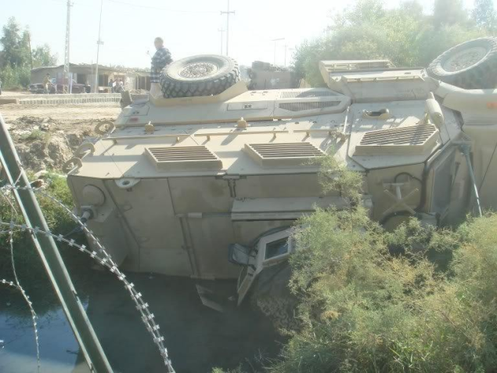
Threat Assessment
WARNING:
Never Touch or hold
An active Antenna
Radio Towers
Concertina Wire
CREW/COMM antennas
Ground Condition
Water
Notes:
Note for the Instructor/Facilitator (I/F)
What are the potential interference sources?
Radio Towers – DSP-27, MD, GPR
Water on the ground – GPR
Barb Wire – MD, DSP-27
Vehicle Antennae – MD, GPR, DSP-27
Need better picture with more contrast
Make sure they fill from top to bottom *adjust*

Slide 21
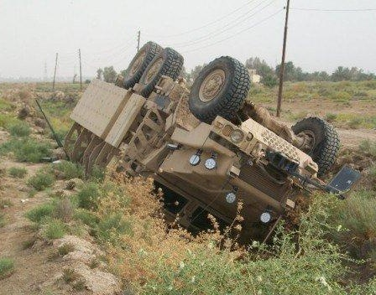
Threat Assessment (cont.)
WARNING:
Never Touch or hold
An active Antenna
Power Lines
Running Engine
CREW/COMM
Antennas
Optional Equipment – RHINO (Iraq) – could be HMDS
Notes:
Note for the Instructor/Facilitator (I/F)
What are the potential interference sources?
Radio Towers – DSP-27, MD, GPR
Water on the ground – GPR
Barb Wire – MD, DSP-27
Vehicle Antennae – MD, GPR, DSP-27

Slide 22
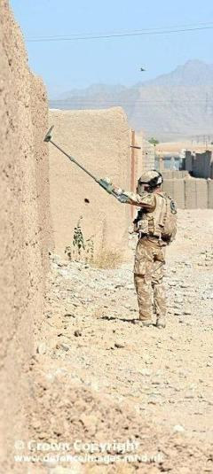
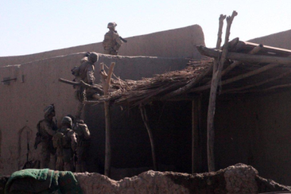
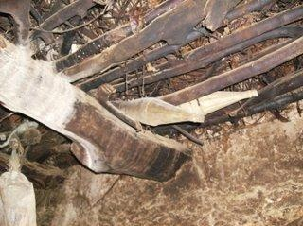
Other Considerations
Sweeping walls and clearing multi-level compounds
Reset GPR Parameters TVG = 10
Stop = 255
LG – Adjust as needed
Increase MD sensitivity
GPR alert that increases/decreases in pitch could indicate motion behind wall
Notes:
Note for the Instructor/Facilitator (I/F)
It is important for operators to remember that the Minehound was compensated for the ground.
Walls and floors in huts and compounds will be composed of material different than the ground.
Increase Stop Point to 255 - ensures max penetration through the wall, listen for constant low warble (similar to bottom of lane) to determine if the other side of the wall is being detected.
Increase TVG to 10 - ensures max signal detection. There is likely nothing to cause a false alarm “deep” in a wall or floor since it should only have air behind it. Adjust LG as needed – could need increase or decrease depending on consistency of the wall/floor, composition, moisture, etc.
Increase MD sensitivity – metal contamination of the wall is less likely than ground and conductivity/resistivity likely more consistent than the ground. Use mineralized mode (VMC1/VMR2-MD) or ground balance (CEIA) as required.
BLUF – don’t assume ground settings are adequate.
Picture on right needs to replaced too dark

Slide 23
Check on Learning
Which of the following HHD is the most susceptible to interference with any electronic device?
a. GIZMO c. Minehound
b. DSP-27 d. CEIA
b. DSP-27
What is linear gain?
Amplifies all signals equally
The Minehound is normally compensated for the ground, but can be adjusted to sweep walls and floors in huts. True or False?
TRUE
23
Notes:
Note for the Instructor/Facilitator (I/F)

Slide 24
Summary
Lesson: Hand Held Detector Compatibility
In this LSA we covered sources of interference for the HHDs that you should recognize which includes:
Radio Towers – DSP-27, MD, GPR
Water on the ground – GPR
Barb Wire – MD, DSP-27
Vehicle Antenna – MD, GPR, DSP-27
Notes:
Note for the Instructor/Facilitator (I/F)
1. Action (TLO): Employ HHDs in the presence of CREW/COMMS equipment, other HHDs, as well as other electrical equipment and recognize EME interference

Slide 25
QUESTIONS?
Notes:
Note for the Instructor/Facilitator (I/F)
Answer any question as necessary.

