Slide 1
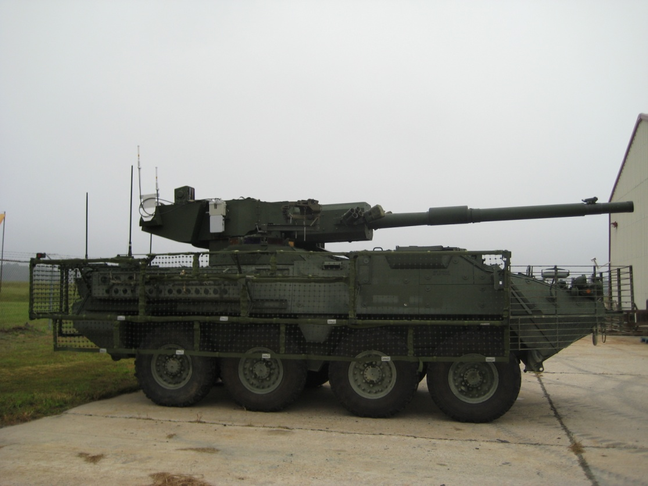
IPU MGS Install Instructions

Slide 2
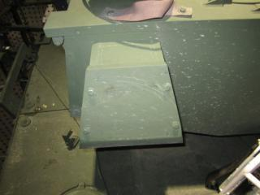
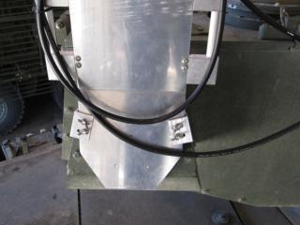
Antenna Mount
Install on the right rear or turret (fan exhaust) and adjust the two side tabs to prevent the mount from shifting left or right.

Slide 3
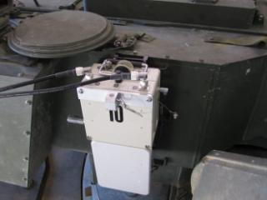
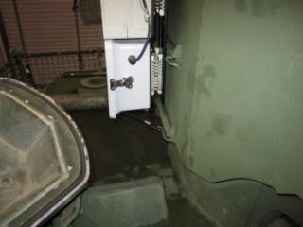
BMU
Install on the turret ammo storage mounts and secure with the bungee strap. The bungee strap has to closed in the BMU battery box compartment and then secured to the ammo storage mounts below. (Ensure that the internal and external battery cables are connected).

Slide 4
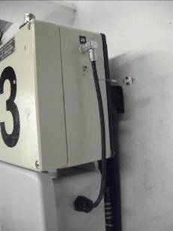
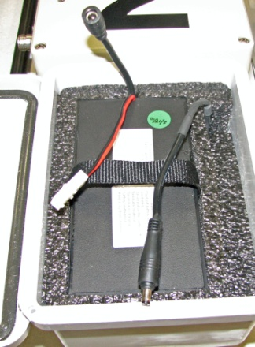
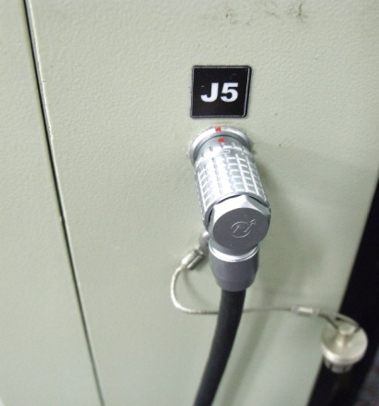
BMU Battery Cable
Battery Power Cable
BMU Power Cable and J5 Connector
BMU Power Cable
Twist the locking latch on the BMU battery box cover and open the cover. Connect the Battery Power Cable to the BMU Power cable, close and lock the cover. Connect the BMU Power Cable connector to the J5 connector on the BMU; ensure that the red dots on the BMU Power Cable connector and the J5 connector are aligned.

Slide 5
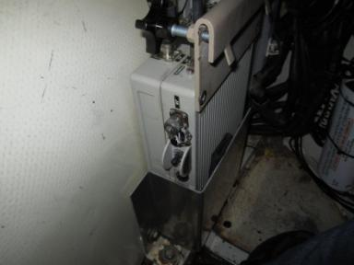
CMU
Install the CMU in the commanders position as shown above using the mounting bracket provided. Loosen the 18mm bolt on the electronics shield to install the mounting bracket and secure. Place the CMU in the mount.

Slide 6
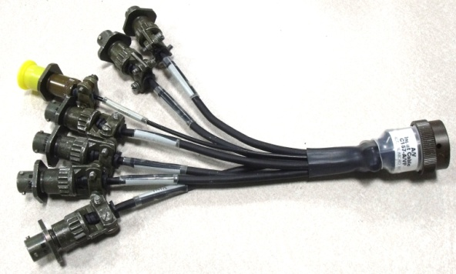
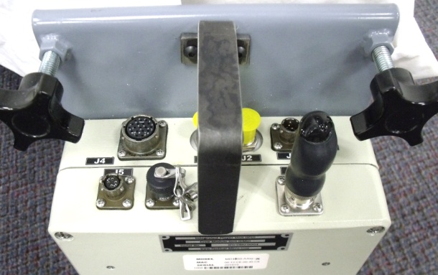
A/V Input Cable
A/V Input Cable
CMU J6
Connect the A/V Input Cable to the CMU J6 connector

Slide 7
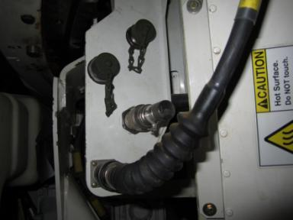
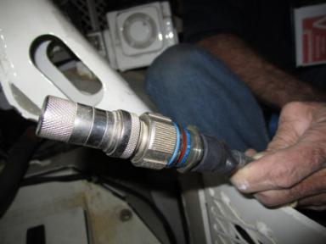
STRYKER Video Cable
Remove the jumper plug from the J3 connector of the training device panel and install the MGS/Stryker video cable. Install the jumper plug on the end of the MGS/Stryker video cable. Connect the 3 video cables to the A/V input cable on the CMU.

Slide 8
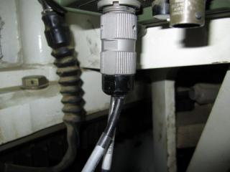
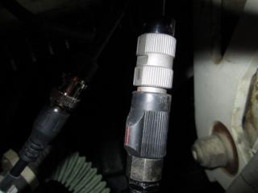
External Audio Adapter
The External Audio Adapter (EAA) attaches to the Full Function Crew Station in the Commander’s Station. Attach the CVC to the External Audio Adapter connector labeled “CVC” and the External Audio Adapter Cable connects to the BNC connector on the external audio adapter. Route the cable to the CMU and connect it to the A/V Input Cable connector labeled (A).

Slide 9
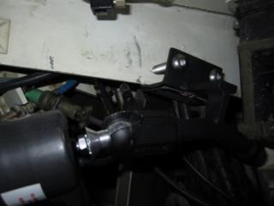
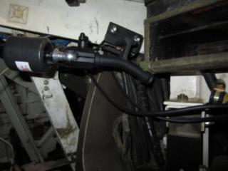
Crew Camera
Using the DCB and one crew camera, secure the camera and mount and install the mount to close to the location of the gunner’s dome light and vision block. Secure the mount to the vehicle by tightening the 9/16 bolts. Attach a camera cable to the crew camera and route it to the CMU and attach it to one of the video inputs on the CMU A/V Input cable.

Slide 10
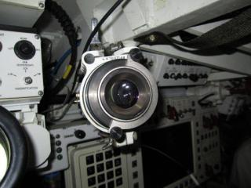
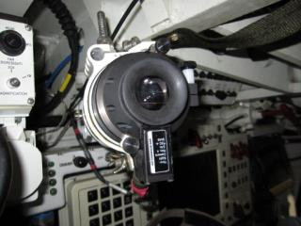
Thru-sight Camera
Remove the eyecup from the GAS and store for future use. Attach the Commanders Aux sight adapter to the GAS and lock in place. Install the Thru-sight Camera onto the adapter and secure with the thumb screw. Attach a camera cable to the TSC and route it to the CMU and connect it to one of the video inputs on the CMU A/V Input cable.

Slide 11
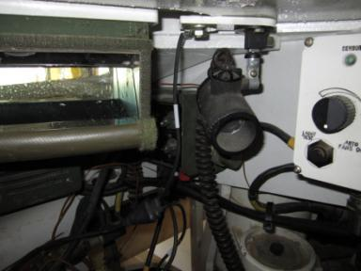
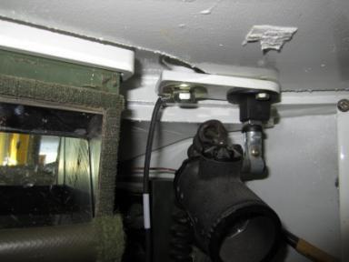
Dome Light Power Cable
Disconnect the commander’s dome light power cable and install connect the IPU dome light power cable. Connect the dome light power to the connector labeled “dome light power”. The dome light to the connector labeled “dome light”. Attaching the ground requires a 7/16” socket/wrench. Attach the power cable to the PowerVerter.

Slide 12
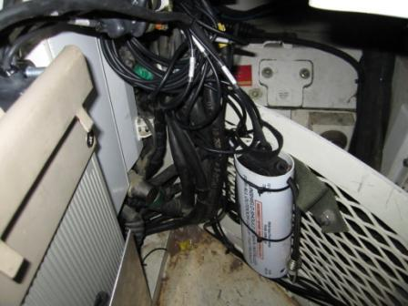
PowerVerter
Ensure that the Dome Light Power Cable is connected to PowerVerter Cable. Connect the PowerVerter Cable labeled “CMU J1” to the CMU J1. Secure the PowerVerter to the wall using zip ties.

Slide 13
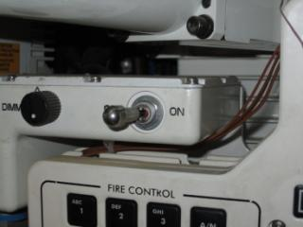
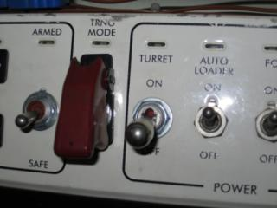
Power-UP
Turn on Turret Auxiliary Switch (TAS)
Turn on turret power
Turn on the BMU Power
Turn on CMU Power

Slide 14
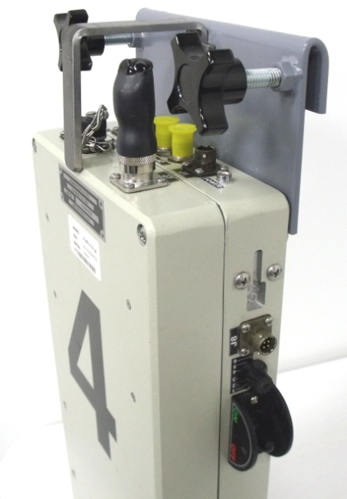
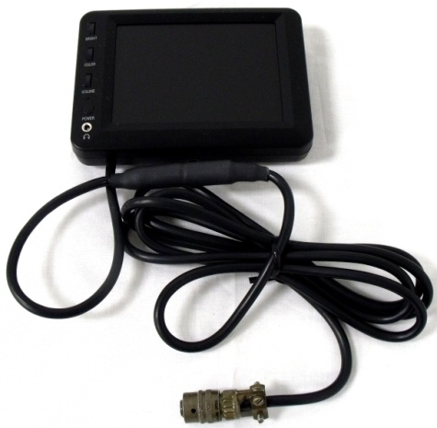
Hand Held Monitor
Handheld Monitor
CMU J8 Connector
Connect the Handheld Monitor connector to J8 connector on CMU. Turn on the Handheld Monitor power. Turn the Monitor Selector Switch on the CMU to the desired video input. Ensure that the cameras are aligned properly. When the cameras are properly aligned, remove the Hand Held Monitor and store it a safe location, so it will not be damaged.
Note: The Handheld Monitor will shut off automatically if it does not detect a video source.

Slide 15
Secure Cables
Once installation is complete ensure that all cables are secured and clear of the turret, main gun, and/or any place where they inhibit the crew’s operation of the vehicle.

