Slide 1
FIELD LEVEL MAINTENANCE

Slide 2
Agenda
What is Field Level Maintenance?
Capabilities and limitations within Field Level Maintenance (FSC/FMT) and the responsibilities of key personnel
Functions of the platoon and suggestions to assist in the success of maintenance operations

Slide 3
Levels of Maintenance
C/10 Crew/Operator
O/20 Organizational
F/30 Direct Support DS
H/40 General Support
D/50 Depot Support
Field Level Maintenance is focused on returning a weapon system to an operational status. The field level maintenance accomplishes this mission by fault isolating and replacing the failed component, assembly, or module on the weapon system.
Field Maintenance
Sustainment Maintenance

Slide 4
Field Level or Sustainment

Slide 5
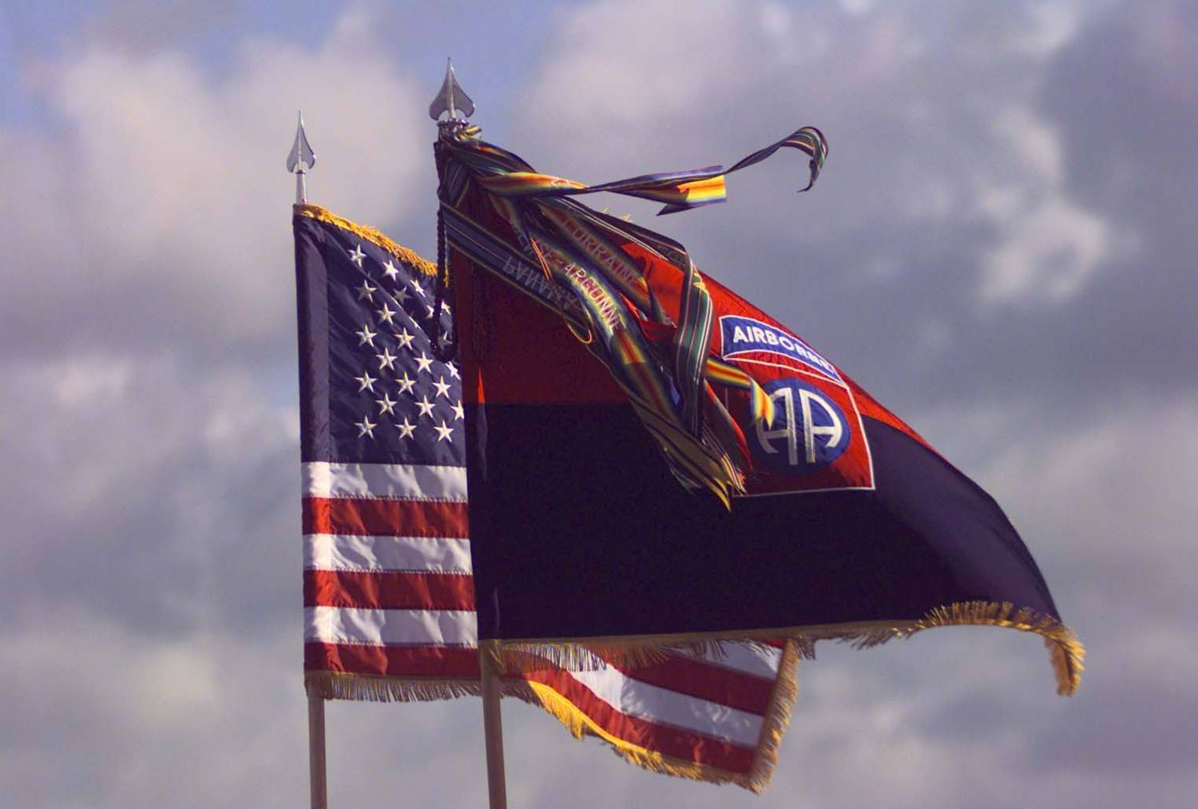
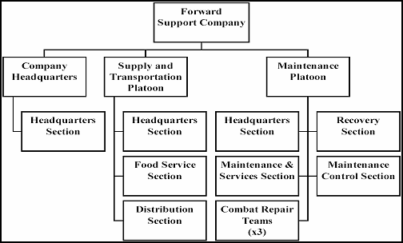
Field Level Maintenance

Slide 6
Key Personnel
Maintenance Control Officer (MCO): Keeps the Commanders and staff informed of maintenance performance, requirements, and problems as they occur.
Maintenance Technician (BMT/SMT): Coordinates and Manages maintenance operations with support groups and establishes central priorities.
Maintenance Control Sergeant (MCS): Assists the MCO and BMT/SMT on all maintenance operations. Supervise shop operations for the BN/SQDN, to include direction of scheduled and unscheduled services/repairs and troubleshooting.
Motor Sergeant: Coordinates with MCS, BMT/SMT and MCO on maintenance workload, priority, and vehicle requirements. Determines whether jobs are to be repaired in the shop, on-site, or evacuated, and makes necessary arrangements in each case.
TAMMS NCOIC: Oversees the ordering and receiving of all CLIX repair parts for the BN/SQDN and manages the Logistics Information Systems (LIS).

Slide 7
Field Level Maintenance
FSC maintenance platoon consists of 49 personnel in various MOS’s
Average BN/SQDN size unit has approximately 200 pieces of rolling stock.
Where did my mechanic go? Is he on detail again?
I need to be serviced.
Where’s my operator?
Me too!
How am I going to fix all this equipment by myself?
At least they drove you in the bay and didn’t forget about you!

Slide 8
The maintenance platoon can function consolidated or split based depending on METT-TC. The FMT from the FSC provides dedicated field maintenance and recovery capability to the supported companies.
Items to consider:
- turn around time FLM vs. Sustainment
- capabilities of your FSC or FMT
Field Level Maintenance

Slide 9
Keys to Success
Crew/operator performing PMCS is the cornerstone of maintenance.
Well executed scheduled maintenance is essential to maintain high readiness rates. Mechanics from the FSC perform -20 level services with assistance from assigned vehicle operators.
Commanders are responsible for equipment readiness.

Slide 10
FLM REFERENCES
AR 385-10 The Army Safety Program
AR 750-1 Army Materiel Maintenance Policy
DA PAM 750-8 The Army Maintenance Management
System (TAMMS)
DA PAM 750-1 Leaders Unit Maintenance Handbook
DA PAM 750-3 Motor Pool Operations
XVIII ABN 750-1 Army Materiel Maintenance Policy and
Retail Maintenance Operations
DR 750-1 Division Maintenance Standing Operating
Procedures
ATTP 4-33 Maintenance Operations

Slide 11
Field Level maintenance
QUESTIONS?

