Slide 1
UNCLASSIFIED//FOR OFFICIAL USE ONLY
Military Intelligence
Readiness Command
Intelligence Oversight
Intelligence Oversight Training for SIGINT
UNCLASSIFIED//FOR OFFICIAL USE ONLY

Slide 2
So why separate Intelligence Oversight training for SIGINT’ers?
This training covers AR 381-10 and DOES NOT replace training required by the National Security Agency IAW:
United States Signals Intelligence Directive (USSID) SP0018 (Legal Compliance and Minimization Procedures)
SE1000, Annex A (Intelligence Oversight for Army Signals Intelligence (SIGINT) Operations
NSA Policy 1-23 (Procedures Governing NSA/CSS Activities that Affect U.S. Persons)
AR 381-10 requires that ALL Army personnel receive training on Army intelligence oversight policies.
Personnel conducting SIGINT will comply with relevant NSA/CSS directives, which take precedence over AR 381-10 for SIGINT missions
.

Slide 3
SIGINT Intelligence Oversight Management
The DIRNSA has overall responsibility for ensuring USSS compliance with US laws, regulations, etc..
The Army DCS G2 has overall responsibility for ensuring Army compliance.
The CG INSCOM is the Army Service Cryptologic Component (SCC) and therefore responsible for ensuring Army SIGINT operations are conducted legally.
INSCOM G3 Army Cryptologic Office (ACO) is charged with managing site profiles, USSIDs (policy development), processing incidents and reporting
INSCOM Intelligence Oversight Advisor (IOA) has overall responsibility for the INSCOM Intelligence Oversight Program
Commanders with approved SIGINT missions are responsible for: conduct of SIGINT operations performed by their subordinates, incident and quarterly reporting.
.

Slide 4
What Is Intelligence Oversight (IO)?
Intelligence Oversight is the process of ensuring all DOD
intelligence, counterintelligence, and intelligence related activities are conducted in accordance with applicable US law, Presidential Executive Orders, and DOD directives and regulations.
Enables DoD intelligence components to carry out their functions while ensuring the rights of U.S. Persons are protected
BLUF: DA intelligence components and individuals MAY NOT
conduct an intelligence mission unless they have been
lawfully assigned that function.
Having the capability and need to collect intelligence does NOT mean you have the authority to collect it.

Slide 5
Intelligence Oversight and the US Army
IO regulations apply to you: soldier, civilian, and contract employee
You are governed by three main references:
EO 12333 U.S. Intelligence Activities
DOD Regulation 5240.1-R DoD Intelligence Activities
AR 381-10 US Army Intelligence Activities - 3 May 2007
MIRC Policy Memorandum Intelligence Oversight- provides the MIRC methods of managing the Commands IO program
IO responsibility usually follows the operational chain of command, but can reside in the ADCON chain.
IO responsibility must be clearly delineated in every command relationship
MIRC IO program managed by the MIRC IO Officer, G33 OPS, Ft Belvoir, VA

Slide 6
Additional SIGINT Directives
The INSCOM G3 ACO (Cryptologic Policy and Oversight) manages approved SIGINT missions with SIGINT Operations Tasking Authority (SOTA)
Completes quarterly Executive Order (EO) 12333 (U.S. Intelligence Activities) report
Ensures incident reporting
Delegated national SIGINT mission is managed by NSA

Slide 7
Why We Have Intelligence Oversight
In the 1960s and 1970s Civilian Leaders ordered Intelligence units to collect information on U.S. Persons involved in the Anti-war and Civil Rights Movement due to suspected Soviet Communist influence on those organizations. These were not legitimate DoD targets.
Change was needed.
President Ford responded with EO 12036. President Reagan subsequently issued EO 12333.
Press coverage and congressional interest of intelligence activities necessitates a need for accountability in decisions to employ MI assets and ability to show ability to self-regulate.
Protecting the Constitutional Rights of U.S. Persons is a major component of our responsibilities – IT IS THE RIGHT THING TO DO!
The IO system is intended to:
Give the Army and DoD leadership confidence we can police ourselves
Indentify, correct and document errors
Protect US Persons
Prevent serious misconduct or violation of law

Slide 8
AR 381-10 Outline
17 Chapters (14 are “procedures”)
Chapter 1 – General provisions
Procedure 2 - Collection
Procedure 3 - Retention
Procedure 4 - Dissemination
Procedure 5 – Electronic Surveillance
Procedure 6 – Concealed Monitoring
Procedure 7 – Physical Searches
Procedure 8 – Mail Searches and Examination
Procedure 9 – Physical Surveillance
Procedure 10 – Undisclosed Participation in Organizations
Procedure 11 – Contracting for Goods and Services
Procedure 12 – Assistance to Civilian Law Enforcement Authorities
Procedure 13 – Experimentation on Human Subjects for Intel Purposes
Procedure 14 – Employee conduct
Procedure 15 – Questionable Activities
Chapter 16 – Federal Crimes
Chapter 17- Force protection, multi-national support
AR 381-10 is a “positive” document, these procedures detail the ways to lawfully collect on a US Person

Slide 9
What Is a “U.S. Person”?
A ‘U.S. Person’ is:
U.S. Citizens
Permanent Resident Aliens (PRA) “Green card”-student VISA does not confer US Person status. An illegal alien is not a US Person
Unincorporated Associations Substantially Composed of U.S. Persons
U.S. Corporations incorporated in the US (even if incorporated by Non-US Persons) Note: the company is the US Person.
(residents of U.S. Commonwealth nations = U.S. Person)
If you do not know someone’s status, then apply one of these presumptions:
Presumption in the US: entities physically located in the US, you presume they are a US person unless there is specific information to the contrary*
Presumption Outside the U.S. entities located outside the United States is presumed NOT to be a U.S. person unless there is specific information to the contrary*.
*Note: Information to the contrary includes passports, drivers’ license, Government ID card, etc...

Slide 10
What Is a “U.S. Person” on the Internet?
-What are the considerations for determining if a website, URL, email address or IP address is or about a US Person?
Some basic guidelines are:
IP Address: Not considered “collected” until processed into intelligible form=no IO restrictions on its maintenance. If URL is deciphered/analyzed, then a reasonable & diligent inquiry is done to determine its association with a US Person using web tools or external information. If unable to determine=assume it is not associated with a US Person. Document efforts taken to make the determination.
URL: Unlike IP addresses and email addresses, URL are almost always publicly available. As such, even if they identify US Persons, lists of URL may be collected if within the scope of a lawful and authorized intelligence function.
Email address: Are almost always associated with an individual. Indentifying the individual is hard. Email addresses may be retained if not analyzed. If analyzed, then an effort must be made to determine if it is associated with a US Person. Some US Person emails are obvious (i.e. Barrack.Obama@whitehouse.gov). Others are not. If unable to determine if associated with a US Person, then presume it is not.
Web site (for a corporation, university, club, association, church, etc..) If the domain is commonly associated with a foreign country (i.e. .UK, .FR) and there is no information to the contrary=presume it is not a US Person. The mere use of a universal domain (.com) does not mean it is automatically associated with a US Person. To determine if a site is a US Person consider: geographic location of the and nature of the underlying organization, its incorporation status, rules of participation, formal membership process, etc…

Slide 11
General Provisions (Procedure 1)
MI activities MUST fall within your approved mission
Prohibits Assassinations
Does not apply to law enforcement activities
Commander’s of units with a MI mission will:
train their personnel to conduct missions lawfully
Designate an intelligence professional in the operational chain as the unit intelligence oversight staff officer (cannot be a contractor or the command’s attorney).
SIGINT units will also have a SIGINT Intelligence Oversight Officer)
Ensure legal advisor reviews all activities conducted under AR 381-10 Chapter 5 thru 13

Slide 12
“Collection (Procedure 2)”
“Information is collected when it is gathered or received by an intelligence employee in the course of official duties, and is intended for intelligence use.
An employee must take an action that demonstrates an intent to use or retain the information, such as producing an intelligence information or incident report or adding the information to an intelligence database.
Data acquired by electronic means….is “collected" only when it has been processed from digital electrons into a form intelligible to a human.
Simply accepting or receiving information to pass to another organization or determine its intelligence value does not constitute “collection”.

Slide 13
Collecting U.S. Person Information (Procedure 2)
1. Information necessary to the conduct of a function assigned to the
intelligence component involved.
AND
2. Falls within one of 13 categories of
collectible information :
1. Obtained with consent
2. Publicly available
3. Foreign intelligence
4. Counterintelligence
5. Potential source of assistance
6. Protection of intel sources and methods
7. Physical security
8. Personnel security
9. Communications security
10. International narcotics
11. Threats to safety
12. Overhead Recon.
13. Administrative purposes
(see Chap 2, AR 381-10 for further definitions)
AND
3. Collected by AUTHORIZED and LEAST INTRUSIVE means.

Slide 14
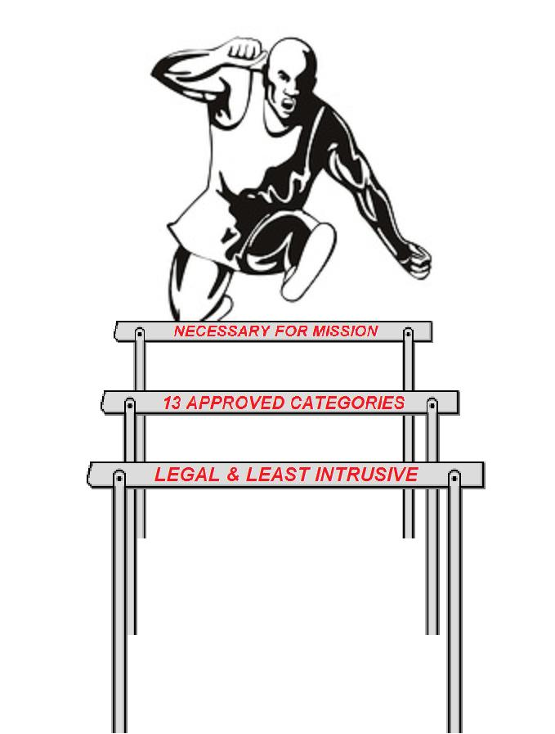
Collecting U.S. Person Information (Procedure 2)
1. Information necessary to the conduct of a function assigned to the
intelligence component involved.
AND
2. Falls within one of 13 categories of
collectible information :
1. Obtained with consent
2. Publicly available
3. Foreign intelligence
4. Counterintelligence
5. Potential source of assistance
6. Protection of intel sources and methods
7. Physical security
8. Personnel security
9. Communications security
10. International narcotics
11. Threats to safety
12. Overhead Recon.
13. Administrative purposes
(see Chap 2, AR 381-10 for further definitions)
AND
3. Collected by AUTHORIZED and LEAST INTRUSIVE means.
Think of a runner who has to clear three hurdles to win the race

Slide 15
Retaining U.S. Person Information (Procedure 3)
A US Persons information MAY be knowingly retained without the individual’s consent.
“RETENTION” = means a US Person’s personal identifying information can be retrieved by name or other personally identifying data (photo, SSN).
Retention is authorized if: 1. Properly collected under Procedure 2. 2. Is necessary to access foreign intel or CI 3. Foreign intelligence or CI collected from authorized electronic surveillance 4. Is incidental to the authorized collection and may indicate federal, state, or local law was violated. Information may be retained long enough to identify and disseminate to it appropriate recipient agency or organization

Slide 16
Retaining U.S. Person Information (Procedure 3)
‘90 Day Rule’ —If you receive a report with US Person info in it, you can be kept up to 90 days (starting with the day it was) “received* “ to solely to determine if info is retainable. After 90 days it is considered “collected” and may result in a Questionable Activity incident that requires reporting.
For electronic databases: the 90 day clock starts the day you recognize an entry in the database contains US Person information.
IP, URL, email addresses may be retained IF NOT analyzed to determine if they are associated with a US person. *Note: the term “received” has different meanings depending on the application. i.e. -- a CI agent receiving information is not the same as a federated database receiving information.

Slide 17
Disseminating U.S. Person Information (Procedure 4)
Information can be disseminated WITH the consent of the person as to whom it pertains.
You can disseminate US Person info outside MIRC* without their consent if:
The information was collected & retained under previous Procedures 2 & 3
you reasonably believe the recipient has a lawful government function that requires them to know the information AND is:
An employee/contractor of DoD.
A federal, state or local law enforcement entity.
Another intelligence/authorized government agency.
A foreign government, IF pursuant to agreement/treaty.
Note: This procedure does NOT apply to info collected solely for admin purposes, or disseminated pursuant to law or court order
Note: Intel passed internal to MIRC is not considered disseminated
*For PROC 4 purposes, “MIRC” includes all DRU’s, MSC’s, and HQ

Slide 18
Procedures 5 – 9 (Technical Procedures)
The Procedures below provide instructions on how to obtain permission to collect on US Persons through various methods:
Procedure 5: Electronic Surveillance
Procedure 6: Concealed Monitoring
Procedure 7: Physical Searches
Procedure 8: Mail Searches and Examination
Procedure 9: Physical Surveillance
Procedure 10: Undisclosed Participation in Organizations
Procedure 11: Contracting for Goods and Services
Procedure 12: Assistance to Civilian Law Enforcement Authorities
Procedure 13: Experimentation on Human Subjects for Intelligence Purposes
ALL procedures require permission from higher (unless this authority was properly delegated in writing). Requests are submitted in writing, in advance of collection effort.

Slide 19
Employee Conduct (Procedure 14)
Individual responsibilities:
Conduct intelligence activities IAW applicable law and policy. STAY WITHIN YOUR APPROVED MISSION, ORDERS, AUTHORITIES.
Be familiar with DoD 5240.1R and AR 381-10 as well as other applicable regulations and policies.
Report questionable intelligence activities(Procedure 15) and federal crimes (Chapter 16) upon discovery, and SIGINT issues to ACO upon discovery.
Know your auditor.
Supervisors:
a. Responsible to get their people trained
b. Personnel are protected from reprisal for reporting questionable intelligence activities.
c. Raise IO issues, concerns and questions early in the intelligence operations planning process.
Keep IO “smart card” in work space.

Slide 20
Questionable Intelligence Activities (Procedure 15)
QUESTIONABLE INTELLIGENCE ACTIVITY – Conduct during or related to an intelligence activity that may violate the law, Executive Order or Presidential Directive, or applicable DoD or Army policy, including AR 381-10. (in short: we have deviated from our authorities)
BLUF: Proc 15 is reporting our: “potential Intelligence mal-practice”
MUST be reported promptly. Do so as soon you learn about a possible violation – the report has to reach DA IG within 5 days.
Report the, WHAT, WHEN, WHERE, WHY, HOW and HOW MUCH (as appropriate) to at least one of the appropriate IO authorities: Your unit IO Officer; MIRC IO Adviser; MIRC IG; DA IG.
Rule of thumb: When in doubt-REPORT. Partial reports/preliminary reporting are OK!
Example: An S2 retaining information in a intelligence file or database about threats made by a Virginia militia group with no foreign threat links. This information should be kept by the MPs -not by an intelligence component.
Procedure 15 process is not intended to: - Be punitive - Question or criticize the skills or abilities of a person or unit - Take a great deal of time or distract from operations

Slide 21
How to Report Questionable Activities
Your unit IO POC is the best start point. (i.e. MIRC IO Advisor : 703-806-6255)
Preferred method is thru the Chain of Command via electronic means (email, fax)
HQ MIRC IO Advisor 703-806-6255/6285; (Fax -5401).
MIRC Inspector General – 703 -806-6355.
MIRC SJA - 703-806-6390
May also go to HQDA (DAIG-IO, Army G2 or Army General Counsel). 703-692-9716
As a last resort, report to DoD (ATSD-IO, DoDIG or DoD General Counsel)
SIGINT issues at Army ACO: NSTS: 963-5483/5563 / DSN: 644-3861 / COM: 301-688-5960
Automated compliance reporting located at:
JWICS: http://army.daiis.inscom.ic.gov/org/aco
SIPRNet: http://army.daiis.mi.army.smil.mil/org/aco/default.aspx

Slide 22
Federal Crimes (Chapter 16)
Army personnel are obligated to report certain Federal Crimes committed by intelligence personnel through AR 381-10 channels.
Examples of Crimes that you must report are listed in Chapter 16, AR 381-10. (espionage, sabotage, tampering with Info systems, theft of intel money, unauthorized disclosure of classified info, etc…)
Does not include ordinary crimes (shop lifting, DWI, etc..)
MUST be reported to DA within 5 working days of discovery. Report to unit IO officer, commander, IG or MIRC IO Advisor. A memo to DA G2 (DAMI-CD) is the accepted reporting mechanism.
If reported as an Serious Incident Report IAW AR 190-45, then no reporting under Chap 16 required, if SIR went to Army G2 and Army General Counsel.
When in doubt?-call: Unit IO Advisor or MIRC IO Advisor
Example of a Chapter 16 activity: A Intel analyst tampered with a government system, gained access to an intel database, then sold the information to a foreign government.

Slide 23
Support to Force Protection, Multinational Intelligence Activities, Joint Intelligence Activities, and other DOD Investigative Organizations (Chapter 17)
Chapter 17 (new) covers support to:
- Command Force Protection programs.
- Multinational intelligence activities. (you can not conduct activities that violate US laws and IO regulations, even if legal under the standards of other nations)
- Joint intelligence activities- (other services have slightly different rules, you will follow the Army Reg.)
- Other DOD investigative organizations (AFOSI, NCIS, Army CID, etc.).

Slide 24
HQ MIRC Intelligence Oversight POCs
MAJ Jason Dickinson – 703-806-6255 jason.dickinson@usar.army.mil CPT Suzanne King
suzanne.king1@us.army.mil
CW4 David Berrey– 703-806-6930
david.berrey@usar.army.mil
MIRC IG for IO Inspections (LTC Daniel Foulkrod) – 703-806-5931/6355
MIRC IO training resources located on the MIRC AKO website under the G2 tab.

