Slide 1
WHEM OPS OVERVIEW

Slide 2
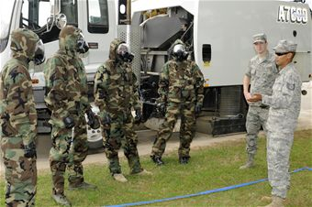
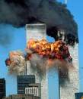
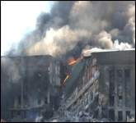
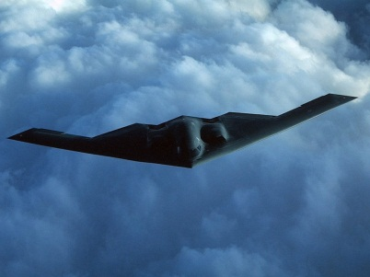
DDNHDCO Organization / Mission
CJCS
DJ-3
J-33 DDNHDCO
Nuclear,
Homeland Defense
and Current Ops
J-35 DDRO
Regional
Operations
J-38DDSAO
Special Actions
And
Operations
NMCS
Ops
Recon
Ops
Protection
WHEM
Ops
Current
Ops
N2C3
Nuclear
Ops
DSCA
Joint Ops/
TS
Special
Events
Notes:
CJCS: GEN Dempsey
J3: Vacant
DDNHDCO: Maj Gen Neal & Brig Gen Fay
Protection: AT/FP programs, Policy & Training, Defense Critical Infrastructure Protection, JSIVAs, Asymmetric Threats, CCMRF, PI, MCM, Render Safe
WHEM Ops: COL Notch/CAPT Meilstrup
- JO/TS: NOBLE EAGLE, SW Border, MOTR, Air/Land/Maritime Security
- DSCA
- Special Events

Slide 3
Joint Staff Role
Civilian Oversight
(Executive Agency)
SecDef thru (ASD-HD&ASA)
LINKAGE
Policy Oversight
Legality, Lethality, Risk, Cost, Appropriateness, &
Readiness Impact
Supervises Homeland Defense Activities
Liaison between DOD and Lead Federal Agencies
DOD Domestic Crisis Manager
Approve Order
Military Staff
(Action Agent)
Joint Staff thru (J-33 WHEM Ops)
Designate Supported Combatant Commander
Focal point for coordination with Force Providers (COCOMs, Services, Defense Agencies & National Guard)
Deconflict with Worldwide demands
Keep SecDef & CJCS informed
Issue Order
Military Commander
(Command)
Combatant Command (COCOM)
Supported Combatant Commanders
- CDR, U.S. NORTHERN COMMAND
- CDR, U.S. PACIFIC COMMAND
Provide Support
Notes:
SECDEF through ASD (HD &ASA) is the Executive Agent for providing DOD support to the PA
J-33 WHEM Ops is the Action Agent for provision of DOD support
- We recommend C2 relationships, appropriate authorities and coordinate with J31 & J33 for sourcing based on the GEF
- We draft the EXORD (SECDEF approves) and we issue it
- We keep SECDEF and CJCS informed on CARRLL and make recommendations
The COCOM provides the necessary support, develops supporting plans and EXECUTES the DOD Federal response to support the PFA

Slide 4
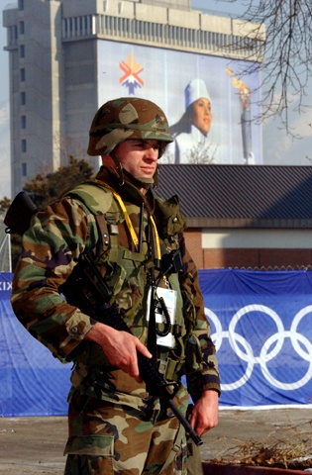
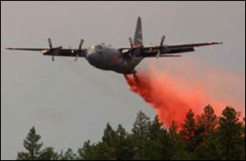
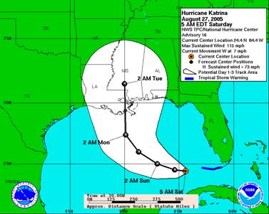
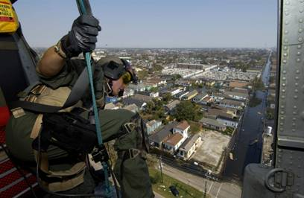
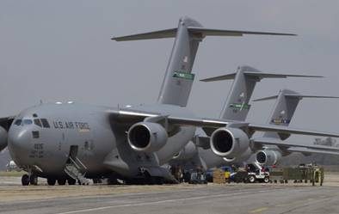
J-33 WHEM Ops Division
Defense Support of Civil Authorities (DSCA)
Plans, coordinates and monitors DoD support within the U.S. and territories in response to requests from federal agencies
Special Events (SE)
Plans, coordinates and facilitates DoD support to federal, state, and local agencies and organizers for significant international and domestic events
Joint Ops/Theater Security (JO/TS)
Plans, coordinates and monitors DoD Homeland Defense operations (NOBLE EAGLE) and supports federal, state and local operations (Maritime Operation Threat Response, Southwest Border) as well as SOUTHCOM operations
Notes:
DSCA: 5 military & 3 civilian
- AF Logistician
- Army Medevac
- Army Civ Affairs
- Marine Infantry
- Army MP (NG)
- 3 x DOD Civilians
Plus FEMA LNO

Slide 5
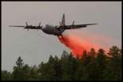
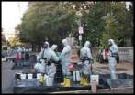
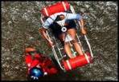
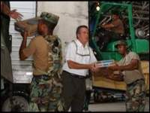
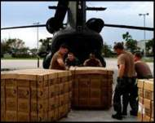
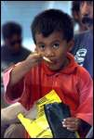
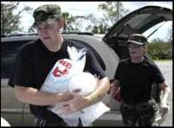
Defense Support of Civil Authorities
TERRORISM
INSURRECTION
CIVIL DISTURBANCE
EARTHQUAKE
FIRE
FLOOD
TSUNAMI/TIDAL WAVE
METEOR IMPACT
CHEMICAL HAZARD
SPACE DEBRIS IMPACT
ANIMAL DISEASE
MASS IMMIGRATION
NATIONAL SPECIAL SECURITY EVENT
HURRICANE/TYPHOON
EXPLOSION
VOLCANIC ERUPTION
LANDSLIDE
MUDSLIDE
RADIOLOGICAL EVENT
SNOWSTORM/SEVERE FREEZE
DROUGHT
OIL SPILL
TORNADO
EPIDEMIC
AVIATION ACCIDENTS
POSTAL WORK STOPPAGE
Notes:
We have touched almost every one of these types of events in the last two years
Main Effort
Hurricanes
Wildfires
Floods
Lots of crisis action/Hasty planning for no-notice situations

Slide 6
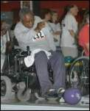
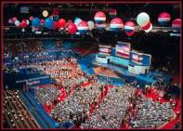
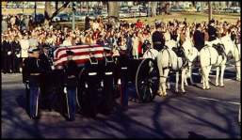
Special Events
International Sporting Competitions (10 U.S.C. § 2564)
DOD support for security and public safety of event.
Olympics, Paralympics, Special Olympics, President’s Cup
Veterans Events
National Veterans Golden Age Games
Agency Events
Support to Primary Federal Agencies (USSS, State)
UN General Assembly (UNGA), Super Bowl
Military Events
Mil-to-Mil Loans of Equipment
Navy Fleet Week, Marine Corps Marathon
Statutory Events
DOD support directed by law
Inaugural, National Scout Jamboree (10 U.S.C. § 2554)
Other (Reimbursable and Non-Reimbursable Support)
Communications and Security Equipment
Community Relations
**National Special Security Event (NSSE)**
Designated by Secretary of Homeland Security (DHS)
Directs US Secret Service as PA for Security Planning (SOTUA)
State Funerals
Republican / Democratic National Convention
Notes:
Special Events role is to conduct the planning, coordination and facilitate DOD support to federal, state, local agencies and event organizers on international and domestic events.
- Approx 18 Special Events every year.
Process for providing DoD support is more deliberate (not crisis mode). Requests from PA are typically more varied.
RFAs from USSS, USCP, DOI, FEMA, US House Of Rep, NASA, and DC Dept of Health.
Coordination between OSD, NC, JTF-NCR, NGB, JFCOM, TRANSCOM, Services, and DoD Agencies – PFPA, NSAP.
Number of special events WHEM Ops supports continues to grow. Transparent to DoD as WHEM Ops conducts the planning, provides the material support (comm, surveillance, contracting support, tents, transportation, box lunches).
Support: DOD capabilities (i.e. personnel and equipment) may be used to provide support for international and domestic special events as authorized by law, regulations and interagency agreements.
Rating: Scope and magnitude of DOD support to a special event may be proportionately related to the Special Event Assessment Rating Level (SEAR).
1) SEAR I - events of such magnitude and significant national/or international importance that may require the full support of the USG.
2) SEAR II - significant events with national and/or international importance that require direct federal support to augment local and state capabilities.
3) SEAR III - significant events with national and/or international importance that require only limited direct federal support to augment local and state capabilities.
4) SEAR IV - events with limited national importance that generally requires only state and local resources.
Implementation: The ASD(HD&ASA), under the authority, direction, and control of the USD(P) and in coordination with CJCS shall oversee in the authority, decision, management and coordination of DOD support to special events (Tom Lacrosse, Carol Corbin).
NSSE vs. SE: 1) Special event is an international or domestic event, contest, meeting, or activity that may require security, public safety and /or logistical support or assistance from DOD; 2) NSSE: significant national or international event, contest, activity or meetings that represent a significant target or terrorist opportunity and therefore warrants additional preparation, planning and mitigation efforts at every level of the USG (Department of Homeland Security)

