Slide 1
Cyberspace 101 Cyberspace Overview and Cyberspace in Intelligence Preparation of the Battlefield

Slide 2
ADMINISTRATIVE DATA
Classification: Unclassified/FOUO
OPSEC: Distribution D, Not Releasable to Foreign Nationals
Safety Requirements: Low
Risk Assessment: Low
Environmental Considerations: None
Evaluation: N/A

Slide 3
TERMINAL LEARNING OBJECTIVE
Action: Analyze The Key Components of Cyberspace
Conditions: Given a Classroom Environment
Standard: List the layers of cyberspace and the missions of cyberspace operations. Explain how cyberspace relates to the IPB process and relate these concepts to military operations and your roles as intelligence professionals

Slide 4
AGENDA
Cyberspace Overview
Cyberspace Operations
Examples of Cyberspace Operations
Basics of Cyberspace Attack
Cyberspace in IPB & Your Role as Professionals

Slide 5
ENABLING LEARNING OBJECTIVE A
Action: Introduce students to Cyberspace and Cyberspace Operations
Condition: Given a Classroom Environment
Standard: List the layers of cyberspace and the missions of cyberspace operations.

Slide 6
CYBERSPACE OVERVIEW
A global domain within the information environment consisting of the interdependent networks of information technology infrastructures and resident data, including the Internet, telecommunications networks, computer systems, and embedded processors and controllers (JP 3-12R)
Three layers
Physical network layer
Logical network layer
Cyber-persona layer
Understanding the cyberspace layers is essential to including cyberspace in the IPB process
Notes:
JP 3-12: Cyberspace operations consists of: Department of Defense Information Network (DODIN) Operations, Defensive Cyberspace Operations (DCO), and Offensive Cyberspace Operations (OCO)

Slide 7
PHYSICAL NETWORK LAYER
The medium where data travel
Includes two components:
Geographic component
Physical network component
Geographic component
Location in land, air, sea, and space where network elements are
Easily cross geopolitical and physical boundaries
Physical network component
Hardware, software, and infrastructure
Wired and wireless links
Routers, servers, switches, modems, computers, etc.

Slide 8
LOGICAL NETWORK LAYER
Those elements of the network that are related in a way that is abstracted from the physical network
The form or relationships are not tied to an individual, specific path, or node
e.g., a website access through a single URL that is hosted on servers in multiple physical locations

Slide 9
CYBER-PERSONA LAYER
Represents the people and groups actually on the network
May relate directly to the represented individual or group by including biographic or corporate data
E-mail addresses
IP addresses
Web pages and blogs
Phone numbers
Social media user names and handles
A single cyber-persona can have multiple users
A single user can have multiple cyber-personas
Attribution requires significant intelligence collection and analysis

Slide 10
CYBERSPACE OPERATIONS
Cyberspace Operations are the employment of cyberspace capabilities where the primary purpose is to achieve objectives in or through cyberspace.
Involves three missions:
Department of Defense information network (DODIN) operations design, build, configure, secure, operate, maintain, and sustain DOD communications systems and networks
Defensive Cyberspace Operations (DCO) take preemptive and reactive measures to defend an information system
Offensive Cyberspace Operations (OCO) project power by the application of force in and through cyberspace
Notes:
JP 3-12: Cyberspace operations consists of: Department of Defense Information Network (DODIN) Operations, Defensive Cyberspace Operations (DCO), and Offensive Cyberspace Operations (OCO)

Slide 11
DEFENSIVE CYBERSPACE OPERATIONS
Active and passive cyberspace operations to defend the DODIN or other friendly cyberspace
Defensive Cyberspace Operations Internal Defensive Measures (DCO-IDM)
Defensive Cyberspace Operations Response Actions (DCO-RA)
DCO-IDM respond to unauthorized activity within the DODIN
Blocking domains and IP addresses associated with threat activity
Closing ports that pose vulnerabilities
Actively hunting for threats on the DODIN
Incident response actions
DCO-RA actions taken outside the DODIN to defeat ongoing or imminent threats
Requires same authorization as OCO
Requires same level of intelligence as OCO

Slide 12
OFFENSIVE CYBERSPACE OPERATIONS
Authorized by EXORD from national command authority
Conducted by US Cyber Command
Require deconfliction
Always occurs outside the DODIN
Cyberspace Attack: Cyberspace actions that create various direct denial effects in cyberspace
Deny – Denial prevents adversary use of resources
Degrade – Limit operation or availability of a target system
Disrupt – Prevent operations or availability of a target system
Destroy – Permanently deny access to or operations of a target system
Manipulate – To control or change a target information system

Slide 13
STUDENT CHECK
List the layers of cyberspace.
What are some challenges to situational understanding of the cyberspace domain within an area of operations?
List the three missions of U.S. cyberspace operations.
Which U.S. cyberspace operations occur inside the DODIN?
Which U.S. cyberspace operations occur outside the DODIN?
Notes:
SEP 07 – Israeli Air Force attacks suspected nuclear facility under construction in Syria
• First large-scale example of convergence of cyber and electromagnetic means
Believed that Israelis used EW to deliver a cyber attack capability to the Syrian radar which executed the code on receipt
• Prior to attack, Syrian IADS along ingress/egress routes paralyzed, allowing IAF planes to fly undetected by radar into Syria and attack the site unimpeded.
AUG 08 – Russian troops cross into South Ossetia w/ stated intent to defend their “Russian compatriots”
• Combined arms assault was led (enabled) by a multi-faceted cyber attack against Georgian gov’t and military infrastructure and defacement of web sites
• Distributed denial of service (DDoS) attacks combined with EW jamming disrupted and denied comms simultaneous to an integrated propaganda (MISO and MILDEC) campaign
• Overall result can be considered a hybrid combined arms operation (air, land, cyber)
• Overall result was disruption of Syrian IADS by cyber attack that enabled kinetic strike of nuclear site.

Slide 14
ENABLING LEARNING OBJECTIVE B
Action: List vectors used to conduct cyberspace attack and examples of cyberspace attacks.
Condition: Given a Classroom Environment
Standard: List two brute force and two social engineering attack vectors. List two example cyberspace attacks.

Slide 15
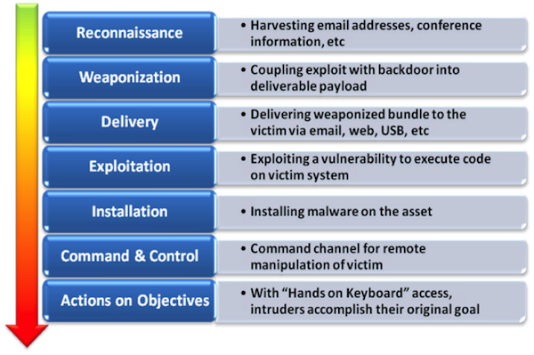
ATTACK VECTORS
“Cyber Kill Chain”
Each step can be conducted through multiple methods
Brute force
Social engineering
Insider threat

Slide 16
ATTACK VECTOR EXAMPLES
Brute force
Zero day exploits
SQL injection
Buffer overload
Password cracking
Social engineering
Social media analysis to support target development
Phishing, whaling, watering holes to gain unwitting assistance
Password guessing
Insider threat
Has credentials and trust relationship
Circumvents network security measures
Allows close access for threat exploitation

Slide 17
BOTWARE / MALWARE TECHNOLOGY
Malware
Spyware
Back Door
Exploit

Slide 18
MALICIOUS SOFTWARE & MITIGATION
Social Engineering, Dumpster Diving, Trashing
Polymorphic Viruses/Code
Worms
Denial of Service Attacks
Spear Fishing
Mass Internet Attacks
Target is intellectual property or operational data
Warrant specific exploit research
High potential revenue per unit
Targeted
\Espionage
Ability to act is targeted
Medium revenue per unit
Computing power or ability to act is targeted
Low revenue per unit
Drive by exploits

Slide 19
CYBERSPACE OPERATIONS EXAMPLES
In 1998, the United States hacked into Serbia’s air defense systems to compromise air traffic control and facilitate the bombing Serbian target .
in 2007, in Estonia, a BOTNET of over a million computers brought down government, business and media websites across the country. The attack was suspected to have originated in Russia, motivated by political tension between the two countries.
Also, in 2007, an unknown foreign party hacked into high tech and military agencies in the United States a download terabytes of information.
in 2009, a cyber spy network call “Ghost Net” accessed confidential information belonging to both government and private organizations in over 100 countries around the world. Ghost Net was reported to originate in China, although that county denied responsibility.
Notes:
SEP 07 – Israeli Air Force attacks suspected nuclear facility under construction in Syria
• First large-scale example of convergence of cyber and electromagnetic means
Believed that Israelis used EW to deliver a cyber attack capability to the Syrian radar which executed the code on receipt
• Prior to attack, Syrian IADS along ingress/egress routes paralyzed, allowing IAF planes to fly undetected by radar into Syria and attack the site unimpeded.
AUG 08 – Russian troops cross into South Ossetia w/ stated intent to defend their “Russian compatriots”
• Combined arms assault was led (enabled) by a multi-faceted cyber attack against Georgian gov’t and military infrastructure and defacement of web sites
• Distributed denial of service (DDoS) attacks combined with EW jamming disrupted and denied comms simultaneous to an integrated propaganda (MISO and MILDEC) campaign
• Overall result can be considered a hybrid combined arms operation (air, land, cyber)
• Overall result was disruption of Syrian IADS by cyber attack that enabled kinetic strike of nuclear site.

Slide 20
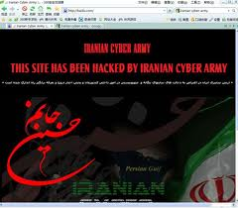
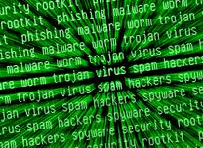
EVOLVING CYBER THREAT
Pre-2007
Cyber “Noise” on Networks
Potential Limited Disruption to
Mission Command
Present
Next
Potential Destruction… Isolation of Tactical Forces
Mission Command - increasingly reliant on networks...
Will become more and more at risk

Slide 21
CYBERSPACE OPERATIONS SPECTRUM
Role of intelligence is much more important than in pure kinetic trial-error warfare
Intelligence exists as nexus for data acquisition, analysis and dissemination – basically for everything defensive and offensive component requests

Slide 22
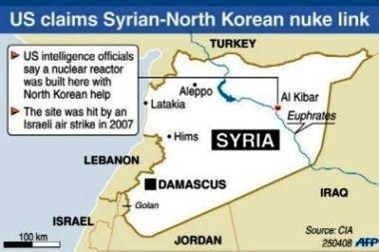
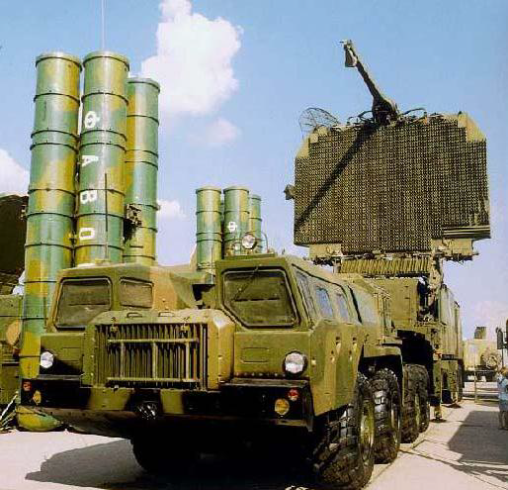
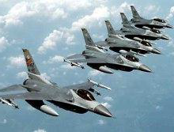
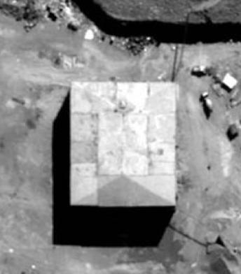
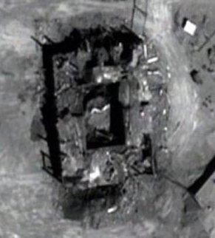
2007: SYRIA – ISRAEL
SEP 07 – Israeli Air Force attacks suspected nuclear facility under construction in Syria
• First large-scale example of convergence of cyber and electromagnetic means
Believed that Israelis used EW to deliver a cyber attack capability to the Syrian radar which executed the code on receipt
• Prior to attack, Syrian IADS along ingress/egress routes paralyzed, allowing IAF planes to fly undetected by radar into Syria and attack the site unimpeded.
• Overall result was disruption of Syrian IADS by cyber attack that enabled kinetic strike of nuclear site.

Slide 23
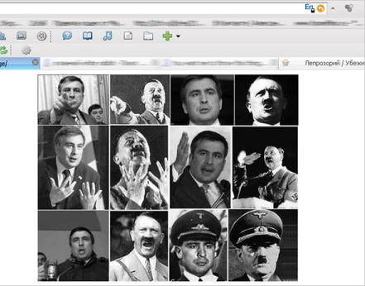
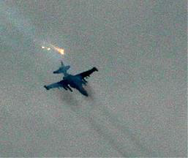
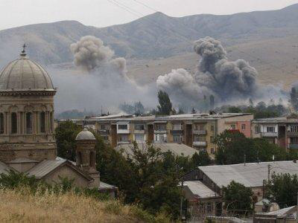
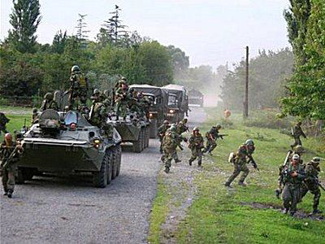
2008: GEORGIA – RUSSIA
AUG 08 – Russian troops cross into South Ossetia w/ stated intent to defend their “Russian compatriots”
• Combined arms assault was led (enabled) by a multi-faceted cyber attack against Georgian gov’t and military infrastructure and defacement of web sites
• Distributed denial of service (DDoS) attacks combined with EW jamming disrupted and denied comms simultaneous to an integrated propaganda (MISO and MILDEC) campaign
• Overall result can be considered a hybrid combined arms operation (air, land, cyber)

Slide 24
CYBER TERRORISM
Cyber terrorism is any “premeditated, politically motivated attack against information, computer systems, computer programs, and data which results in violence against non-combatant targets by sub-national groups or clandestine Agents”
Unlike a nuisance virus or computer attack that results in a denial of service, a cyber terrorist attack is designed to cause physical violence or extreme financial harm.
Possible Cyber Terrorism Targets Include:
Banking Industry
Military Installations
Power Plants
Air Traffic Control Centers
Water Treatment Systems

Slide 25
STUDENT CHECK
What methods and vectors are employed in cyberspace attacks?
How have countries used cyberspace operations to support their land objectives?
Explain cyber terrorism and some of the methods for interrupting networks

Slide 26
ENABLING LEARNING OBJECTIVE C
Action: Discuss how to incorporate cyberspace into the Intelligence Preparation of the Battlefield process
Condition: Given a Classroom Environment
Standard: Deconstruct the 4-steps of the IPB Process and incorporate cyberspace into each

Slide 27
CYBERSPACE IN THE IPB PROCESS
Helps intelligence analysts to consider the cyberspace domain with respect to threat objectives in the land domain
Evaluates:
The cyberspace domain as it relates to the operational environment
A threat’s access, capability, and motivation to conduct cyberspace operations
A threat’s ability to mass effect of cyberspace operations with other operations to achieve objectives
Potential threat courses of action based on the full analysis
27
Notes:
Key Definitions
(U) CYBERSPACE: A global domain within the information environment consisting of the interdependent network of information technology infrastructures, including the Internet, telecommunications networks, computer systems, and embedded processors and controllers. Source: JP 3-12R
(U) INFORMATION ENVIRONMENT: The aggregate of individuals, organizations, and systems that collect, process, disseminate, or act on information. Source: JP 3-13

Slide 28
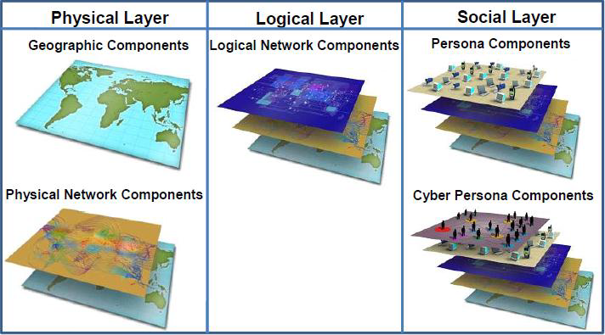
VISUALIZING CYBERSPACE LAYERS
Despite being a man-made domain, the Cyberspace Domain is operational and interdependent with traditional war fighting domains (air, land, sea, space)
Cyberspace cannot be treated as distinct (unique) – it is part of the operating environment and needs to be accounted for during IPB

Slide 29
CYBER Considerations In IPB
Four-Step Process
Cyber is considered in each of the four process and associated activities found in IPB:
Step 1: Define the Operational Environment
Step 2: Describe Environmental Effects on Operations
Step 3: Evaluate the Threat
Step 4: Determine Threat Courses of Action
Part of the Operating Environment – Special but Not Unique
29

Slide 30
IPB FOUR-STEP PROCESS
Step 1: Define the Operational Environment
Consider the physical network layer within the area of operations
Telephony infrastructure and technology, e.g., 3G, 4GLTE, dial up, DSL, fiber optics
Information gap analysis is important during this step because it allows the analyst to initiate action to collect the information required to fill the gaps
(U) Tactical Intelligence Considerations
First establish an understanding of existing cyberspace layers (Adversary, Neutral, and Friendly)
Identify the cyber integration within the OE
Infrastructure (Power, Water, Waste, etc)
Information (Social Media, etc)
Commerce
Governance
Security
Determine/Nominate intelligence gaps for collection
Define the Operational Environment
Determine Threat Courses of Action
Describe Environmental Effects on Operations
Evaluate the
Threat

Slide 31
IPB FOUR-STEP PROCESS
Step 2: Describe Environmental Effects on Operations
Step 2 considers how environmental conditions in the natural domains as well as in the cyberspace domain effect operations
Weather effects on radio waves associated with phone towers, microwave relay, WLAN
Terrain effects on infrastructure, e.g., where rely towers are placed
How bandwidth availability, reliance on dial up, or rolling power outages effect operations
(U) Tactical Intelligence Considerations
Define the Operational Environment
Cyberspace transits through and relies on the natural domains. Environmental conditions there can limit or enable actions in cyberspace.
The environment equally affects operations of friendly, neutral, and enemy forces
Understanding these effects will directly tie into developing courses of action in step 4
Identify gaps and nominate for collection
Determine Threat Courses of Action
Describe Environmental Effects on Operations
Evaluate the
Threat
31

Slide 32
IPB FOUR-STEP PROCESS
Step 3: Evaluate the Threat
This step consists of identifying and analyzing the adversary's objectives, intent, current processes, preferred tactics, and critical factors
The analyst also identifies and visualizes the adversary's current course of action as a process
Details of the adversary process includes related network and physical locations, data and information flow, and related physical or cyber persona information
(U) Tactical Intelligence Considerations
When identifying the threat’s characteristics, consider operations, capabilities and vulnerabilities in cyberspace
Determine the threat’s access, capabilities, and motivation to conduct cyberspace operations
Evaluate past, demonstrated doctrine or TTP including the threat’s level of sophistication
Detail the threat in terms of the three cyberspace layers
Define the Operational Environment
Determine Threat Courses of Action
Describe Environmental Effects on Operations
Evaluate the
Threat
32

Slide 33
IPB FOUR-STEP PROCESS
Step 4: Determine Threat Courses of Action
When evaluating the threat’s potential COAs, begin with the intent and objectives then consider all the capabilities the threat may use to achieve those. Where cyberspace is a factor, include that
Visually depict adversary COAs of interest, decisive points, high value targets, target areas of interest, indicators, named areas of interest, and decision points.
Consider whether the threat will coordinate military operations in the natural domains with cyberspace operations
(U) Tactical Intelligence Considerations
The COA should depict how the threat will perform actions to achieve objectives. This could be solely in cyberspace, solely in the natural domains, or a combination
Evaluation of HVTs and decision points will support the information collection plan development
Information about threat activity in cyberspace may be available from network sensor data
Define the Operational Environment
Determine Threat Courses of Action
Describe Environmental Effects on Operations
Evaluate the
Threat
33

Slide 34
OUTCOMES OF CYBER IN IPB
IPB results in the creation of intelligence products that are used during the MDMP to aid in developing friendly courses of action (COAs) and decision points for the commander.
Process
Potential Indicators
Intent
Decisive Points
Objectives
High-Value Targets (HVTs)
Courses of Action (COAs)
Target Areas of Interest (TAIs)
Preferred Tactics
Named Areas of Interest (NAIs)
Critical Capabilities
Decision Points
Critical Requirements
Information Gaps
Critical Vulnerabilities
The conclusions reached and the products created during IPB are critical to planning information collection and targeting operations
34

Slide 35
STUDENT CHECK
List considerations for cyberspace in each of the four IPB steps
Discuss how the proliferation of technology relates to the IPB process and to you as a military intelligence professional
Notes:
SEP 07 – Israeli Air Force attacks suspected nuclear facility under construction in Syria
• First large-scale example of convergence of cyber and electromagnetic means
Believed that Israelis used EW to deliver a cyber attack capability to the Syrian radar which executed the code on receipt
• Prior to attack, Syrian IADS along ingress/egress routes paralyzed, allowing IAF planes to fly undetected by radar into Syria and attack the site unimpeded.
AUG 08 – Russian troops cross into South Ossetia w/ stated intent to defend their “Russian compatriots”
• Combined arms assault was led (enabled) by a multi-faceted cyber attack against Georgian gov’t and military infrastructure and defacement of web sites
• Distributed denial of service (DDoS) attacks combined with EW jamming disrupted and denied comms simultaneous to an integrated propaganda (MISO and MILDEC) campaign
• Overall result can be considered a hybrid combined arms operation (air, land, cyber)
• Overall result was disruption of Syrian IADS by cyber attack that enabled kinetic strike of nuclear site.

Slide 36
QUESTIONS
36

Slide 37
Cyberspace Overview Back-Up Slides

Slide 38
Key Terms & Definitions
Network Operations - Activities conducted to operate and defend the Global Information Grid. Also called NETOPS. Source: JP 6-0
Cyberspace - A global domain within the information environment consisting of the interdependent network of information technology infrastructures, including the Internet, telecommunications networks, computer systems, and embedded processors and controllers. Source: CJCS CM-0363-08
Information Environment - The aggregate of individuals, organizations, and systems that collect, process, disseminate, or act on information. See also information system. Source: JP 3-13
Cyberspace Operations - The employment of cyberspace capabilities where the primary purpose is to achieve objectives in or through cyberspace. Source: JP 3-0

Slide 39
Cyberspace Target and Planning Considerations (1 of 3)
Cyberspace reaches across geographic and geopolitical boundaries, and is tightly integrated into the operation of critical infrastructures and the conduct of commerce, governance, and national security
• Cyberspace operations are interdependent with the physical domains (i.e., air, land, maritime, and space) electromagnetic spectrum, and should be integrated with other military operations
• Cyberspace effects can be used as a force multiplier or an enabler across the spectrum of operations
• Cyberspace effects must be included as early in the planning process as possible, including pre-deployment training and preparations

Slide 40
Cyberspace Target and Planning Considerations (2 of 3)
Constants
• Linked to Commander’s desired end-state and objectives — integrate cyberspace fires with Joint Fires Process
• Target system analysis is essential (objectives-based vs. access-based)
Maximum flexibility and agility to keep up with the dynamic environment
Considerations
• Target system analysis / OPE dependent on assets and authorities
• Target characterization and access — Open vs. Closed Networks
• Rapid Capability Development — weaponeered before target list nomination
• Deliberate vs. Dynamic targeting capability
• Modeling, simulation, and BDA required

Slide 41
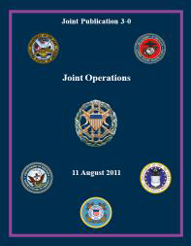
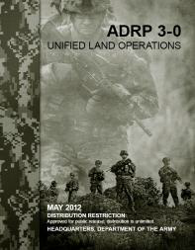
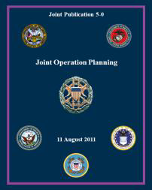
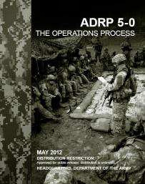
Cyberspace Target and Planning Considerations (3 of 3)
Effects can be described in terms of deny, degrade, disrupt, destroy, and manipulate
• Determining a specific desired effect is the most important element in requesting cyberspace fires on a nominated target
• Planners and end users should focus on effects, not the offensive cyberspace operations means to create these effects
• Effects should support one or more objectives and do not suggest ways or means
DENY - To degrade, disrupt, or destroy access to, operation of, or availability of a target by a specified level for a specified time. Denial prevents adversary use of resources.
DEGRADE - To deny access (a function of amount) to, or operation of, a target to a level represented as a percentage of capacity. Level of degradation must be specified. If a specific time is required, it can be specified.
DISRUPT - To completely but temporarily deny (a function of time) access to, or operation of, a target for a period of time. A desired start and stop time are normally specified. Disruption can be considered a special case of degradation where the degradation level selected is 100 percent.
DESTROY - To permanently, completely, and irreparably deny (time and amount are both maximized) access to, or operation of, a target.
MANIPULATE - To control or change the adversary’s information, information systems, and/or networks in a manner that supports the commander’s objectives.

Slide 42
Target Characteristics
Targets in cyberspace still have physical, functional and cognitive characteristics (FM 3-60 / JP 3-60)
Have to also consider the logical characteristics – websites, virtual networks, etc.
Logical characteristics are similar to grid coordinates – IP and URL addresses, etc. – unique to the target and tie content or function to the physical domains (e.g., servers, routers)
Also need to consider the social characteristics – corresponds w/ cyber-personas and links closely to target’s cognitive characteristics
Important to distinguish between state and non-state targets – different target systems, different perspectives
Complete and holistic understanding of a target… must avoid target development that overlooks any one characteristic

Slide 43
Target Systems
2 categories of target systems
Nation-State and Non-State
Nation-State Target Systems (14)
C4I
WMD
Ground Forces and Facilities
Non-State Target Systems (9)
Leadership
Safe havens
Finances
Air Forces and Aircraft
IAD Forces
Naval Forces and Ports
Communication
Movement
Intelligence
Space Forces
Ballistic Missile Forces
Electric Power
Weapons
Personnel
Ideology
Petroleum Industry
Transportation and LOCs
Industry
- JP 3-26, Chap. V
Counterterrorism
Counterdrug
Target significance may be due to its own characteristics – real importance lies in relationship to other targets within an operational system
- JP 3-60, App. H

Slide 44
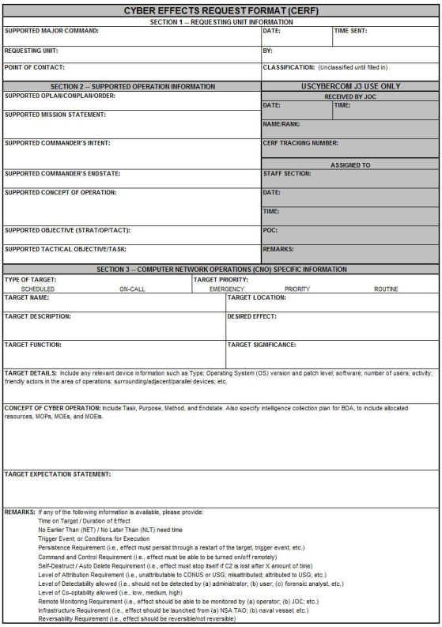
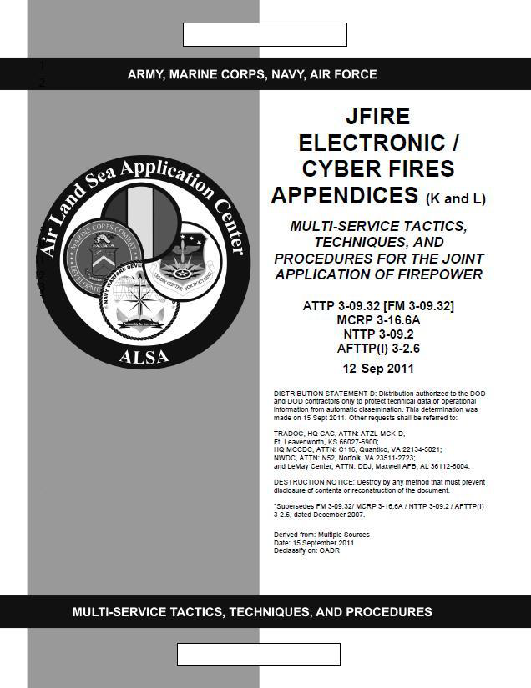
Cyber Effects Request Format (CERF)
Contained in the new JFIRES MTTP (ATP 3-09.32) Appendix L
JFIRES Appendix L designed as guide for tactical and operational-level planners
Requests are tied to commanders’ objectives
Supports Deliberate targets, increasing ability to support Dynamic targets
Tactical/operational requests forwarded thru Fires channels to JTF or component Expeditionary Cyber Support Element (ExCSE)
Expectation management – undeveloped targets may need long lead time to develop access and pair with capability
Available on ALSA’s SIPRNET website

