Slide 1
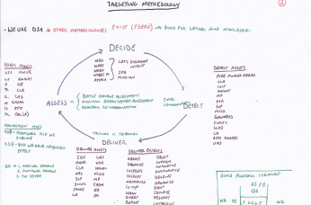
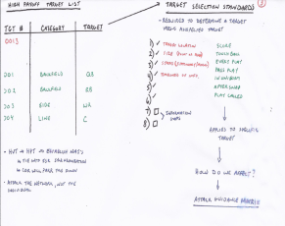
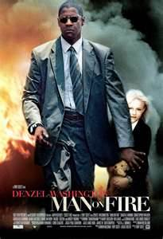
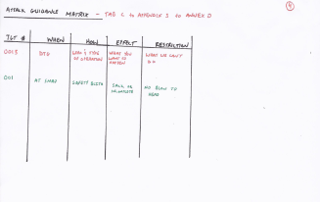
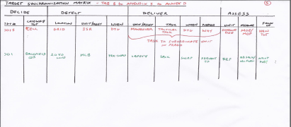
Targeting
Lesson Id / Version Technique of Delivery Hours Method of Instruction 071C1617 / Version 5 (SG) Small Group Instruction (SGI) 45 mins/ Conference / Discussion
5 mins/ Lecture
Test 0 hrs
Test Review 0 hrs
Total Hours: 1 hr
Security Clearance: Unclassified
Lesson Title: Targetting
Condition: In a small group classroom environment, given doctrinal readings and references, an instructor facilitated or guided discussion coupled with a multimedia presentation and incorporating student/instructor personal experiences on doctrinal concepts and tactical operations. The Soldier has been provided guidance on the rules of engagement (ROE) and/or rules of interaction (ROI). Coalition forces and noncombatants (such as refugees, media, NGOs and/or contractor personnel) may be present in the operational area.
Standard: Student understands the doctrine, requirements, and task organization for conducting operations with a SBCT Company during counterinsurgency operations. Student produces a tactically proficient verbal order that reaches the decisive point in 45 minutes.
Concrete Experience | Publish & Process | Generalized New Information
There are several ways to go about this. One method is to use a recent football game. Have the student discuss which teams played recently. Have them write on the board the passing totals, rushing totals, touchdowns, etc. for the winning team. Then when that is complete, transition into the losing team. Ask the students why the other team was ineffective. How could they have prevented the winning team from being successful? Do you think that if the losing team had effectively targeted the winning team, would they have increased their chance of success? Another option is though a movie. There are several to choose from. An example is the movie, “Man on Fire”, with Denzel Washington. In this movie, have the students watch the movie from the point where Denzel is in Pita’s room and he interacts with Pita’s mother. She gives Denzel Pita’s Teddy Bear, and Denzel then says he is going to kill everyone involved in Pita’s capture and death. Allow the students to watch from this point of the movie up until the point where Denzel conducts the Ambush on the Police Chief. Then you can discuss how Denzel was able to effectively target “La Hermindad”. The video should take approximately 30 minutes. You can then go back and forth from the movie to your class to reinforce the Targeting Methodology. | How did Denzel get to the Police Chief? How did Denzel decide whom to target? How did Denzel detect his targets? How did he deliver effects against them? How was he able to assess his targets? Have the students draw a link diagram of the personnel Denzel targeted | Draw the following class on your white boards, using either the Football Concrete Experience or the “Man on Fire” concrete experience:

Slide 2
Targeting Board Drill 1
Effective targeting identifies options both Lethal and non-lethal to support the commander’s objectives. Ask the students what defines lethal and non-lethal. Lethal: Kill/Destroy…Non-Lethal: CMO, MISO, PA, II. In a COIN environment In most cases, Non-lethal is more important than lethal. The methodology we use to do this is Decide, Detect, Deliver, and Asses. For those that like flow charts, diagrams….Go through the board and talk D3A with the students. Have them define and give you some real world examples of how they executed this at their last unit. Build the Man on fire or Football structure, to tie in the concrete experience. Write in on the boards how Denzel was able to Decide, detect, deliver, and assess and what assets he used to do this effectively. Or how we target an NFL quarterback and what assets we use…

Slide 3
Targeting Board Drill 2
To target we are going to build several products that help us collect information and data. This board discusses the HPTL. Have the students define what a High payoff target is, use the Ask, Pause, Call technique if needed. Reinforce that this product captures both lethal and non-lethal targets; it is a way to prioritize for the commander and help him decide on a COA. Have the students get up and fill it in base on the concrete experience. Everything in red is what you already have filled in, use a real world IED cell as an example. Then have a student or a couple of students fill in the HPTL either using the NFL structure, or the Man on Fire structure from the concrete experience. Make sure they understand that these products are used to build the TSM, and help the staff develop COA’s and recommendations to the commander. Also discussed on this board is Target Selection Standards; transition between HPTL and TSS. “Now that I know what my targets are, how do I know that those targets are ready for action?” Have the students, define and tell you what a Target selection standard is. FM 3-60 will give you location, size, status, and timeliness of info, but often in today’s COE (and based on CDR guidance) we have several more to add. For example, think Iraq during the security agreement…now, we need a warrant, a competent Iraqi authority ready to receive individual, 2 or more sworn statements, JAG approval… To reinforce have the students use the NFL or Man on Fire concrete experience and write them in on the board in green. Bottom line in order for us to action against this target we need to meet these criteria…TSS

Slide 4
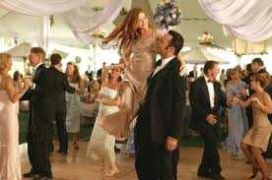
Targeting Board Drill 3
Now that we know we have a valid target, how do we get after them? Now what? Well, we need to figure out how we are going to attack them. That is where the Attack Guidance Matrix comes into play. Again, have a student define, based out of doctrine, what the AGM is and what it does for us and the Commander. The AGM consists of TGT #, When to attack, how to attack, the effect we want to achieve and any restrictions imposed on us against this target. In red, have a real world example already filled in. After defining the AGM and discussing it, have a student get up and fill this out using the NFL concrete experience or the Man on Fire experience.
The other thing to bring up is Measure of performance and Measure of effectiveness. Before we action a target we need to determine what our grading standard is. At this point have the student define Measure of performance and measure of effectiveness. This may require some explanation on your part, and possibly a real world example of something you may have used in the past. In red, have the IED cell example, and once again have a student or multiple students place the NFL/Man on Fire Concrete Experience into the AGM.
Red Head
Cleary
daughter
DANCE MOVES/
WE LOST A LOT
OF GOOD MEN
RECEPTION
DIRTY ON THE BEACH

Slide 5
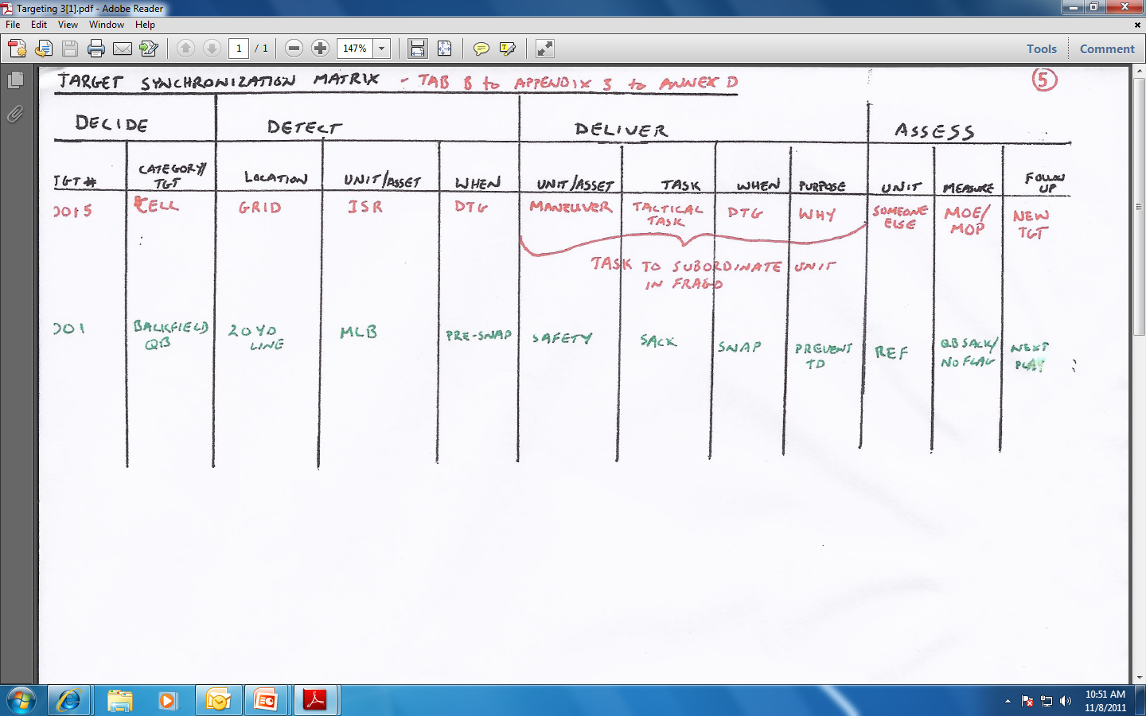
Targeting Board Drill 4
All of this builds into the Target Synchronization Matrix (TSM). So, all of the work I have just done is actually for something. The TSM allows me to see the target, and understand how I will apply the methodology (D3A) to take action against it. Also, the product helps us to produce the order. The Deliver function in this matrix becomes Task to Maneuver units in either an OPORD or FRAGO.
This is a cyclical process. It is updated continuously as the targeting process is executed within TLP/MDMP.

Slide 6
Targeting – SGI Notes
From the significant conclusions of studying the Enemy’s WFF you derive the High Value Targets (what assets he needs to accomplish his mission).
From these you are going to pick your High Pay-off Targets (assets we need to destroy/effect IOT accomplish our mission).
To pick them we compare them against Target Selection Standards decided upon prior to execution to ensure they are appropriate targets that we can engage (such as size, location, activity). This stops us from blowing up a mosque or capturing the mayor.
Then we decide when and how we want to engage and with what results and put all that down in the Attack Guidance Matrix.
Then we align our units with the appropriate missions to attack these targets both lethally and non-lethally in the Target Synchronization Matrix.

