Slide 1
U.S. Army Doctrinal Reference Publication 3-37 Protection
FM 3-37
PROTECTION
DISTRIBUTION RESTRICTION: Approved for public release;
Distribution is unlimited
Protecting the Force
HEADQUARTERS
DEPARTMENT OF THE ARMY
Notes:
Army Doctrinal Reference Publication (ADRP) 3-37 provides doctrinal guidance for commanders and staffs who are responsible for planning and executing protection in support of unified land operations. It describes protection as both an element of combat power and as a warfighting function. ADRP 3-37 corresponds with Army operations doctrine introduced in the ADRP 3-0 capstone manual.

Slide 2
Why is Doctrine Important?
“We must emphasize doctrine as the driver for change. You can’t cement change in the organization until you adapt the institutions. That change begins with doctrine.”
GEN George W. Casey
Chief of Staff of the Army
Doctrine describes the way forces are intended to work in pursuit of a larger idea. Doctrine influences a force’s organization, training, materiel, leader development, personnel, and facilities.
An image of conflict is implicit in a military’s doctrine. If we get that image wrong, the result can be disastrous.
Notes:
Why is doctrine so important?
ADRP 3-0 represents the intellectual underpinnings for how we shape our future; we need to couch this message in terms of future security environment.
How does doctrine drive change? We must emphasize doctrine as the driver for change. You can’t cement change in the organization until you adapt the institutions. That change begins with doctrine.
It will then be reflected in changes in the other areas of organizations, training, materiel, leader development, personnel and possibly even facilitates.
And in fact, it has already impacted training and organizations, as we have made changes in these areas already, changes that were made during the development of ADRP 3-0 and in concert with it.

Slide 3
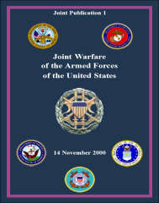
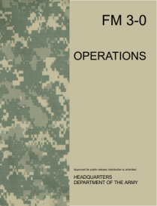
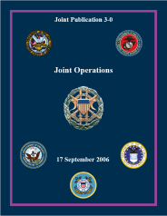
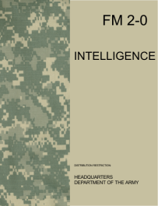
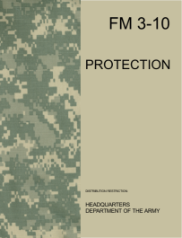
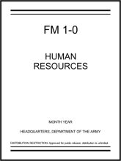
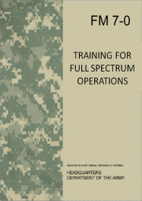
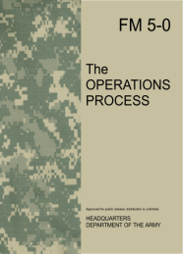
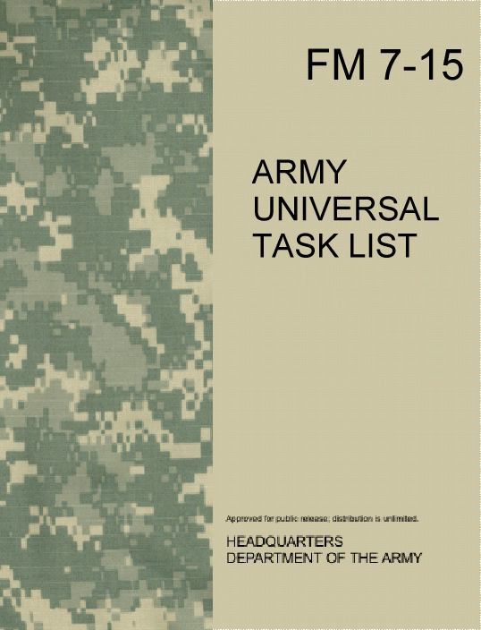
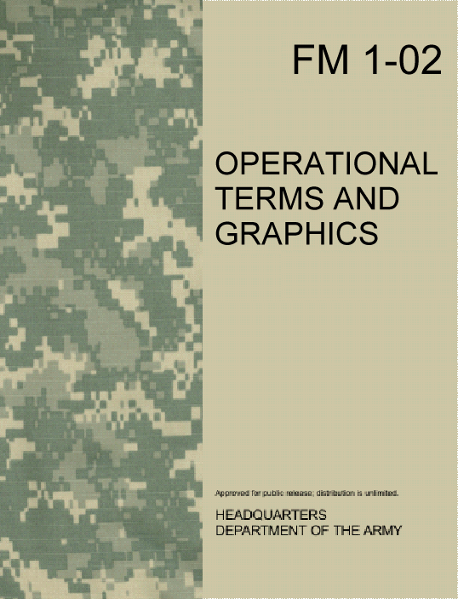
ARMY DOCTRINE HIERARCHY
Joint Doctrine
JP 1 & JP 3-0
Army Capstone Doctrine
ADRP 1 & ADRP 3-0
CONTINUUM OF OPERATIONS
ELEMENTS OF COMBAT POWER
UNIFIED LAND OPERATIONS
WARFIGHTING FUNCTIONS
REFERENCE
FIELD
MANUAL
FIELD
MANUAL
FIELD
MANUAL
FIELD
MANUAL
FIELD
MANUAL
FIELD
MANUAL
FIELD
MANUAL
FIELD
MANUAL
FIELD
MANUAL
FIELD
MANUAL
FIELD
MANUAL
FIELD
MANUAL
FIELD
MANUAL
FIELD
MANUAL
FIELD
MANUAL
FIELD
MANUAL
FIELD
MANUAL
FIELD
MANUAL
SUPPORTING DOCTRINE
Notes:
Joint Doctrine drives service component doctrine.
Army Capstone doctrine (ADRP 1 and ADRP 3-0) sets the overarching framework for planning and execution in a Unified Land Operation mission environment.
………

Slide 4
Changes from FM 3-37
FM 3-37
PROTECTION
ADRP 3-37
Change 1
28 Feb 13
DOCTRINE 2015
Fully integrated the Protection Framework within the operations process.
Aligned the protection definition with JP 3-0.
Replaced the protection principle of “full dimension” with “comprehensive.”
Added Law and Order task from Mission Command WFF to the Protection Warfighting Function (WFF).
Added Implement physical security procedures to the Protection WFF.
Added Implement operations security (OPSEC) to the Protection WFF.
Moved Internment and Resettlement task from Sustainment WFF to the Protection WFF.
Moved Information protection task from Protection WFF to the Mission Command WFF.
Moved Fratricide Avoidance from stand-alone, placing it under Safety in the Protection WFF.
Notes:
These are the major changes in this manual.
Changes reflect lessons learned over the past 12 years of sustained land combat

Slide 5
Emerging Protection Doctrine
ADRP 3-37: Army Keystone Manual for Protection
Protection Warfighting Function
Reinforcing and Complementary Capabilities
Protection has no direct antecedent
Five Principles of Protection
Fourteen Army Protection Tasks and Systems
Risk Management
Plan, Prepare, Execute and Continuous Assessment
Notes:
As the Army keystone manual for protection, ADRP 3-37 will help commanders understand and visualize protection concepts and ideas and enable them to describe protection tasks and systems for integration into the operations process. ADRP 3-37 expands on the protection and combined arms terminology outlined in ADRP 3-0.
It explains how protection can be achieved and applied through the combination and integration of reinforcing and complementary capabilities to preserve combat power or to protect personnel, physical assets, or information.
This manual recognizes that protection has no direct antecedent from the former battlefield operating systems, so protection is realized in many ways. Therefore, the text introduces the five forms and five principles of protection to provide a context for mission command and a framework for task assignment.
ADRP 3-37 also introduces and explains the fourteen Army tasks that comprise the protection warfighting function and describes how those tasks are realized and represented during unified land operations. This manual affirms the risk management (RM) process as the overarching process for integrating protection into Army operations and depicts a broad methodology for determining protection priorities from which specific decision support tools can nest. ADRP 3-37 provides guidance on how the protection cell within the division, corps, and Army headquarters is formed for protection planning, preparation, execution, and continuous assessment.

Slide 6
Protection Logic Chart
Notes:
This chart lays out the underlying logic and central idea of ADP/ADRP 3-37
Protection, using the five protection principles, is executed thru the operations process by commanders, staffs, leaders, and Soldier. the Protection Warfighting Function is one of the six elements of combat power for chapter 3 of ADRP 3-0
Guided by the principles of Protection, commanders use the Protection warfighting function to integrate the other warfighting functions into a coherent whole. By itself, the Protection warfighting function will not secure an objective, and protect a force. Instead, it provides a framework for protection to the other warfighting functions. Commanders use the protection warfighting function to help maintain Combat Power and accomplish missions.
Together , integrated and synchronized with combat power, the protection and the warfighting function guide, integrate, and synchronize Army protection tasks, systems, personnel and measures throughout unified land operations.

Slide 7
Preserving the Force
ADRP 3-37 provides guidance on protection and the protection warfighting function. It also provides the guiding protection principles for commanders and staffs who are responsible for planning and executing protection in support of unified land operations.
ADRP 3-37, Protection, Preface
Protection is the preservation of the effectiveness of mission-related military and nonmilitary personnel, equipment, facilities, information, and infrastructure deployed or located within or outside the boundaries of a given operational area.
Protection is an element of combat power and a warfighting function.
Notes:
Protection is the preservation of the effectiveness of mission-related military and nonmilitary personnel, equipment, facilities, information, and infrastructure deployed or located within or outside the boundaries of a given operational area.
ADRP 3-37 introduces and discusses the forms and principles of protection and the risk management (RM) process. The purpose of these protection constructs, methodologies, and processes is to help frame and organize protection activities for their integration into the operations process where they can facilitate decisionmaking.
Keep in mind as you read this definition that Protection is more than Survivability, Protection preserves “effectiveness” of an asset, not just its survivability, after all, after a threat or hazardous event has occurred, Army forces must still continue to operate and be successful.

Slide 8
The Army Protection Program
Emergency Management
Computer Network Defense
Continuity of Operations
Critical Infrastructure Risk Management
Operations Security (OPSEC)
Antiterrorism (AT)
Fire and Emergency Services
Force Health Protection
High Risk Personnel
Law Enforcement
Information Assurance
Physical Security
The protection warfighting function is the related tasks and systems that preserve the force so the commander can apply maximum combat power to accomplish the mission (ADRP 3-0).
The Army Protection Program is a management framework to synchronize, prioritize, and coordinate protection policies and resources (see Army Directive 2011-04). It includes the twelve
non-warfighting functional elements:
Force protection is preventative measures taken to mitigate hostile actions against Department of Defense personnel (to include family members), resources, facilities, and critical information (JP 3-0).
Notes:
The protection warfighting function, the Army Protection Program, and force protection are important aspects of protection that reinforce each other.
The protection warfighting function supports decisive action and unified land operations, whereas the Army Protection Program manages and executes the programs within the non-warfighting functional elements. Additionally, the protection warfighting function focuses on preserving the force and protecting personnel (friendly combatants and noncombatants) and physical assets of the United States and unified action partners. The complementary capabilities within the non-warfighting elements and the protection warfighting function assist in reinforcing protection throughout.

Slide 9
ADRP 3-37 Organization
Chapter 1 Protection Framework
Chapter 2 Protection Planning
Chapter 3 Protection in Preparation
Chapter 4 Protection in Execution
Chapter 5 Protection Assessment
Notes:
ADRP 3-37, Protection, is organized into five chapters.
The chapters within this manual expound on the protection framework (chapter 1) and protection integration and synchronization throughout the operations process (chapters 2 through 5). Chapter 1 provides a common understanding of protection principles, protection nesting within unified land operations, the protection warfighting function, and the integration of the protection warfighting function tasks and systems.

Slide 10
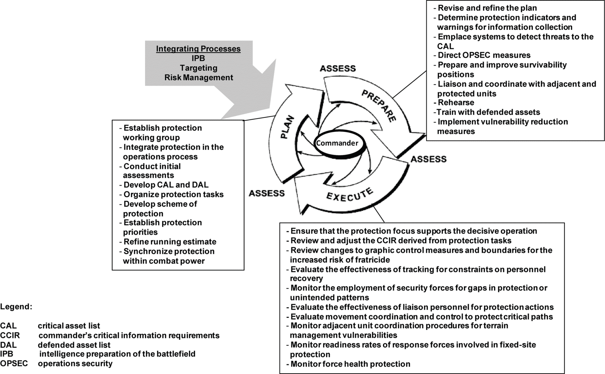
Protection within the Operations Process
Notes:
Chapters 2 through 5 elaborate on protection within the operations process—plan, prepare, execute, and assess.
Commanders and staffs synchronize, integrate, and organize capabilities and resources throughout the operations process to preserve combat power and the freedom of action and to mitigate the effects of threats and hazards. Protection safeguards the force, personnel (combatants and noncombatants), systems, and physical assets of the United States and unified action partners. Survivability refers to the capacity, fitness, or tendency to remain alive or in existence. For the military, survivability is about much more than mere survival—it is also about remaining effective.

Slide 11
Principles of Protection
Comprehensive
Integrated
Layered
Redundant
Enduring
These principles provide military professionals with a context for implementing protection efforts, developing protection strategies, and allocating resources.
They are not a checklist and may not apply the same way in every situation.
Notes:
The five principles of protection—comprehensive, integrated, layered, redundant, and enduring— represent or summarize the characteristics of successful protection integration and practice. These principles provide military professionals with a context for implementing protection efforts, developing protection strategies, and allocating resources. They are not a checklist and may not apply the same way in every situation.
Comprehensive – Protection is an all-inclusive utilization of complementary and reinforcing protection tasks and systems available to commanders, incorporated into the plan, to preserve the force.
Integrated – Protection is integrated with other activities, systems, efforts, and capabilities associated with unified land operations to provide strength and structure to the overall effort. Integration must occur vertically and horizontally with unified action partners throughout the operations process.
Layered – Protection capabilities are arranged using a layered approach to provide strength and depth. Layering reduces the destructive effect of a threat or hazard through the dispersion of energy or the culmination of the force. Exclusion areas, barriers, sally ports, passwords, and identity badges are examples of layering tactics, techniques, and procedures (TTP) and resources for protection
Redundant – Protection efforts are often redundant anywhere that a vulnerability or a critical point of failure is identified. Redundancy ensures that specific activities, systems, efforts, and capabilities that are critical for the success of the overall protection effort have a secondary or auxiliary effort of equal or greater capability. Power generation systems, water purification systems, and patrol distribution patterns are often resourced for redundancy.
Enduring – Protection capabilities are ongoing activities for maintaining the objectives of preserving combat power, populations, partners, essential equipment, resources, and critical infrastructure in every phase of an operation. The enduring character of protection may affect freedom of action and resource allocation.

Slide 12
Forms of Protection
Deterrence
Mitigation
Prevention
Protection
Passive
Defense
Active
Security
Visualization Non-sequential Continuous
Unlike maneuver, the forms of protection may orient on the terrain, the protected asset, and/or the enemy.
Notes:
Protection can take many forms. Military operations recognize five broad forms of protection (deterrence, prevention, active security, passive defense, and mitigation) to help organize the protection element of combat power. These forms of protection support mission command and the leader’s visualization to provide a context within which all protection activities can be understood and further described. They are non-sequential, reflect the continuous nature of protection, and may serve as a method to conceptualize protection capabilities for conducting operations. Some military activities may support more than one form of protection at a time in an overlapping manner, reflecting the dual nature of protection as an element of combat power and as a warfighting function. Unlike maneuver, the forms of protection may orient on the terrain, the protected asset, and/or the enemy.
Deterrence - The posture of an individual, formation, or structure can have a deterrent effect on threat decisionmaking and result in protection. The presence of well-trained, equipped, disciplined troops can often deter confrontation or conflict and protect the success of an operation or organization. Well-armed vehicles and fortifications may also deter enemy action and provide some level of protection for occupants and inhabitants. Random AT measures help deter terrorist attacks by disrupting routine patterns and presenting the appearance of greater security.
Prevention - Prevention involves the ability to neutralize, forestall, or reduce the likelihood of an imminent attack before it occurs; it can be achieved through deliberate action or as an effect. When linked to effective action, information sharing can increase situational awareness and increase protection. AT, OPSEC, and information security programs rely on situational awareness and individual protective measures to reduce the likelihood of an accident or attack. Alert and warning systems can reduce the effectiveness of an attack or environmental event. Prevention does not typically represent an offensive, preemptive capability, but may employ other measures (information engagement, civil and public affairs, preventive medicine).
Active Security - Dynamic activities with the organic ability to detect, interdict, avert, disrupt, neutralize, or destroy threats and hazards while maintaining the freedom of action can provide protection to the overall operation or force. Aggressive patrolling, route security, or local security measures in the vicinity of critical assets and bases provide protection. Some air missile defense assets represent active security measures.
Passive Defense - Protection can be achieved from survivability positions, fortifications, and physical barriers that are designed to protect forces and material from identified threats and hazards. Some level of protection can also be derived from the geographic positioning of a formation or critical asset; this may often be the most expedient method of providing protection for some assets or resources. Bases, base clusters, tactical command posts, refuel-on-the-move positions, forward logistics elements, and detainee holding areas are all positioned after considering the protection potential of a particular location. The proximity to threats and hazards, exploitable terrain and water features, and infrastructures can contribute to combat power potential by influencing the protection potential of a specific area. The use of camouflage or smoke provides protection through passive means
Mitigation - Mitigation is the activities and efforts that— Have the ability to minimize the effects or manage the consequence of attacks and designated emergencies on personnel, physical assets, or information. Preserve the potential, capacity, or utility of a force or capability Have a protective quality.
CBRN decontamination and PR, AT, and consequence management efforts may provide protection through mitigation and enable the restoration of essential capabilities.

Slide 13
Art and Science of Protection
Protection
1
2
Protection as an Element of Combat Power
Overall protection potential is achieved through the combined integration of the elements of combat power (protection, movement and maneuver, intelligence, fires, sustainment, and MC), focused by leadership and information.
3
Protection Warfighting Function
The protection warfighting function employs the fourteen specific tasks and systems of protection.
4
5
Relative Protection Potential
6
7
8
Protection Tasks & Systems
9
10
11
12
14
13
Notes:
Protection is an element of combat power and a warfighting function. As a contributor to overall combat power, protection represents relative potential; as a warfighting function, protection refers to fourteen specific tasks and systems.
Commanders and leaders typically describe or give guidance using the warfighting functions to identify specific tasks from which operations and missions can be developed. The protection warfighting function—
Serves to specifically focus the broad range of protection activities into quantifiable tasks and relevant systems for simplification, integration, and synchronization in the Army operations process.
Describes the fourteen specific tasks and systems that must be analyzed during planning, organized during preparation, monitored and evaluated during execution, and continually assessed to protect the force from threats and hazards.

Slide 14
Protection Integration
The force as a whole is often most vulnerable to surprise and enemy attack during preparation. As such, security is essential during preparation. In addition, commanders ensure integration of the various tasks of the protection warfighting function to safeguard bases, secure routes, and protect the force, while it prepares for operations. ADRP 5-0, Operations Process, Chapter 3
Operational Area Security
Safety (incl Fratricide Avoidance)
OPSEC
Intelligence Support
Physical Security
Antiterrorism
Law and Order
Survivability Operations
Force Health Protection
CBRN Operations
Explosive Ordnance Disposal
Air & Missile Defense
Personnel Recovery
Internment and Resettlement
The protection warfighting function is the related tasks and systems that preserve the force so the commander can apply maximum combat power.
Protection Tasks and Systems Keys to Success:
Integrate and Synchronize to Reduce Risk
Mitigate Identified Vulnerabilities
Act on Opportunity
Each task and its associated system are typically associated with a staff or staff proponent that performs specific duties.
Notes:
The protection warfighting function is the related tasks and systems that preserve the force so the commander can apply maximum combat power.
Preserving the force includes protecting personnel (combatants and noncombatants), physical assets, and information of the United States and multinational military and civilian partners. The protection warfighting function facilitates the commander’s ability to maintain the force’s integrity and combat power. Protection determines the degree to which potential threats can disrupt operations and counters or mitigates those threats. Emphasis on protection increases during preparation and continues throughout execution. Protection is a continuing activity; it integrates all protection capabilities to safeguard bases, secure routes, and protect forces.

Slide 15
Protection Tasks and Systems
Operational Area Security – MP (G3/S3)
Safety – Aviation (G3/S3)
OPSEC – G3/S3
Intelligence Support – G2/S2
Physical Security – MP (G3/S3)
Antiterrorism – MP (G3/S3)
Law and Order – MP (G3/S3)
Survivability Operations - Engineer
Force Health Protection - Surgeon
CBRN Operations - CBRN
Explosive Ordnance Disposal - ORD
Air & Missile Defense – Fire Support
Personnel Recovery – G1/S1
Internment and Resettlement – MP (G3/S3)
Notes:
Well, ADRP 3-0 helped end the debate by describing what Protection specifically means as a WFF by outline 14 specific tasks and systems. The protection warfighting function is the related tasks and systems that preserve the force so the commander can apply maximum combat power.
This chart identifies the 14 tasks and systems, and assigns a staff proponent primarily responsible for that area.

Slide 16
Protection Planning
Risk Management is the Army’s primary decisionmaking process for identifying hazards and controlling risks across the full spectrum of Army missions, functions, operations, and activities.
ATP 5-19
Integrating Process for Protection
Assess
Hazards
“Assessment”
Identify
Hazards
Develop
Controls & Make
Decisions
“Management”
Supervise
& Evaluate
Implement
Controls
Notes:
As a continuing activity, Protection is integrated into the operations process through the 5-step Risk Management process. This process ensures that threats and hazards are identified, assessed and that controls and risk decisions are implemented at the right time, place, and level. Strong leadership and supervision are necessary to bring the discipline to the process that is necessary for nesting and continuity through all phases of the operations process, (plan, prepare, execute, and assess).

Slide 17
Threats and Hazards
Threats and hazards have the potential to cause personal injury, illness, or death; equipment or property damage or loss; or mission degradation. Commanders and staffs analyze the following potential threats and hazards:
Hostile actions. Threats from hostile actions include any capability that forces or criminal
elements have to inflict damage upon personnel, physical assets, or information. These threats may include improvised explosive devices, suicide bombings, network attacks, mortars, asset theft, air attacks, or CBRN weapons.
Nonhostile activities. Nonhostile activities include hazards associated with Soldier duties within their occupational specialty, Soldier activity while off duty, and unintentional actions that cause harm. Examples include on- and off-duty accidents, OPSEC violations, network compromises, equipment malfunctions, or accidental CBRN incidents.
Environmental conditions. Environmental hazards associated with the surrounding
environment could potentially degrade readiness or mission accomplishment. Weather, natural disasters, and diseases are common examples. The staff also considers how military operations may affect noncombatants in the area of operations. Such considerations prevent unnecessary collateral damage and regard how civilians will affect the mission. Heavy civilian vehicle or pedestrian traffic adversely affects convoys and other operations.

Slide 18
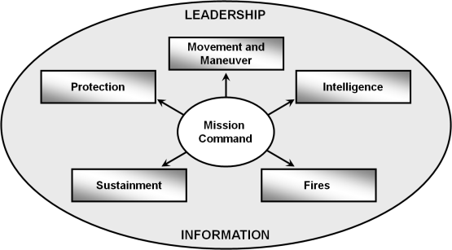
CAL and DAL
Continuous Assessment
Plan
Prepare
Execute
Threat Assessment
Criticality Assessment
Vulnerability Assessment
Protection
DP
DP
Command Guidance
Task Organize
Adjust
CAL
Critical Asset List
Vulnerability
Reinforcing
DP
Prioritize
DAL
Capabilities
Defended Asset List
Personnel
Information
Preserve
DP—Decision Point
Physical Assets
Complimentary
Notes:
This slide shows that a commander provides protection guidance to the staff who identify and assess threats and hazards leading to a list of critical assets (CAL). The commander uses mission command and directs his staff via the operations process to integrate the various complimentary and reinforcing protection capabilities from all of the WFFs as he continues to make decisions to reduce vulnerability and allocate resources to the assets he wants defended (DAL). This way the commander can focus on Protection at all times or he/she can conduct Protection as an economy of force activity at key times and locations.
Critical Asset List. The critical asset list (CAL) is a prioritized list of assets that should be protected; it is normally identified by the phase of an operation and approved by the commander. Once the threat, criticality, and vulnerability assessments are complete, the staff presents the prioritized list of critical assets to the commander for approval. Commanders typically operate in a resource-constrained environment and have a finite amount of combat power for protecting assets. Therefore, the protection cell determines which assets are critical for mission success and recommends protection priorities based on the available resources. The list will vary depending on the mission variables.
Defended Asset List. The DAL is a listing of those assets from the CAL, prioritized by the commander, to be defended with the resources available. It represents what “can” be protected, by priority. This allows the commander to apply finite protection capabilities to the most valuable assets. The combat power applied may be a weapon system, electronic sensor, obstacle, or combination. The CAL and DAL are dynamic lists .Assessment permits the commander to shape protection measures and provides valuable information for refining future protection activities. Commanders stay alert to transitions in operations. Significant changes in the situation and environment often affect vulnerabilities to the force; such changes may require adjustments to CALs and DALs.
Commanders and units remain flexible while conducting protection operations. When the situation changes significantly, the protection plan must be adapted so that resources and opportunities are not wasted. Commanders should not hesitate to modify the protection plan if it fails to adequately protect critical assets.
The most important question when assessing the effectiveness of applied protection capabilities is whether the allocation of resources and combat power to protection tasks remain valid. The staff compares expectations to actual events to determine the overall effectiveness of the plan, and they recommend appropriate adjustments.

Slide 19
Scheme of Protection Development
Protection priorities.
Work priorities for survivability assets.
Air and missile defense positioning guidance.
Specific terrain and weather factors.
Intelligence focus and limitations for security efforts.
Areas or events where risk is acceptable.
Protected targets and areas.
Civilians and noncombatants in the area of operations.
Vehicle and equipment safety or security constraints.
Personnel recovery actions and control measures.
Force protection condition status.
Force health protection measures.
Mission-oriented protective posture guidance.
Environmental guidance.
Information operations condition.
Explosive ordnance and hazard guidance.
Ordnance order of battle.
OPSEC risk tolerance.
Fratricide avoidance measures.
Rules of engagement, standing rules for the use of force, and rules of interaction.
Escalation of force and nonlethal weapons guidance.
Operational scheme of maneuver.
Military deception.
Obscuration.
The staff considers these items, at a minimum, as it develops the scheme of protection
Notes:
The scheme of protection describes how protection tasks support the commander’s intent and concept of operations, and it uses the commanders guidance to establish the priorities of support to units for each phase of the operations.
The scheme of protection is developed after receiving guidance and considering the principles of protection in relation to the mission variables, the incorporation of efforts, and the tasks that comprise the protection warfighting function.
The scheme of protection is based on the mission variables, thus includes protection priorities by area, unit, activity, or resource. It addresses how protection is applied and derived during the conduct of operations.

Slide 20
Running Estimate
The protection cell develops and refines the protection running estimate. The protection estimate provides a picture to the command on the protection warfighting function. It is developed from information (including the facts, assumptions, constraints, limitations, risks, and issues) pertaining to the
protection mission and the scheme of protection. ADRP 3-37, Chapter 2
Notes:
The protection cell develops and refines the protection running estimate. The protection estimate provides a picture to the command on the protection warfighting function. It is developed from information (including the facts, assumptions, constraints, limitations, risks, and issues) pertaining to the protection mission and the scheme of protection. It includes the essential tasks from a higher order.
Integrating process data and continuing activities (assets available, civil considerations, threat and hazard assessments, criticality assessments, vulnerability assessments, capability assessments, MOEs, MOPs, essential elements of friendly information, CALs, DALs, protection priorities, risk decision points, supporting tasks) feed updates to the running estimate.

Slide 21
Protection Cells
The protection warfighting function applies to all levels of command. The Army structure provides established protection cells at division level and above. Protection cells are found in main and tactical command posts at division and corps levels and in main or contingency command posts at theater Army headquarters.
Protection Working Group
Members
Functions
Chief of Protection
AMD officer
AT officer
CBRN officer
Engineer officer
EOD officer
Fire Support rep
OPSEC officer
Provost marshal
Safety officer
Intelligence rep.
Civil Affairs officer
Personnel Recovery
Public affairs officer
Staff judge advocate
Surgeon
Medical Rep
Veterinary Rep
Subordinate Unit LNOs
Operations Rep
Area Contracting Officer
Recommend Protection Priorities
Develop CAL and DAL
Protection Planning Forum
Deconflict Protection Responsibilities
Recommends MC Relationships
Adjacent Unit Coordination
Recommends Allocation of Resources
Monitors Protection Measure Effectiveness
Facilitates Protection Integration
Notes:
The protection cell is generally responsible for integrating or coordinating the tasks and systems that fall under the protection warfighting function. Protection cells help craft protection strategies that are reflected in the concept of protection included in the base order and appropriate annexes and appendixes. Some protection tasks, such as FHP and AMD, may also have representation in other operational cells at higher level organizations. At the theater army level, the protection cell may recommend that the commander tailor protective elements when required for the campaign or major operation.
The protection cell advises commanders on the priorities for protection and coordinates the implementation and sustainment of protective measures to protect assets according to the commander’s priorities. During the planning process, the protection cell provides input to the commander’s MDMP by integrating the threat and hazard assessment with the commander’s EEFI, CAL, and DAL. While the planning cell develops plans, the protection cell attempts to minimize vulnerability based on the developing COA. The intent is to identify and recommend refinements to the COA that are necessary to reduce vulnerability and ensure mission success. The protection cell provides vulnerability mitigation measures to help reduce risks associated with a particular COA and conducts planning and oversight for full spectrum operations.
Roles and Responsibilities. The protection cell is generally responsible for integrating or coordinating the tasks and systems that fall under the protection warfighting function. Protection cells help craft protection strategies that are reflected in the concept of protection included in the base order and appropriate annexes and appendixes. Some protection tasks, such as FHP and AMD, may also have representation in other operational cells at higher level organizations.
Chief of Protection. A chief of protection is assigned to the modular division, corps, and theater Army headquarters. At brigade and below, the commander normally designates a senior leader to this role. The AMD coordinator, engineer coordinator, provost marshal, or CBRN officer may be designated as a protection coordinator to support integration. Chiefs of protection and protection coordinators participate in various forums to facilitate the continuous integration of protection tasks and systems in the operations process. This typically occurs through protection working groups in a theater of operations and in force protection working groups and executive forums as part of the installation force protection program.
The protection cell helps develop a concept of protection tailored to the type of operation the unit is conducting.

Slide 22
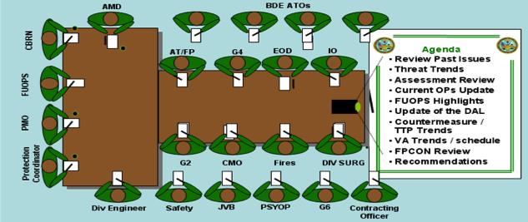
Protection Working Group – “A Way”
Notes:
Listed here are examples of duties and responsibilities of the PWG.
Determines likely threats and hazards from updated enemy TTPs
Determines vulnerabilities as assessed by the vulnerability assessment team
Determines critical assets
Establishes and recommends protection priorities
Reviews and coordinates unit protection measures
Recommends FPCON and random antiterrorism measures
Determines resources required and makes recommendations for funding and equipment fielding
Provides input and recommendations on protection-related training
Provides protection input to plans across all time / event horizons

Slide 23
Protection at Brigade and Below
X
X
X
MP
Commanders at brigade and below echelons are not organized with dedicated protection staff cells, but they are still responsible for integrating the protection warfighting function into unified land operations.
Commander designates staff lead (Protection Officer)
Experience with risk management and process integration
(i.e., DCO, XO, Operations Officer, Operations SGM)
Protection Coordinators (BDE staff sections)
In all cases, protection officers and coordinators work with higher and lower echelons to nest protection activities with complementary and reinforcing capabilities.
Notes:
Commanders at brigade and below echelons are not organized with dedicated protection staff cells, but they are still responsible for integrating the protection warfighting function into unified land operations.
Protection integration at these echelons may require commanders to designate a staff lead (protection officer) who has the experience to integrate risk management and other integrating processes. These duties could be accomplished by the deputy brigade commander, executive officer, operations officer, or a sergeant major. Assistant operations officers and other staff members could be designated as protection coordinators to facilitate the integration of the fourteen protection tasks and systems into operations.
In all cases, protection officers and coordinators work with higher and lower echelons to nest protection activities with complementary and reinforcing capabilities.

Slide 24
Protection in Preparation
Continue to coordinate and conduct liaison.
Conduct rehearsals.
Initiate information collection.
Conduct plans-to-operations transitions.
Initiate security operations.
Refine the plan.
Initiate troop movement.
Integrate new Soldiers and units.
Initiate sustainment preparations.
Complete task organization.
Initiate network preparations.
Train.
Manage terrain.
Perform pre-operation checks and inspections.
Prepare terrain.
Continue to build partnerships and teams.
Conduct confirmation briefs.
Commanders, units, and Soldiers conduct preparation activities (as described in ADRP 5-0) to help ensure that the force is protected and prepared for execution.
Protection is incorporated throughout preparation activities.
Notes:
The force is often most vulnerable to an enemy or adversary surprise attack during preparation. Preparation creates conditions that improve friendly force opportunities for success. It requires commander, staff, unit, and Soldier actions to ensure that the force is trained, equipped, and ready to execute operations. Preparation activities help commanders, staffs, and Soldiers understand a situation and their roles in upcoming operations. During the preparation phase, the protection focus is on deterring and preventing the enemy or adversaries from actions that would affect the combat power. The implementation of protection tasks with ongoing preparation activities helps prevent negative effects. Commanders ensure the integration of protection warfighting function tasks to safeguard bases, secure routes, and protect the force while it prepares for operations. Active defense measures help deny the initiative to the enemy or adversary, while the execution of passive defense measures prepares the force against the threat and hazard effects and accelerates the mitigation of those effects.

Slide 25
Protection in Execution
Unified Land Operations
Notes:
Unified Land operations is the Army’s operational concept of combining offensive, defensive, and stability or civil support operations simultaneously as part of an interdependent joint force to seize, retain, and exploit the initiative, accepting prudent risk to create opportunity. They employ synchronized action—lethal and nonlethal—proportional to the mission and informed by a thorough understanding of all variables of the OE.
Commanders use the mission variables to develop protection strategies that integrate all forms of protection to deter, prevent, secure, defend, and restore the force during unified land operations. Commanders evaluate the significance of each mission, the vulnerabilities inherent in infrastructure and the environment, and their ability to protect the force.

Slide 26
Elements of Unified Land Operations
Operation
Primary Task
Purpose
Offensive
Movement to contact
Attack
Exploitation
Pursuit
Dislocate, isolate, disrupt and destroy enemy forces
Seize key terrain
Deprive the enemy of resources
Develop intelligence
Deceive and divert the enemy
Create a secure environment for stability operations
Defensive
Mobile defense
Area defense
Retrograde
Deter or defeat enemy offensive operations
Gain time
Achieve economy of force
Retain key terrain
Protect the populace, critical assets and infrastructure
Develop intelligence
Stability
Civil security
Civil control
Restoration of essential services
Support to governance
Support to economic and
infrastructure development
Provide a secure environment
Secure land areas
Meet the critical needs of the populace
Gain support for host nation government
Shape the environment for interagency and host
nation success
Civil Security
Support in response to disasters
or terrorist attacks
Support of civil law enforcement
Other support as required
Save lives
Restore essential services
Maintain or restore law and order
Protect infrastructure and property
Maintain or restore local government
Shape the environment for interagency success
Notes:
Commanders and leaders use all aspects of military art and science to protect the force.
Offensive Tasks. Offensive tasks are combat operations conducted to defeat and destroy enemy forces and seize terrain, resources, and population centers. Surprise, concentration, tempo, and audacity characterize the offense. Protection can be derived through audacity or surprise or by increasing the tempo of offensive operations.
Protection in the Offense. Protection activities, tasks, and systems are applied and conducted to preserve combat power by reducing risk or mitigating vulnerability. Air and missile systems defend maneuver forces, critical infrastructure, and logistics bases. Although all commanders have some organic capability for air defense and warning, enhanced capabilities are often provided by higher-echelon commanders and air component organizations.
Defensive Tasks. Defensive tasks are combat operations conducted to defeat an enemy attack, gain time, economize forces, and develop conditions favorable for offensive or stability operations. Preparation, security, disruption, massed effects, and flexibility characterize the defense.
Protection in the Defense. No matter which defensive task is performed, the survivability of MC centers and key communications nodes in defensive tasks is critical to their success. Survivability and AT tasks and plans are essential during the defense and may require a deliberate and detailed approach to ensure that combat power is apportioned where it is most needed. Commanders may use decision support tools and analysis to assess critical assets and key vulnerabilities.
Stability Operations. Stability operations is an overarching term encompassing various military missions, tasks, and activities conducted outside the United States in coordination with other instruments of national power to maintain or reestablish a safe and secure environment and provide essential governmental services, emergency infrastructure reconstruction, and humanitarian relief.
Protection Considerations. Like offensive and defensive operations, stability operations can derive some protection from the concept of operations alone, but the most sustainable protection success for the force is achieved by integrating the protection tasks and systems that comprise the protection warfighting function.
Civil Support Operations. DOD civil support operations are divided into the three broad categories of domestic emergencies, support of designated law enforcement agencies, and other support activities
Protection Considerations. Soldiers engaged in civil support operations may face threats from criminals, disease, the weather, or TIM. The tasks of safety, FHP (preventive medicine), AT, and CBRN defense are critical considerations for protecting deployed personnel and assets. An accurate, on-going assessment of risk and mitigation measures is vital to force protection.

Slide 27
Protection and Modularity
Among the Army’s modular support brigades, the Maneuver Enhancement Brigade (MEB) presents a capability that is ideally suited to perform protection tasks and functions for a division, corps, or multinational force.
X
l
I
I I
I I
I I
I I
I I
I
I I
I I
I I
I I
BSB
MP
EOD
CA
CBT
MP
Organic
As required
Maneuver Enhancement Brigade task-organized for protection tasks
Notes:
Brigade combat teams (BCTs), functional brigades, and support brigades perform protection tasks and functions directed by higher headquarters. Brigades incorporate their efforts into an established protection framework developed by the staff at higher headquarters. Among the Army’s modular support brigades, the MEB presents a capability that is ideally suited to perform protection tasks and functions for a division, corps, or multinational force. The MEB can be task-organized as needed to provide the protection requirements needed at division and corps levels. At these levels, the protection cell may recommend the task organization of units whose primary mission is protection. Task organization is the temporary reorganization of the force by using command and support relationships, including a recommended task organization for the MEB and other functional units as required. MEBs are designed to conduct MC activities for the following units that provide protection and other support to the force:
Engineer.
Military police.
CBRN.
CA.
Air defense artillery.
EOD.
TCF.
When protection requirements exceed the capabilities of the MEB, the protection cell can identify the need for a functional brigade headquarters.
The protection cell translates protection guidance and capabilities and the results of analysis into protection strategies using various decision support and analytical tools and the principles of protection.
The use of protection principles in developing protection strategies provides coherence to the many diverse and overlapping protection activities and forms existing or occurring in the OE. Commanders at all levels allocate resources to support protection strategies based on an accurate and continual assessment of threats and hazards over time, but remain flexible enough to respond to variances and opportunities and to make adjustments.

Slide 28
Movement Corridor as Protection
I I
MP
I
MP
I
RIVER
I
X
X
SUST
TCP
EOD
TRP
TCP
MSR BLACK
CSC
X
ACP
ACP
ACP
ACP
ACP
X
TRP
X
NAI
X
X
Notes:
A Movement Corridor is defined as a designated area established to protect and enable ground movement along a route.
One example of an MEB establishing and conducting operations in a movement corridor. In this example, the MEB AO and the BCT AO are connected by MSR BLACK. Based on METT-TC, the division needs to secure movement between the brigade AOs and has tasked the MEB to expand its existing AO to include an area that runs about 4 kilometers on each side of the MSR and establish a movement corridor. The MEB is required to conduct reconnaissance, clear, and secure the new area; support the sustainment brigade to establish the convoy support center (CSC) and conduct movement regulation and traffic control; and to maintain the MSR in its expanded AO. Due to the complexity of the requirement, the MEB has assigned the mission to an MP TF (shown with its headquarters in the CSC), but retained control of the movement corridor as part of its AO. The MEB has developed an initial ISR plan. The TF MP conduct police engagement to leverage HN or multinational police assets to enhance security. The brigade has also established traffic control points along the MSR, an air corridor, and air control points (ACPs) in conjunction with the division headquarters and the BCT to regulate ground traffic and control rotary wing and UAS traffic between the MEB and BCT airfields. The ACP near the CSC supports air traffic to and from the CSC and respond to the named area of interest (NAI) in the built up area. The MEB develops an initial fires plan for convoy and CSC security and defense with target reference points (TRPs).

Slide 29
Example – Protecting Movement
Build a new Route
Insulate the Route
Air Surveillance
Restrict the Route
Increased Enemy mobility
Probable
Secure the Route
Isolate the Route
RISK
Operate Check Points
Catastrophic Injury
ROE Change
Dedicated Escort
Ground Surveillance
Combat Isolation
Possible
Clear Routes
HN Patrols
Route Patrols
An activity that must be continually integrated and synchronized into the operations process
Use of Curfews
Use of Patterns
Unit Self Protection
LESS
Protection/Resources
MORE
Notes:
This slide shows a menu of protection measures or TTPs that might be used in an operational area to control or protect Movement of all kinds and as the Risk of catastrophic injury increases, a commander could choose to apply more protection in the form of these techniques and capabilities.
In Iraq, there were some commanders at Bn TF level doing some of these activities, like using pattern analysis and moving or conducting operations only during curfew. Other commanders were conducting snap checkpoints in their area, and Brigades had access to continual UAV feeds that could some times be distributed. However, there was NO Bde level headquarters continuously integrating these activities from TF AO to TF AO or between Bde AOs and LOC. This was doable and the 2nd and 3rd order effects of losing our ability to protect and control movement even in a relatively small urban area negative and significant. Perhaps the most dramatic effect was the feeling among Soldiers of “every man for yourself”. Or what SLA Marshall called the problem of Combat Isolation. This was never more evident then by observing 2 realities in country. First was Soldiers trying with every creative ability they possessed to jury-rig or modify their vehicles to protection themselves and their commander’s reluctance to stop them. Second, was dramatic Escalation of Force events and issues that stemmed from the “save yourself first” attitude and that manifested itself in the high number of civilians that were killed or wounded in EOF events. Some say the Italians pulled out of the Coalition because American soldiers killed one of their agents on Route Irish after freeing their political correspondent from kidnappers. Lastly, reports of Death Squads moving in broad daylight from one part of the city to another in groups of 3-5 vehicle movements and killing political opponents revealed our loss of movement control and had a chilling effect on the population. What was needed here was an organizing and integrating HQ that implement many of the tasks and activities noted above in a coherent manner that would have utility in the movement-protection equation.

Slide 30
Protection Assessment
Lead
Principles of war
Operational
themes
Experience
PMESII-PT
METT-TC
Understand
Visualize
Describe
Direct
Problem
End State,
Nature, and Design
Of Operation
Time, Space
Resources,
Purpose, and
Actions
Warfighting
Functions
Operational
environment
Enemy
Offense
Defense
Stability
Civil support
Decisive operations
Shaping operations
Sustaining operations
Movement and maneuver
Intelligence
Fires
Sustainment
Mission Command
Protection
Running estimates
Initial commander’s
intent
Planning guidance
CCIR
EEFI
Plans and orders
Branches and
sequels
Preparation
Execution
Elements of operational
design
Assess
Notes:
Commanders drive the operations process through the application of mission command, which is the art and science of understanding, visualizing, describing, directing, leading, and assessing forces to impose the commander’s will on a hostile, thinking, and adaptive enemy.
Mission command applies leadership to translate decisions into actions—by synchronizing forces and warfighting functions in time, space, and purpose—to accomplish missions. (ADRP 3-0)
Commanders combine the military art and science to translate information and experience into superior decisions faster than the enemy. They also determine priorities, provide guidance, establish time horizons, create command climates, and accept risk in ways that are clear and help focus the staff and subordinate organizations. The commander’s inherent responsibility to protect and preserve the force, while seeking every opportunity to act decisively, makes it imperative to consider protection in the operations process.
Commanders understand and broadly visualize protection considerations and opportunities in relation to the mission and the OE in terms of the forms of protection. They discern hazards that are preventable and divide threats into those that may be deterred and those that may require the application of security or defensive measures to achieve protection. Commanders provide guidance on risk tolerance, CCIR, and asset or capability criticality to help focus the staff and subordinate leadership.
A commander’s tolerance for risk may vary with the nature of the threat, operational theme, environmental conditions, or external factors. Leaders always protect all military personnel. All military resources have value, but all military assets are not linked to mission accomplishment in the same manner or at the same time. As the competition for protection assets increases, commanders must provide a clear intent and guidance on where, when, and how much risk they are willing to assume or tolerate. The RM process provides a context for risk assessment to support decisionmaking. Decision support tools and systems may be helpful within the assessment process to help commanders differentiate between important assets and mission-critical assets.

Slide 31
Protection and the Operations Process
Plan
Prepare
Execute
TLP and MDMP
Plans and Orders
Reconnaissance
Security
Force protection
Plan revision and refinement
Coordination and liaison
Rehearsals
Task organization
Training
Movement
Precombat checks and
inspections
Integration of new Soldiers and
units
Decide
Execution
Adjustment
Direct
Apply combat power
Synchronize
Maintain continuity
Assessment During
Planning
Assessment During
Preparation
Assessment During
Execution
Monitor the situation
Monitor MOP / MOE
Evaluate COAs
Monitor preparations
Evaluate preparations
Monitor operations
Evaluate progress
Continuous Assessment
Situational understanding—sources, solutions.
Monitoring—situation/operations, MOP/MOE.
Evaluating—forecast, seize, retain, and exploit the initiative; variances.
Notes:
The operations process is composed of several supporting topics that further illustrate the activities and tasks necessary to conduct Army operations. For example, the MDMP and orders production support planning, while activities such as reconnaissance and rehearsals support preparation. Decisionmaking characterizes execution and is necessary to direct the application of combat power and to synchronize activities. While assessment occurs continuously throughout the operations process to provide situational understanding, monitoring and evaluating additional assessments also occur specifically to planning, preparing, and executing operations.
While each protection task and system has its own operational consideration, each must be synchronized within a coherent protection strategy or concept to ensure synergistic protection efforts. For example, AMD without survivability is much less effective. Area security without AT, OPSEC, and physical security is also less effective. To ensure this synergy, the protection cell develops protection strategies around which MOP and MOE can be established. In this way, the success or failure of each individual protection effort can be monitored and evaluated.

Slide 32
Running Estimates / MOPs and MOEs
Measuring Change and Variances
Where are Protection Change Indicators listed and how are they determined….?
Measure of Performance: a criterion tied to measuring task accomplishment that is used to assess friendly actions - (are we doing the right things?)
Measure of Effectiveness: a criterion that measures the attainment of an operation’s end state, achievement of objectives, or creation of an effect that is used to assess changes in the operational environment –
(are we doing the right things right?)
Notes:
Measure of Performance. A MOP helps determine whether a commander has applied enough, correct resources to an operation. A MOP is a criterion used to assess friendly actions and that is tied to measuring task accomplishment. (JP 3-0) This measure is friendly force-oriented. It measures task accomplishment; and in its simplest form, it answers whether a task was performed successfully. FM 7-15 provides a table with MOPs that can be used to develop standards for each task. Some specific MOPs may be altered for their relevance to the local situation or they may be omitted; however, all changes to established MOPs should be disseminated vertically and horizontally among headquarters and participants in an operation or activity.
Measure of Effectiveness. A MOE is useful in determining success and deciding whether a commander must maintain, adjust, or reallocate resources. An MOE is a criterion used to assess changes in system behavior, capability, or OE that is tied to measuring the attainment of an end state, achievement of an objective, or creation of an effect. (JP 3-0) It is oriented to mission accomplishment, focuses on the results or consequences of an action, and is used to assess changes in the OE. This is more often a subjective assessment as it tends to measure long-term results. As a result, an MOE may consist of a series of indicators that are used to judge success or failure.
Significant changes in some environmental conditions are subtle and only occur over a long period of time, yet protection activities must be continual. The enduring nature of protection could cause complacency or inattentiveness, requiring leaders to stay focused on determining, monitoring, and evaluating accurate protection indicators and warnings that maintain situational understanding and alert them to risk.
Commanders monitor MOEs and evaluate variances and change indicators for cause and effect to forecast failure or identify a critical point of failure in an activity or operation. Based on this type of assessment, resources can be reassigned to mitigate the overall risk to the mission or to support or reinforce specific local security efforts. The goal is to anticipate the need for action before failure occurs, rather than react to an unplanned loss.

Slide 33
Protection the Web
Download Manual (ADRP 3-37): http://armypubs.army.mil/doctrine/ADRP_1.html
Collective Task 71-8-6700, Coordinate Protection Measures: https://atn.army.mil/ (Search by Task Number) (CAC required)
CGSC Warfighting Function Page: https://www.milsuite.mil/book/community/spaces/cgsc/tactics_community/warfighting_functions (CAC required)
Notes:
As mentioned earlier, the holistic approach to Protection has no direct antecedent in Army Doctrine.
To facilitate force-wide education on Protection, we have a designed a multi faceted approach to information distribution.
The ADRP is accessible through public domain.

Slide 34
Back up / Additional Information

Slide 35
Protection Tasks and Systems (1 of 5)
Protection Task
Significant Activities / Employment Principles
Operational Area Security
(ADRP 3-90) (FM 3-19.4)
Conduct ISR.
Control movement.
Prepare response forces.
Employ passive defense measures.
Position sniper teams.
Defend against attacks
by fire.
Convoy Security
Support area damage
control.
Employ Safety Techniques
(incl Fratricide Avoidance)
(AR 385-10; DA Pamphlet
385-10, Appendix J)
(ADRP 3-90) (FM 5-19)
Manage safety and accept no unnecessary risk.
Investigate mishaps and near misses.
Conduct hazard analysis and recommend countermeasures.
Provide safety education, training, and promotion.
Implement fire and maneuver control measures
Conduct inspections, surveys, assessments, and technical
consultations.
Communicates and enforces rules of engagement.
Fire prevention, fire suppression and firefighting.
Operations Security (OPSEC)
(incl Information Protection)
(AR 530-1) (FM 3-13)
Identify EEFI.
Analyze adversaries and vulnerabilities.
Assess risk.
Recommend countermeasures.
Protect against threat events.
Monitor/detect threat events.
Analyze threat events.
Respond to threat events.
Notes:
Operational Area Security
Operational area security is a form of security operations conducted to protect friendly forces, installations, routes, and actions within an AO. Forces engaged in area security operations focus on the force, installation, route, area, or asset to be protected. Although vital to the success of military operations, area security is normally an economy-of-force mission, often designed to ensure the continued conduct of sustainment operations and to support decisive and shaping operations.
Area security operations often focus on the following assets and activities: Base and base cluster defense; Critical Asset Security; C2 Node protection; High Risk Personnel (HRP) security; Physical Security; Response Force operations; LOC security; checkpoints and combat outposts; Convoy security; Port areas and pier security; Surveillance;; and Area Damage Control.
Employ Safety Techniques (incl Fratricide Avoidance)
Safety has a full spectrum mission. Operational conditions often impose significant hazards to Soldiers through the increased probability of an accidental event. Integrating safety into the operations process through the protection warfighting function and the RM process provides an opportunity to identify and assess hazards to the force and develop risk reduction measures. The responsibility for safety starts with the commander and continues through the chain of command to individuals.
Fratricide is the unintentional killing of friendly personnel by friendly firepower. Fratricide is accidental and is usually the end product of an error by a leader and/or Soldier.
Fratricide avoidance is normally accomplished through a protection strategy that emphasizes prevention, centered on two fundamental areas—situational awareness and target identification.
The potential for fratricide may increase with the fluid nature of the noncontiguous battlefield.
Operations Security (OPSEC)
OPSEC is the process of identifying essential elements of friendly information (EEFI) and subsequently analyzing friendly actions attendant to military operations and other activities to: a. identify those actions that can be observed by adversary intelligence systems; b. determine indicators hostile intelligence systems might obtain that could be interpreted or pieced together to derive critical information in time to be useful to adversaries; and c. select and execute measures that eliminate or reduce to an acceptable level the vulnerabilities of friendly actions to adversary exploitation. Overall objective of OPSEC is to preserve essential secrecy.

Slide 36
Protection Tasks and Systems (2 of 5)
Protection Task
Significant Activities / Employment Principles
Intelligence Support
(ADRP 2-0) (FM 2-01.3)
Identifies and tracks threat activities near critical assets.
Provides threat courses of action (COA).
Alerts the commander to threats.
Provides vulnerability assessments of all threats.
Counterintelligence.
Physical Security
(ATP 3-39.32)
Establish physical security requirements for:
Unit areas.
Communications.
Area access (personnel access rosters)
Established procedures for handling, storing, safeguarding, and destroying classified material.
Protect personnel, information, and critical resources in all locations and situations against various threats.
Antiterrorism
(FM 3-37.2) (ATP 3-37.2)
Conducts vulnerability assessment.
Assesses terrorist threat.
Conducts risk management (threat, critical asset and vulnerability assessment of units, installations, facilities and bases/base camps).
Develops measures to prevent and respond to terrorist attack
Designates the appropriate force protection condition (FPCON)
Notes:
Intelligence Support
This is an intelligence warfighting function task that supports the protection warfighting function. It includes providing intelligence that supports measures which the command takes to remain viable and functional by protecting itself from the effects of threat activities. It also provides intelligence that supports recovery from threat actions. It includes analyzing the threats, hazards, and other aspects of an operational environment and utilizing the intelligence preparation of the battlefield process to describe the operational environment and identify threats and hazards that may impact protection. Intelligence support develops and sustains an understanding of the enemy, terrain and weather, and civil considerations that affect the operational environment.
Physical Security
Physical security consists of physical measures that are designed to safeguard personnel; to prevent unauthorized access to equipment, installations, material, and documents; and to safeguard them against espionage, sabotage, damage, and theft. The Army employs physical security measures in depth to protect personnel, information, and critical resources in all locations and situations against various threats through effective security policies and procedures. This total system approach is based on the continuing analysis and employment of protective measures, including physical barriers, clear zones, lighting, access and key control, intrusion detection devices, defensive positions, and nonlethal capabilities. The goal of physical security systems is to employ security in depth to preclude or reduce the potential for sabotage, theft, trespass, terrorism, espionage, or other criminal activity. To achieve this goal, each security system component has a function and related measures that provide an integrated capability
For— Deterrence, Detection, Assessment, Delay and Response.
Antiterrorism
AT is an integral part of Army efforts to defeat terrorism. Terrorists can target Army elements at any time, in any location. By effectively preventing and, if necessary, responding to terrorist attacks, commanders protect all activities and people so that Army missions can proceed unimpeded. AT is neither a discrete task nor the sole responsibility of a single branch; all bear responsibility. AT must be integrated into all Army operations and considered at all times..
The FPCON system standardizes DOD identification, recommended preventive actions, and responses to terrorist threats against U.S. personnel and facilities. The five FPCON levels are—NORMAL; ALPHA; BRAVO; CHARLIE; and DELTA

Slide 37
Protection Tasks and Systems (3 of 5)
Protection Task
Significant Activities / Employment Principles
Coordinate Law and Order
(ATTP 3-39.10)
Perform law enforcement.
Conduct criminal investigations.
Conduct traffic management and enforcement.
Employ forensics capabilities.
Conduct police engagement.
Provide customs support.
Provide host nation police development.
Support civil law enforcement.
Support border control, boundary security, and the freedom of movement
Survivability
(ATP 3-37.34)
Achieve situational awareness.
Determine degree of acceptable risk.
Analyze terrain features.
Establish priorities of work.
Employ camouflage, cover, and concealment
Force Health Protection
(FM 4-02) (ATTP 4-02)
Prevent and control diseases.
Assess environmental and
occupational health.
Determine force health activities
protection.
Employ PVNTMED toxi-
cology and lab services.
Perform health risk
assessments.
Disseminate health info
Notes:
Coordinate Law and Order
Law and order operations encompass policing and the associated law enforcement activities to control and protect populations and resources and to facilitate the existence of a lawful and orderly environment. Law and order operations and the associated skills and capabilities inherent in that function provide the fundamental base on which all other military police functions are framed and conducted.
Law and order operations are conducted across the range of military operations. As the operation transitions and the operational environment stabilizes, civil control efforts are implemented and the rule of law is established. The closer the operational environment moves toward stability and full implementation of host nation governance under the rule of law, the more general policing activities transition to law enforcement activities. The ultimate goal is to maintain order while protecting personnel and assets
Survivability
Survivability includes all aspects of protecting personnel, weapons, and supplies while simultaneously deceiving the enemy. Survivability tactics include building a good defense; employing frequent movement; using concealment, deception, and camouflage; and constructing fighting and protective positions for both individuals and equipment.
Survivability operations frequently enable other protection tasks and systems, including AMD, operational area security, AT, and CBRN operations. Survivability operations also provide support to the movement and maneuver warfighting function by conducting mobility and countermobility operations.
Survivability consists of four areas : Mobility; Situational Understanding; Hardening; Camouflage, Concealment and Deception
Force Health Protection
FHP includes measures taken by all to promote, improve, or conserve the behavioral and physical well-being of Soldiers. These measures enable a healthy and fit force, prevent injury and illness, and protect the force from health hazards. It includes: Preventive medicine, including medical surveillance and occupational and environmental health surveillance; Veterinary services, including food safety and surety, animal care missions, and the prevention of zoonotic diseases transmissible to man; Combat and operational stress control; Laboratory services, including area medical laboratory (AML) support; and Dental services, including preventive dentistry.

Slide 38
Protection Tasks and Systems (4 of 5)
Protection Task
Significant Activities / Employment Principles
CBRN Operations
(FM 3-11, FM 3-11.21
and FM 4-02.17)
Identify threat.
Assess situation.
Identify vulnerability reduction measures.
Conduct operations.
Provide logistics and health support.
Decontaminate.
Explosive Ordnance Disposal
(EOD)
(ATTP 4-32.2)(ATTP 4-32.16)
Advise commanders on EO/IEDs (including CBRN).
Positively identify, respond to, and dispose of EO/IEDs
(including CBRN).
Perform EO/IED site exploitation and technical intelligence
collection.
Perform postblast analysis.
Air and Missile Defense (AMD)
(ADRP 3-09) (FM 3-01)
Active and passive measures.
Coordinates protection of CAL and DAL.
Integrates the employment guidelines.
Identifies the Air Defense Warning System status.
Designates the Weapon Control Status.
Notes:
CBRN Operations
CBRN operations are the employment of tactical capabilities that counter the entire range of CBRN threats and hazards through WMD proliferation prevention, WMD counterforce, CBRN defense, and CBRN consequence management activities in support of operational and strategic objectives to combat WMD and operate safely in CBRN environments. CBRN threats and hazards include WMD, improvised weapons and devices, and TIM and can potentially cause mass casualties and large-scale destruction.
The CBRN and EOD elements of the protection cell plan and coordinate CBRNE operations.
Conduct threat analysis and Mission Oriented Protective Posture (MOPP) level
Explosive Ordnance Disposal (EOD)
The mission of EOD is to eliminate or reduce the effects of explosive ordnance (EO) hazards to protect combat power.
EOD elements normally— Identify EO/IEDs/captured enemy ammunition and threats; Render-safe/dispose of EO/IEDs; Perform technical intelligence; and Perform postblast analysis.
Air and Missile Defense (AMD)
An air defense system protects the force from air and missile attacks and aerial surveillance. Additionally, maneuver and fires elements in the OE must be prepared to augment air defense systems using direct-fire weapons.
The AMD task consists of active and passive measures that protect personnel and physical assets from an air or missile attack. Passive measures include camouflage, cover, concealment, hardening, and OPSEC. Active measures are taken to destroy, neutralize, or reduce the effectiveness of hostile air and missile threats.
When designing AMD protective systems, protection planners use the six employment guidelines—mutual support, overlapping fires, balanced fires, weighted coverage, early engagement, and defense in depth—and additional considerations necessary to mass and mix AMD capabilities.
Air Defense Warning System (ADW): RED; YELLOW; and WHITE.
Weapon Control Status: FREE; TIGHT; and HOLD

Slide 39
Protection Tasks and Systems (5 of 5)
Protection Task
Significant Activities / Employment Principles
Personnel Recovery (PR)
(FM 3-50.1)
Establish PR organization.
Perform cross-staff coordination.
Analyze PR gap.
Integrate diplomatic/military/civil PR.
Establish PR SOPs.
Exercise/rehearse.
Report.
Locate.
Support.
Recover.
Return/reintegrate.
Internment and Resettlement (IR)
(FM 3-39.40)
Perform internment.
Intern U.S. military prisoners.
Support host nation corrections reform.
Conduct resettlement operations.
Conduct enemy prisoner of war operations.
Conduct detainee operations..
Notes:
Personnel Recovery (PR)
PR is the sum of military, diplomatic, and civil efforts to prepare for and execute the recovery and reintegration of isolated personnel. (JP 3-50) PR is the overarching term for operations that focuses on recovering isolated or missing personnel before becoming detained or captured and extracting those detained or captured personnel through coordinated and well-planned operations.
PR is not a separate mission; it is incorporated into planning for all missions.
Isolated Soldier Guidance (ISG) defines “isolation”, and describes where to go, what to do and signals.
Internment and Resettlement (IR)
Internment and resettlement operations are conducted by military police to shelter, sustain, guard,
protect, and account for populations (detainees, dislocated civilians, and U.S. military prisoners) as a result of military or civil conflict and natural or man-made disasters or to facilitate criminal prosecution:
● Internment. Internment involves the detainment of a population or group that pose some level
of threat to military operations.
● Resettlement. Resettlement involves the quartering of a population or group for their protection.
These operations inherently control the movement and activities of their specific population for
imperative reasons of security, safety, or intelligence gathering. The Army is the DOD executive agent for all detainee operations and for the long-term confinement of U.S. military prisoners.

