Slide 1
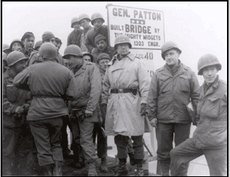
Gap Crossing Operations
"Throughout history, wars had been lost by not crossing rivers."
General George S. Patton
Notes:
Gap-crossing operations are functional areas of combined arms mobility operations and are applied across the spectrum of conflict. Each of the warfighting functions have the potential to contribute to a gap crossing. This manual focuses on the engineer roles and responsibilities for gap-crossing support to tactical commanders at the BCT level and above. It also discusses the general engineering aspects related to the establishment and maintenance of LOCs and other crossing operations. Finally, geospatial engineering is used to enable gap-crossing operations and the other functional areas of mobility. It is an important contributor to the planning process. FM 3-90.12 also discusses how commanders can best plan and execute gap crossing as a part of all operations with the support of their engineer and other key staff members. The planning of gap crossings is linked to the fundamentals of operations and planning contained in FM 3-0 and FM 5-0. Because gap-crossing operations are focused on support of maneuver forces at the BCT level, the primary combined arms manual for this manual is FM 3-90.6. For the same reason, this manual complements FM 3-34 and FM 3-34.2. Additionally, since many gap crossings involve or require a subsequent general engineering effort, FM 5-104 has applicability.

Slide 2
Purpose
To foster an understanding of the doctrinal concepts of discussed in FM 3-90.12/MCWP 3-17.1 (1 July 2008)
Combined Arms Gap-Crossing Operations
Notes:
Purpose: Discuss as needed.
FM 3-90.12 is the primary reference for this discussion; particularly Chapter 4 which addresses Wet Gap (River Crossing) operations.
Key point – combined arms operation, not an engineer or MEB opration.

Slide 3
Agenda
Terms
Fundamentals
Types & Phases
Control Measures
Command Posts
Notes:
Agenda: Discuss as needed.

Slide 4
Terms And Definitions
Gap-crossing operations. A mobility operation consisting of river crossing, brigade-level crossing, and special gap-crossing operations conducted to project combat power across a linear obstacle (wet or dry gap).
River crossing. A type of gap-crossing operation required before ground combat power can be projected and sustained across a water obstacle. It is a centrally planned and controlled offensive operation that requires the allocation of external crossing means and a force dedicated to the security of the bridgehead.
Bridgehead. (joint) An area of ground held or to be gained on the enemy’s side of an obstacle. (Army) In gap-crossing operations, an area on the enemy’s side of the linear obstacle that is large enough to accommodate the majority of the crossing force, has adequate terrain to permit defense of the crossing sites, provides security of crossing forces from enemy direct fire, and provides a base for continuing the attack.

Slide 5
Terms And Definitions
Crossing Force - The unit that has responsibility to establish the bridgehead.
Crossing Force Commander - Controls the lead brigades. Usually the Division Deputy Commander.
Crossing Force Engineer - Provides planning support to the CFC & coordinates engineer support to the CACs.
Crossing Site - location along a water obstacle or other gap where the crossing can be made using amphibious vehicles, assault boats, rafts, bridges, or fording vehicles.
Crossing Site Commander (CSC) - the individual, normally an engineer company commander or a platoon leader, responsible for the crossing means and the crossing site. He commands the engineers operating the crossing means and the engineer regulating points at the call forward areas and the staging areas for that site.

Slide 6
Critical Control Measures
RELEASE LINE - Delineates the crossing area (Phase lines)
BRIDGEHEAD LINE - (Joint, NATO) The limit of the objective area in the development of the bridgehead.
CROSSING AREA - Controlled access area for a gap-crossing operation used to decrease traffic congestion.
WAITING AREAS- Staging area, call forward area, holding area, attack position, assault position, AA.
ENGINEER EQUIPMENT PARK - Area located a convenient distance from crossing sites for assembling, preparing, and storing bridge or other crossing equipment and material.
TRAFFIC CONTROL POST - assist the crossing area HQ in traffic control by reporting and regulating the movement of units and convoys.
ENGINEER REGULATING POINT – Check point to ensure that vehicles do not exceed the capacity of the crossing means and to give drivers final instructions .
Notes:
As used in gap-crossing operations, a release line (RL) is used to delineate the crossing area. RLs are
located on both the farside and nearside and indicate a change in the HQ that is controlling movement. RLs
are normally located within 3 to 4 kilometers of the gap and on easily identifiable terrain features, if
possible. Typically, they are graphically identified as phase lines (PLs).
A crossing area is a controlled access area for a gap-crossing operation used to decrease traffic
congestion at the river (JP 1-02) (the definition was shortened, and the complete definition is printed
in the glossary). This permits swift movement of forces. Each lead brigade has a crossing area on both
sides of the gap that is defined by brigade boundaries and RLs. Crossing areas normally extend 3 to 4
kilometers on each side of the gap, depending on the terrain and the anticipated battle.
A waiting area is a location adjacent to the route or axis that may be used for the concealment
of vehicles, troops, and equipment while an element is waiting to resume movement. Waiting areas
are normally located on both banks (or sides) close to crossing areas. Commanders use the following
waiting areas to conceal vehicles, troops, and equipment while waiting to resume movement or to make
final crossing preparations:
􀁺 Staging area.􀁺 Call forward area.􀁺 Holding area.􀁺 Attack position.􀁺 Assault position.
􀁺 AA.
An engineer equipment park (EEP) is an area located a convenient distance from crossing sites for
assembling, preparing, and storing bridge or other crossing equipment and material. It is at least 1
kilometer from the gap and holds spare equipment and empty trucks that are not required at the crossing
Sites.
A traffic control post is a manned post used to preclude interruption of traffic flow or movement
along designated routes. They are used to support maneuver and mobility support operations only when
needed (FM 3-19.4). In deliberate gap crossings, TCP personnel assist the crossing area HQ in traffic
control by reporting and regulating the movement of units and convoys. TCP personnel relay messages
between the crossing area HQ and moving units. The provost marshal (PM) identifies locations that need
or require TCPs.
An engineer regulating point (ERP) is a checkpoint to ensure that vehicles do not exceed the
capacity of the crossing means and to give drivers final instructions on site-specific procedures and
information, such as speed and vehicle intervals.

Slide 7
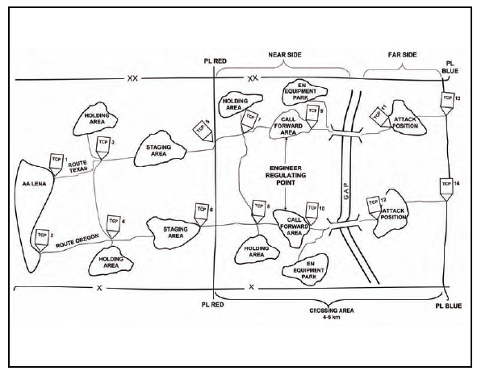
Control Measures
Notes:
he commander uses graphic control measures to delineate areas of responsibility for subordinates and to ease traffic control. This figure provides a conceptual illustration of the graphic control measures described in the following paragraphs.
CROSSING AREA is a controlled access area for a gap-crossing operation used to decrease traffic congestion at the river (JP 1-02) (the definition was shortened, and the complete definition is printed in the glossary). This permits swift movement of forces. Each lead brigade has a crossing area on both sides of the gap that is defined by brigade boundaries and RLs. Crossing areas normally extend 3 to 4 kilometers on each side of the gap, depending on the terrain and the anticipated battle.
A waiting area is a location adjacent to the route or axis that may be used for the concealment of vehicles, troops, and equipment while an element is waiting to resume movement. Waiting areas are normally located on both banks (or sides) close to crossing areas. Commanders use the following waiting areas to conceal vehicles, troops, and equipment while waiting to resume movement or to make final crossing preparations: Staging area, Call forward area., Holding area, Attack position, Assault position, AA.
An engineer equipment park (EEP) is an area located a convenient distance from crossing sites for assembling, preparing, and storing bridge or other crossing equipment and material. It is at least 1 kilometer from the gap and holds spare equipment and empty trucks that are not required at the crossing sites. An EEP should be located where it does not interfere with the traffic to the crossing sites and where equipment can be concealed and dispersed. Ideally, routes leading from EEPs to the crossing sites are not the same routes used by units crossing the gap.
A traffic control post is a manned post used to preclude interruption of traffic flow or movement along designated routes. They are used to support maneuver and mobility support operations only when needed (FM 3-19.4). In deliberate gap crossings, TCP personnel assist the crossing area HQ in traffic control by reporting and regulating the movement of units and convoys. TCP personnel relay messages between the crossing area HQ and moving units. The provost marshal (PM) identifies locations that need or require TCPs. Military police or engineers, as available, operate TCPs on both sides of the gap to control traffic moving toward or away from it. TCPs are additionally operated at major or critical crossroads and road junctions, staging areas, holding areas, and ERPs. If necessary, military police may also establish a detainee collection point to prevent traffic interruption. Additional military police augmentation may be needed from a higher military police command, depending on the amount of traffic and number of detainees in the area.
An engineer regulating point (ERP) is a checkpoint to ensure that vehicles do not exceed the capacity of the crossing means and to give drivers final instructions on site-specific procedures and information, such as speed and vehicle intervals. See Figure 4-2, page 4-8. They help maintain traffic flow. Vehicles that will not be allowed to cross are removed so that they do not cause a traffic backup at the actual crossing site. Engineers man the ERPs and report to the CSC. TCPs are collocated with the ERPs to ensure that all vehicles clear the call forward areas. Additionally, ERP personnel give the drivers final instructions on site-specific procedures and other information such as speed and vehicle intervals. As a minimum, each crossing site requires an ERP at its own call forward area. If enough engineer assets are available, ERPs may be established at farside holding areas to regulate rearward traffic. Finally, the ERP may be used to issue crossing specific safety equipment and information. Safety equipment may need to be recovered on the farside to sustain the operation.

Slide 8
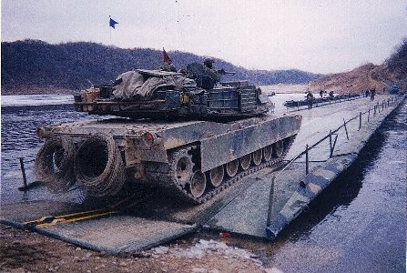
Fundamentals
Gap Crossing Fundamentals
Surprise
Extensive Preparation
Flexible Planning
Traffic control
Organization
Speed

Slide 9
Fundamentals
Assured Mobility: A planning framework –integration of engineer functions.
Predict : Understanding of the OE (R&S)
Detect: Indicators or actual conditions (R&S)
Prevent: Deny enemy ability to influence mobility (R&S, Fires, Protection)
Avoid: Bypass if possible, pick site to avoid enemy advantage and enhance our mobility (R&S, M2)
Neutralize: Overcome obstacles ASAP to allow unrestricted movement of forces (M2)
Protect: Measures to deny enemy ability to influence maneuver. (M2, Fires, Protection)
FM 3-34, Para 4-32 – 4-33

Slide 10
Keys to Success
Direct fires into crossing area eliminated
Observed indirect fires into crossing area eliminated
All units in position to support crossing (ADA, Chemical, Artillery, MP, Engineers…)
Terrain Management
Traffic Control to ensure uninterrupted movement through the crossing area
Communications

Slide 11
Planning Rules of Thumb Movement and Maneuver
Division selects crossing areas for lead BCTs
BCTs determine crossing sites based on tactical intelligence and scheme of maneuver.
An EN Bn HQ will typically be assigned to support each BCT Crossing
Crossing areas normally extend 3-4 km on each side of the river.
Main effort brigade = 2 BN-size assault sites (70 x assault boats = 6 Cos) & at least 2 raft/bridge sites.
Supporting Brigade = 1 BN-size assault sites (31 assault boats = 3 x Cos/wave) & at least 2 raft/bridge sites.
Assault Companies need 200m, centerlines >100m apart.

Slide 12
Planning Rules of Thumb Movement and Maneuver
Rafting
Raft sites should be no closer than 300 meters.
Each raft site has 1-3 active centerlines & at least 1 alternate centerline.
Raft centerlines are spaced 100-300 meters apart.
Ribbon Bridge
Rate of construction = 200m/hour day, 133 m/hour night
Completed bridge crosses 200 vehicles per hour
BCT bridge crossing time: 4 hrs w/ 2 crossing sites (1200 vehicles)
Float Bridge Company per 200m river width
EEPs are at least 1 km from the river.
Each CFA requires 1 engineer squad to operate the ERP.

Slide 13
Planning Rules of Thumb Typical PIR
Enemy positions that can place direct or observed indirect fires on crossing sites and approaches.
The location and type of enemy obstacles, particularly mines, in the water and on exit banks.
The location of enemy reserves that can counterattack assault units.
The location of enemy artillery that can range crossing sites, staging areas, and approaches.
The location and condition of existing crossing sites.
The width, depth, and water velocity of the wet gap.
The condition and profile of the gap (river) bottom.
The height, slope, and stability of the bank.

Slide 14
Planning Rules of Thumb Information Requirements
Impact of forecasted and/or past seasonal weather conditions.
Amount of time and effort that is required to develop sites, assemble rafts, if necessary, and construct bridges.
Entry and exit routes and off-road trafficability.
The condition of nearside and far side road networks.
Capabilities of friendly forces to deny observation, suppress fires, and provide site protection.

Slide 15
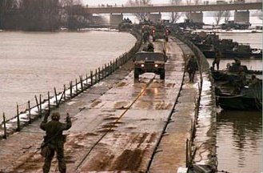
Types of Gap Crossings
Hasty - using the crossing means at hand or those readily available, and made without pausing for elaborate preparations.
Deliberate - requires extensive planning and detailed preparations.
Covert - planned and executed without detection by opposing forces. It’s primary purpose is to facilitate undetected infiltration on the far side of a gap and is normally conducted by battalion and smaller forces.
Notes:
There are three types of gap crossings: deliberate, hasty, and covert. Each of these has a general list of conditions that help define their category. As with the categories of breaching operations, all other labels placed upon a crossing are a variation of a deliberate, hasty, or covert gap crossing. The planning requirements for each type of gap crossing are similar. However, the required degree of detail and necessary conditions for a high degree of success will vary based on the type and the unique features associated with a given crossing operation.
Deliberate gap crossings are conducted as part of an offensive operation when a hasty crossing is not feasible or has failed. The phases, echelons, organizations, and C2 of a division or BCT deliberate gap crossing are discussed in detail in this chapter. This type of crossing normally requires additional augmentation that is focused exclusively on facilitating the crossing . Additionally, deliberate crossings usually involve more than one BCT and/or the crossing of gaps greater than 20 meters.
Hasty gap crossings tend to be focused on a combined arms operation to project combat power across a terrain feature (wet or dry) that can be overcome by self-bridging assets within the BCT. These assets may be organic, provided to the BCT as augmentation, or found as expedient crossing materials within the AO. They typically are, but are not limited to, gaps that are 20 meters or less in width.
The third type of gap crossing is the covert gap crossing. The covert gap crossing is an operation used to overcome obstacles (gaps) without being detected by the enemy. It is used when surprise is essential to infiltrate over a gap, and when limited visibility and terrain present the opportunity to reduce or defeat the enemy obstacle (gap) without being seen.
A retrograde gap crossing is not a fourth type of gap crossing. In reality it is merely a variation of a deliberate or hasty gap crossing and is typically performed as a deliberate gap crossing. It may be performed with or without enemy pressure on the maneuver force. Clearly it is more difficult when performed under enemy pressure.

Slide 16
Hasty Gap Crossing
The preferred method.
Decentralized control at the BCT level.
Speed and surprise are key.
Multiple sites, broad front, gaps <20 meters or seize bridge intact.
Idea is to maintain momentum.

Slide 17
Deliberate Gap Crossing
BCT can do with augmentation, but usually conducted at the Division or Corps level when hasty crossing is not feasible or has failed.
Division or Corps level organizations plan the crossing
Requires detailed reconnaissance, meticulous planning, coordination of fires, preparation, extensive rehearsals, and centralized control.
Requires the concentration of combat power on a narrow front, capitalizing on the element of surprise whenever possible.
Notes:
Deliberate gap crossings are conducted as part of an offensive operation when a hasty crossing is not feasible or has failed. This type of crossing normally requires additional augmentation that is focused exclusively on facilitating the crossing. While a BCT is capable of making a deliberate crossing, this type of crossing normally requires a higher HQ to assist in the planning and C2 as it requires detailed reconnaissance, meticulous planning, preparation, and coordination; centralized control; and extensive rehearsals. Additionally, deliberate crossings usually involve more than one BCT and/or the crossing of gaps greater than 20 meters. A gap of this length limits the effectiveness of tactical bridging assets and will typically require other bridging assets. To cross gaps of this magnitude, support bridging is normally required in the form of float bridging (wet gap) or other types of standard bridging.
A deliberate gap crossing is generally more costly than a hasty crossing in terms of manpower, equipment, and time. It requires the concentration of combat power on a narrow front, capitalizing on the element of surprise whenever possible. Deliberate gap crossings are generally conducted in the same manner as hasty gap crossings and utilize the same basic terminology. Deliberate wet-gap crossing are usually more difficult in terms of complexity and amount and type(s) of specialized resources required.

Slide 18
Deliberate Gap Crossing
Usually an implied task in a larger mission.
It is not the objective but is part of the scheme of maneuver and overall offensive action against the enemy.
Requires disciplined / controlled movement.
Division or Corps prepares and resources the deception plan, AMD and MP support.
Requires an appropriate HQ specifically for control of the gap crossing.
Notes:
While they may be conducted by a BCT, deliberate gap crossings are normally conducted by a division. Division and brigade commanders organize their forces into assault, assured mobility, bridgehead (defined as an area of ground held or to be gained on the enemy’s side of an obstacle [the definition was shortened, and the complete definition is printed in the glossary]), and breakout forces for deliberate gap-crossing operations. Assault forces seize the farside objective to eliminate direct fire on the crossing sites. Assured mobility forces may consist of sapper companies, MACs, MRBCs, military police, and CBRN units that provide crossing means, traffic control, and obscuration. Further augmentation requirements may be necessary and are based on METT-TC conditions that affect the operation.
Bridgehead forces assault across a gap to secure the enemy side (the bridgehead) to allow the buildup and passage of a breakout force during river crossing operations.

Slide 19
Covert Gap Crossing
Used to overcome gaps without being detected.
Surprise is essential.
Normally done at Battalion level or below.
Can precede hasty or deliberate crossing, but planned and conducted as separate operation.
Notes:
A covert breach is defined as a breaching operation that is planned and intended to be executed
without detection by opposing forces. Its primary purpose is to reduce obstacles undetected to facilitate the
passage of maneuver forces (FM 3-34.2). The forces executing a covert gap crossing can mark nearside
and far side entry and exit points and secure and/or guard the crossing site if the covert gap crossing is a
precursor to a larger, deliberate gap-crossing operation.
The covert gap crossing applies the same gap-crossing fundamentals as the other gap-crossing types;
however, it is focused on the crossing fundamental of surprise. Surprise is the primary element of the
covert crossing. The requirement to execute the crossing without enemy detection is the element that
distinguishes it from the other types of crossings.
The battalion is usually the principal unit to conduct a covert breach. A covert breach requires a level
of detailed planning, intelligence collection, and C2 that is normally beyond the capability of a company. A
BCT is usually too large to maintain the level of stealth necessary to conduct a covert breach. A covert gap
crossing is ideally suited for foot-mobile forces that are battalion-sized or smaller.

Slide 20
Organization
Division and Brigade Commanders organize their forces into assault, assured mobility, bridgehead and breakout forces.
Assault forces seize the far side objective to eliminate direct fire on the crossing sites.
Assured mobility forces may consist of sapper companies, MACs, MRBCs, military police, and CBRN units that provide crossing means, traffic control, and obscuration.
Bridgehead forces assault across a gap to secure the enemy side (the bridgehead) to allow the buildup and passage of a breakout force during river crossing operations.

Slide 21
Organization
ASSAULT FORCE
T: Seize far side objectives,
P: Prevent direct fire on crossing site
ASSURED MOBILITY FORCE
T1: Provide means to cross gap
T2: Control traffic
T3: Obscure and protect crossing sites.
P: Facilitate rapid maneuver.

Slide 22
Organization
BRIDGEHEAD FORCE
T1: Assault across gap to Intermediate Objective
P1: Prevent direct and observed indirect fires on crossing site
T2: Seize Bridgehead Objective
P2: Allow space to build up combat power
T3: Pass follow-on forces
P3: Enable decisive operation
BREAKOUT FORCE
T: Attack to seize subsequent objective or destroy enemy
P: Accomplish DO or SO Objectives

Slide 23
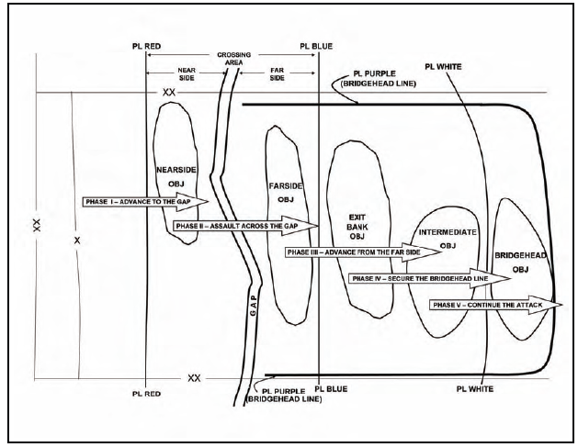
Phases of a Deliberate Wet-gap Crossing
Notes:
An offensive deliberate wet-gap-crossing operation has five phases. They are distinct phases for planning, but there is no pause between them in execution. The phases are as follows:
Advance to the gap (Phase I). The first phase is the attack to seize the nearside objective.
Assault across the gap (Phase II). The second phase involves units assaulting across the gap to seize the far side objective, eliminating direct fire into the crossing sites.
Advance from the far side (Phase III). The third phase is the attack to secure the exit bank and intermediate objectives that eliminate direct and observed indirect fires, into the crossing area.
Secure the bridgehead line (Phase IV). The fourth phase involves units that secure bridgehead objectives to protect the bridgehead against a counterattack. This gains additional time and space for force buildup for the attack out of the bridgehead.
Continue the attack (Phase V). The fifth phase is the attack out of the bridgehead to defeat the enemy at a subsequent or final objective. It is considered as a phase of the gap-crossing operation because the timing and initiation of this phase is typically dependent on the success of the other four phases of gap crossing.
Control Measures to highlight:
Crossing area delineated by PL RED and PL BLUE. 3-4 KM on each side of gap.
OBJ – Near side, far side, exit bank, bridgehead objectives
Bridgehead Line – PL PURPLE

Slide 24
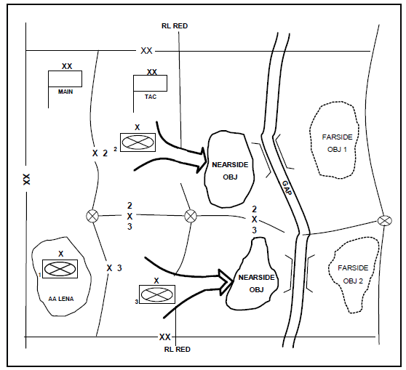
Advance to the Gap (PHASE I)
Notes:
Once the division has planned the operation, the first phase is initiated. The division will attack to seize nearside terrain that includes favorable crossing sites and road networks. Normally, the division advances with two brigades abreast and a reserve brigade trailing. The division TAC CP controls the efforts of the lead brigades. Well before the division reaches the river, a reconnaissance element moves ahead of the main body to conduct a reconnaissance of the nearside and predetermined crossing sites. Engineer Recon Teams may need to be allocated to the reconnaissance element to assist in the reconnaissance of crossing sites. If the tactical situation prohibits reconnaissance of the crossing sites, one or both of the lead brigades must conduct the reconnaissance. As the division arrives at the gap, the lead brigades establish security on the nearside. The lead brigades develop hasty defensive positions to protect the crossing area and cover the crossing sites with direct and indirect fires.
During the advance to the river, the division main CP shapes the operation by counterfire, close air support (CAS), and support of the division aviation brigade against deep targets. By effectively using these assets, the division main CP shapes and isolates the bridgehead.
As METT-TC allows, the crossing area HQ (an engineer brigade or MEB coordinates the improvement, control, and marking of routes within the nearside crossing area to the crossing sites; lays out staging, holding, and other areas and establishes TCPs and ERPs. The crossing area HQ ensures that key classes of supplies are pre-positioned forward.
The BCT TAC controls the fight of the TFs within its brigade. The brigade travels in a formation that is METT-TC driven. The brigade seizes objectives that secure the nearside. Each BCT main CP functions as the crossing area HQ. The crossing area is the area, bound on either side of the gap by RLs, in which units move on predetermined routes and use the time tables that are specified in the division operation plan (OPLAN). The RL on the friendly side is usually set 2 to 3 kilometers from the exit bank, out of the range of enemy direct-fire weapons. The RL on the enemy side delineates an area large enough for forces to occupy battalion-sized attack positions. The far side must provide enough space and time for the initial buildup of combat power to continue offensive combat operations to establish the bridgehead.
The BCT main CP is responsible for controlling units that provide the crossing means, traffic management, and obscuration. Once the brigade has secured the nearside, military police and engineers mark routes from the staging area to the crossing sites; lay out staging, holding, and call forward areas; and set up ERPs and TCPs. Additionally, the BCT commander, in coordination with the CFC, normally designates an appropriate area around the crossing sites as critical friendly zones (CFZ) to ensure priority is given to the protection of the crossing site(s).

Slide 25
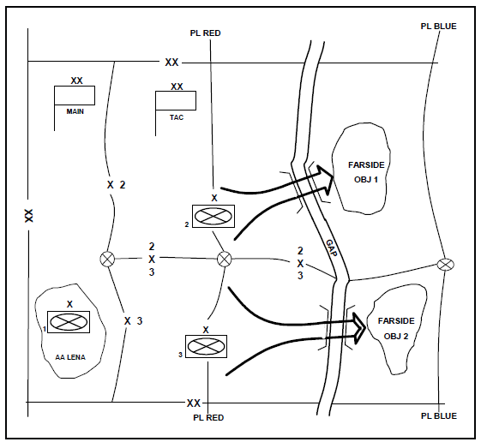
Assault Across the Gap (PHASE II)
Notes:
The division main CP continues to control deep fire assets to isolate the bridgehead. As units advance, deep fires shift to subsequent targets.
The division coordinates with the corps for AMD coverage to protect the bridgehead from enemy air interdiction. The gap creates lucrative targets at relatively fixed locations that are easily targeted by enemy air. Therefore, approaches; holding, staging, and call forward areas; and crossing sites along the gap are the highest priority for AMD during the crossing. AMD units occupy positions to engage aircraft with massed fires before the aircraft can reach weapons release points (RPs).
The division TAC CP (in conjunction with the crossing area HQ) coordinates the actions of the brigades conducting the assault across the gap (Figure 4-6). The crossing sites are chosen because of available concealment, good route systems, and enough space for AAs on the nearside. These sites also have defensible terrain on the far side of the gap to provide a secure base for continuing the operation.
Each BCT TAC controls their own respective assault crossing elements, which normally consist of dismounted infantry. Combat maneuver battalions conducting the assault across the gap move to it under the direct control of their BCT commander. The BCT commander keeps the remainder of the BCT back from the gap to avoid congestion. Elements not engaged in security or supporting the crossing occupy AAs and prepare for movement across the gap.
An engineer company, operating assault boats, transports the dismounted Soldiers and Marines of the assault force to the far side. The dismounted element crosses the gap and secures terrain for the reinforcing armored vehicles. The assault across the gap may also be an air assault operation, or the two types may both be conducted. The dismounted assault forces are supported by the tanks and infantry fighting vehicles from their TF and by other combat units in support from fire positions. Heavy rafts are prepared to transport tanks and infantry fighting vehicles to the far side for reinforcing the dismounted infantry. M9 ACEs and/or dozers are transported to prepare the far side exit sites. Rapid reinforcement of dismounted assault forces with armored vehicles may be so critical, based on the METT-TC, that it justifies using any expedient method to get the first few armored vehicles across. This includes winching, towing, or pushing the first ones across normally unsuitable places while engineers improve entry and exit points for the rest. In certain situations, tanks may be able to cross using fording equipment.
Each BCT main CP controls smoke to obscure the crossing sites of the gap in conjunction with the division OPORD. When employed, the smoke blanket covers several kilometers of the gap and gap approaches to conceal the actual crossing locations, but not as to obscure the bridge crewmen’s vision. The crossing area HQ uses smoke generators, smoke pots, and smoke munitions from the division. Each BCT main CP controls military police and engineer units to establish nearside waiting areas, mark routes to the crossing sites, and begin constructing heavy rafts and/or bridges in conjunction with the division OPORD.
The intent of this phase is to rapidly place combat power on the far side to eliminate the enemy's direct fire onto the crossing sites and secure terrain for attack positions. Brigades normally establish limits of advance (LOAs) and fire-support coordination lines (FSCLs) for the dismounted TFs conducting the assault in conjunction with the division OPORD. These lines establish an LOA that encompasses the farside objective. Enemy indirect fire into the crossing area will probably continue; however, each crossing site within the crossing area must be isolated from direct fire to enable the construction and operation of rafts. These rafts will then be used to transport armored vehicles for rapid reinforcement of the dismounted infantry TF. Within the crossing area, secured attack positions allow units to form into combat formations before continuing the attack.
The CAC may consider immediate construction of a bridge during this phase without ever conducting rafting operations, if this is viable. The advantage to this is that it may allow for combat power to be massed on the farside at a much faster rate. The risk that the commander takes in making this decision is that a large amount of bridging assets are potentially exposed to enemy fire before the elimination of enemy indirect fires on the crossing area. This phase is completed once the farside objectives are secure.

Slide 26
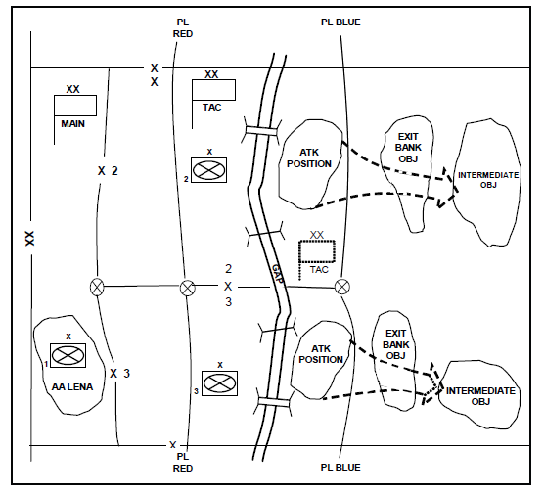
Advance from the Far side (PHASE III)
Notes:
The division TAC CP continues to secure the far side until the BCTs are set in attack positions. The intent is to eliminate direct fires and observed indirect fires from the crossing area. Once set in attack positions, the division TAC CP coordinates the attack of the lead brigades from the farside attack positions to the bridgehead.
The division commander selects exit banks and intermediate objectives based on METT-TC. The gap splits the attacking force, limiting massed direct fires beyond the exit bank. Therefore, these objectives are usually smaller and not as far from the attack positions as the objectives used in other offensive operations.
The BCT main CP prepares push packages of Class III and V supplies that will support the attack out of the bridgehead. They also begin to push Class IV and V supplies for the hasty defense during the last phase of the gap-crossing operation.
Each respective BCT main CP controls the movement of their follow-on TFs from the staging areas across the gap to their attack positions on the far side. They control the upgrade of crossing sites from assaults boats to heavy rafts and/or bridging in conjunction with the division OPORD to ensure that the force buildup can support the advance from the exit bank to the intermediate objectives. Military police and, if available, engineers assist in movement control through the crossing area.
During this phase, limited two-way traffic begins to allow for the return of disabled equipment and casualties by ground transportation. Each respective BCT TAC, in conjunction with division TAC CP, controls the movement out of the attack positions to the exit bank, intermediate objectives, and a subsequent bridgehead. Exit bank objectives are those positions that, when seized, eliminate the enemy's ability to use direct-fire weapons on the crossing area. Intermediate objectives are those positions from which the enemy can provide observation for indirect-fire weapons. This enables the expansion of AMD coverage, allowing more time to engage aircraft in air avenues of approach on the far side of the gap.
The TF that conducted the dismounted assault across the gap continues to cross armored and/or wheeled vehicles and remount their dismounted Soldiers and Marines in preparation for continued offensive operations. The BCT commander (with staff support) establishes the order of raft loads based on the division's crossing priorities. Bridge companies run heavy raft sites and begin to construct ribbon bridges. Military police mark routes and control holding areas on the far side to ensure rapid transit within the crossing area.

Slide 27
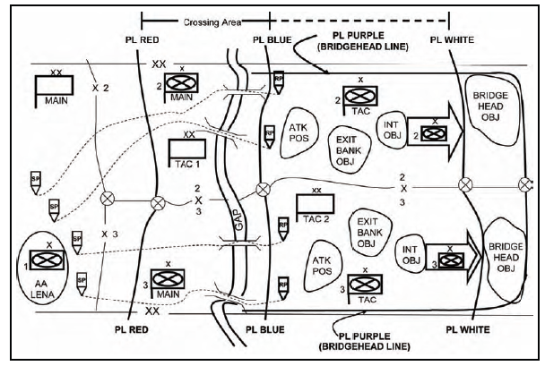
Secure the Bridgehead Line (PHASE IV)
Notes:
The bridgehead must be defendable and large enough to accommodate forces that will break out to continue offensive combat operations. The lead brigades attack to secure the final objectives within the bridgehead to prevent the enemy from successfully counterattacking against forces within the bridgehead line by rapidly building enough combat power to establish a hasty defense in the sector. The lead brigades maintain continuous far side security to prevent bypassed enemy elements from infiltrating back to the gap and disrupting activities at the crossing sites.
The division TAC CP controls the lead brigades as they secure the bridgehead objectives and preparation is made to move the reserve brigade or other forces (breakout forces) into attack positions within the bridgehead. Once the bridgehead objectives are secured, the lead brigades establish a hasty defense in sector.
The BCT main CP continues to upgrade and monitor the crossing sites and control the movement of forces through the crossing area. The farside RL, defining the crossing area, is moved just past the intermediate objectives to provide space for the breakout forces. The division TAC CP controls the movement of the breakout forces through the crossing area to attack positions within the bridgehead. During this phase, specific bridges and/or rafts are designed for full time return traffic. This ensures that ground resupply and the evacuation of wounded Soldiers and Marines and disabled equipment can occur. The division main CP controls the aviation, artillery, and available CAS sorties to screen the flanks and interdict enemy counterattacks. Deep operations play a key role in the bridgehead defense by targeting enemy formations as they move to counterattack. They also eliminate effective artillery fire within range of the bridgehead and destroy other enemy artillery forces moving up to the fight.
The lead BCT elements that secure the bridgehead line must control the avenues of approach into the bridgehead and be large enough to defeat counterattacks. After the bridgehead is secure, the division commander commits the breakout force to an attack position within the bridgehead. The bridgehead needs enough space (20 to 30 kilometers deep) to accommodate both the lead brigades and the breakout force with their sustainment. The bridgehead line must also be deep enough to employ AMD systems against hostile aircraft before they can engage crossing sites.

Slide 28
Continue the Attack (PHASE V)
Division secures the bridgehead and the breakout forces are in attack positions, crossing is complete
Crossing area control will normally be passed to a higher HQ or follow-on HQ
Breakout force must complete its passage before continuation of offensive operations
Lead BCTs must reorganize and prepare to follow the breakout force as the division or corps reserve
Security forces from the higher HQ must come forward to relieve the lead BCTs from their bridgehead security mission
Notes:
Discuss these key points

Slide 29
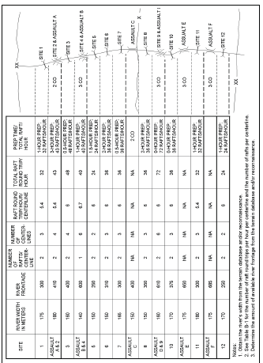
Crossing Plan
Notes:
The crossing plan is integrated throughout the division's and brigade's OPORD and is as detailed as time permits. The crossing annex to the OPORD contains much, but not all, of the plan. It has the crossing overlay and the crossing synchronization matrix.
The crossing overlay shows the crossing areas, the crossing sites, the routes leading up to them from the waiting areas, and all the control measures necessary for the crossing. The crossing synchronization matrix (Appendix D, Figure D-6, page D-8) is a tool to adjust the crossing plan as the battle develops. It shows crossing units in relation to their planned crossing times and locations. The crossing overlay, in conjunction with the crossing synchronization matrix, provides critical information to the CAC as they depict the locations of critical C2 nodes and detail unit crossing schedules and locations while they are within the crossing area.

Slide 30
CP Focus by Phase
Advance to River | Assault Across | Advance From Far Shore | Secure BHL | Continue Attack
1. Isolate Division advance 2. Sustain | 1. Isolate X-ing Area | 1. Isolate Intermediate OBJ | 1. Isolate BHL | 1. Shape for Breakout
Seizure of near shore | Division Assault | Seizure of Intermediate OBJ | Seize BHL OBJ | 1.Direct attack 2. Integrate follow-on BCT
Establish X-ing site infrastructure | Support assault X-ings | Continue X-ings
Nearside OBJ | Assault Gap | Intermediate OBJ | Bridgehead OBJ | FPOL Follow
1. Move in to crossing area 2. Sustain | 1. Coord Assault X-ing means 2. Obscuration | Follow-on TF through X-ing area | 1. BDE units through X- ing 2. Prep to pass breakout force | 1. Pass Breakout force 2. Pass X-ing area to DTAC
XX
MAIN
XX
TAC
X
X
TAC
X
MAIN
Notes:
MEB may also be an EN Brigade HQs. A Mvr Brigade HQs could also be used to control crossing area, with augmentation.

Slide 31
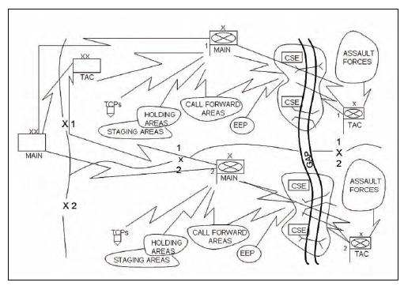
Communications
Notes:
The communications network that supports a deliberate crossing is critical to the success of a gap crossing. It should be planned and support the five phases of the deliberate gap-crossing operation (Table 4-1, page 4-11). The operation is divided into phases for planning purposes only, with no intentional pauses during execution. This will require early planning and a redundancy of communications. It may even be desirable to include wire as one of the redundant means of communication. The selected mode(s) of communications are dependent on what is available; however, all sites involved in control of execution (all CPs, waiting areas, EEPs, TCPs, and ERPs) should have communications capable of monitoring and sending information to every other element that has a role in the crossing operation. This is an important consideration to ensure efficient vehicle positioning, traffic flow, and proper crossing order. Figure 4-3 provides a graphic depiction of the minimum communications linkages to support a deliberate crossing during Phase 3 of the operation. Regardless of the phase, it should be understood that each node must have a similar communications structure for proper control.

Slide 32
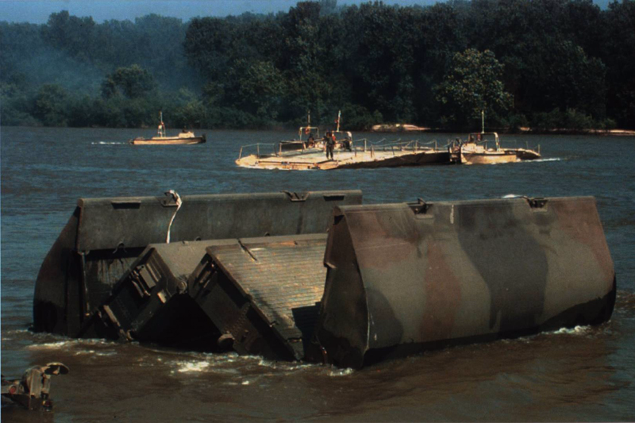
“The passage of great rivers in the presence of the enemy is one of the most difficult operations in war. “
Frederick the Great

