Slide 1
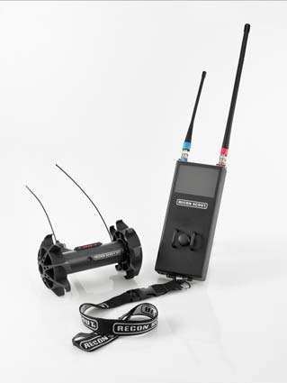
Recon Scout

Slide 2
Action: Introduction to the Recon Scout
Conditions: In a classroom environment, discuss the uses, characteristics, capabilities, limitations, and components of the Recon Scout.
Standards: Identify the uses, characteristics, capabilities, limitations, and components of the Recon Scout.

Slide 3
Safety Requirements: None
Risk Assessment Level: Low
Environmental Consideration: None
Evaluation: None

Slide 4
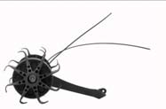

Slide 5
Item | Characteristics
Dimensions
Platform
Height | 4.5 in.
Length | 4.5 in.
Width | 7 in.
Weight | 1.2 lbs.
Ground Clearance | 1.5 in.
OCU
Weight | 2.5 lbs.
Operating Range | ~100M
Speed | 1.02 mph
Camera(s)
Number of Cameras | 1
Color | Grayscale
Height | 2 in.
Lights(White/IR) | IR Capable
Run Time | ~2 hrs. for OCU and ~1 hr for Platform
Power Source | Lithium ION chargeable with BB 2590 adapter or A/C
Charge Time | 1.5 hrs. for quick charge/6 hrs. for full charge
Operating Temp | Up to 140 Degrees Fahrenheit
Impact Resistance
Throw | >30 ft.
Drop | 30 ft.
Slope | Negotiates obstacles up to 2.3 in.

Slide 6
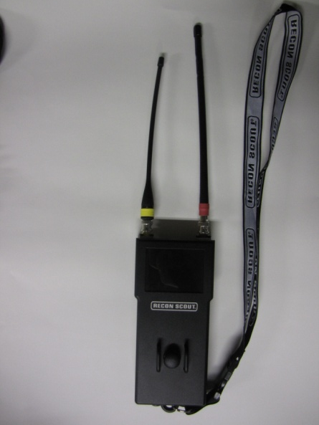
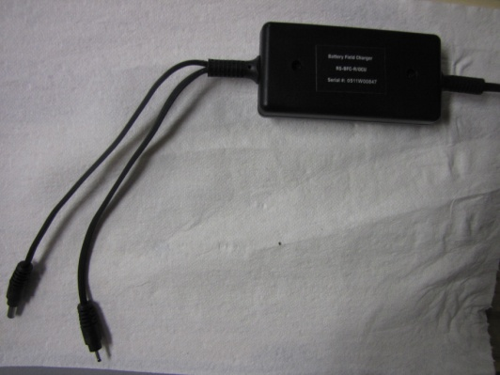
Components
1.
Recon Scout
OCU
Battery Charger Kit
2.
3.

Slide 7
Sub-Components
Antennas
Camera
Wheels
1.
2.
3.

Slide 8
System Operation
Power Up Procedures
Platform Power
OCU Power
Pull the pin on the robot. The robot is ready.
Flip the On/Off toggle switch on the bottom of the OCU to the “On” position.

Slide 9
System Operation
Controls
Drive the robot with the joystick in the center of the OCU

Slide 10
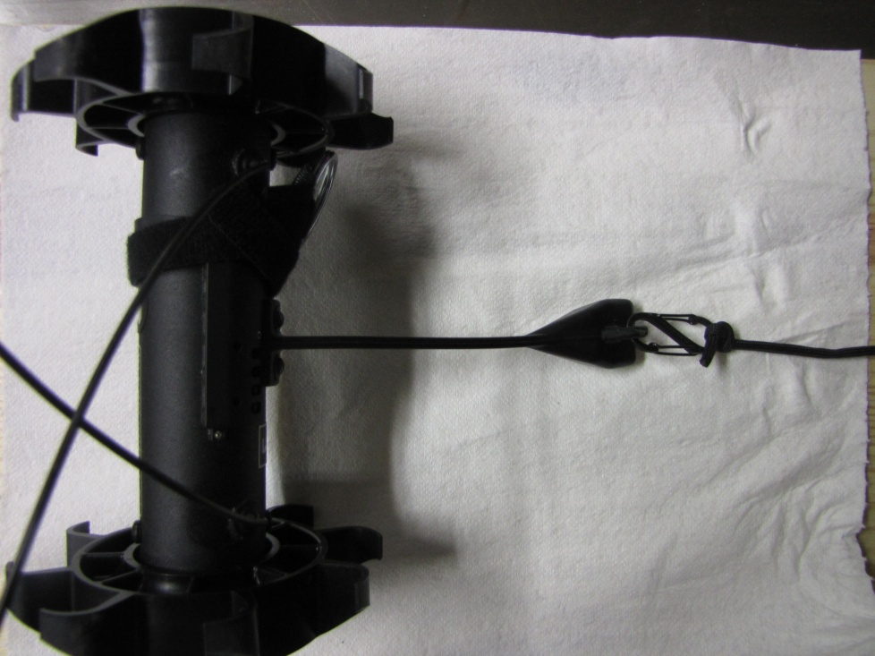
System Operation
Tether
Tether Connection – Robot does not
posses enough torque and can easily
stop forward movement if tether gets
caught on debris. Any tether heavier than
550 cord is to heavy to pull. A tether is
included with the robot.
If lowering in hole by tether ensure
first movement of joystick is forward
to allow stabilizer to rest on ground
and proper camera orientation.
If antennas get oriented under the
robot erratic behavior will be
experienced. If this happens raise the
robot by tether and reorient.
Tether connected
*Due to track design tether can easily get wrapped up in track. When this happens retrieve robot by tether by pulling it back to your location. Ensure your tether connection to robot is secure prior to deployment.

Slide 11
System Operation
Power Down Procedures
Platform Power
OCU Power
Replace the pin on the robot. The robot is ready to charge or be returned to the carrying case.
Flip the On/Off toggle switch on the bottom of the OCU to the “Off” position.

Slide 12
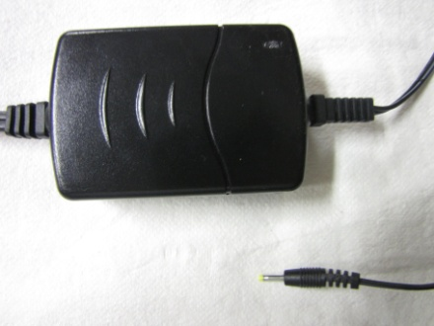
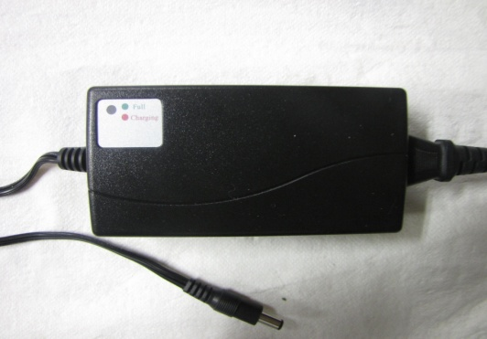
Charging
Robot Charger – Indicated by yellow tip on plug in to
robot
OCU Charger – Has red green light for charging status
Field charger both robot and OCU powered
from BB390 or 2950 battery

Slide 13
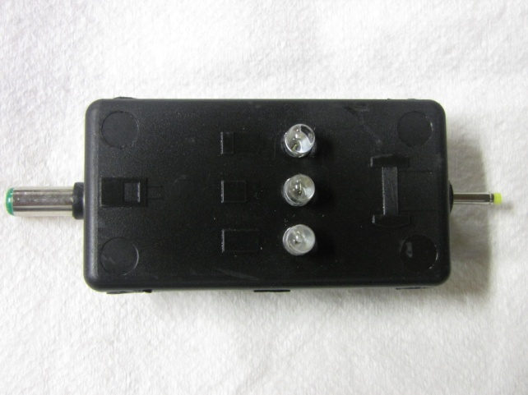
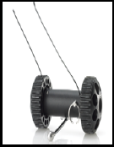
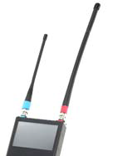
Charging Cont.
Battery Charge Indicator (BCI) – allows you to
Determine the battery charge level of your
Robot and OCU. Gives you a red/yellow/green
light for battery level.
Yellow tip is for robot and green tip for OCU.
Robot set-up – Refer to GTA card

Slide 14
System Maintenance
Always Power down the system first.
Using a low-pressure hose, spray the vehicle from the top down with fresh water until clean. A mild detergent-such as dish soap-may also be used. DO NOT PRESSURE WASH.
Using a clean cloth, wipe the excess water from the vehicle; especially in areas where water may collect.
Dry the system with a clean cloth or low-pressure air to ensure water does not remain on the vehicle.
Power on Robot to ensure proper mobility and control.
Wipe Down the OCU with a soft, dry, clean cloth or air brush. Use a slightly damp cloth to clean smudges from the OCU screen.

Slide 15
REVIEW
Action: Introduction to the Recon Scout
Standards: Identify the uses, characteristics, capabilities, limitations, and components of the Recon Scout.

