Slide 1
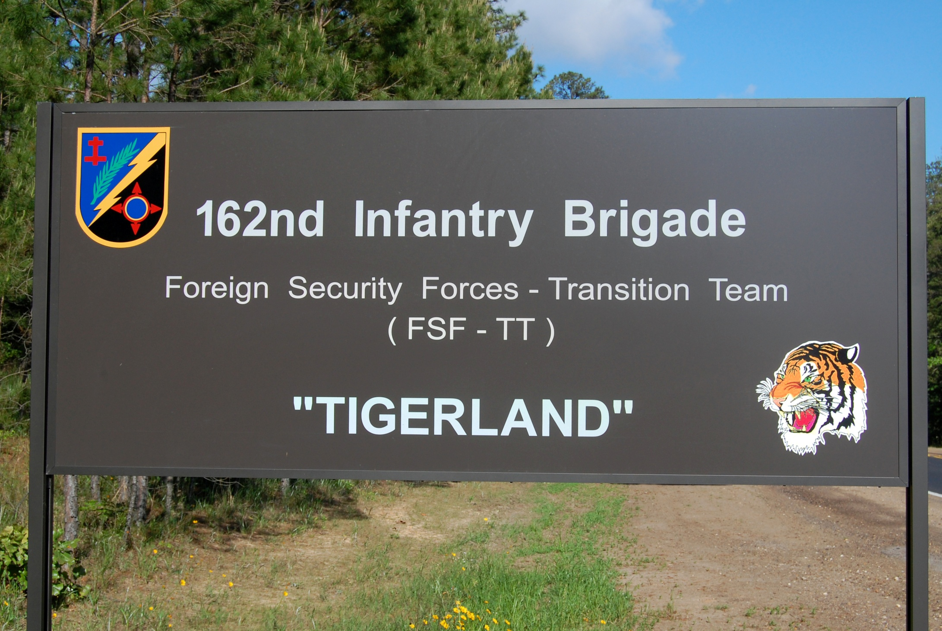
162nd Infantry Brigade
Combat Advisor
CA
Training Combat Advisors and Security Force Assistance for the Army and for Joint Force Commanders to Build Security Capacity in Designated Countries
“Every One a Tiger”

Slide 2
Agenda
Higher Guidance
Brigade Mission
SFAT Training
Resident Training
Security Force Assistance Brigade (SFAB) Training
GCC Mission Expansion
USARAF RAF Employment Overview
AFRICOM RAF Training Plan Proposal
Phases in AFRICOM RAF Training Support
Quarterly Training Package Proposals

Slide 3
Strategic Guidance
National Security Strategy (2010)
We will undertake long-term, sustained efforts to strengthen the capacity of security forces to guarantee internal security, defend against external threats, and promote regional security and respect for human rights and the rule of law.
Quadrennial Defense Review (2010)
Within the range of security cooperation activities, the most dynamic in the coming years will be security force assistance (SFA) missions: “hands on” efforts, conducted primarily in host countries to train, equip, advise and assist…..
National Military Strategy (2011)
We will strengthen and expand our network of partnerships to enable partner capacity to enhance security. Military to military relationships must be reliable to be effective, and persevere through political upheavals or even disruption.
Department of Defense Instruction 5000.68-Security Force Assistance (2010)
SFA shall encompass DoD efforts to support the professionalization and the sustainable development of the capacity and capability of the foreign security forces and supporting institutions of host countries, as well as international and regional security organizations.
Army Capstone Concept (2010)
Developing effective and sustainable institutions is a critical aspect of security force assistance. Security force assistance efforts must develop competent units that are part of legitimate and trusted institutions.
Notes:
Recent national level and strategic level policy documents have identified Security Force Assistance as a major focus area for the United States military in the years to come.
Building long term capability and capacity in partner nation security institutions is a key and critical component of global security.
References:
National Security Strategy (dtd May 2010): Invest in the Capacity of Strong and Capable Partners pg 26
Quadrennial Defense Review (dtd FEB 2010): Build The Security Capacity of Partner States pg 26
National Military Strategy (dtd FEB 2011): Para 3.A. pg 6
DODI 5000.68 (dtd OCT 2010): Para 4b pg 2
ARMY CAPSTONE Concept (dtd DEC 2009): Para 3-5, b. (1) pg 25

Slide 4
FORSCOM CDR Vision for the 162d INF BDE
Near Term (2013-2014):
JRTC and 162nd IN BDE build capacity and capability to train and prepare Security Force Assistance and Security Cooperation forces for the CENTCOM and PACOM CDRs.
Mid Term (2015-2020):
JRTC expands the capability and capacity to prepare a sustained flow of Security Force Assistance and Security Cooperation forces to meet the GCC CDR requirements in support of the Regionally Aligned Force construct.
162nd serves as the repository of knowledge and skills, enabling the preparation of RAF units to operate with SOF and in a JIIM environment.

Slide 5
FORSCOM CDR SPECIFIED TASKS
(GENERAL)
Brigade Commanders and their subordinate Commanders are responsible for training their teams. (T6/SFAT BDE CDRs)
Prepare SFA/SC forces to train Command and Control with systems which are sustainable by host nation forces (acetate graphics and analog comms). (SFA BN/JRTC)
Identify and select leaders with strong influence, coaching skills, and practical experience for service in 162d and reinforce these traits during training. (S1/G1)

Slide 6
FORSCOM CDR
SPECIFIED TASKS/NEAR TERM
(2012-2014)
Establish and sustain direct coordination with IJC Headquarters to clearly identify readiness requirements for the SFAT elements. (S3/G3)
Create a database of the RC South and RC East BSO orders and inform SFAT training and preparation. (S3/SFA BN)
ICW Leadership in Afghanistan, identify the Afghan equipment required at JRTC to familiarize SFATs and enhance their readiness. Submit list of required equipment through FORSCOM G4. (S4/G4)
Work with theater to develop a profile of each “real world” key individual by battalion operation to include their real-world strengths and weaknesses. Populate CENTRIX database and train roll-players. (SFA BN/Ops Grp)

Slide 7
FORSCOM CDR SPECIFIED TASKS/NEAR TERM
(2012-2014)
Partner with USASOC to enhance scenarios by integrating their unique capabilities into SFAT training. (SFA BN/Ops GRP)
Provide HRC and FORSCOM G1 a list of required leadership positions and Soldier skill sets with Afghanistan experience to enhance the 162d Brigade. FORSCOM G1 will work with you to secure these personnel over next two manning cycles. (S1/G1)
NLT 01OCT12, ICW FORSCOM, coordinate with USARPAC to determine the requirements for building Security Cooperation capabilities at JRTC to better prepare Regionally Aligned Forces for the Pacific Theater. (S5/Ops Grp)

Slide 8
FORSCOM CDR
SPECIFIED TASKS/MID TERM
(2015-2020)
ICW FORSCOM, develop a flexible training construct that is adaptable to each Geographic Combatant Command based on their unique requirements to prepare SFA and SC forces. (S3/S5/SFA BN)
Work with FORSCOM staff to identify the requirements to improve the 162nd Brigade training facilities to accommodate this expanded mission set. (ALL)
Create the model for a mobile training capability to be utilized if required to help prepare SFA or SC forces. (S3/S5/SFA BN)
Develop the model and requirements to produce and sustain up to ten SFA/SC training rotations per year to meet potential COCOM requirements. (SFA BN/Ops Grp/G3)
Create the conditions to select quality replacements from the Regionally Aligned Force Pool retaining the talent to remain current and relevant. (S1/G1)

Slide 9






























Brigade Mission
X
162
733/1000
II
II
II
II
II
II
I
1
353
353
3
353
DCC
HHC
4
353
5
353
2
6
353
71/113
73/113
72/113
75/113
66/113
209/239
21/31
146/184
I
52
MI
165/158
The 162d Infantry Brigade trains Advisor Skills, Combat Skills, and Security Force Assistance skills to provide Army and Joint Force Commanders with trained personnel and units to build security capacity in designated countries.
Future
Resident Training
Joint Sourced Teams
10-week Training at Ft Polk
Operational/Service HQ Advisors
Logistics Depot Advisors
Medical Advisors
NATO OMLT Augmentees
OEF SFAB Training
Army Sourced Advisors
Mobile Training Team
Brigade Combat Team Based
Brigade/Division HQ Advisors
GCC/ASCC Support
Army Sourced Advisors
Mobile Training Team
Regionally Aligned Brigades
Theater Security Cooperation
Phase 0 SFA
Slovenia
Hungary
Albania
Poland
Lithuania
Croatia
Latvia
Bulgaria
1st BN
2nd BN
3rd BN
4th BN
5th BN

Slide 10
SFAT Training Overview
OUTPUT
-CENTCOM, ISAF, IJC and RC CDRs receive SFATs trained IAW the ISAF Joint Command Training Guidance
- SFATs trained on Afghan systems and linkages to ISAF enablers
Graduate Level SFA Training
Culminating Training Event
Build proficiency through repetition
Exercise SFATs at all echelons
Application of Afghan Systems
Linked scenarios
Complex Coordination
Vertical Collaboration
Exercise enabler support
Advisor and Security Force
Assistance Fundamentals
SFAT TEAM CAPABILITIES
STX Lanes
-Staff MDMP Refresher
ANSF Led Cordon and Search
ANSF Led Patrol
Afghan Detention Procedures
Advisor Academy
-Afghan Systems
-Army
-Police
-Advisor Skills
Combat Skills Training
-Theater Training Requirements
TIME
Unit Home Station
Fort Polk and JRTC (162nd / OPS GRP)
FORSCOM pre-deployment training requirements complete
SFATs educated and understand Afghan systems and standards
SFATs conduct combat focused training to develop and refine SOPs
SFATs trained by echelon/type and are capable of advising ANSF in theater specific Area of Responsibility
OUTPUT per
Phase

Slide 11
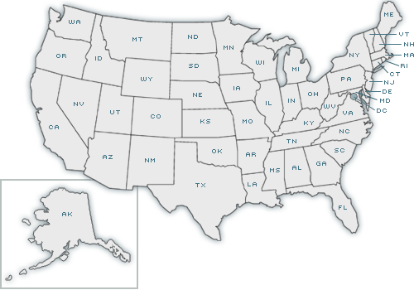




Resident Training
Joint Sourced Teams
10-week training program at Ft Polk
Operational Headquarters Advisors
Logistics Depot Advisors
Medical Advisors
NATO Operational Mentor and Liaison Team (OMLT) Augmentees

Slide 12
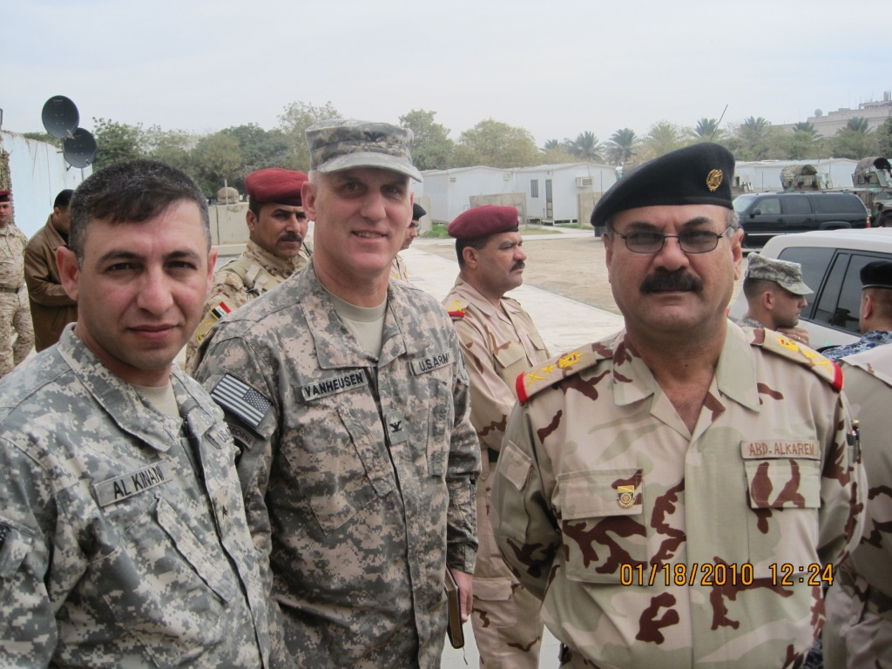
Resident Combat Advisor Training –
Achieving Balance
Combat Skills
Weapons qualification
Short range marksmanship
Battle drills
Call for fire
Patrolling
Culture
History of dominant religion
History of country & region
Customs & courtesies
Counterinsurgency
Fundamentals
Application
OE Framework
Technical / Tactical Training
MOS specialties
Commo training
Blue force tracker
Detainee operations
Cordon and search operations
Advisor Skills
Role of advisor
Use of interpreter
Gain influence
Rapport
HNSF organization
Staff functions
Partnership unit
Ethics
Force Protection
Personnel / Vehicle search
Checkpoint operations
Unexploded ordnance
Personnel recovery
Combat lifesaver
Biometrics
IED defeat
Graduated Response
Subject Matter
Expertise
Combat
Skills
Mission
Specific
MOS TRAINING
EXPERIENCE
COMMON SKILLS
WARRIOR SKILLS
SURVIVAL SKILLS
ENABLING
UNDERSTANDING HUMAN NATURE
INFLUENCING
NEGOTIATING
RAPPORT
BUILDING
WORKING
THROUGH AN
INTERPRETER
DEVELOPING
TEACHING
COACHING
MENTORING
CULTURE
LANGUAGE
COUNTER-INSURGENCY ENVIRONMENT
Advisor Skills
Communication
Local language
With and w/out terp
B A L A N C E
Affected by Operational Environment
157 Tasks

Slide 13
Resident Advisor Training

Slide 14
Advisor Academy-ARMY Focus
  Training Objectives
  Through classroom instruction and with the assistance of Subject Matter Experts:
  Train SFATs in Advisor/and Security Force Assistance skills tailored to Army specific organizations at echelon.
  Understand and support ANSF objectives
  Understand ANSF mission, structure, and capabilities, and able to train ANSF to Afghan standards
  Trained on Afghan Systems
  Provide SFATs with the tools to develop effective and sustainable ANSF capabilities to prepare them for unilateral operations.
Advisor Academy
RSOI / PRT
STX
CTE
DAY1 | DAY2 | DAY3 | DAY4 | DAY5 | DAY6 | DAY7
CORE ADVISOR SKILLS |  |  | Security Force Assistance Skills
Theater Framework Islam Green on Blue Case Study Roles and Traits of An Advisor Culture/Tribe (RC Specific) Cross Cultural Rapport Building Key Leader Engagement Use of Interpreter Vignettes |  |  | Afghan National Security Force Systems Logistics Personnel Mission Command ISR Fires QRF MEDEVAC Theater Framework Afghan Judicial Systems Interagency Partners
162nd Provided Instructors
THTR Provided Instructors
ARMY
ANA CORPS
ANA BDE
ANA IN Kandak
CS Kandak
CSS Kandak
Ect…
JOINT
OCC-Provincial OCC-Regional

Slide 15
Advisor Academy-Police Focus
  Training Objectives
  Through classroom instruction and with the assistance of Subject Matter Experts:
  Train SFATs in Advisor/and Security Force Assistance skills tailored to Police specific organizations at echelon.
  Understand and support ANSF objectives
  Understand ANSF mission, structure, and capabilities, and able to train ANSF to Afghan standards
  Trained on Afghan Systems
  Provide SFATs with the tools to develop effective and sustainable ANSF capabilities to prepare them for unilateral operations.
Advisor Academy
RSOI / PRT
STX
FoF
DAY1 | DAY2 | DAY3 | DAY4 | DAY5 | DAY6 | DAY7 | DAY8 | DAY9
CORE ADVISOR SKILLS |  |  | SECURITY FORCE ASSISTANCE SKILLS |  |  |  | POLICE SKILLS
Theater Framework Islam Green on Blue Case Study Roles and Traits of An Advisor Culture/Tribe (RC Specific) Cross Cultural Rapport Building Key Leader Engagement Use of Interpreter Vignettes |  |  | Afghan National Security Force Systems Logistics Personnel Mission Command ISR Fires Theater Framework Afghan Judicial Systems Interagency Partners Police Common Core Police Theory Police Roles and Responsibilities
162nd Provided Instructors
Theater/USAMPs Provided Instructors
AUP District
AUP Province
ANCOP BDE
ANCOP Kandak
ABP Zone
ABP Kandak
ABP Customs
PSS

Slide 16
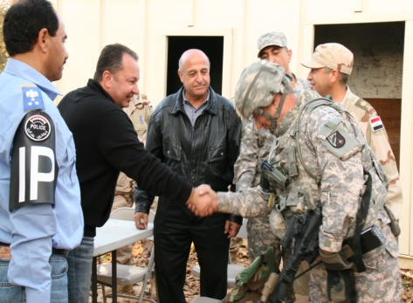
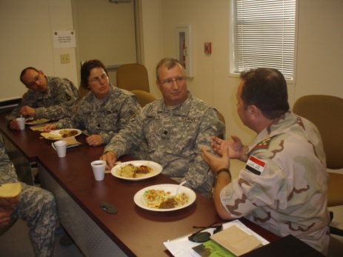
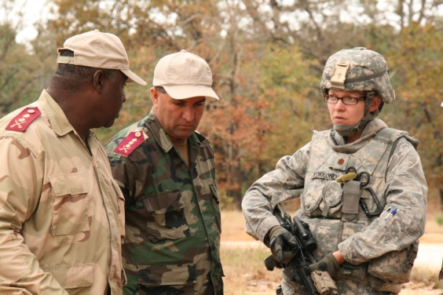
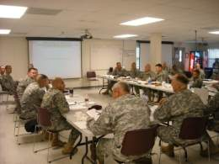
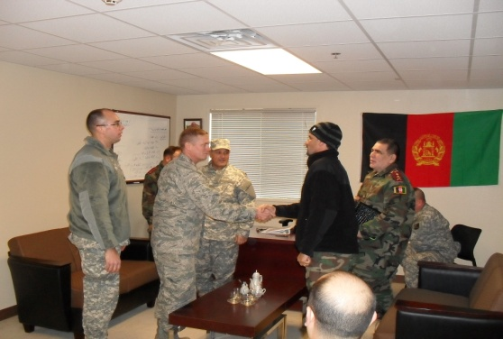
Language and Culture Instruction
Emphasizes Rapport Building
Appreciation of Culture
Building Loyalty
Establishing Trust
Creating Friendships
Language Program
  “Meet, Eat and Greet” Philosophy
  40 Hours Classroom Instruction
  Language Lab Availability
  Course Book
  Head Start Pocket Guide
  Language Proficiency Test
Culture Program
  History of Country/Region
  History of Religion(s)
  Customs and Courtesies
  Cultural Meal
  Reinforced through Key Leader Engagements

Slide 17

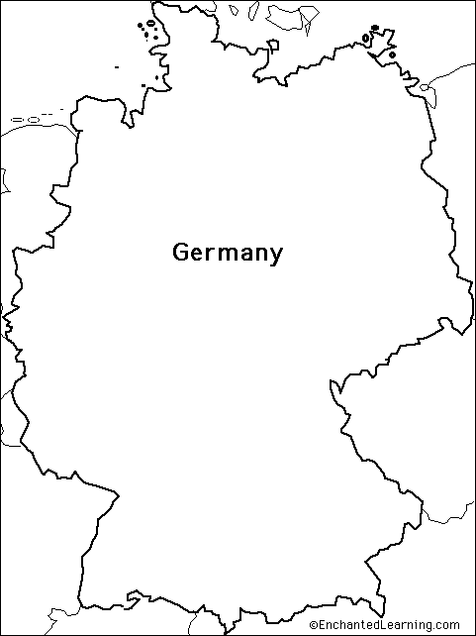


Security Force Assistance Brigade (SFAB) Training
MTT
Army Sourced Advisors
Mobile Training Team
Brigade Combat Team Based
Brigade/Division HQ Advisors

Slide 18

Security Force Assistance
Brigade Training Model
36 Mo BCT ARFORGEN Cycle
Reset
6 mo
Train/Ready
18 mo
Available
12 mo
Initial Planning Conference
COIN Seminar
Role of the Advisor
Leader Training Program
Advisor Employment
Advisor Training
Tactical Leader Partnering
Augmented Advisor CERTEX
Mission Rehearsal Exercise
1
2
3
4
5
6
7
Initial Planning Conference. 1 Day. Audience is the Brigade leadership. Introduction of the Advisor training program.
Counter-Insurgency (COIN) Seminar Role of the Advisor ~2 Days. Audience Brigade, Battalion & Company leadership & Staff. Role of the Combat Advisor, employment models and integration in mission analysis.
Leader Training Program Advisor Employment ~1 Day. Brigade, Battalion leadership & Staff. Advisor and Stability Transition Team employment and command relationships. S-TT Employment Command Relationships
Advisor Academy. ~10 Days. Audience is the 48 augmented Advisors. The purpose is to ensure the Soldier understands his role as a Combat Advisor to teach, coach, advise, and assist Host Nation Security Forces (HNSF) to become effective counterinsurgents.
Tactical Leader Partnering ~ 3 Days. Audience is junior leaders in the Brigade who will be working alongside Advisors and/or partnering with Host Nation Security Forces. Similar topics as the Advisor Academy but in a shortened timeframe
Certification Exercise (CERTEX). ~2 Days. Trains Advisors and Brigade and Battalion staff members collectively to integrate Host Nation Security Forces in a combined planning exercise
Mission Rehearsal Exercise Support ~ 14 Days. Trainer/Mentor support to Combat Training Centers .Trains Advisors and Brigade combat team/Battalion staff members collectively to integrate Host Nation Security Force.
1
2
3
4
5
6
7

Slide 19
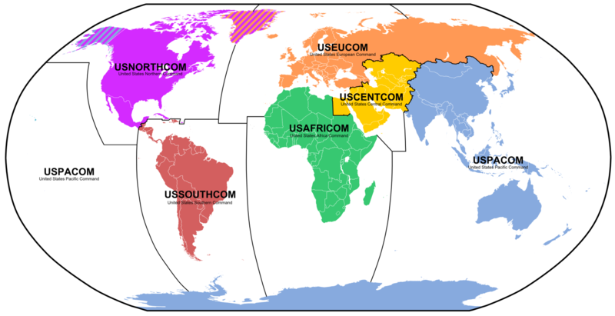







162nd Infantry Brigade Mission Expansion
162D IN BDE GCC SECTION
CENTCOM
SOUTHCOM
PACOM
AFRICOM
EUCOM
NORTHCOM
Approved addition of 175 PAX to 162nd IN BDE TDA
  32 Trainers x 5 Teams dedicated to training units for Phase Zero “Prevent” Theater Security Cooperation Missions
  Coordinating Staff (BDE S5)
  Police/Border Training Section
Enduring capability to support Geographic Combatant Commander’s Theater Security Cooperation objectives
Regionally Aligned Brigades will be aligned to Army Service Component Commands beginning in JAN 13
162nd IN BDE will provide training support to Regionally Aligned Brigades throughout the ARFORGEN cycle
Notes:
19

Slide 20
Key Planning Info from
RAB Working Group in
ARFORGEN Synchronization and
Resourcing Conference (ASRC)

Slide 21
USARAF FY13 RAF Employment Overview
Category / Type of Event | # of Events | Preliminary Mission Tasks | Countries Included
Military-to-Military (M2M) Traveling Contact Teams (TCT) and Familiarizations (FAM) | 75-100 | Logistics Sustainment Support, HMMWV Logistics/Supply Management, Staff Judge Advocate/International Law Capability, Prepare to Deploy for PKO Medical Assessment, BN Staff Roles and Responsibilities/Planning and MDMP/C2, Convoy Operations, Intelligence, Disaster Response Consequence Management, ISR, Logistics Operations, Training Management and Development, Tactical Operations Center TTPs, Staff Development of IPB, MDMP for Logistics Planning, Transportation Planning, Employment of Communications Assets in FSO, Physical Fitness Program Development, Junior Officer Leadership | All except Somalia, Eritrea, Sudan, Zimbabwe, Equatorial Guinea, Guinea-Bissau, and Madagascar
African Contingency Operations Training Assistance (ACOTA) | 16 – 20 | Battalion Soldier Skills, Driver Training, NCO Development, Combat Lifesaver, Battalion Staff Roles, Heavy Weapons, Reconnaissance | Ghana, Nigeria, Senegal, Sierra Leone; Burkina Faso (tentative), Togo (tentative)
Africa Deployment Assistance Partnership Team (ADAPT) | 4-6 | Deployment Doctrine Overview, Air load Planner Training, Train-the –Trainer, HAZMAT, Convoy operations, Unit Movement Officer training, Unit Movement Planning, Movement Control Basics | Burkina Faso, Burundi, Ghana, Tanzania, Uganda
Military Intel Professional Course (MIPC) / Basic Course (BC) | 4-6 | Senior NCO, Junior and Field Grade level intelligence Professional Military Education; includes Tactical Signal Intelligence, other Intelligence Operations in support of multinational Peace Operations | DRC
Train & Equip | 4-6 | Intelligence (Analysis; Fusion, Production, and Dissemination; Reporting; Training and Doctrine), Counter-Terrorism, Maintenance Support | Niger, Mali and other OEF-TS partners, Kenya, Uganda
Humanitarian Mine Action (HMA) | 7-9 | Ordnance identification – landmines and grenades; Calculating K-factor; Conducting demining operations to the UN-developed International Mine Action Standards (IMAS); Conducting battle area clearance (UXO); Electric demo procedures; Combat lifesaver/tactical combat casualty care (TCC); Train-the-trainer | DRC, Chad, Namibia
Exercises | 4-6 (plus 4-5 prep events per exercise) | BDE-level planning team in support of AFRICOM/USARAF crisis response certification exercise; BDE-level participation /support in combined regional Humanitarian Assistance/Disaster Relief (HA/DR), Peace Operations (PO), and Noncombatant Evacuation Operations (NEO) exercises (could include TTX, STX, CPX, and FTX) | Regional Accord Series (including Algeria or Mauritania, South Africa, Kenya, Rwanda, Uganda, and other regional partners TBD) and Judicious Response (includes US joint military, interagency, and multinational partners)

Slide 22
FY13 Employment Overview
(2 of 2)
Category / Type of Event | # of Events | Preliminary Mission Tasks | Countries Included
Security Force Assistance (SFA) as directed | TBD | TBD | Potentially Libya, South Sudan and DRC
U.S. Army unfilled RFFs in support of AFRICOM TCP operations and activities | TBD | TBD | Liberia
Support to OSCs in AFRICOM AOR | TBD | EUM, augmentation, assessment | Potentially in Uganda, CAR, DRC, South Sudan, Libya
Notes:
SECURITY FORCE ASSISTANCE (SFA) (TBD). As directed, U.S. Army forces will conduct focused security force assistance to develop select partner nations’ internal security and external defense capabilities through the use of multiple programs to train, advise, and assist land forces.
Additionally, we could utilize the RAB for unfilled existing Army RFFs, such as the one in Liberia (for OPERATION ONWARD LIBERTY) which could include up to 25-30 pax for the duration of the RAB employment; also, many of the Offices of Security Cooperation (OSC) in Africa are under-manned, and the RAB could provide some senior NCOs and/or junior to mid-grade officers to priority OSCs to help meet many of their operational requirements (including forward planning and assessments).
Finally, the combatant commander has stressed that his priority effort (CT, in the East region) should be weighted; AFRICOM continues to conduct planning to determine operational requirements and capabilities to achieve East Africa Campaign Plan objectives. The RAB will probably get some of these missions/tasks once defined and validated.

Slide 23
USARAF Priority Missions and Countries
1) Northern Accord 13: 12-25 MAY 13 in Algeria
-Combined TTX for HA/DR
-Projected RAB role: TBD
2) Judicious Response 13-1: 13-23 MAY 13 in Suffolk, VA/Stuttgart, GE/Vincenza, IT
-AFRICOM STAFFEX/Academics
-Projected RAB Role: ~8 BCT planners
3) Eastern Accord 13: Part 1: 1-15 JUN 13 in Kenya; Part 2: 7-14 JUL 13 in Rwanda
-Combined BDE CPX for HA/DR
-Projected RAB role: TBD
4) Western Accord 13: 15-26 JUL 13 in Ghana
-Combined BDE CPX and BN FTX for PKO
-Projected RAB Role: BDE HQ(-) ~40 pax, IN BN(-) ~200 pax, Logistics TF ~40 pax
5) Southern Accord 13: 15-31 JUL 13 in South Africa
-Crisis Response PKO FTX
-Projected RAB Role: BDE HQ(-) ~40 pax, IN BN(-) ~200 pax, Logistics TF ~40 pax
6) Judicious Response 13-2: 9-20 SEP 13 in Suffolk, VA/Stuttgart, GE/Longare & Vincenza, IT
-AFRICOM CPX
-Projected RAB Role: BCT Response Cell of ~30 pax

Slide 24
USARAF Revised Language Priorities
1) Arabic
2) French
3) Swahili
4) Hausa
5) Portuguese

Slide 25
AFRICOM RAF
Training Support Plan

Slide 26
162d AFRICOM Cell
Team Composition
5 Training Teams
East Africa (4 Pax: MAJ / CPT / 2 SFC)
North Africa (3 Pax: 2 CPT / 1 SFC)
South Africa (6 Pax: MAJ / 2 CPT / 3 SFC)
Central Africa (5 Pax: 2 CPT / 3 SFC)
West Africa (6 Pax: MAJ / 2 CPT / 3 SFC)
Executes RAF training (Train/Ready Phase).
Assists and potentially deploys with RAF as necessary (Available Phase).
Develops and revises area- and mission-specific RAF training POIs.
Maintains POCs in theatre.
AFRICOM Cell Composition
AFRICOM Branch HQ (4 pax: MAJ / CPT / SFC / SSG)
Reports to SFA-B leadership.
Overall responsible for coordination of training missions.
Manages training and certification of pax.
Assists in development of curriculum common to AFRICOM.
Augments training teams as necessary.
AFRICOM
E. AFR
N. AFR
S. AFR
C. AFR
W. AFR
28 Personnel Total
AFRICOM Cell Task & Purpose
Task: Trains RAF to effectively conduct Theater Security Cooperation activities in support of AFRICOM. Develops, revises area- and mission-specific POIs to prepare RAF. Maintains currency on AFRICOM Operational Environment.
Purpose: Provide subject matter experts who specialize in language, regional expertise, and advising and can be leveraged to maximize RAF effectiveness in SFA activities.

Slide 27
Distribution of USARAF FY13 Events
by Region and QTR
Tunisia
NORTH
Western
Sahara
Morocco
N&E C S W
1 QTR: 7 8 5 12
2 QTR: 8 9 7 8
3 QTR: 4 6 11 7
4 QTR: 5 7 4 7
TOTAL: 24 30 27 34
Algeria
Libya
Mauritania
Mali
Niger
Sudan
Eritrea
Senegal
Benin
Chad
Djibouti
Gambia
Burkina
Faso
Guinea-
Bissau
Guinea
Cote
D’Ivore
Nigeria
Somalia
WEST
Cameroon
Central African
Republic
S. Sudan
Ethiopia
Sierra
Leone
Togo
Uganda
Ghana
Rwanda
EAST
Liberia
Sao Tome
& Principe
Congo
Kenya
Gabon
Democratic
Republic of
Congo
Equatorial
Guinea
Tanzania
CENTRAL
Seychelles
Burundi
Malawi
Comoros
Angola
Zambia
Namibia
Botswana
Zimbabwe
Mozambique
South
Africa
Swaziland
Madagascar
Lesotho
SOUTH

Slide 28
162d AFRICOM RAF Training
Task Organization
Team 1
N. AFR
E. AFR
AFRICOM
Cell task organization
changes from:
1) Mirroring AFRICOM structure
to
2) Matching USARAF demand signals
Team 2
E. AFR
C. AFR
N. AFR
Team 3
S. AFR
S. AFR
C. AFR
W. AFR
Team 4
W. AFR
Total 28 Personnel

Slide 29
AFRICOM RAF Quarterly Training Packages
Team 1
Team 2
Team 3
Team 4
N. AFR
E. AFR
C. AFR
S. AFR
W. AFR
DLI: LANGUAGE A
DLI: LANGUAGE B
DLI: LANGUAGE C
DLI: LANGUAGE D
CUBIC
ROLE PLAYERS
CUBIC
ROLE PLAYERS
CUBIC
ROLE PLAYERS
CUBIC
ROLE PLAYERS
Who else can contribute to the teams?

Slide 30
162d RAF Training Timeline
Small-Scale
Mil-to-Mil
Activities
USARAF Events
Southern Accord (South Africa)*
Eastern Accord, Part II (Rwanda)
Eastern Accord, Part I (Kenya)
Judicious Response (US HQs)
Judicious Response (US HQs)
Northern Accord (Algeria)
Western Accord (Ghana)*
OCT-DEC
12
JAN
13
FEB
13
MAR
13
APR
13
MAY
13
JUN
13
JUL
13
AUG
13
SEP
13
*projected
IN BN (-)
involvement
162d Training
SFA Academy for 2 QTR
Small-Scale TSC
Pre-RAB Mission Assumption Seminar
SFA Academy for JUL-SEP Exercises
and 4 QTR Small-Scale TSC
SFA Academy for MAY-JUN Exercises
and 3 QTR Small-Scale TSC

Slide 31
Security Force Assistance
Advisor Development Course
Day 1
Day 2
Day 3
Day 4
Day 5
Course Introduction and Advisor History
Language
Language
Language
Language
Religion:
Islam;
Arab Spring
Africa Overview;
Operational Framework;
USFP Africa
Africa is not Iraq or Afghanistan;
Country & Culture Overview
Leader Engagements:
Use of Interpreter;
Mutual Perceptions;
KLE 1
First impressions
Roles & Traits
Principles;
Human Behavior;
Culture
Cross Culture Commo
Day 6
Day 7
Day 8
Day 9
Day 10
Language
Language
Language
Language
Language
Case Study 27 Articles;
Rapport;
Influencing;
Developing Skills;
Training Foreign Forces
Media;
Assess PNSF;
KLE 2 Teaching with Terp
Read Ahead: Constitution;
Government Overview;
Conflict Assessment
Advisor Test and Scenarios;
Influencing Assessment
PR/HRI;
Final KLE:
Hands On
Tunisia
(Example)

Slide 32
Phases
in the
AFRICOM RAF
Training Support
Plan

Slide 33
162d Internal Certification
SFA Academy Certification
  Observe Instruction
  Teach 2 classes
  Live Teach
JRTC OC/T Certification and Experience
Foreign Service Institute Courses
In-Theater Experience
DLI Headstart
Other courses or in-theater opportunities?

Slide 34
POI Development and Validation
Task to TRADOC
Intent
Scalable – Tailorable POI using PMESII Descriptors
10 Day Model (10 to 15 hours of instruction)
Audience: Senior NCOs and Officers in leadership positions
The question: What does a Soldier need to know about Country X in order to prepare for this peacetime assignment and be comfortable stepping off the plane to meet his/her hosts?
TRADOC to provide authority and SMEs
AWG to provide Tactical – Operational experience
162nd FAOs to provide Theater and National Strategic experience
NPS to provide graduate course
162nd CMD as the executive agent
DLI language instruction needs validated
Scripts for Cubic role players developed

Slide 35
RAF Pre-Mission Assumption
Seminar

Slide 36
Quarterly RAF Training Packages
Based on USARAF FY 13 Concept

Slide 37
AFRICOM RAF 2QTR FY 13Training Packages
Team 1
Team 2
Team 3
Team 4
N. AFR
E. AFR
C. AFR
S. AFR
W. AFR
DLI: Arabic, French
DLI: French
DLI: Portuguese
DLI: French
CUBIC :
Initial Engagement KLE; Teaching with Terp.
CUBIC :
Initial Engagement KLE; Teaching with Terp.
CUBIC :
Initial Engagement KLE; Teaching with Terp.
CUBIC :
Initial Engagement KLE; Teaching with Terp.
Tunisia: ISR Seminar
S.Sudan: MDMP, NCO Development
CAR: NCO Leadership Assessment
Chad: Military Education and TNG TCT
DRoC: Staff Processes and Procedures
Mozambique: JR Officer TCT, NCO Leadership
Namibia: Staff NCO Development
Cameroon: Medical Assessment TCT

Slide 38
AFRICOM RAF 3QTR FY 13Training Packages
Team 1
Team 2
Team 3
Team 4
N. AFR
E. AFR
C. AFR
S. AFR
W. AFR
DLI: Arabic, French
DLI: French
DLI: Portuguese
DLI: French
CUBIC :
Initial Engagement KLE; Teaching with Terp.
CUBIC :
Initial Engagement KLE; Teaching with Terp.
CUBIC :
Initial Engagement KLE; Teaching with Terp.
CUBIC :
Initial Engagement KLE; Teaching with Terp.
Morocco: Staff College Lecture TCT
S.Sudan: Counter- insurgency Operations Seminar
No events recommended
Malawi: Disaster Response FAM Visit
Angola: Logistics Assessment
Mali: Intel Institutional Development Seminar

Slide 39
AFRICOM RAF 4QTR FY 13Training Packages
Team 1
Team 2
Team 3
Team 4
N. AFR
E. AFR
C. AFR
S. AFR
W. AFR
DLI: Arabic, French
DLI: French
DLI: Portuguese
DLI: French
CUBIC :
Initial Engagement KLE; Teaching with Terp.
CUBIC :
Initial Engagement KLE; Teaching with Terp.
CUBIC :
Initial Engagement KLE; Teaching with Terp.
CUBIC :
Initial Engagement KLE; Teaching with Terp.
S.Sudan: INTEL Seminar
DRoC: Military Intel Professional Course/ Basic Course
Malawi: NCOPD TCT
Angola: Medical TCT
Cameroon: Medical TCT

Slide 40
QUESTIONS?

Slide 41
Back-Up Slides

Slide 42
2nd Quarter FY13 Events
MEDACCORD Central 13 Execution
Atlas Accord 13 Execution
Judicious Response 13-1 Planning Conference
Northern Accord 13 Planning Conference
Southern Accord 13 Planning Conference
Eastern Accord 13 Planning Conference
Botswana: Frequency Mgmt TCT
Burkina Faso: ACOTA
Burundi: ADAPT Phase I
Cameroon: Medical Assessment TCT
Central African Republic: NCO Leadership Assess TCT
Chad: Military Ed & Training TCT; Chad Humanitarian Mine Action (HMA)
DRoC: Military Intel Prof Course (MIPC) / Basic Course (BC); HMA Course; BDE Staff Process; Staff procedures
Gabon: C2 Ops (Basic TOC Functions)
Ghana: ACOTA
Malawi: Engineer TCT
Morocco: Center for Army Lessons TCT; Artillery Gunner School FAM; Med Emergency Res TCT; PAO TCT
Mozambique: Jr. Officer TCT; MOZ NCO Leadership
Namibia: Staff NCO Development FAM
Nigeria: ACOTA
Senegal: ACOTA
Sierra Leone: ACOTA
South Africa: Border Security Seminar/Exchange
Sudan: MDMP NCO Development
Togo: ACOTA
Tunisia: ISR Seminar TCT; Medical - First Responder TCT
Uganda: ADAPT Phase I
Tunisia
Morocco
2
Western
Sahara
4
Algeria
Libya
Mauritania
Mali
2
Niger
Sudan
Eritrea
1
Senegal
Benin
Chad
1
Djibouti
Gambia
1
Burkina
Faso
2
Guinea-
Bissau
Guinea
Cote
D’Ivore
Nigeria
Somalia
1
1
Cameroon
Central African
Republic
S. Sudan
Ethiopia
Sierra
Leone
1
Togo
1
1
1
Liberia
Ghana
Rwanda
Uganda
Kenya
Sao Tome
& Principe
Gabon
Congo
Democratic
Republic of
Congo
1
Equatorial
Guinea
1
Tanzania
Seychelles
3
Burundi
1
Malawi
Angola
1
Comoros
Zambia
Namibia
Botswana
Zimbabwe
Mozambique
1
1
3
South
Africa
Swaziland
Madagascar
Note: The numbers on the map represent the number of projected RAB missions in each country by quarter. The short titles aligned with the countries are from data pulled from TSCMIS
1
Lesotho

Slide 43
3rd Quarter FY13 Events
Northern Accord 13 Execution
Judicious Response 13-1 Execution
Judicious Response 13-2 Planning Conference
Southern Accord 13 Planning Conference
Eastern Accord 13 Planning Conference
Angola: Logistics Assessment
Botswana: NCO Roles within an Eng BN; MDMP; MDMP Course Assessment; Medical Engagement TCT; Employ of Comms Assets in PSO
Burkina Faso: Burkina Faso ACOTA
Chad: Humanitarian Mine Action (HMA) Course; Officer Training Assess FAM; Recruit Training FAM
Congo Democratic Republic: HMA Course
Gabon: Staff Org/Battle Rhythm TCT
Ghana: ADAPT Phase I; ACOTA
Malawi: Disaster Response FAM Visit
Mali: Intel Institution Dev FAM
Morocco: Staff College Lecture TCT; Staff College Lecture TCT
Mozambique: Explosive Ordnance Disposal (EOD) School ; NCOA FAM Visit (WLC); NCOPD (WLC)
Namibia: NCO Leader Development TCT; NCO Leader Development TCT
Nigeria: Nigeria ACOTA
Senegal: Senegal ACOTA
Sierra Leone: ACOTA
Sudan: Counter Insurgency Ops Seminar
Tunisia
Western
Sahara
Morocco
3
Algeria
Libya
Mauritania
Mali
1
Niger
Sudan
Eritrea
1
Senegal
Benin
Chad
1
Djibouti
Gambia
1
Burkina
Faso
3
Guinea-
Bissau
Guinea
Cote
D’Ivore
Nigeria
Somalia
2
1
Cameroon
Central African
Republic
S. Sudan
Ethiopia
Sierra
Leone
Togo
Uganda
1
Liberia
Ghana
Rwanda
Kenya
Sao Tome
& Principe
Gabon
Congo
Democratic
Republic of
Congo
Equatorial
Guinea
1
Tanzania
Seychelles
1
Burundi
Malawi
Comoros
Angola
1
1
Zambia
Namibia
Botswana
Zimbabwe
Mozambique
Note: The numbers on the map represent the number of projected RAB missions in each country by quarter. The short titles aligned with the countries are from data pulled from TSCMIS
2
5
3
South
Africa
Swaziland
Madagascar
Lesotho

Slide 44
4th Quarter FY13 Events
Southern Accord 13 Execution
Eastern Accord 13 Execution
Judicious Response 13-2 Planning Conference
Judicious Response 13-2 Execution
Angola: Medical TCT
Botswana: Medical Engagement FAM; Ground Doctrine Development TCT
Burkina Faso: Burkina Faso ACOTA
Cameroon: Medical I TCT; Officer Development and Leadership FAM Central African Republic: Engineering Infrastructure 2 TC
Chad: Humanitarian Mine Action (HMA) Course
Congo Democratic Republic: DRoC Military Intel Professional Course (MIPC) / Basic Course (BC); DRC HMA Course
Ghana: Ghana ACOTA; Combat Casualty Care & DMRTI TCT
Malawi: NCO PD TCT
Morocco: Staff College Lecture TCT; Staff College Lecture TCT
Mozambique: Military Mental Health in HA/CR TCT
Nigeria: ACOTA
Senegal: ACOTA
Sierra Leone: ACOTA
Sudan: Intelligence Seminar; MDMP Officer Development
Tanzania: ADAPT Phase I
Togo: ACOTA
Tunisia
Western
Sahara
Morocco
2
Algeria
Libya
Mauritania
Mali
Niger
Sudan
Eritrea
1
Senegal
Benin
Chad
2
Djibouti
Gambia
1
Burkina
Faso
1
Guinea-
Bissau
Guinea
Cote
D’Ivore
Nigeria
Somalia
2
1
Cameroon
Central African
Republic
S. Sudan
Ethiopia
Sierra
Leone
1
Togo
2
1
Uganda
1
Liberia
Ghana
Rwanda
Kenya
Sao Tome
& Principe
Gabon
Congo
Democratic
Republic of
Congo
Equatorial
Guinea
Tanzania
Seychelles
2
Burundi
1
Malawi
Comoros
Angola
1
1
Zambia
Note: The numbers on the map represent the number of projected RAB missions in each country by quarter. The short titles aligned with the countries are from data pulled from TSCMIS
Zimbabwe
Namibia
Botswana
Mozambique
2
1
South
Africa
Swaziland
Madagascar
Lesotho

